Slide 1



Serine protease homolog from snake venom, a promising new anticoagulant lead molecule
Križaj Igor¹
Latinović Z.^{1,2}, Leonardi A.¹, Pungerčar J.¹, Trampuš Bakija A.³,
Kovačič L.⁴, Koh C.Y.⁵, Kini R.M.⁵
¹Department of Molecular and Biomedical Sciences, Jožef Stefan Institute, Ljubljana, Slovenia;
²Jožef Stefan International Postgraduate School, Jamova cesta 39, Ljubljana, Slovenia
³University Medical Center, Division of Pediatrics, Ljubljana, Slovenia
⁴Novartis Ireland Ltd, Dublin, Ireland
⁵Department of Biological Sciences, Faculty of Science, National University of Singapore, Singapore
igor.krizaj@ijs.si
http://www-b2.ijs.si/

Slide 2
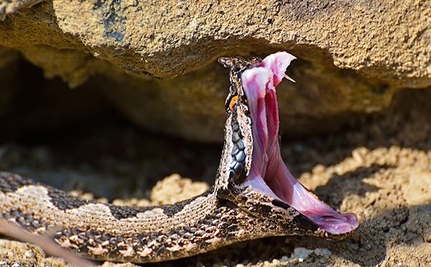
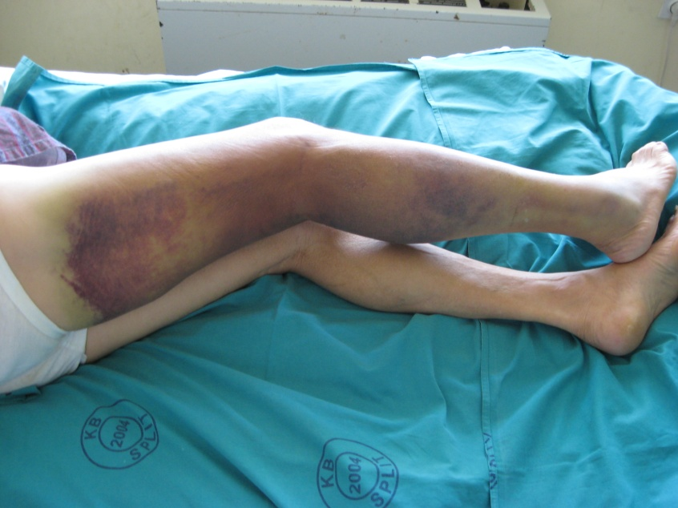
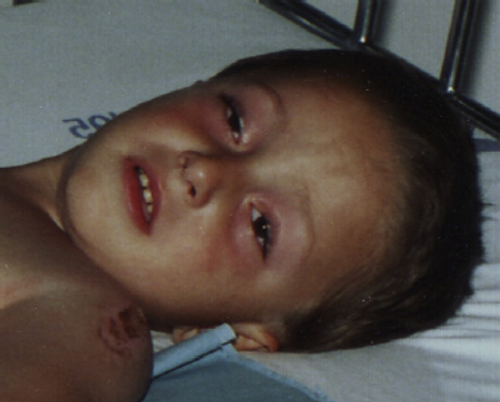
Nose-horned viper
(Vipera ammodytes ammodytes)
Hematotoxicity
Neurotoxicity
Notes:
Vipera ammodytes ammodytes is the most venomous snake in Europe. The most critical manifestations of its venomous bite for man are hemorrhage and local tissue damage.

Slide 3
Nose-horned viper
(Vipera ammodytes ammodytes)
Hematotoxicity
Neurotoxicity
Notes:
Vipera ammodytes ammodytes is the most venomous snake in Europe. The most critical manifestations of its venomous bite for man are hemorrhage and local tissue damage.

Slide 4
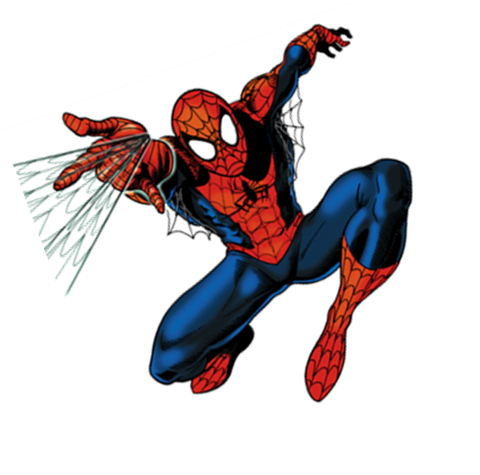
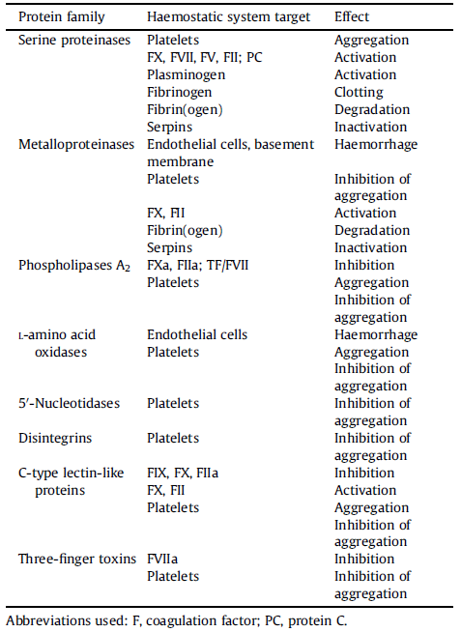
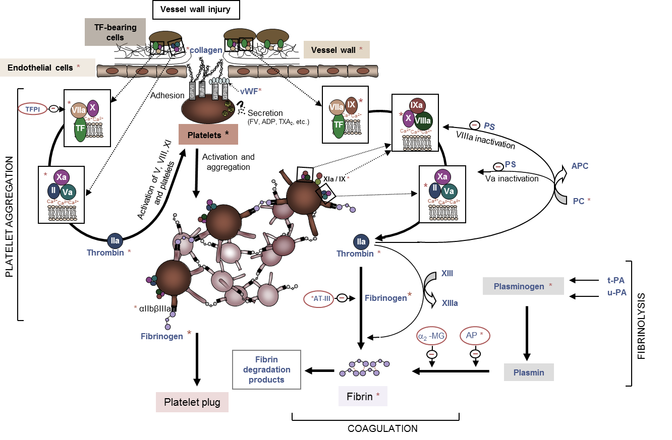
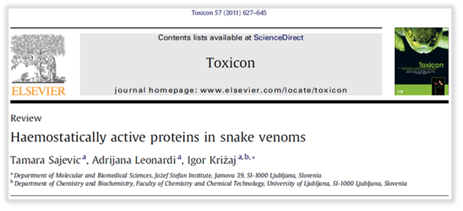
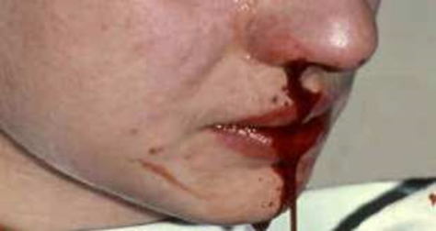
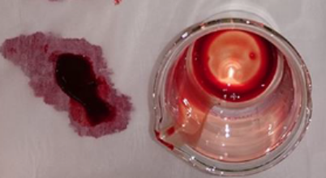
Proteins from SV act on haemostatic system
Notes:
Haemostasis is a very subtle, highly regulated system. The precise control of blood coagulation is essential to the life of animals, including humans, so it is no surprise that venomous snakes evolved the arsenal of proteins that target a variety of processes in this system in order to disable their prey or enemy. Snake venom proteins from eight protein families were found to interfere with the haemostatic system at many different points, resulting in inhibition or augmentation of the blood coagulation.

Slide 5
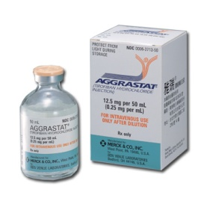
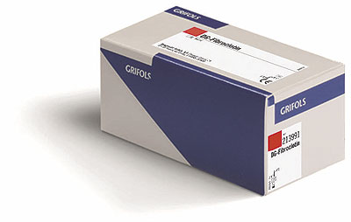
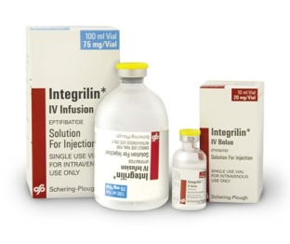
CVDs are huge health problem!
responsible for > 30% of death and morbidity of the world population (WHO) and
47% of all deaths in Europe (> 4 million/y) .
Snake venoms represent a prime source of molecules
for development of novel drugs and reagents
to treat or diagnose haemostatic disorders
Notes:
According to the World Health Organisation (WHO), cardiovascular diseases (CVDs), such as ischemic heart disease, hemorrhagic stroke, ischemic stroke, and hypertensive heart disease, represent the leading cause of death and morbidity of the world population with a 30% share. The latest European CVD statistics give even more alarming figures: CVDs cause over 4 million deaths in Europe (47% of all deaths), of which 1.9 million (40%) in the European Union (EU); CVDs cost the EU economy almost €196 billion a year.

Slide 6
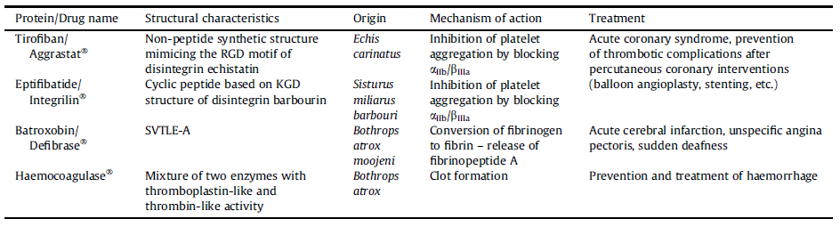
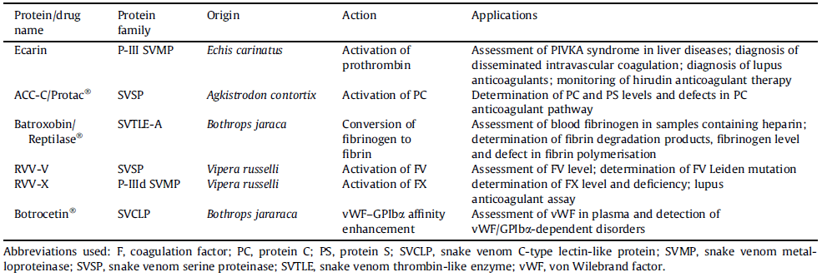
Some drugs and reagents based on SV components
for treatment or diagnosis of various haemostatic disorders
Notes:
Here are some examples of SV proteins and their derivatives acting on haemostasis that have already been utilized in human medicine to treat different haemostatic disorders by targeting coagulation, fibrinolysis or platelet functions.
SV components that influence the haemostatic system are in use as diagnostic tools in coagulation laboratories.
PIVKA syndrome (Proteins Induced by Vitamin K Absence/Antagonists).

Slide 7
Lack of safe anticoagulants:
warfarin, aspirin, heparin and small non-peptidic inhibitors of TF, FXa, thrombin or FVIIa
⇨ high risk of excessive bleeding!
Our goal
New inhibitors of (intrinsic) blood coagulation pathway
⇨ lower risk of excessive bleeding.
Notes:
As anticoagulant therapy, aspirin, heparin and warfarin have been available for several decades, but each of them has limitations. Of oral anticoagulants, warfarin, a vitamin K antagonist, is the most widely used anticoagulant drug that is more effective in venous disease, where it provides about 60% risk reduction in venous thrombosis, but is considerably less effective in arterial thrombosis prophylaxis. Its dosage must be very carefully controlled since it may cause severe bleeding. Long-term treatment with aspirin is an acceptable alternative to warfarin only in patients with low to moderate risk of arterial and recurrent venous thromboembolism. A particularly serious complication of heparin anticoagulation is thrombocytopenia induced by an immune reaction against complexes of heparin and platelet factor.

Slide 8
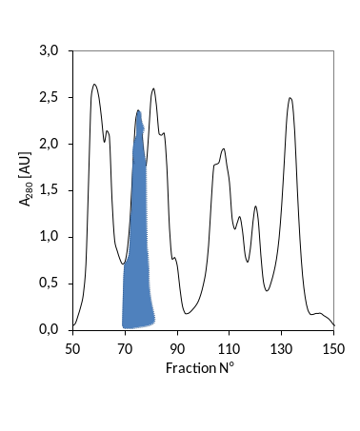
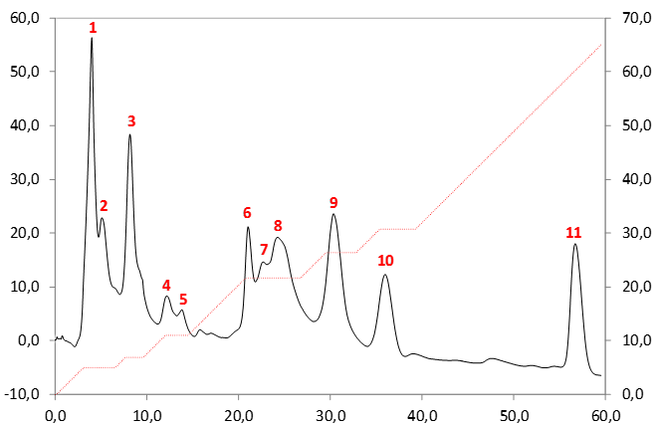
Hemostatically-active Vaa venom SPs
B₁
- α+β-fibrinogenolysis
- degradation of angiotensin-I
- kallikrein-like activity
- activation of FIX and FX
FPLC on Mono-S
- potent procoagulant activity
A₂₈₀ [mAU]
%B (1M NaCl)
MonoS-11
- potent anticoagulant activity
- no enzymatic activity
Time [min]
Notes:
In fraction B1 we identified several anti- and pro-coagulant SPs. The whole fraction was first separated by cation-exchange chromatography, and then the peaks 2 to 5 were recromatographed on a RP-HPLC column.
These two fractions were potently fibrinogenolytic and since they degrade angiotensin-I and possess plasma kallikrein-like activity in vitro, they might in vivo cause hypotension. SP in peak 6 was, besides degrading fibrinogene, also slightly activating FIX and FX. SPs in peaks 9 and 10 markedly shortened PT and APTT, so we asume they might activate a coagulation factor in the common pathway of blood coagulation. Since they do not activate FX nor prothrombin or clot fibrinogen, we assume they might activate the cofactor FV.
The last peak is very distinct from the others because of its elution profile, no enzymatic activity and a pronounced anticoagulant effect, since it substantially prolonged PT and aPTT. So, the anticoagulant effect is obviously independent on the enzymatic activity of the protein.

Slide 9
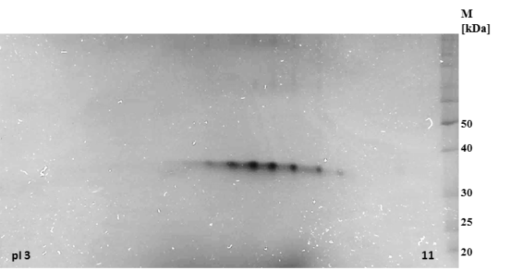
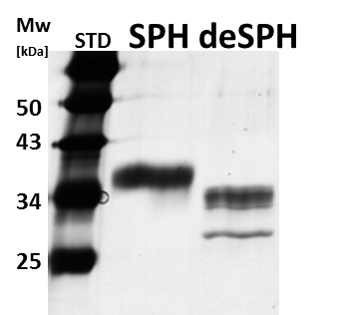
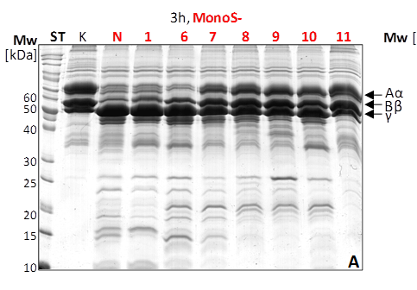
Basic biochemical characterisatics of MonoS-11
35 kDa (SDS-PAGE)
multiple basic pI
N-glycosylated
in vitro unable to hydrolyze
fibrinogen, prothrombin,
FIX, FX, protein C
PNGF
- +
Notes:
Vaa-SPH nima nikakršne encimske aktivnosti.
Deglikozilacija s PNGF, slika po 24h in po redukciji. Spodnja lisa predstavlja popolnoma deglikoziliran SPH, zgornje pa delno deglikozilirane oblike VaaSPH.

Slide 10
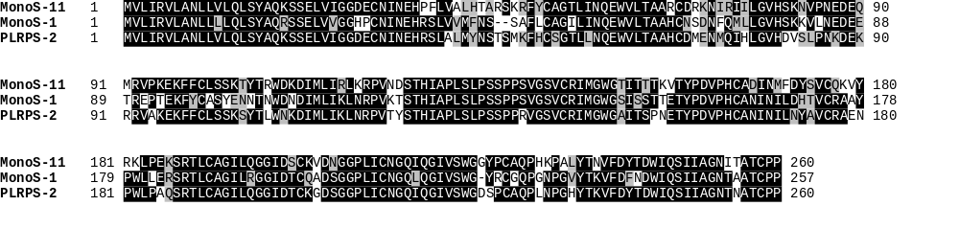
Some structural features of MonoS-11
prepro domain
calculated molecular mass: 26 kDa
2 N-glycosylation sites (Asn123 & Asn253)
mutations in the canonical SP catalytic triad:
Ser195Asn, His57Arg, Asp102
MonoS-11 ⇒ Vaa Serine Protease Homologue (SPH)
Notes:
By MS and MS/MS analysis of the tryptic fragments we identified this protein to be a SP-homolog.
From the venom gland cDNA library we cloned a sequence coding for an SP-like protein. It has two amino acid residue substitutions in the canonical catalytic triad, as shown in this alignment. Usual for SPs: Ser195, His57 and Asp102 ; in the case of MonoS-11: Asn195, Arg57 and Asp102 (chymotripsinogen numbering).
So, the absence of the proteolytic activity of this fraction is obviously the consequence of the two canonical amino acid residue substitutions in its active site.
Vaa-SPH has 260 amino acid residues and predicted molecular weight 26 kDa (primary structure) but 33 kDa (SDS PAGE) due to N-glycosylation: Asn123 in Asn253. Glycosylation contributes to higher stability and solubility of proteins. It has 12 cysteine residues, which form 6 bridges. Calculated pI is 8.7 (basic character). The cDNA sequence of VaaSPH revealed two amino acid replacements in the active site catalytic triad characteristic for SPs. It catalytic triad is different from active serine proteinases: H, D, S -> R, D, N. This is the main reason why VaaSPH was not able to hydrolyze in vitro any of protein substrates tested, fibrinogen, prothrombin, FIX, FX and protein C. Other SPs from the Vaa venom cleaved these proteins at the basic amino acid residues (Arg and Lys). Protein was recognized by antibodies in anti-Vaa serum.

Slide 11
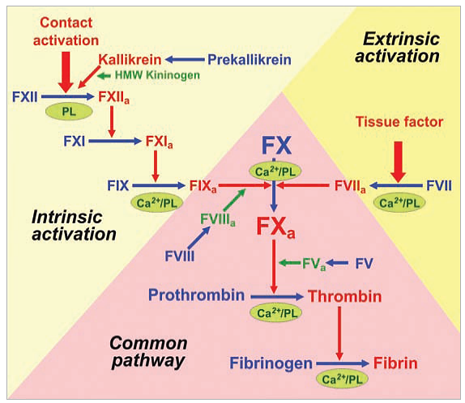
Effects of VaaSPH on blood coagulation
Blood coagulation testing:
- aPTT (intrinsic p.)
- PT (extrinsic p.)
- TT (common p.)
- LA1 (dRVV) test
- LA2 (dRVV+PL in excess)
Thrombin generation test
(thrombin potential)
Notes:
V dRVV (Dilute Russell's viper venom time) testu plazmi dodamo razredčen Vipera russelli (Daboia russelli) strup, ki vsebuje aktivatorja FV in FX. Potem merimo aktivnost trombina, kar priča o aktivnosti protrombinaze in trombina. dRVVT is a laboratory test often used for detection of lupus anticoagulant (anti-PL antibodies in blood).
ZL: Katero dodatno informacijo, glede na PT test, dobimo pri Thrombin Generation Testu (TGT)? Pri TGT se doda manj TF (<5pM) kot pri PT (>10pM), zato opazujemo mobilizacijo trombina po vseh (obeh) poteh (2-5pM ⇒ v odvisnosti od FVIII in FIX, pri še nižji koncentraciji TF pa od FXI). Ko opazujemo učinek VaaSPH, torej opazujemo učinek na celokupno sproščanje trombina. Pri PT pa se doda veliko količino TF (>10pM), s čimer se hitro mobilizira sproščanje trombina izključno po zunanji (ekstrinzični) poti (>10pM ⇒ FVIII, FIX and FXI are bypassed). PT test temelji na merjenju časa do tvorbe fibrinskega strdka, ki pa nastane že ob mobilizaciji 5% vsega razpoložljivega trombina. Test je torej zasnovan tako, da opazujemo le delovanje komponent zunanje (ekstrinzične) poti! Dodatek TF imitira poškodbo žile.
ZL: Kako razlagaš (navidezno?) neskladje med rezultatoma PT testa in Thrombin Generation Testa (TGT) pri VaaSPH? Neskladja ni, ker sta testa različno zasnovana in ne kažeta istih stvari. Rezultat TGT pove, da je VaaSPH sposoben popolnoma zavreti sproščanje trombina v krvi, rezultat PT pa pove, da VaaSPH sproščanje trombina zavira (tudi) z vplivom na zunanjo (ekstrinzično) pot.
VaaSPH does not affect platelet aggregation. Kateri testi so bili narejeni? : ADP- in kolagen-inducirana koagulacija trombocitov.
TGT determines blood coagulability. Measurement of thrombin generation, and in particular the enzymatic work potential of thrombin, provides a method for quantifying the composite effect of the multiple factors that determine coagulation capacity and the influence of the environment on these factors.

Slide 12
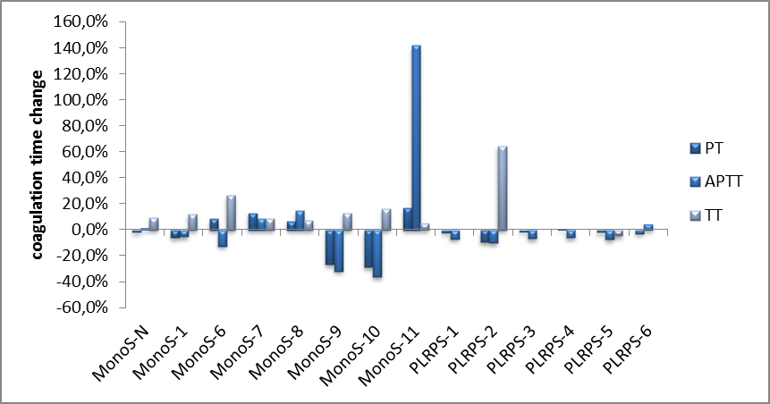
Coagulation times
[1 µM]
  Significant effect on intrinsic pathway (aPTT).
  Moderate effect on extrinsic pathway (PT).
  No effect on common pathway (TT).
Thrombin generation assay
  VaaSPH at 770 nM completely abolished endogenous
  thrombin potential/activity (blood coagulation potential)!
Notes:
Test izveden pri 1 mikroM proteina v frakcijah.
Izrazito večji vpliv VaaSPH na aPTT kot na PT je posledica hkratnega vpliva na delovanje intrinzičnega tenaznega kompleksa in protrombinaznega kompleksa (inhibicija encimske kaskade => eksponentni efekt), kot je videti s posebno močnim vplivom na intrinzični tenazni kompleks (verjetno kot posledice močne vezave na FIX/FIXa).
VaaSPH significantly prolongs the activated partial thromboplastin time (aPTT), has only small effect on the prothrombin time (PT), and does not affect the thrombin time (TT) when added to plasma, indicating major disturbances of the intrinsic coagulation pathway. The aPTT represents the time for clot formation after adding Ca2+, PL, and kaolin (surface activator) to a sample of citrated blood. It is prolonged by heparin, direct thrombin inhibitors, a deficiency of or inhibition of factors in the intrinsic and common coagulation pathways (e.g., factors II, V, VIII, IX, X, XI, and XII) as well as lupus anticoagulant (anti-PL antibodies) and vitamin K deficiency.
thromboplastin (tissue factor(TF)+PL); partial thromboplastin (PL)
The PT represents the time for clot formation after the addition of thromboplastin (TF+PL) and Ca2+ to citrated blood. It is prolonged with deficiencies of factors II, V, VII, and X or fibrinogen, liver disease, vitamin K deficiency, and warfarin use. This is in extrinsic and common coagulation pathways.
The TT presents time time to clot formation after the addition of thrombin to citrated blood.

Slide 13
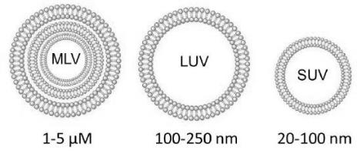
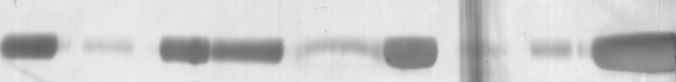
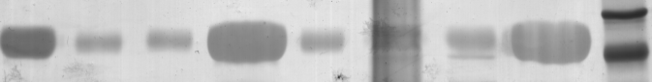
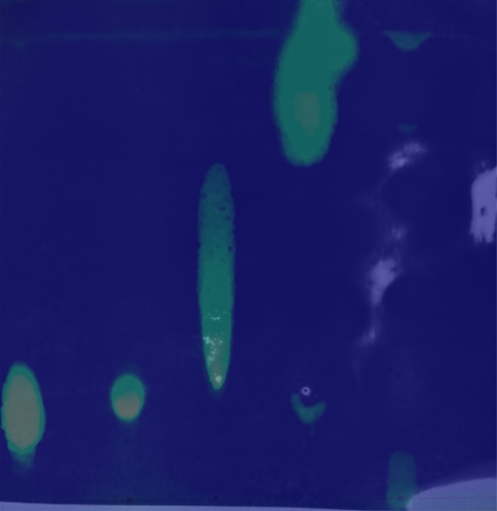
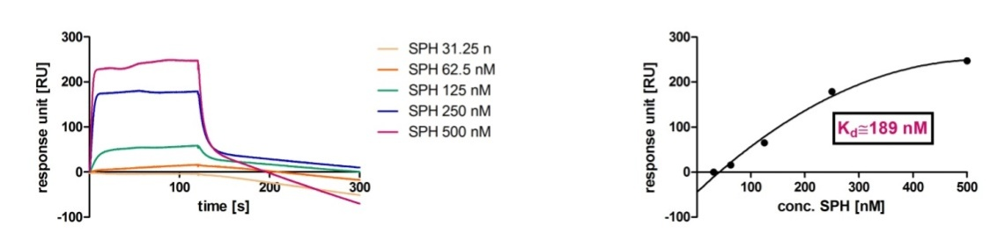
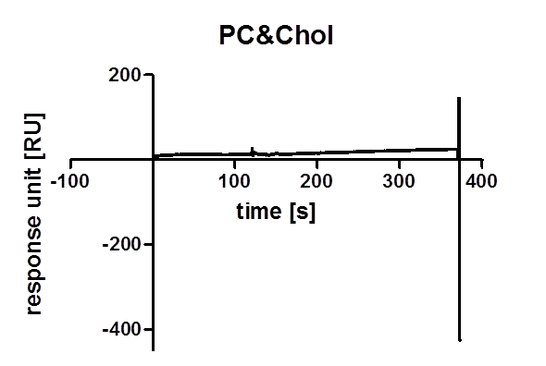
VaaSPH binds to negatively charged PL
Sedimentation assay
(multilamellar vesicles - MLV)
su se su se su se su se su se su se su se su se
SM sphingomyelin
Chol cholesterol
PC phosphatidylcholine
PS phosphatidylserine
PI phosphatidylinositol
buffer SM&PC SM&Chol PI&Chol MQ PC&PS PC&Chol PS&Chol
TLC & blot
SPR (small unilamellar vesicles – SUV)
PS+Chol
SM PC PS Chol
PC+Chol
Notes:
Prekritje TLC lipidov in njihovega blota (PVDF) inkubiranega z VaaSPH. Signal za VaaSPH je prisoten le na mestu PS (PI slika ni uspela, je pa tudi bil signal).
SPR na SUV.
su = supernatant
se = sediment

Slide 14
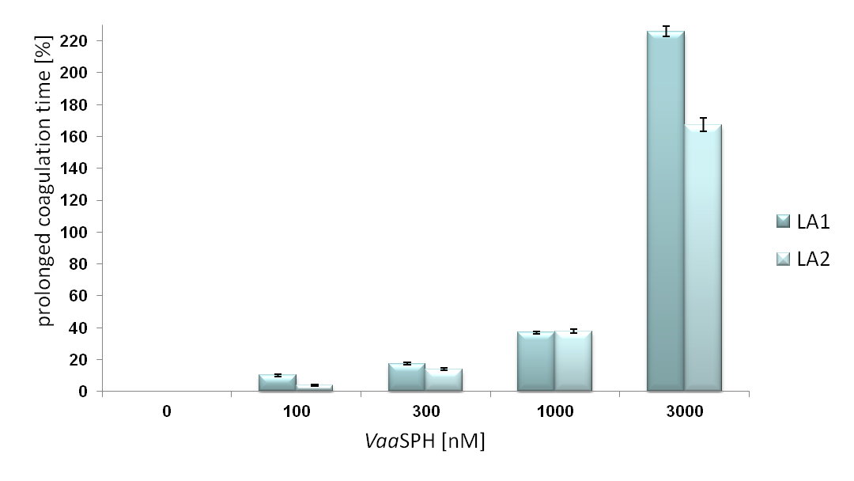
Lupus Anticoagulant (LA) assay
(dRVV assay)
(excess of PL)
⇨ Main target of VaaSPH in the coagulation cascade
is a protein and not PL!
⇨ A target of VaaSPH is the prothrombinase complex.
Notes:
In LA1 (Lupus Anticoagulant) screening assay, the coagulation cascade is activated by adding of diluted venom of Vipera russelli (Daboia russelli), which directly activates FV and FX and thus trigger the formation of thrombin (dRVV test). Addition of VaaSPH prolonged the coagulation time in a dose-dependent manner. To bi lahko bila posledica vezave VaaSPH na PL. To možnost preverimo v LA2 testu, ki je enak LA1 testu, le da dodamo prebitek PL. Če bi bila za koncentracijsko-odvisno podaljšanje koagulacijskega časa res odločilna vezava VaaSPH na negativno nabite PL, potem bi ob prebitku PL moralo priti do skrajšanja časa koagulacije, to je zmanjšanja učinka VaaSPH na koagulacijo krvi. V prisotnosti 1000 nM VaaSPH, kjer je učinek VaaSPH na koagulacijo velik, je bila sprememba časa koagulacije enaka pri LA1 in LA2 testu.
Razlika med LA testom in TT testom je v tem, da se mora pri LA testu trombin šele tvoriti v sistemu, torej se mora protrombinazni kompleks sestaviti v funkcionalno obliko, medtem ko pri TT testu dodamo v plazmo že aktivni trombin.
Rezultat pove, da je tarča VaaSPH v sistemu hemostaze protein in ne PL in jasno izpostavi interferenco VaaSPH s funkcijo protrombinaznega kompleksa!

Slide 15
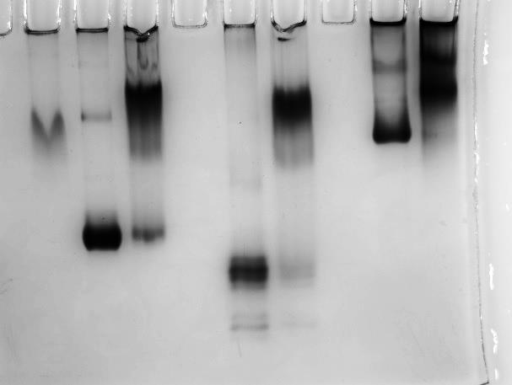
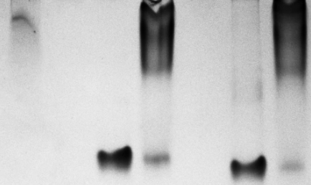
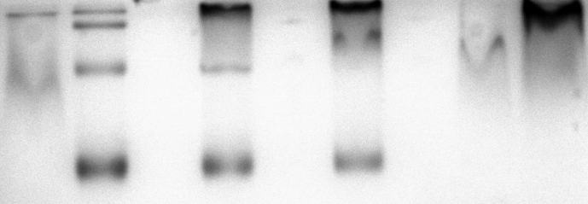
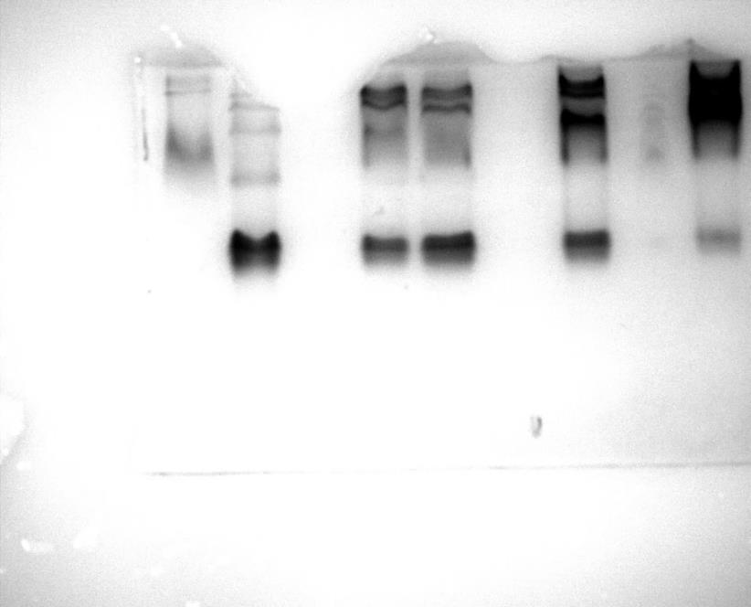

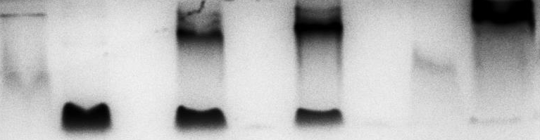
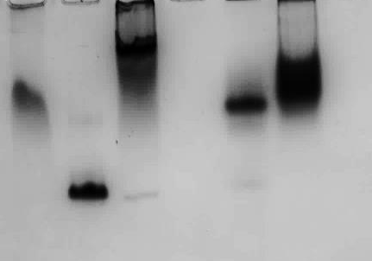
VaaSPH binds to several blood coagulation factors
SPH FX FXa 5:1
SPH FVII FVIIa 5:1
VaaSPH did not inhibit hydrolysis of small chromogenic peptide substrates by these coagulation factors!
SPH FIX 1:1 3:1 5:1
SPH FIXa 1:1 3:1 5:1
SPH FVa 5:1
SPH PT 1:1 3:1 5:1
SPH PT TH 5:1
⇨ FXI/FXIa, FXII/FXIIa, FVIII/FVIIIa, kallikrein & TF did not form complex
with VaaSPH!
Notes:
Kakšna je bila koncentracija VaaSPH v poskusih? Taka, da so bili proteini lepo vidni s CBB.
FXI/FXIa, FXII/FXIIa, FVIII/FVIIIa, kalikrein in TF niso tvorili kompleksa z VaaSPH.
Posamezni F se med sabo vežejo v komplekse, dva tenazna in protrombinazni, torej imajo afiniteto eden do drugega. Na podoben način se na F lahko veže tudi VaaSPH (nativna PAGE).
Lahko bi pa VaaSPH, zaradi strukturne podobnosti, tudi izpodrival določene F (FIXa in FXa) iz kompleksov (kompetitivna inhibicija)! Kompetitivno inhibicijo bo potrebno še dokazati.

Slide 16
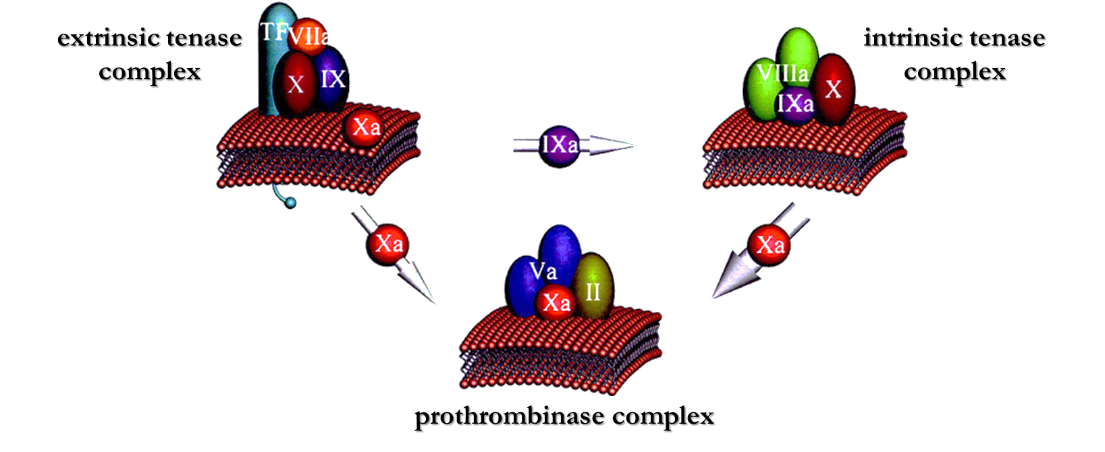

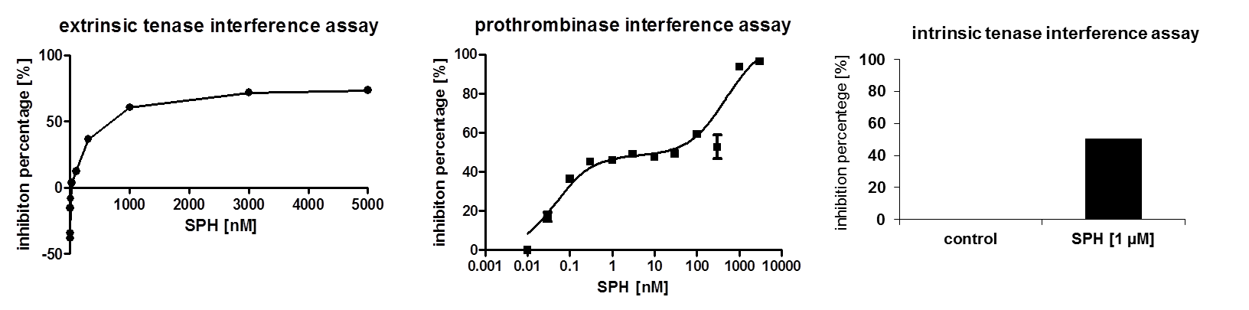
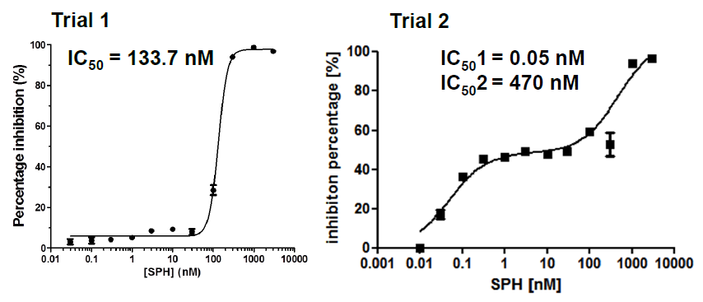
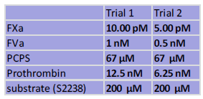
Complex interference assays
Notes:
Razlaga inhibicije extrinzičnega tenaznega kompleksa le do okoli 70%? Z nižjo finiteto VaaSPG do FVIIa in FX. Zato tudi podaljšanje PT ni tako izrazito kot podaljšanje aPTT. Iz tega sledi, da bi morala biti afiniteta VaaSPH do FIXa visoka! Na to kaže tudi nativna PAGE – že pri razmerju 1:1 je precej VaaSPH v kompleksu s FIX/FIXa! Ali pa podobnost med VaaSPH in FIXa visoka, kar povzroči visoko stopnjo izpodrivanja (interferenco) FIXa iz intrinzičnega tenaznega kompleksa.
Vse kaže na to, da je funkcija FIXa glavna tarča antikoagulantnega delovanja VaaSPH!

Slide 17
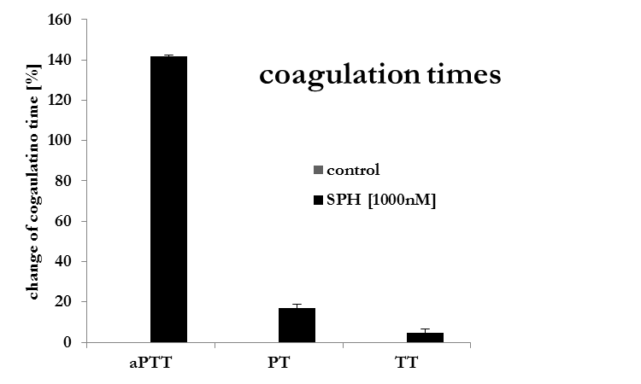
Main targets of VaaSPH action
Notes:
Vse kaže na to, da je funkcija FIXa glavna tarča antikoagulantnega delovanja VaaSPH!

Slide 18
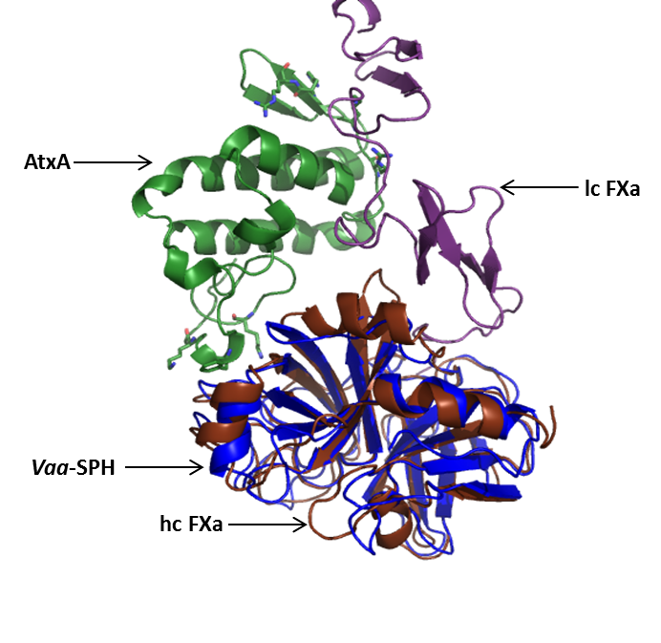
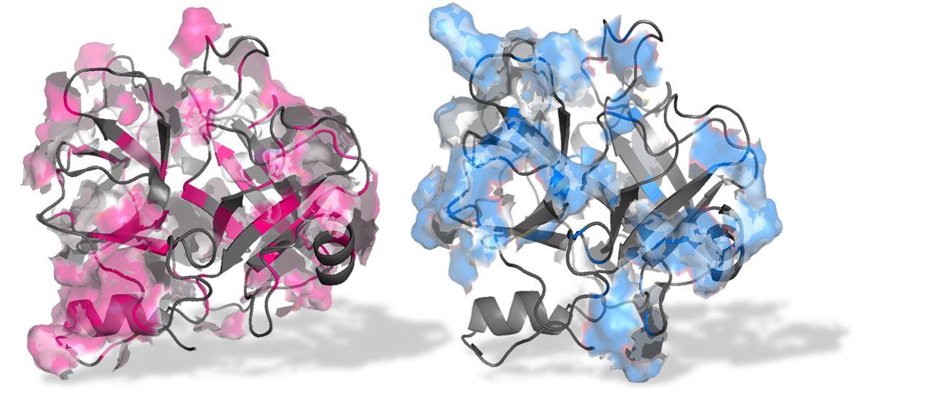

3D modelling of VaaSPH
RMSD = 3Å
⇨ 3D structure of VaaSPH is very similar to the structure of FX/FXa heavy chain (as also to the structure of FIX/FIXa).
Notes:
VaaSPH: rdeče so označene pozitivne ak na površini (Arg, Lys), modro pa hidrofobni ostanki na površini.
Model VaaSPH je bil narejen po strukturi težke verige FXa.

Slide 19
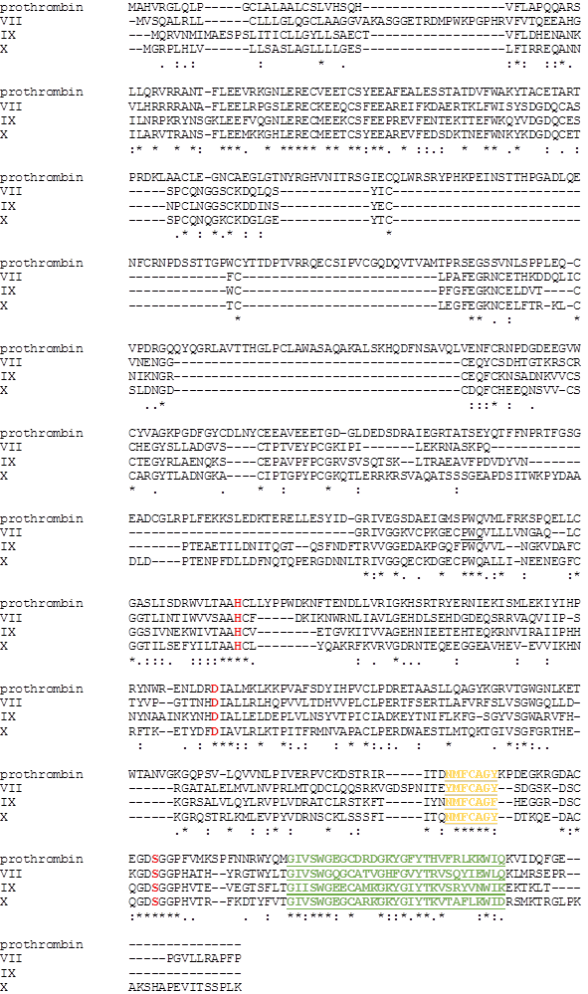
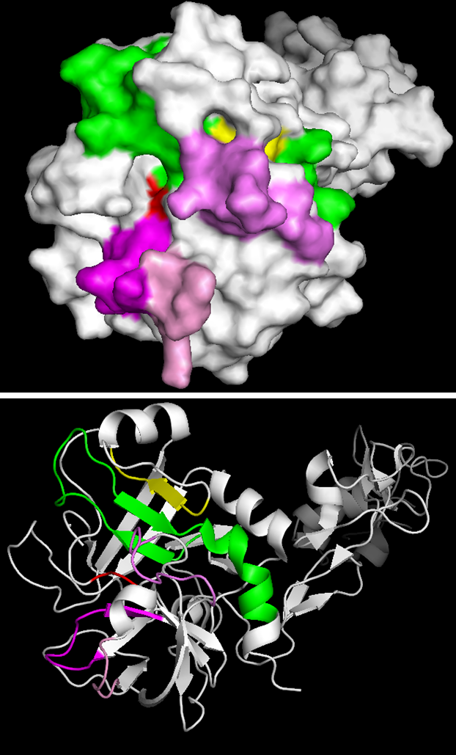
Towards new anticoagulants
FIXa
FIXa
Notes:
ZL: VaaSPH se veže tudi na FVa – zakaj ni tudi sekvence FVa v poravnavi? FVa je kofaktor, tako kot FVIII/VIIIa. Po strukturi sta si podobna in sta drugačna od ostalih F.
Primerjava primarnih struktur faktorjev na katere se veže VaaSPH (FVII, FIX, FX, prothrombin). Dva peptida, ki sta identična pri vseh, rumeni peptid je v notranjosti strukture, zeleni pa na površini in bi lahko predstavljal vsaj del interakcijske površine med F in VaaSPH. Če je to res, bi moral identificirani peptid preprečiti vezavo VaaSPH na F. Robni pogoj za modeliranje kompleksov VaaSPH-F, za pripravo malih molekul z antikoagulantno aktivnostjo na osnovi podobnosti z vezavno površino VaaSPH na F.
Vijolično so označeni ostanki substrat-vezavnega mesta F. Vezava VaaSPH na F ne prepreči encimske aktivnosti F, torej se ne veže na to mesto.

Slide 20

Conclusions
-VaaSPH is an SP-like protein with a potent
anticoagulant activity.
-Its main target is the intrinsic coagulation pathway.
-It inhibits the activity of both tenase complexes
and the prothrombinase complex.
-It binds several blood coagulation factors,
most avidly FIX/FIXa.
VaaSPH is a promising lead to develop inhibitors of intrinsic coagulation pathway.

Slide 21






Acknowledgements
Zorica Latinović
Adrijana Leonardi
Igor Križaj
Lidija Kovačič
Cho Y. Koh
Manjunatha R. Kini
Alenka Trampuš Bakija
Vesna Hodnik
International Postgraduate School
Jožef Stefan, Ljubljana, Slovenia
Jožef Stefan Institute
Ljubljana, Slovenia

Slide 22
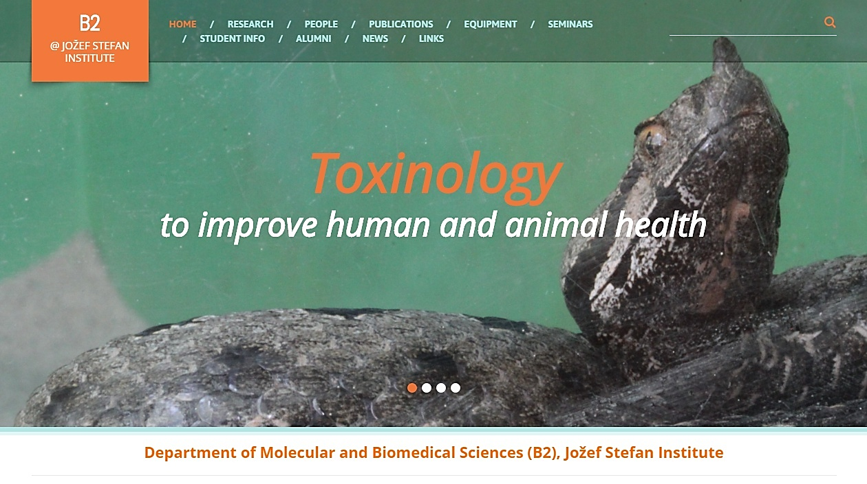
Thank you and welcome to our webpage
http://www-b2.ijs.si/

