Slide 1
About Omics Group
OMICS Group International through its Open Access Initiative is committed to make genuine and reliable contributions to the scientific community. OMICS Group hosts over 400 leading-edge peer reviewed Open Access Journals and organize over 300 International Conferences annually all over the world. OMICS Publishing Group journals have over 3 million readers and the fame and success of the same can be attributed to the strong editorial board which contains over 30000 eminent personalities that ensure a rapid, quality and quick review process.

Slide 2
About Omics Group conferences
OMICS Group signed an agreement with more than 1000 International Societies to make healthcare information Open Access. OMICS Group Conferences make the perfect platform for global networking as it brings together renowned speakers and scientists across the globe to a most exciting and memorable scientific event filled with much enlightening interactive sessions, world class exhibitions and poster presentations
Omics group has organised 500 conferences, workshops and national symposium across the major cities including SanFrancisco,Omaha,Orlado,Rayleigh,SantaClara,Chicago,Philadelphia,Unitedkingdom,Baltimore,SanAntanio,Dubai,Hyderabad,Bangaluru and Mumbai.

Slide 3

Quantum Cascade Lasers in Bio-Medical Applications
The Reality Check
Igor Trofimov
PTAC Inc.
Notes:
My first encounter with QCL was about 15 years ago when I

Slide 4
Why Would One Care of Mid-IR?
Fundamental vibrations of all molecules reside in
Mid-IR – strongest interaction with light.
Fingerprint region
Sensing (gases , liquids, solids) cells & bacteria
Imaging (tissue) without contrast agents, dyes or stains
Photo-chemistry, welding, cutting and ablation
Diagnosis
Screening
Prognosis
CTC
Pharma
Therapy
response
Research
Notes:
Vibrations of all molecules from small (O2, N2, H2O) to very large (proteins) have energy corresponding to mid-IR

Slide 5
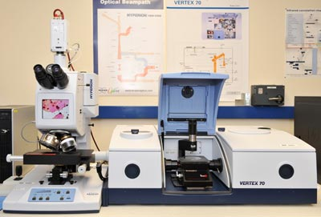
Mid-IR Sources
Fourier Transform Spectrometer
Low power
Low brightness
Low spatial resolution
Bulky
End of Lead Salt Laser Production
04.01.12 Product Discontinuation US27-075 Lead salt lasers have been widely used for high resolution IR spectroscopy since the 1970’s. Laser Components has been actively supporting the research community and has been a major supplier of these tunable diode lasers. Many researchers have recently focused on newer Quantum Cascade technology and the demand for lead salt lasers has been steadily declining. Due to lack of demand, LASER COMPONENTS will discontinue production of lead salt lasers

Slide 6
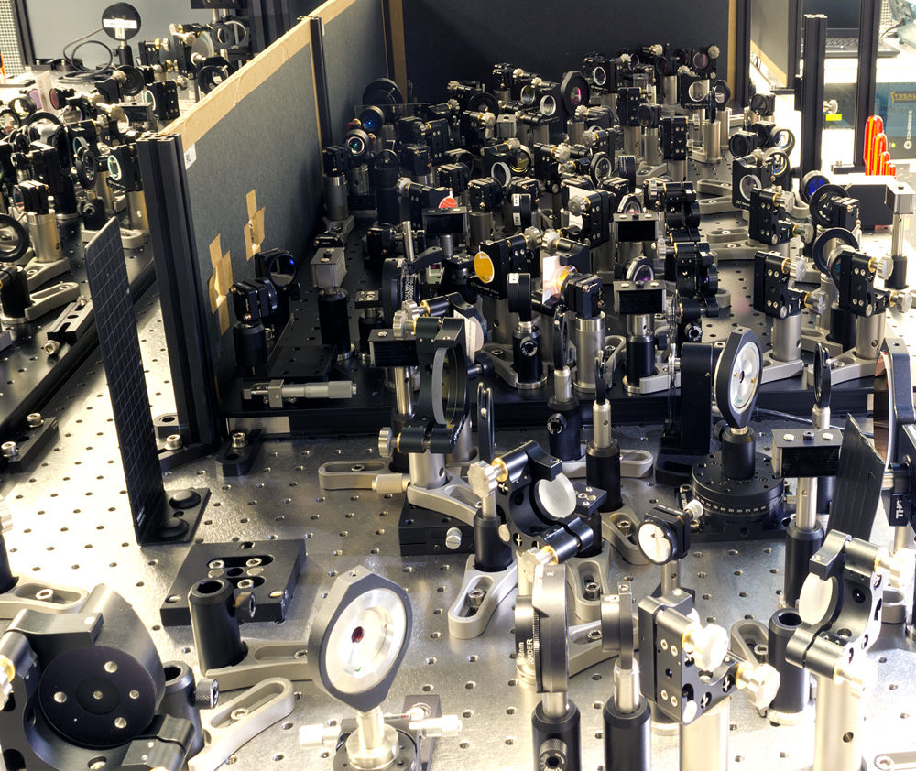
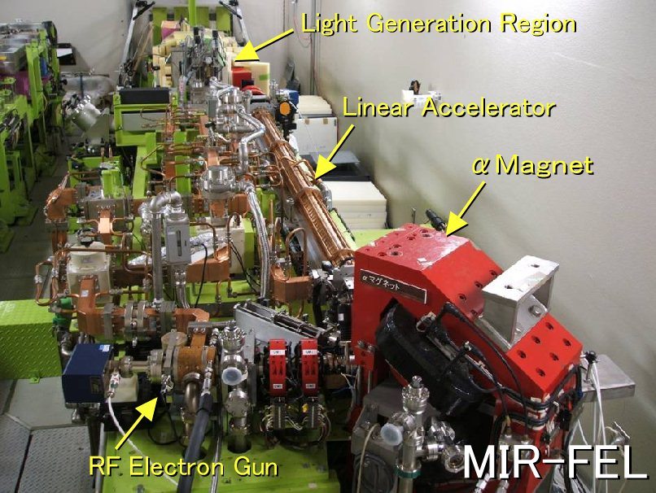
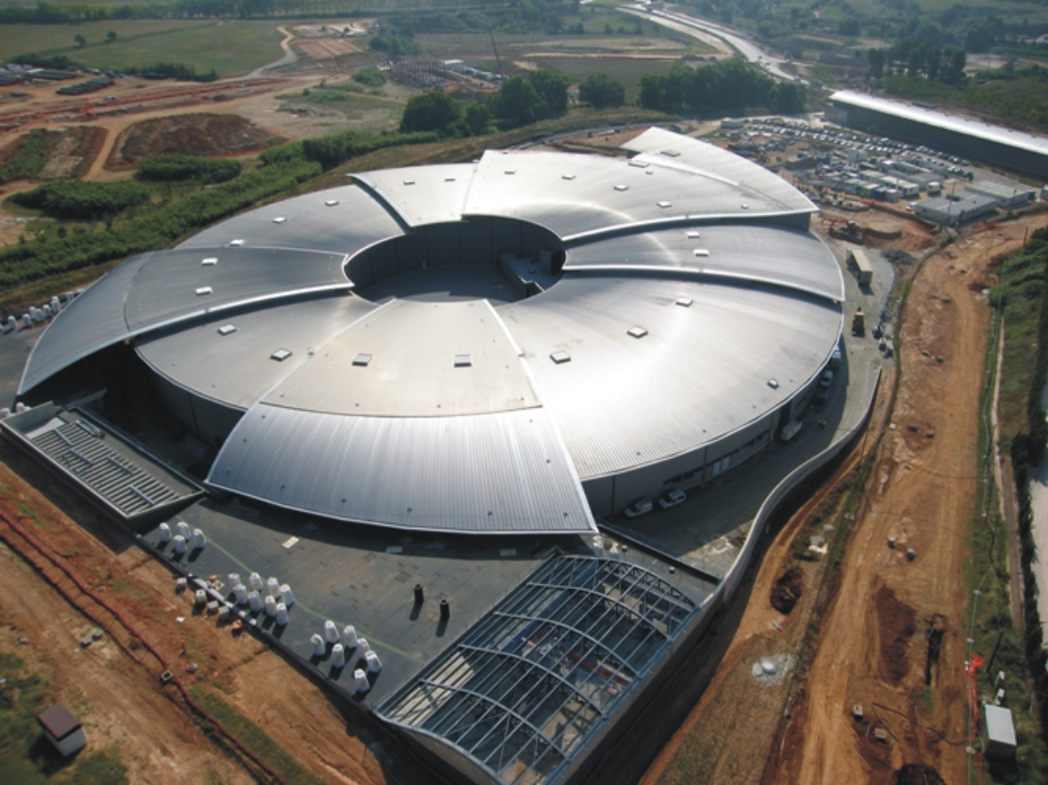
Mid-IR Sources
OPA &DFG
Free Electron Laser
Synchrotron beam
The 800mn light is converted to Mid-Infrared radiation, ranging from 4 to 20 µm.
Prof. Andrea Cavalleri, Max Planck Institute for the Structure and Dynamics of Matter
Free-electron lasers involve major facilities.
Broadband tunable 2-12 µm
macro-pulse length > 10 µs
▪ ≈ 100 mJ / macro-pulse
▪ 10 – 20 µJ / micro-pulse
Mid-IR microscopy

Slide 7
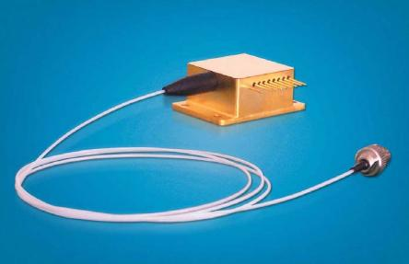
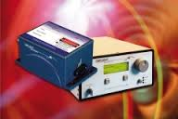
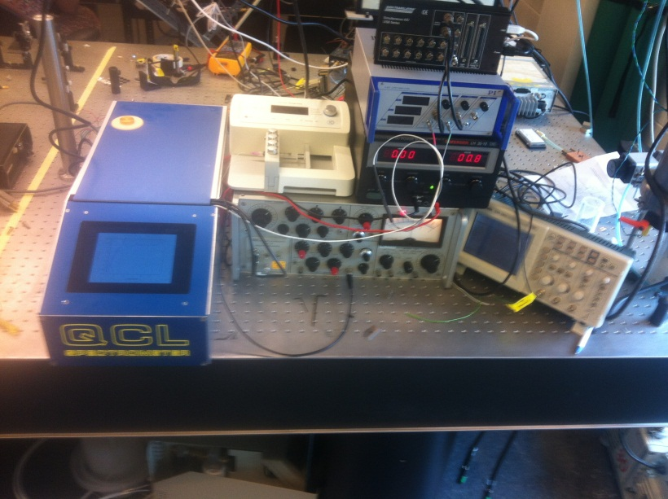
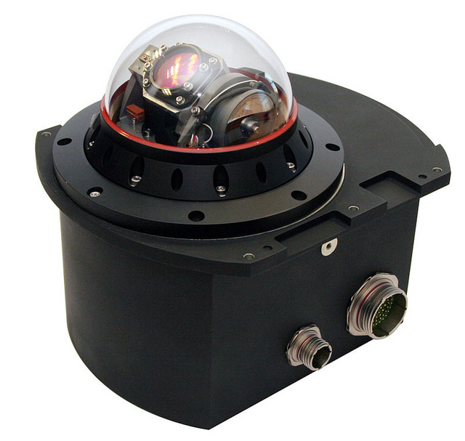
Mid-IR Sources - QCL
Power >5W
Wavelength 3-24µm
DFB, External Cavity, Multi-emitter
Fiber coupled

Slide 8
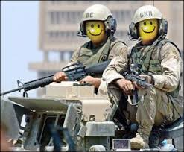

QCL Technology is There!
Where are the Applications?

Slide 9
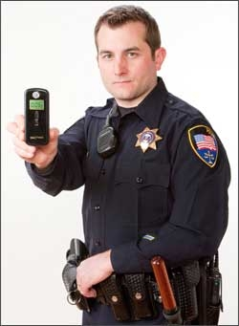
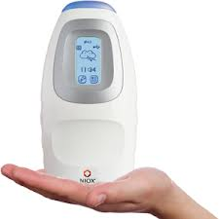
Breath Analysis
Relatively inexpensive
Rapid
Non-invasive
Landmark in clinical breath testing occurred in 2003 when the FDA approved the first device that measures the fraction of exhaled nitric oxide (FENO) for asthma monitoring.
Current clinical use of breath analysis:
monitor asthma
diagnose transplant organ rejection
diagnose Helicobacter pylori infection
detect blood alcohol concentration
monitor breath gases during anesthesia, mechanical ventilation, and respiration

Slide 10
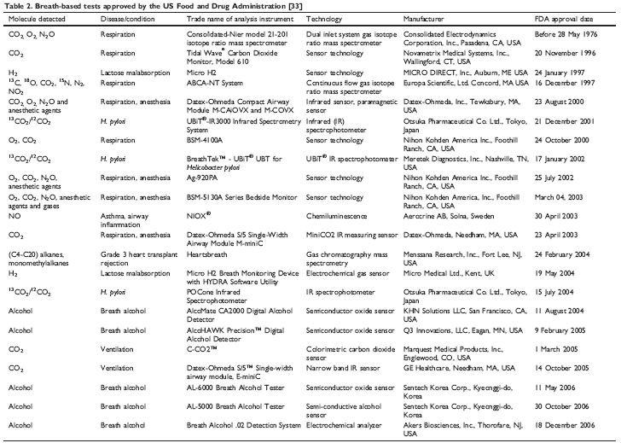
Breath Analysis

Slide 11
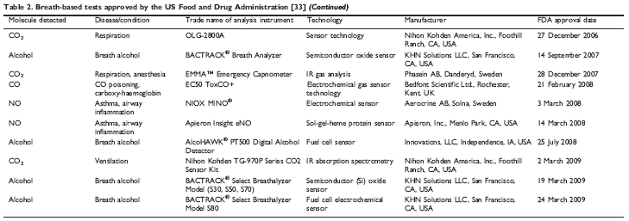
Breath Analysis
NONE REQUIRES QCL!

Slide 12
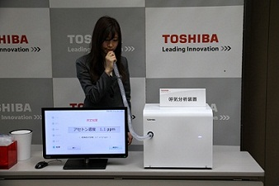
Breath Analysis
Toshiba Develops Breath Analyzer for Medical Applications 18 March, 2014
TOKYO – Toshiba Corporation announced that it has developed a prototype of a compact breath analyzer that can detect a wide range of trace gases in exhaled breath. The analyzer has the potential to provide analysis that can be applied to health monitoring and diagnosis of disease.
Constituents that can be measured by a breath analyzer
Acetaldehyde: Intermediate of alcohol metabolism. The cause of hangovers.
Acetone: Intermediate of fatty acid metabolism. An indicator of obesity and diabetes.
Carbon monoxide: Intermediate of heme catabolism. An indicator of smoking
Constituents that will be measured by a breath analyzer in the future
Methane: Discharge from metabolism of intestinal bacterium.
An indicator of the intestinal environment.
Nitric monoxide: Generated by airway inflammation. An indicator of asthma.
¹³C carbon dioxide: Generated by 13C-labeled drug metabolism. Used for helicobacter pylori testing.

Slide 13
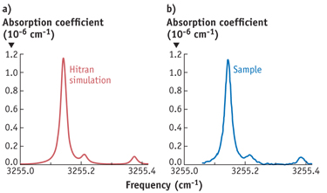
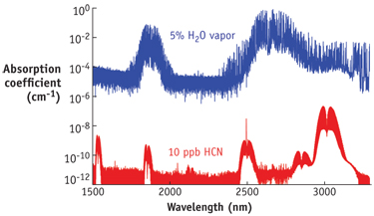
Breath Analysis
"Breath analysis as a tool for early disease detection"
a project by iMERA (implementing Metrology in the European Research Area),
an initiative of the European Metrology Research Programme (EMRP).
Cystic fibrosis - the most common lethal genetic disease in the Caucasian population
affecting more than 70,000 individuals worldwide.
Most patients are infected by the bacteria Pseudomonas aeruginosa.
Early treatment of the infection leads to a pronounced survival benefit.
Stefan T. Persijn and Adriaan M.H. van der Veen 2013
Smoking kills!
2nd International Conference and Exhibition on Lasers, Optics & Photonics
September 8, 2014

Slide 14
Prospects of QCLs for Breath Analysis
Diagnostics - Rare cases, mostly complimentary
Disease progression monitoring - likely
Treatment efficacy -likely
Economics factors
2nd International Conference and Exhibition on Lasers, Optics & Photonics
September 8, 2014

Slide 15
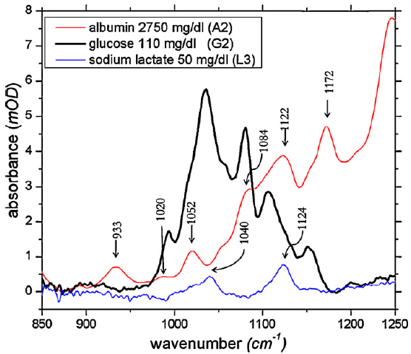
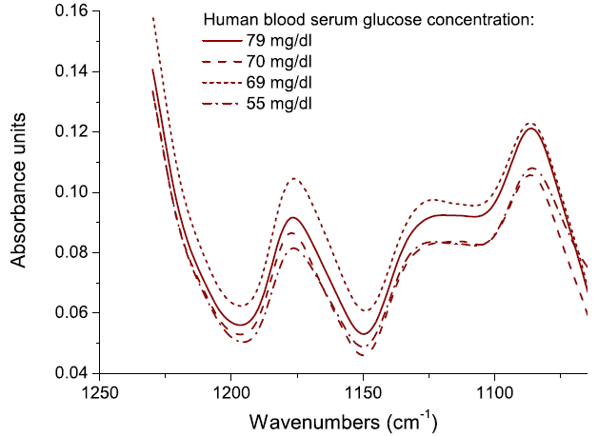
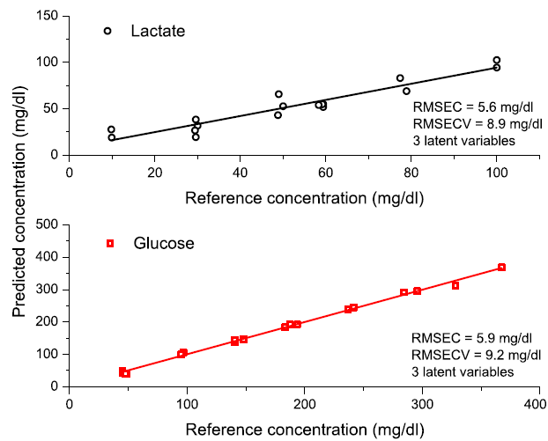
Blood Glucose Monitoring
3 million people in US with Type1 diabetes
100,000 users of CGM will grow to 450,000
$1.8 Billion market opportunity
M.Pleitez 2012
B.Lendl 2010
Set of 42 different patients
Glucose in blood serum prediction error 6.9 mg/dl
Triglycerides cross-validation error of 17.5 mg/dl
In spiked serum samples the lactate concentration
could be determined with cross-validation error of 8.9 mg/dl.
B.Lendl 2010
Notes:
Electro-enzimatic and fluorescence based methods are more accurate and work with whole blood. Also cheaper.

Slide 16
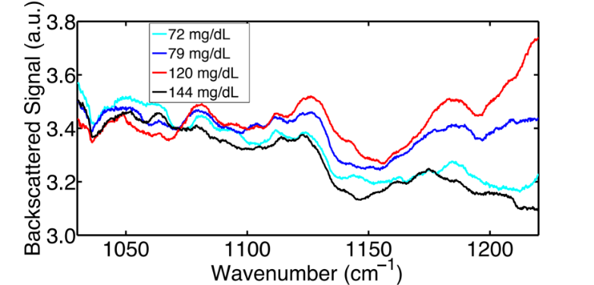
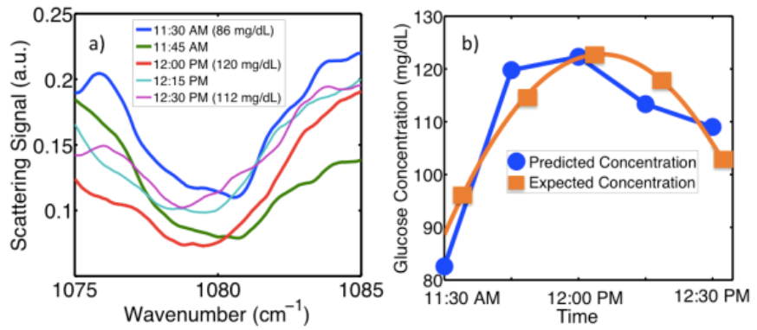
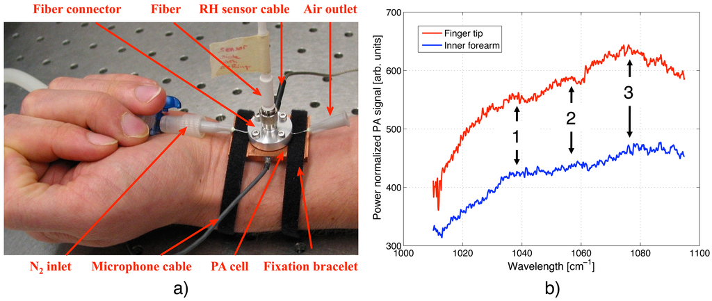
Blood Glucose
Diffuse reflectance
Gmachl 2014
Photo-acoustics
Mid-IR penetration depth <45 mm
S/N=1 at 100mg/dL
M.Sigrist 2012
Notes:
Electro-enzimatic and fluorescence based methods are more accurate and work with whole blood. Also cheaper.

Slide 17
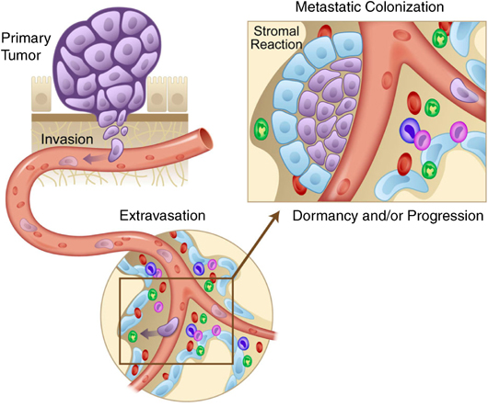
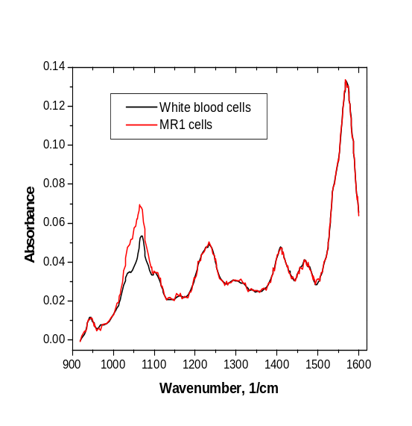
Cell Differentiation
Circulating tumor cells
Leukemia
Malaria
CTCs originate from solid tumor, circulate in blood stream, and may seed metastasis
Estimated frequency of one in 100 million to one in a billion blood cells
Flow cytometry - 2 cells/mL
Screening >100 cells/ml
Leukocytes and MR1 in PBS (10⁶/mL)

Slide 18
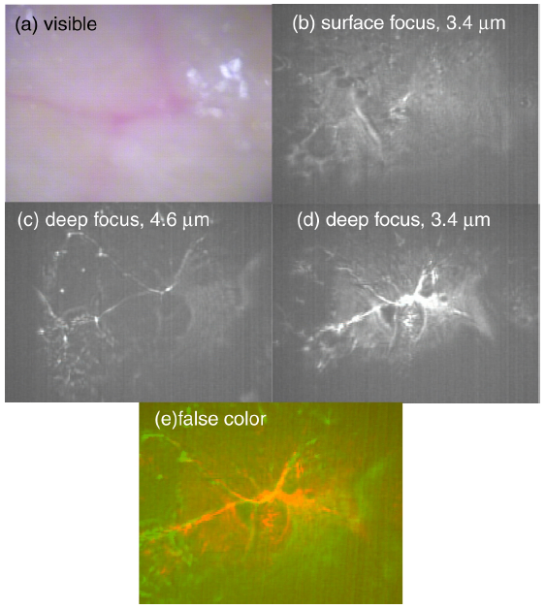
Mid-IR Imaging
Chemical imaging – digital histopathology
Over 90% of cancers start in epithelial tissues
Cell dynamics – live cells
B. Guo, Y. Wang, C. Peng, H. Zhang, G. Luo, H. Le, C. Gmachl, D.
Sivco, M. Peabody and A. Cho, Optics Express, 2004, 12, 208

Slide 19
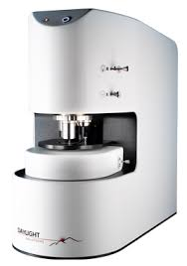
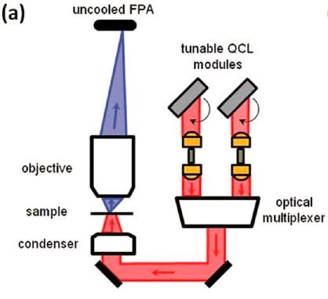
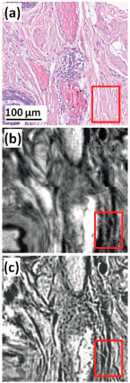
Mid-IR Imaging
Spectral range 900-1800cm⁻¹
Power >10mW
Diffraction limited spatial resolution
P.Bassan 2014

Slide 20
Mid-IR Laser Surgery
Mid-IR spectral range is attractive for highly precise surgical procedures and medical ablation of both soft and hard tissue because of the following main reasons:
it has absorption-dominant properties and its high absorption by water and proteins is associated with minimal penetration depth within tissue
mid-IR tissue ablation effects are superficial with submicron ablation rates and with minimal submicron damage layers around the exposed area
mid-IR radiation lacks the carcinogenetic potential that has generated concern at ultraviolet laser tissue interaction

Slide 21
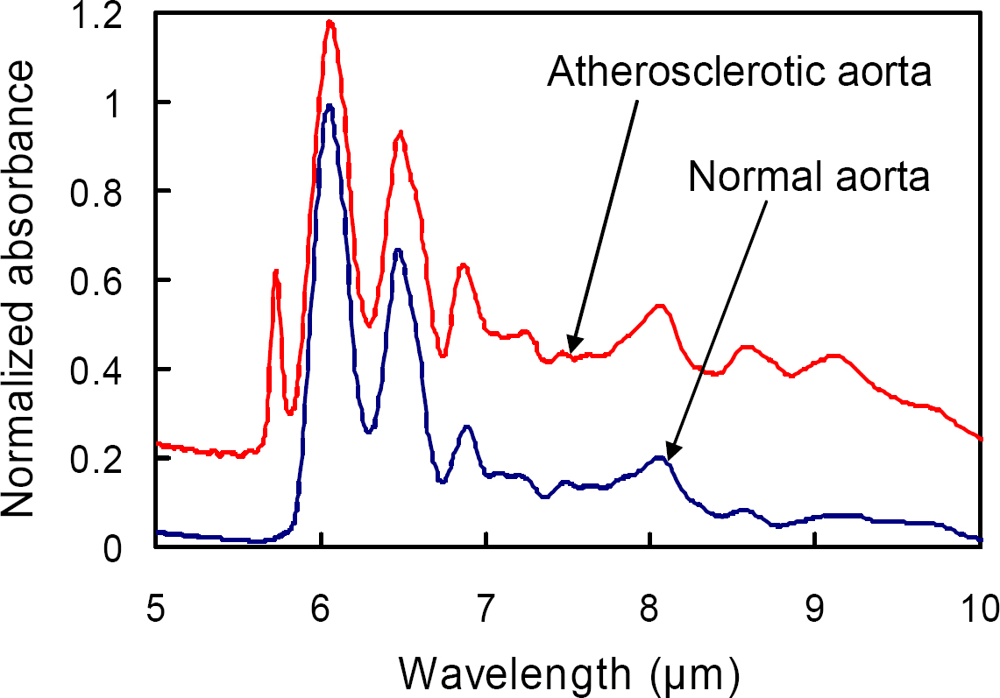
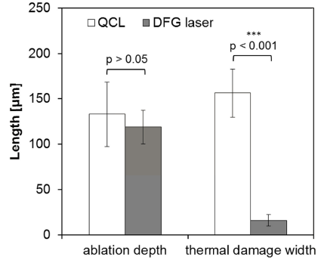
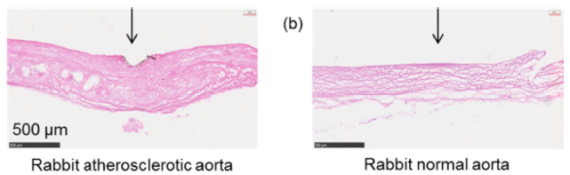
Mid-IR Laser Angioplasty
Atherosclerotic plaques consist mainly of cholesterol esters. Radiation at a wavelength of 5.75 μm is strongly absorbed
by the C=O stretching vibration mode of cholesterol esters.
QCL 500ns 1MHz 200W/cm²
DFG 5ns 10Hz 50W/cm²
K. Awazu 2008, 2012
Higher peak power is needed
Notes:
Laser angioplasty is a treatment modality for atherosclerosis. Unlike percutaneous transluminal coronary angioplasty that
uses balloons and stents, laser angioplasty actively removes atherosclerotic lesions. In addition, it is suitable for difficultto-
treat lesions such as totally occluded and complex lesions. However, erroneous or excessive irradiation by
conventional XeCl excimer lasers (wavelength: 308 nm) may damage normal vessels1. Therefore, safer lasers are
required to accomplish less-invasive laser angioplasty.

Slide 22
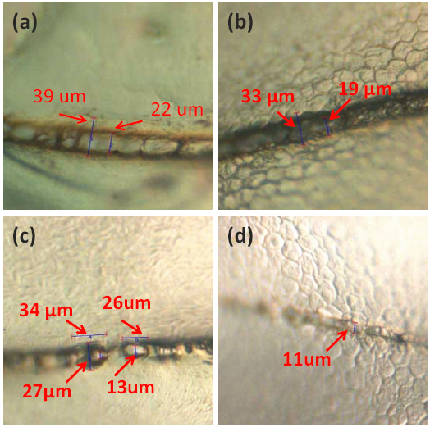
Laser ablation of corneal stroma
Absorption bands of the amide
protein groups Amide-I and Amide-II 6.1 μm and 6.45 μm
QCL a) 20ms 25Hz Depth 50 μm
b) 10ms 25Hz Depth 20 μm
c) 5ms 100Hz Depth 6 μm
d) 5ms 10Hz
Less collateral damage than at 3 μm
Not as good as Excimer laser
Jin U. Kang 2012
Higher peak power is needed

Slide 23
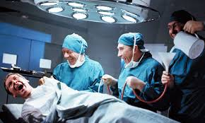
Thank You
Katya Zhupan, U. Michigan Ann Arbor
Sergey Agoulnik, Eisai Pharmaceutical
Ian Lewis, Princeton University
Michel Nofal, Princeton University
Loan Le, Princeton University
Sabbir Liakat, Princeton University
Claire Gmachl, Princeton University
NSF ERC MIRTHE, NSF

Slide 24
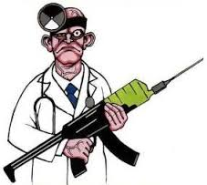
Many biological experiments are performed under the assumption that all cells of a particular “type” are identical. However, recent data suggest that individual cells within a single population may differ quite significantly and these differences can drive the health and function of the entire cell population. Single cell analysis comprises a broad field that covers advanced optical, electrochemical, mass spectrometry instrumentation, and sensor technology, as well as separation and sequencing techniques. Although the approaches currently in use can offer snapshots of single cells, the methods are often not amenable to longitudinal studies that monitor changes in individual cells in situ.
The NIH Single Cell Analysis Program (SCAP) is searching for novel methods for analyzing dynamic states of individual cells that can serve as the basis for predicting alterations in cell behavior and function over time. The ultimate goal is to develop new tools and methods that allow time-dependent measurements at the single cell level in a complex tissue environment to assess functional changes, provide information on the health status of a given cell, and help guide diagnosis and therapeutic treatments related to human disease states. Technological breakthroughs in this arena could allow researchers and physicians to identify rare cells in a mixed population such as individual cells that can transform and become cancerous; cells that are latently infected with a pathogenic virus; or cells that develop resistance to drugs over time. This challenge is structured in 2 phases: Phase 1 is a Theoretical Challenge and Phase 2, a Reduction to Practice Challenge. Phase 1 may award up to 6 prizes from a total prize award pool of $100,000 for the theoretical portion of the competition.

Slide 25
Let Us Meet Again
We welcome all to our future group conferences of Omics group international
Please visit:
www.omicsgroup.com
www.Conferenceseries.com
http://optics.conferenceseries.com/

