Slide 1
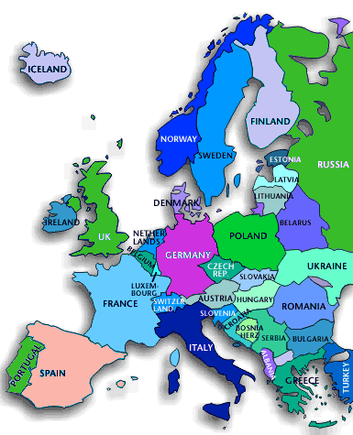
How to make “green” plastics “greener”
Ignacy Jakubowicz
SP Technical Research Institute of Sweden
Department of Chemistry, Materials and Surfaces
SP Group owners 100 % RISE
Subsidiaries 10
Employees 1400
Postgraduates 400
Turnover 180 MUSD
Customers More than 10,000
Papers and Reports 520
·

Slide 2
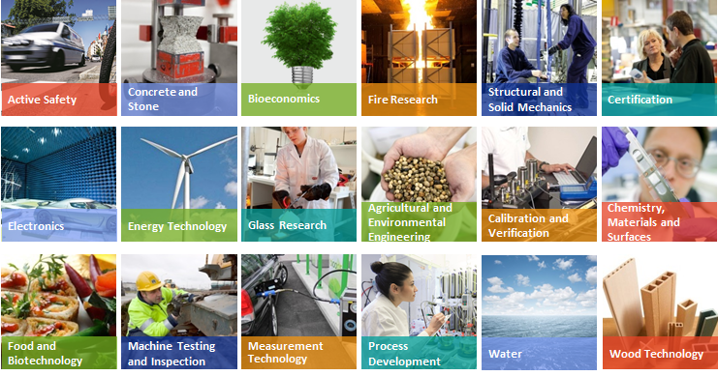
Sweden's most extensive resource for research, innovation and development
www.sp.se

Slide 3
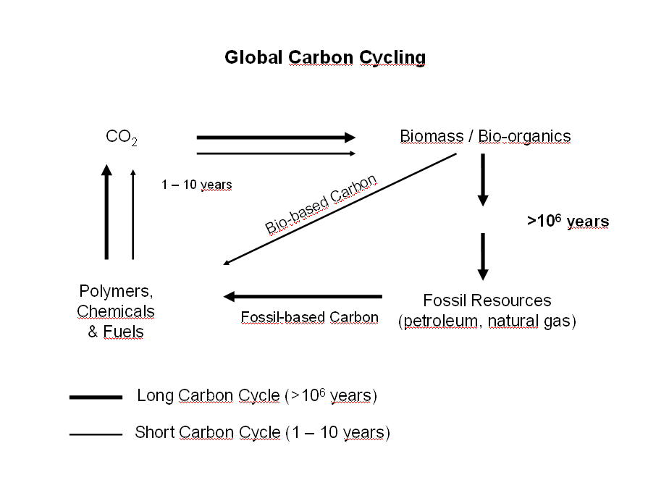
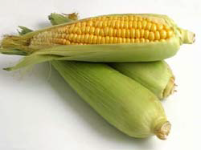
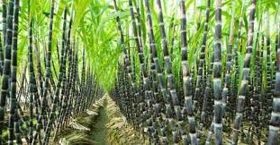
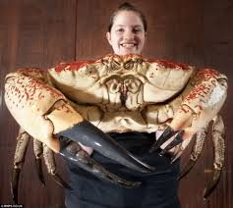
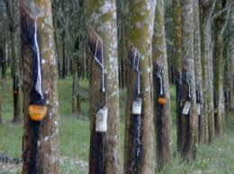
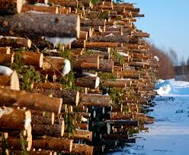
What are bio-plastics or ”green” plastics?
Various definitions are used:
Bio-degradable
Bio-compatible
Made from renewable resources
Starch
Sugar
Chitin
Latex
Cellulose

Slide 4

Renewable feedstock for polymers
Bio-based plastics can be seen as a part of a broader bio-based economy
Diverting agricultural land from producing food crops to producing feedstock for the bio-economy leads to food insecurity and food prices
Biomass
Solar
cell
Thermal gasification with stem and oxygen
Fermentation
Hydrogen gas (H₂)
Ethanol (C₂H₅OH)
Synthesis gas (CO + H₂)
Methanol (CH₃OH)
ethylene
Polymers
Ethylene, propylene, butylene

Slide 5
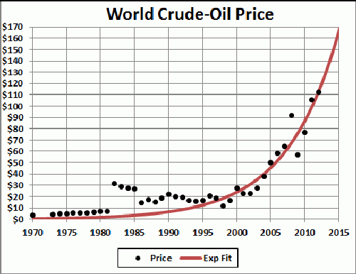
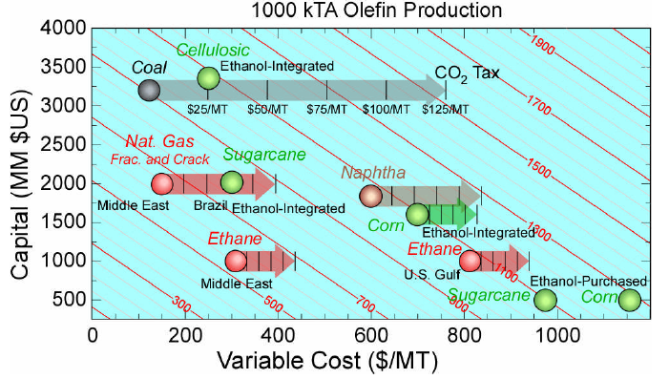
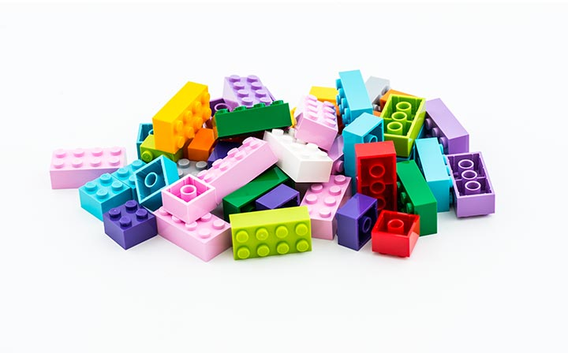
Why should we make plastics from renewable feedstock?
Production cost of ethylene in the future?
Customer demands
Price & supply of crude oil
Reduce emissions of CO₂
Improved public opinion about plastics
Political decisions
LEGO Group to invest 1 Billion DKK boosting search for sustainable materials

Slide 6
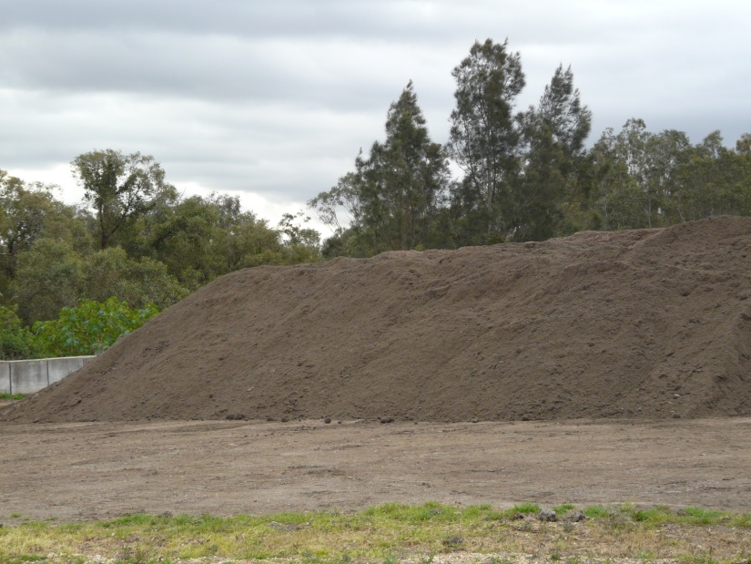
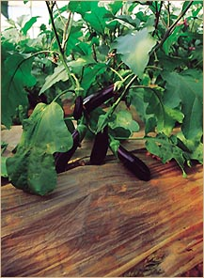
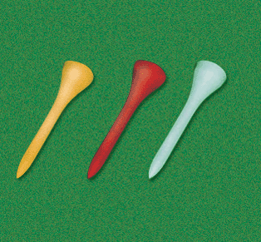
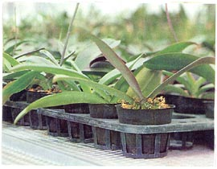
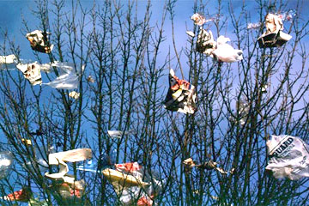
Why biodegradable plastics?
EN 13432 composting
Special products for better economy & environment
“The antisocial littering issue falls not within the scope of this standard.
Plastics’ biodegradability is not an encouragement to antisocial behaviours.”
Littering
Workshop 15 June 2015
Notes:
Materialen bearbetads i form av en produkt (kniv) två gånger på industri (Hammarplast) för att simulera återvinning av produktionspill.

Slide 7
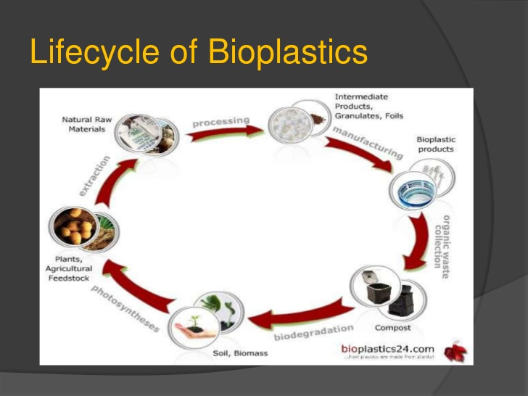
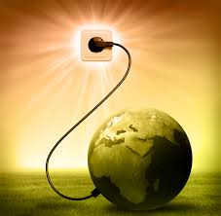
Is biological recycling the ideal solution?
Value as materials – can be recycled
Value as feedstock – can be converted to useful chemicals
Energy value – can be incinerated with energy recovery
Biodegradation to CO₂ and water is equivalent to incineration but without recovery of any useful value and should be the very last option
Workshop 15 June 2015
Notes:
Bearbetning (extruderad och pressad)
Granulat och sex cyklar bearbetad material har granskat i syfte med nedbrytning av materialet under processbetingelse för både PLA/HDPE och PLA/PC.

Slide 8
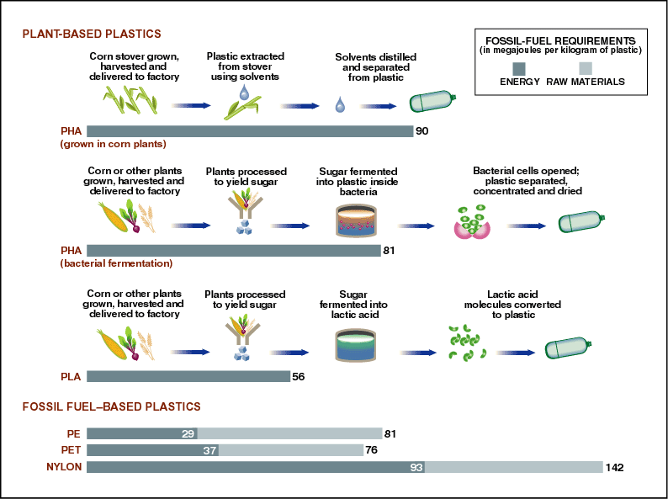
Do we need to recycle bio-plastics?
Renewable resources are finite because they can only be replenished at a certain rate
Process Energy
Transportation Energy
Energy of Material Resource
Sustainability is superior to renewability
New raw material to each product
1
2
1
2
3
New raw material to the first generation then 100% recycled

Slide 9

Why should we recycle bio-based plastics?
Waste Policy and Legislation in European Union
End of Life Vehicles Directive (2000/53/EC):
min. 95 % recovery, 85 % recycling by 2015
Waste Electrical and Electronic Equipment Directive, 2012/19/EU,
min. 85 % recycling by 2016
EU Waste Framework Directive 2008/98/EC, the Landfill Directive 1999//31/EC and the Packaging and Packaging Waste Directive 94/62/EC targets by weight :
50 % for household and 70 % for construction and demolition waste by 2020
packaging waste 80 % by 2030
plastics 60 % by 2025

Slide 10
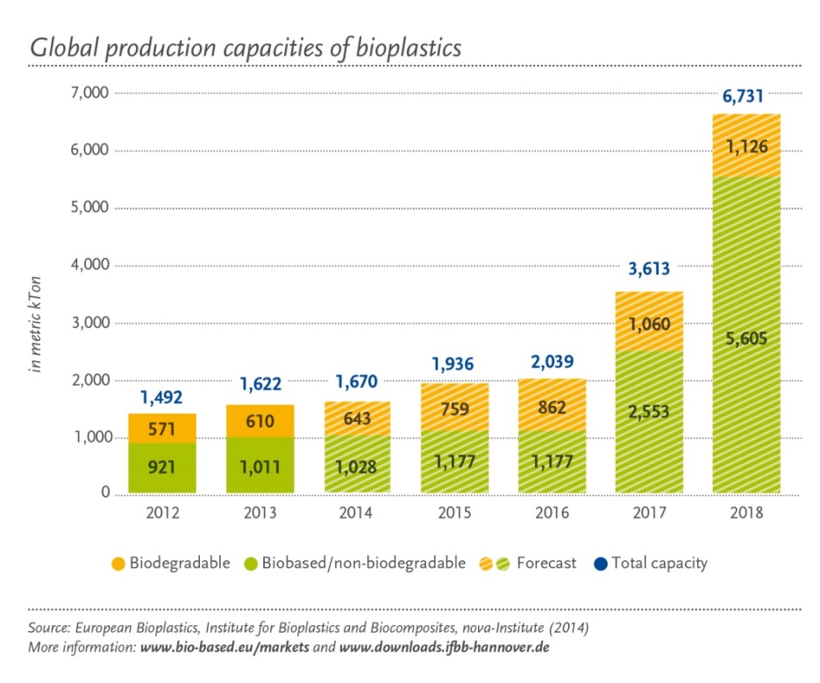
Drivers for the future development in bio-plastics production
Durable bio-plastics that can be recycled constitute a much more resource efficient and environmentally beneficial solution
The market demand: bio-plastics must meet the same processing and performance specifications that exist for conventional fossil based polymers
The most dynamic development is in “drop-in” bio-based polymers

Slide 11
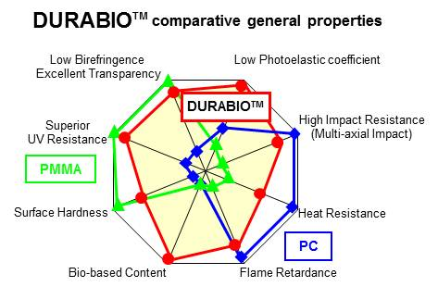
Bio-based engineering plastics
PA11 (100 % bio-C, Arkema), PA1010 (99 % bio-C, EMS-Grivory)
PA610 (62 % bio-C, EMS-Grivory),
PA
PET
bio-PET (30 % bio-C)
Polytrimethylene terephthalate PTT (28 % bio-C, DuPont)
Polyethylene furanoate PEF (100 % bio-C)
Bio-based polymers as replacement
for fossil-based are not identical

Slide 12
Challenges for plastics industry
Bio-based plastics
Fossil-based plastics
Only fossil-plastics
Both fossil and bio plastics exist at the same time
Only bio-plastics
Develop recovery systems and end markets for post-consumer waste
Prevent contamination of the existing recycling systems
Prepare suitable labelling system and increase public awareness
Develop collection, separation and sorting technologies for bioplastics
Develop processing technology
Evaluate their indoor and outdoor ageing and durability properties
Develop additives to enhance durability, compatibility and other properties
Evaluate safety and health factors
Develop business models and policy instruments

Slide 13

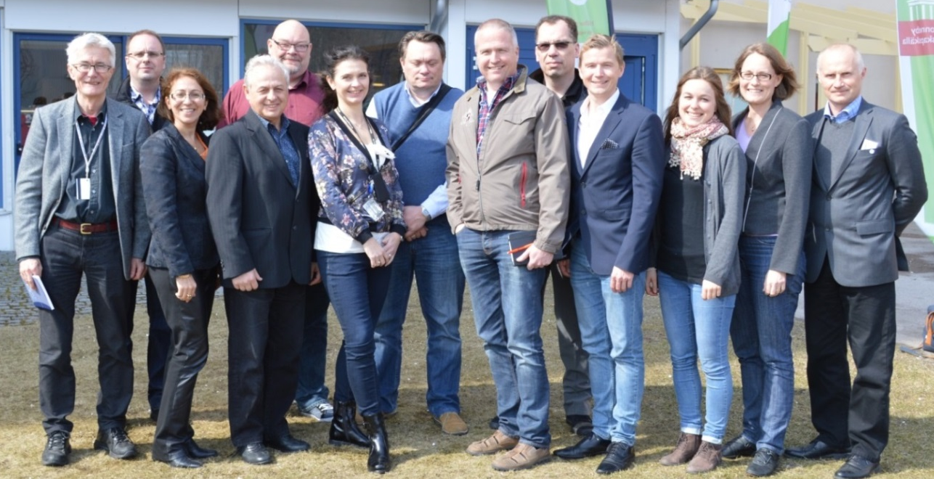








Sustainable management of bio-plastic waste
A part of the Mistra programme ”Closing the loop”

Slide 14

Acknowledgments
Organizing committee for the kind invitation
MISTRA for the financial support
My co-workers for the fruitful collaboration
Thank you for your kind attention !

