Slide 1
INFLUENCE OF WRIST AND FINGERS POSITIONS ON MEDIAN NERVE DISTAL LATENCY RESPONSES WITHIN CARPAL TUNNEL IN HEALTHY SUBJECTS

Slide 2

Introduction

Slide 3
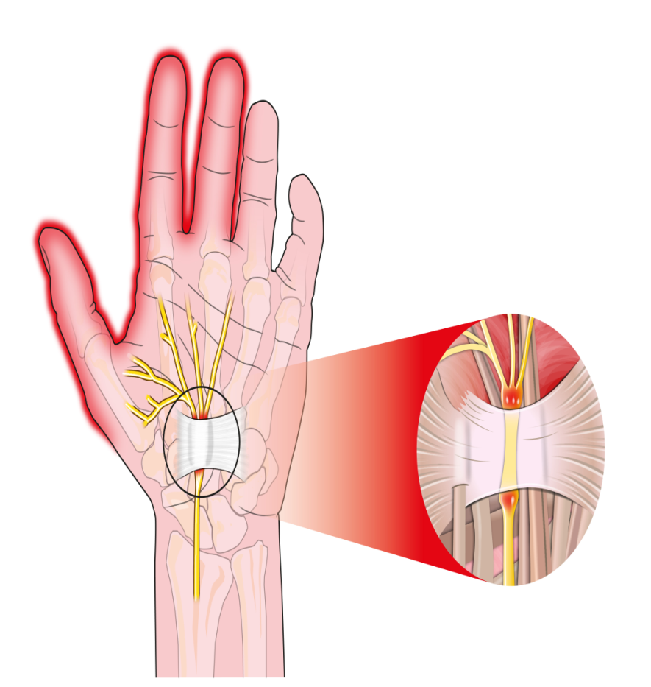
Carpal Tunnel Pressure
Carpal tunnel pressure (CTP) has been found to be a suitable predictor of carpal tunnel syndrome risk since increased pressure in the carpal tunnel has been associated with disturbed nerve function suggesting that fluctuations in fluid pressure is influenced by hand, wrist and forearm posture.

Slide 4
Extreme Postures and Effect on nerves
Extreme postures increase load on muscles and tendons which may increase load on joints in an asymmetrical manner imposing a static load on the musculature thereby inhibiting blood and axonal flow. Some wrist postures may be stressful due to tendon strain.
Tension developed in finger flexor tendons combined with wrist flexion may compress the underlying median nerve against the transverse carpal ligament.

Slide 5
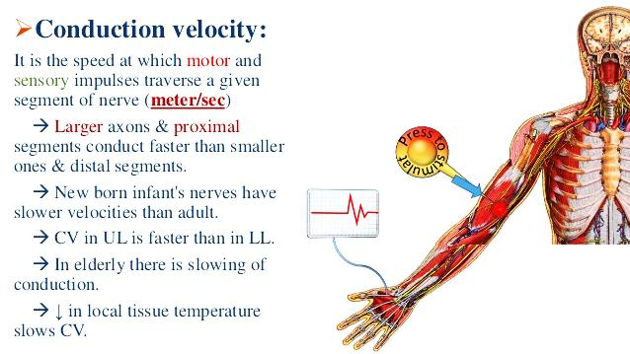
Nerve conduction velocity
Nerve conduction velocity shortly known as “NCV” tests are used to determine the velocity of the electrical signals moving along a specific peripheral nerve.
The use of NCV tests permit physicians to distinguish between an injury that aroused in the myelin sheaths or an injury in the nerve axons

Slide 6
NCV as a standardized testing tool for CTS
NCV is used as a standardized testing tool for CTS due to its objectivity in providing information on the status of the median nerve across the carpal tunnel.
Comparing the latency and amplitude of a median nerve segment across the carpal tunnel to another nerve segment that does not go through the carpal tunnel is commonly used

Slide 7
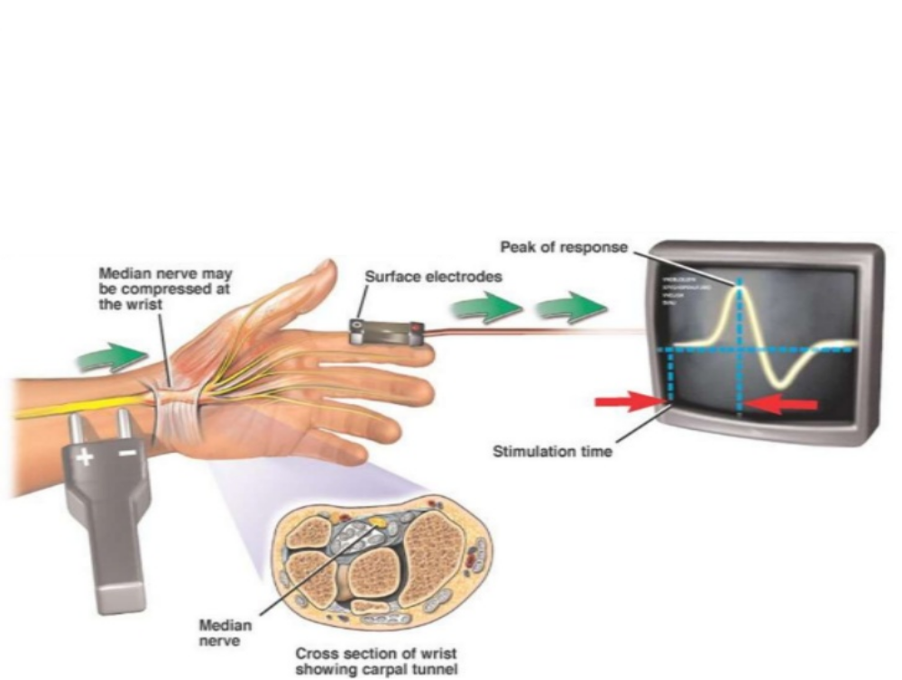
Subjects, Materials and Methods

Slide 8

Subject criteria
  60 healthy participants were involved in the study.
  Age ranging between 30-50 years .
  All participants were conscious.
  All participants were non- smokers.
  All participants had Body mass index between 21 and 29.9 kg/m2.

Slide 9

Exclusion criteria
Participants were clinically examined to rule out carpal tunnel syndrome diagnosis. History, physical examination and electrodiagnsosis were used to rule out this possibility.
Participants with factors resulting in carpal tunnel syndrome such as arthritis, fluid retention in pregnancy, hyperthyroidism, traumatic changes, and prior injury to the wrist were excluded from the study

Slide 10
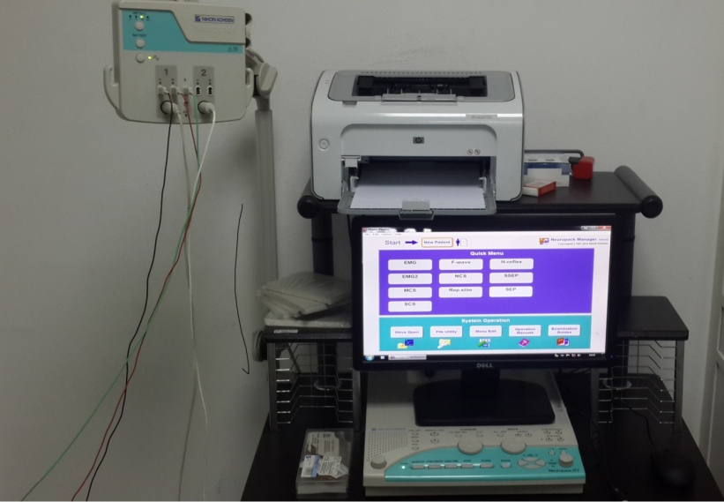
Materials
Neuropack S1 MEB-9004 NIHON KODEN, JAPAN device (EMG machine)

Slide 11

Procedures
This part of the study was divided into two phases :
Subjects preparation.
Measurement phase.

Slide 12
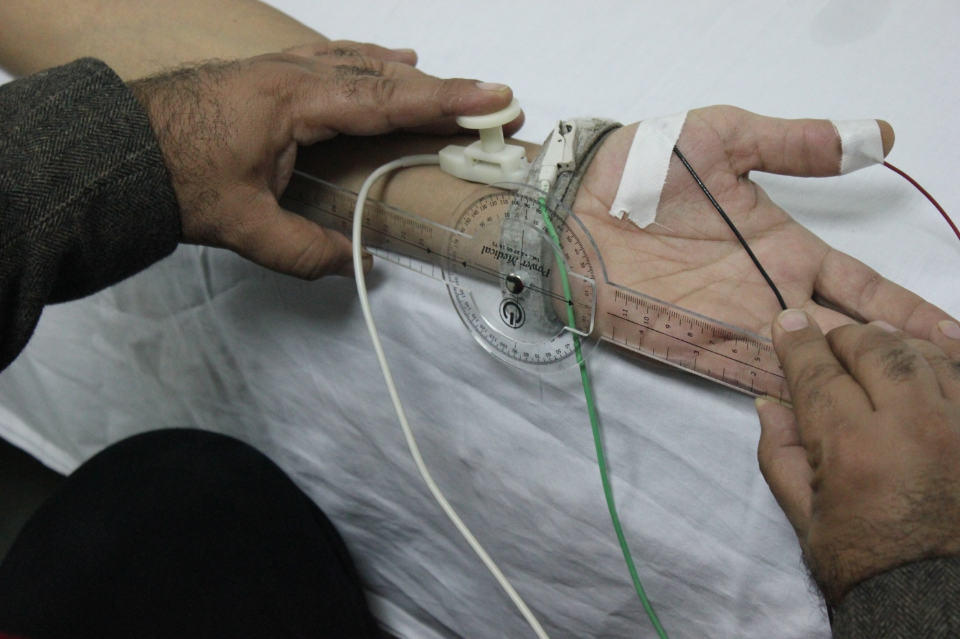
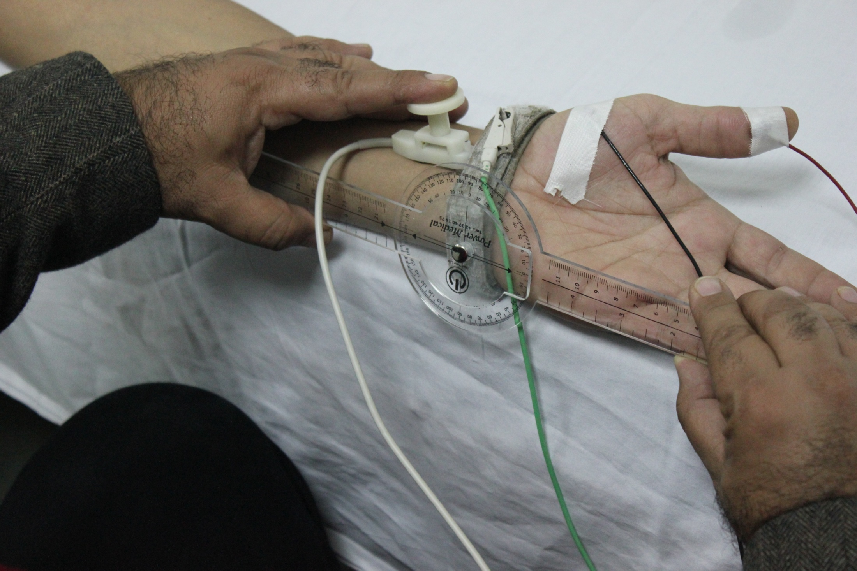

Measurement phase

Slide 13
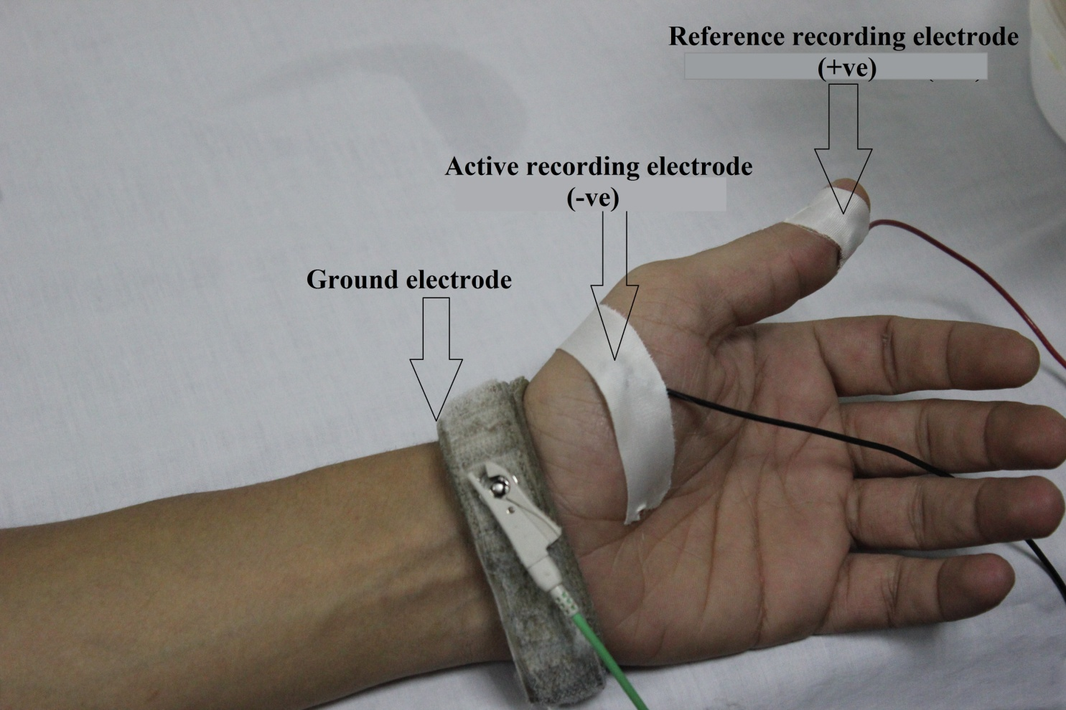
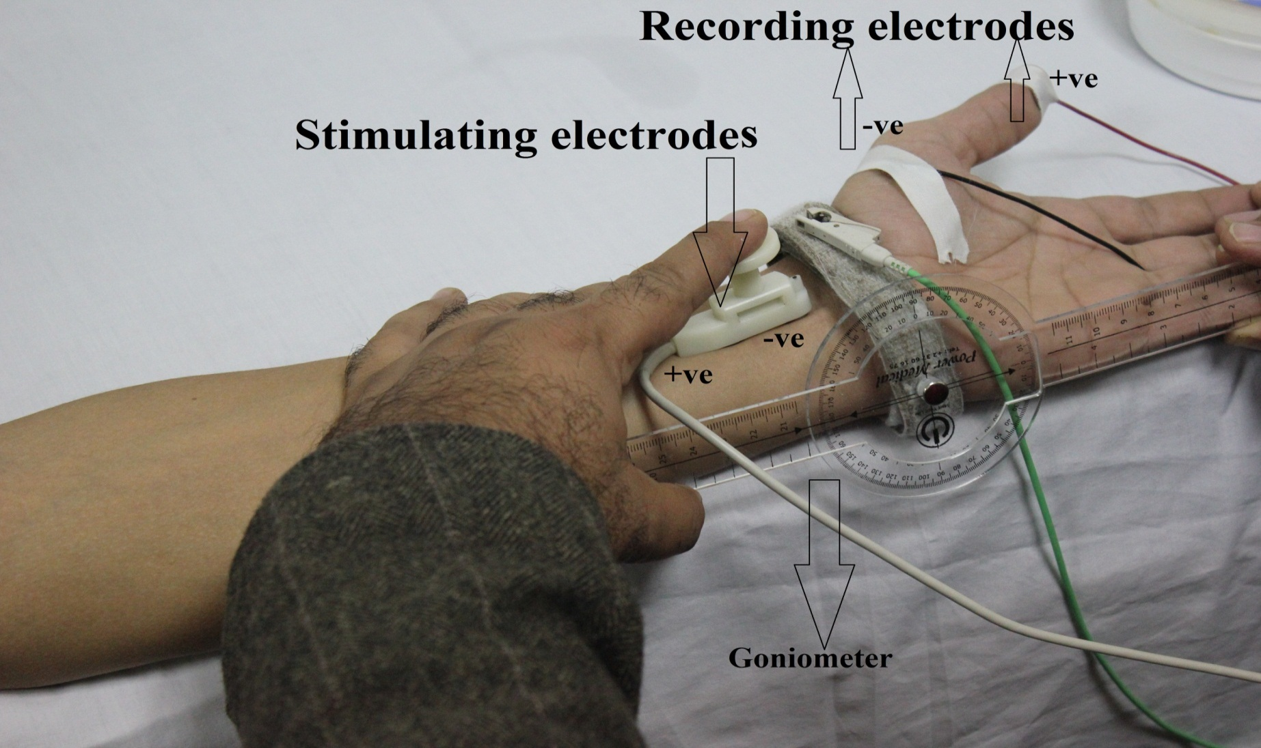
Measurement phase
Median nerve motor conduction study measured in wrist neutral position

Slide 14
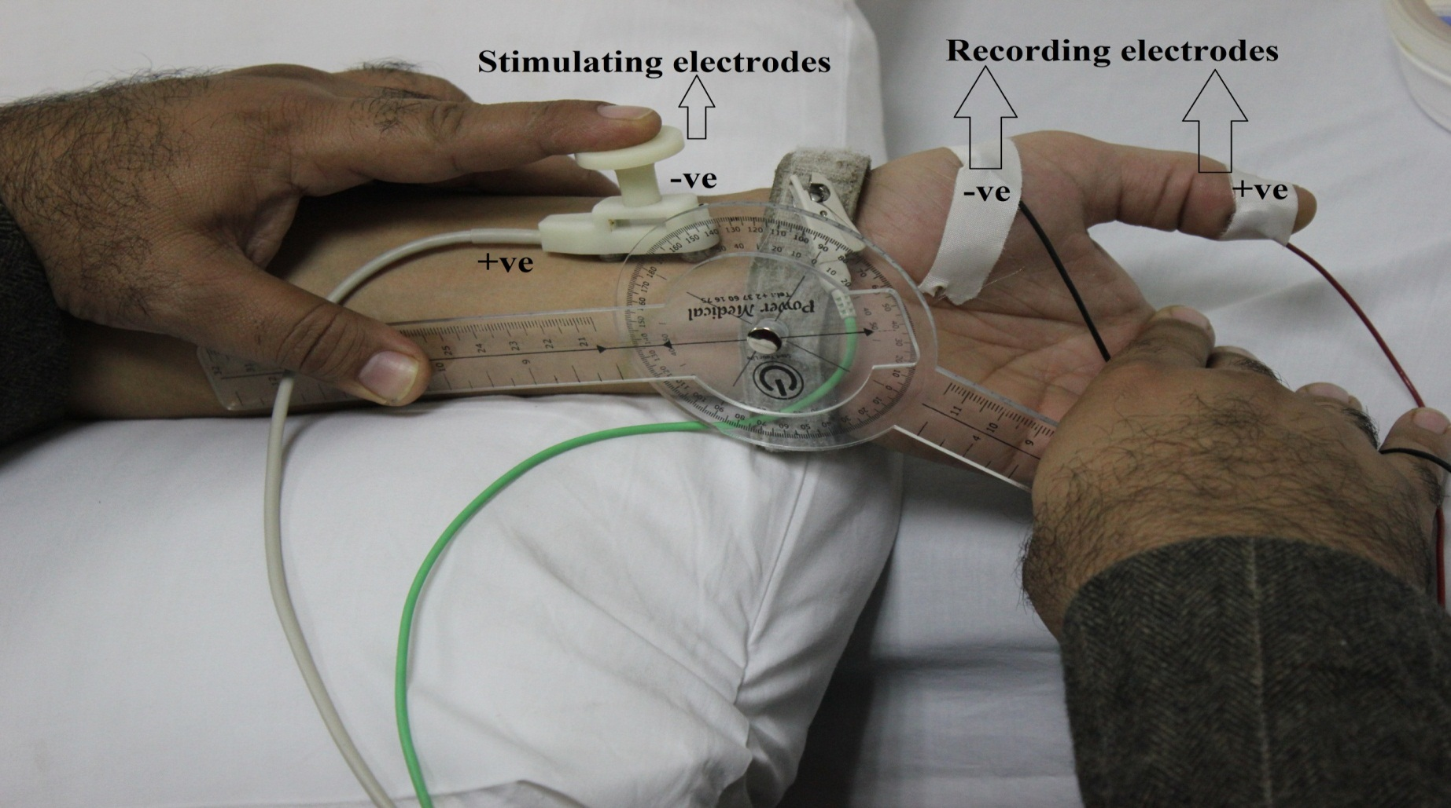
Measurement phase
Median nerve motor conduction study measured in wrist 60◦ extension

Slide 15
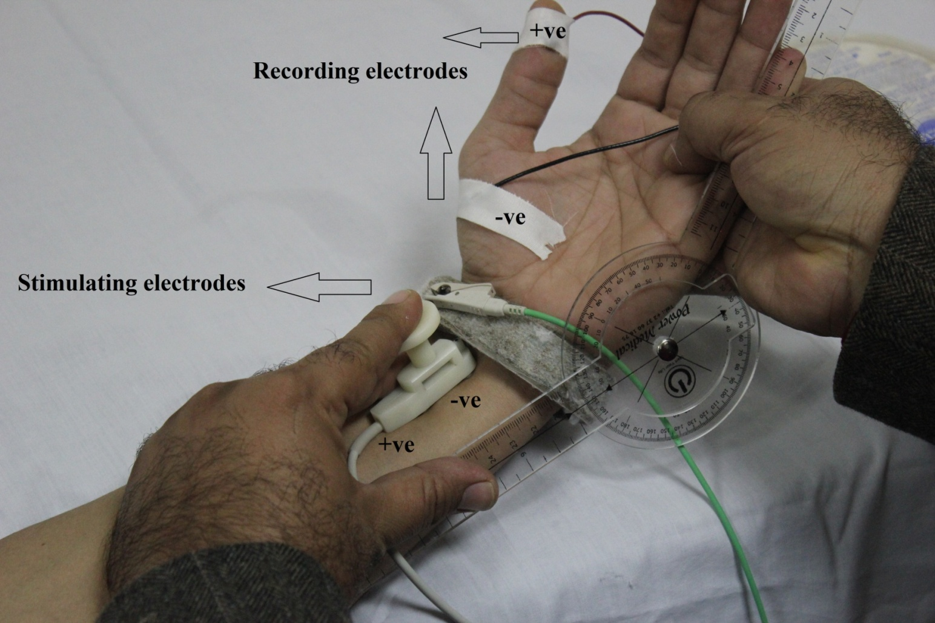
Measurement phase
Median nerve motor conduction study measured in wrist 60◦ flexion

Slide 16
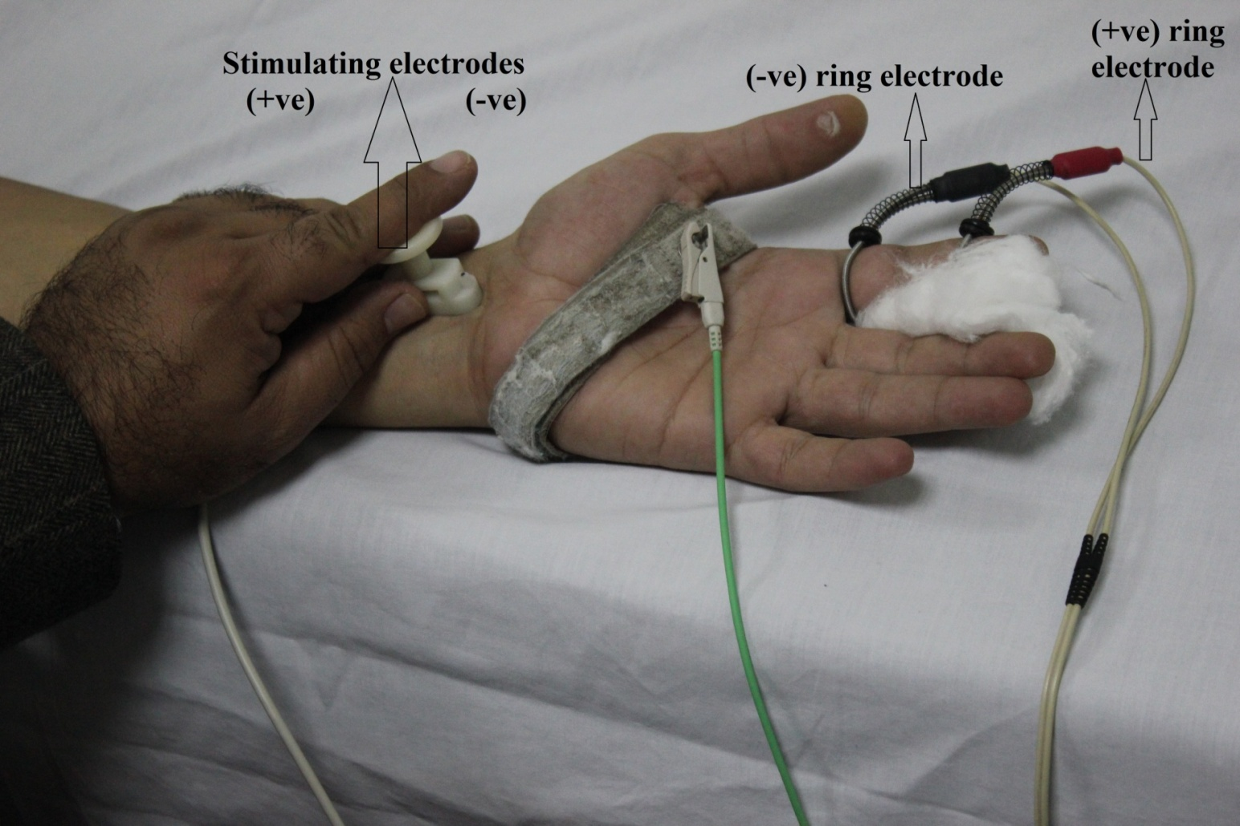
Measurement phase
Median nerve sensory conduction study measured in finger extension

Slide 17
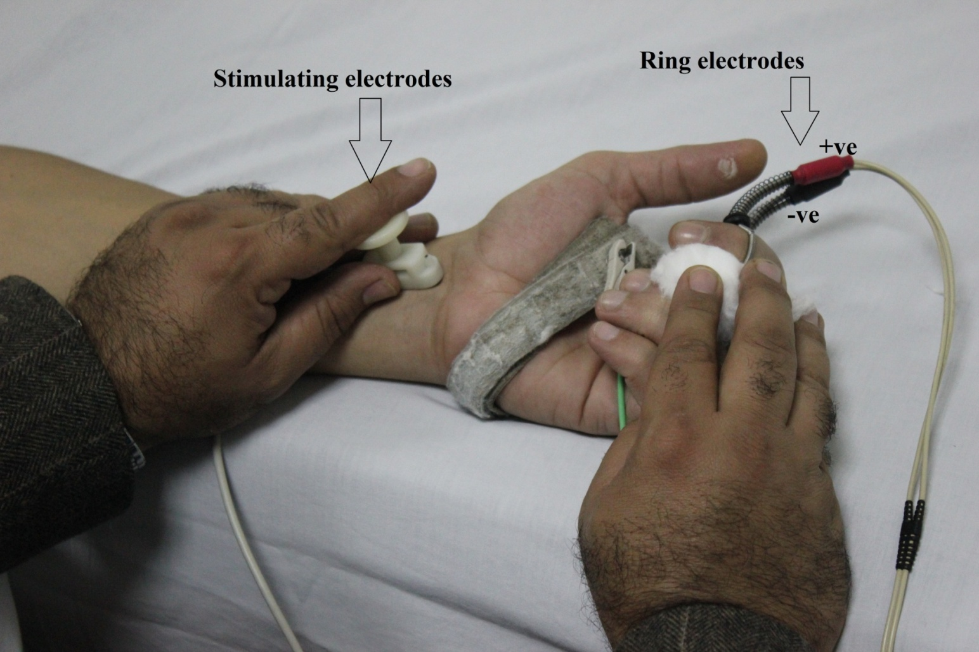
Measurement phase
Median nerve sensory conduction study measured in finger flexion

Slide 18

Results

Slide 19
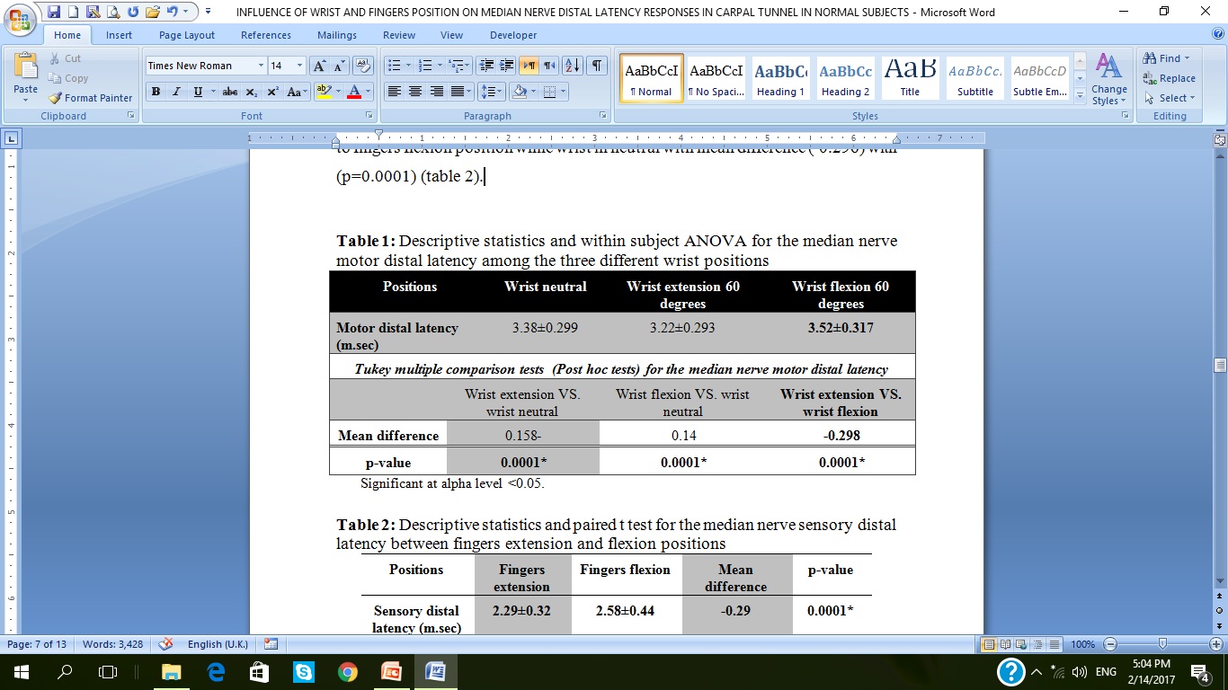

Slide 20
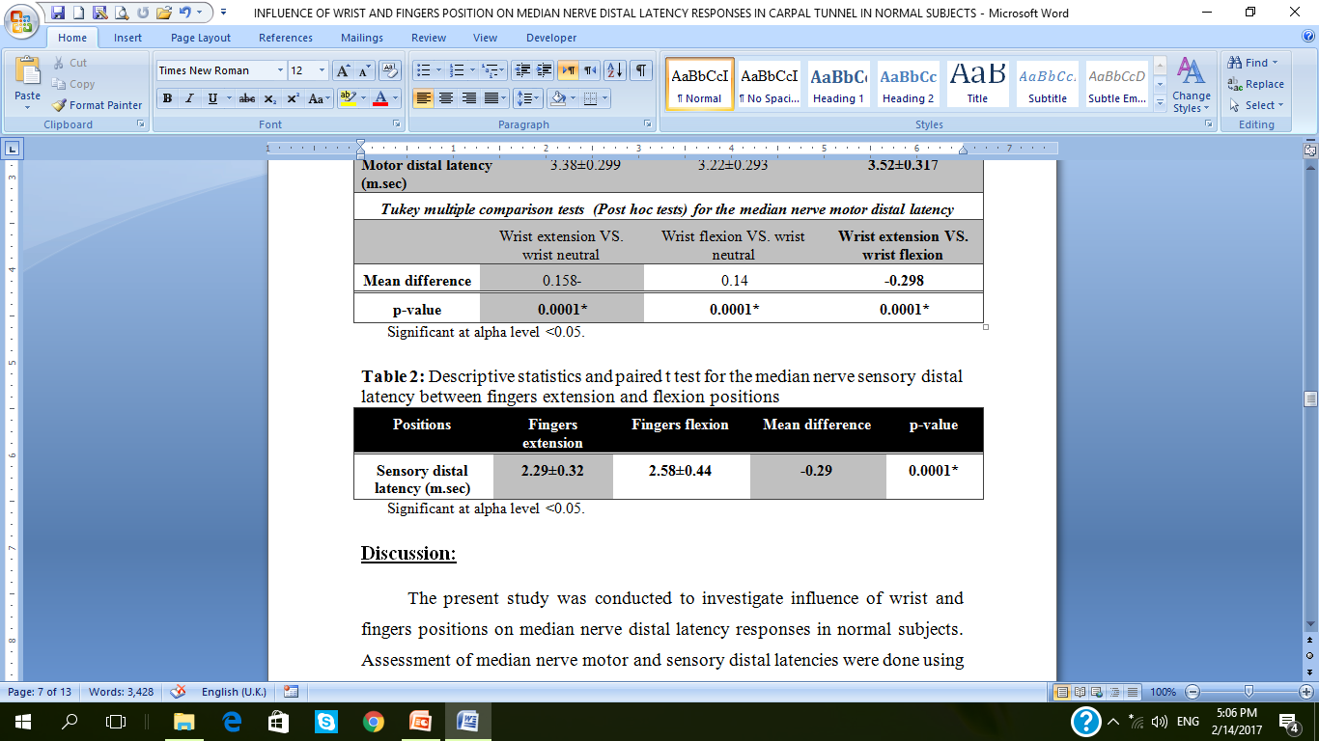

Slide 21

Discussion

Slide 22
Discussion
60◦ wrist extension was displayed as the preeminent position when compared with other wrist positions in which can be explained by :
1. Balanced carpal tunnel pressure in wrist extension thus improving nerve function.
2. Shear strain and gliding resistance of flexor tendons against carpal tunnel walls observed in wrist flexion.
3. This results in swelling of synovial sheath which increase CTP.
4. During wrist extension , the median nerve relocated most dorsally away from site of pressure.

Slide 23
Discussion
Fingers extension was the most convenient position when compared with fingers flexion in study group 1 , due to :
  1. Lower carpal tunnel pressure found in fingers extension.
  2. Lumbar muscle incursion during fingers flexion which increase CT content volume and elevates pressure.

Slide 24
Conclusion
Wrist and fingers extension position was the most convenient position for assessment of median nerve.
Also preventing repeated and prolonged wrist and fingers flexion may reduce the risk of CTS

Slide 25

Recommendations
Follow up studies should be undertaken on greater sample.
Further research should be conducted to investigate the effect of different wrist positions on median nerve distal latency but with more angles in wrist flexion & extension.
Explore different treatment protocols for rehabilitation of workers who perform repetitive wrist and fingers flexion.

Slide 26
THANK YOU FOR YOUR TIME!

