Slide 1
Combining technologies for food decontamination and extending the shelf-life of fruit and vegetables
Ian A. Watson
Systems, Power and Energy Research Division
School of Engineering
University of Glasgow
Glasgow, United Kingdom
G12 8QQ
ian.watson@glasgow.ac.uk

Slide 2
Contents
  Introduction
  Lasers, what they can do
  Laser and environmental parameters for bacterial inactivation
  General materials and methods
  Using different lasers
  Laser inactivation on different substrates
  Laser scanning systems - ham
  Combined inactivation systems
    Laser, UV, Pulsed light, Microwave, Heating, Chemical
    Shelf life extension – carrots and potatoes
    Modelling decontamination on potatoes
  Real time detection systems
  Conclusions
  References

Slide 3
Introduction
Consumers need safe food with a reasonable shelf-life
Food poisoning costs the USA alone an estimated $152B
Kills 5000 people per year in the USA.
Globally, between 1.2-2.0 Billion tonnes of food produced each year is wasted, in part due to limited shelf-life.
Solutions?
Systems have been designed, built and evaluated at the University of Glasgow, UK, utilising a diverse range of technologies; from lasers, microwaves, ultrasonic, pulsed light, UV, and chemical methods.
These technologies have been combined to reduce levels of contamination on different produce and extend their shelf-life. Some specific examples of these different treatments and systems will be given.
Real time detection technologies developed

Slide 4
Introduction

Slide 5
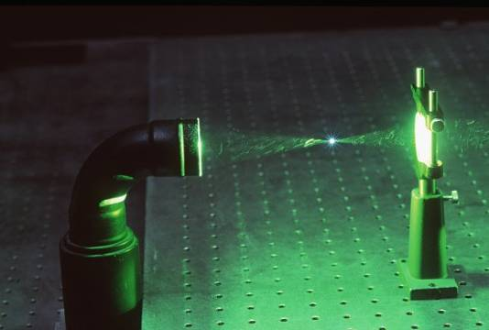
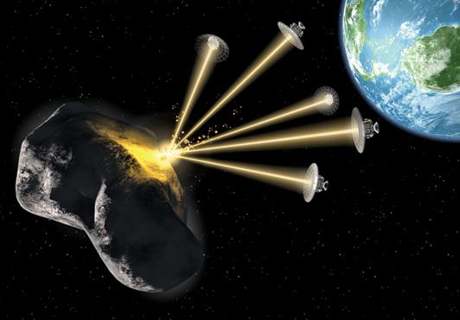
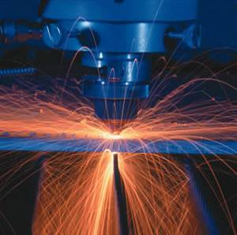
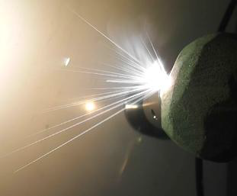
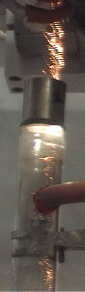
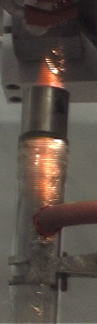
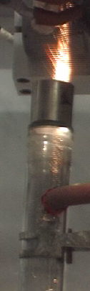
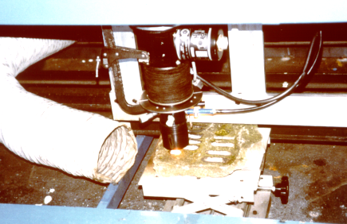
Lasers, what they can do!

Slide 6
Laser and environmental parameters for inactivation
Power
Beam Area
Exposure time
Energy density (Jcm⁻²)
Pulsed
pH
Water activity
Salt concentration
Polarisation
Ambient
Conditions
Laser
CW
Temperature
Laser
Sterilization
Sterility assurance
Wavelength
Liquid
Micro
organism
Fungal
Solid
Sample
Spores
Gaseous
Bacterial
Population statistics

Slide 7
General Materials and Methods
Produce overnight culture
Inoculate onto sample medium – agar plates, small sample disks, food sample, or place in aerosol generator for air decontamination
Perform scoping experiments to determine treatment levels
Devise parameters settings e.g. laser, microwave…
Treat with system – laser, UV, pulsed light, microwave, chemical, combination
Recover counts
Analyse data

Slide 8
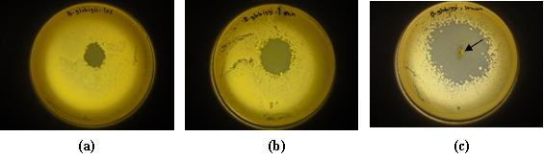
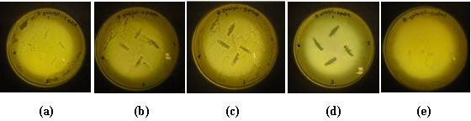
Example of treatment on agar plates
Excimer Laser (248 nm, KrF) on surfaces
Agar plates lawned with B. globigii spores and treated with excimer laser of fixed
power for a) 10 seconds, b) 1 minute and c) 10 minutes at 100 Hz PRF
Agar plates lawned with B. globigii spores and treated with a
different number of pulses from the excimer laser
a) 1 pulse, b) 2 pulses, c) 5 pulses, d) 10 pulses and e) control (no laser radiation)

Slide 9
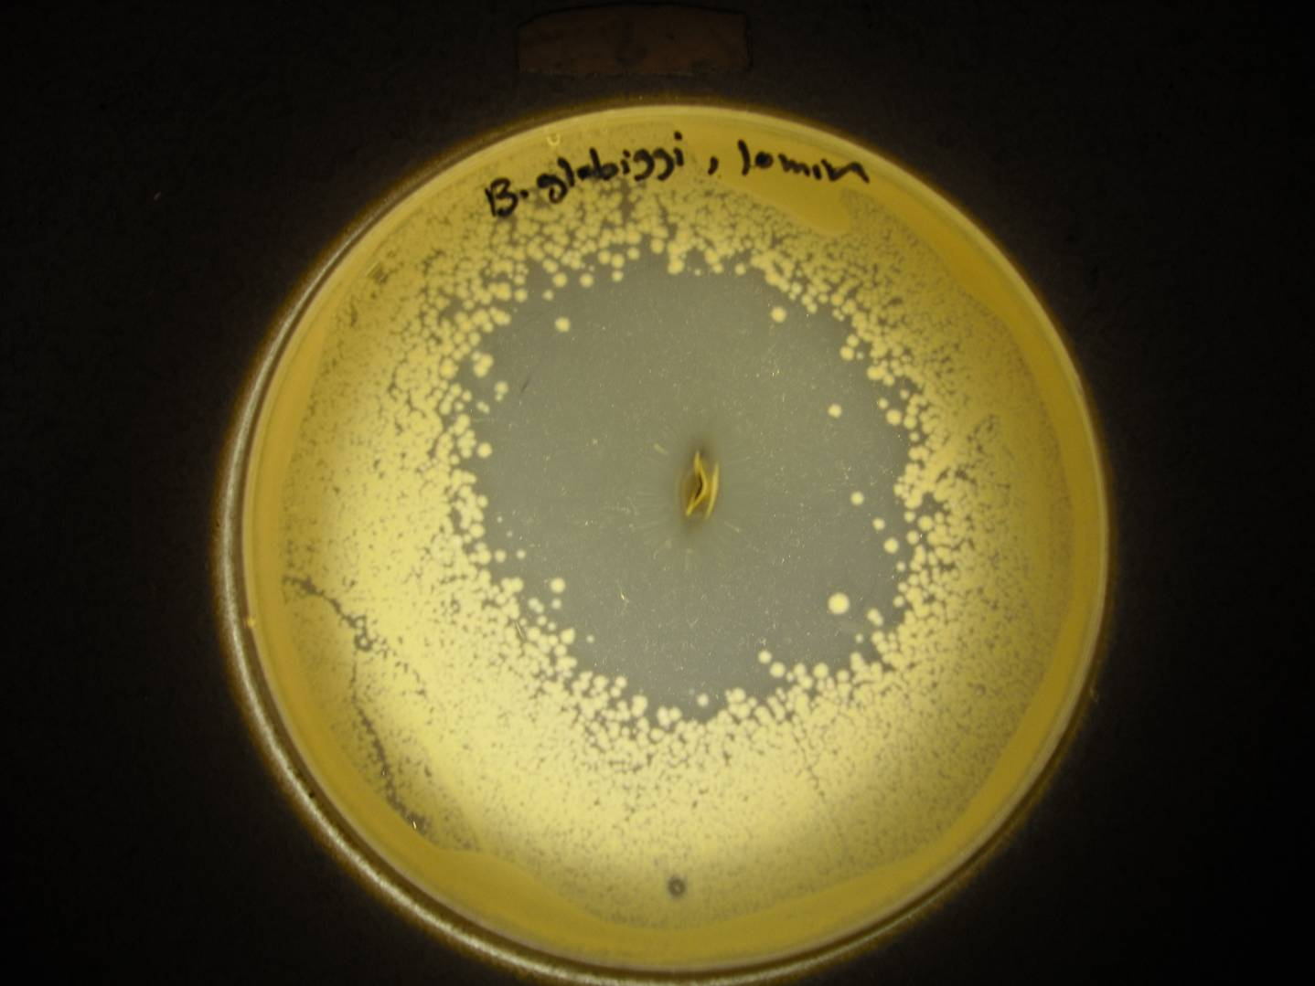

Slide 10
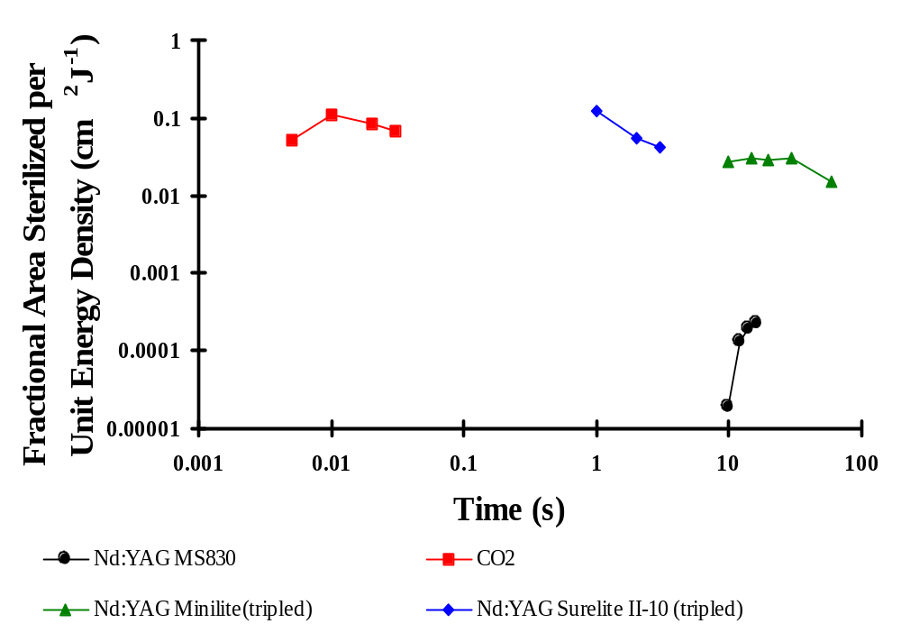
Effect of laser wavelength
Exposure times to generate zones of clearing, normalized to the laser beam area and applied energy density, for each laser which demonstrated a biocidal capacity against E. coli lawned on nutrient agar culture plates
No inactivation with:
FIR laser(118µ, 7.96 J/cm²),
Ar ion (488nm, 2210 J/cm²)
10.6µm, 1.06 µm, 355nm

Slide 11
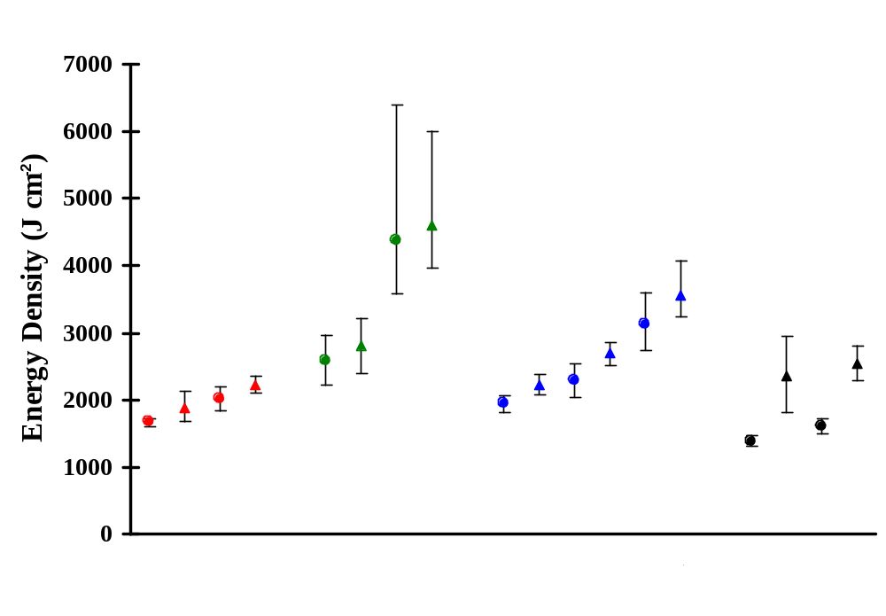
Effect of microorganism
Comparative sensitivities of seven bacterial and two yeast strains to Nd:YAG laser light
(10J, 8 ms, 10Hz).
95% confidence limits of the energy densities required to sterilize an area of 0.825 cm².

Slide 12
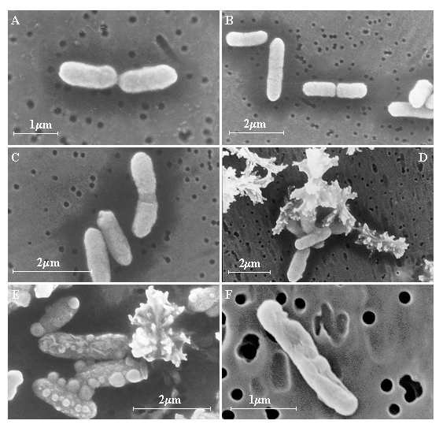
Effect of Nd:YAG laser radiation on E. coli in saline solution
Scanning Electron Micrographs of E. coli after various laser exposures and water bath treatments.
A. Control; laser exposure to temperatures (B-E) of 40, 50, 60 and 70°C and F. 100°C in a waterbath.

Slide 13
Effect of substrate
Nd:YAG laser killing curves of S. aureus films dried on
glass, nylon and stainless steel
Log cfu ml⁻¹
9
8
7
6
5
Nylon
Stainless steel
4
Glass
3
Pulse energy 10 J
2
PRF 30 Hz
Beam diameter 1.6 cm
1
0
0
500
1000
1500
2000
-2
Energy density (J cm
)

Slide 14
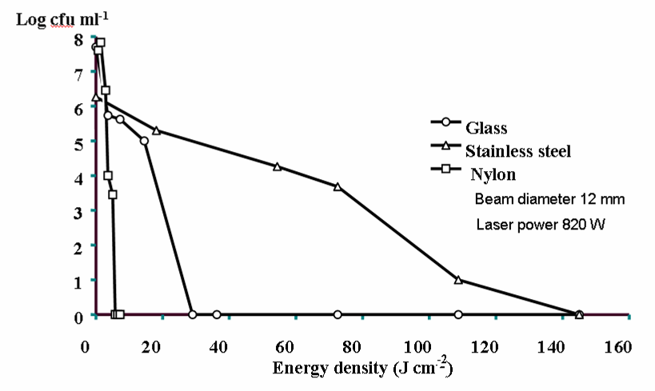
Effect of substrate
CO₂ laser killing curves of S. aureus films dried on
glass, plastic and stainless steel

Slide 15
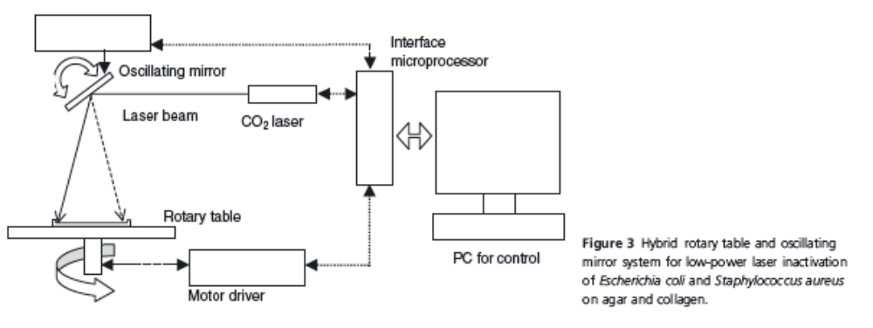
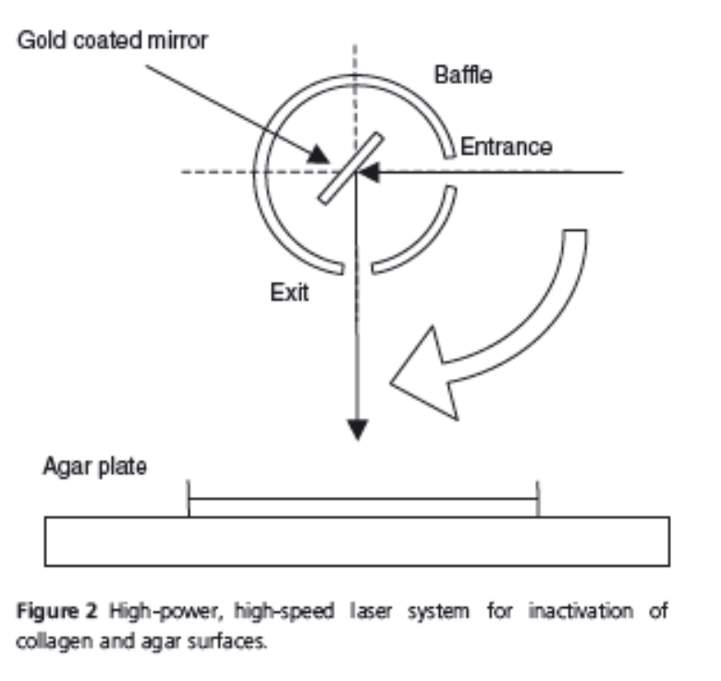
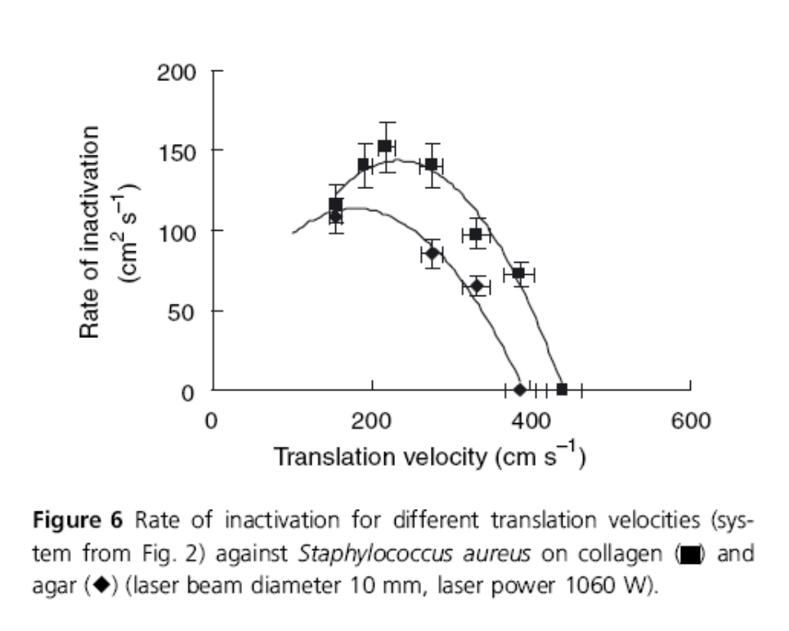
Laser scanning systems
CO₂ laser systems
low power and high power
High power system (~1kW), S. aureus on collagen (square) and agar (diamond),
10 mm beam diameter

Slide 16
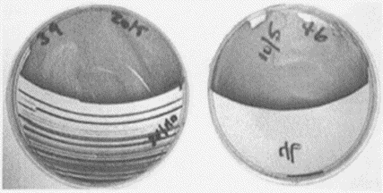
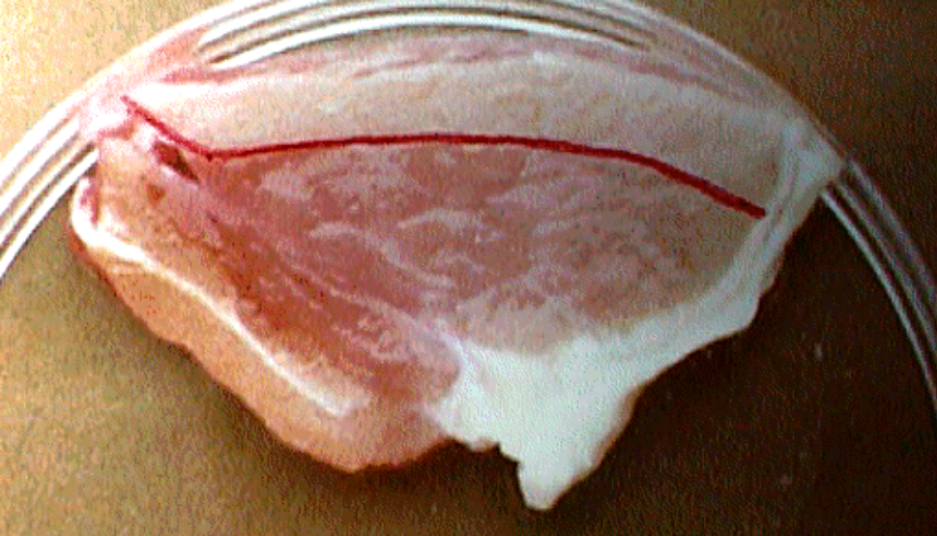
Low power laser scanning systems
Optimal scanning speed
Scanning speed too slow and/or insufficient power

Slide 17
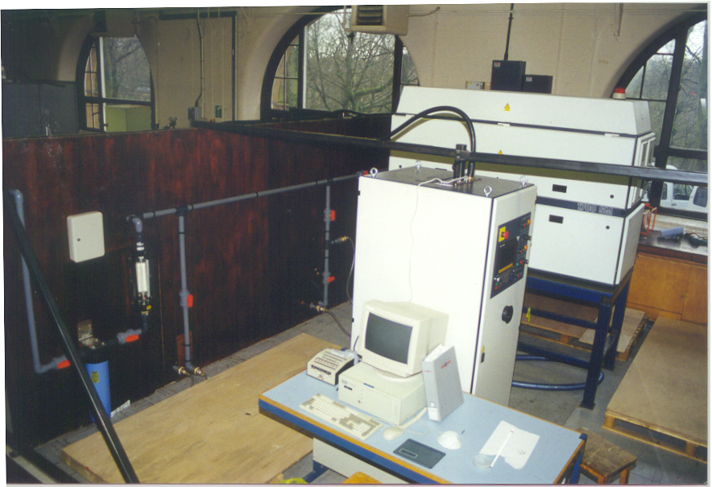
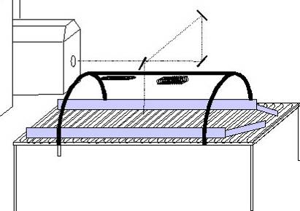
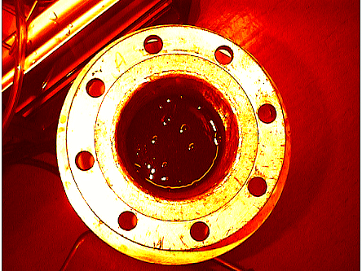
Combined inactivation systems (EU funding – carrots and potatoes)
Electrical connection
Laser Beam
UV Flashlamp
UV cw lamp
Water cooling connections
Microwaves
Ultrasonic system
Radiation enclosure

Slide 18
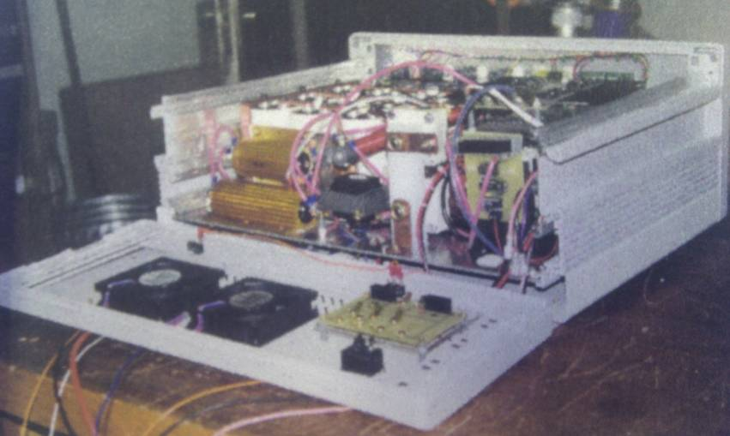
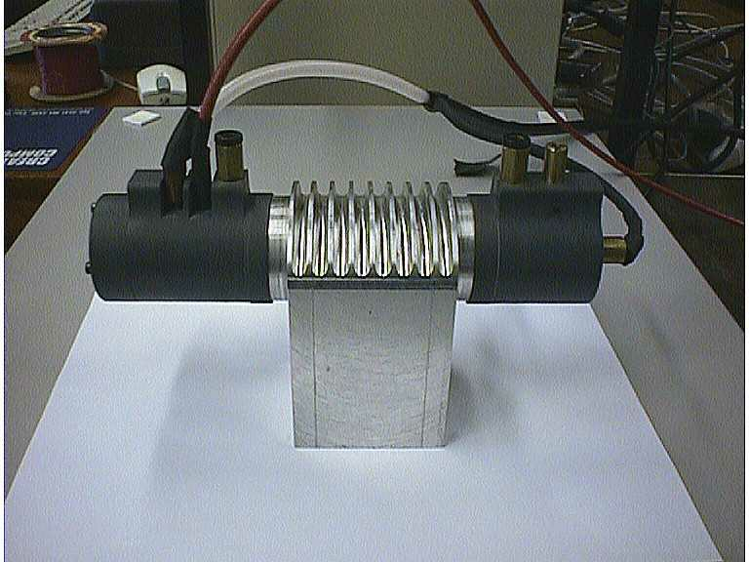
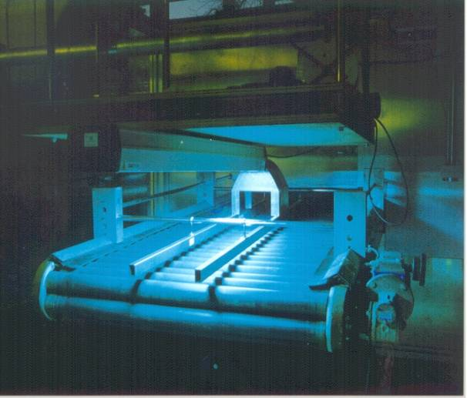
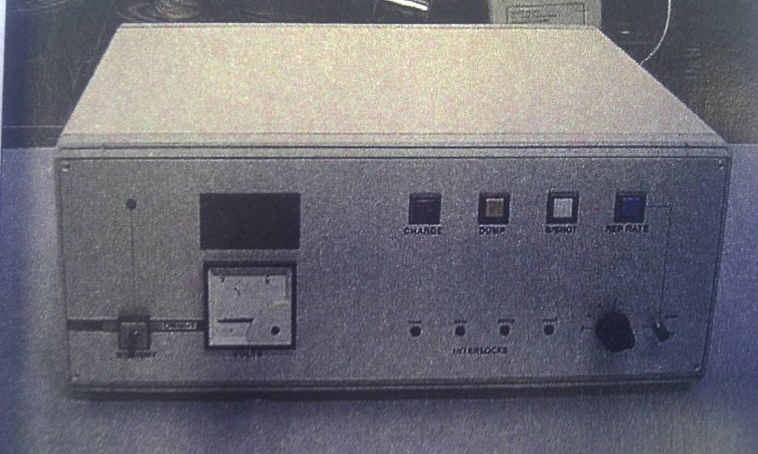
Pulsed light systems
CW UV lamp
UV system, installed above roller table

Slide 19
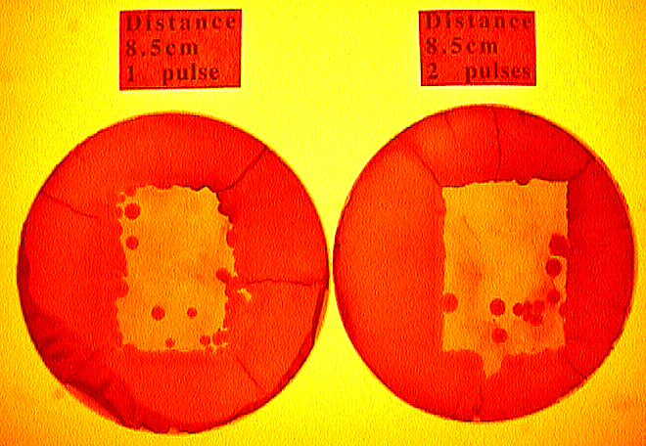
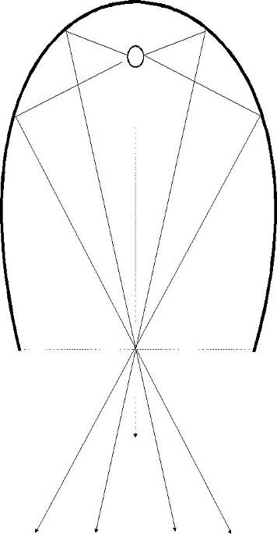
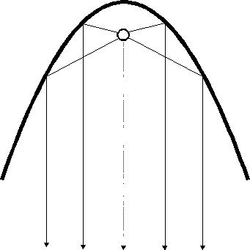
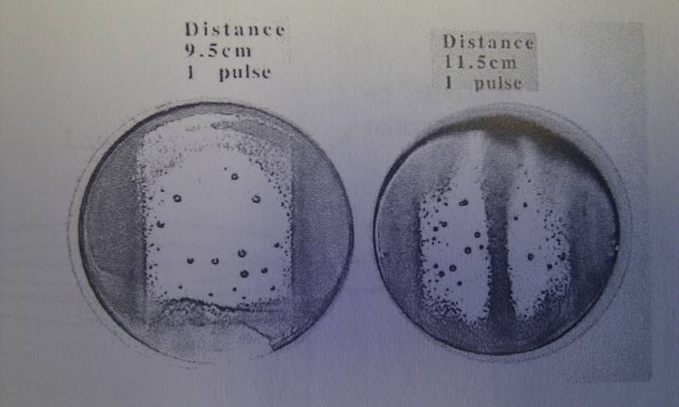
Pulsed light (B. cereus spores)
Parabolic UV pulsed light head
Elliptical pulsed light head

Slide 20
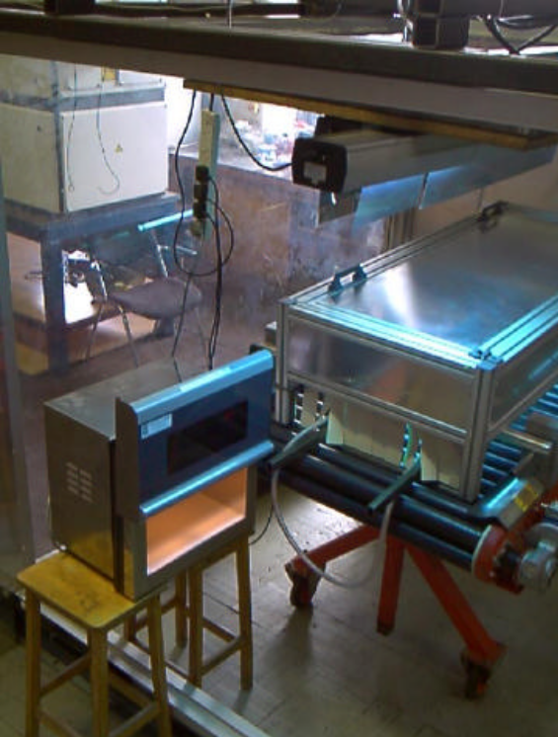
Combined inactivation systems
Shelf life extension of carrots and potatoes:
A comparison of H₂O₂, laser, UV, and microwave treatments
UV Treatment
  Delivered via 210 W, UV source (254 nm)
  Lamps warmed up for 15 min/until stabilised
  irradiated area ~0.48 m²
  Produce passed through system at ~0.21 ms⁻¹
  After treatment, produce stored in autoclave plastic bags
Laser Treatment
  1kW CO₂ laser (Rofin MS1700, UK)
  Samples rotated at 4 rps and exposed for 4s
Microwave Treatment
Variable power microwave source (max.1kW)
Operated at 800 W for 5 s
H₂O₂ Treatment
1% H₂O₂ mixed with sterile water 1 minute before treatment process
Mixture prepared in sterile and chemically inert vessel
Carrots and potatoes were immersed in solution for 20s.

Slide 21
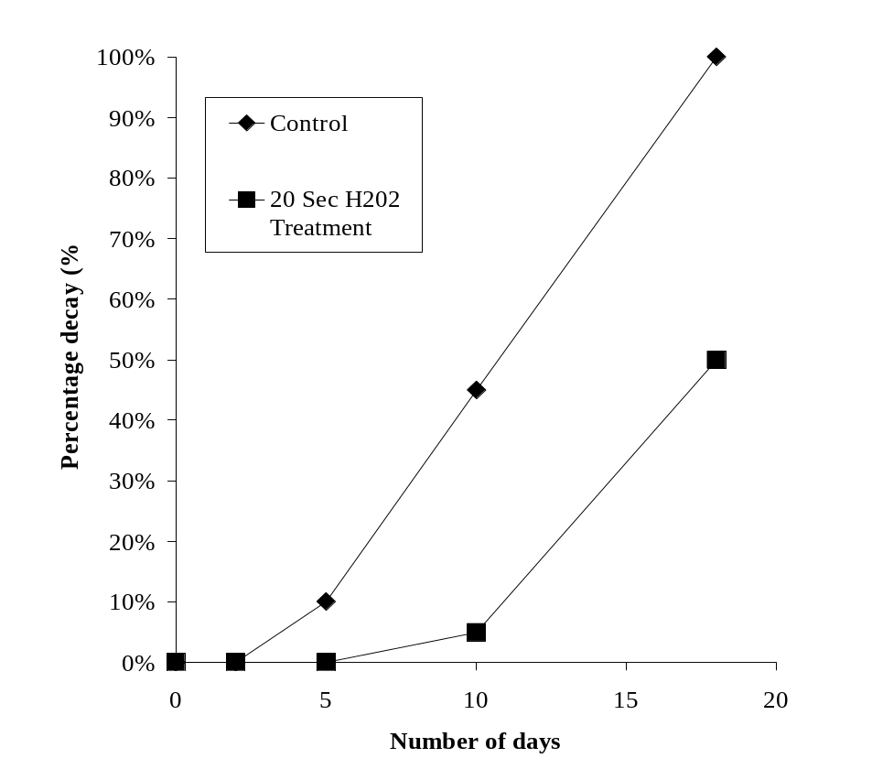
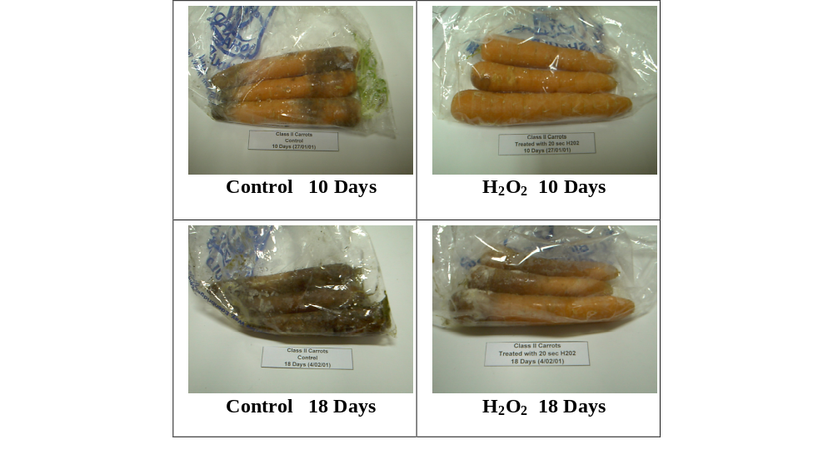
Combined inactivation systems
Shelf life extension of carrots and potatoes:
A comparison of H₂O₂, laser, UV, and microwave treatments
Region 3
Region 2
Region 1

Slide 22
Combined inactivation systems
Shelf life extension of carrots and potatoes:
A comparison of H₂O₂, laser, UV, and microwave treatments
From Figures of decay the approximate rate of decay (%/day) for the regions defined as 2 and 3 can be found. By definition there is no decay in region one. Table 1 shows the shelf life, obtained by extrapolating back the late phase decay to 0 percent decay, and the early (region 2) and late phase decay (region 3) as % decay/day.
Sample | Shelf life (Day) | Early Phase Decay (%/Day) | Late Phase Decay (% / Day)
Control | 3.6 | 3.3 | 6.9
H₂O₂ | 9.1 | 1.0 | 5.6
Laser | 8.0 | 2.0 | 5.0
Microwave | 5.0 | 6.2 | 6.2
UV | 5.0 | 6.2 | 6.2

Slide 23
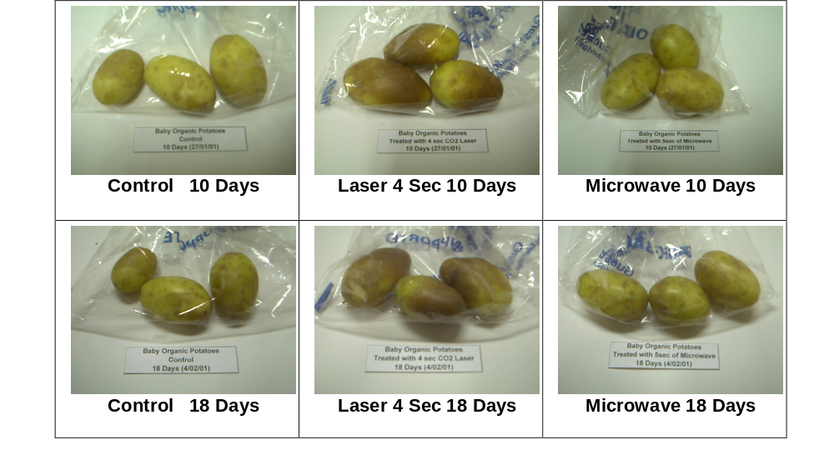
Combined inactivation systems
Shelf life extension of carrots and potatoes:
A comparison of H₂O₂, laser, UV, and microwave treatments
Laser treatment darkened potato on first day, didn’t worsen (unacceptable)
Experiments done in ambient conditions, accelerate decay process and shorten shelf life compared to refrigerated conditions
Laser successfully extended shelf life of the carrots but again discolouration
No variation in beta carotene or vitamin C

Slide 24
Modelling decontamination on potatoes
Model used to investigate effect of spatial distribution of bacteria before and after treatment
Samples of eyes and smooth skin (~ 1g of potato flesh) were analysed microbiologically for input data
Various assumptions
no killing on the eyes due to shadowing
complete killing on the skin
equal killing on the skin and eyes
1 D value reduction on the skin only
1 D value reduction on the skin and eyes
Effect of varying weight of potato flesh investigated
Input data included weight and radius of potato.
Assumed potato was round
Different scenarios were run through model to investigate the effect of different number of eyes (and weight) and different size of potatoes

Slide 25

Modelling decontamination on potatoes
Spatial distribution of bacteria over the surface of the potato, in the skin and eye areas was determined experimentally
Found that eyes had ~4x contamination of that of the smooth skin
Data were used as input into the model to estimate the effect of different decontamination treatment on the overall bioburden.

Slide 26
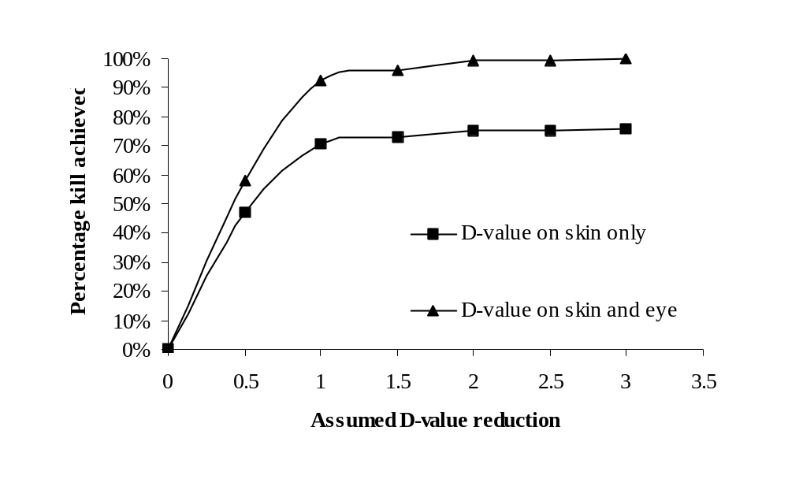
Modelling decontamination on potatoes
Calculations based on weight or surface area.
The calculations based on weight gave a greater reduction than those based on area, but with similar trends in the results for each set of assumptions.
Different scenarios were put into the model to investigate the effect of a different number of eyes (and weight) and different size of potatoes.
Model of potato inactivation showing percentage of organisms killed after different assumed log reductions on skin and eyes
(140g, 30 mm radius, 10 eyes, 1 g/eye)

Slide 27
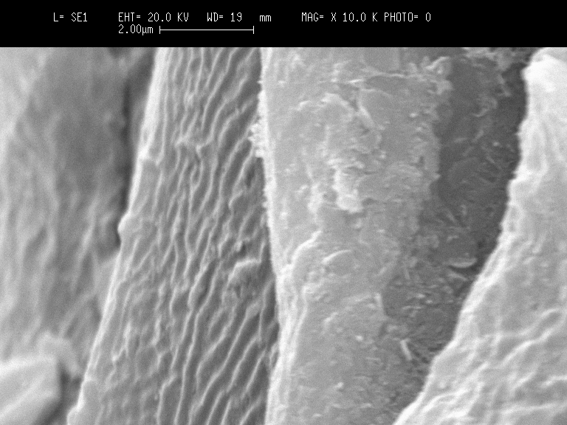
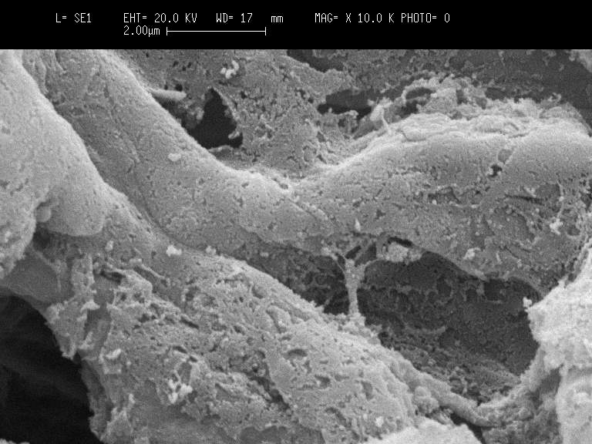
Surface decontamination affected by surface topology decontamination on potatoes
SEM Analysis
Carrot’s fibres arranged in longitudinal direction along circumference of produce
Fibre width about 10 to 15 μm, skin cells on potato about 50 μm
These dimensions are same order as CO₂ laser wavelength (10.6 μm), considerably larger than the UV wavelength (254 nm) and vastly smaller than the microwave wavelength (~12 cm).
Carrot (left) and potato surface at 10000x magnification

Slide 28
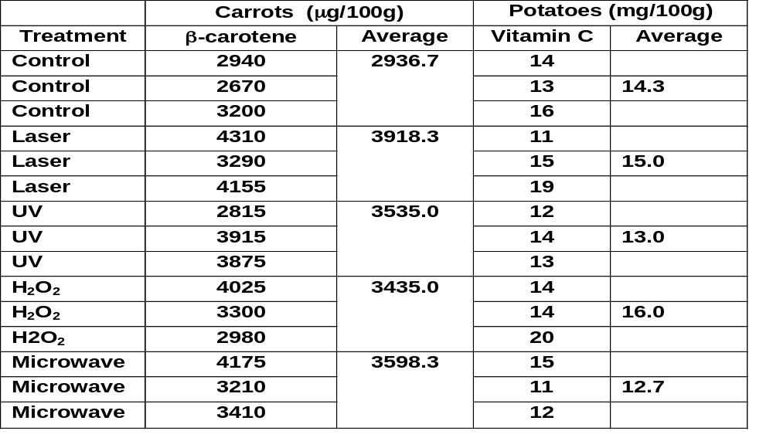
Comparison of Vitamin C in Potatoes and Beta-carotene in
carrots before/after treatment
No statistical difference between the control or treated samples for β-carotene or Vitamin C concentrations
No adverse effects from treatment that damaged the β-carotene or Vitamin C.

Slide 29
Combined inactivation systems
UV, laser, microwave or conventional heating on:
Escherichia coli,
Listeria monocytogenes,
Shewanella putrefaciens,
Pseudomonas fragi
Micrococcus leteus
Determined optimal treatment energy densities, power and time
Individual treatments investigated
Effects of order of sequential treatment studied
Sum of log kill of individual treatments compared to combined treatments

Slide 30
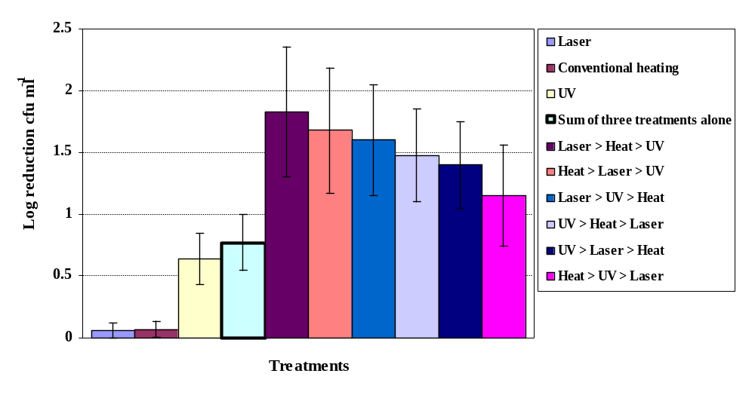
Combined inactivation systems
Killing effect of different treatments on E. coli in saline suspension,
errors show the standard error of the mean (n = 3)
Treatment order important
Laser ➔ Heat ➔ UV more effective than Heat ➔ UV ➔ Laser
Synergistic effect discovered – combined treatment > than sum of treatments alone

Slide 31
Real time detection technologies
Biodynamic Speckle for real time analysis of bacterial suspensions
Cuvette
CCD Camera
He-Ne laser
Focusing lens
Various concentrations of Hibitane disinfectant added to E. coli suspension and speckle pattern analysed.
Computer
TV monitor

Slide 32
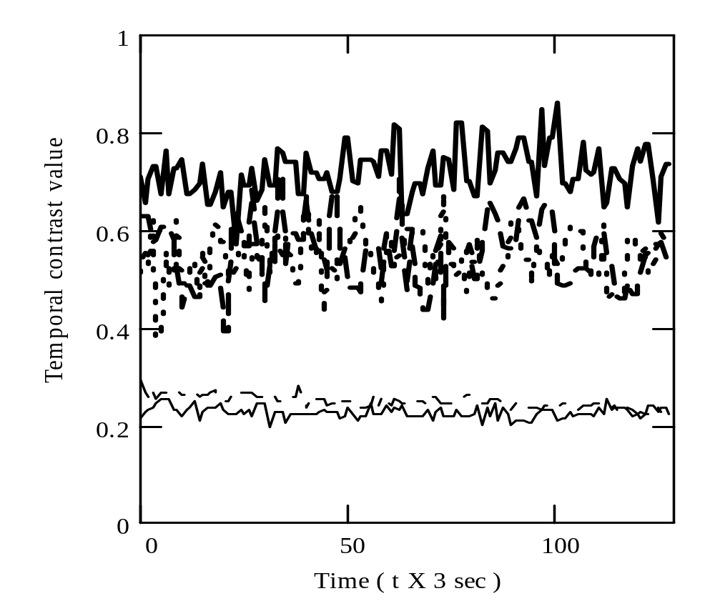
Speckle
Temporal Contrast of
  a) E.coli suspension
  b) with 1/6000
  c) 1/4000
  d) 1/40
  e) Neat hibitane disinfectant solution
b)
a)
d)
c)
e)
Time (t x 3s)

Slide 33
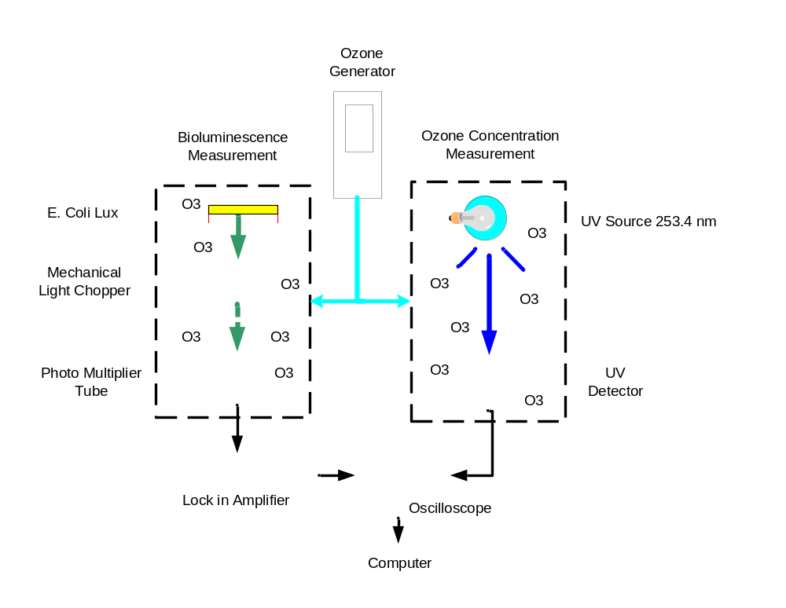
Bioluminescent system for biocide treatment
optimization on solid surfaces.
E. coli lux on agar plates placed in one chamber, ozone concentration measured in another. Lux output measured via a photomultiplier, results correlated

Slide 34
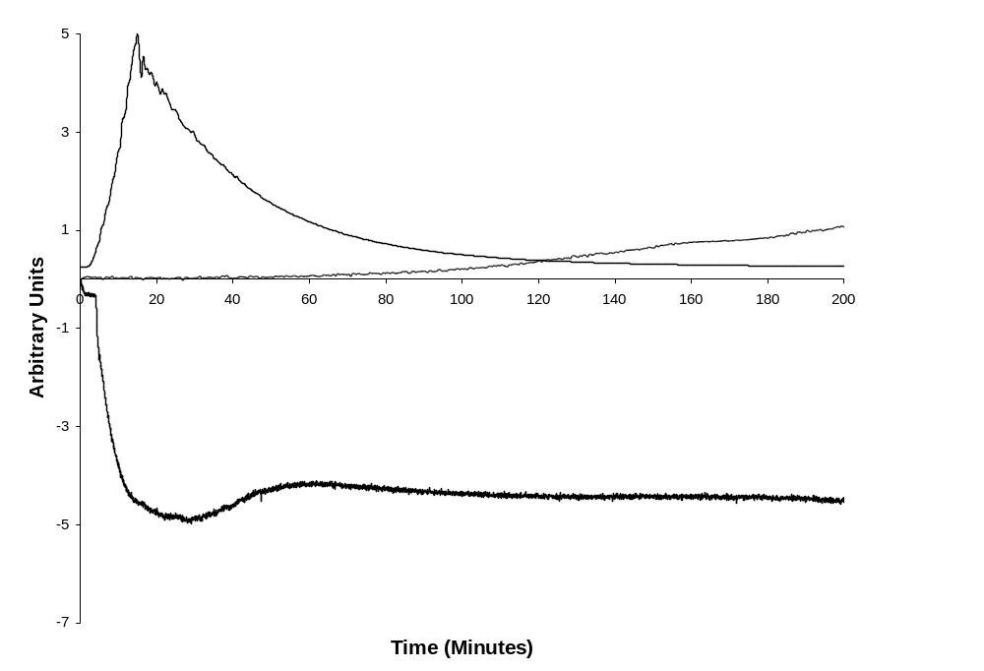
Temporal variation of bioluminescent output from an E. coli lux culture with (treated) and without (control) ozone treatment

Slide 35
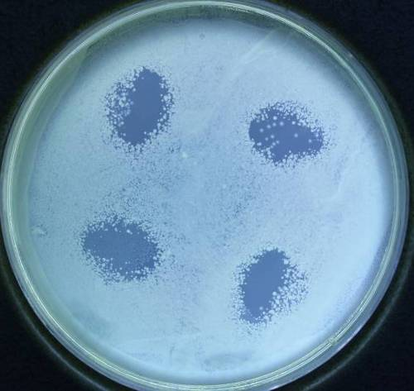
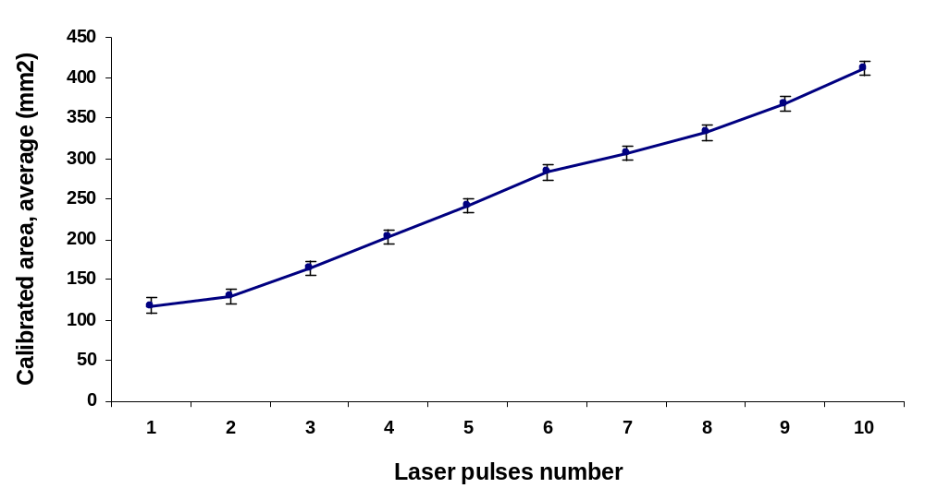
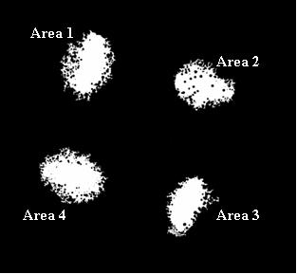
Microscopy and image processing

Slide 36
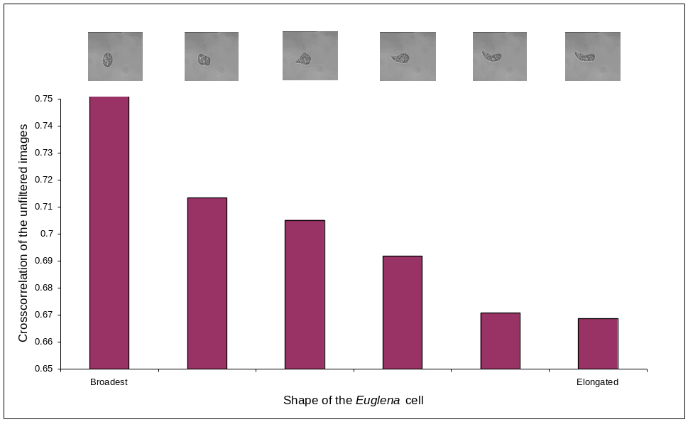
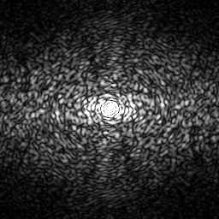
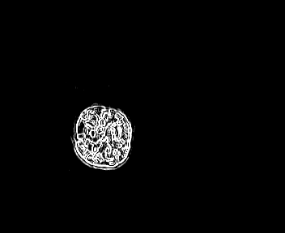
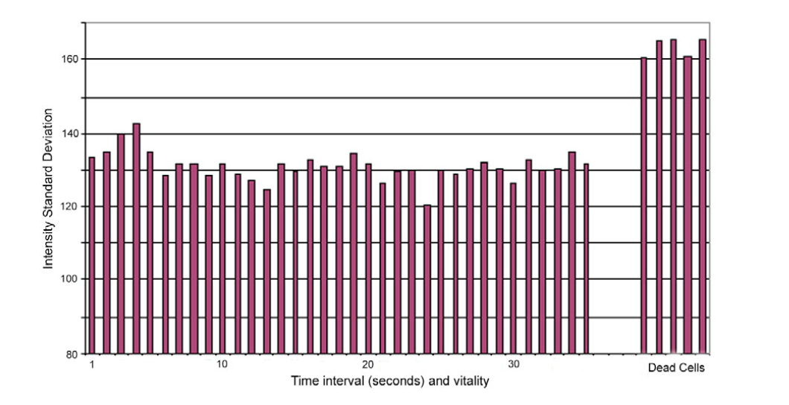
Microscopy and image processing

Slide 37
Conclusions
Most efficient order for CO₂: nylon, glass, stainless steel.
Nd:YAG most efficient order: stainless steel, glass, nylon.
Differences mainly due to properties of materials at 1.06 and 10.6 µm.
For laser and carrot treatments, all extended shelf life beyond the control (3.6 days), H₂O₂ most efficient treatment (9.1), laser (8.0), microwave and UV (5.0 days).
Laser successfully extended shelf life of the carrots but discolouration (unacceptable for consumer).
No adverse effects on β-carotene or vitamin C, possibly an increase.
The treatment processes induced shoot growth whereas none were evident with the control samples.
Reduce damage of substrate but still inactivate microorganisms.
Treatment order important
Laser ➔ Heat ➔ UV more effective than Heat ➔ UV ➔ Laser
Synergistic enhancement i.e. combined treatment > than sum of treatments
Real time detection systems introduced.

Slide 38
Acknowledgements
Duncan Stewart-Tull
Richard Parton
Alastair Wardlaw
Ian Peden
Glenn Ward
Allen Yeo
Boon Kit Tan
Graham Armstrong
Siavash Maktabie
Weaam Jaafar

Slide 39
Selected References
ian.watson@glasgow.ac.uk
Armstrong, G.; Watson, I.; Stewart-Tull, D. Inactivation of B. cereus spores on agar, stainless steel or in water with a combination of Nd:YAG laser and UV irradiation. Innovative Food Science and Emerging Technologies. 7(1), 94-99, (2006).
Maktabie, S.; Watson, I.; Parton, R.; Synergistic effect of UV, laser and microwave radiation/conventional heating on E. coli and some spoilage and pathogenic bacteria. Innovative Food Science and Emerging Technologies., doi:10.1016/j.ifset.2010.12.011.
Ward, G.; Watson, I.; Stewart-Tull, D.; Wardlaw, A.; Chatwin, C. Inactivation of bacteria and yeasts on agar surfaces with high power Nd:YAG laser light. Letters in Applied Bacteriology, 23, 136-140 (1996).
Watson, I.; Ward, G.; Wang, R.; Sharp, J.; Budgett, D.; et al. Comparative bactericidal activities of lasers operating at seven different wavelengths. Journal of Biomedical Optics 1(4), 1-7 (1996).
Watson, I.; Stewart-Tull, Minimal processing with combined emerging unit operations – laser, UV, microwave and chemical – for microbial killing and improved food quality. EU-FAIR Contract No. FAIR CT 98-9522, 1/1/99- 31/12/00. (Model developed with Boon Kit Tan).
Watson, I.; Wang, R.; Peden, I.; Ward, G.; Stewart-Tull, D.; et al. Effect of laser and environmental parameters on reducing microbial contamination of stainless steel surfaces with Nd:YAG laser irradiation. Journal of Applied Microbiology. 99, 934-944, (2005).
Watson, I.; Yeo, C.B.A.; Stewart-Tull, D. Scanning CO₂ laser bacterial inactivation systems. Journal of Applied Microbiology 102(3), 766-773 (2007).
Yeo, C.B.A.; Watson, I.; Armstrong, G.; Stewart-Tull, D.; Wardlaw, A. Bactericidal effects of high-power Nd:YAG laser irradiation on Staphylococcus aureus in-vitro. Institute of Physics: Journal of the European Optical Society Part A; Pure & Applied Optics, 1998, 7, 643-655.

