Slide 1


Onion Waste Recycling to Produce the Value Added by-Products
Hyeun-Jong Bae

Slide 2

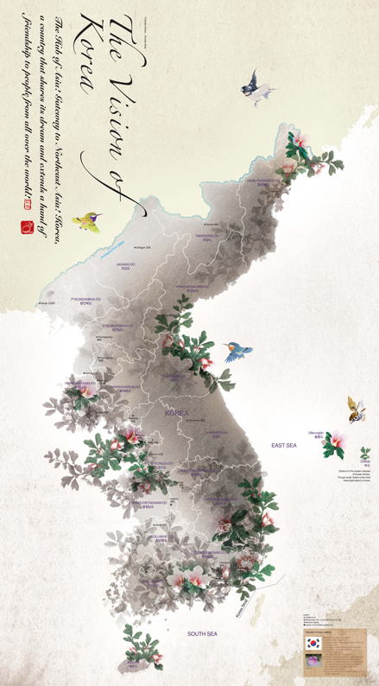
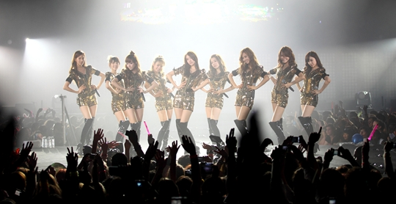
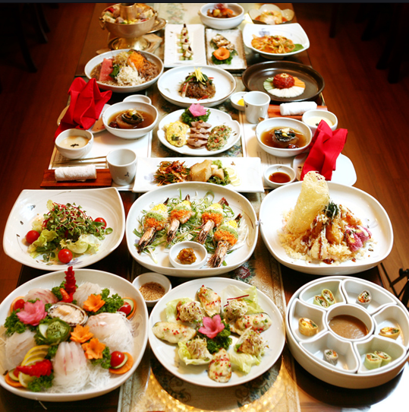

South Korea

Slide 3

Chonnam National University

Slide 4

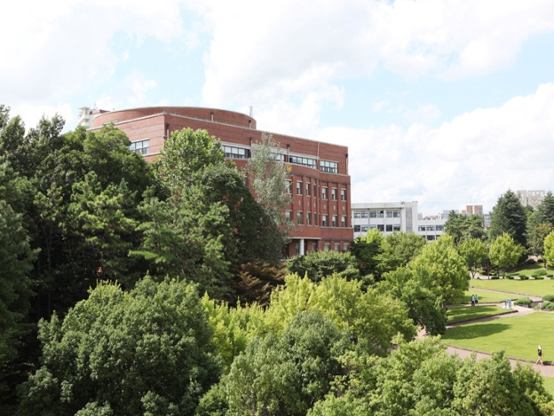
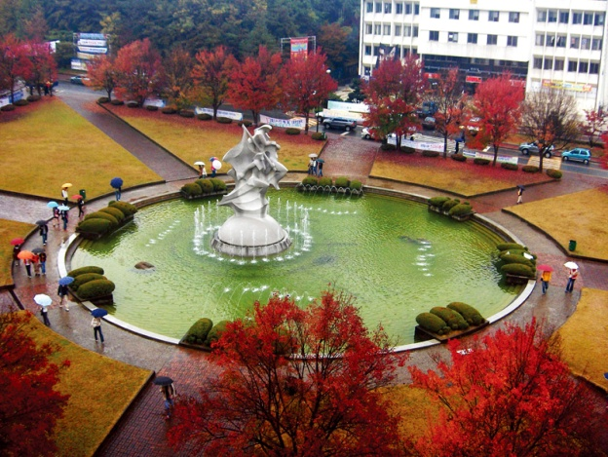
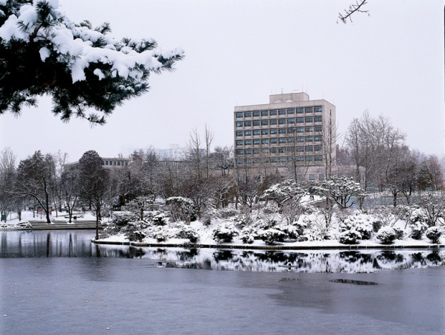

Slide 5

CHONNAM NATIONAL UNIVERSITY
Serving the community With Global Vision
Chonnam National University
Bioenergy Research Center
2010-2019 Priority Research Center

Slide 6

Biotechnolgy is key Competences of BRC
1
Development of Efficient Pretreatment Methods
High Value Creation in Biomass Bioconversion
2
Biomass Bioconversion
by Enzymatic Process
3
Developing Advanced Biotechnology System

Slide 7
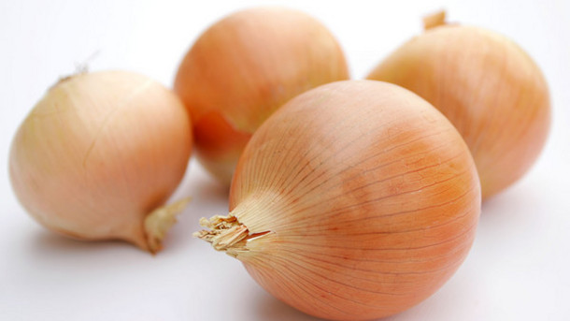
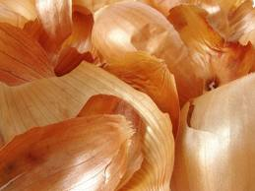
Onion waste is produced from various processed onions.
They are one of major industrial waste.

Slide 8
BRC Pioneering Following Issues
Environmental-Friendly Safe to handle Wastes
Cost reduction of Waste treatment
Design Agricultural Wastes Recycling
Value Added Material Production

Slide 9
World Onion Production
83 million tons of onions are produced annually (2013)
Country | Thousand Tons
World | 82,852
China | 22,600
India | 16,309
United States | 3,277
Iran | 2,260
Russia | 2,081
Egypt | 2,025
Turkey | 1,819
Korea, South | 1,196
Spain | 1,187
Algeria | 1,183
Others | 28,915
From FAO (Food and Agriculture Organization of the United Nations)

Slide 10
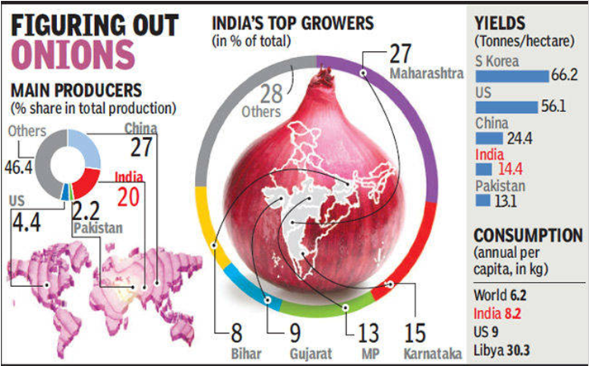
High yields are found in Korea, Japan, Europe and the USA.
Source: The Times of India

Slide 11
Onion Production (Dry) in South Korea
yr | ton
2009 | 1,372,291
2010 | 1,411,646
2011 | 1,520,016
2012 | 1,195,737
2013 | 1,294,009
Production Area | (ha)
Chonnam | 12,080
Kyungnam | 5,294
Kyungpook | 2,602
Chobuk | 1,654

Slide 12


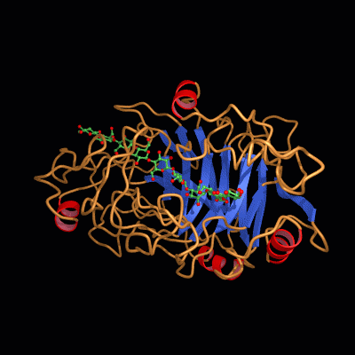
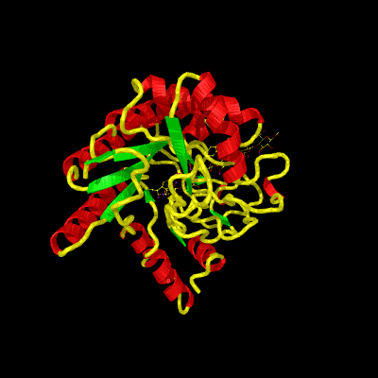
Enzymatic bio-process- biodegradation of lignocellulose
β-glucosidase
Endo cellulase
CBH II
Cellobiose
CBH I
R
NR
Crystalline
Amorphous
Crystalline

Slide 13


Strategy for Enzyme Cost Reduction
Increase
Enzyme Activity
Low Cost
Mass Production

Slide 14
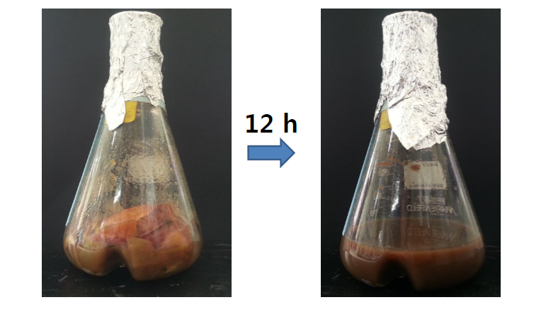
Produce of Onion Waste Hydrolysates by Enzymatic Bioprocess

Slide 15
Onion Skin Waste
Enzymatic hydrolysis
Onion sugars
Fermentation
Bioethanol

Slide 16
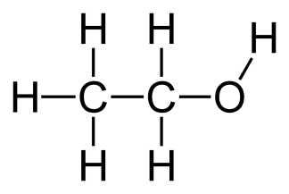
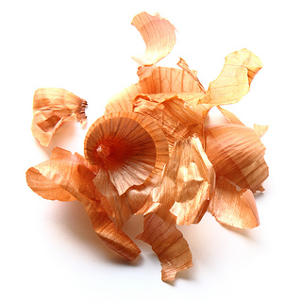
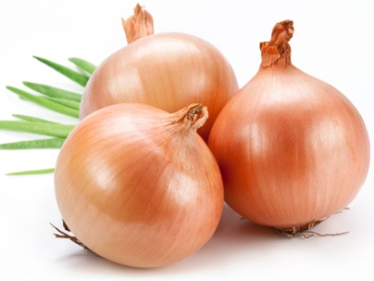
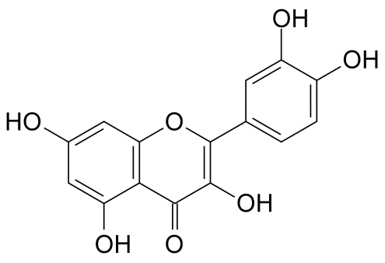
We evaluated the use of OSW for biosugar and Quercetin production
Bio-ethanol
Onion production
82.9 million T/yr
Onion Skin Waste
Quercetin
Value-added byproduct
Notes:
Onions are low in calories, very low in sodium, and contain no fat or cholesterol. Furthermore, onions contain fiber and flavonoid

Slide 17
Chemical composition (% dry weight) of onion skin waste.
% (w/w) | Onion skin
Rhamnose | 2.5
Arabinose | 1.4
Xylose | 4.2
Mannose | 3.7
Galactose | 2.8
Glucose | 40.6
Total (sugar) | 53.7
Quercetin | 0.1- 0.2

Slide 18
Glucose Concentration of OSW Hydrolysate under
Different Enzyme Loading Conditions.
Cellulase (FPU/g OS) | Pectinase (mg/ g OS) | Xylanase (mg/g OS) | Glucose (mg/mL) | Conversion rate (%)
4.8 | 0.06 | 0.1 | 0.4 | 9.9
4.8 | 0.06 | 0.5 | 1.65 | 40.6
4.8 | 0.06 | 0.75 | 2.53 | 62.3
4.8 | 0.06 | 1.0 | 3.3 | 81.3
4.8 | 0.16 | 0.1 | 0.55 | 13.5
4.8 | 0.16 | 0.5 | 1.76 | 43.3
4.8 | 0.16 | 0.75 | 2.66 | 65.5
4.8 | 0.16 | 1.0 | 3.5 | 86.2
12 | 0.06 | 0.1 | 0.67 | 16.5
12 | 0.06 | 0.5 | 2.19 | 53.9
12 | 0.06 | 0.75 | 2.88 | 70.9
12 | 0.06 | 1.0 | 3.72 | 91.6
12 | 0.16 | 0.1 | 0.86 | 21.2
12 | 0.16 | 0.5 | 2.37 | 58.4
12 | 0.16 | 0.75 | 3.16 | 77.8
12 | 0.16 | 1.0 | 3.83 | 94.3
24 | 0.06 | 0.1 | 1.46 | 36.0
24 | 0.06 | 0.5 | 2.87 | 70.7
24 | 0.06 | 0.75 | 3.63 | 89.4
24 | 0.06 | 1.0 | 3.92 | 96.6
24 | 0.16 | 0.1 | 1.60 | 39.4
24 | 0.16 | 0.5 | 2.94 | 72.4
24 | 0.16 | 0.75 | 3.85 | 94.8
24 | 0.16 | 1.0 | 4.01 | 98.5

Slide 19
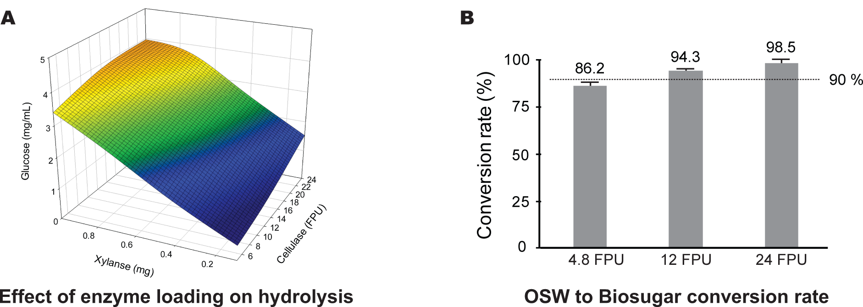
Optimized enzyme loading volume – 90% bioconversion rate
Pec: 0.16 mg
Xyl: 1mg

Slide 20
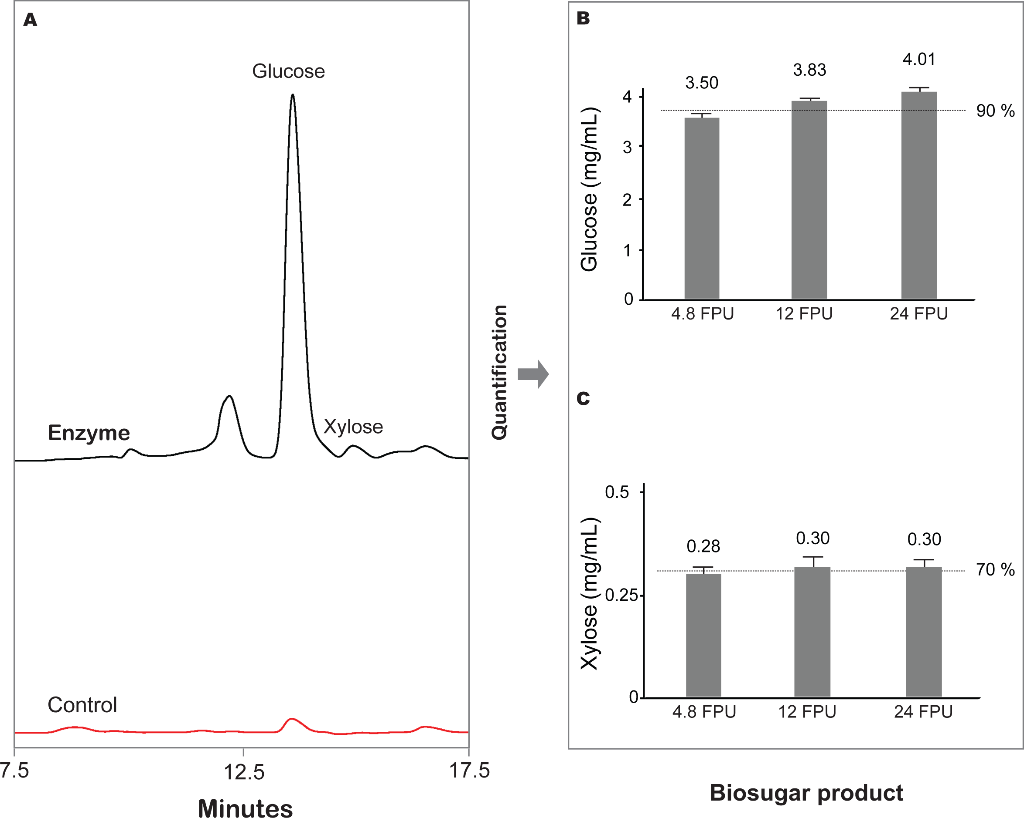
Sugar Analysis after Enzymatic Hydrolysis

Slide 21
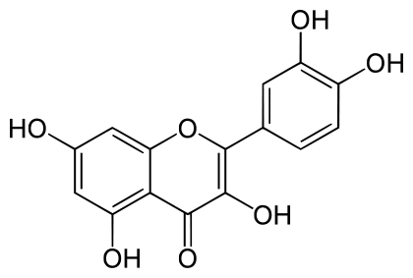
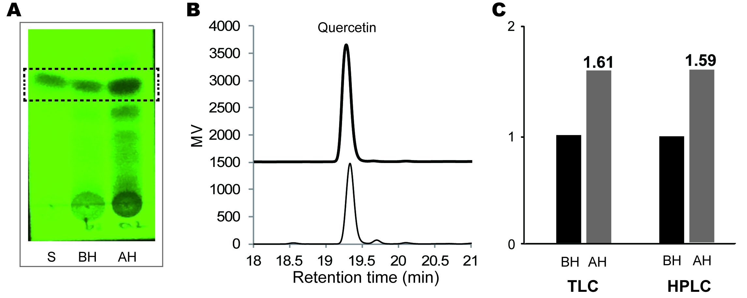
Thin-layer chromatography (TLC) plates showing the presence of quercetin in isolated onion skin wastes (OSWs) samples before and after enzymatic hydrolysis.
약 1.6 배 증가

Slide 22

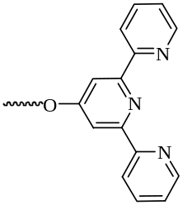
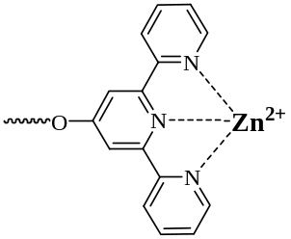

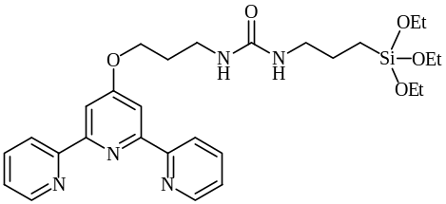
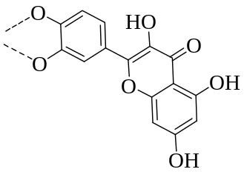
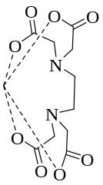
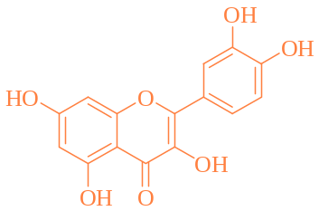
Biomagnetic Separation Techniques
Silica coated magnetic nanoparticle
Receptor 1
ZnCl₂
SMNP
TSMNP
TSMNP-Zn
Terpyridine receptor
Extracts of onion skin
Receptor 1
EDTA
+
Notes:
먼저 silica coated magnetic nanoparticle (SMNP)을 준비 후 Zn와 잘 결합하는 성질을 가진 terpyridine 유도체 (receptor 1)를 SMNP의 표면에 도입시킵니다.
이후 ZnCl₂를 이용하여 terpyridine 유도체가 도입된 magnetic nanoparticle에 Zn 이온을 도입시킵니다.
준비된 TSMNP-Zn에 양파 껍질 추출물을 첨가하면 TSMNP-Zn은 quercetin과 잘 결합을 이룰 수 있습니다.
TSMNP-Zn에 결합된 quercetin을 분리시키기 위하여 quercetin 보다 Zn이온과 결합력이 뛰어난 EDTA를 첨가하면 원하는 quercetin을 분리시킬 수 있습니다.
참고로 SMNP 만드는 과정입니다.
먼저 FeCl₃와 FeCl₂를 이용하여 magnetic nano particle (MNP)을 합성하였고 여기에 TEOS를 이용하여 MNP 표면을 silica로 코팅하였습니다. Silica 코팅 이유는 receptor 1을 도입시키기 위해서 입니다. Receptor 1 말단에 도입된 -Si-(OEt)₃가 공유결합(covalent bonding)에 의해 silica 표면에 잘 붙습니다.

Slide 23
Mass balance –Bioethanol and quercetin production
10 ton
(M.C: 80%)
Enzymatic hydrolysis
Glucose: ≒ 800kg
Quercetin: 20kg → 32kg
1.6배
Fermentation
(≒90%)
1. Separation
(≒90%)
2. Extraction
(≒75%)
EtOH: ≒ 370kg
Quercetin: 21.6kg

Slide 24
Thank you for your attention.

Slide 25
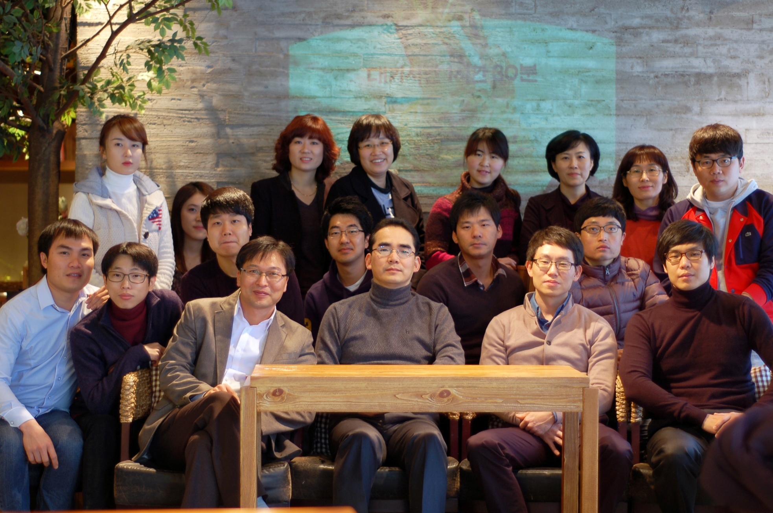

Slide 26


baehj@chonnam.ac.kr
Hyeun-Jong Bae
Question
Question
??????
??????
QUESTIONS?

