Slide 1
Transcription Profiling of CD4+ T Cells in Rhesus Macaques that Infected with Simian -Human Immunodeficiency Virus and Re-challenged with SIVmac251
5th World Congress on Virology
Dec 07-09, 2015 Atlanta
Hye Kyung Chung Ph.D
Advanced BioScience Laboratories, Inc

Slide 2
SHIV infection Patterns
Viral Load
Post-Infection

Slide 3
THANK YOU
Advance BioScience Laboratories
Ranajit Pal
Lindsay Gregory
Michael Lee
Allison Younkins
Ahae Woo
Gayatri Patel
EunMi Lee
Jessica Livesay
Anthony Cristillo
Gerald Kovacs
Animal Facility
Debora Weiss
Jim Treece
National Cancer Institute, NIH
John Brady
Cindy Masision
Mike Rodonovichi
Moffitt Cancer Center , University of South Florida
Jae K. Lee
Annamalai Muthiah
Soo-Young Cheon
Support: Partial Support by NIH/NIAID contract N01-AI-15430 to Advanced BioScience Laboratories

Slide 4
Purpose
We hypothesize that there are differences among animals in their ability to control virus infection by mounting appropriate immune responses.
We believe that the molecular basis for these differences can be determined by analyzing gene expression profiles.
To test this hypothesis, we are comparing global gene expression patterns in rhesus macaques that control –or do not control- persistent virus replication.

Slide 5
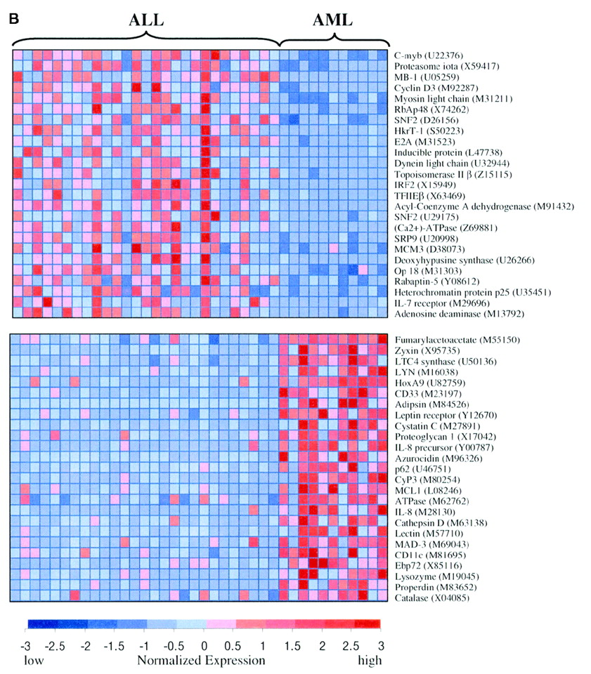
In vaccine research, we need to have better markers to predict whether a vaccine will be protective.
Using the power of modern genetic analysis such as microarray, we can establish a “signature” or gene expression profile that defines the protective immune response.
This technology has been used successfully to establish gene expression signatures, ALL-AML
class Prediction in tumors.
Science, 1999

Slide 6
Contents
Part 1 Innate Host Immune Responses: Natural Control of SHIV Replication
Part 2 Innate and Adaptive Antiviral Immune Responses
Biomarkers of Innate and Adaptive Immunity in CD4⁺ T Cells

Slide 7
Part 1 Innate Immunity
An ideal vaccine stimulates four components of the immune system. 1) Elicit neutralizing antibody at high titer. 2) Stimulate a cellular (T-Cell) immune response, especially cytotoxic T-cells. 3) Stimulate mucosal immunity. 4) Provoke the innate immune system.
The rhesus macaque has served as an animal model system for vaccine development and also to study pathogenesis of several human infectious diseases.
Microarray technology has been extensively used to analyze a global gene expression pattern in cancer and other diseases to monitor the molecular mechanism of pathogenesis.
Knowledge of natural host defense mechanisms may lead to their exploitation for therapeutic or prophylactic purposes.

Slide 8
SHIVsf162P3 RNA levels in Plasma in Virus Infected Rhesus Macaques

Slide 9
Gene Expression Profiles in PBMC from Naïve vs SHIVsf162P3 infected Rhesus Macaques
Condition Animal Time Viral load
Controlled 714L, 718L Day 21 High
714L, 718L >Year 2 Low
Non-controlled 713L, 720L Day 21 High
713L, 720L >Year 2 High
Naïve Pool of 8 uninfected monkeys

Slide 10
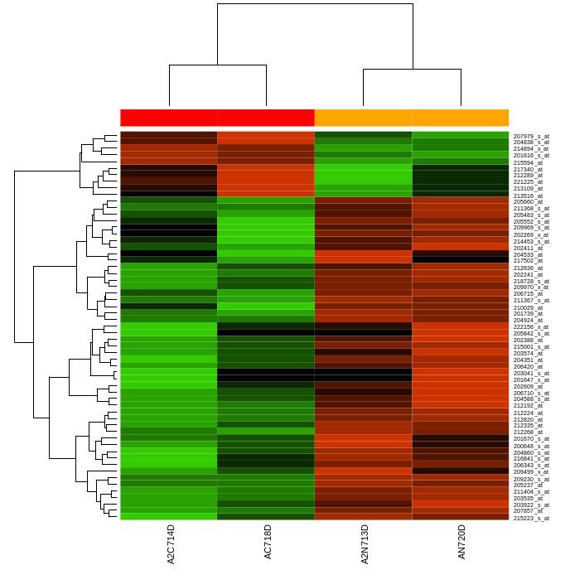
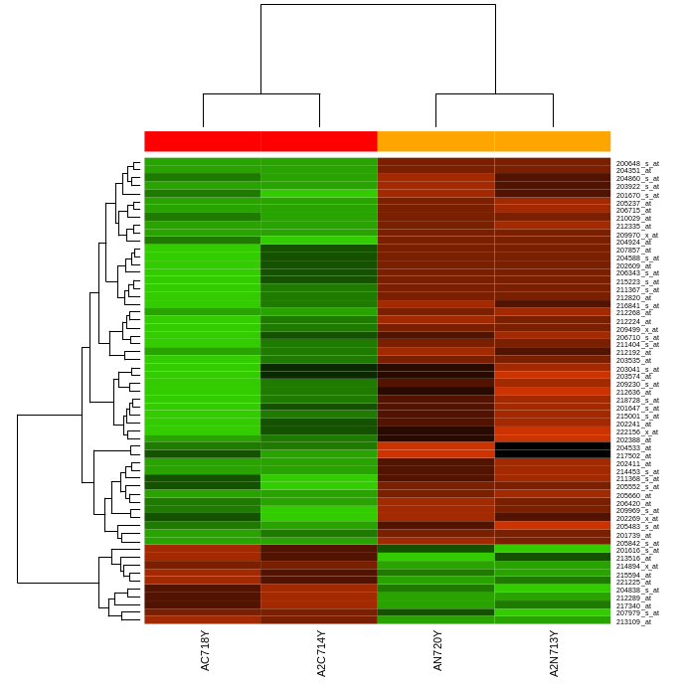
Clustering Heatmap of Differentially Expressed Genes
Day 21 Year 2
A. Day
B. Year

Slide 11
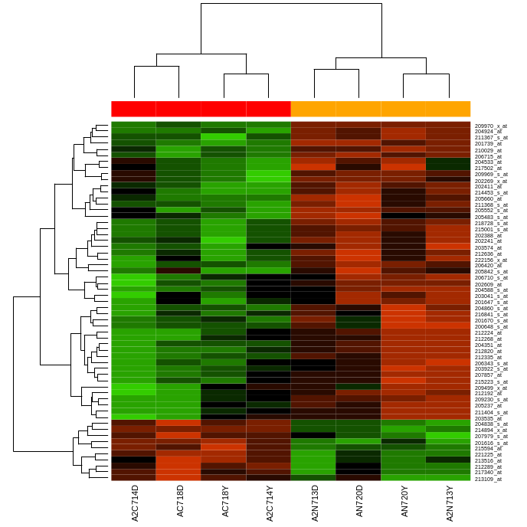
Heatmap of Differentially Expressed Genes at Day 21 and Year 2
C. Day+Year

Slide 12
Part 1 Summary
We were examined differences between protective and non-protective host response by measuring global cellular gene expression profiles in SHIV-infected macaques.
Comparing gene expression profiles in PBMC from animals that exhibit different levels of virus control showed interesting differences in gene expression pattern.
We identified 59 genes. Activation of host defense-related genes such as interference-inducible genes, apoptosis genes, and inflammation-related genes are up-regulated in the non-controllers.
The results suggested that these genes might contribute to a favorable microenvironment for virus replication in vivo.
It could help identify early parameters that predict the efficiency of protective immune responses.

Slide 13
Part 2 Innate and Adaptive Immune Responses
0
5.2 y
Group 1 N=3
SHIVsf162P3
SIV mac 251 Day 3 Day10 Day 28 Day 160
0
2.7 y
Group 2 N=3
SHIVBaL
SIV mac251 Day 3 Day 10 Day 28 Day 60

Slide 14
Characteristics of Rhesus Macaques Used for Global Gene Expression Analysis
Animal* | Weight | Sex | Prior to SIV mac251 Challenge | Re-Challenge Virus | Challenge Route
714L | 8.9 | Male | SHIVsf162P3 | SIVmac251 | Rectal
717L | 10.8 | Male | SHIVsf162P3 | SIVmac251 | Rectal
718L | 11.2 | Male | SHIVsf162P3 | SIVmac251 | Rectal
184M | 8.7 | Male | SHIV BaL | SIVmac251 | Rectal
185M | 8.7 | Male | SHIV BaL | SIVmac251 | Rectal
186M | 8.4 | Male | SHIV BaL | SIVmac251 | Rectal

Slide 15
MHC Class 1 Genotyping
Animal ID | Mamu-A*01ª | Mamu-B*08^{b} | Mamu-B*17^{b}
714L | Negative | Negative | Negative
717L | Negative | Positive | Negative
718L | Negative | Negative | Negative
184M | Negative | Negative | Negative
185M | Negative | Negative | Negative
186M | Positive | Negative | Negative

Slide 16
TRIM 5 alpha Genotyping
Animal ID | G/T | T307P | P327T | Q332R | 333A/S/T | 334P/Q/R | ACGTTT | C1002A | Genotypesª
 | Splice Site Mutation |  |  |  |  |  | TF339-340 | P341Q
714L | G/G | T/P | P/T | Q | A/S | P | TF/∆∆ | P/Q | TRIM TFP/TRIM Q
717L | G/G | T/P | P/T | Q | A/S | P | TF/∆∆ | P/Q | TRIM TFP/TRIM Q
718L | G/T | T | P | Q | A | P | TF | P | TRIM TFP/TRIM CYPA
184M | G/G | P | P | Q | A/S | P | TF/∆∆ | P/Q | TRIM TFP/TRIM Q
185M | G/T | P | P | Q | S | P | ∆∆ | Q | TRIM Q/TRIM CYPA
186M | G/G | T/P | P | Q | A | P | TF | P | TRIM TFP/TRIM TFP
Moderate Resistance |  | Most Resistance

Slide 17
Virological Outcome in Plasma/PBMC at Pre- and 160 days Post-Rechallenge
 | Prior to SIV mac251 Re-challenge |  | 160 days Post Challenge
Animal | SIV proviral DNA copy number / 10⁶ PBMC | Viral RNA Load/ml of Plasma | SIV proviral DNA copy number / 10⁶ PBMC | Viral RNA Load/ml of Plasma
714L | <10 | <50 | 1.03E+02 | 509
717L | <10 | <50 | 7.87E+01 | <50
718L | 3.37E+01 | <50 | 1.58E+02 | 64,192
184M | 1.53E+02 | <50 | 3.52E+02 | 346
185M | 5.39E+02 | <50 | 4.85E+03 | 61,638
186M | 3.29E+02 | <50 | 2.45E+02 | 23,635

Slide 18
Viral RNA Levels in Plasma in SIVmac251 Infected Macaques
Chung, et al., J Med Primatol. 2015

Slide 19
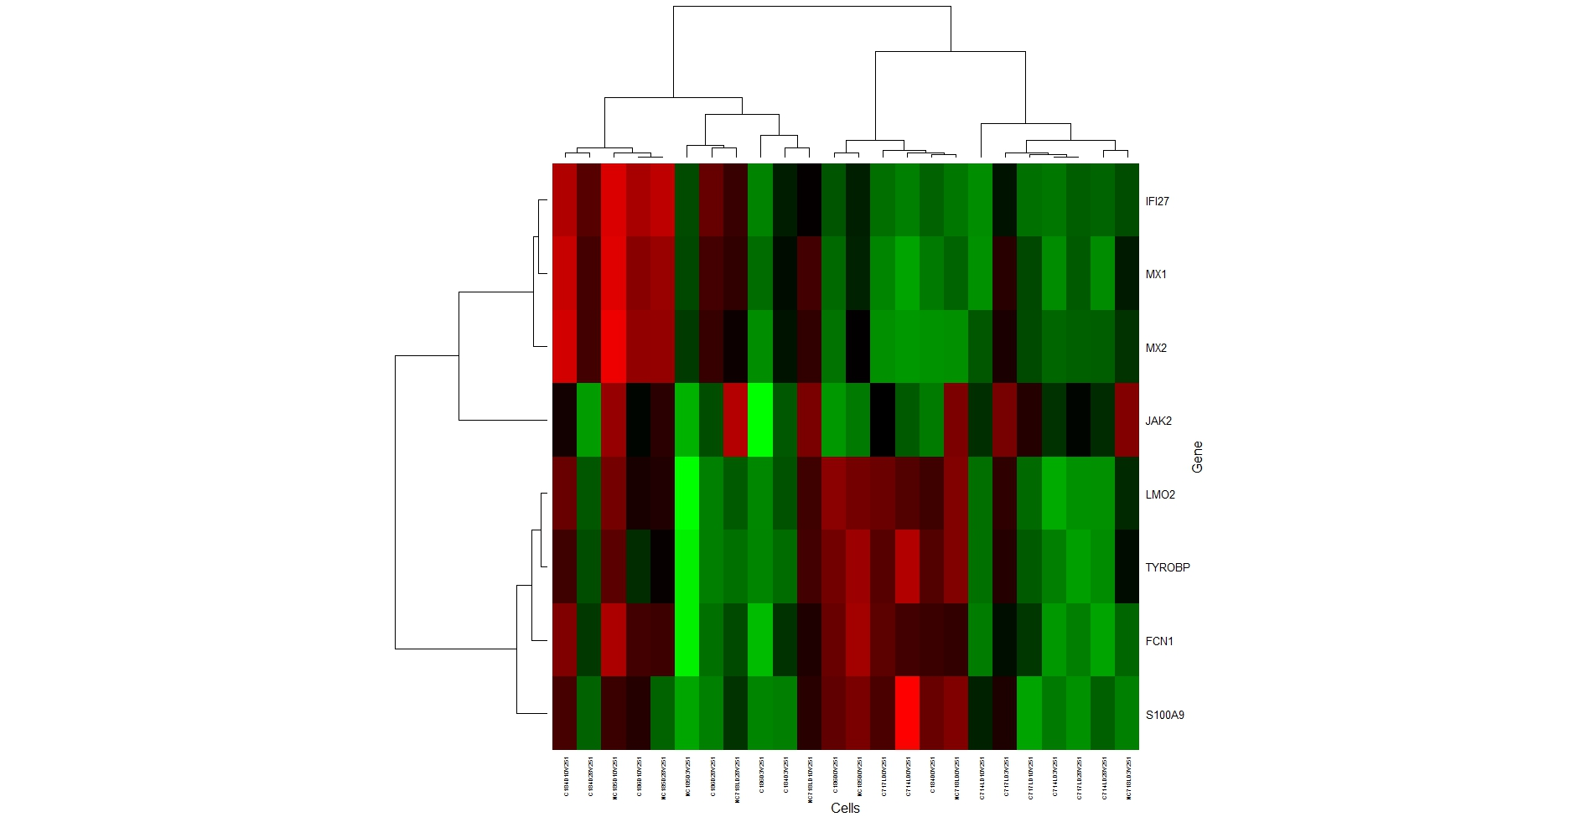
Heatmap for Differentially Expressed Genes between Protected and Un-Protected Rhesus Macaque

Slide 20
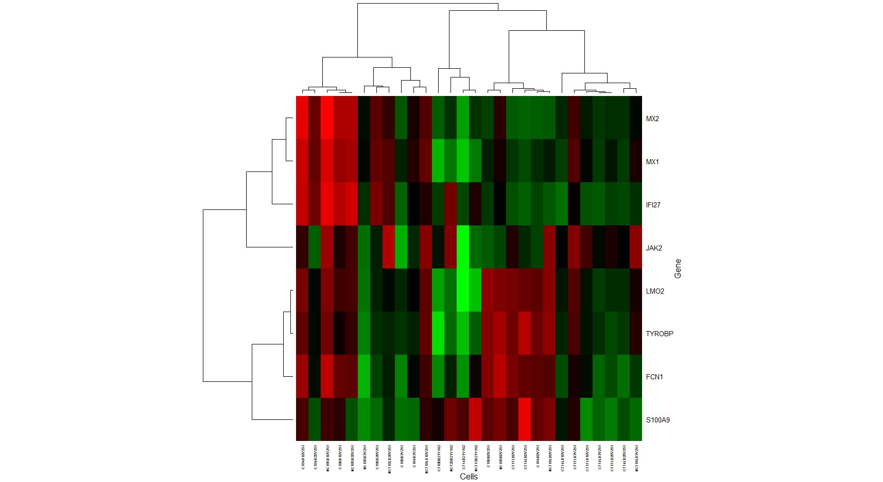
Heatmap for Differentially Expressed Genes with Human and Rhesus Macaque Chips

Slide 21
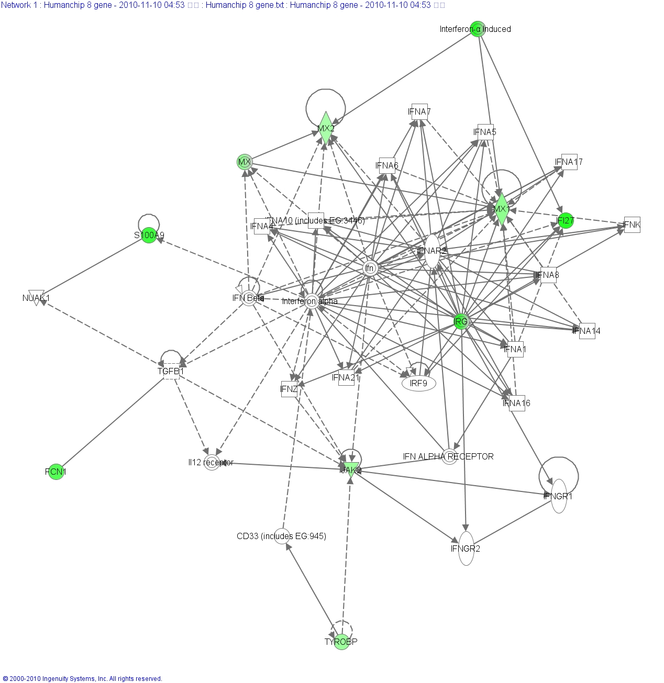
Network Diagram Derived from Eight Common Genes of Human Chip Microarray Data

Slide 22
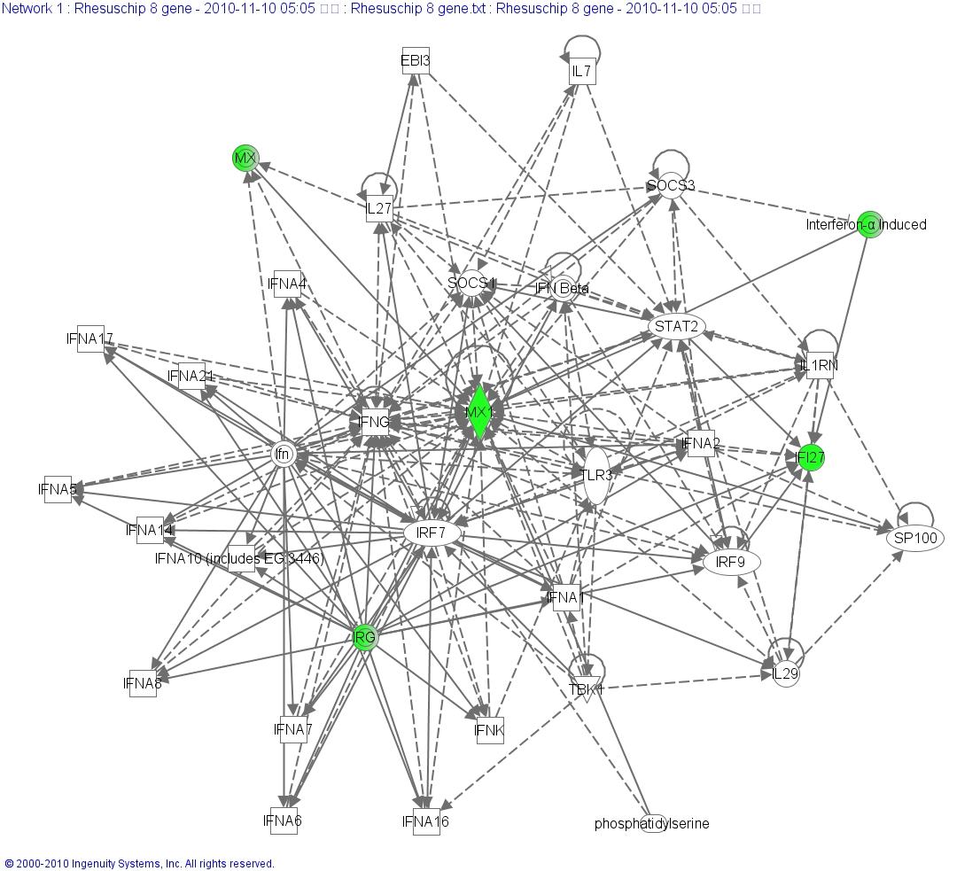
Network Diagram Derived from Eight Common Genes of SIV mac251 Re-Challenge Study using Monkey Chip Microarray Data

Slide 23
Eight Protective Biomarker
 |  | Human chip | Monkey chip
Gene Symbol | Probe Set ID | Exponential fold changes | Exponential fold changes
MX1 | 202086_at | 2.61 | 2.23
IFI27 | 202411_at | 6.83 | 2.23
S100A9 | 203535_at | 5.33 | 1.18
TYROBP | 204122_at | 2.34 | 1.30
LMO2 | 204249_s_at | 1.71 | 1.32
MX2 | 204994_at | 2.10 | 1.77
FCN1 | 205237_at | 4.35 | 1.52
JAK2 | 205842_s_at | 2.35 | 1.74

Slide 24
Part 2 Summary
Our finding suggested that SHIV a model of attenuated viral vaccine-induced protective immune response from pathogenic SIVmac 251 infection.
Down regulation of certain interferon responses and tyrosine kinase pathway may indicate protective vaccine responses.
The eight common genes MX1, MX2, IFI27, JAK2, LMO2, TYROBP, FCN1, and S100A9 with P values <0.01 were identified as a potential protective biomarker, and all genes were down-regulated in the protected macaques.

Slide 25
Conclusions
Carefully designed global gene expression profiling could help identify early parameters that predict the protective immune responses in HIV vaccine evaluation in NHP model.
Despite the fact that we were able to identify statistically significant differences in expression levels between protected and unprotected animals these observations were warrant validation using larger study groups.

Slide 26
THANK YOU
Advance BioScience Laboratories
Ranajit Pal
Lindsay Gregory
Michael Lee
Allison Younkins
Ahae Woo
Gayatri Patel
EunMi Lee
Jessica Livesay
Anthony Cristillo
Gerald Kovacs
Animal Facility
Debora Weiss
Jim Treece
National Cancer Institute, NIH
John Brady
Cindy Masision
Mike Rodonovichi
Moffitt Cancer Center , University of South Florida
Jae K. Lee
Annamalai Muthiah
Soo-Young Cheon
Support: Partial Support by NIH/NIAID contract N01-AI-15430 to Advanced BioScience Laboratories

