Slide 1
Potential Controls on Trends in Background Concentrations of Hg° in the Northeastern US
Huiting Mao
Department of Chemistry
State University of New York
College of Environmental Science and Forestry

Slide 2
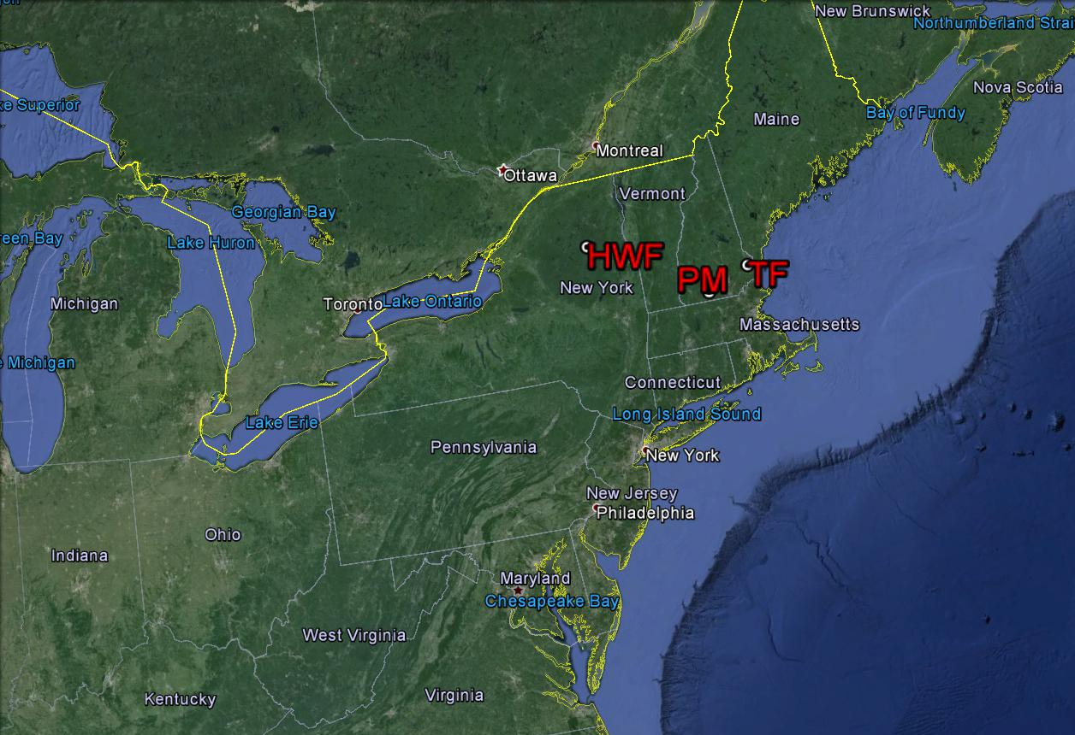
Thompson Farm – TF, Durham, NH, sea level
Pack Monadnock – PM, Pack Monadnock, NH, 700 asl
Huntington Wildlife Forest – HWF, Adirondacks, NY, 510 m asl

Slide 3
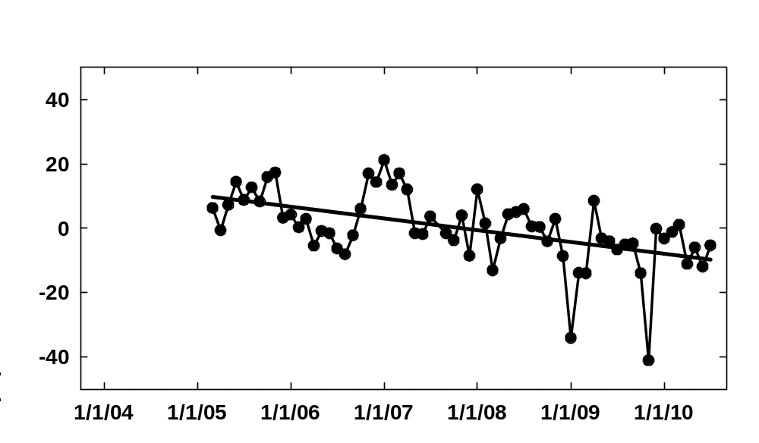
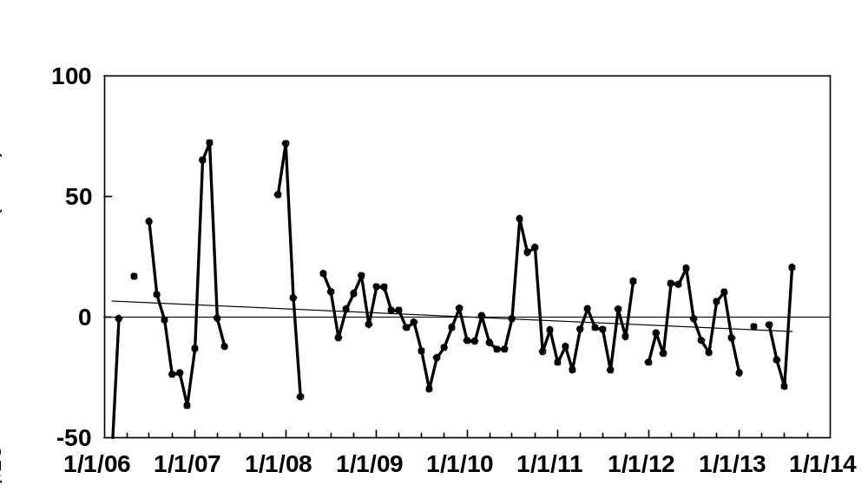
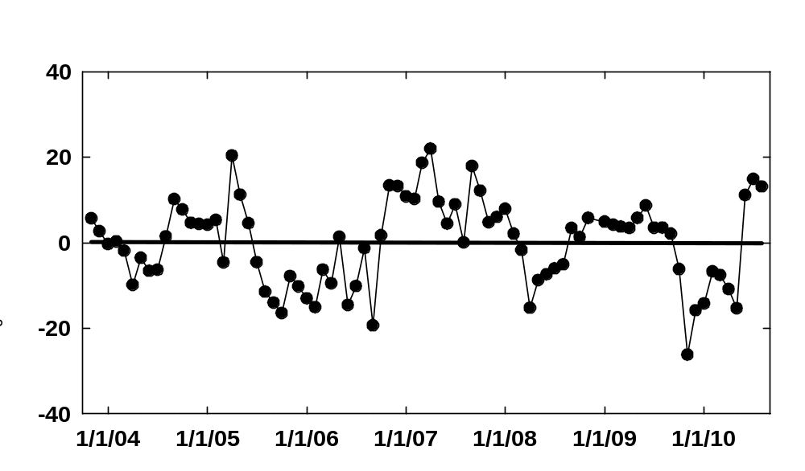
3.8±0.9 ppqv yr⁻¹
Mace Head: 3.1±1.1 ppqv yr⁻¹
Ebinghaus et al. (2011)
Pack Monadnock
Cape Point South Africa
3.8±0.6 ppqv yr⁻¹, Slemr et al. (2011)
Canadian mid-latitude sites
~2.6 – 3.9 ppqv yr⁻¹
Cole et al. (2013)
Huntington
Thompson Farm

Slide 4
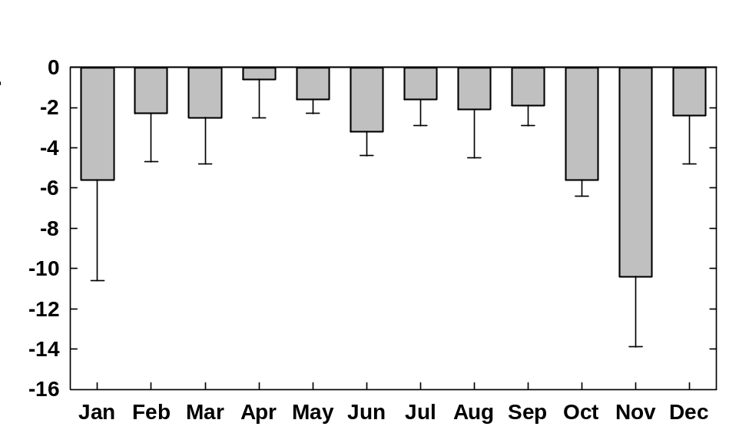
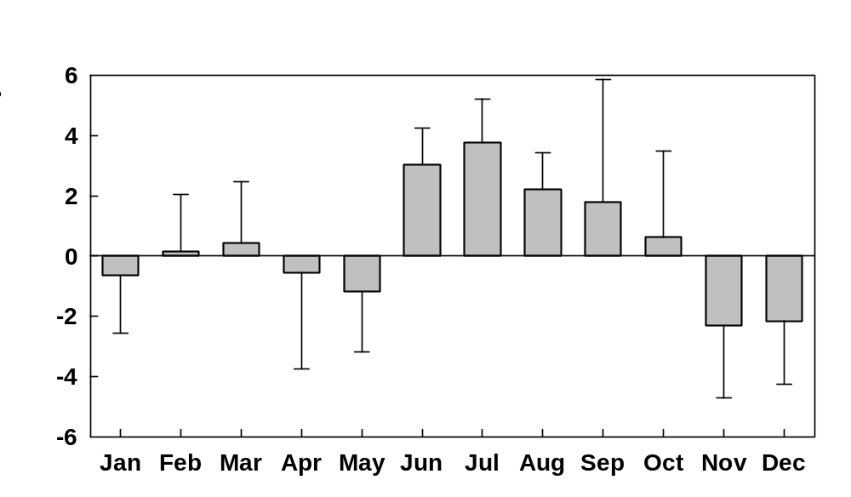
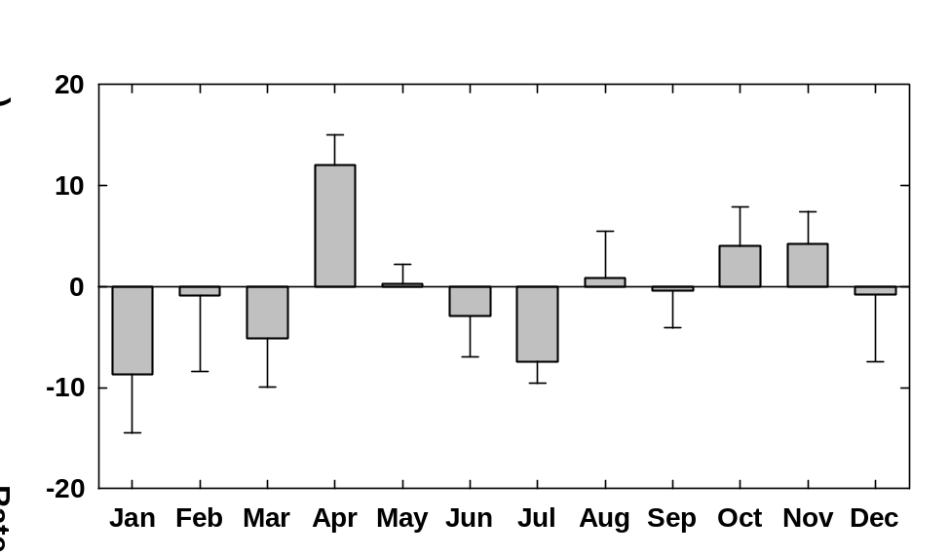
Pack Monadnock
Thompson Farm
Huntington
In colder months the trends were more associated with anthropogenic emission reductions;
In warmer months other sources/sinks and processes became more significant and even predominant.

Slide 5
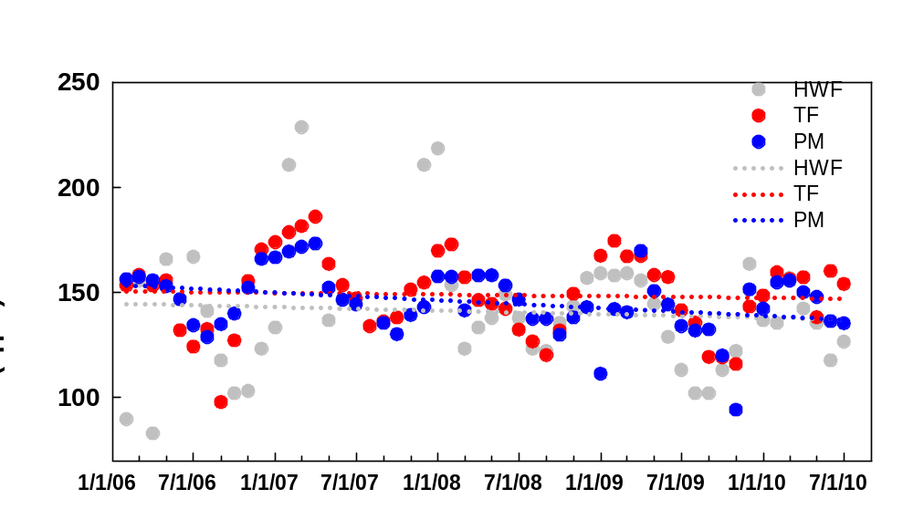
For the overlapping period February 2006 – August 2010
HWF: -1.8 ± 3.4 ppqv yr⁻¹
TF: -0.8 ± 1.9 ppqv yr⁻¹
PM: -3.6 ± 1.4 ppqv mon⁻¹

Slide 6
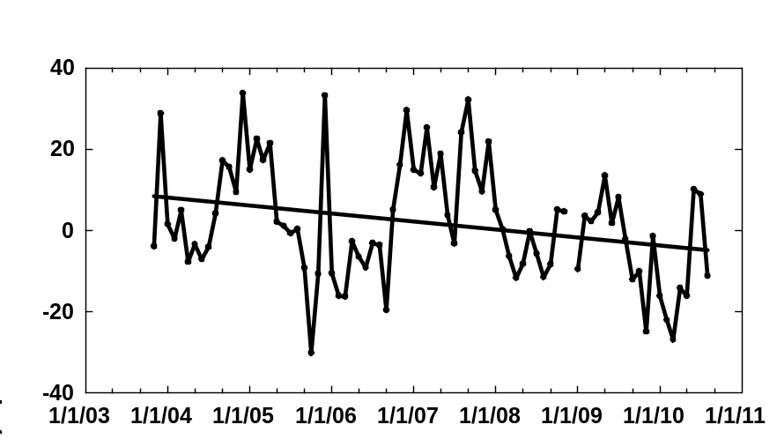
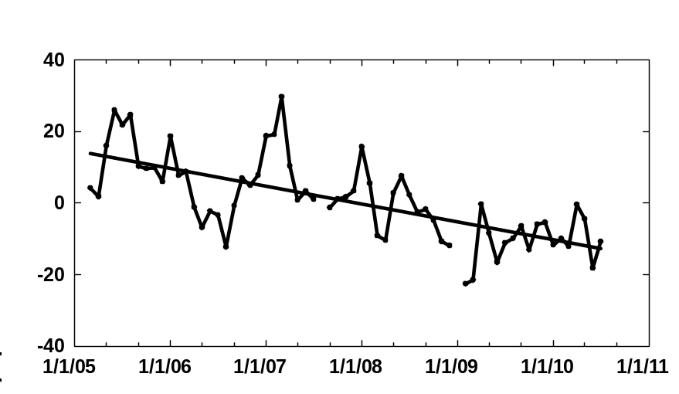
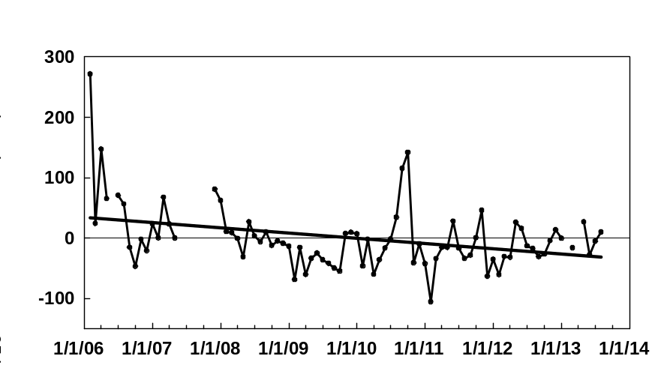
a) TF
Hg⁰ MMAs corresponding to 75th percentile CO mixing ratios at TF and PM
2.0±0.8 ppqv yr⁻¹
b) PM
4.8±0.7 ppqv yr⁻¹
c) HWF
95th percentile Hg⁰ MMAs at HWF
3.5±1.3 ppqv yr⁻¹

Slide 7
PM GEM in Polluted Air Masses (CO>75th percentile)
TF (CO> 75th percentile)
Figure 6.
HWF (95th percentile)
For TF, other sources/processes in warmer months could overtake anthropogenic influence.

Slide 8
Background Concentrations
Pack Monadnock
Huntington
Thompson Farm

Slide 9
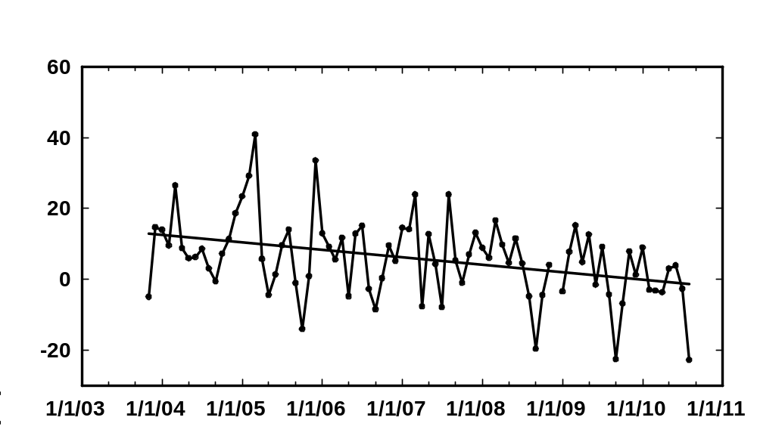
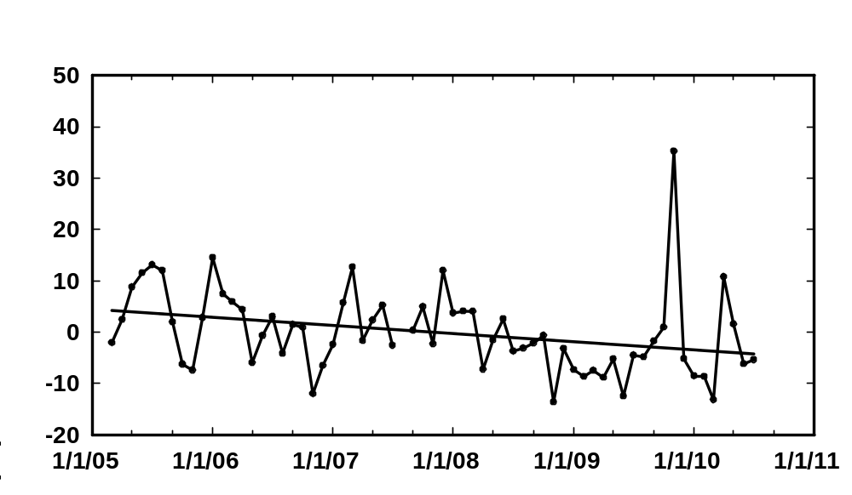
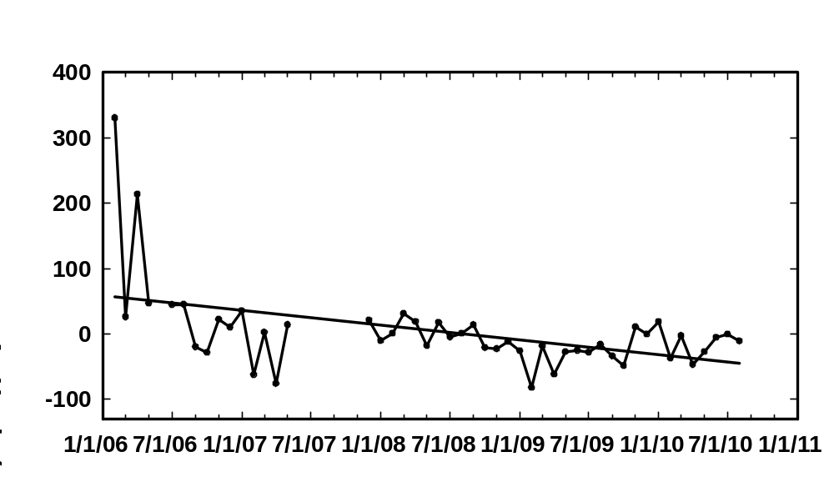
a) TF
2.1 ± 0.6 ppqv yr⁻¹
Anthropogenic Contribution
b) PM
1.6 ± 0.6 ppqv yr⁻¹
c) HWF
22 ±6 ppqv yr⁻¹

Slide 10
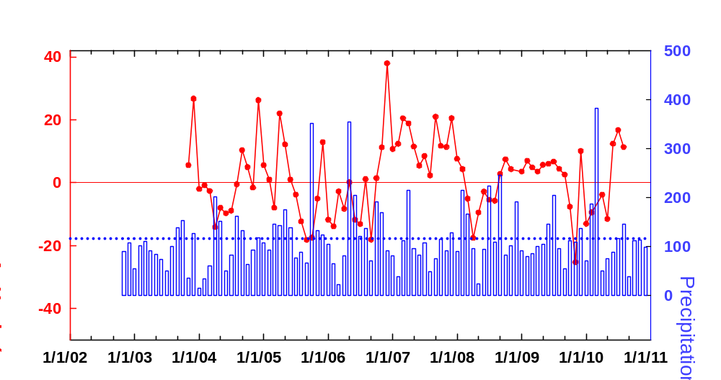
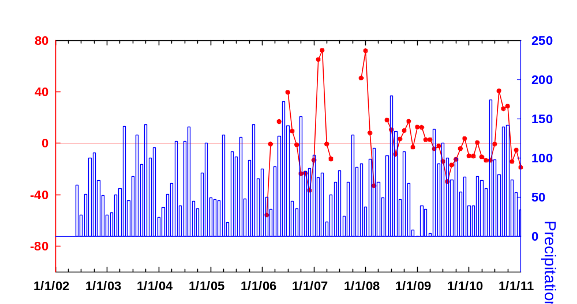
TF Background GEM vs. Precipitation
HWF

Slide 11
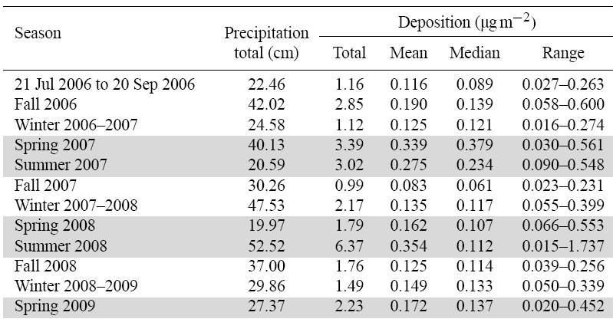
TF Wet Deposition
Lombard et al., 2011, acp

Slide 12
Acknowledgments
This study was funded by NSF AGS 1141713 and EPA STAR 83521501

