Slide 1
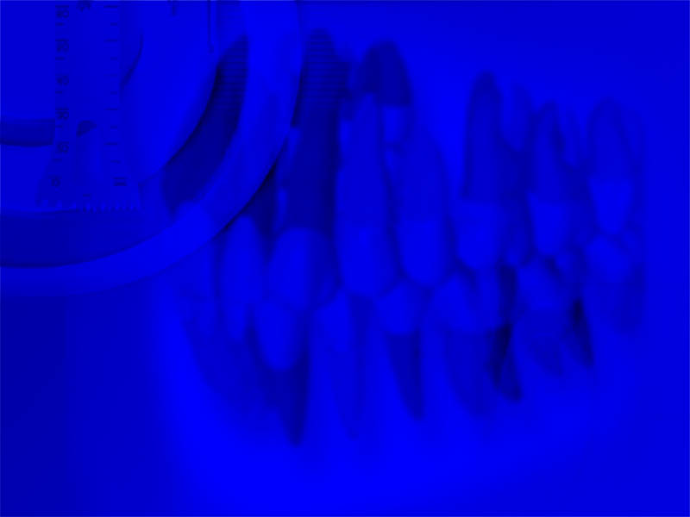
Treatment plane
for
Restoration of the extremely
worn dentition
DR.HUSSIEN ALATTAS
APRIL 19, 2016
15:50 T0 16:10

Slide 2
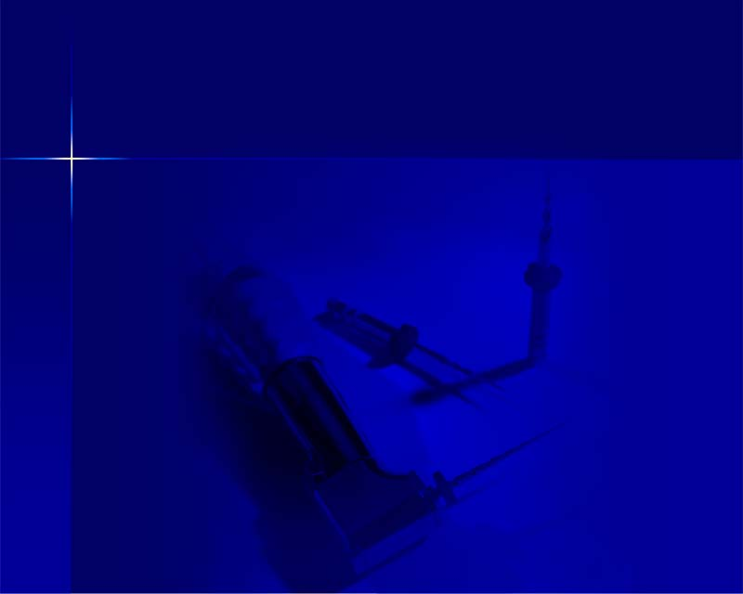
ART AND SCIENCE OF DIAGNOSIS
- Chief Complaint
- Medical History
- Dental History
- History of Present Dental Problem
- Dental History Interview
EXAMINATION AND TESTING
- Extraoral Examination
- Intraoral Examination
- Soft Tissue Examination
- Intraoral Swelling
- Intraoral Sinus Tracts
- Palpation
- Percussion
- Mobility
- Periodontal Examination

Slide 3
- Pulp Tests
- Thermal
- Electric
- Laser Doppler Flowmetry
- Pulse Oximetry
Radiographic Examination and Interpretation
- Intraoral Radiographs
- Digital Radiography
- Root Fractures and Cracks
- Crack Types
- Vertical Root Fractures
- Referred Pain

Slide 4
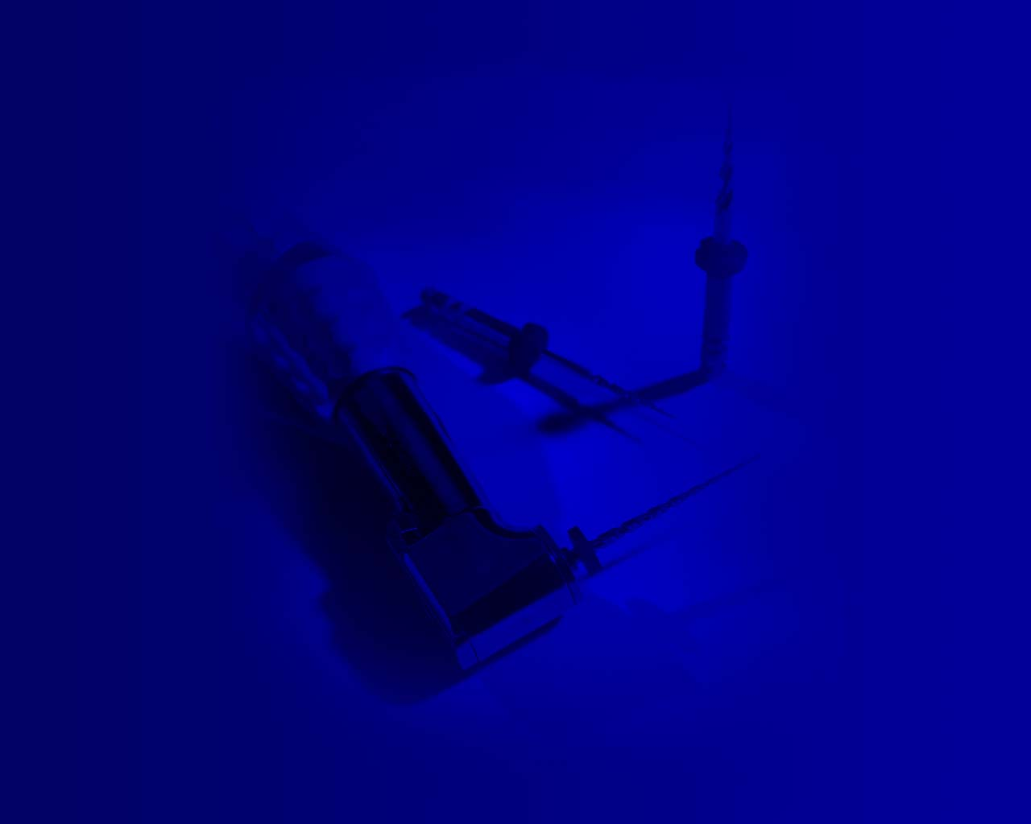
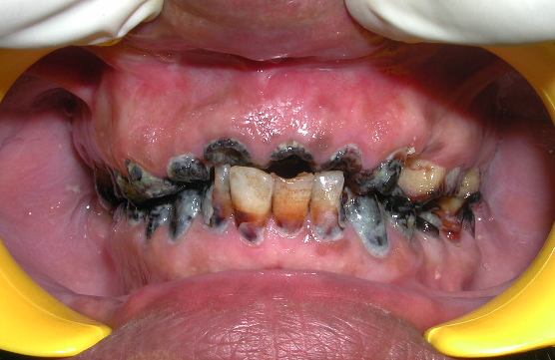
A 45-year-old non Saudi male with noncontributory medical
history was c/o pain in upper anterior teeth since 3 days ,
poor esthetics.

Slide 5
Clinical Examination
1. Extra-oral examination:
acne and physiological dark pigmentation on the face.
a symptomatic clicking in TMJ .
2. Intra oral examination:
Soft tissues : all within normal.
periodontium: generalized gingivitis with accumulation
of plaque and calculus.

Slide 6
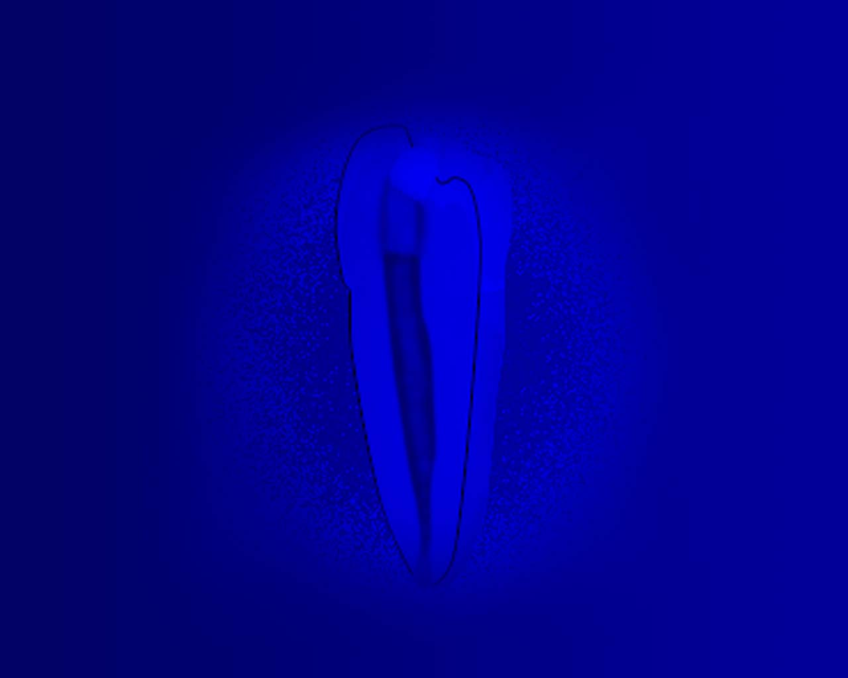
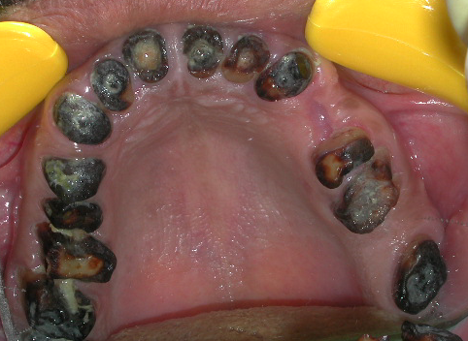
Dentition:
21
11
22
12
23
24
13
Remaining root
25
14
26
Missing teeth
Extensive caries
15
27
16
28
17

Slide 7
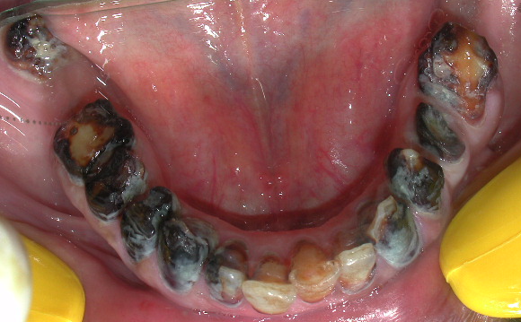
37
48
Impacted tooth
Missing teeth
36
47
Remaining roots
Extensive caries
46
35
45
34
44
33
43
32
42

Slide 8
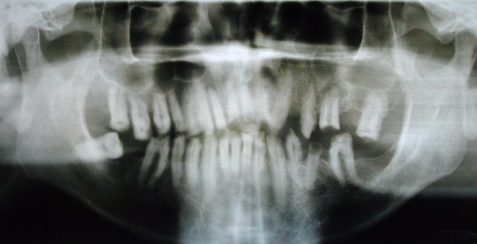
Special Investigation
A. Radiographs:
1. OPG
Generalized horizontal bone loss.
# 48 horizontal impaction

Slide 9
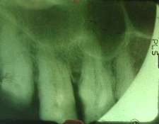
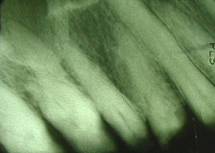
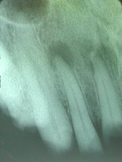
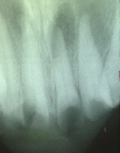
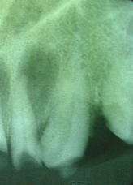
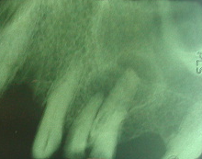
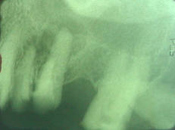
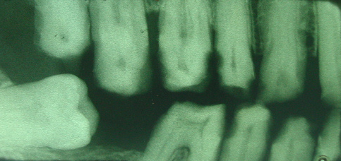
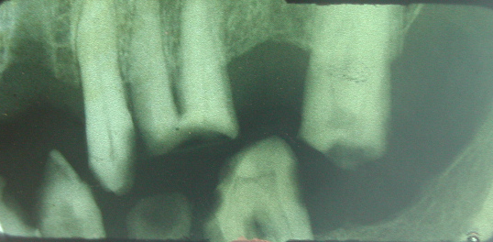
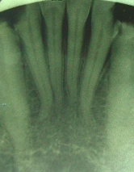
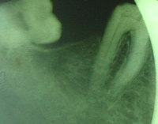
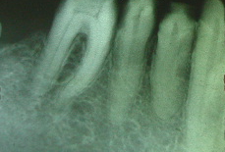
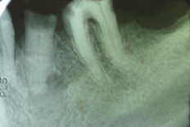
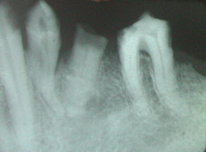
2. Bitewing & Priapical :
# 17 extensive bone loss
# 12,11,21,22 R.R
With priapical pathosis
# 26 with priapical
Pathosis and extensive caries
# 48 horizontal impaction
# 36 mild bone loss
#35 remaining root
# 33 & # 43 deep distal caries

Slide 10
Percussion test:
#12,11,21,22 tender to vertical
percussion.
Sensitivity Tests
thermal test:
#17 …….. -ve response.
Remaining teeth…… +ve response.
Electric pulp test:
#17…….. -ve response.
Remaining teeth…… +ve response.
Mobility test
# 17 mobility grade II.
# 11,# 21,# 22 mobility II.

Slide 11
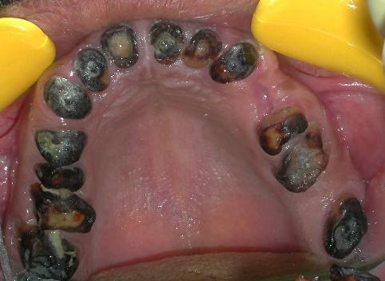

Slide 15
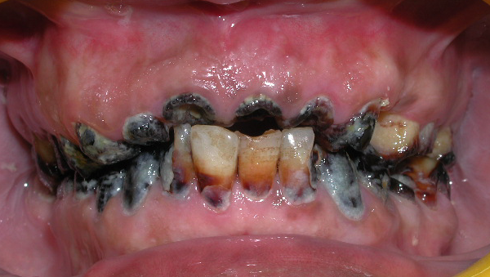
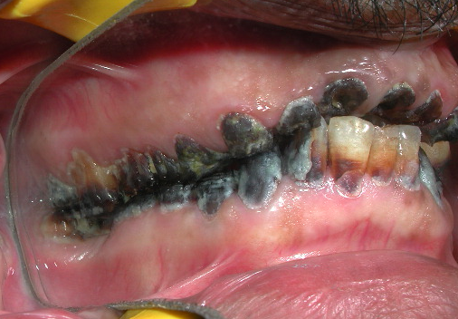
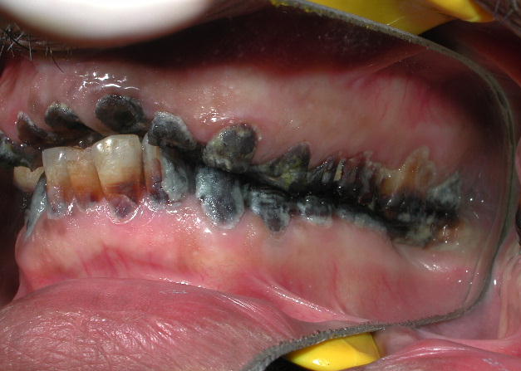
Occlusion:
loss of vertical dimension .

Slide 16
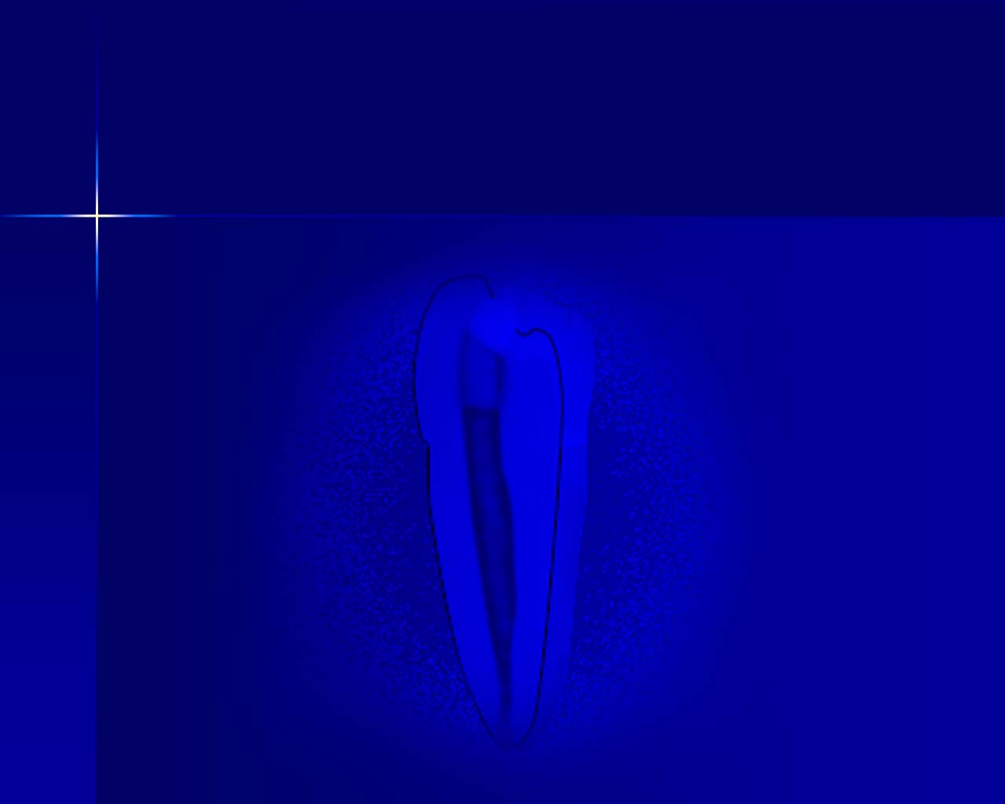
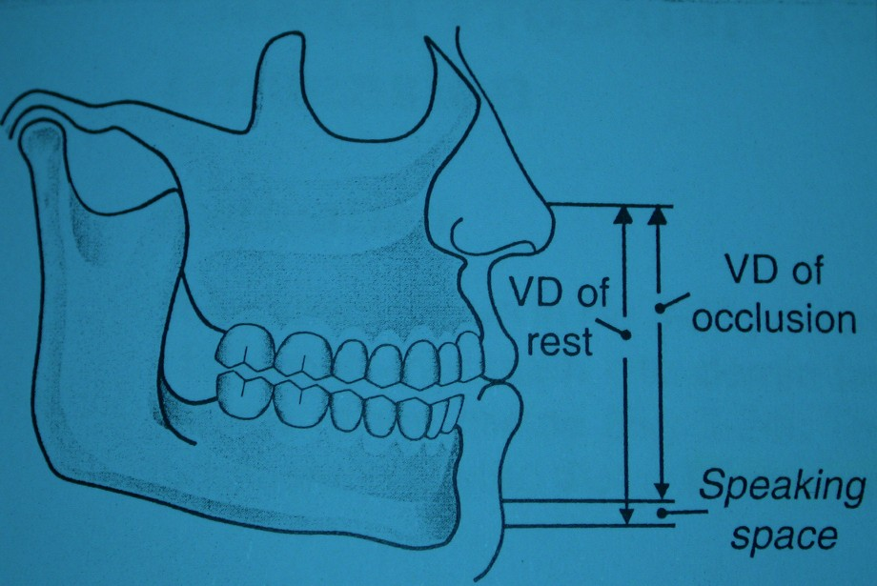
Evaluation of occlusal vertical dimension.
1. Interocclusal distance.

Slide 17
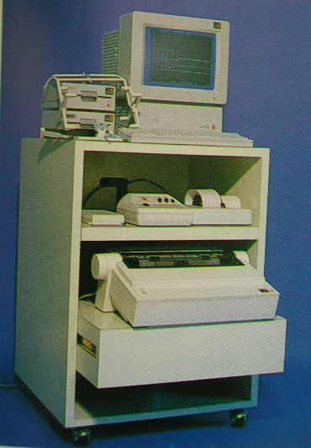
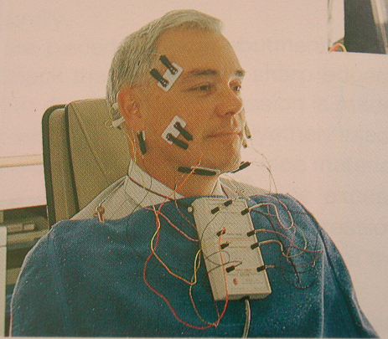
Evaluation of occlusal vertical dimension.
2.Facial appearance.
diminished facial contour, over closure, wrinkling
3. Computer.

Slide 18
why vertical dimension loss ?
Tooth surface loss
Etiology
1. Congenital anomalies
a. Amelogenesis imperfecta.
b. Dentinogenesis imperfecta.
2. Parafunctional occusal habits.
Bruxism , biting on needles, pipe steme, pencils.

Slide 19
3. Abrasion
Wearing away of tooth tissue by extrnal agents
eg.toothbrush
4. Erosion.
The destruction of hard dental tissues by chemical
action.
5. Loss of posterior support.
6. caries.

Slide 20
Category No.1.
Excessive wear with loss of occlusal vertical dimension
Category No.2.
Excessive wear without loss of occlusal vertical
dimension but with space available

Slide 21
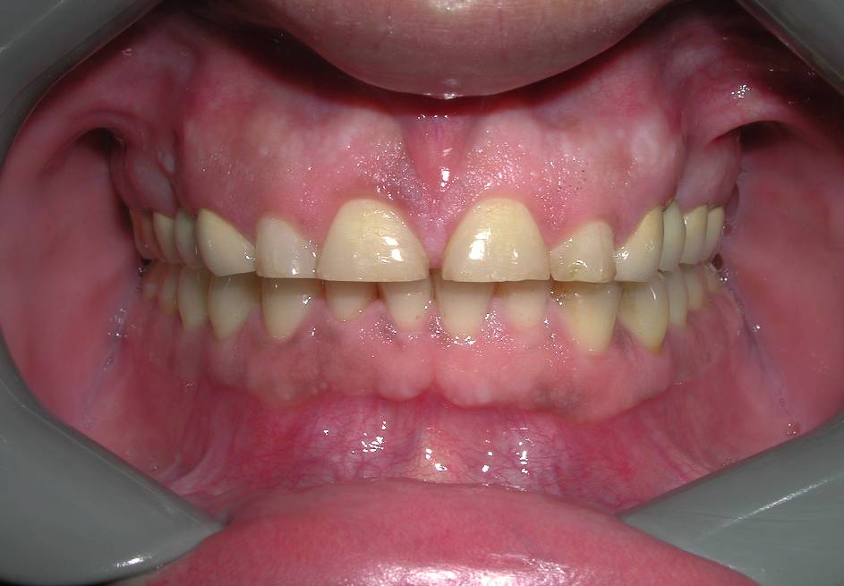
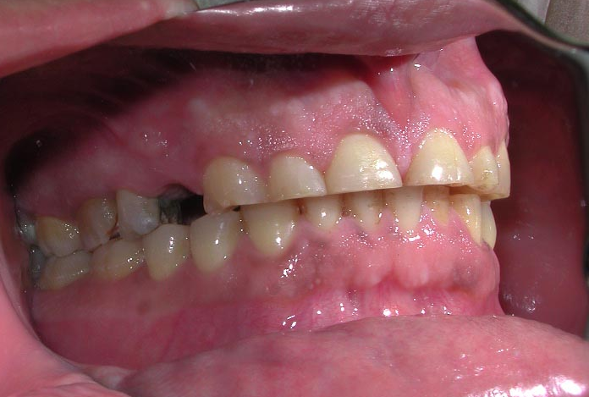
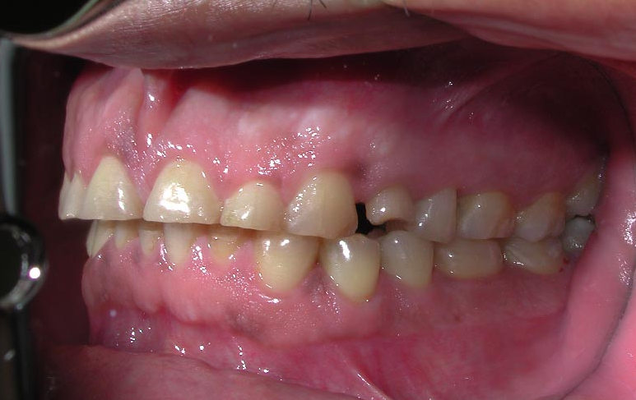
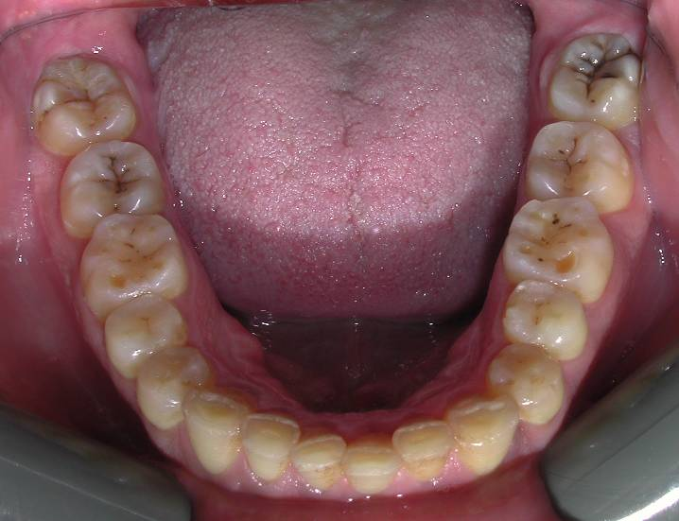
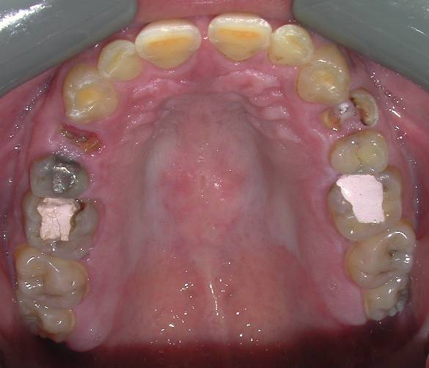

Slide 22
Category No.1.
Excessive wear with loss of occlusal vertical dimension
Category No.2.
Excessive wear without loss of occlusal vertical dimension
but with space available
Category No.3.
Excessive wear without loss of occlusal vertical dimension
but with limited space .

Slide 23
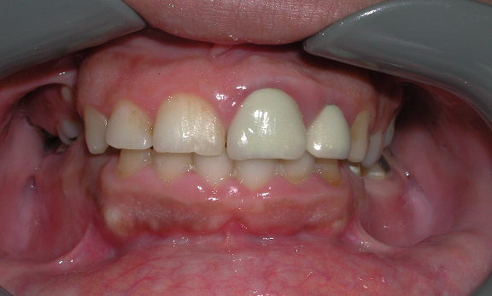
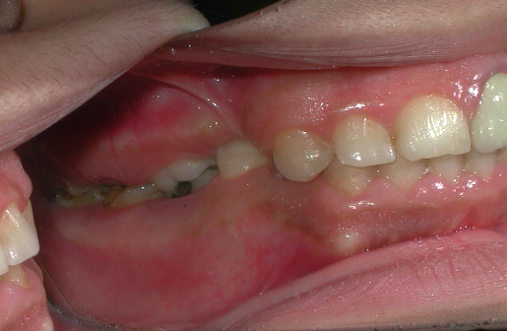
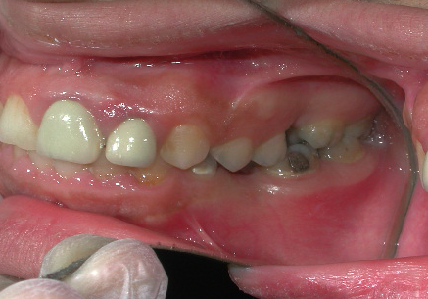

Slide 24
Centric Relation (CR)
Refers to the RELATIONSHIP of the MANDIBLE TO THE SKULL as it rotates around the ‘hinge-axis” before any translatory movement of the condyles from
their “upper-most and mid-most position”.
It is irrespective of tooth position or vertical dimension.
Peter E. Dawson. Evaluation, Diagnosis, and Treatment
of Occlusal Problems, 2nd ed.. Mosby.

Slide 25
Centric relation :
Glossary of prosthodontic Terms (1987)
“An anteriorly ,superiorly braced position along the articular
eminence of glenoid fossa, with the articular disc interposed
between the condyle and eminence”
This position is
Reproducible.
Repeatable.
Recorded as a stable position.
(McCollum, Stuart, 1955;lucia, 1961;Hobo,1978)

Slide 26
Centric Occlusion (CO)
Refers to the RELATIONSHIP of the
MANDIBLE TO THE MAXILLA when
the teeth are in maximum occlusal
contact, irrespective of the position or alignment of the condyle-disk
assemblies.
Peter E. Dawson. Evaluation, Diagnosis, and Treatment
of Occlusal Problems, 2nd ed.. Mosby.

Slide 27
Five requirements
of a stable occlusion.
Peter E. Dawson. Evaluation, Diagnosis, and Treatment of
Occlusal Problems, 2nd ed.. Mosby. Chapter 27, p470-476.

Slide 28
1. Stable stops on all the teeth
when the condyles are in
Centric Relation (CR).

Slide 29
2. Anterior Guidance in harmony
with the border movements of
the Envelope of Function.

Slide 30
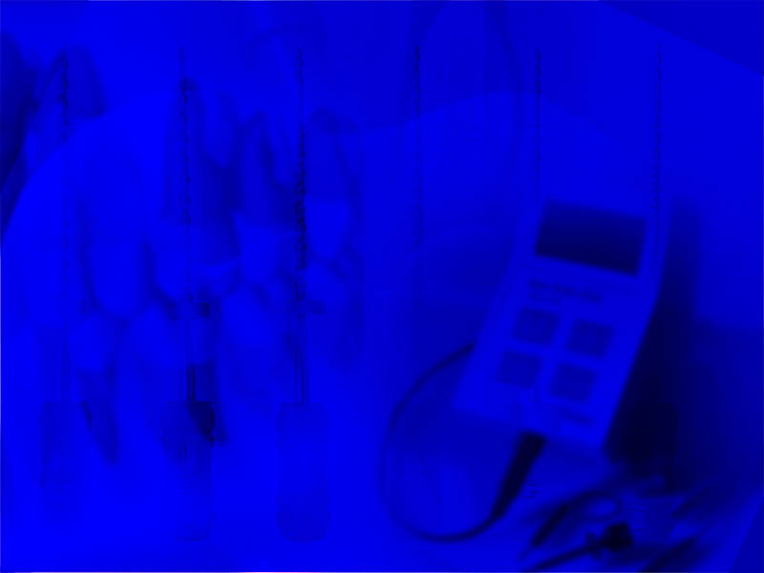
3. Disclusion (separation) of all the
posterior (back) teeth in protrusive
(forward) movements by the MOST
ANTERIOR (front teeth (Anterior
Guidance).
Ideally this should be the 6 front teeth, but in
some cases of an open bite for example, the
most anterior tooth could be a bicuspid.

Slide 31
4. Disclusion of all the posterior teeth
on the non-working or balancing side
(side where the lower teeth are
moving toward the tongue).

Slide 32
5. Disclusion of all the posterior teeth
on the working side during excursions (side where the lower teeth are moving toward the cheek).

Slide 33
Exception for rule 5.
Teeth may be in GROUP FUNCTION
if they are in precise harmony with
anterior and condylar guidance.

Slide 34
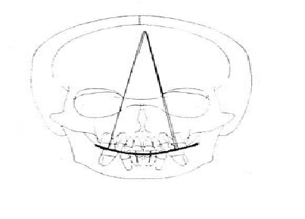
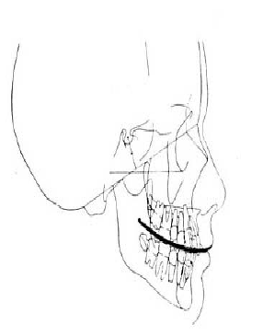
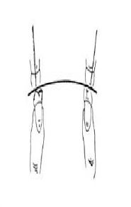
Curve of Spee
Curve of Wilson
Reverse Curve of Wilson

Slide 35
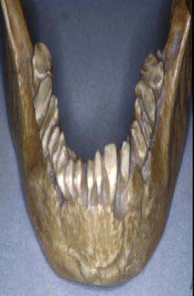

Slide 36
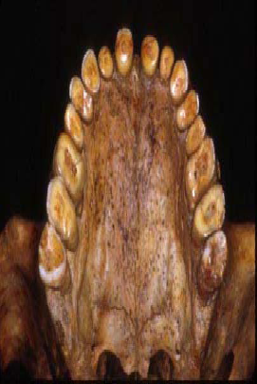

Slide 37
Key Points:
All five requirements must be fulfilled or one or
more signs of instability will be seen in time.
• Teeth could loosen.
• Teeth could wear excessively.
• Teeth could move out of alignment.
• Teeth could get sore.
• Teeth could get cervical notching – abfractions.
• Open contact could develop.
• TMJ could break down.
• Bone loss could occur.
• Tori could develop.

Slide 38
Malocclusion
Traumatic Occlusion

Slide 39
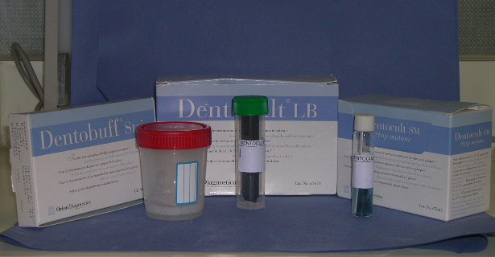
Fluoride program
No
Related diseases
No systemic D.
Plaque amount
>50% plaque adhering S.
Evaluation
of
The Caries Risk
Mutans strep.
1000,000/ml (high)
Caries experiences
Worse than normal
Diet, contents
High sugar intake
Buffer capacity
pH 4.5-5.5 ( medium)
Saliva secretion
1 ml / m.)normal)
Diet, frequency
3 meals/day v.low diet intake F.

Slide 40
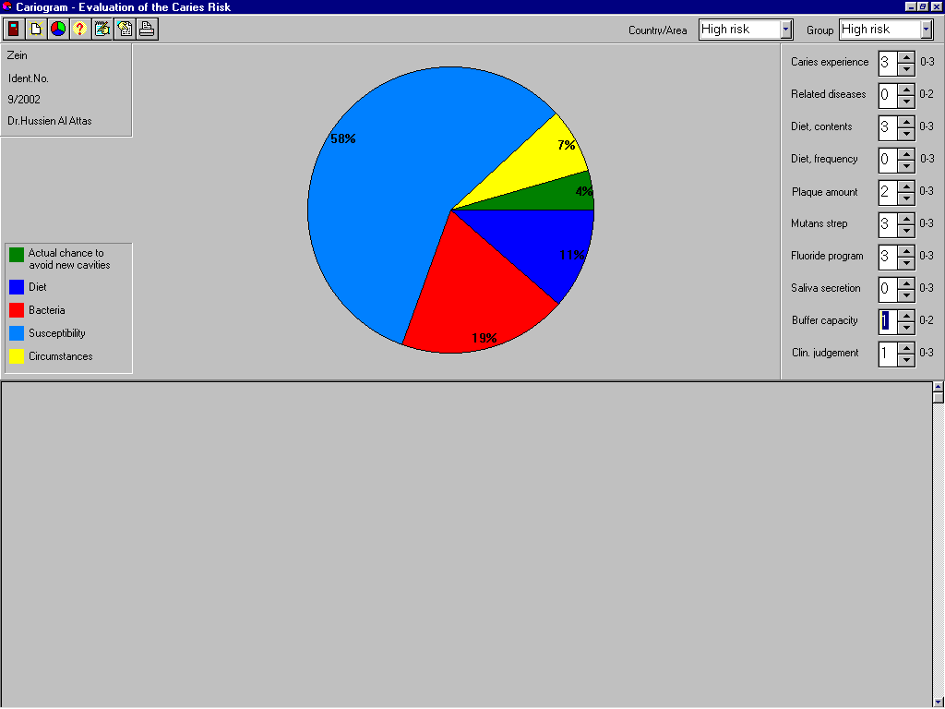

Slide 41
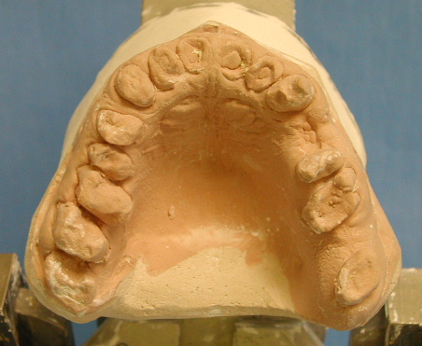
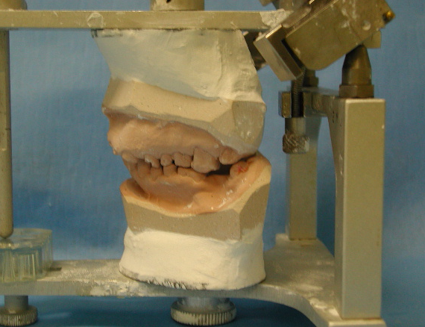
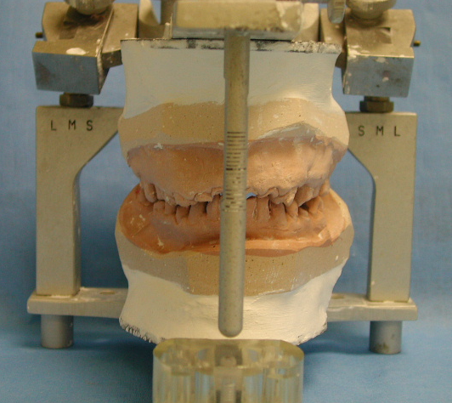
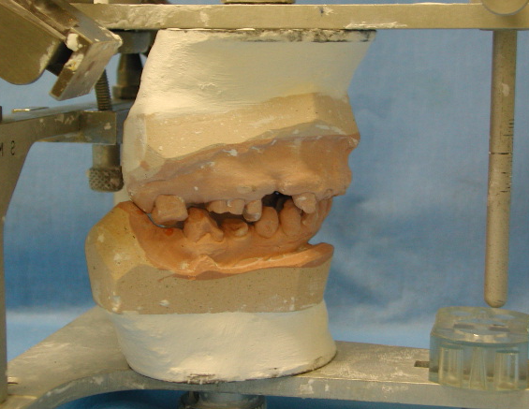

Mounted Diagnostic casts.

Slide 42
Diagnosis
mild to moderate generalized periodontitis.
Dental caries.
Necrotic pulp #17,#12,#11,#21,#22,#35 .
Acute apical periodontitis # 12,#11,#21.
Missing teeth # 27,#37,#47.
impacted tooth # 48
Prognosis:
Good if all potential cariogenic factor controlled

Slide 43
Treatment planning
Phase I
Extraction #17, # 26 , #38, R.R #11,21,22, 35.
Prophylaxis and oral hygiene instruction.
Patient motivation and caries control:
1. Reduced sugar intake.
2. A Chlorhexidine gel .
3. Fluoride toothpaste.
4. Stop smoking to improve buffer capacity of saliva.
Evaluation of occlusal vertical dimention.
Constriction lower transitional RPD .

Slide 44





Mounted maxillary and mandibular diagnostic wax up

Slide 45


PHASE II
1.Endodontic treatment
# 16, # 15
# 16

Slide 46


# 13, # 12
#23

Slide 47


# 33, # 32
# 36, # 34

Slide 48




# 44, # 45
# 43, # 42
# 46

Slide 49










PHASE III
12
23
13
14
25
15
16

Slide 50






36
46
45
34
44
43
33
42
32

Slide 51
Design for fixed partial denture.

Slide 52

jaw relation and vertical dimension record.

Slide 53
vertical dimension.
1. Interocclusal distance.

Slide 54






Slide 55

PRE.
POST.

Slide 56

PRE.
POST.

Slide 57

PRE.
POST.

Slide 58
PHASE IV
Recall maintenance every 3 months

Slide 59

POST.
12 month

Slide 60

Follow up RCT # 12
12 months

Slide 61



6 months
# 41
# 41 RCT
6 months

Slide 62


Slide 63


