Slide 1

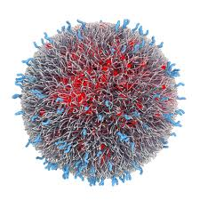
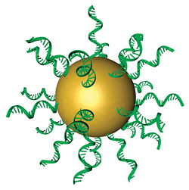
New Trends in Nanotechnology-Based Targeted Drug Delivery Systems
Prof. Dr. Hussein O. Ammar
Chairman of Pharmaceutical Technology Department, Faculty of Pharmaceutical Sciences and Pharmaceutical Industries, Future University in Egypt

Slide 2
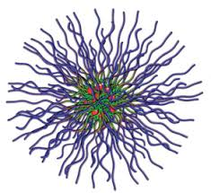
Background
In recent years, it has become more and more evident that the development of new drugs alone was NOT sufficient to ensure progress in drug therapy.

Slide 3
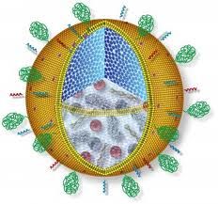
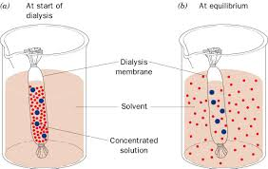
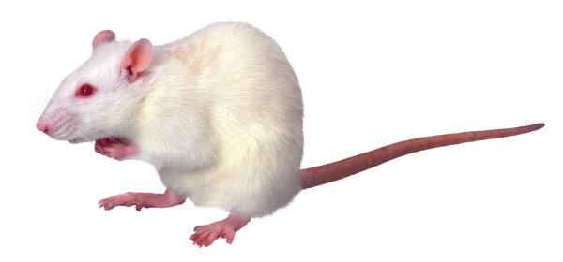
Background
Exciting experimental data obtained in-vitro were very often followed by Disappointing results in-vivo, due to several factors leading to lack of drug delivery
in sufficient amount
at the right place
and
at appropriate time.

Slide 4
Background
A promising strategy to overcome these problems involves the development of
suitable drug delivery systems

Slide 5
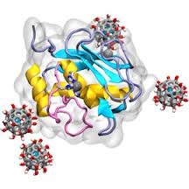
Background
Compared with traditional drug preparations, DDSs can
Directly
Deliver the drug to its designated location
Improve
Therapeutic efficacy
Reduce
Side effects

Slide 6
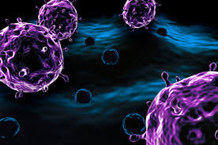
Nanotechnology
Application of nanotechnology in areas of drug delivery and therapy has the potential to
revolutionize
the treatment of many diseases

Slide 7
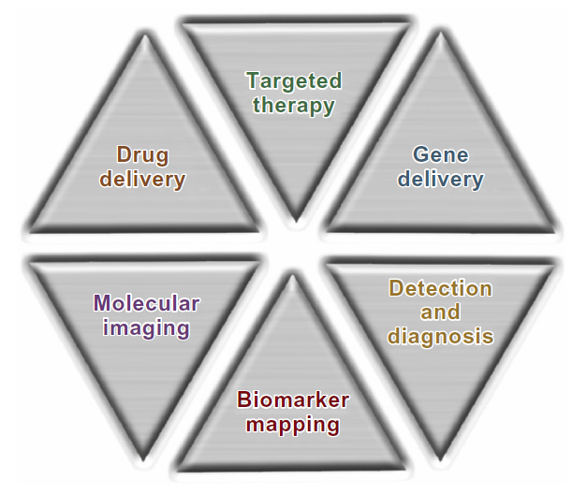
Biomedical Applications of Nanotherapeutics

Slide 8
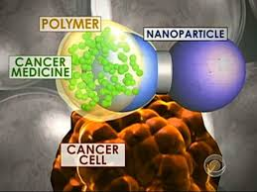
Among the many potential applications of nanotechnology in medicine
Cancer diagnosis and therapy
remains the most significant and has led to the development of a new discipline of
Nano-oncology

Slide 9
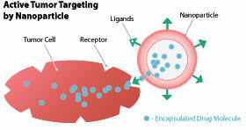
Nano-oncology
In cancer chemotherapy, cytostatic drugs damage both malignant and normal cells alike. Thus, a drug delivery strategy that selectively targets the malignant tumor is very much needed

Slide 10
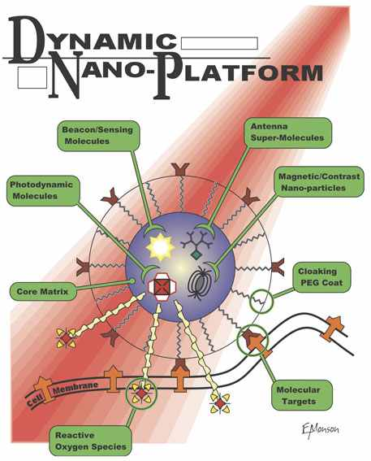
Nano-oncology
Compared with conventional drug delivery approaches, nanoparticle-mediated delivery of anticancer drugs brings several remarkable advantages.

Slide 11
Nano-oncology
Drugs delivered by nanoparticles may have a longer biological life, due to
  packaging protection
  and
  may be concentrated in the site of cancer due to enhanced permeability and retention (EPR) at cancer sites.

Slide 12
Nano-oncology
EPR is caused by the leakiness of tumor vasculature as well as poor lymphatic drainage.
Therefore, nanotechnology increases treatment efficacy and decreases side effects

Slide 13
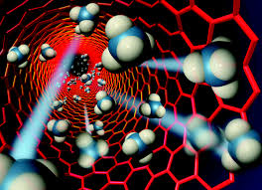
Nano-oncology
Over the past 2 decades, various diagnostic and drug-delivery systems have been developed for cancer therapy.
In the efforts to improve the accuracy of diagnosis/ prognosis and to improve the therapeutic efficiency, the joint delivery of therapeutic and diagnostic agents has proven to be a very promising direction.

Slide 14
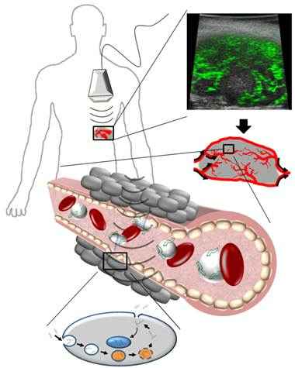
The so-called
“Theranostic Strategy”
is capable of combining dual functions into one nanomedicinal system; that is, simultaneous drug therapy (eg, chemotherapy), and monitoring of pathological progress and therapeutic efficacy with medical imaging tools such as magnetic resonance imaging (MRI).

Slide 15
Theranostic Strategy
Such integrated diagnostic and therapeutic designs allow for the timely tailoring of nanomedicine modules to address the challenges of tumor heterogeneity and adaptive resistance, which can ultimately help achieve the goal of
Personalized Therapy for Cancer

Slide 16
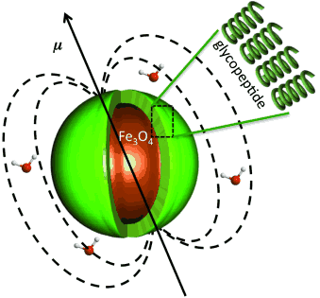
Theranostic Strategy
As a result of their novel intrinsic physical properties, there has been considerable interest in the development of a variety of functional inorganic nanoparticles for use in biomedical technology.

Slide 17
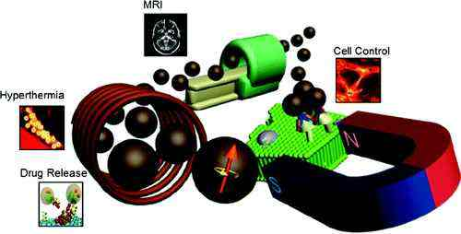
Theranostic Strategy
Of particular significance are
Magnetic Nanoparticles
  Which have the advantages of :
  being able to be visualized by magnetic resonance imaging (MRI)
  guided to target sites by an external magnetic field
  heated to provide hyperthermia,
  i.e., magnetic fluid hyperthermia
In order to fully exploit their potential
magnetic nanoparticles are often engineered
by conjugation with biomolecules to target
specific cells.

Slide 18
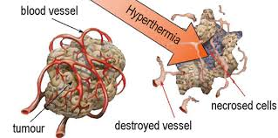
Hyperthermia
Hyperthermia is a fairly new concept that finds its application in the treatment of different types of cancers and is based on generation of heat at the tumor site. This results in changes in the physiology of diseased cells, finally leading to apoptosis.

Slide 19
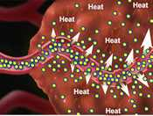
Hyperthermia
Hyperthermia treatment mechanisms involve intracellular heat stress in the temperature range of 41–46°C, resulting in activation and/or initiation of many intracellular and extracellular degradation mechanisms.
The intracellular and extracellular effects of hyperthermia include
  Protein misfolding and aggregation
  Alteration in signal transduction
  Induction of apoptosis changes and pH changes
  AND
  Reduced perfusion and oxygenation of the tumor.

Slide 20
Hyperthermia
Magnetic fluid hyperthermia is induced by the response of superparamagnetic nanoparticles to an alternating magnetic field, the energy of which is absorbed by the system and then converted into heat.
The general clinical idea is to use locally generated heat to destroy tumors, limiting the side effects at the frequencies used in magnetic fluid hyperthermia (50–500 kHz).
Importantly, the magnetic field is not absorbed by living tissues.

Slide 21
Hyperthermia
The high surface area-to-volume ratio of Magnetic Iron Oxide Nano-particles (MIONs) results in a tendency to aggregate and absorb plasma proteins upon intravenous injection, leading to rapid clearance by the reticuloendothelial system.
Additionally, they are limited in their capacity for drug loading and rapid drug clearance after intravenous administration.
Thus, MIONs are commonly protected with a polymer coating to improve their dispersity and stability.

Slide 22
Liposomes have been intensively investigated for the sustained and controlled delivery of imaging and therapeutic agents for cancer diagnosis and cancer treatment, which can result in high diagnostic and therapeutic efficiency and low side effects.
Coating MIONs with liposomes can prevent them from aggregation and opsonization, while evading nanoparticle uptake by the reticuloendothelial system, increasing colloidal stability in physiological solutions, and increasing its blood circulation time.

Slide 23
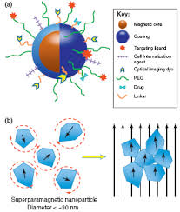
Moreover, liposomes can be easily conjugated with ligands that target disease-specific receptors or other molecules.
Improved stability in plasma benefits accumulation of MNP in tumor lesions via magnetic targeting and the enhanced permeability and retention effect.

Slide 24
Polyethylene glycol (PEG), with the advantage of low recognition by the reticuloendothelial system, has been deemed to be the answer for delivery of drugs with a poor plasma pharmacokinetic profile.
The stability of MNP in plasma can be greatly increased when modified with PEG.

Slide 25
However,
it has been reported that PEG fails to completely avoid uptake by macrophages and still partially activates complement systems, which leads to shorter circulation time.

Slide 26
Recently, PVP has been found to be a very promising alternative option to PEG. PVP modification could lengthen the in vivo circulation time of nanoparticles due to
A more effective escape from macrophage systems.

Slide 27

Therefore, the drug-loaded nanoparticles could be considered a
“Trojan horse”
designed to deliver anticancer drugs.

Slide 28
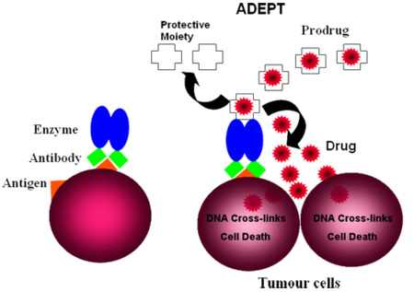
Directed Enzyme Prodrug Therapy (DEPT) has been investigated as a means to improve the tumor selectivity of therapeutics.
This strategy comprises the targeted delivery of a prodrug-activating enzyme or its encoding gene to the tumor before administering a prodrug.

Slide 29
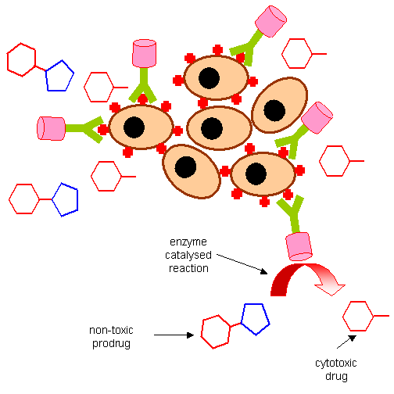
DEPT
After targeting and clearance of the enzyme from the circulation, the prodrug is administered and then converted to an active anticancer drug
ONLY
in the tumor lesion, achieving enhanced anticancer efficacy and decreased systemic toxicity.

Slide 30
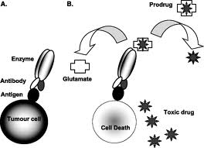
Magnetic DEPT, which is attracting increasing attention, involves coupling the bioactive prodrug-activating enzyme to magnetic nanoparticles (MNP) that are then selectively delivered to the tumor by applying an external magnetic field.

Slide 31
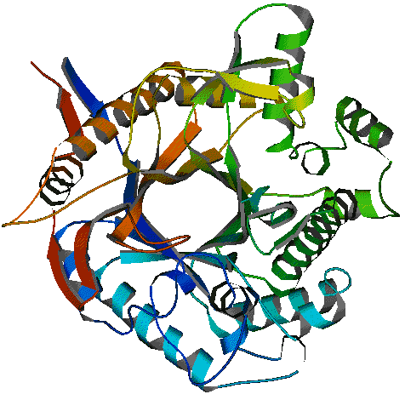
Of all the DEPT strategies, the
β-glucosidase/amygdalin system
in which amygdalin is converted to hydrogen cyanide to kill tumor cells, is the most widely used. The nonspecific toxicity of hydrogen cyanide in normal cells/tissues can be greatly minimized by administering amygdalin with the maximum concentration ratio of β-glucosidase-conjugated MNP in tumor tissue and the blood circulation. Increasing accumulation of β-glucosidase in tumor tissue is extremely important for this targeted enzyme/prodrug (β-glucosidase/amygdalin) strategy to be successful.

Slide 32
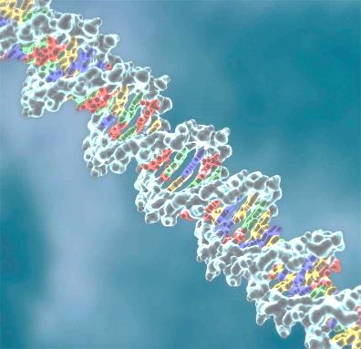
Gene therapy has been developed over the past years and is intended to use genetic material to prevent or treat monogenic diseases and acquired genetic pathologies, like cancer.
However,
it still has a limited clinical application, mainly due to
The reduced gene delivery efficiency
And
specificity into target cells.

Slide 33
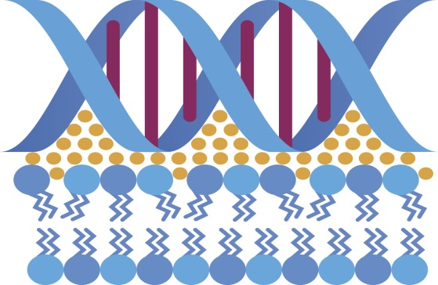
Gene Therapy
For this reason, several types of gene delivery nanosystems have been investigated in order to achieve successful and efficient nucleic acid delivery into target cells and consequently the desired therapeutic effect.
Among these, cationic liposome/DNA complexes
Lipoplexes
have been the most extensively studied, since they present higher gene delivery efficiency, both in vitro and in vivo, than that observed with other non-viral gene delivery systems.

Slide 34
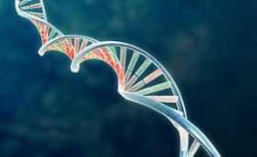
Gene Therapy
A Technology for curing brain disorders, such as Alzheimer’s disease and Parkinson’s disease, constitutes an unmet medical need.
Gene therapy or treatment with functional nucleic acid, i.e., short interference RNA (siRNA), is an attractive method for meeting these needs.
To realize these therapies, a Nanosized Carrier that is capable of delivering plasmid DNA and siRNA to brain parenchymal cells is essential.

Slide 35
Gene Therapy
Hepatocellular carcinoma (HCC) is the major primary malignant tumor of the liver.
Currently, it is the fifth most prevalent malignancy and the third leading cause of cancer-related deaths worldwide.
Despite advances in therapy against HCC such as recent modifications in chemotherapy and modern surgical innovations, the overall clinical outcome has not been substantially improved.
Long-term survival of patients with HCC is uncommon due to the frequent presence of reoccurrence, metastasis, or the development of new primaries.

Slide 36
Gene Therapy
Curative treatment such as hepatic resection and liver transplantation can be utilized when HCC is diagnosed at an early stage.
Unfortunately, when diagnosed the vast majority of liver cancers are inoperable, and thus the patients have to receive chemotherapy, which has limited success due to the fact that HCC is intrinsically resistant to standard chemotherapeutic agents.
Therefore,
it is urgently needed to develop more effective cures for HCC patients, of which gene therapy is among those with the most potential.

Slide 37
Gene Therapy
The difficulty of employing gene therapy as a cure for HCC is the ability to design an efficient vector that is able to deliver therapeutic genes specifically into the cancer cells but not the surrounding benign cells.
Cancer targeting is usually achieved by adding to the gene carriers a ligand moiety specifically directed to certain types of binding sites on cancer cells.
Antibodies, epidermal growth factor, aptamers, and small molecules such as galactose have been reported as potential targeting moieties for specific delivery of genes and drugs to HCC cells.

Slide 38
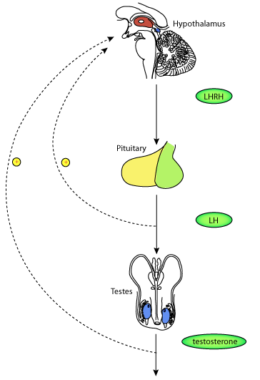
Previous reports demonstrated that Luntinizing Hormone –Releasing Hormone (LHRH) peptide could be used as a targeting moiety on drug-delivery systems to enhance drug uptake by breast, ovarian, and prostate cancer cells, and reduce the relative availability of the toxic drug to normal cells.

Slide 39
LHRH
These studies confirmed the high anticancer activity of LHRH-targeted carrier–drug conjugates against the aforementioned cancer cells, and that the cytotoxicity of the LHRH-targeted conjugates against the human cancer cells could be competitively inhibited by free LHRH peptide.

Slide 40
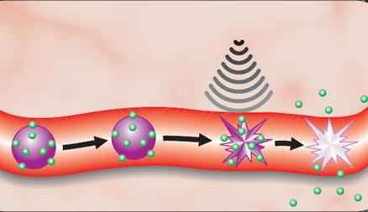
Ultrasound-Mediated Drug Delivery (UMDD) is a novel technique for enhancing the penetration of drugs into diseased tissue beds noninvasively.
This technique is broadly appealing, given the potential of ultrasound to control drug delivery spatially and temporally in a noninvasive manner.

Slide 41
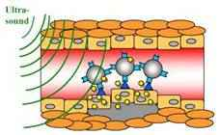
Ultrasound-mediated Drug Delivery
UMDD has been demonstrated in a number of tissue beds, including the blood–brain barrier, cardiac tissue, prostate, and large arteries.
By encapsulating drugs into microsized and nanosized liposomes, the therapeutic can be shielded from degradation within the vasculature until delivery to a target site by ultrasound exposure.

Slide 42
Ultrasound-mediated Drug Delivery
Acoustic cavitation is a physical mechanism that is hypothesized to mediate UMDD.
Cavitation refers to nonlinear bubble activity that occurs within the vasculature upon ultrasound exposure and can exert mechanical stress on nearby cells and junctions.
Mechanical stress can trigger the reduction of barriers to drug delivery, such as endothelial tight junctions or phospholipid membranes, via transient permeabilization.

Slide 43
Ultrasound-mediated Drug Delivery
Nitric oxide (NO) is a molecule that plays a mechanistic role in UMDD.
The potent vasodilating gas, NO is involved in the regulation of paracellular and transcellular transport pathways, and is implicated as a regulatory promoter of hyperpermeability.
Attenuation of NO production in the etiology of progression of atherosclerosis and diabetic vascular disease further highlights the need for novel therapeutic NO modulation and delivery strategies.

Slide 44

Future
Prospects

Slide 45
In the near future, oncologists and patients will benefit from suitable nanotechnology-based drug delivery systems that could lead to improved therapeutic outcomes with reduced costs.
There are few clinical studies on oral cancer in the field of nanotechnology, but nanotechnology is also predicted to alter health care in dentistry, with novel methods of identifying the cancer as well as customization of a patient’s therapeutic profile.
Future Prospects

Slide 46

Future Prospects
However,
Further studies are needed to turn concepts of nanotechnology into practical applications and to elucidate correct drug doses and ideal release from these systems for the treatment of several cancers with different molecular and cellular mechanisms.

Slide 47


