Slide 1

New Trends in Nanotechnology-Based Targeted Drug Delivery Systems
Prof. Dr. Hussein O. Ammar
Chairman, Department of Pharmaceutics and Pharmaceutical Technology, Future University in Egypt

Slide 2
In recent years, it has become more and more evident that the development of new drugs alone was NOT sufficient to ensure progress in drug therapy.

Slide 3
Exciting experimental data obtained in-vitro were very often followed by Disappointing results in-vivo, due to several factors leading to lack of drug delivery
in sufficient amount
at the right place
and
at appropriate time.

Slide 4
A promising strategy to overcome these problems involves the development of
suitable drug delivery systems

Slide 5
Compared with traditional drug preparations, DDSs can
Directly
Deliver the drug to its designated location
Improve
Therapeutic efficacy
Reduce
Side effects

Slide 6
Application of nanotechnology in areas of drug delivery and therapy has the potential to
revolutionize
the treatment of many diseases

Slide 7
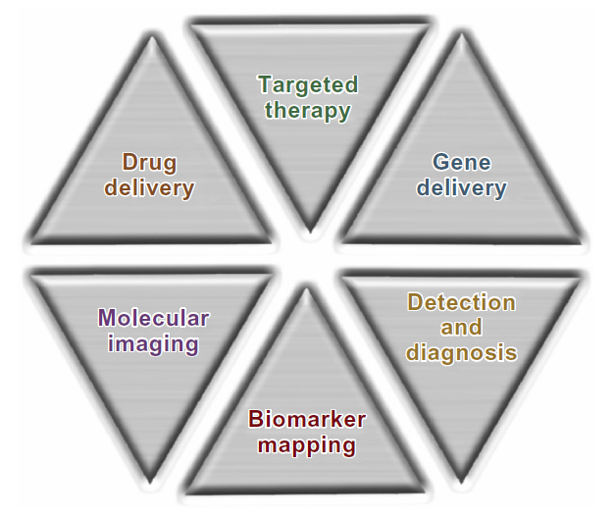
Biomedical Applications of Nanotherapeutics

Slide 8
Conventional free-drug-treatment methods mainly involve oral, subcutaneous, and intravenous administrations. A drug spreads all over the body via blood circulation, and accumulates
to a certain concentration
in the target location to achieve a therapeutic effect.

Slide 9
However, the desirable effects of drug treatment often decrease, due to the disadvantages of free drugs, such as:
The short half-life in the body
High dosage
Poor selectivity
Side effects on normal tissues
Multidrug resistance

Slide 10
Additionally, considerable amounts of marketed drugs and many new chemical drug candidates (as much as 70%) are
neither absorbed through the intestines
nor circulated by intravenous injection
because of low water solubility.

Slide 11
Therefore
solubilizing agents, such as dimethyl sulfoxide or surfactants, are typically added for systemic administration.

Slide 12
However

Slide 13
Such agents can still lead to neurotoxicity or other toxicities, even at very low dosages, thereby restricting the applications of free drugs.

Slide 14
The application of nanomedicines, such as inert carrier-based nanomedicines, polymer–drug conjugates, coordination polymer nanoparticles and carrier-free nanomedicines, can partly overcome the potential problems of free drugs in therapy.

Slide 15
Excellent properties of nanomedicines are simultaneously or sequentially obtainable.

Slide 16
1) Expanded application ranges of hydrophobic drugs as a result of enhanced water solubility.
2) Long circulation times of drugs when dosed into the circulatory system.
3) Targeted delivery of drugs at the sites of the diseases through nonspecific targeting, such as the enhanced permeability and retention effect or specific NP–cell surface interactions.
4) Responses to local stimulation of the target location, such as abnormal pH, temperature, and ionic strength.
5) Synergistic therapy via co-delivery of multiple drugs at the same time and location.
6) Real-time monitoring of carrier (and drug) biodistribution and targeted accumulation.

Slide 17
Since the first FDA approval of nanomedicine (liposomal amphotericin B in 1990), more than 24 nanomedicines have been approved for clinical use, with total sales exceeding US$5.4 billion.
The average cost and time required to develop a new nanomedicine (approximately $20–$50 million and 3–4 years) are significantly lower than for a new chemical drug (approximately $500 million and over 10 years).

Slide 18
Therefore

Slide 19
The design and development of novel nanomedicines have higher market value and application prospects than that for conventional chemical drugs.

Slide 20
Directed Enzyme Prodrug Therapy has been investigated as a means to improve the tumor selectivity of therapeutics.
This strategy comprises the targeted delivery of a prodrug-activating enzyme or its encoding gene to the tumor before administering a prodrug.

Slide 21
After targeting and clearance of the enzyme from the circulation, the prodrug is administered and then converted to an active anticancer drug
ONLY
in the tumor lesion, achieving enhanced anticancer efficacy and decreased systemic toxicity.

Slide 22
Magnetic DEPT, which is attracting increasing attention, involves coupling the bioactive prodrug-activating enzyme to magnetic nanoparticles that are then selectively delivered to the tumor by applying an external magnetic field.

Slide 23
Of all the DEPT strategies, the
β-glucosidase/amygdalin system
In which amygdalin is converted to hydrogen cyanide to kill tumor cells, is the most widely used. The nonspecific toxicity of hydrogen cyanide in normal cells/tissues can be greatly minimized by administering amygdalin with the maximum concentration ratio of β-glucosidase-conjugated MNP in tumor tissue and the blood circulation. Increasing accumulation of β-glucosidase in tumor tissue is extremely important for this targeted enzyme/prodrug strategy to be successful.

Slide 24
Gene therapy has been developed over the past years and is intended to use genetic material to prevent or treat monogenic diseases and acquired genetic pathologies, like cancer.

Slide 25
However
It still has a limited clinical application, mainly due to the reduced gene delivery efficiency and specificity into target cells.

Slide 26
For this reason, several types of gene delivery nanosystems have been investigated in order to achieve successful and efficient nucleic acid delivery into target cells and consequently the desired therapeutic effect.

Slide 27
Among these, cationic liposome/DNA complexes
Lipoplexes
have been the most extensively studied, since they present higher gene delivery efficiency, both in vitro and in vivo, than that observed with other non-viral gene delivery systems.

Slide 28
A Technology for curing brain disorders, such as Alzheimer’s disease and Parkinson’s disease, constitutes an unmet medical need.

Slide 29
Gene therapy or treatment with functional nucleic acid, i.e., short interference RNA is an attractive method for meeting these needs.

Slide 30
To realize these therapies, a Nanosized Carrier that is capable of delivering plasmid DNA and siRNA to brain parenchymal cells is essential.

Slide 31
Hepatocellular carcinoma is the major primary malignant tumor of the liver.
Currently, it is the fifth most prevalent malignancy and the third leading cause of cancer-related deaths worldwide.

Slide 32
Despite advances in therapy against HCC such as recent modifications in chemotherapy and modern surgical innovations, the overall clinical outcome has not been substantially improved.
Long-term survival of patients with HCC is uncommon due to the frequent presence of reoccurrence, metastasis, or the development of new primaries.

Slide 33
Curative treatment such as hepatic resection and liver transplantation can be utilized when HCC is diagnosed at an early stage.
Unfortunately, when diagnosed the vast majority of liver cancers are inoperable, and thus the patients have to receive chemotherapy, which has limited success due to the fact that HCC is intrinsically resistant to standard chemotherapeutic agents.

Slide 34
Therefore
It is urgently needed to develop more effective cures for HCC patients, of which gene therapy is among those with the most potential.

Slide 35
The difficulty of employing gene therapy as a cure for HCC is the ability to design an efficient vector that is able to deliver therapeutic genes specifically into the cancer cells but not the surrounding benign cells.

Slide 36
Cancer targeting is usually achieved by adding to the gene carriers a ligand moiety specifically directed to certain types of binding sites on cancer cells.
Antibodies, epidermal growth factor, aptamers, and small molecules such as galactose have been reported as potential targeting moieties for specific delivery of genes and drugs to HCC cells.

Slide 37
Previous reports demonstrated that Luteinizing Hormone –Releasing Hormone peptide could be used as a targeting moiety on drug-delivery systems to enhance drug uptake by breast, ovarian, and prostate cancer cells, and reduce the relative availability of the toxic drug to normal cells.

Slide 38
These studies confirmed the high anticancer activity of LHRH-targeted carrier–drug conjugates against cancer cells, and that the cytotoxicity of the LHRH-targeted conjugates against the human cancer cells could be competitively inhibited by free LHRH peptide.

Slide 39
Ultrasound-Mediated Drug Delivery is a novel technique for enhancing the penetration of drugs into diseased tissue beds noninvasively.
This technique is broadly appealing, given the potential of ultrasound to control drug delivery spatially and temporally in a noninvasive manner.

Slide 40
UMDD has been demonstrated in a number of tissue beds, including the blood–brain barrier, cardiac tissue, prostate, and large arteries.
By encapsulating drugs into microsized and nanosized liposomes, the therapeutic can be shielded from degradation within the vasculature until delivery to a target site by ultrasound exposure.

Slide 41
In the past 30 years, the development of nanocarrier-based platform technologies has led to significant progress in nanomedicine fabrication and applications.

Slide 42
However

Slide 43
Most of the existing nanomedicines have low drug-loading content (generally lower than 10%), causing extra system toxicity and burden on patients to excrete carrier materials.

Slide 44
Therefore

Slide 45
It is difficult for most of the carrier-based nanomedicines to get FDA approval, which limits their applications in the clinic.

Slide 46
With this in mind,
emergence and fabrication of high drug-loading nanomedicines may not provide the final answer, but present a promising alternative approach to solve this problem, because of the reduced or avoided use of carrier materials.

Slide 47
According to the fabrication strategies of nanomedicines, high drug-loading nanomedicines can be divided into four main classes:

Slide 48
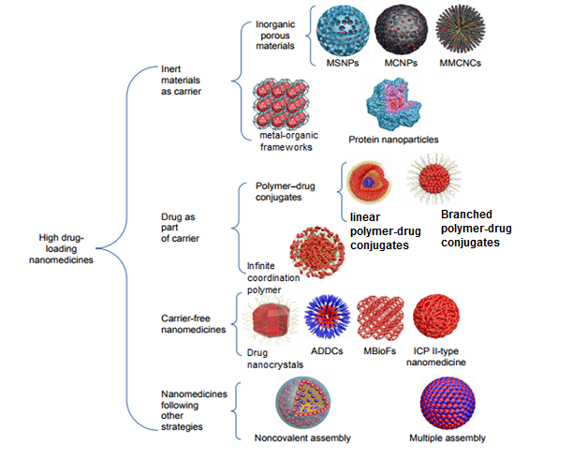

Slide 49
Meanwhile, the following issues are worth noting.

Slide 50
For some specific drugs, such as gene drugs that are unstable in the circulatory system and brain-targeting drugs that need to cross the blood–brain barrier, carrier materials are essential for the realization of their function.

Slide 51
For some carrier materials with function, such as Pluronic block copolymers, biological response modifiers affecting cell-membrane microviscosity and ATPase activity of drug-efflux transporters, the use of carrier materials will enhance the therapeutic effect.

Slide 52
For most of the high drug-loading nanomedicines, it is hard to realize in vivo controlled release, such as ultrasound-controlled release, magnetism-controlled release, and microwave-controlled release.

Slide 53
For nanomedicines with drug-loading content higher than 50%, sustained-release effects are far below expected, and there are fewer pharmacokinetic studies in this category of articles.

Slide 54
For nanomedicines with drug-loading content higher than 90%, it is usually hard to achieve surface modification, so further study is needed on the action of those high drug-loading nanomedicines in the complicated physiological environment and highly dynamic and heterogeneous tumor sites.

Slide 55
Clearly, the high drug-loading property serves therapeutic effect and function purposes.

Slide 56
Over the past few years, the number of FDA-approved drugs, including protein drugs, oligonucleotide drugs, and small-molecule inhibitors, has increased.

Slide 57
Although these drugs show excellent performance against certain diseases, it cannot be ignored that their inherent drawbacks, such as poor water solubility and unstable properties in the circulatory system, lead to unsatisfactory absorption and frequent injection for patients.

Slide 58
A promising approach to overcome these drawbacks is loading them into nanomedicine.

Slide 59
Even though much time and high costs are required to develop a new nanomedicine, I still believe that there will be more nanomedicines approved by the FDA in the future.

Slide 60
In order to overcome the disadvantages of conventional chemotherapeutic agents, molecularly targeted therapies need to be developed, along with their potential for augmenting drug efficiency and concentrations in cancerous cells, while preventing toxicity in healthy cells.

Slide 61
Still, cancer cells can also acquire resistance toward these newly developed targeted therapeutic agents.

Slide 62
Nanodelivery systems are developed in order to also target this resistance.

Slide 63
The loaded particles can have optimal dimensions and can pass through the highly permeable tumor blood vessels and remain in that microenvironment for a longer period, due to the deficient lymphatic drainage.

Slide 64
Nanotechnology-based drug delivery system acts as an effective strategy to circumvent multidrug resistance by bypassing P-glycoprotein efflux, improving anticancer efficacy, and reducing the side effects of chemotherapeutic drugs.

Slide 65
In particular, self-assembled polymeric micelles have emerged as promising vehicles for drug delivery in cancer therapy.

Slide 66
PMs have a typical core–shell structure, where hydrophobic drugs can be solubilized and stabilized in the hydrophobic inner core of the micelles, and the hydrophilic outer shell can extend the circulation time and improve the steric stabilization by reducing opsonization in blood circulation.

Slide 67
In general, PMs could selectively and effectively accumulate in tumor through enhanced permeability and retention effect, thereby enhancing the therapeutic effects of chemotherapeutic drugs. Nonetheless, passive targeting through EPR effect is still limited in tumor therapy, due to the recognition and clearance by reticuloendothelial system ,systemic toxicity, and low delivery efficiency.

Slide 68
Therefore
Active tumor-targeted PMs, which could be internalized by specific receptor-mediated endocytosis in tumor cells, and achieve a higher chemotherapy efficacy and are beneficial in reducing the side effects in normal tissues, have been extensively focused toward cancer treatment.

Slide 69
To achieve active targeting, various specific targeting ligands, such as folic acid, peptide, hyaluronic acid, and other ligands, have been grafted onto the surface of PMs, and then the PMs specifically interact with the receptor expressed on target cancer cells.

Slide 70
Future
Prospects

Slide 71
In the near future, oncologists and patients will benefit from suitable nanotechnology-based drug delivery systems that could lead to improved therapeutic outcomes with reduced costs.

Slide 72
There are few clinical studies on oral cancer in the field of nanotechnology, but nanotechnology is also predicted to alter health care in dentistry, with novel methods of identifying the cancer as well as customization of a patient’s therapeutic profile.

Slide 73
However
Further studies are needed to turn concepts of nanotechnology into practical applications and to elucidate correct drug doses and ideal release from these systems for the treatment of several cancers with different molecular and cellular mechanisms.

Slide 74
I expect that high drug-loading nanomedicines with still-better properties will be prepared by:
Developing novel carrier materials.
Exploring new fabrication strategies and modification methods.
Perfecting theoretical research at the cell and animal level.

Slide 75
I also believe that high drug-loading nanomedicine-delivery systems will be gradually improved through the joint efforts of chemists, biologists, material specialists, and cancer and pharmaceutical researchers, and will occupy an important position in the field of drug-delivery systems in the future.

Slide 76
Thank you

