Slide 1

International Conference on
Metabolic Syndromes
Cross-talk between Two Partners
Regulates the Gating of the
K_{ATP} Channel Pore
Dr Hussein N Rubaiy
h.rubaiy@leeds.ac.uk
School of Medicine, University of Leeds, U.K.
October 2016

Slide 2
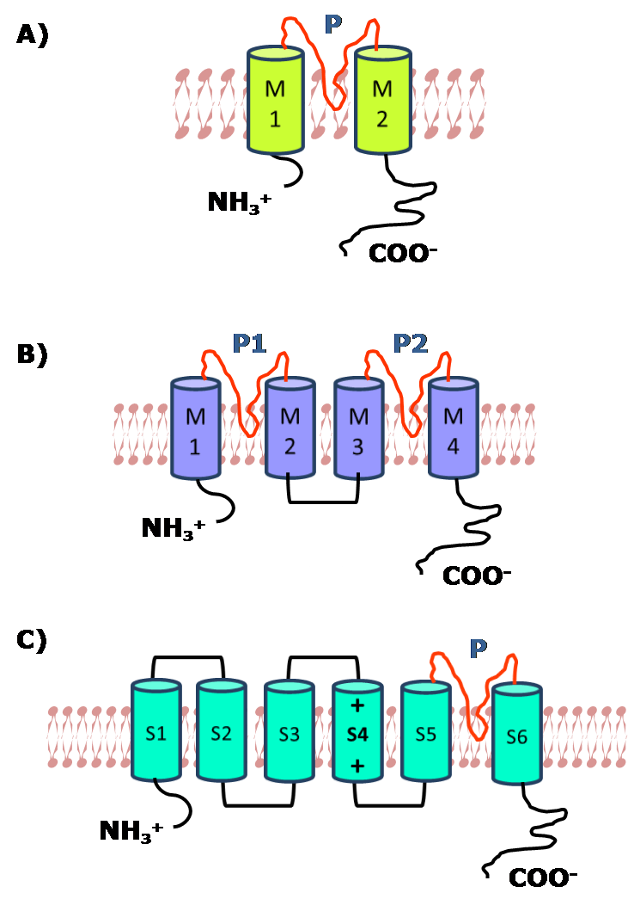
Introduction
Potassium Channels
Structure
Role
Shape action potentials
Resting membrane potentials
Diversity
Calcium activated Potassium Channels
Voltage-gated Potassium Channels
Twin pore Potassium Channels
Inwardly Rectifying Potassium Channels

Slide 3
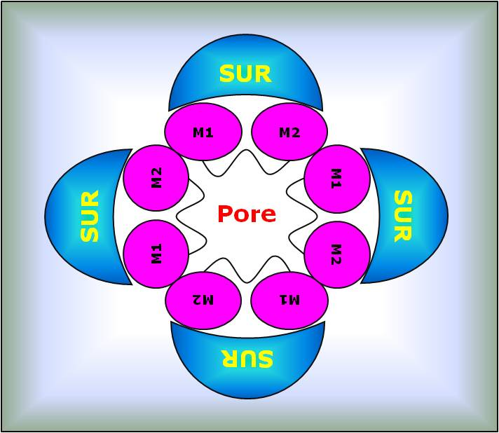
Hetero-Octameric Kir6₄/SUR₄ Complex
K_{ATP} channels are composed of:
  4 pore-forming Kir6.x: Kir6.1 or Kir6.2
  4 regulatory SUR: SUR1, SUR2A or SUR2B
Hussein N. Rubaiy, Acta pharmaceutica, Vol. 66 No. 1, 2016

Slide 4
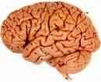
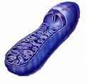
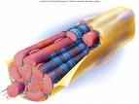
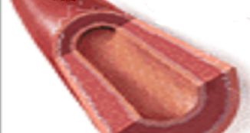
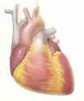
Why Understanding Allosteric Communications between
K_{ATP} Channels Subunits is so Important
Various Tissues / Cells
Brain/Nerve Cells
Kir6.2 + SUR1
Mitochondria
Kir6.1 + SUR1
Regulation of insulin
Pancreatic
β-Cells
Kir6.2 + SUR1
Kir6.1 + SUR2A
K_{ATP}
Channels
??
Skeletal Muscle
Kir6.2 + SUR2A
Vascular Smooth Muscle
Kir 6.1/6.2 + SUR2B
Cardiac
Kir6.2 + SUR2A
vascular tone regulation
Hussein N. Rubaiy, Acta pharmaceutica, Vol. 66 No. 1, 2016

Slide 5
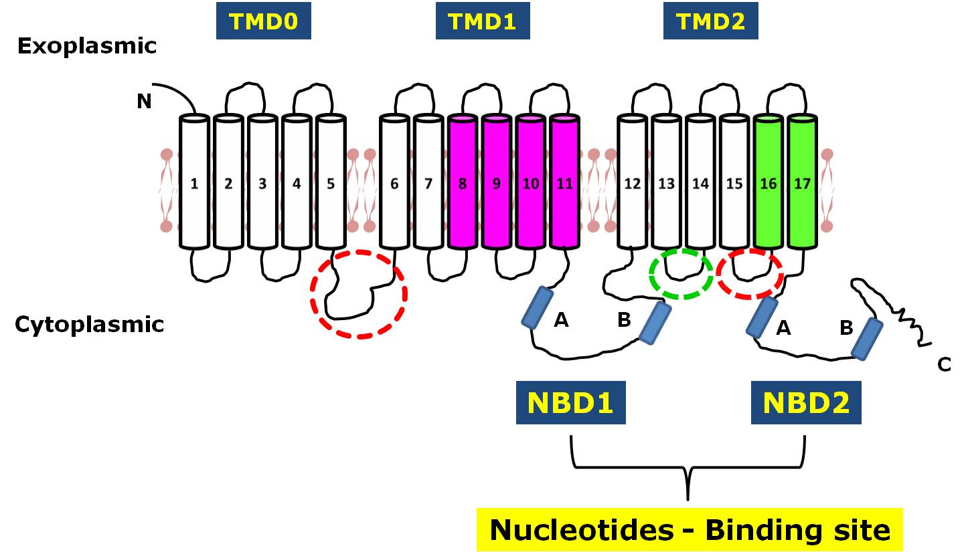
Sulphonylurea receptor
(SUR)
Inward rectifier
K⁺ channel (Kir6)
P
M1
M2
NH₃⁺
COO⁻
ATP - Binding
Cytoplasmic Interactions ???
Agonists
Green pinacidil and cromakalim
Pink diazoxide
Antagonists
Red sulphonylureas (glibenclamide)
Hussein N. Rubaiy, Acta pharmaceutica, Vol. 66 No. 1, 2016

Slide 6
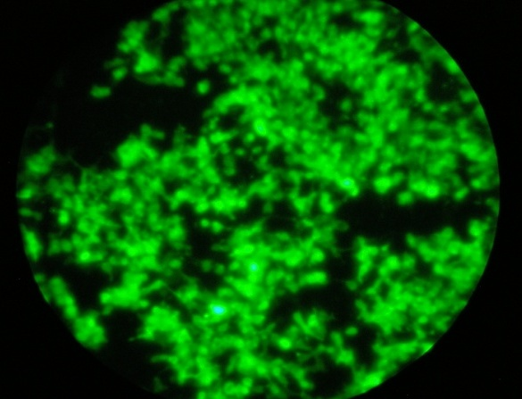
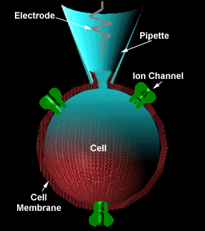
Electrophysiological Study
HEK293 Cells
EGFP
Transfection
Kir6.2 WT-EGFP / SUR2A WT
Patch Clamp Configurations
Notes:
Solution (Kir6.1)
Pipette solution (internal solution), pH 7.2:
1. 140 mM KCl
2. 2 mM MgCl2
3. 2.5 mM EGTA
4. 10 HEPES
5. 1 CaCl2
6. 1 mM K2ATP
7. 100 µM NaADP
8. 100 µM GTP
9. 10 mM UDP

Slide 7
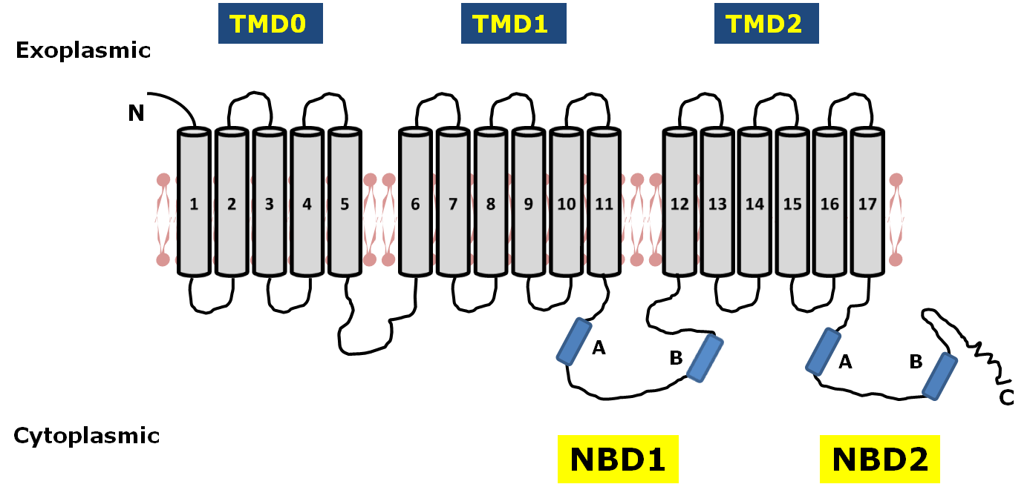
Sulphonylurea receptor (SUR)
rSUR2A-CTE
Minimal interacting fragment
65 amino acids
E1318, K1322 and Q1336
Rainbow et al., 2004, The Biochemical journal 379, 173-181

Slide 8
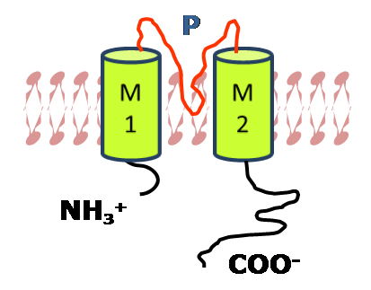
Previous Work
  Proximal C-terminal of SUR2A is a crucial link between ligand binding to SUR2A and Kir6.2 activation
Kir6.2
  Kir6.2/2.1 Chimaeras and rSUR2A-CTC (C6);
  Interaction domain on Kir6.2 is located within
  the 75 amino acids of the C-terminal tail beyond residue 315
Dupuis, J.P., 2008, The Journal of physiology 586, 3075-3085

Slide 9
Identification of Critical Conserved Residues for Co-ip
D323K
K338E
RKR369-371AAA
K377A
M1
M2
Kir6.2
(315-390 aa)
N
C
Kir6.2 QDLEIIVILEGVVETTGITTQARTSYLADEILWGQRFVPIVAEEDGRYSVDYSKFGNTVK 338
Kir6.1 QDLEVIVILEGVVETTGITTQARTSYIAEEIQWGHRFVSIVTEEEGVYSVDYSKFGNTVR 347
Kir2.1 ADFEIVVILEGMVEATAMTTQCRSSYLANEILWGHRYEPVLFEEKHCYKVDYSRFHKTYE 349
 Δ36
Kir6.2 VP-TPLCTARQLDEDRSLLDALTLAS---SRGPLRKR--------------------SVA 374
Kir6.1 VA-APRCSARELDEKPSILIQTLQKSELSHQNSLRKRNSMRRNNSMRRSNSIRRNNSSLM 406
Kir2.1 VPNTPLCSARDLAEKKYILSNANSFCYENEVALTSKEEEDSENGVPESTSTDSPPGIDLH 409
Kir6.2 VAKAKPKFSISPDSLS-- 390
Kir6.1 VPKVQFMTPEGNQCPSES 424
Kir2.1 NQASVPLEPRPLRRESEI 427
Δ36 Tucker et al, 1997, Nature 387: 179-183

Slide 10
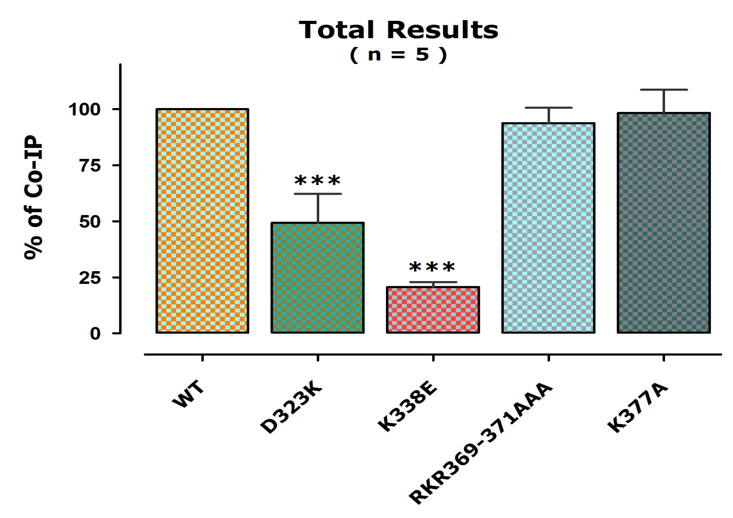
Identification of Kir6.2 D323 and K338 as Residues Involved in Interaction with MBP-rSUR2A-CT-C

Slide 11
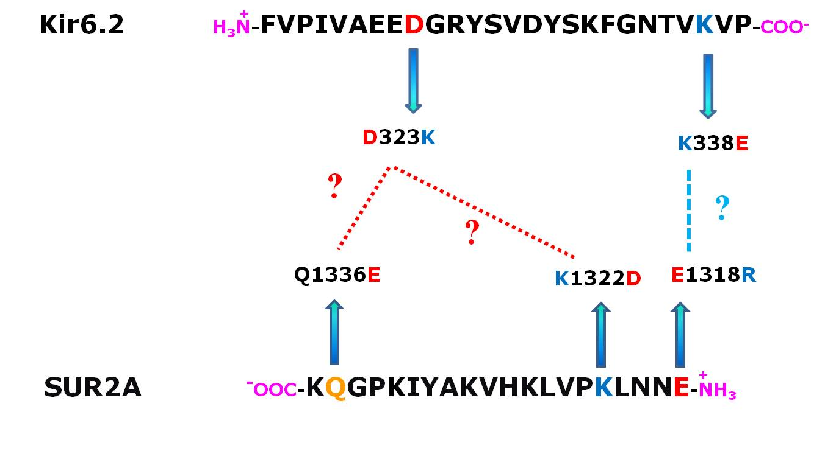
Do the Swap Mutants of Kir6.2 and SUR2A Restore the Interaction and the Function?

Slide 12
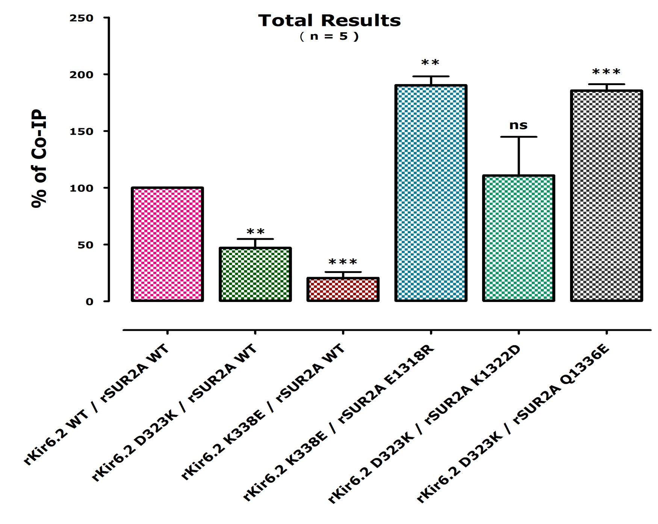
ns ; not significant
** P ; very significant
*** P ; extremely significant

Slide 13
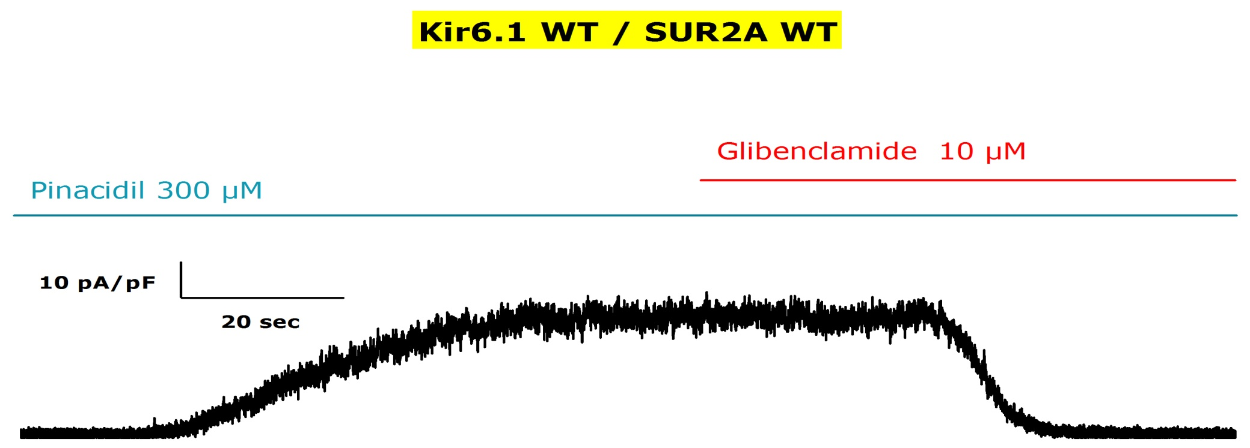
Are Kir6.1 E332 and R347 Involved in Allosteric Communications?
Kir6.2 QDLEIIVILEGVVETTGITTQARTSYLADEILWGQRFVPIVAEEDGRYSVDYSKFGNTVK 338
Kir6.1 QDLEVIVILEGVVETTGITTQARTSYIAEEIQWGHRFVSIVTEEEGVYSVDYSKFGNTVR 347
Kir 6.1 E332K
Kir 6.1 R347E

Slide 14
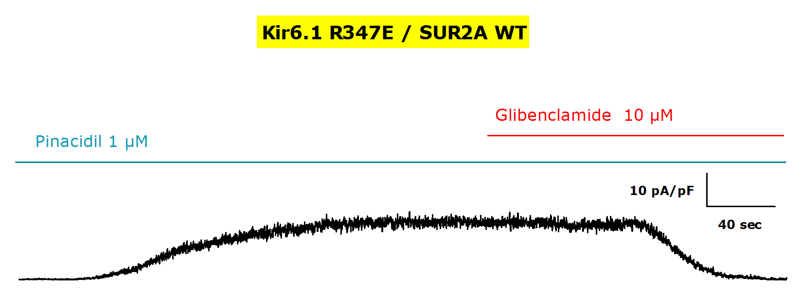
Pharmacological Response and Functional Characterization
of Kir6.1 R347
Kir6.2 QDLEIIVILEGVVETTGITTQARTSYLADEILWGQRFVPIVAEEDGRYSVDYSKFGNTVK 338
Kir6.1 QDLEVIVILEGVVETTGITTQARTSYIAEEIQWGHRFVSIVTEEEGVYSVDYSKFGNTVR 347

Slide 15
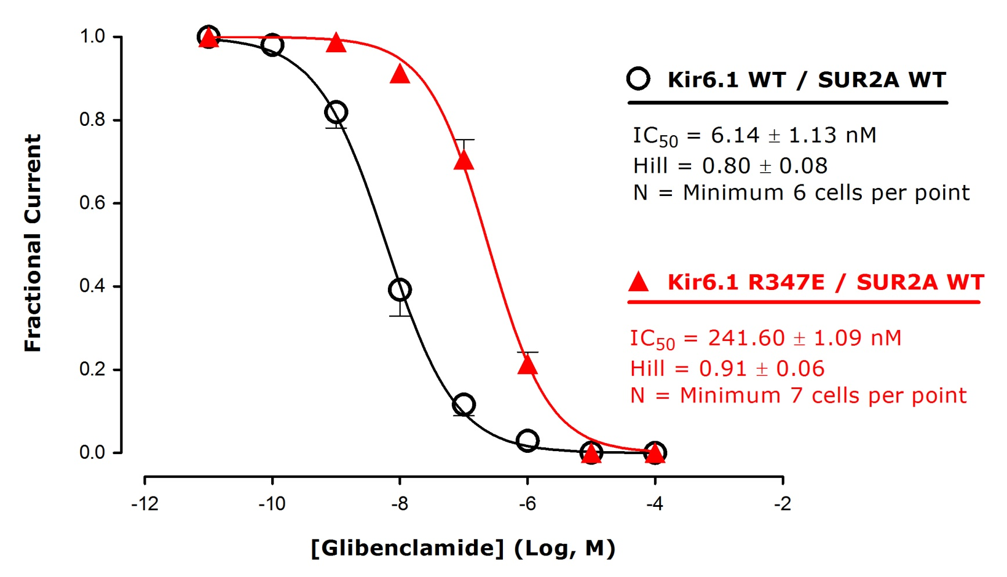
Kir6.1 R347E Mutant Disrupt the Function

Slide 16
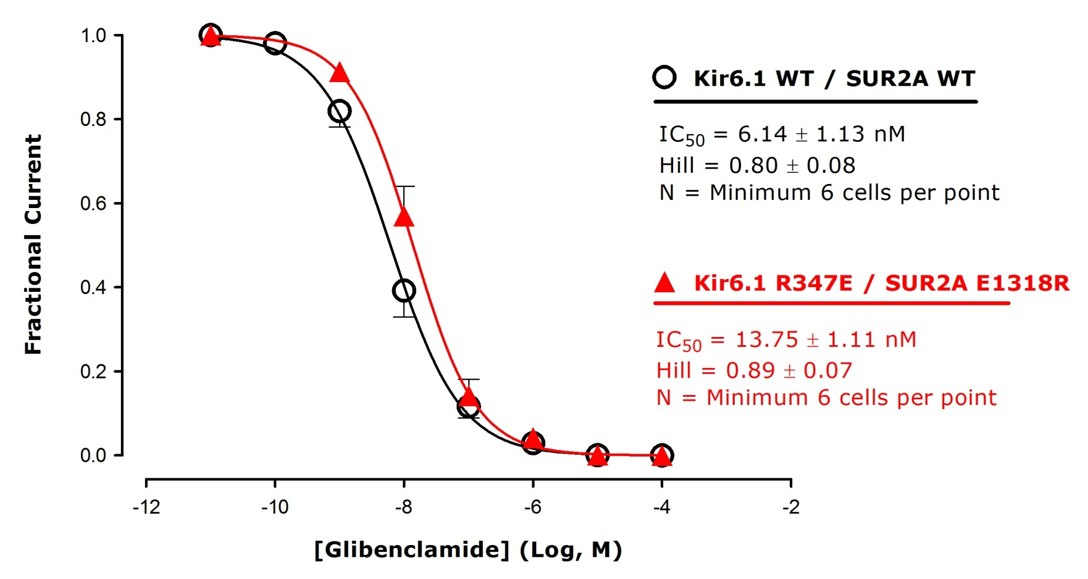
Inter-subunit Salt Bridge Communicate
Glibenclamide Sensitivity

Slide 17
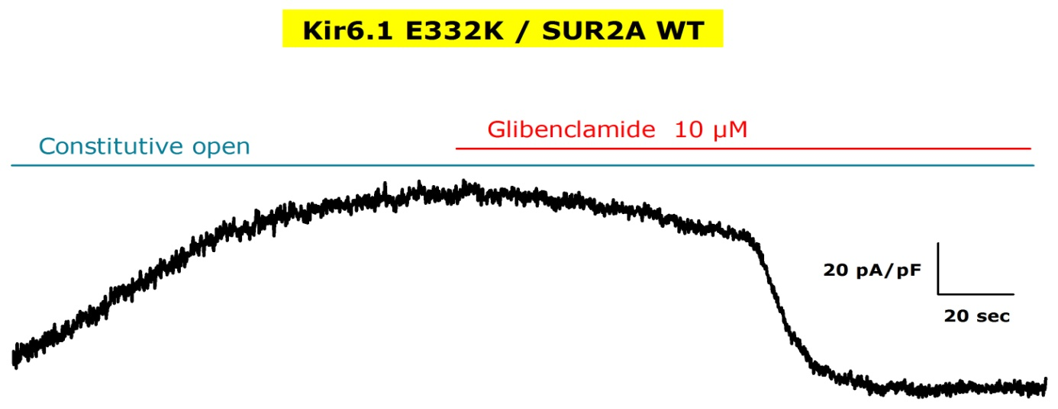
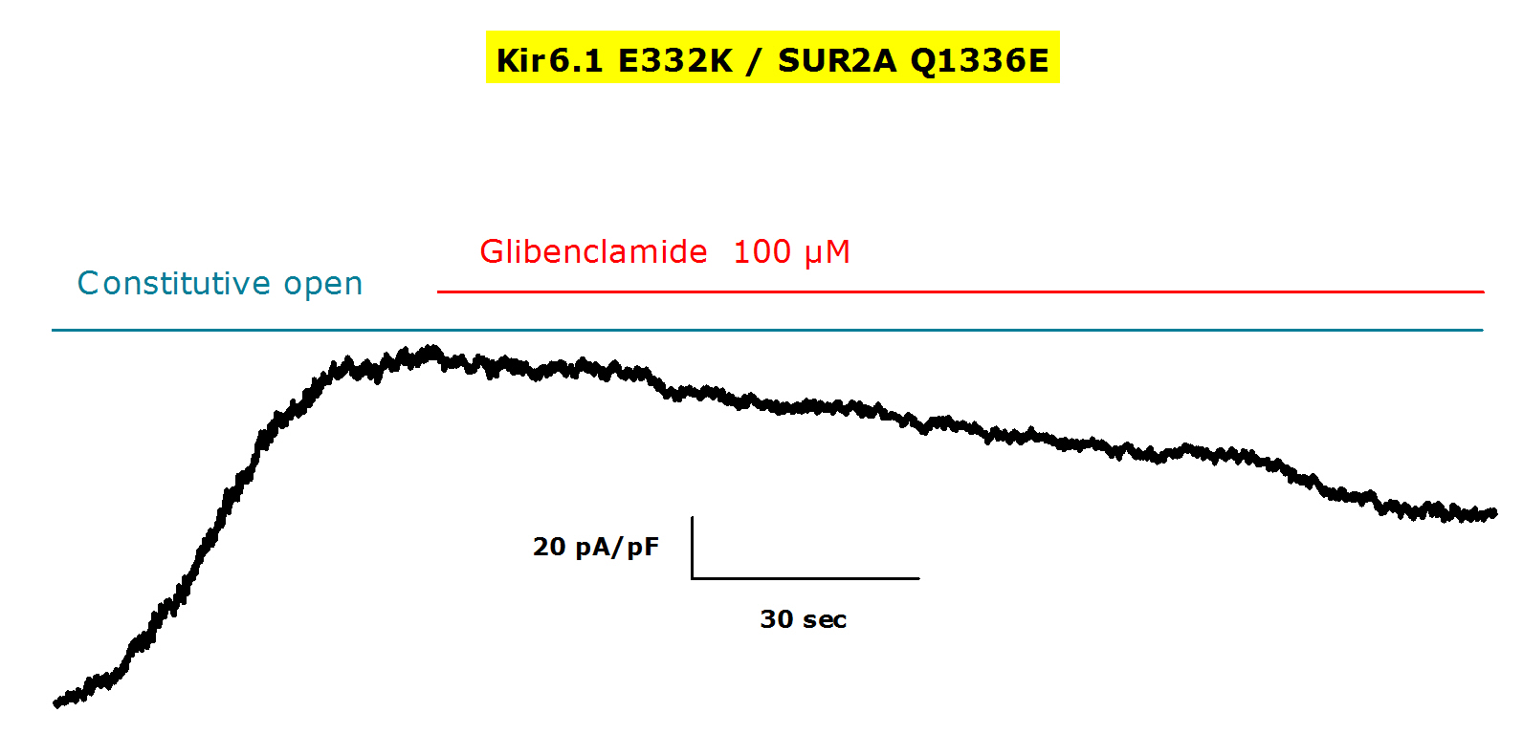
Kir6.1 E332K Mutant Disrupt the Function Causing Constitutive Open Channel

Slide 18
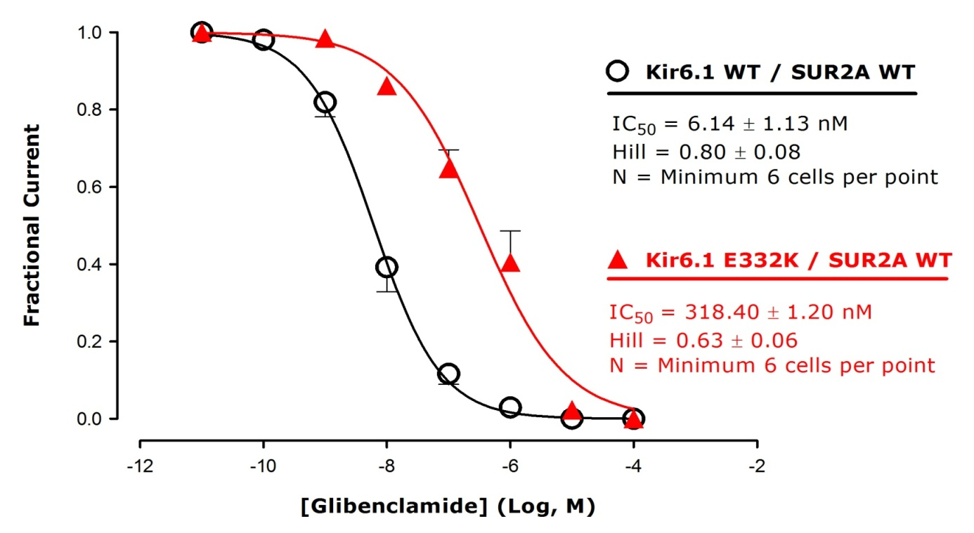
Kir6.1 E332K Mutant Disrupt the Function

Slide 19
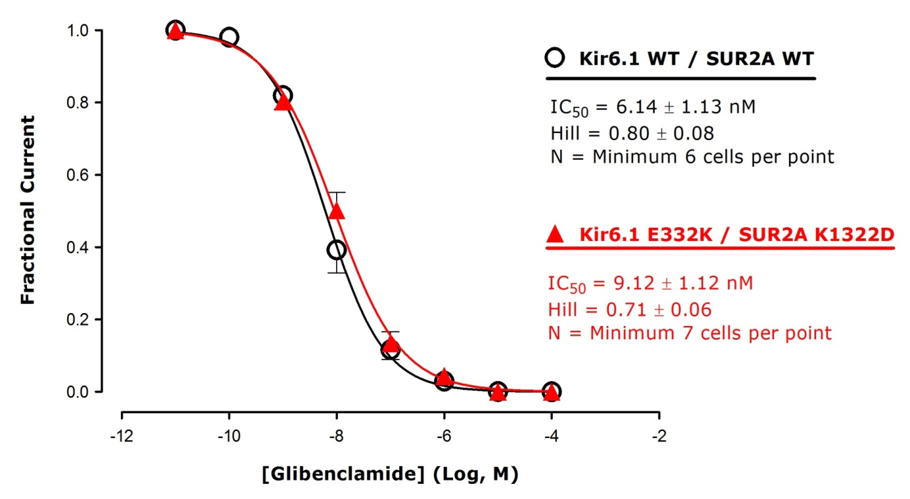
Inter-subunit Salt Bridge Communicate
Glibenclamide Sensitivity

Slide 20
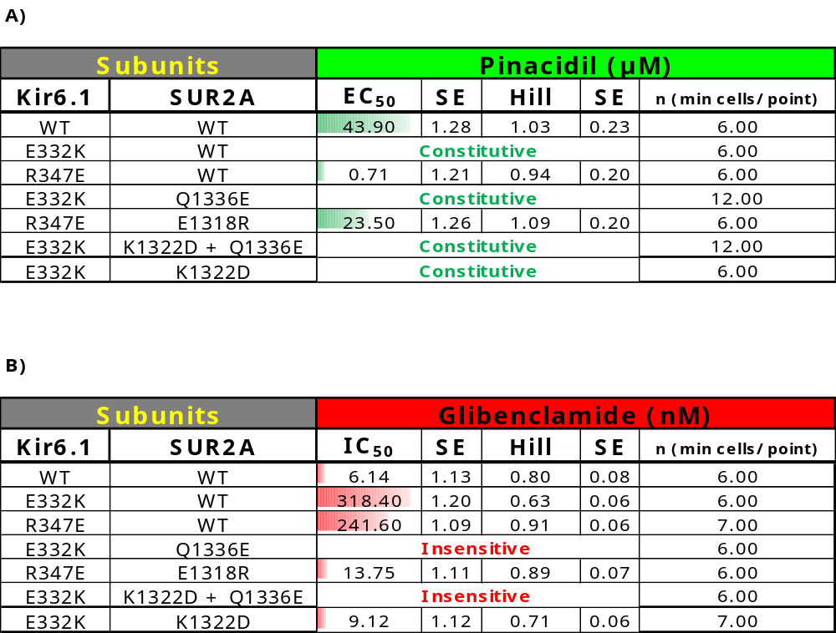
Pharmacological Response and Functional Characterization
of Kir6.1 / SUR2A

Slide 21
Conclusion
Evidence for the transmission of
allosteric information via
salt bridges (electrostatic interactions)
between the cytoplasmic NBD-2 of SUR2A and
the distal C-terminus of Kir6

Slide 22

Acknowledgements
Cardiovascular Sciences (Leicester)
Dr Bob Norman
Dr Dave Lodwick
Dr Richard D. Rainbow
T H Wathes

