Slide 1
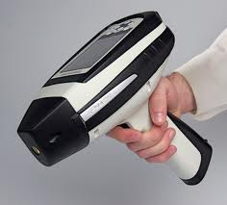
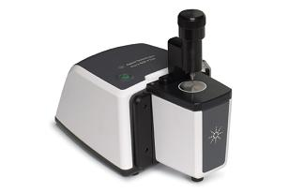
Acrylamide in foods: A review and recent updates
Huseyin Ayvaz
Canakkale Onsekiz Mart University, Department of Food Engineering, Canakkale 17100, Turkey

Slide 2
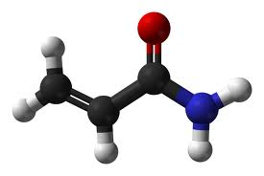
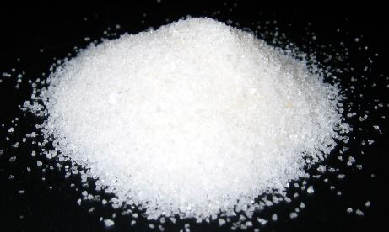
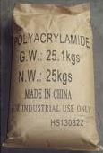
What is acrylamide?
CH₂=CH-CO-NH₂ (2-propenamide)
White and odorless flake-like crystalline substance
Highly soluble in water (2155 g/l in water at 30 °C)
Low molecular weight (71.08 g/mol) and low volatility
Commercially produced from the acrylonitrile
A monomer used for the production of polyacrylamide
for several industries since 1950`s

Slide 3
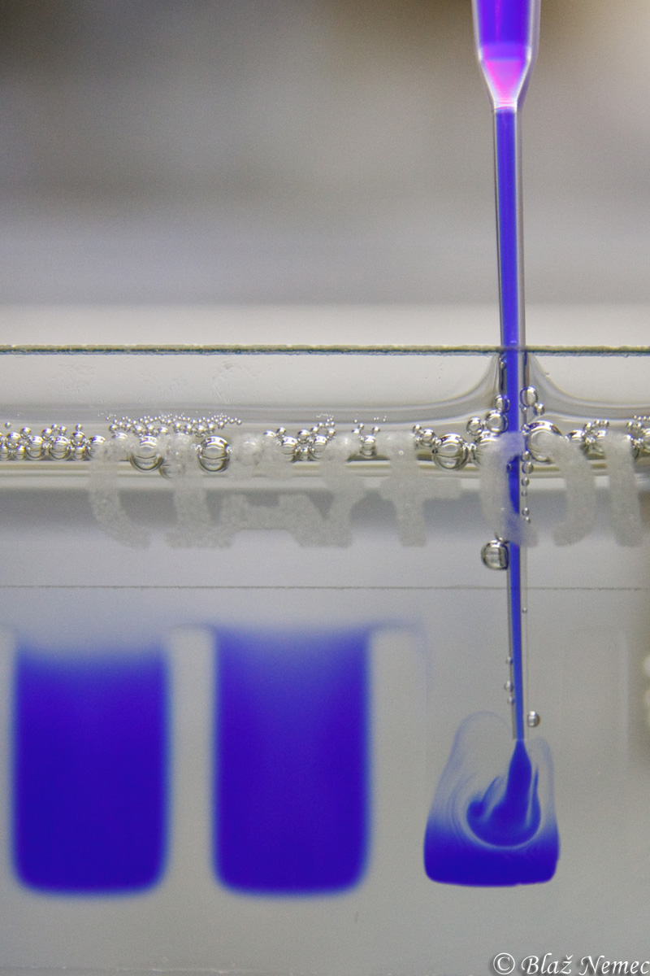
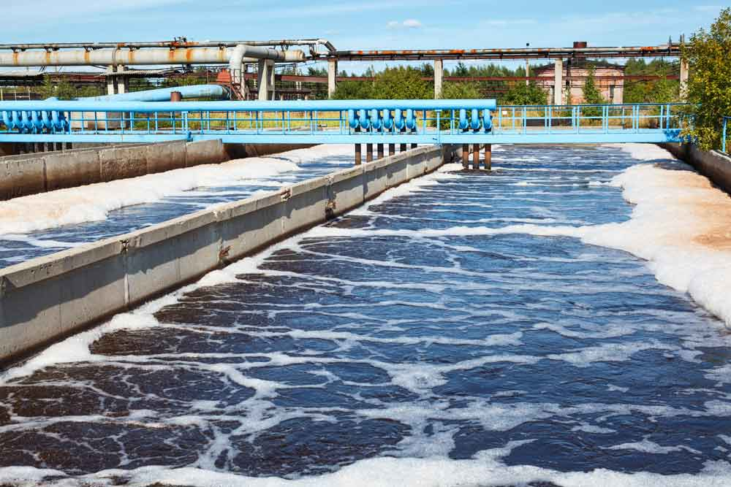
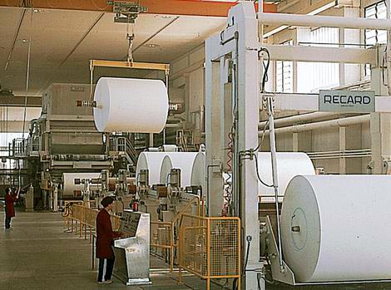
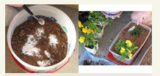

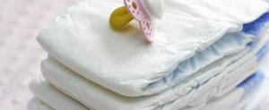
Applications?
Production of polyacrylamide gels
Treatment of waste water
Papermaking
Soil conditioning
Filler in cosmetics
Superabsorbent in disposable diapers
Grouting agent in constructions

Slide 4
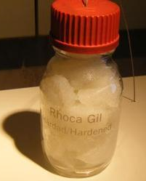
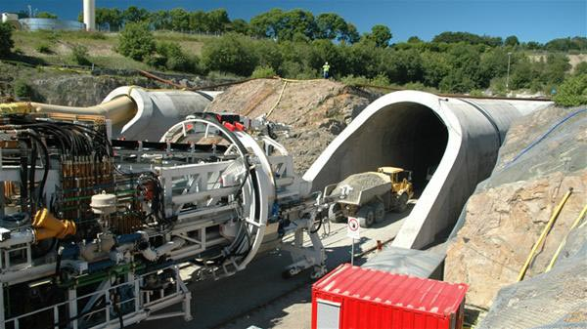
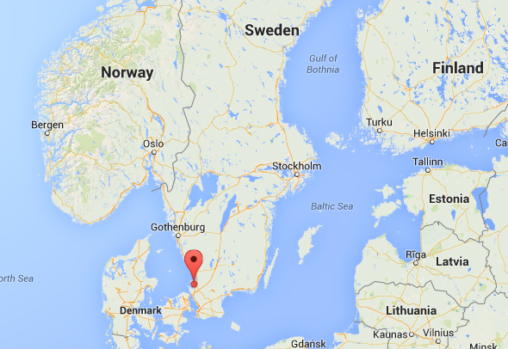
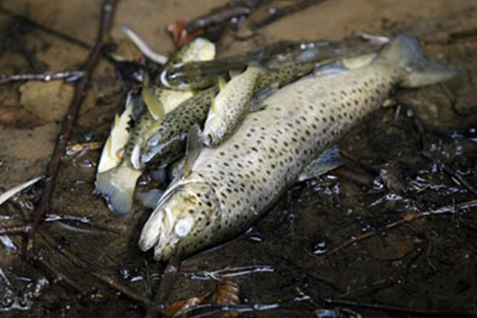
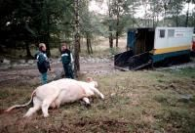
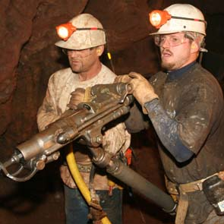
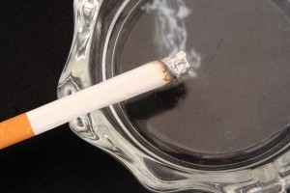

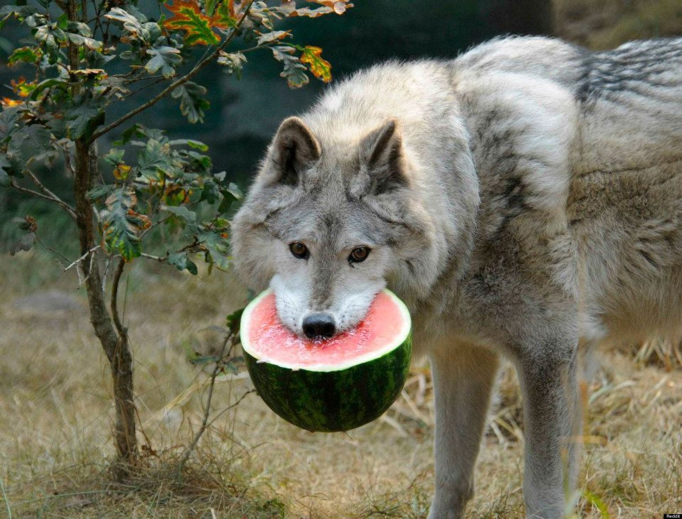
How did acrylamide become a concern in foods?
Then, a large leak of this sealant into the streams and ground water occurred
Acrylamide was also detected in the blood of a subject group of non-smokers, who did not get exposed to the leakage

Slide 5
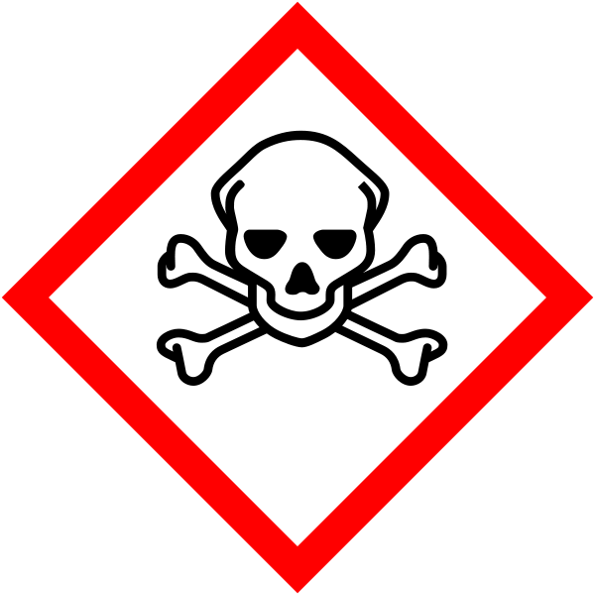

Why is acrylamide a concern?
Moderate levels (5-50 µg/kg) in heated carbohydrate and high levels (150-4000 µg/kg) in protein rich foods (Tareke and others, 2002)
Shown to cause cancer in laboratory animals (LD₅₀ values are in the range of 107-203 mg/kg bw in rats) (Animal carcinogen)
Human neurotoxin; Classified as “probably carcinogenic to human” (IARC, 1994)
It has the ability to be absorbed by the skin, inhaled by mucosa or by ingestion through the oral route
Acrylamide is metabolized to glycidamide in the liver
and becomes more reactive towards DNA and proteins

Slide 6
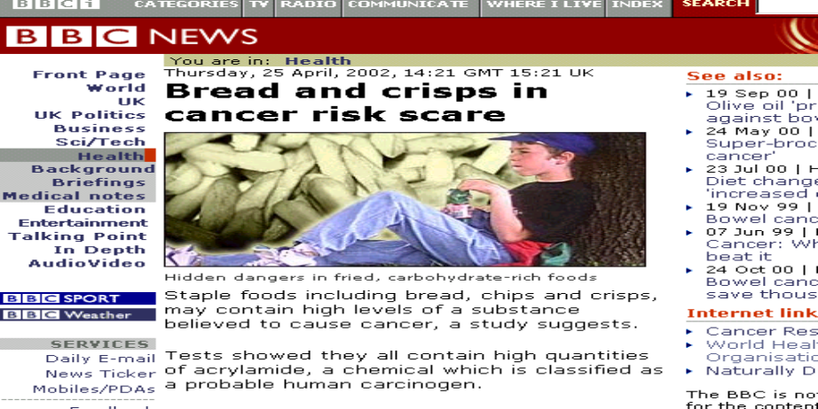
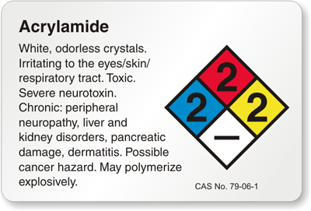
Up to 50 % of the acrylamide can be transferred to fetus
Immediate reaction from governments worldwide, as well as intense media coverage
The Joint FAO/WHO Expert Committee on Food Additives (JECFA) in 2005 concluded that the levels of acrylamide in food were of concern, given the carcinogenicity rates seen in rodents (FAO/WHO, 2005)
Found in industrially processed food, home-prepared food, and in foods prepared in food-service/restaurant operations

Slide 7
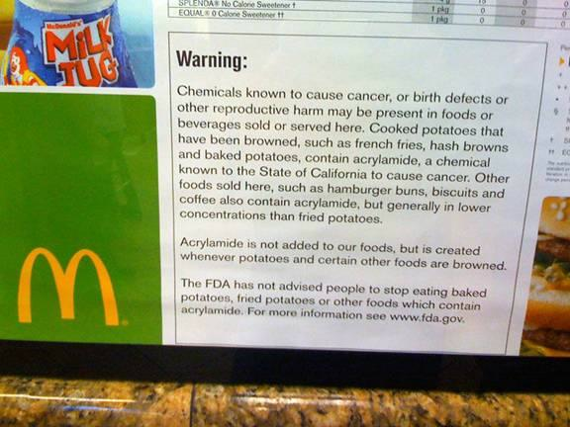
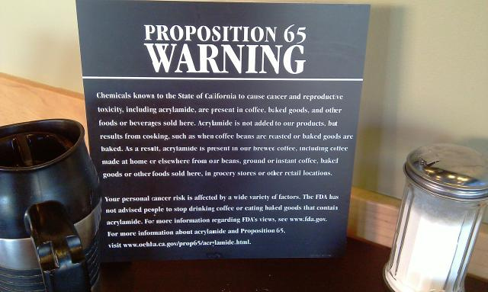

Appeared on the FDA Center for Food Safety and Applied Nutrition (CFSAN) Program Priority list
Added to the list of substances of very high concern by The European Chemical Agency (ECHA) in March, 2010 (ECHA, 2010)
It has been included in California’s Proposition 65 list of chemicals (California OEHHA, 2011) (275 ppb)

Slide 8
Some chemicals formed in heated foods
(Modified from Robin, 2007)
Contaminant | Source of foods | Mean intake (µg/day)
Acrylamide | Heated potato and cereal products (e.g., French fries, potato chips, cookies, crackers), coffee | 21-60
Furan | Canned soups, stews, and sauces; jarred baby foods; coffee | 15
Heterocyclic amines | Cooked meat or fish | ≤ 1
3-monochloro-propane-1,2-diol | Acid-hydrolyzed vegetable protein, soy sauce and related sauces, heated cereal products (e.g., cookies, crackers) | 3.5-25
N-nitroso compounds | Meats cured with sodium nitrite or nitrate | ≤ 1
Polycyclic aromatic hydrocarbons | Grilled and smoked foods, vegetable oils and also fruits, vegetables, and mollusks, through environmental deposition | 2-3
Urethane | Fermented foods and beverages | 1-4

Slide 9
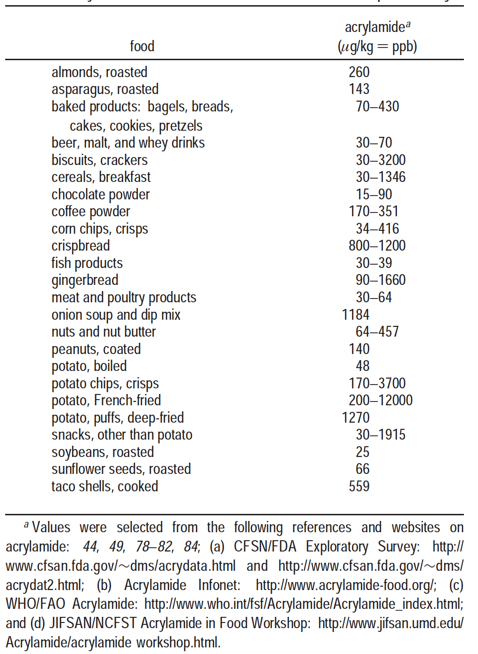
What foods contain acrylamide?
(Mendel and others, 2003)

Slide 10
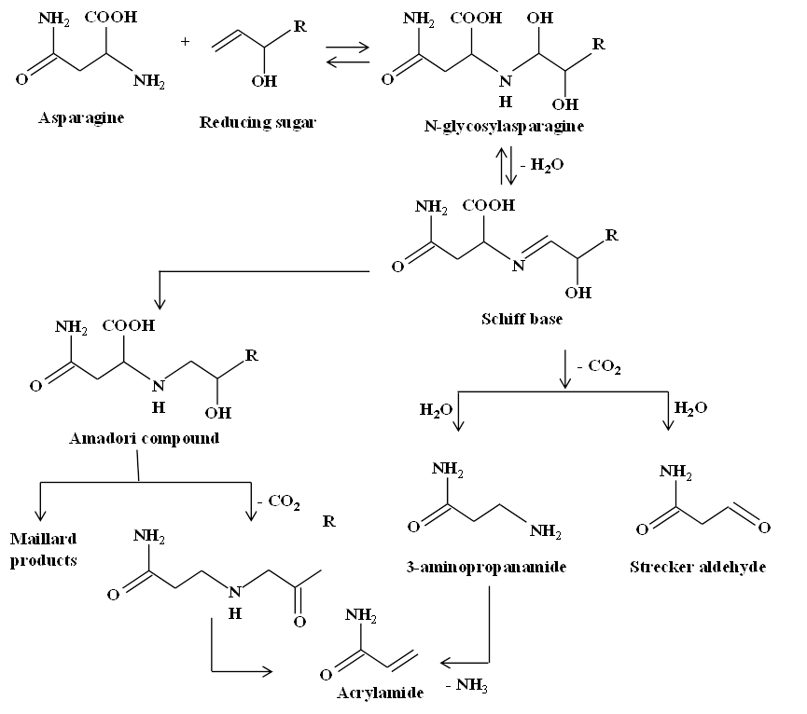
How is acrylamide formed in foods?
(modified from Zyzak and others, 2003)

Slide 11
H₂N
N
C – CH₂ – CH
Maillard Products
O
E_{A}~25 - 50 kcal/mole
COOH
- CO₂
H₂N
H₂N
N
C – CH = CH₂
C – CH₂ – CH₂
Beta-elimination
O
O
E_{A} ~70 kcal/mole
Notes:
By now we all know that this is the reaction we are dealing with. Although it has been suggested that other pathways are theoretically possible, no data to support this.
It seems likely that this reaction is a part of, or off-shoot of the Maillard reaction.
This is a proposed reaction pathway from Mottram.

Slide 12
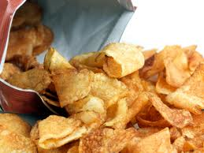
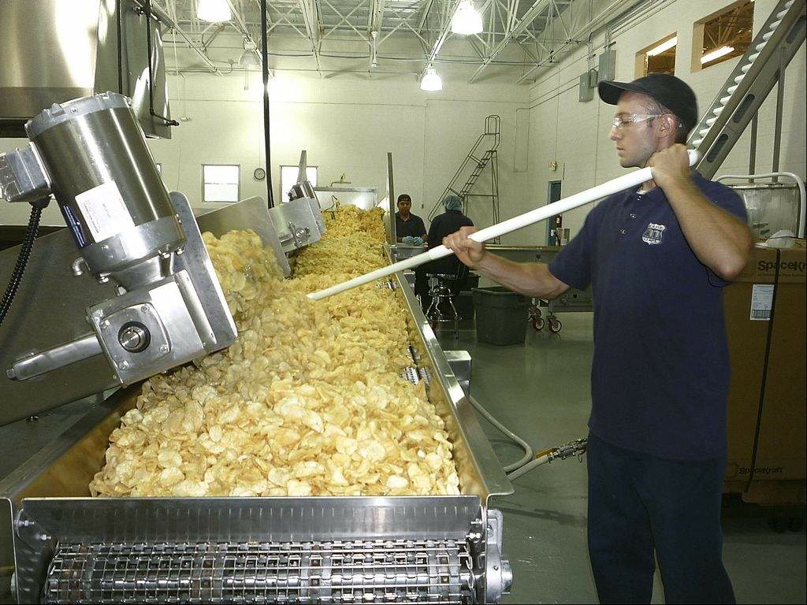
Asparagine is found at higher levels than reducing
sugars in regular potatoes (as opposed to sweet
potatoes, cereals and coffee)
Sucrose can go through decomposition under
the frying and baking conditions
Several factors includes the level of precursors and therefore the concentration of acrylamide upon heating;
    variety
    storage temperature and time
    the conditions of the soil
The level of reducing sugars changes more
among different varieties and during the storage

Slide 13
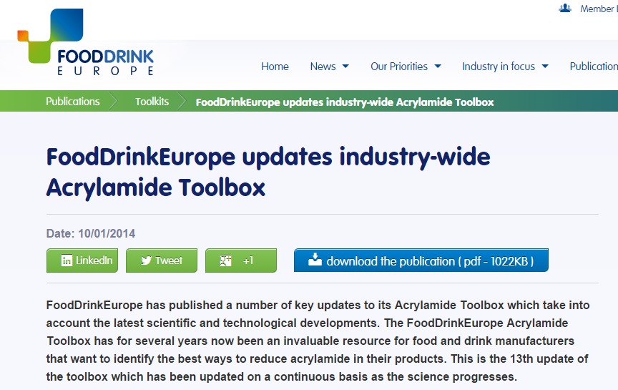
Some mitigating strategies
“ALARA” As Low As Reasonably Achievable”
Variety selection
Maturity
Asparaginase treatment
Blanching / Soaking
Storage
Irradiation
Lowering the pH
Treatment with cations
Antioxidant addition
Addition of amino acids and vitamins
Thermal input
Slicing
Removing already formed acrylamide from the foods

Slide 14
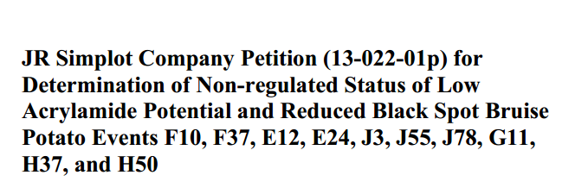
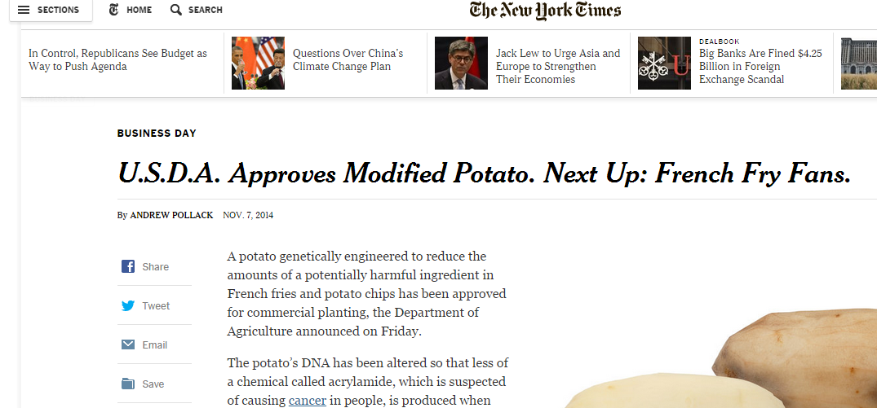
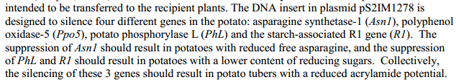
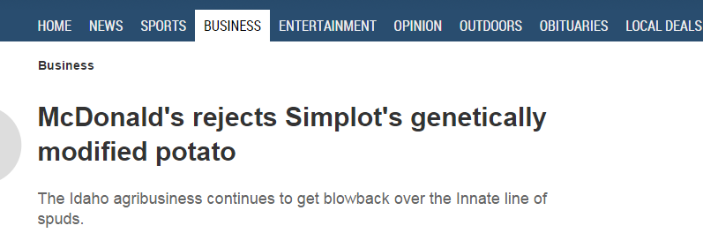
Recent news

Slide 15
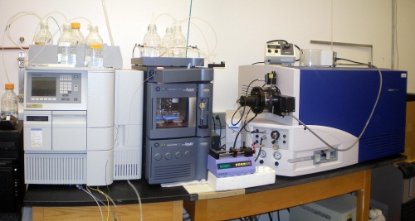
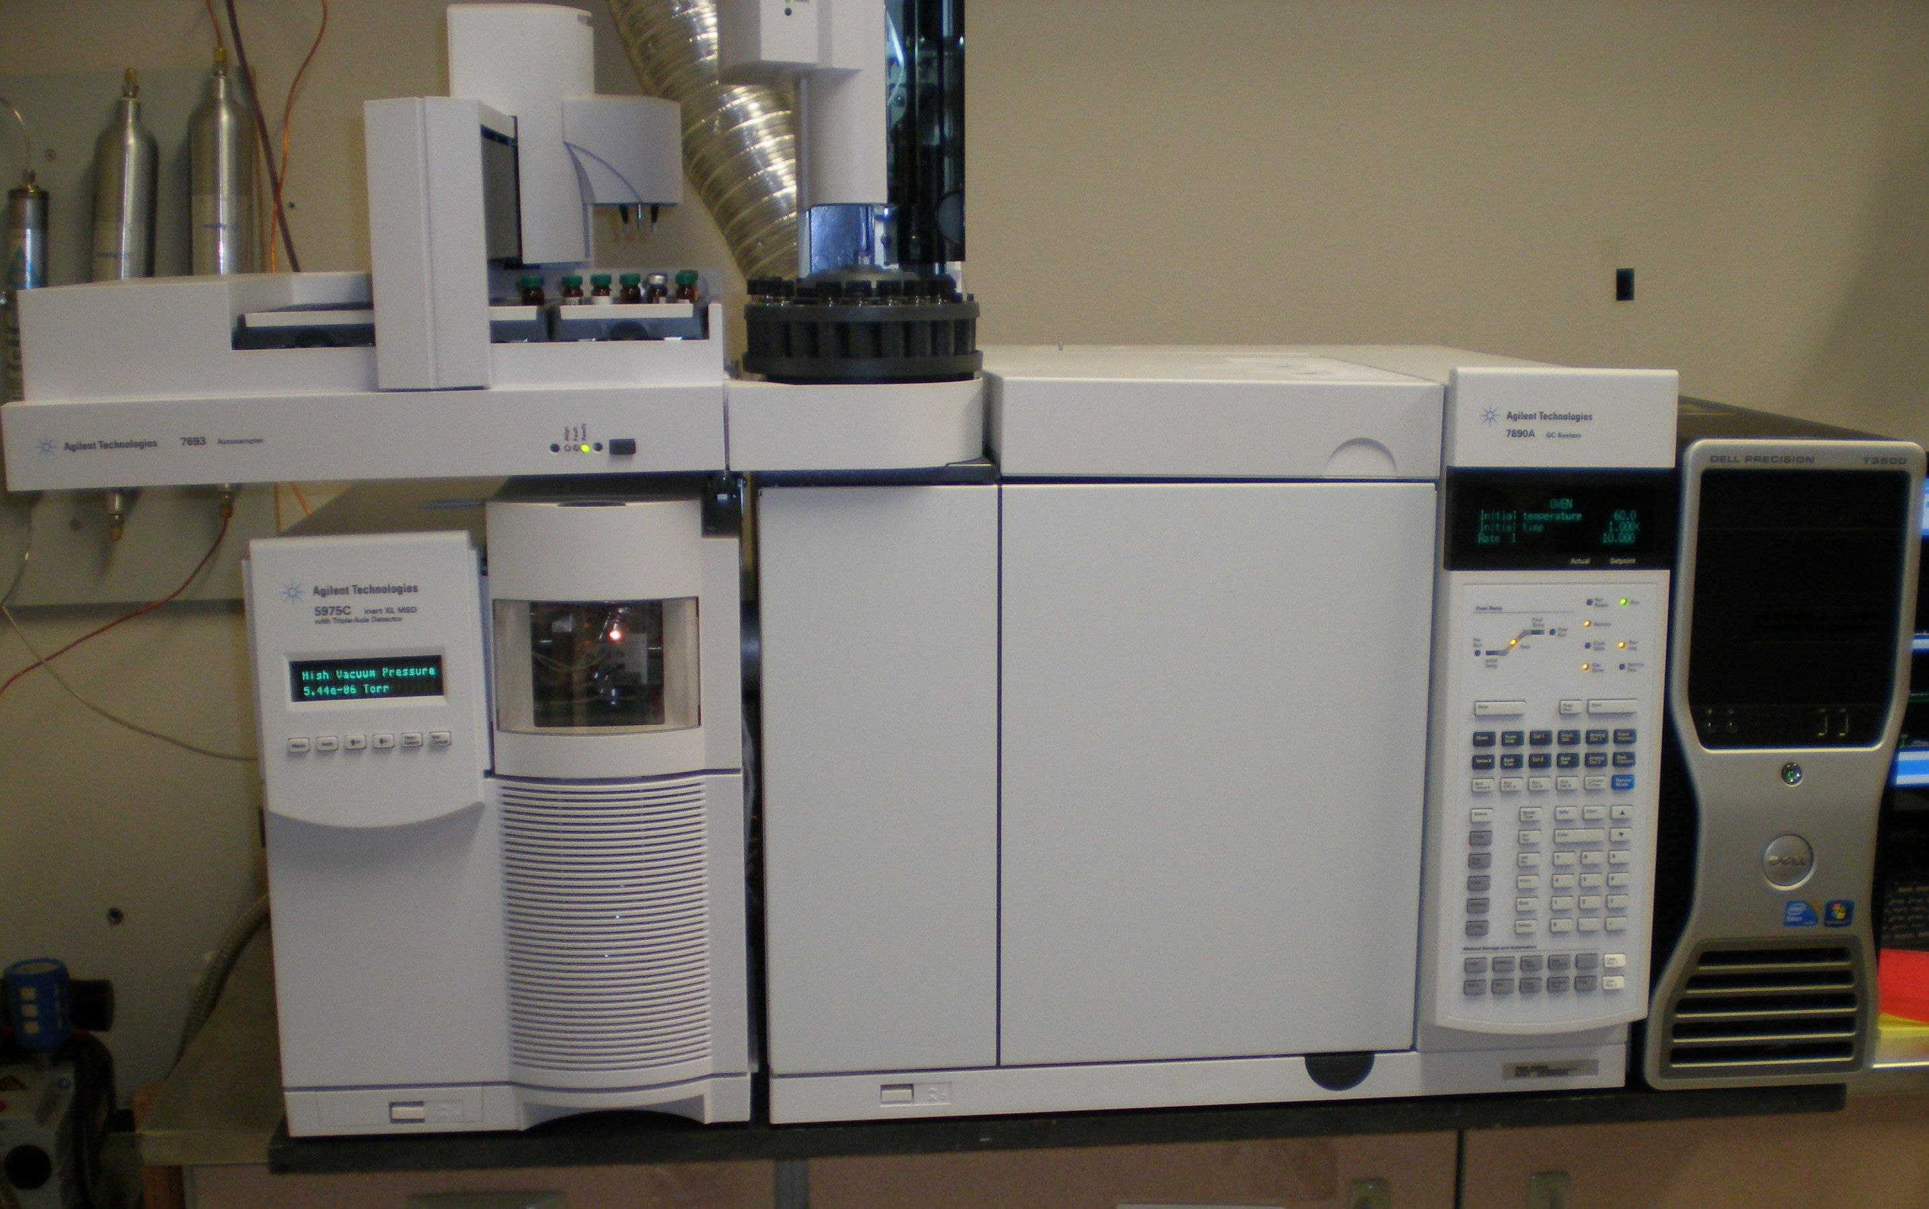
The most common analytical methods
Current assays to identify and quantitate acrylamide in foods rely on
- LC-MS/MS
- GC-MS
ADVANTAGES | DISADVANTAGES
Excellent analytical performance | Extraction and SPE cleanup steps required
Very low detection limits (10-20 ppb) | Derivitization required for GC-MS
 | Highly specialized instrumentation needed
 | Expensive and time consuming
 | Well-trained technician to operate

Slide 16
Scheme for Acrylamide Analysis
Representative sampling
Homogenization
Internal standard
Extraction
Fat removal by cold centrifugation
Extract cleanup
Derivitization
Detection

Slide 17
Rapid methods
Color analysis
Computer vision
Capillary electrophoresis
Enzyme-linked immunosorbent assay
Fluorescent sensing methods
Electrochemical biosensor
Infrared spectroscopy

Slide 18
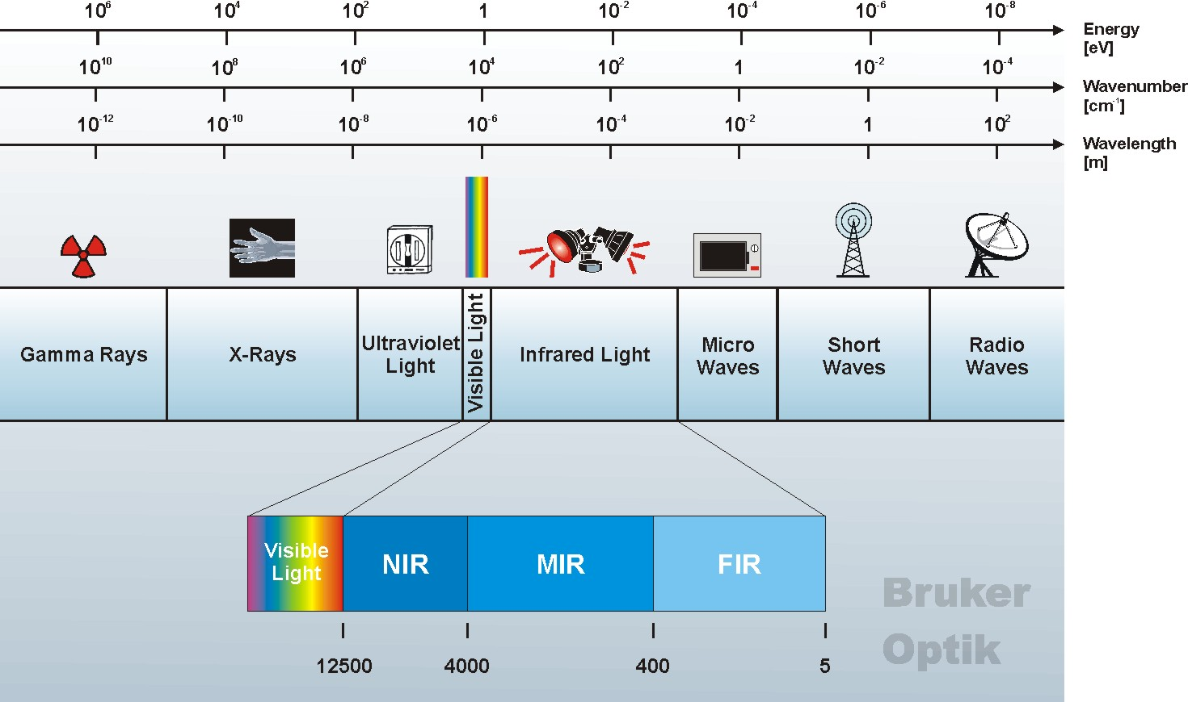
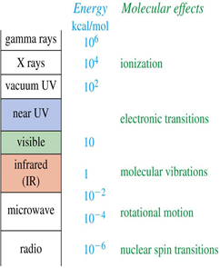
Infrared Spectroscopy
Monitors the absorbance of infrared light by functional groups in the sample
Provide a chemical fingerprint (spectrum) of the sample

Slide 19
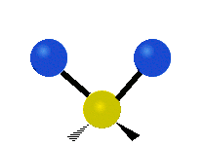
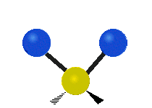



Energy levels in Infrared Absorption
sym stretching
asym stretching
scissoring
rocking
twisting
wagging
Excited states
hν
Infrared Absorption and Emission
ν₃
h(ν₂ - ν₁) (overtone)
ν₂
h(ν₁ - ν₀ )
h(ν₁ - ν₀)
Ground (vibrational) states
ν₁
If the frequency of the radiation matches the natural frequency of the vibration (or rotation), the IR photon is absorbed

Slide 20
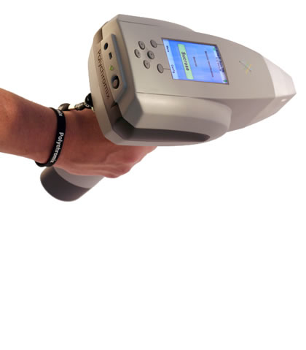
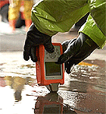
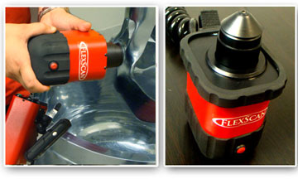
Handheld and Portable Systems

Slide 21

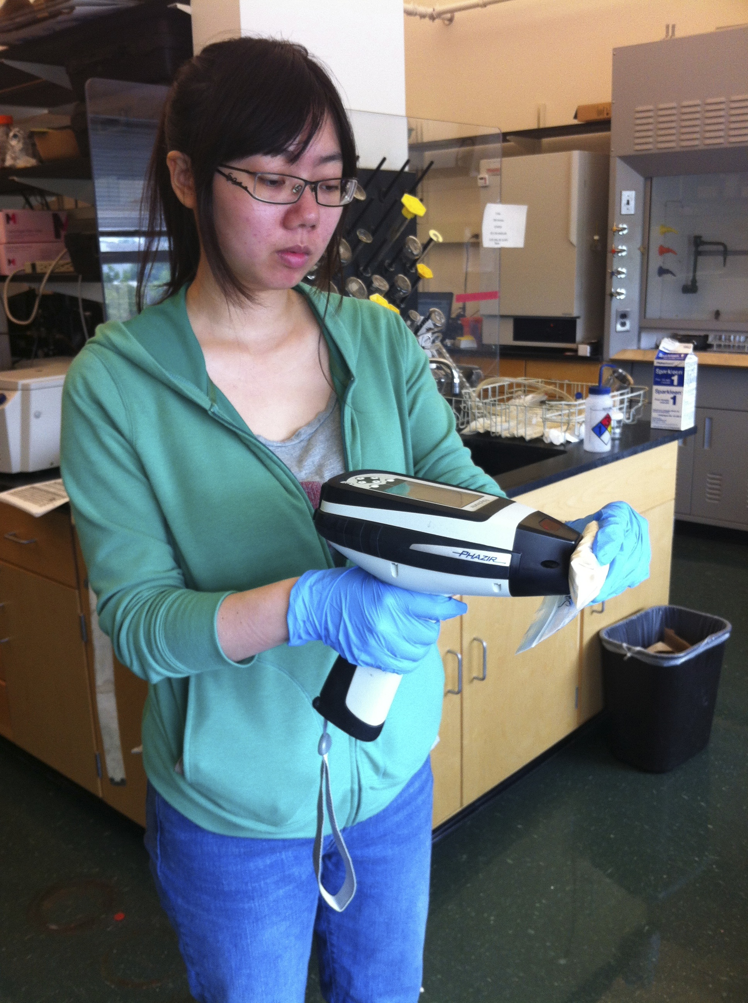
Is the Star Trek famous handheld “Tricorder,” capable of instantaneous, accurate, and sensitive materials analysis a reality?????

Slide 22
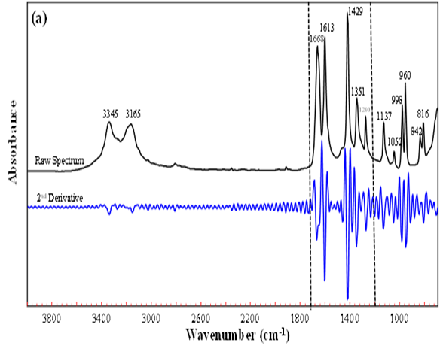
Pure acrylamide (>99 %)
* v: stretching, v_{a} and v_{s}: asymmetric and symmetric stretching, δ: in plane bending, γ: rocking, w: wagging
*Band assignments were done according to Jonathan, 1961
Band Position (cm⁻¹) |  | Assignments
3345 | v_{a} (NH₂)
3165 | v_{s}(NH₂)
1668 | v (C=C)
1613 | δ (NH₂)
1429 | δ (CH₂)
1351 | δ (CH)
1280 | v (C-N)
1137 | γ (NH₂)
1052 | γ (CH₂)
998 | v (C-C)
960 | w (CH₂=C)
842 | w (NH₂)
816 | w (HRC=C)

Slide 23
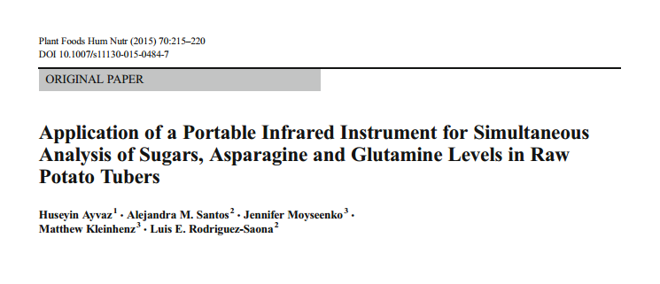
Project 1
To develop simple and robust methods for simultaneous quantification of sugars (glucose, fructose and sucrose), free asparagine and glutamine levels in raw potatoes using a portable FTIR system equipped with dial path and ATR accessories

Slide 24
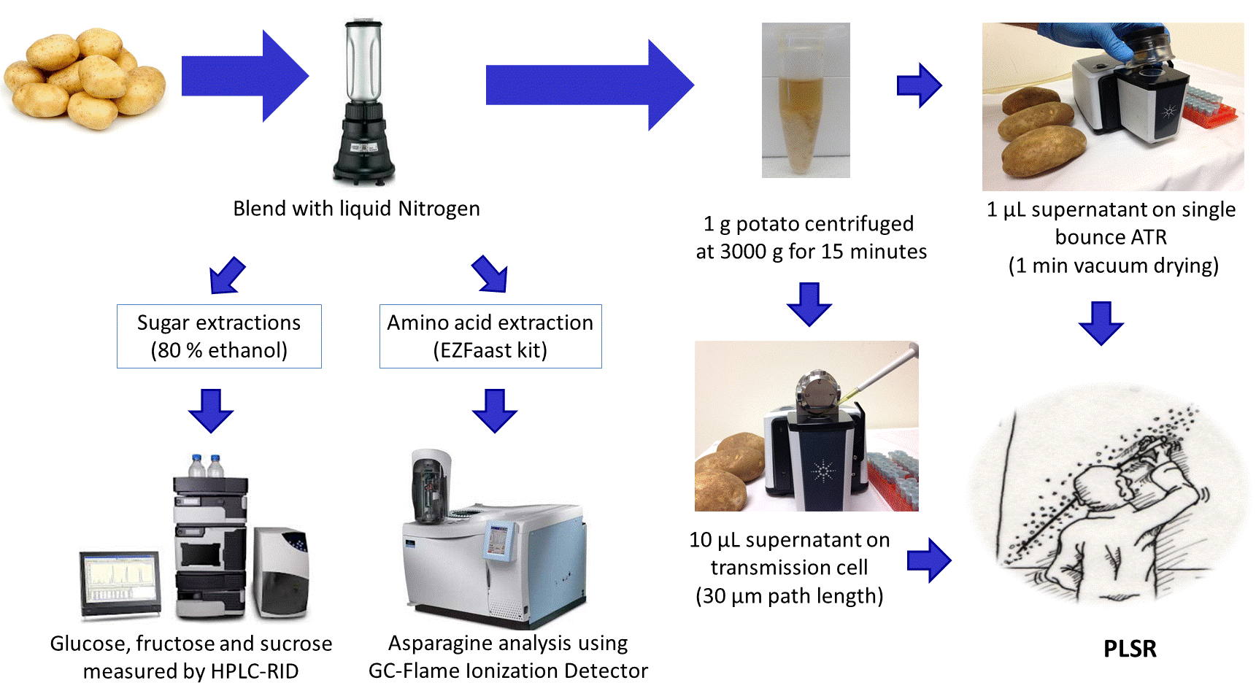
Materials and methods
84 varieties

Slide 25
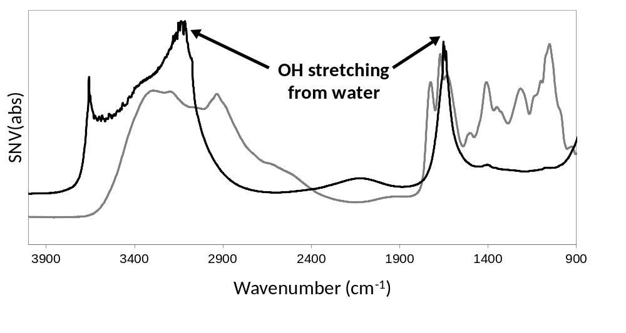
Average of all spectra collected using dial path (black line) and ATR (gray line) accessories of the portable Cary 630 IR system

Slide 26
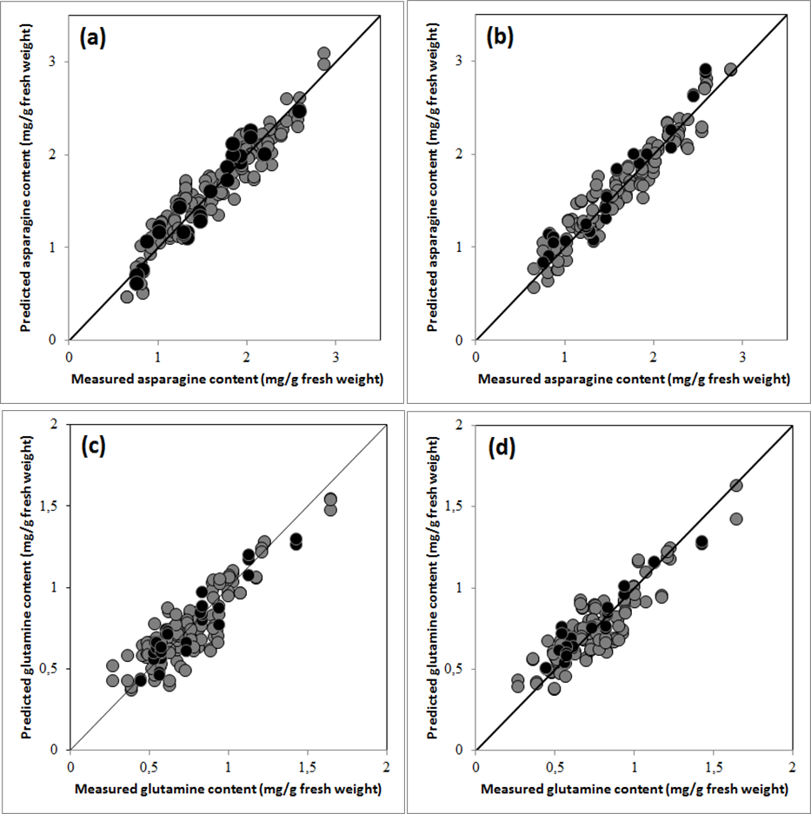
PLSR models for aminoacids using Cary 630 with validation group
Analyte | Conc. range | Accessory | Region (cm⁻¹) | Factor | SECV | SEP | rCV | rPred | RPD
Asparagine (mg/g fresh weight) | 0.7-2.9 | ATR | 1299 - 1800 | 5 | 0.17 | 0.15 | 0.95 | 0.95 | 3.4
 |  | Dial Path | 1166 - 1500 | 5 | 0.15 | 0.16 | 0.96 | 0.97 | 3.4
Glutamine (mg/g fresh weight) | 0.3-1.7 | ATR | 1299 - 1800 | 5 | 0.12 | 0.09 | 0.88 | 0.95 | 3.1
 |  | Dial Path | 1166 - 1500 | 5 | 0.11 | 0.08 | 0.86 | 0.96 | 3.4
Asparagine ATR
Asparagine Dial path
Glutamine ATR
Glutamine Dial path

Slide 27
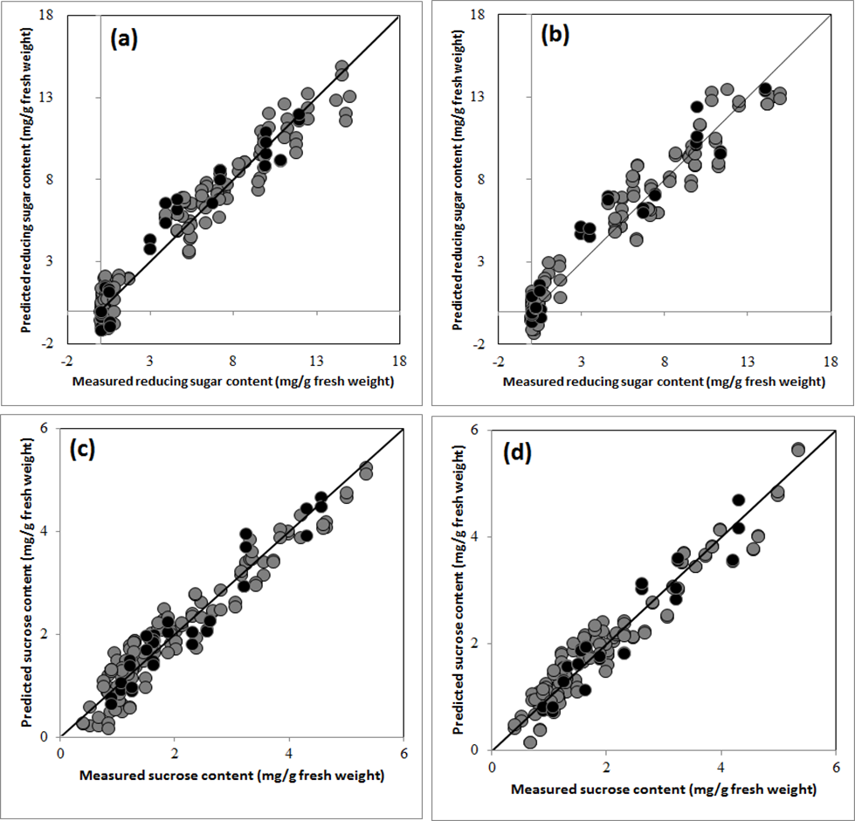
PLSR models for sugars using Cary 630 with validation group
Analyte | Conc. range | Accessory | Region(cm⁻¹) | Factors | SECV | SEP | rCV | rPred | RPD
Glucose (mg/g fresh weight) | ND-6.9 | ATR | 900 - 1500 | 6 | 0.44 | 0.46 | 0.97 | 0.98 | 4.6
 |  | Dial Path | 900 - 1500 | 6 | 0.43 | 0.38 | 0.97 | 0.98 | 5.5
Fructose (mg/g fresh weight) | ND-9.3 | ATR | 900 - 1500 | 6 | 0.81 | 0.73 | 0.96 | 0.96 | 3.9
 |  | Dial Path | 900 - 1414 | 6 | 0.95 | 0.70 | 0.95 | 0.97 | 4.1
Reducing Sugar (mg/g fresh weight) | ND-15 | ATR | 900 - 1500 | 6 | 1.06 | 1.15 | 0.97 | 0.96 | 3.9
 |  | Dial Path | 900 - 1500 | 6 | 1.09 | 1.15 | 0.97 | 0.97 | 4.2
Sucrose (mg/g fresh weight) | 0.4-5.4 | ATR | 900 - 1500 | 4 | 0.34 | 0.32 | 0.96 | 0.96 | 3.5
 |  | Dial Path | 900 - 1500 | 5 | 0.31 | 0.34 | 0.97 | 0.95 | 3.2
Reducing sugar-ATR
Reducing sugar-Dial path
Sucrose -ATR
Sucrose-Dial path

Slide 28
Conclusions
Using the same spectra, separate sucrose, glucose, fructose, reducing sugars (sum of glucose and fructose) and asparagine and glutamine PLSR models were successfully developed (rPed > 0.95) (both 3,000 g and 12,000 g)
Multivariate models accurately predicted sugar, asparagine and glutamine levels in independent sample sets with RPD value being higher than 2.5 (ranging between 3.1 and 5.5)
The models can help potato breeders, industrial manufacturers and research facilities by providing fast and simple ways of measuring these campounds
Using the portable systems is simple, cost-effective and requires low sample volume. Additionally, portable systems provide increased flexibility and great potential for in-field applications compared to bench-top IR systems or chromatographic systems such as HPLC and GC, which can only be used in a laboratory setting.

Slide 29
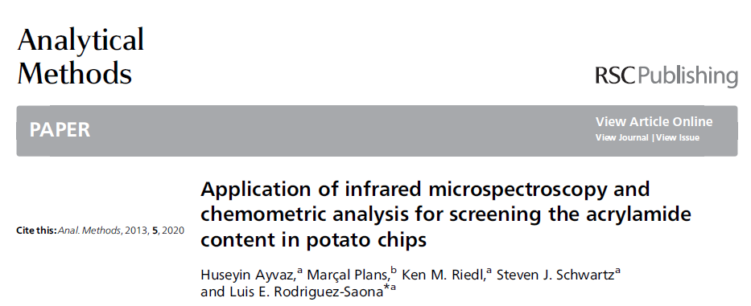
Project 2
To evaluate the feasibility of Infrared Microspectroscopy (IRMS) for rapid, sensitive and high-throughput screening of acrylamide content in a variety of commercial potato chips

Slide 30
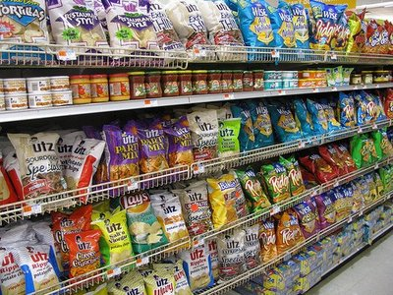


Materials and methods
58 commercial potato chips

Slide 31


0.15
0.10
Absorbance
0.05
NO SPE
WITH SPE
0.00
3800
3400
3000
2600
2200
1800
1400
1000
Wavenumber

Slide 32
Statistical Performance of PLSR models
SPE | Type of Potato Chips | Concentration range (µg/L) |  | Factors | SE (µg/L) | r
No | Regular | 206-510 | Calibration | 6 | 20.2 | 0.95
 |  |  | Cross Val. | 6 | 21.8 | 0.94
 |  |  | Prediction | 6 | 28.5 | 0.92
 | Seasoned | 262-381 | Calibration | 6 | 9.3 | 0.97
 |  |  | Cross Val. | 6 | 11.1 | 0.95
 | All samples | 219-510 | Calibration | 6 | 24.2 | 0.89
 |  |  | Cross Val. | 6 | 25.1 | 0.88
 |  |  | Prediction | 6 | 24.9 | 0.91
Yes | Regular | 206-510 | Calibration | 7 | 20.6 | 0.96
 |  |  | Cross Val. | 7 | 22.1 | 0.95
 |  |  | Prediction | 7 | 28.9 | 0.91
 | Seasoned | 262-381 | Calibration | 8 | 8.6 | 0.98
 |  |  | Cross Val. | 8 | 10.6 | 0.96
 | All samples | 219-510 | Calibration | 9 | 23.5 | 0.92
 |  |  | Cross Val. | 9 | 25.1 | 0.90
 |  |  | Prediction | 9 | 22.1 | 0.91

Slide 33

PLSR plots
Regular
Regular
Seasoned
Seasoned
Regular + Seasoned
Regular + Seasoned

Slide 34
Conclusions
Our data supports the application of mid-infrared microspectroscopy for acrylamide analysis in potato chips, reporting prediction errors (SEP) ranging from 22.1 to 28.9 µg/L
Our results gave lower SEP as compared to research studies conducted using NIR spectroscopy, predicting acrylamide levels with SECV of ~270 µg/L (Segtnan et al., 2006; Pedreschi et al., 2010)
Similar results obtained for the non-SPE models compared to SPE models would allow for exclusion of the SPE cleaning step, increasing efficiency and reducing the length of the analysis

Slide 35

Project 3
To develop simple, sensitive and robust methods for detection and quantification of acrylamide in potato chips using handheld and portable IR spectrometers based on highly specific MIR/NIR spectroscopic signature profiles in combination with supervised pattern recognition techniques

Slide 36



Infrared Instruments used
Handheld MIR system
(Cary 630 FT-IR spectrometer, Agilent)
Benchtop MIR and NIR
(Excalibur FT-IR spectrometer, Varian)
Handheld NIR system
(MicroPHazar, Thermo Fisher Scientific)
Fiber Optic Accessory
(Pike Technologies)

Slide 37


Materials and methods
64 commercial potato chips

Slide 38




Spectral variation among regular, seasoned and sweet potato chips
Sweet potato chips
0.30
Regular Potato chips
Starch
Chips with seasonings
Absorbance
0.20
0.10
Amide
0.00
1800
1700
1600
1500
1400
1300
1200
1100
1000
900
Wavenumber
Interclass distances were obtained among the all three groups, with ICD values between regular and sweet potato chips, seasoned and sweet potato chips and regular and seasoned potato chip of 12.7, 10.8 and 3.3, respectively.

Slide 39
Statistical Performance of PLSR models with NIR
Sensor | Concentration range (µg/kg) | Potato Chip Type |  | Factors | SE (µg/kg) | r | RPD
 | 178-1084 | Regular | Calibration | 8 | 68 | 0.96
 |  |  | Cross Val. | 8 | 87 | 0.92 | 2.6
 |  |  | Prediction | 8 | 78 | 0.91 | 2.4
 | 223-850 | Seasoned | Calibration | 7 | 32 | 0.99
 |  |  | Cross Val. | 7 | 47 | 0.97 | 3.9
 | 921-2453 | Sweet | Calibration | 8 | 38 | 1.00
 |  |  | Cross Val. | 8 | 99 | 0.98 | 4.4
 |  | Regular | Calibration | 8 | 70 | 0.95
 | 178-1084 |  | Cross Val. | 8 | 81 | 0.93 | 2.6
 |  |  | Prediction | 8 | 100 | 0.94 | 1.9
 |  | Seasoned | Calibration | 6 | 55 | 0.96
 | 223-850 |  | Cross Val. | 6 | 66 | 0.92 | 2.7
 |  | Sweet | Calibration | 8 | 60 | 0.99
 | 921-2453 |  | Cross Val. | 8 | 96 | 0.97 | 4.5
Fiber |  |  | Calibration | 8 | 40 | 0.98
 | 178-1084 | Regular | Cross Val. | 8 | 109 | 0.86 | 2.0
 |  |  | Prediction | 8 | 97 | 0.92 | 1.9
 |  | Seasoned | Calibration | 6 | 32 | 0.99
 | 223-850 |  | Cross Val. | 6 | 56 | 0.95 | 3.1
 |  | Sweet | Calibration | 7 | 12 | 1.00
 | 921-2453 |  | Cross Val. | 7 | 185 | 0.92 | 2.6

Slide 40


Statistical performance of MIR models
Sensor | Concentration range (µg/kg) | Potato Chip Type |  | Factors | SE (µg/L) | r | RPD
 | 178-1084 | Regular | Calibration | 7 | 96.1 | 0.91
 |  |  | Cross Val. | 7 | 112 | 0.87 | 2.0
 |  |  | Prediction | 7 | 83 | 0.90 | 2.3
 | 223-850 | Seasoned | Calibration | 7 | 38 | 0.98
 |  |  | Cross Val. | 7 | 45 | 0.97 | 3.9
 | 921-2453 | Sweet | Calibration | 7 | 100 | 0.98
 |  |  | Cross Val. | 7 | 159 | 0.94 | 2.9
 |  | Regular | Calibration | 7 | 65 | 0.95
 | 178-1084 |  | Cross Val. | 7 | 74 | 0.93 | 2.7
 |  |  | Prediction | 7 | 75 | 0.90 | 2.2
 |  | Seasoned | Calibration | 7 | 59 | 0.96
 | 223-850 |  | Cross Val. | 7 | 75 | 0.92 | 2.6
 |  | Sweet | Calibration | 7 | 74 | 0.99
 | 921-2453 |  | Cross Val. | 7 | 98 | 0.98 | 4.7

Slide 41

PLSR plots for regular potato chips
Benchtop MIR
Portable MIR
Benchtop NIR
Handheld NIR
Fiber optic NIR

Slide 42
Conclusions
Our data supports the application of both MIR and NIR instruments for acrylamide analysis in commercial potato chips, reporting RPD values between 2.0 to 4.7 for MIR instruments and 1.9 to 4.5 for NIR instruments used in this research
The portable and handheld systems performed similarly to the benchtop units tested
Only sample preparation involves blending the potato chips and pressing the oil out using a hydraulic press (no solvents, other chemicals, cartridges, LC-MS/MS and GC-MS etc)
The use of the portable and handheld systems can provide food producers with increased flexibility and great potential for in-field applications compared to bench-top systems which can only be used in a laboratory setting.

Slide 43


Slide 44



Slide 45



Slide 46
References
Bermudo, E., Nunez, O., Moyano, E., Puignou, L., & Galceran, M. T. (2007). Field amplified sample injection–capillary electrophoresis–tandem mass spectrometry for the analysis of acrylamide in foodstuffs. Journal of Chromatography A, 1159, 225-232.
California OEHHA (office of environmental health hazard assessment) (2011). Proposition 65; Available from http://www.oehha.org/prop65/prop65_list/acrylamide022511.html (Accessed 8 September 2012).
ECHA (European Chemicals Agency) (2010). Available from http://echa.europa.eu/en/view-article/-/journal_content/title/acrylamide-included-in-the-reach-candidate-list-of-substances-of-very-high-concern-for-authorisation (Accessed 1st, March 2014).
FAO/WHO, (2005). Joint FAO/WHO Expert Committee on Food Additives: Summary and conclusions report from sixty-fourth meeting, Rome, 8–17 February 2005 (Rep. No. JECFA/64/SC).
Friedmann, M. (2003). Chemistry, biochemistry, and safety of acrylamide. J Agric Food Chem, 51, 4504-4526.
Hogervorst, J. G., Schouten, L. J., Konings, E. J., Goldbohm, R. A., & van den Brandt, P. A. (2007). A prospective study of dietary acrylamide intake and the risk of endometrial, ovarian, and breast cancer. Cancer Epidemiology Biomarkers & Prevention, 16, 2304-2313.
Hogervorst, J. G., Schouten, L. J., Konings, E. J., Goldbohm, R. A., & van den Brandt, P. A. (2008). Dietary acrylamide intake and the risk of renal cell, bladder, and prostate cancer. The American journal of clinical nutrition, 87, 1428-1438
IARC (1994). Acrylamide. In IARC monographs on the evaluation of carcinogenic risks to humans, 60. (pp. 389–433) Lyon France: International Agency for Research on Cancer.
Mendel F. (2003).Chemistry, Biochemistry, and Safety of Acrylamide. A Review. Journal of Agricultural and Food Chemistry,51 (16), 4504-4526
Pedreschi, F., Segtnan, V. H., & Knutsen, S. H. (2010). On-line monitoring of fat, dry matter and acrylamide contents in potato chips using near infrared interactance and visual reflectance imaging. Food chemistry, 121(2), 616-620.
Pollien, P., Lindinger, C., Yeretzian, C., & Blank, I. (2003). Proton transfer reaction mass spectrometry, a tool for on-line monitoring of acrylamide formation in the headspace of Maillard reaction systems and processed food. Analytical chemistry, 75, 5488-5494.
Robin, L. P. (2007). Acrylamide, Furan, and the FDA. Food Safety Magazine, 13, 17-21.
Roach, J. A., Andrzejewski, D., Gay, M. L., Nortrup, D., & Musser, S. M. (2003). Rugged LC-MS/MS survey analysis for acrylamide in foods. Journal of Agricultural and Food Chemistry, 51, 7547-7554.
Segtnan, V. H., Kita, A., Mielnik, M., Jørgensen, K., & Knutsen, S. H. (2006). Screening of acrylamide contents in potato crisps using process variable settings and near‐infrared spectroscopy. Molecular nutrition & food research, 50, 811-817.
Singh, G., Brady, B., Koerner, T., Becalski, A., Zhao, T., Feng, S., ... & Delahaut, P. (2014). Development of a Highly Sensitive Competitive Indirect Enzyme-Linked Immunosorbent Assay for Detection of Acrylamide in Foods and Water. Food Analytical Methods, 7, 1298-1304.
Sun, Q., Xu, L., Ma, Y., Qiao, X., & Xu, Z. (2014). Study on a biomimetic enzyme‐linked immunosorbent assay method for rapid determination of trace acrylamide in French fries and cracker samples. Journal of the Science of Food and Agriculture, 94(1), 102-108.
Tareke, E., Rydberg, P., Karlsson, P., Eriksson, S., & Törnqvist, M. (2002). Analysis of acrylamide, a carcinogen formed in heated foodstuffs. Journal of agricultural and food chemistry, 50, 4998-5006.
Zargar, B., Sahraie, N. R., & Khoshnam, F. (2009). Catalytic square-wave voltammetric determination of acrylamide in potato chips. Analytical Letters, 42, 1407-1417.
Zyzak, D. V., Sanders, R. A., Stojanovic, M., Tallmadge, D. H., Eberhart, B. L., Ewald, D. K., & Villagran, M. D. (2003). Acrylamide formation mechanism in heated foods. Journal of Agricultural and Food Chemistry, 51, 4782-4787.

Slide 47
Thank you

