Slide 1


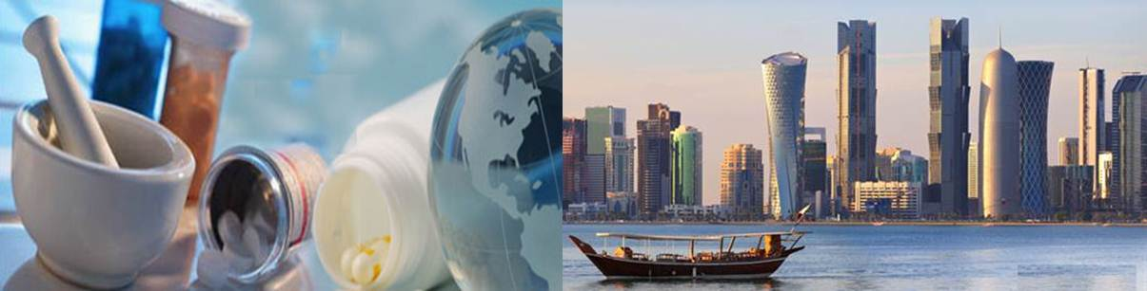
Fabrication & characterization of 3D electrospun biodegradable nanofibers for wound dressing, drug delivery and other tissue engineering applications
The 5th International Conference and Exhibition on Pharmaceutics & Novel
Drug Delivery Systems - Dubai, UAE
March 17th , 2015
Husam M. Younes, PhD
Associate Professor of Bio-Pharmaceutics
Pharmaceutics & Polymeric Drug Delivery Research Lab (PPDDRL)
College of Pharmacy, Qatar University, Doha, QATAR.

Slide 2
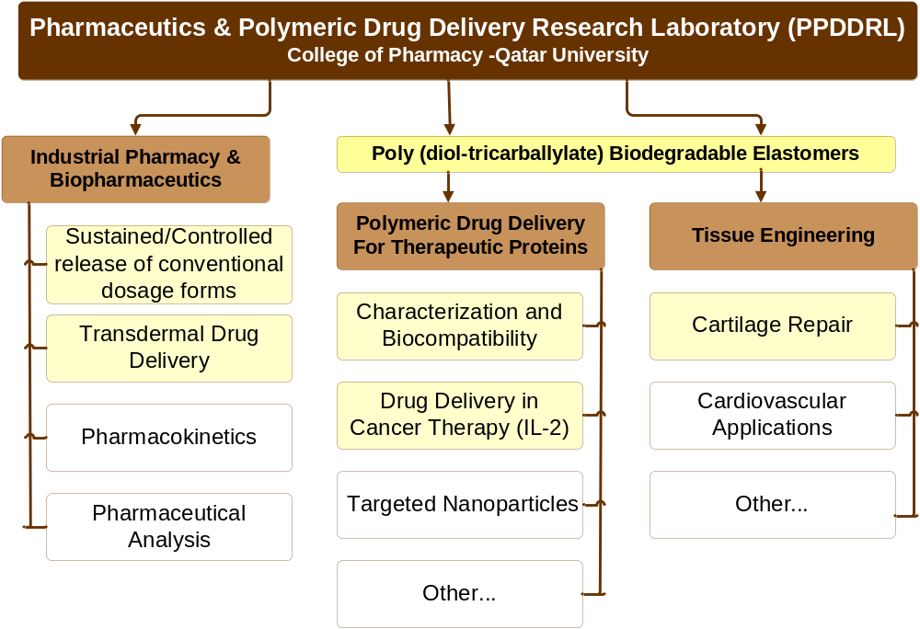

Slide 3
Objectives
Prepare biodegradable electrospun fibers using drug-unloaded and drug-loaded polymers to demonstrate the formation of 3D electrospun scaffolds.
Characterize the prepared electrospun fibers using Differential Scanning Calorimetry (DSC), Fourier Transform-Infrared Spectroscopy (FT-IR) and Scanning Electron Microscopy (SEM).

Slide 4
Background
The main purpose of using a wound dressing is to protect the wound from environmental threats and promote tissues re-generation and replacement.
Traditional dressing challenges direct towards advanced multifunctional wound dressing development.
Use of polymers in tissue engineering and drug delivery.
  Electrospinning

Slide 5
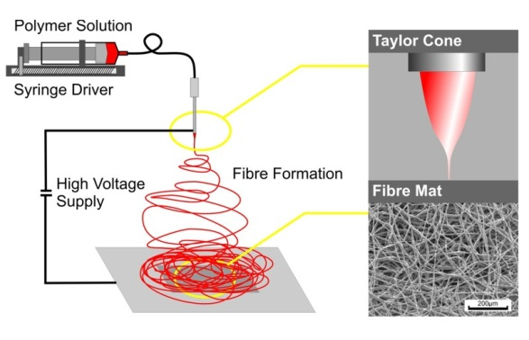
Electrospinning

Slide 6
What was done?
Amoxicillin Trihydrate (AMX), one of the most important antibiotics used in wound dressing and other tissue regenerative applications, has been used as a model drug.
AMX- loaded PEG 35000 biodegradable electrospun nanofibers (BENS) were successfully produced by electrospinning and the interaction between Amx and PEG fibers was fully investigated.

Slide 7
How Was it is done?
Solutions of PEG35000 in chloroform of varying concentrations (20, 30, 35, 40 % w/v) were prepared.
These solutions were used to fabricate BENS using ET. Different Voltage, flow rate and distance to collector were set to standardize the method.
10% w/v AT in PEG35000 solutions were prepared and fabricated to produce AMX loaded BENS.

Slide 8
Characterization
Morphology, size and diameter of BENS were assessed using Scanning Electron Microscopy (SEM).
Fourier Transform Infrared (FT-IR) Spectroscopy was used to identify the interaction between PEG35000 and AMX.
Differential Scanning Calorimetry (DSC) was used to assess the crystallinity and thermal behavior of the prepared BENS.
X-Ray Diffraction Analysis (XRD)
Cytocompatibility studies on unloaded BENS.

Slide 9
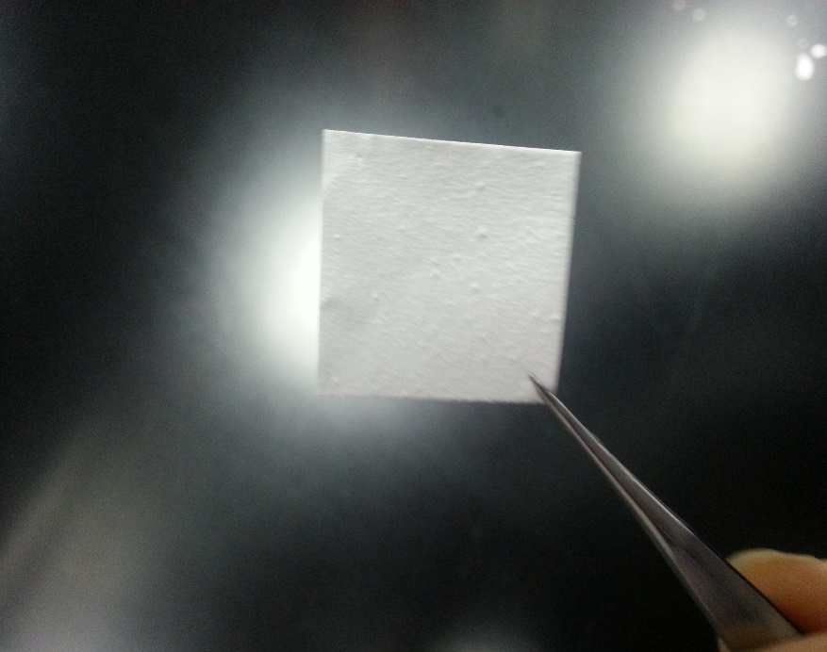
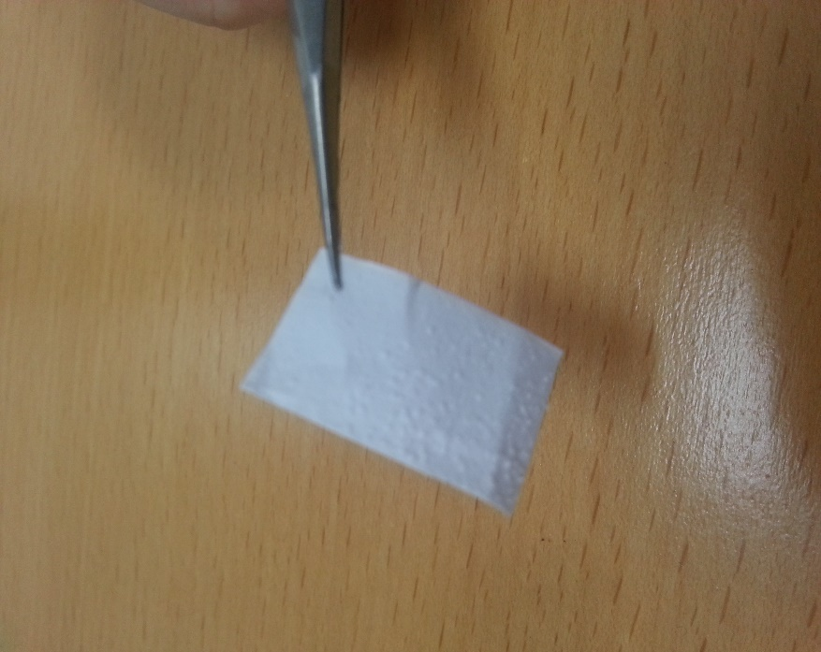
Scaffolds/Dressings
A
B
Images of (A) Blank & (B) AT loaded BENS

Slide 10
FT-IR of PEG

Slide 11
FT-IR of AMX BENS

Slide 12
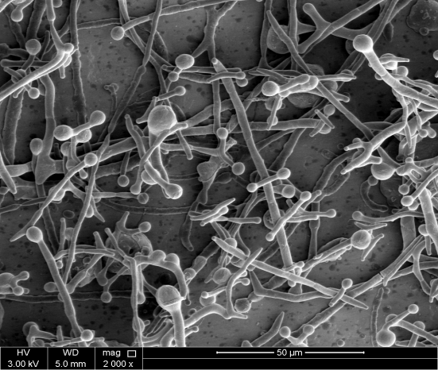
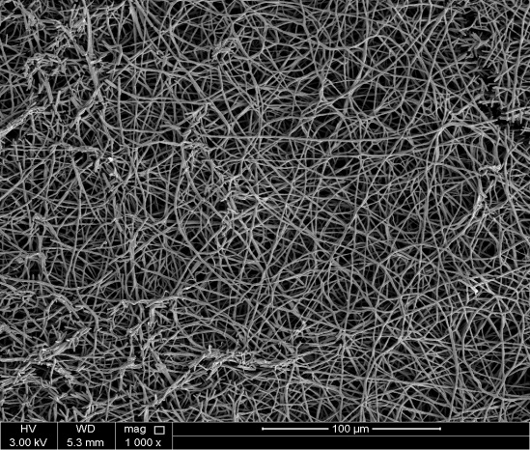
SEM Analysis

Slide 13
35% PEG solution, electrospinning parameters which include a voltage of 14 KV, flow rate of 1ml/h and distance of 15 cm between the needle and the collector

Slide 14
DSC Analysis

Slide 15
XRD Analysis

Slide 16
XRD All

Slide 17
Cytocompatibility Studies
Notes:
Figure: Attachment and viability assay of MSCs cells at day 7cultured on ethanol sterilized 2D elastomeric PDDT films. The cells attached were healthy with regular spindle-shaped.

Slide 18
Current Research..
In vitro degradation studies
Copolymerization of PEG with hydrophobic polymer to increase degradation time and mechanical strength.
Testing on an injured animal model

Slide 19




Acknowledgements
Graduate Students
Mr. M. Shaker (PhD)
Mr. Hany Ellaboudy (MSc)
Post Docs & Research Assistants
Dr. Somayeh Zamani
Dr. Mohamed Shaker
Dr. Najla Benameur
Dr. Nazish Khan
Mr. Ahmed Abu Helwa, MSc
Ms. Sandi Ali Adib, MSc
Ms. Tamara Marji, MSc
Ms. Shiji Molma, MSc
Undergraduate Students
Ms. Oraib Abdallah
Ms. Fatemeh Jalali
Collaborators
Bristol University -UK
Dr. Wael Kafieneh – School of Cellular and Molecular Medicine
Memorial University -Canada
Dr. Noriko Daneshtalab - Basic Medical Sciences
Dr. Pad Wadden - Pathology Department.
Funding:
NPRP grant # 09 - 969 - 3 - 251 (Qatar)
NSERC – Discovery Grants (Canada)
Pharmaceutics
& Polymeric Drug
Delivery Research lab

Slide 20
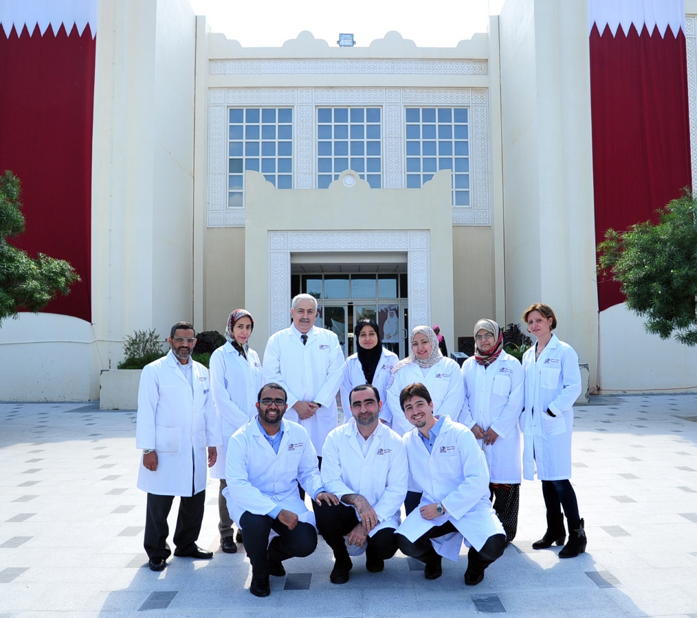
PPDDRL Team

Slide 21

Questions!

