Slide 1
Rapid and Reliable Genotyping of
HLA-B*58:01 in Four Chinese Populations Using a Single-tube Duplex Real-time PCR assay
Huijuan Wang, Ph.D
The National Engineering Research Center for Miniaturized Detection Systems;
College of Life Science, Northwest University, Xi'an, China
Notes:
Good afternoon, thank you for your patience and thank you all in attendance. I come from northwest university of China. Now I am a lecture, my study field is pharmacogenomics and functional genomics. Today I will give a presentation of

Slide 2
Contents
HLA-B*58:01 and Allopurinol-induced SCARs
Detection system for HLA alleles
Establishment of a novel multiple Real-time PCR assay
I
II
III
Notes:
My report consists of three parts. The first part is a brief introduction of the relationship between HLA-B poly

Slide 3
Adverse drug reaction, ADR
China
Hospitalized patients：50,000,000/year
Hospital admission due to ADRs：2,500,000/year
Severe adverse drug reaction：500,000/year
Death case caused by ADR：193,000/year
U.S.
Hospital admission due to ADRs: 1,000,000/year
Death case caused by ADR: 100,000/year
ADRs ranked fourth to sixth on the factors that caused death in the USA
China
Estimated direct medical cost of ADRs:4 billion RMB/year
U.S.
In 1998, medical expenses related to high dose and unnecessary prescription drugs exceeded 100 billion dollars; in 2000, the incidence and mortality associated with the drug exceeded 177 billion dollars
JAMA 1997, 277:301-17; JAMA. 1998, 279:1200-5; Nature Genetics 37: 671, 2005
Notes:
The situation of ADRs is serious. In China, ,
In China,

Slide 4
Cutaneous Adverse Drug Reaction(cADR) is the most common type of ADRs
Studies on hospital-based inpatient populations
Studies in children and adolescents
Nation | Year | Number studied | Prevalence of ADRs | Prevalence of cADRs
France | 2003 | 48 | - | 3.6/1000
Singapore | 2002 | 90910 | 4.2/1000 | 4.02/1000 (95.7% of ADRs)
Mexico | 2006 | 4765 | - | 7/1000
Korea |  | 55432 | 4.84/100 | 1.8/1000
One 10 year retrospective cohort study in the United States showed that 24% of all ADRs were attributed to drug hypersensitivity
reactions
Studies from emergency department (ED) attendances
In the United, the estimated incidence for ADRs between 2004–05 was 2.4 ED visits per 1000 population (95% CI 1.7, 3.0 per 1000 persons). Drug allergies comprised 33.5% of all ADR-related ED visits, with 11.3% requiring hospitalization.
Thong BY, Tan TC. Br J Clin Pharmacol. 2011;71(5):684-700.
Notes:
is the skin allergic reaction. According to the studies on hospital-based inpatient populations, we can see the prevalence of cADRS is about 1.8-7 in one thousand. And studies
Cutaneous: kju’tenies

Slide 5
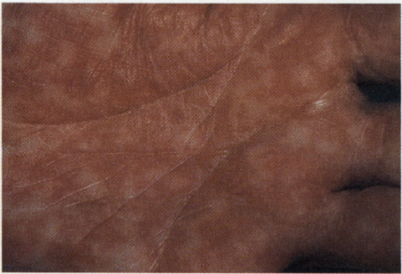
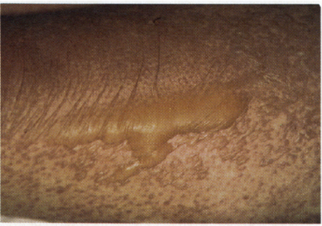
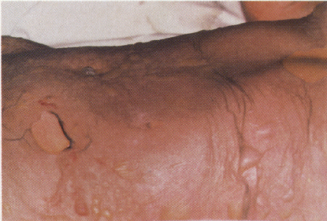
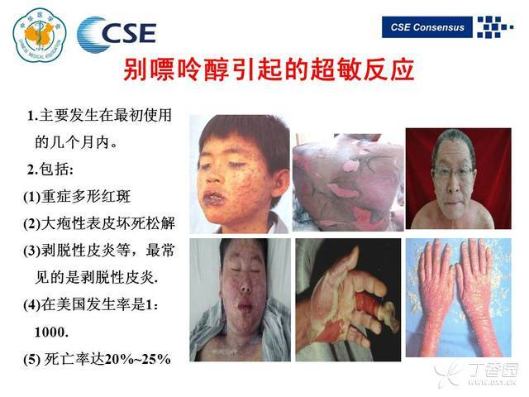
Severe Cutaneous Adverse Reactions (SCARs)
SCARs include Stevens Johnson syndrome (SJS), toxic epidermal necrolysis (TEN) , drug-induced hypersensitivity syndrome (DiHS) or drug rash with eosinophilia and systemic symptoms (DRESS)
SJS and TEN are characterized by high fever, malaise, and rapid development of blistering exanthema, with macules and target-like lesions, accompanied with mucosal involvement. The time to onset of SCAR was within 4 weeks
The incidence of SJS and TEN is extremely low, but the mortality is as high as 1–5% for SJS and 20–30% for TEN.
Certain drugs were ‘high risk’ for SCAR (e.g. cotrimoxazole, allopurinol, carbamazepine, phenytoin, phenobarbital and oxicam-NSAIDs), and no significant risk persisted beyond 8 weeks of use
Notes:
SJS and TEN are very serious and even fatal.
Based on the investigation, certain
Exanthema, 疹子。[英][ˌeksæn'θi:mə][美][ˌeksæn'θi:mə
The reported incidence of SCAR in the Haidian district was not less than 1.8 per million person-years. The
reported incidence of erythema multiforme, SJS, TEN and DRESS in the Haidian district was not less than 0.6, 0.8, 0.05 and 0.4 per million person-years, respectively. The most common underlying disorders were infection, pain-related diseases and epilepsy.

Slide 6
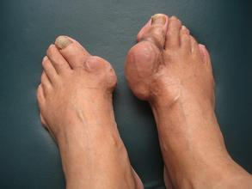
Allopurinol-induced SCARs
Allopurinol is the most commonly used drug for the treatment of hyperuricemia and gout
The greatest safety concern with allopurinol is an estimated 0.1–0.4% risk of SCARs (accounting for 5% of all cases of SCARs), also known as allopurinol hypersensitivity syndrome.
Allopurinol and its metabolites（ oxypurinol ）
（ － ）
Hypoxanthine
Xanthine
Xanthine oxidase
Serum uric acid
Uric acid
Uric acid
Notes:
It acted as a xanthine oxidase inhibitor that prevents the production of uric acid to reduce plasma uric acid levels to a normal range
xanthine[英]['zænθɪn][美]['zænθɪn]
It is also one of the most common cause of SJS–TEN
allopurinol is also one of the most frequent causes of a variety of delayed SCARs , including SJS and TEN

Slide 7
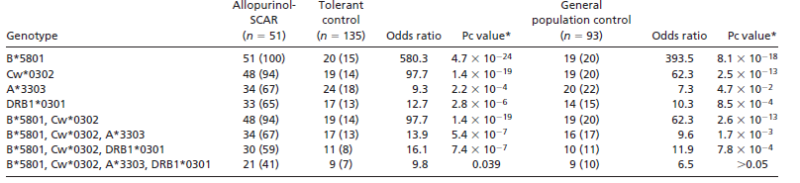
HLA-B*58:01 allele as a genetic marker for SCARs caused by allopurinol
Subjects：Taiwan Han Chinese
Drug usage：case:100mg/day; mtached control: 150mg/day
Hung SI, et al. Proc Natl Acad Sci USA. 2005;102:4134-9.
Notes:
A study reported in 2005 firstly demonstrated the strong association between 5801 and allo induced Scars, The study was performed in Taiwan Han
Chinese, they found that the prevalence of 5801 in allo-scar patients is 100%......., for the 5801 carriers, if they take allo, the scar risk increased several hundred times. Therefore, the confirmed that 5801 could be used as a genetic …

Slide 8
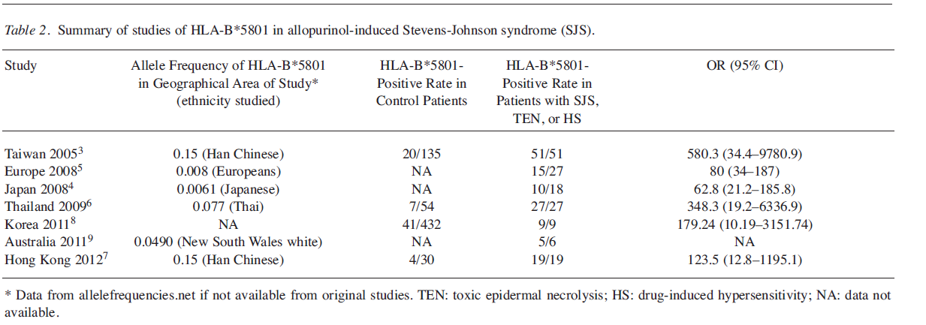
The strong association between HLA-B*58:01 and allopurinol
-induced SCARs were replicated in other populations.
In some populations (Han Chinese, Thai, Korean) HLA-B*58:01 explains 80-100% of the SCAR cases whereas in other populations (Japanese, European)HLA-B*5801 explains around 55% of the cases
Notes:
And the strong association were replicated in other populations, but association degree varies in different ethnicities,

Slide 9
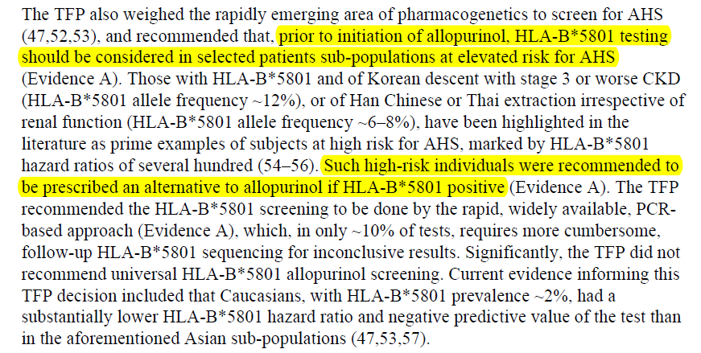
The American College of Rheumatology guidelines for the management of gout
Arthritis Care Res (Hoboken). 2012 October ; 64(10): 1431–1446.
Notes:
Based on the studies, in the guidelines for the management of gout published by

Slide 10
Contents
HLA-B polymorphic alleles and SCARs
Detection methods for HLA alleles
The establishment of a novel multiples Real-time PCR assay
I
II
III
Notes:
Therefore, in order to guide the medication use of allopurinol, it is essential of establish a fast and reliable techniques for hla-b5801 detection . Now let us to go over the genotyping methods for

Slide 11
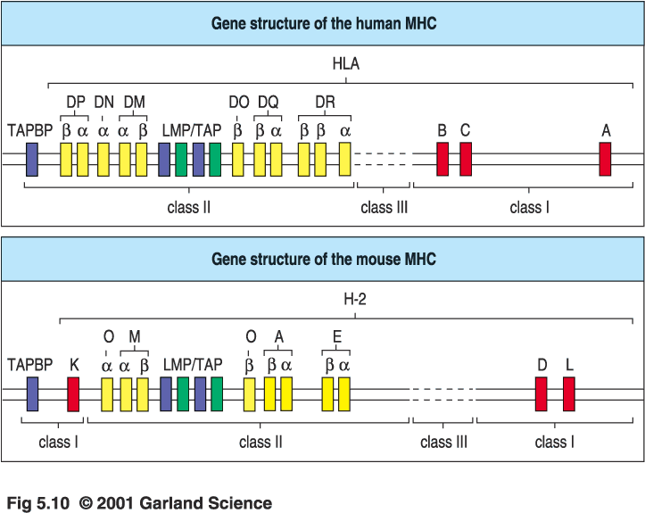

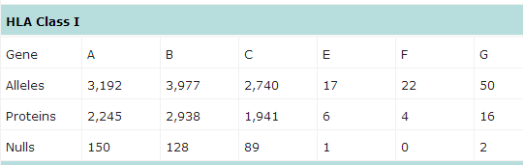
HLA (Human leukocyte antigen) system: the most complex and highly polymorphic genetic system in the human genome
Notes:
HLA system constitutes the most complex and highly polymorphic genetic system in the human genome that has ever been discovered. The HLA system is rich in highly homologous genes, and multiple polymorphic loci are involved in the generation of certain HLA alleles [101,102], in perspective of HLA-B gene, there are 3977 polymorphic alleles included the IMGT/HLA database
Therefore, high homology among the alleles raises more challenge and difficulties for HLA genotyping, and usually multiple amplified primers would be used to determine a certain HLA allele.

Slide 12
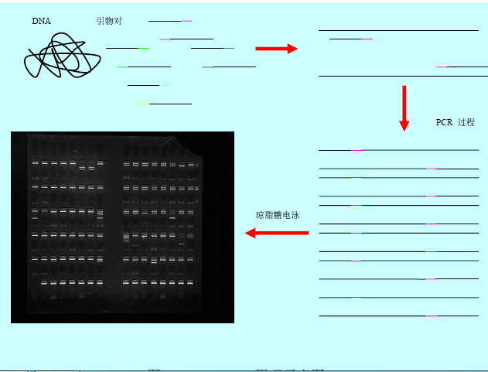
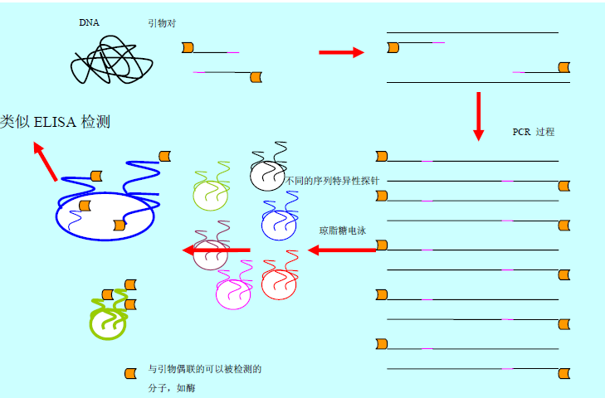
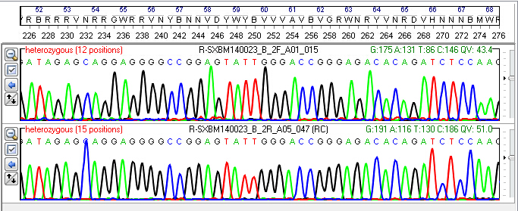
Conventional DNA-based methods for HLA typing
PCR-sequence-specific primer (PCR-SSP)
PCR sequence- specific oligonucleotide probe (PCR-SSOP)
PCR-sequencing-based typing (PCR-SBT)
Notes:
Conventional ……mainly included ……Of these, PCR-SBT now is recognized as the golden-standard method for HLA typing. These methods are commonly used, but they are not appropriate for detection inbvthe routine clinical settings, due to their some well-known drawbacks, such as laborious post-PCR process, contamination of post-pcr handling, Time-consuming operation,, or high testing cost,

Slide 13
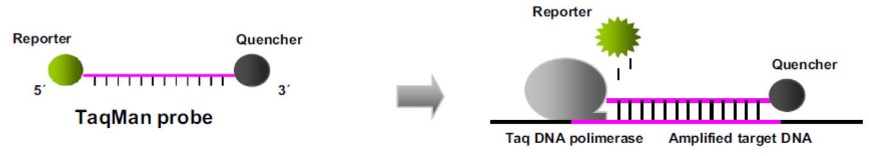
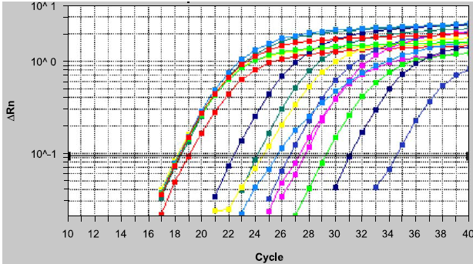
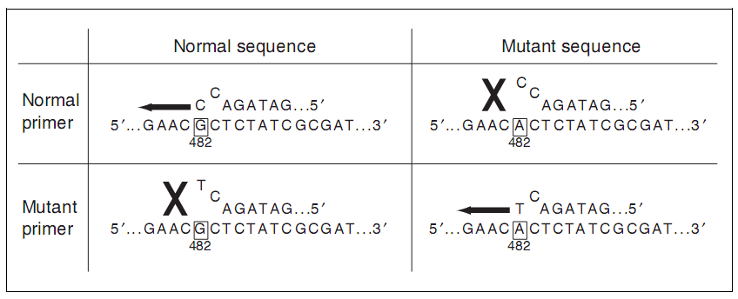
TaqMAMA assay: combination of ARMS and TaqMan real-time PCR
（1）TaqMan real-time PCR
（2）ARMS PCR(Amplification Refractory Mutation Systems)
High Specificity
High Sensitivity
Notes:
TaqMAMA assay, is an method of combination of . TaqMan …PCR is TaqMan probe based real-time pCR., recent years it becomes very popular in molecular biology labtories., with the advantages of high sensitivity, high specificity. ARMS is….., it also called allele-specific PCR, , a mismatch was introduced in a base at the 3′ end of the specific primer to discriminate the wild type and mutant sequences, by doing so, the specificity of the reaction was enhanced. In summary, TaqMAMA assay, by the combined using of allele-specific primers and sequence-specific probes, the speficifity of reaction is largely increased, this is quite appropriate for the detection of HLA alleles, due to multiple polymorphic loci are involved in the generation of certain HLA alleles

Slide 14
Contents
HLA-B polymorphic alleles and SCARs
Detection system for HLA alleles
The establishment of a novel multiple Real-time PCR assay
I
II
III
Notes:
The we go to the third part, the establishment of a novel for the detection of HLA-B alleles in our lab

Slide 15
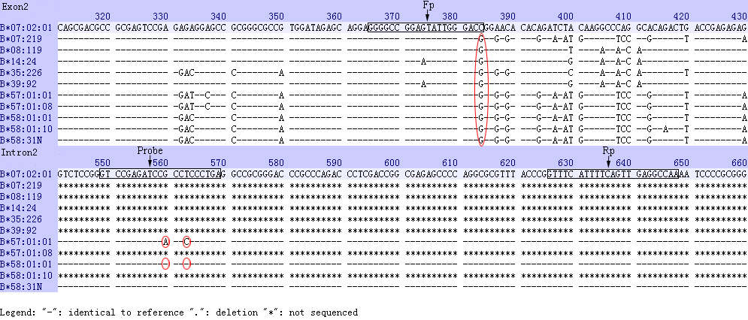
Primer and Probe design
One pair of ARMS primers and one sequence-specific probe
Notes:
Basing on the sequence comparisons, we found that among the homologous genes, HLA-B*57:01 mostly resembled the HLA-B*58:01 (Figure 1). The highest variability was found in exon 2 and intron 2 sequences, and three specific bases in exon2 (position 384, G) and intron 2 (position 560, G; position 563, T) together make HLA-B*58:01 distinguished from most HLA-B alleles. Therefore, one pair of sequence specific primers and one probe were designed for the amplification of HLA-B 5801 allele

Slide 16
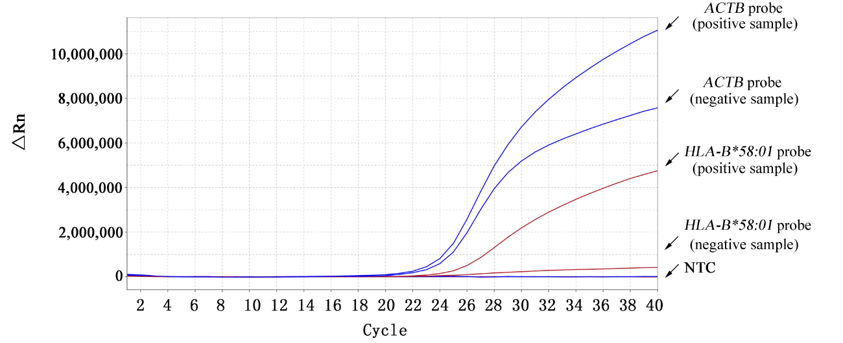
Main Results
Target (HLA-B*58:01) and reference genes were simultaneously detected in one single-tube duplex Real-time reaction
FAM
HEX
Notes:
ACTB was selected as the internal reference gene. The probe of target gene and the internal were labeled with different fluorescent dyes, thus the Target (HLA-B*58:01) and reference gene were simultaneously detected in one single-tube duplex Real-time reaction. From the amplification result of standard samples, we can see that the reaction system was successfully established.Samples that simultaneously generated FAM and HEX (red) “S”-type fluorescence amplification curves contained the HLA-B*58:01 allele, whereas the absence of a signal for the target gene (HLA-B*58:01) probe indicated that samples did not contain the HLA-B*58:01 allele

Slide 17
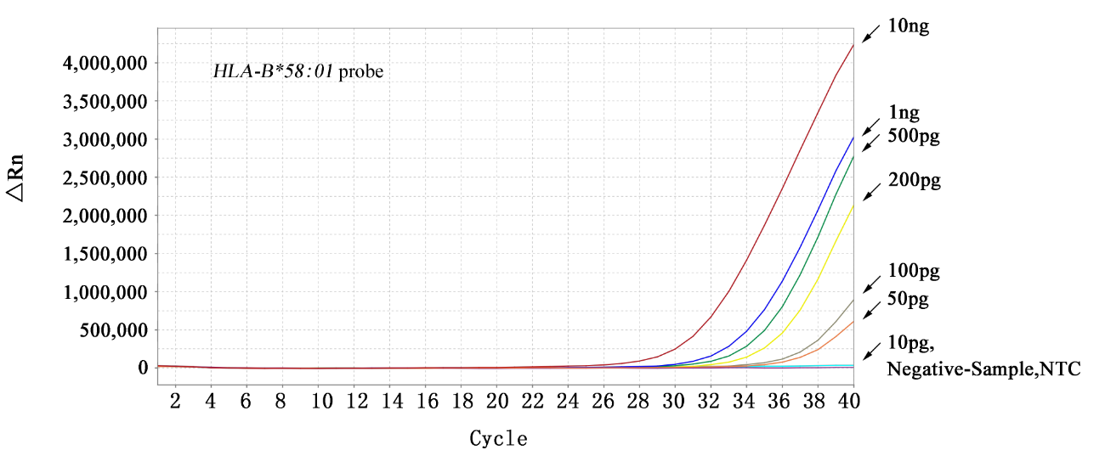
Detection limit of HLA-B*58:01 reaction system
Notes:
Pg,picogram

Slide 18
Assay Validation:
Agreement analysis of the genotyping results between TaqMan assay and PCR-SBT
PCR-SBT | Real-time PCR |  | total
 | Positive | Negative
Positive | 17 | 0 | 17
Negative | 0 | 83 | 83
total | 17 | 83 | 100
100% accordance between two methods
Notes:
We used the golden-standard method , PCR-SBT to validate the reliability of our established method. 100 samples were analyzed by these two method.

Slide 19
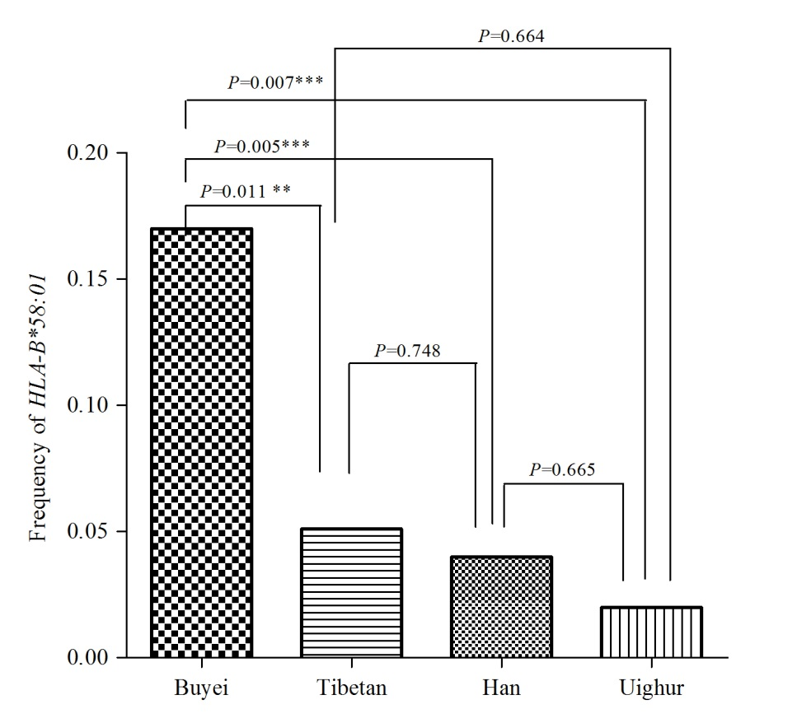
HLA-B*58:01 distribution in Four Chinese populations
Allele | Han (n=100) | Tibetan(n=99) | Uighur(n=50) | Buyei (n=100)
HLA-B*5801 | 4% | 5.1% | 2% | 17%
Notes:
[wi:guə]

Slide 20
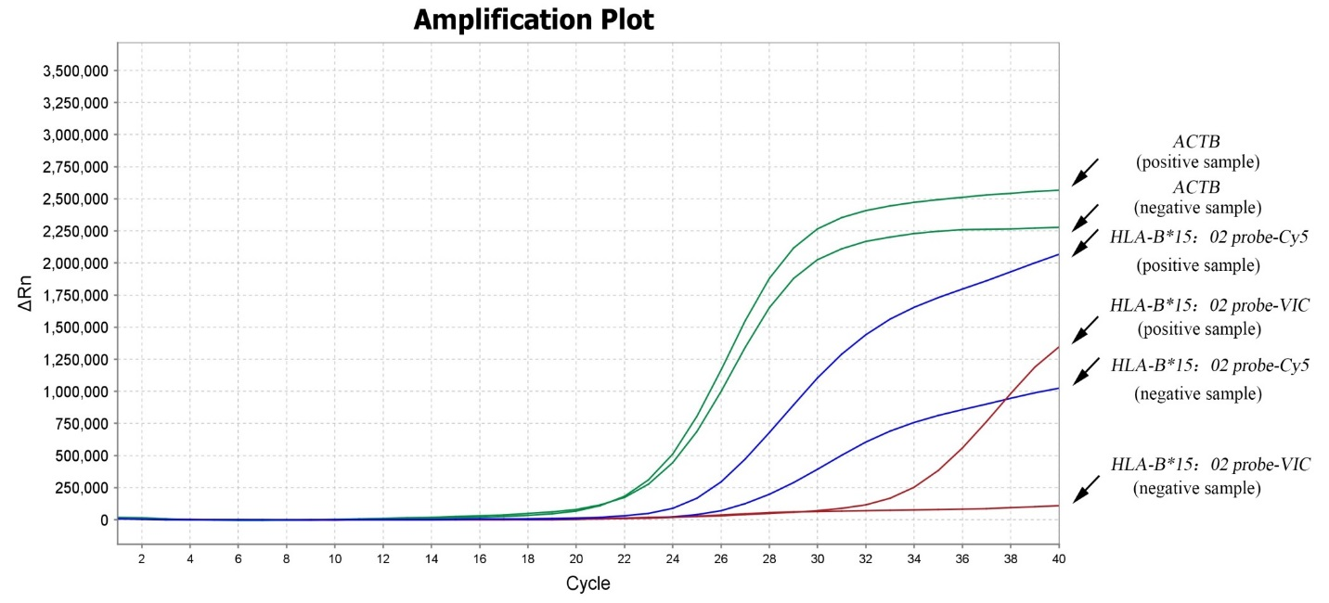
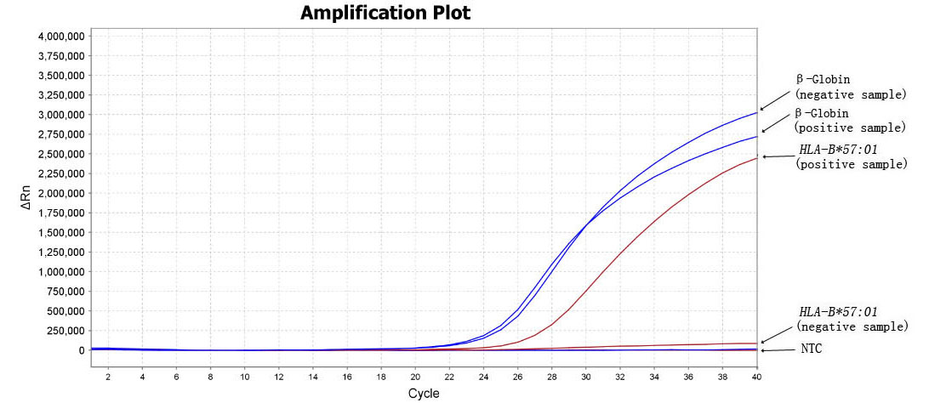
Similar multiplex TaqMan Real-time PCR assays for HLA-B*1502 and *5701, the biomarkers related to carbamazepine and abacavir induced-SCARs were also established
HLA-B*15:02
HLA-B*57:01

Slide 21
Conclusion
We developed a novel single-tube multiplex real-time PCR assay for the detection of SCARs-related biomarkers. The assay is rapid, sensitive, cost-effective, and reliable. It is appropriate for routine HLA-B alleles detection prior to drug administration, thus reducing the prevalence of drug-induced SCARs.
The information of the prevalence of HLA-B alleles obtained in the Chinese populations could facilitate the design of future pharmacogenetic association studies and implementation of personalized medicine in these populations.

Slide 22

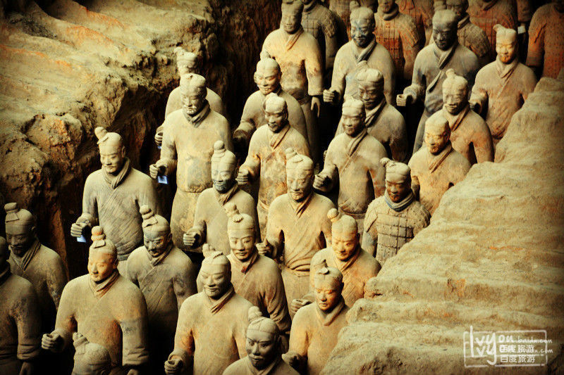


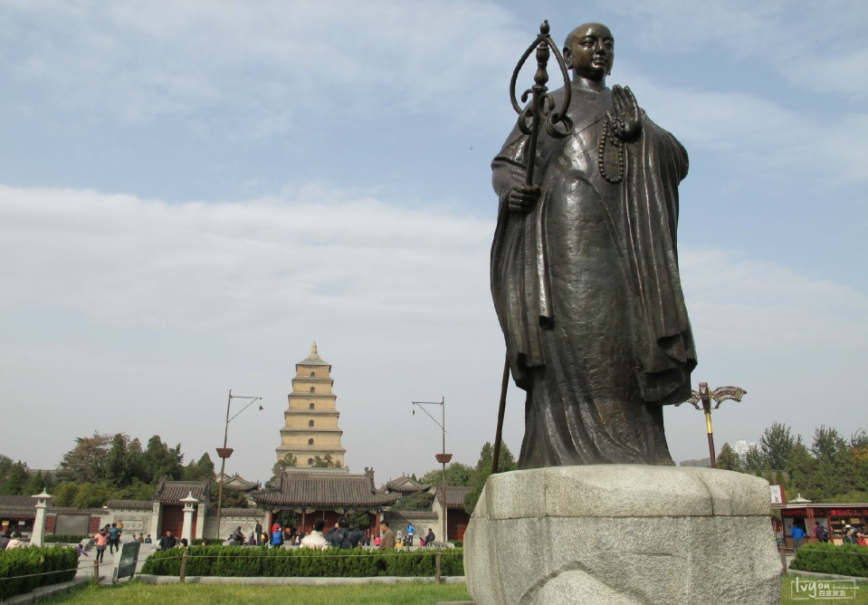
Xi’an
A city with 5000 years of history
Notes:
Thanks for your attention. I come from Xi’an, an ancient city with 5000 years of history. It is the location of the terracotta army and many other tourist attractions, Welcome to Xi’an.

