Slide 1
About OMICS Group
OMICS Group is an amalgamation of Open Access publications and worldwide international science conferences and events. Established in the year 2007 with the sole aim of making the information on Sciences and technology ‘Open Access’, OMICS Group publishes 500 online open access scholarly journals in all aspects of Science, Engineering, Management and Technology journals.
OMICS Group has been instrumental in taking the knowledge on Science & technology to the doorsteps of ordinary men and women. Research Scholars, Students, Libraries, Educational Institutions, Research centers and the industry are main stakeholders that benefitted greatly from this knowledge dissemination. OMICS Group also organizes 500 International conferences annually across the globe, where knowledge transfer takes place through debates, round table discussions, poster presentations, workshops, symposia and exhibitions.

Slide 2
About OMICS International Conferences
OMICS International is a pioneer and leading science event organizer, which publishes around 500 open access journals and conducts over 500 Medical, Clinical, Engineering, Life Sciences, Pharma scientific conferences all over the globe annually with the support of more than 1000 scientific associations and 30,000 editorial board members and 3.5 million followers to its credit.
OMICS Group has organized 500 conferences, workshops and national symposiums across the major cities including San Francisco, Las Vegas, San Antonio, Omaha, Orlando, Raleigh, Santa Clara, Chicago, Philadelphia, Baltimore, United Kingdom, Valencia, Dubai, Beijing, Hyderabad, Bengaluru and Mumbai.

Slide 3
Carboxyl terminus of Hsp70-interacting protein functions as a tumor suppressor and enhance the radiosensitivity in cervical cancer
Yang Hui, Zhou Yunfeng
Department of Radiation Oncology & Medical Oncology
Hubei Key Laboratory of Tumor Biological Behavior
Hubei Cancer Clinical Study Center
Zhongnan Hospital, Wuhan University, Hubei, China
2015.8.5
Valencia. Spain

Slide 4
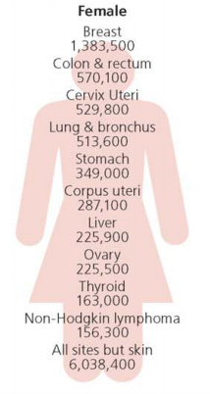
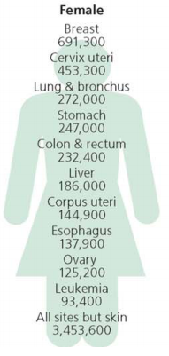
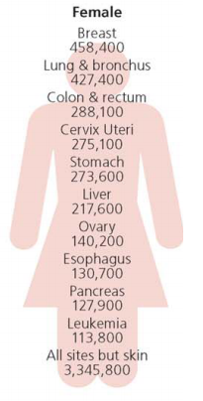
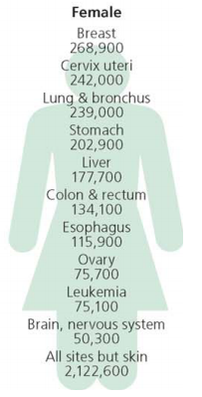
Introduction
Estimated New Cases
Estimated Deaths
Worldwide
Developing Countries
Global Cancer Statistics，2012. CA CANCER J CLIN，2015

Slide 5
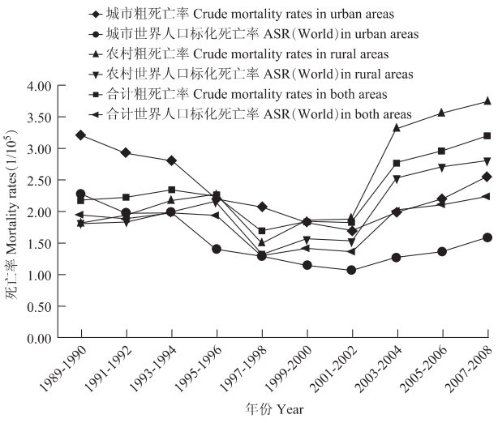
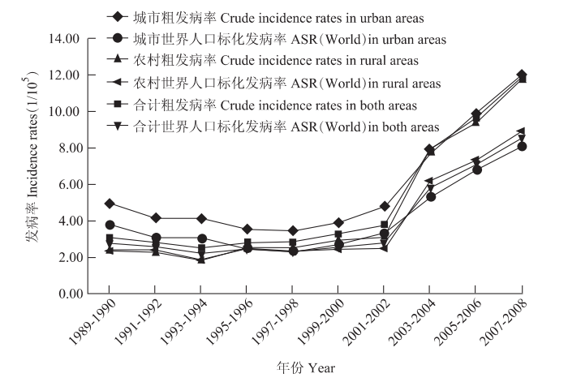
Trend Analysis of Cervical Cancer Incidence and Mortality Rates in Chinese Women during 1989-2008

Slide 6
Treatments
5 years overall survival (OS) about 55%
Ⅰ→ⅡA | Surgery or radiotherapy
ⅡB→Ⅳ | Radiotherapy
Radiotherapy
10%-74%
Central pelvic recurrent
(60%)
Relapse
Distant metastases
(40%)
Notes:
a

Slide 7
“4R” in radiobiology
Repopulation
Restribution within the cell cycle
Radiosensitivity
Oxygen effect and reoxygenation
Repair of radiation damage
Telomere/ telomerase

Slide 8
Telomerase and radiosensitivity in cervical cells
Telomerase activity is changed after different dose changes
Telomere length is a predictor of radiosensitivity
Inhibition of telomerase components (hTR, hTERT)
Telomerase activity
Telomere length
Radiosensitivity

Slide 9
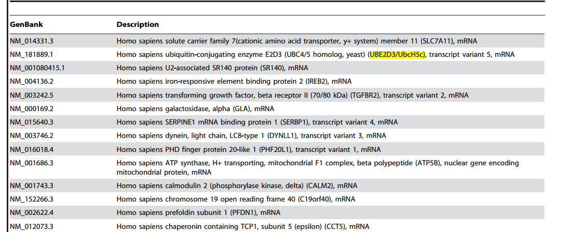
UBE2D3 and radiosensitivity
UBE2D3 is negatively regulate radiosesitivity by down regulate hTERT expression
hTERT ubiquitination plays an important part in radiosensitivity

Slide 10
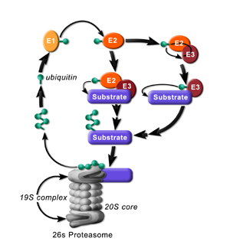
The procession of ubiquitination
E1-ubiquitin activation enzyme
E2-ubiquitin conjugating enzyme (UBE2D3)
E3-ubiquitin ligase enzyme

Slide 11
Carboxyl terminus of Hsp70-interacting protein (CHIP)
E2
E3
Substrate
UBE2D3
CHIP
hTERT
Low expression in some tumor tissues
Modulate some tumor related pathways
CHIP roles in the radiosensitivity and invasion of cervical cancer is unclear

Slide 12

CHIP is lowexpression in cervical cancer tissues by gene microarray.
GEO Datasets: GSE 7803
P<0.05
P<0.05
P<0.05

Slide 13
Q-PCR to know the relative expression of hTERT/CHIP after different radiation doses
CHIP is changed companion with hTERT change.

Slide 14
CHIP & Radiosensitivity
Establish radioresisitant cell lines
Protein levels of CHIP are associated with telomerase activity, telomere length and radiosensitivity in cervical cancer cells
Verify the relationship between CHIP and radiosensitivity

Slide 15
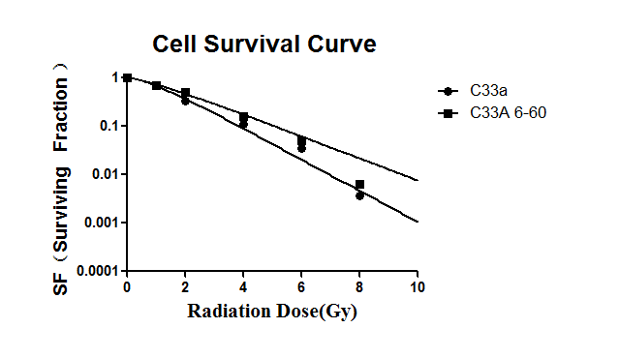
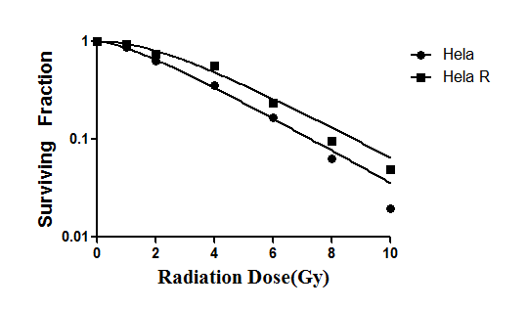
Clonogenic assay for verify radioresisitant cell lines
Cell lines | D₀ | D_{q} | SF₂
C33A | 1.343±0.028 | 0.723±0.015 | 0.516±0.058
C33AR | 1.894±0.008* | 0.752±0.006* | 0.655±0.041*
Hela | 2.592±0.007 | 1.830±0.014 | 0.6254±0.041
HelaR | 2.119±0.012* | 4.045±0.033* | 07513±0.041*
Notes:
67l;;j ./;’’KLI、、、13

Slide 16
CHIP & Radiosensitivity
Establish radioresisitant cell lines
Protein levels of CHIP are associated with telomerase activity, telomere length and radiosensitivity in cervical cancer cells
Verify the relationship between CHIP and radiosensitivity

Slide 17
Telomere length
Telomerase activity
The telomere length and telomerase activity are increased in radioresisitant cell lines. CHIP is low expression, but hTERT is hight expression in radioresistant cell lines.

Slide 18
Cell Apoptasis
Radioresisitant cells could attenuate the spontaneous and radiation induced apoptosis levels.

Slide 19
Cell Cycle
Exposure to ionizing radiation (6Gy) induced pronounced G2/M arrest in C33AR cells

Slide 20
CHIP & Radiosensitivity
Establish radioresisitant cell lines
Protein levels of CHIP are associated with telomerase activity, telomere length and radiosensitivity in cervical cancer cells
Verify the relationship between CHIP and radiosensitivity

Slide 21
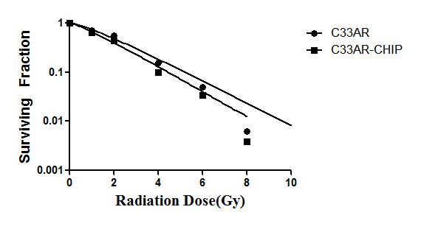
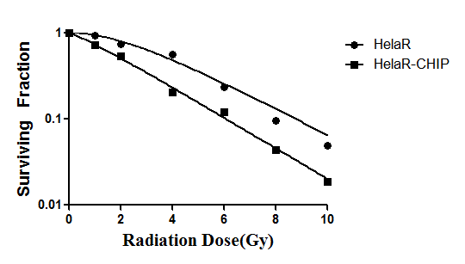


Verification
C33AR-CHIP
C33AR
HelaR
HelaR-CHIP
CHIP
Β-actin
The radiosensitivity is increasing after overexpression of CHIP in resistant cell lines.

Slide 22
Summary
Tumor suppression
CHIP
?
Radiosensitivity
increasing
hTERT ubiquitination/ other pathways

Slide 23

Thank you

Slide 24
Let Us Meet Again
We welcome you all to our future conferences of OMICS International
Please Visit:
http://integrativebiology.conferenceseries.com/
http://conferenceseries.com/
http://www.conferenceseries.com/genetics-and-molecular-biology-conferences.php

