Slide 1
STRUCTURAL SIMILARITY INDEX
ALGORITHM FOR ACCURATE
MAMMOGRAM
REGISTRATION
Huda Al-Ghaib
Utah Valley University
November 18, 2015
Biometrics % Biostatistics
San Antonio, November 18, 2015

Slide 2





Huda Al-Ghaib
Education
• B.S. in Computer Engineering, 2006
University of Technology, Baghdad-Iraq
• MSE in EE, 2012, a recipient of Fulbright Scholar
University of Alabama in Huntsville, Huntsville-Alabama
• Ph.D. in EE, 2012-2015
University of Alabama in Huntsville, Huntsville-Alabama
Employment History
• Engineer, 2007-2009
Ministry of Higher Education and Scientific Research, Baghdad-Iraq
• Research/Teaching Assistant, 2009-2015
University of Alabama in Huntsville, Huntsville, Alabama
• Assistant Professor, 2015
Utah Valley University, Orem, Utah

Slide 3
Acknowledgment
The author would like to thank
• Dr. Melanie Scott, M.D.
• Diagnostic Radiology, Breast Diagnostic Center
• Huntsville, Alabama
• Dr. Heidi Umphrey, M.D.
• Chief, Breast Imaging, Program Director Breast Imaging Fellowship, UAB
• Associate Professor, Breast Imaging Section, UAB
• Birmingham, Alabama

Slide 4
Outline
• Objective
• Breast Cancer Detection
• Screening Mammography
• Computer Aided Diagnosis
• Pectoral Muscle Detection
• Mammogram Registration
• Conclusion

Slide 5
Objective
Screening mammography often incorporates a computer aided diagnosis (CAD) scheme in its procedure to increase the accuracy of detecting gradual changes in breast tissues. One method for detecting gradual changes in temporal mammograms is through registration algorithms

Slide 6
Breast cancer
• Mammography
• Screening
• 2-D
• 3-D (Tomosynthesis)
• Diagnostic
• 2-D
• 3-D (Tomosynthesis)
• Ultrasound
• Biopsy
..
Detection

Slide 7
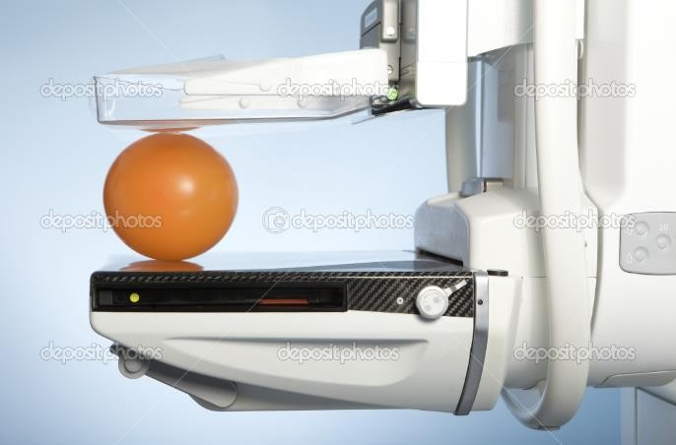
2-D Screening Mammography
A low dose X-ray machine acquires mammogram images for the breast
http://www.123royaltyfree.com/photo_12860317_laboratory-with-mammography-machine.html

Slide 8
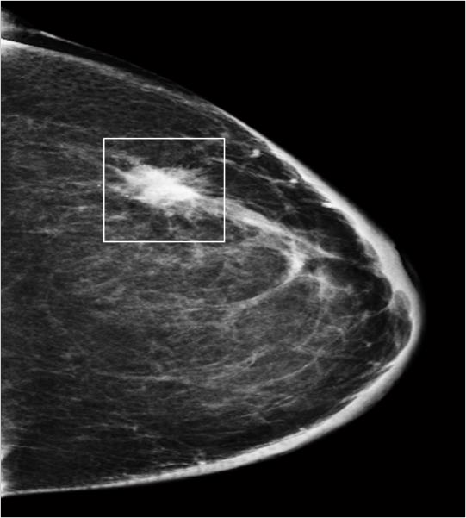
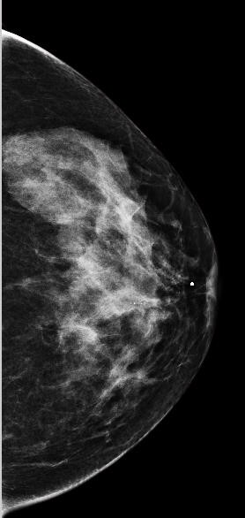
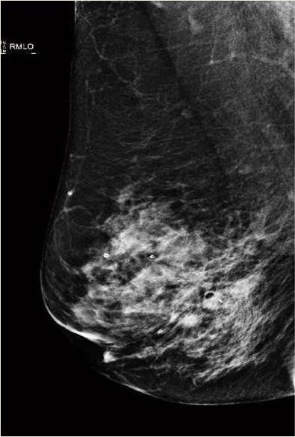
Mammographic
Appearance
of
Breast
Lesions
Mass
Calcifications
Architectural distortion

Slide 9
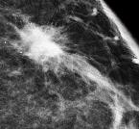
Masses

Slide 10
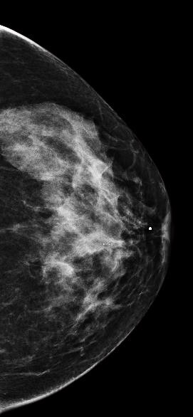
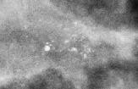
Calcifications

Slide 11
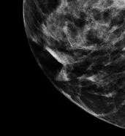
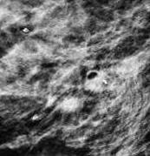
Architectural
Distortions
Nipple retraction
Spiculation radiating from a point

Slide 12
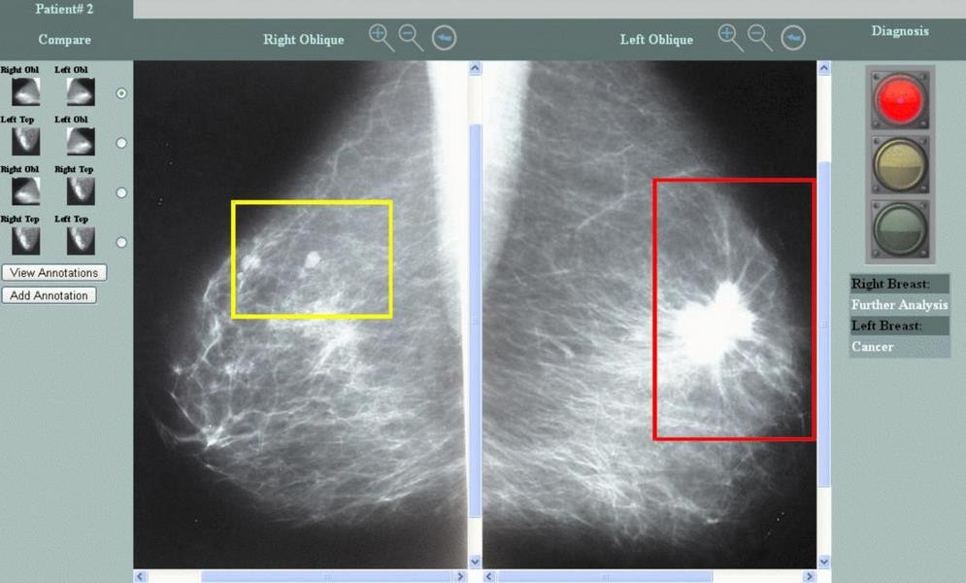
Computer-Aided Diagnosis
(CAD)
• 10-30% of breast lesions are overlooked
radiologists
• Retrospective study
by
• 48% of malignant cases signs were visible on prior
mammograms
• 9% of malignant cases were visible on screening mammograms obtained 2 years earlier
http://www.aicml.ca/?q=node/42

Slide 13
Computer-Aided Diagnosis
(CAD)
• Developing an automated diagnostic and screening
system that uses a fast computation environment for providing a second opinion
• Main goal
• Improve the accuracy and consistency of mammogram interpretation by radiologists
• Detect small gradual changes in breast tissue

Slide 14
CADs
Available CADs
• work effectively in detecting masses and calcifications
• do not incorporate registration algorithm to map information in temporal
mammograms
• incapable of detecting architectural distortion with a high level of accuracy

Slide 15
Mammogram Registration
Mammogram registration locates the differences in temporal
mammograms to provide meaningful information to the radiologist for the purpose of early breast cancer detection

Slide 16
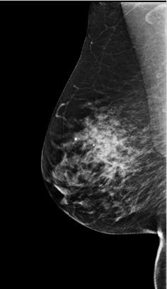
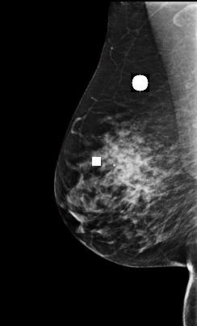
Ideal
Registration
Reference mammogram
Target mammogram

Slide 17
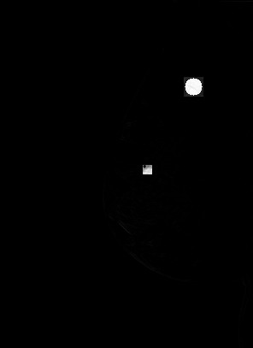
Ideal
Registration
Registered mammogram pair
image difference

Slide 18
Challenges in Mammogram
Registration
• Breast is a non-rigid object
• Variation
• Compression
• Imaging parameters
• Shape
• …

Slide 19
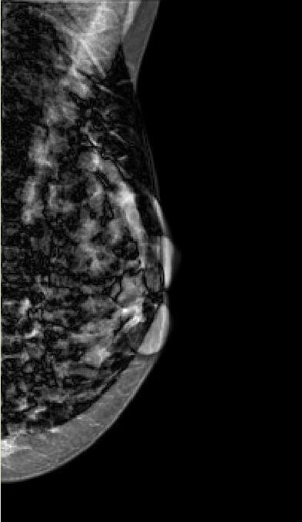
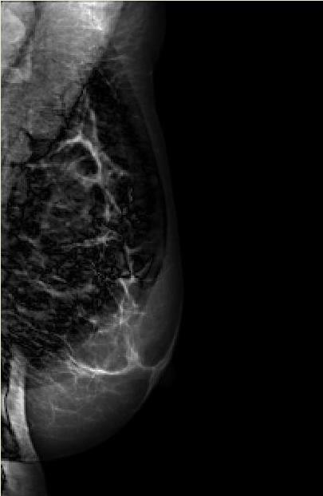
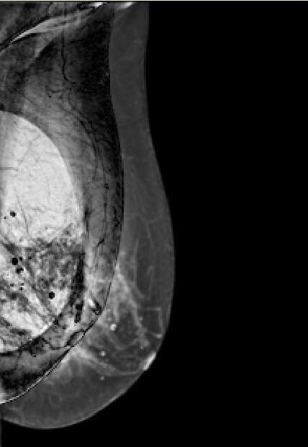
Challenges in Mammogram Registration

Slide 20
Registration Algorithm
• The pectoral muscle is removed
from
view
mammograms
with mediolateral oblique
registration algorithm
(MLO)
and
applied
for
a
• Registration Algorithm
• Preprocessing
• Transformation function
• Resampling
• Evaluation
• Objective
• Subjective

Slide 21
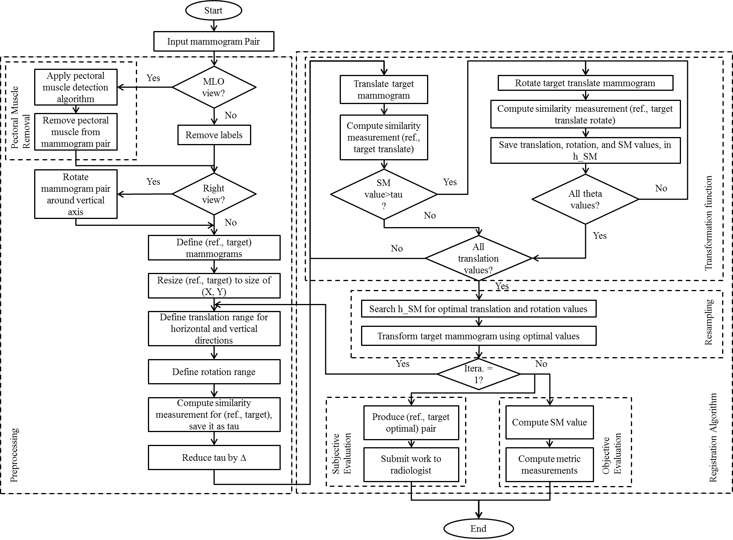

Slide 22
Similarity Measurement
• structural similarity (SSIM) index is applied to compute the maximized
similarity measurement between the registered mammogram pair
• The performance of SSIM is compared with mutual information (MI)

Slide 23
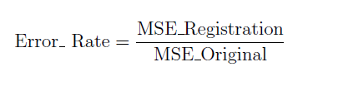
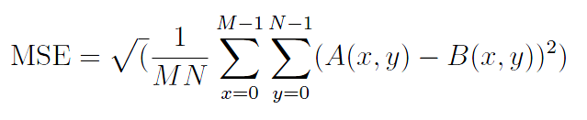
Objective Evaluation
• The registration algorithm
is
applied
on
45
of
MLO
view
• Objective
evaluation
• Subjective evaluation
• By experienced radiologist

Slide 24
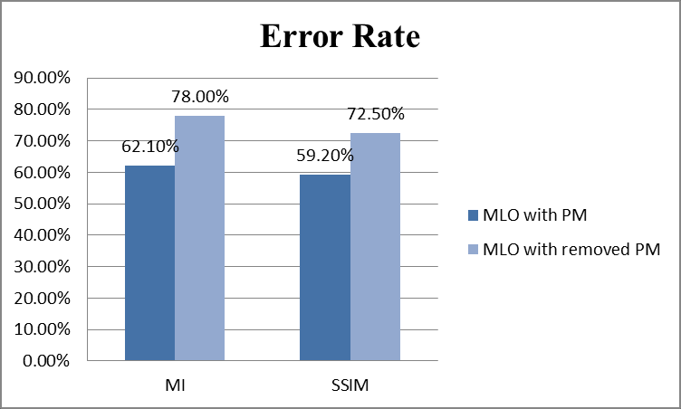
Objective Evaluation

Slide 25
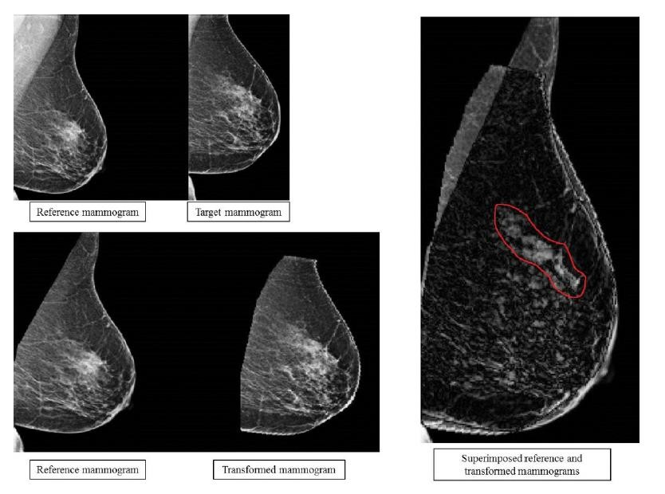
Subjective Evaluation
by
Radiologist
S3_C815

Slide 26
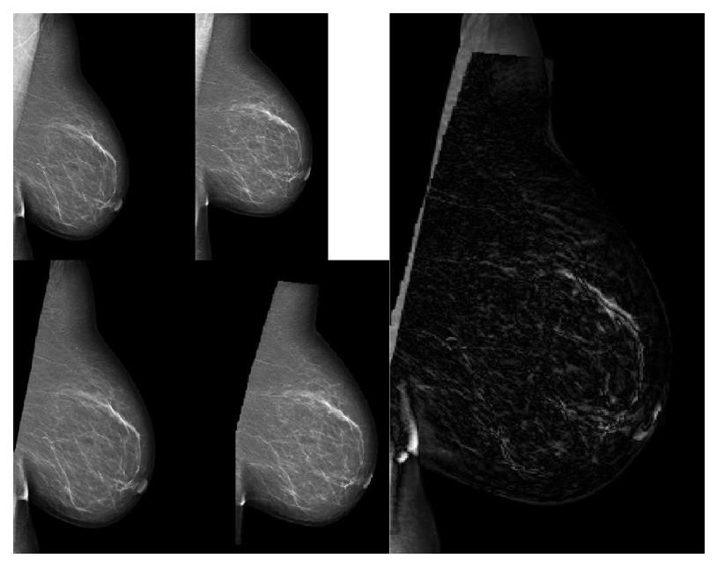
Subjective Evaluation
by
Radiologist
S1_1043, left breast

Slide 27
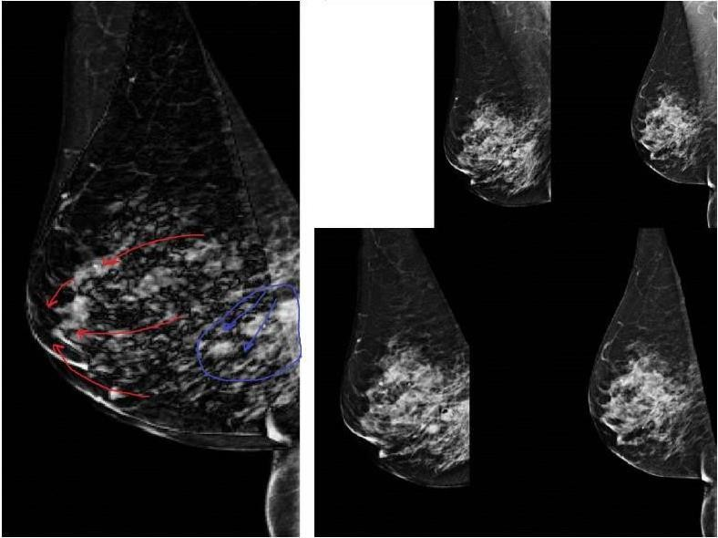
Subjective Evaluation
by
Radiologist
Diagnostic registration mammography, Case 49 and Case50, left breast

Slide 28
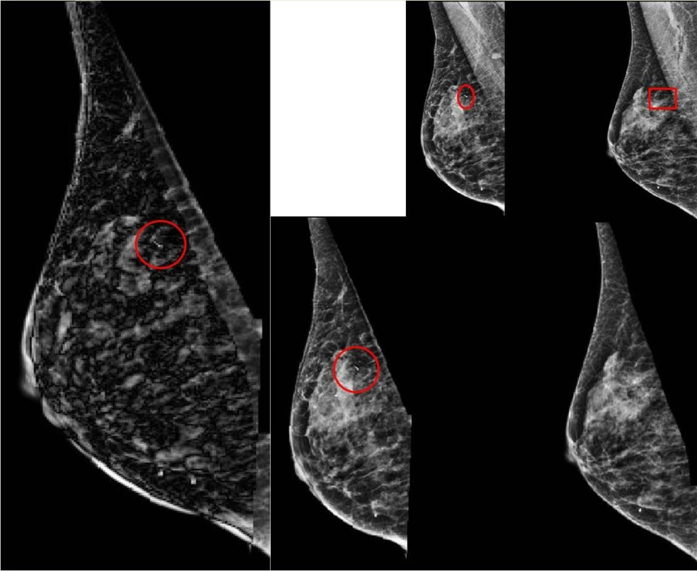
Subjective Evaluation
by
Radiologist
Case55, right breast

Slide 29
Subjective Evaluation
by Radiologist
SSIM
Performance
Count
Percentage
Better
16
35.56%
Same
21
46.66%
Worse
8
17.78%
Total
45
100%

Slide 30
Conclusion
• Mammogram registration
• Reduced error rate when the
• 72.50% to 59.20%
pectoral muscle is removed
• Applied SSIM and compare it with MI for MLO view with
removed pectoral muscle, and MLO view with pectoral muscle, respectively
• (59.40%, 72.50%) for SSIM
• (64.30%, 78.00%) for MI

Slide 31

31
Publications
Journals and Magazines

Slide 32

32
Publications
Conferences

Slide 33

Questions

