Slide 1

Tissue Engineering Approaches to
Model Cancer
Huanhuan Joyce Chen, PhD
Meyer Cancer Center, Weill Cornell Medicine
Biomedical Engineering, Cornell University

Slide 2
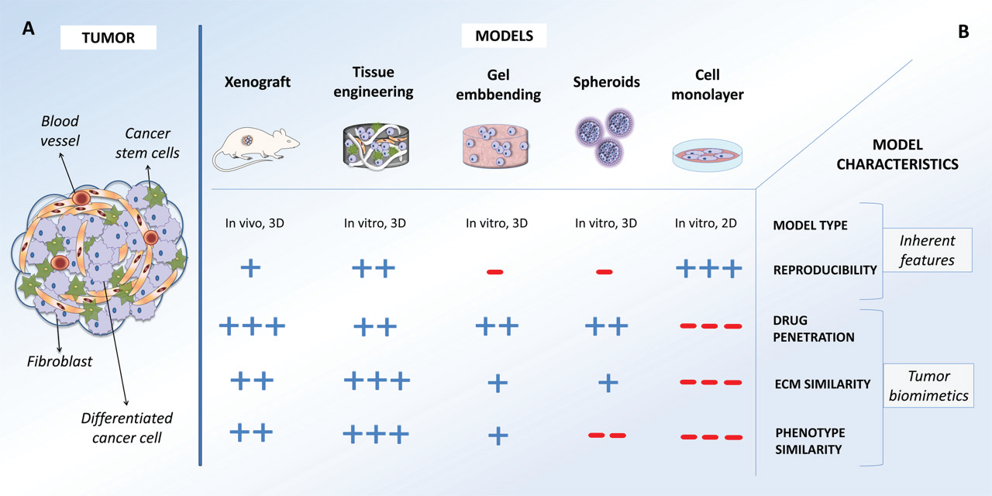
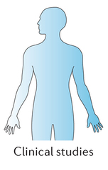

Development of cancer models
Cancer diseases ----- the most deadly diseases driven by mutations in cancer genes
Understanding cancer biology
Tumor microenvironment
Tumor heterogeneity & cancer stem cells
Development of effective therapies
poor translation to clinical applications
< 8%

Slide 3

Ex vivo cancer models
Limitation in currently existing systems
shortage of concordance with human studies --- poor translation into clinical study
1. Conventional 2D cell culture models:
No interactions of tumor cells with extracellular matrix (ECM);
Not replicating tissue-specific microenvironment.
2. Animal models:
Short of appropriate resolution and sensitivity;
Costly, time-consuming;
Considerable differences to human cancers regarding to oncogenic transformation.
refined models
Clinical
research
Cell culture
Animal models
Notes:
Animal models are not perfect, from my personal feeling, worry about long-term preparation, smelly and biting.

Slide 4
Ex vivo cancer models
Limitation in currently existing systems
Intrinsic difficulty in studying cancer genetics:
Difficult to identify drivers from passengers
Difficult to explore low-frequency mutations
through reverse genetics study
Notes:
More human mimic conditions.

Slide 5
Ex vivo cancer models
Solutions :
shortage of concordance of human studies
--------- ex vivo cancer models using human – origin components
Intrinsic difficulty in studying cancer genetics
--------- Forward genetic study: transposon-mediated mutagenesis

Slide 6
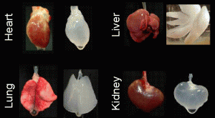
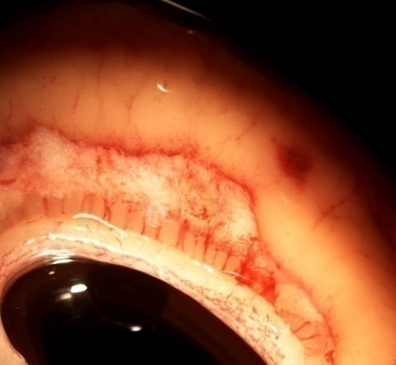
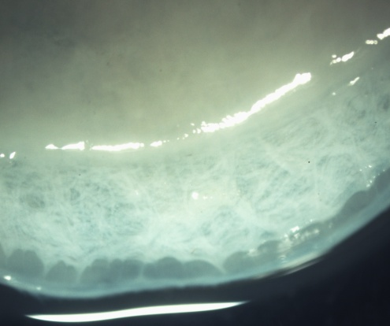
Decellularization
De/re-cellularization in regenerative tissue engineering
Generation of acellular human colon matrix
ML
Mucosa
Native
SM
Ott, et. al, Nat. Med. 2008, 14; 213
Mucosa
ML
M
Decellularized
SM
SM
*
*
*
ML
Intact muscularis mucosa layer
Chen, HJ., et.,al. Nature. Biotech, (2016) Jul 11.

Slide 7
Decellularization
Characterization of acellular colon matrix
F-actin
Collagen I
Laminin
Fibronectin
Native
DAPI
DAPI
DAPI
DAPI
F-actin
Collagen I
Laminin
Fibronectin
decellularized
DAPI
DAPI
DAPI
DAPI
Chen, HJ., et.,al. Nature. Biotech, (2016) Jul 11.

Slide 8
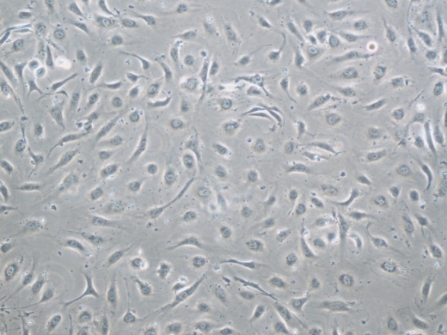
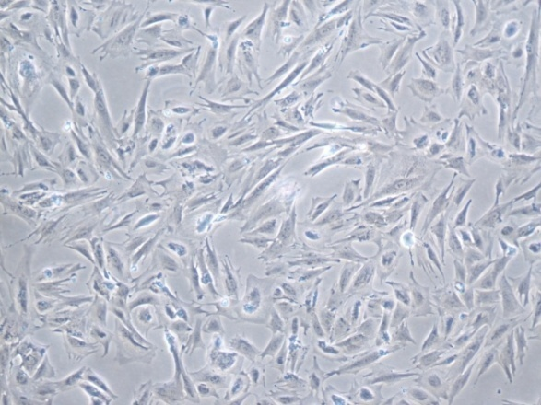
Human colonic epithelial cells (hCECs).
hCEC in 3D culture
Day 1 2 3 4 6
hCEC contains stem cell like cells and forms crypt-like structure
Human colonic microvascular endothelial cells
Human colonic myofibroblasts
CD31
α-smooth muscle actin

Slide 9
Recellularization
Native colon
Recellularized colon
H&E
H&E
ML
ML
Keratin
Fibronectin
Keratin
Fibronectin

Slide 10
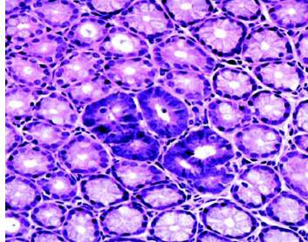
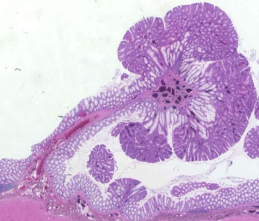
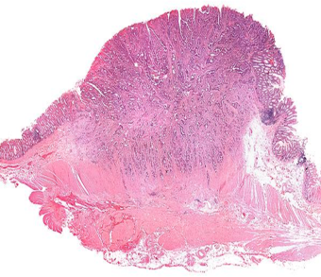
CRC progression
High –frequency mutations correlated to distinct steps in CRC progression
KRAS
BRAF
TP53
Notch
TGF-β/SMAD
APC
Distant metastasis
Adenoma Carcinoma in situ invasive CRC
90%
5%
(Wood, et.al. Science. 2007; 318, 1109-1113)
Notes:
According to vogertstin models, If we picture crc genome landscape, high-frequency and low , like maintain and hills.
correlated well with physiological features.
Thanks to advance of secondary generation sequencing, uncover. Explore.

Slide 11
Malignant transformation
Native colon
Recellularized colon
Recellularized colon with APC- hCEC
C
D
E
F
Recellularized colon with APC- KRAS+ hCEC
Recellularized colon with APC- KRAS+TGF-β- hCEC
G
H
I
J
M
Keratin
Fibronectin
SM
Notes:
These results indicate that the ex vivo crc models can recapitulate the different stages of CRC disease from mucosa in situ to submucosa invasion.

Slide 12
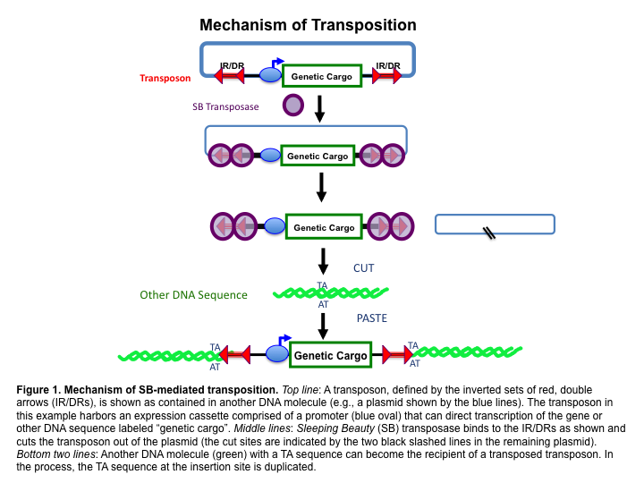
Transposon mediated mutagenesis
Forward genetic study: Sleeping Beauty (SB) transposon-mediated mutagenesis
Mechanism of “Cut & Paste” of SB transposon system
NG Copeland & NA Jenkins, Nat. Rev. Cancer 2010; 696-706

Slide 13
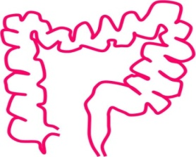
Schematics of SB – based genetics screen
decellularization
recellularization
APC- hCEC
Normal human colon
Acellular matrix
Recellularized colon
APC- SB hCEC
In situ neoplasia
Invasive neoplasia

Slide 14
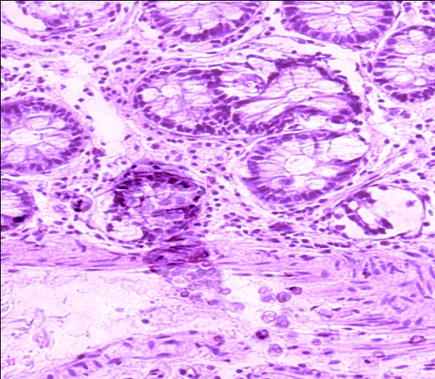
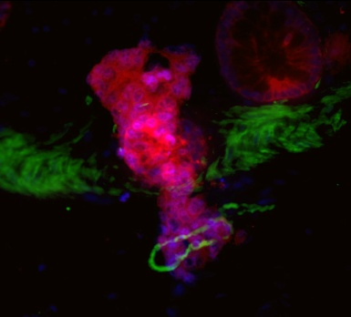
ex vivo CRC models with SB mediated mutagenesis
SB induced submucosa invasion
A
B
P = 0.002
H&E
Keratin
Fibronectin
Invasive neoplasia #/
5 cm³ recellularized colon
control
C
D
invasive

Slide 15
ex vivo CRC models with SB mediated mutagenesis
In vitro recapitulate CRC in different stages within weeks
G
H
I
In situ
Week 2
invasive
Week 4
invasive
Week 6
Nature. Rev. Gastroenterology & Hepatology, 2016, July

Slide 16
 |  | No. unique | No. invasive neoplasia | Mutation frequency | mRNA level change
Gene symbol | Chromosome | insertions | with insertions** | in CRC patients | in CRC patients
AFF3 | 2 | 1 | 1 | 5% | 0.1
AKTIP | 16 | 1 | 1 | 1% | 0.8
ANTXR1 | 2 | 1 | 1 | 1% | 1.2
ASXL2 | 2 | 1 | 1 | 2% | 0.8
CAMTA1 | 1 | 1 | 1 | 8% | 0.8
CSTF3 | 11 | 1 | 2 | 2% | 1.6
DBF4 | 7 | 1 | 1 | 2% | 2.3
DCC | 18 | 1 | 1 | 9% | 0.8
DDX20 | 1 | 1 | 1 | 1% | 1.3
DENND2C | 1 | 1 | 1 | 6% | 0.9
DMXL2 | 15 | 1 | 1 | 10% | 0.6
EPHB1 | 3 | 1 | 1 | 4% | 2.4
EPHB2 | 1 | 1 | 1 | 4% | 1.8
FGF13 | X | 1 | 1 | 2% | 0.3
JAK1 | 1 | 1 | 1 | 6% | 0.4
FSTL5 | 4 | 1 | 1 | 2% | 1.2
FXR1 | 3 | 1 | 1 | 6% | 3.7
GRM8 | 7 | 1 | 2 | 2% | 0.7
KDM2B | 12 | 1 | 2 | 2% | 1.4
LATS2 | 13 | 2 | 2 | 5% | 0.8
LPP | 3 | 1 | 1 | 2% | 0.3
MAML3 | 4 | 1 | 1 | 1% | 0.6
MITF | 3 | 1 | 1 | 3% | 0.4
MSH2 | 2 | 1 | 1 | 3% | 1.5
NRCAM | 7 | 1 | 1 | 4% | 0.9
PAX7 | 1 | 1 | 2 | 7% | 3.9
PDE4DIP | 1 | 1 | 1 | 5% | 0.7
PRKG1 | 10 | 1 | 1 | 9% | 0.4
PTPRD | 9 | 2 | 3 | 6% | 0.7
ROCK1 | 18 | 1 | 1 | 5% | 0.7
RPAP1 | 15 | 1 | 1 | 4% | 1.3
SEMA6D | 15 | 1 | 1 | 6% | 0.1
STAT3 | 17 | 1 | 1 | 4% | 0.8
SUPT3H | 6 | 1 | 1 | 3% | 1.7
TCF7L2 | 10 | 1 | 2 | 14% | 0.6
TTN | 2 | 1 | 1 | 40% | 1.0
TWIST2 | 2 | 1 | 1 | 1% | 0.3
WNT9B | 17 | 1 | 1 | 2% | 1.3
Candidate diver genes

Slide 17
Candidates have been identified as malignancy drivers in CRC
 | Number of | Invasive neoplasia | Predicted effects | Function
Gene symbol | insertions | with insertions | on gene
AKTIP | 1 | 1 | Loss | AKT signaling
DCC | 1 | 1 | Loss | Cell adhesion/apoptosis signaling
EPHB1 | 1 | 1 | Loss | Cell migration and adhesion
EPHB2 | 1 | 1 | Loss | Cell migration and adhesion
FSTL5 | 1 | 1 | NP | Calcium ion binding
JAK1 | 1 | 1 | NP | STAT signaling
LATS2 | 2 | 2 | Loss | P53 signaling
MAML3 | 1 | 1 | Loss | NOTCH signaling
MSH2 | 1 | 1 | Loss | DNA mismatch repair
NRCAM | 1 | 1 | NP | Cell adhesion
PTPRD | 2 | 3 | Loss | Cell growth and differentiation
ROCK1 | 1 | 1 | Gain | Cell motility
STAT3 | 1 | 1 | Gain | STAT signaling
TCF7L2 | 1 | 2 | NP | WNT signaling
TTN | 1 | 1 | NP | Cell motility
TWIST2 | 1 | 1 | NP | Epithelial to mesenchymal transition
WNT9B | 1 | 1 | Gain | WNT signaling

Slide 18
Summary
ex vivo human colon model from native matrix
2. ex vivo human CRC model mimicking diseases in different stages
3. Combining with SB allows rapid forward genetics screens in human tissues
4. explore new driver genes in CRC progression.

Slide 19



Acknowledgement
----- Michael Shuler, PhD (Cornell University)
Paula Miller
Wang Ying PhD
Mandy Esch PhD
----- Nancy Jenkins, PhD and Neal Copeland, PhD (Methodist hospital research institute)
Zhubo Wei PhD
----- Harold Varmus, MD (Weill Cornell Medicine)
Collaborators:
Steven Lipkin, MD. PhD (Weill Cornell Medicine)
Jian Sun, PhD
Shuibing Chen, PhD (Weill Cornell Medicine)
Rita Serda, PhD (Methodist hospital research institute)
Winfried Edelmann, PhD (Albert Einstein Medical school)
Robert Edwards, MD. PhD (UC-Irvine)
Zeynep H. Gümüş, PhD (New York University)
Xiling Shen, PhD (Duke University)
Notes:
First I want to thank my current postdoc mentor, Dr. Harold Varmus, especially for his encouragement, as a pure biologist of US cancer chef, Noble laurate for discovery first oncogene, Harold believes confronting cancer complexity, engineering approach could be one of the solutions.
Thanks my mentor Micheal Schuler for supporting ex vivo human cancer models.
Thanks biomentors Neal and Nancy, as world pretiguous biologist on mouse genetics, they very support the forward genetic study on human tissues.
Thanks my biomentor Steven Lipkin for providing precious clinical samples and resources.

