Slide 1
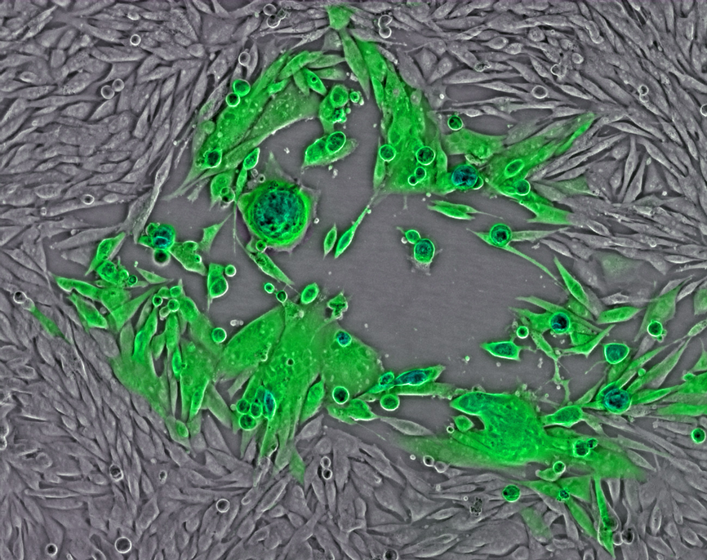
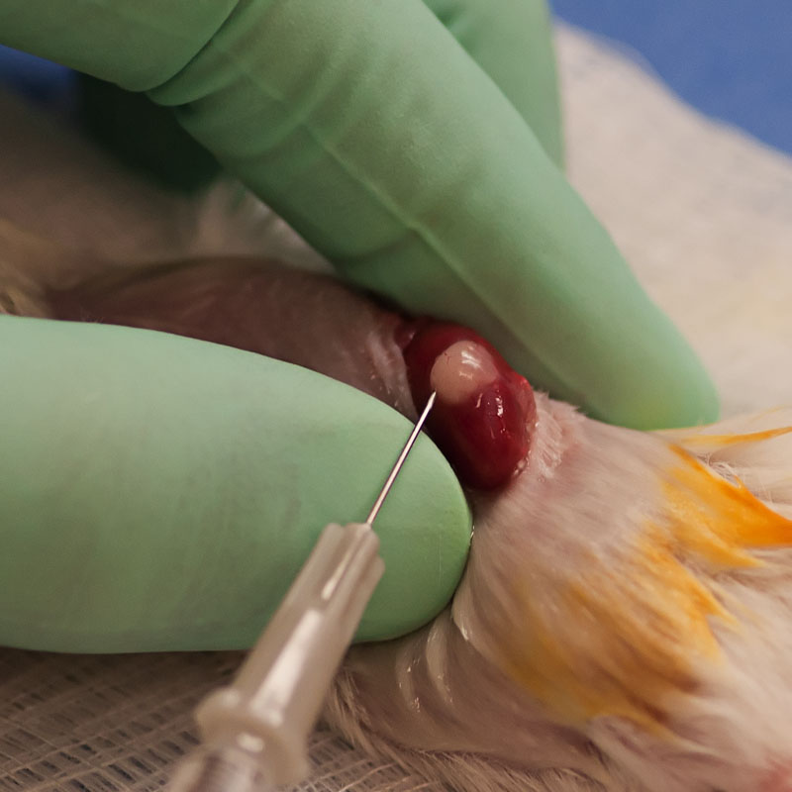
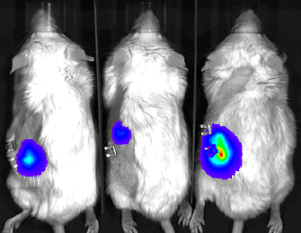
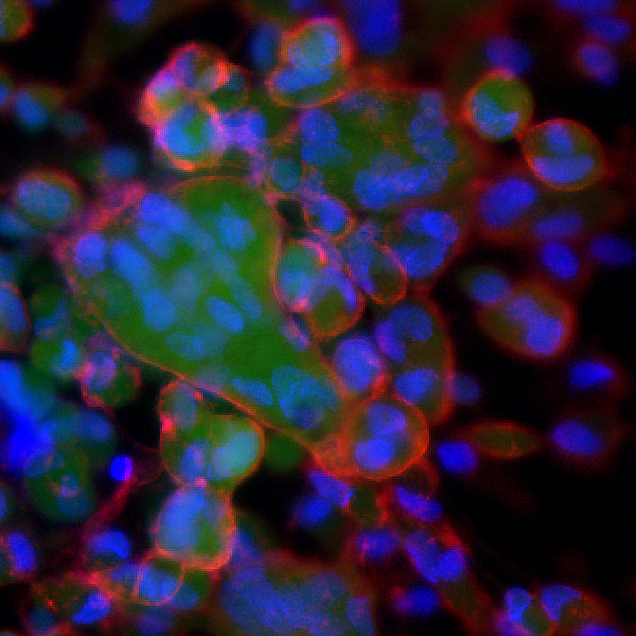
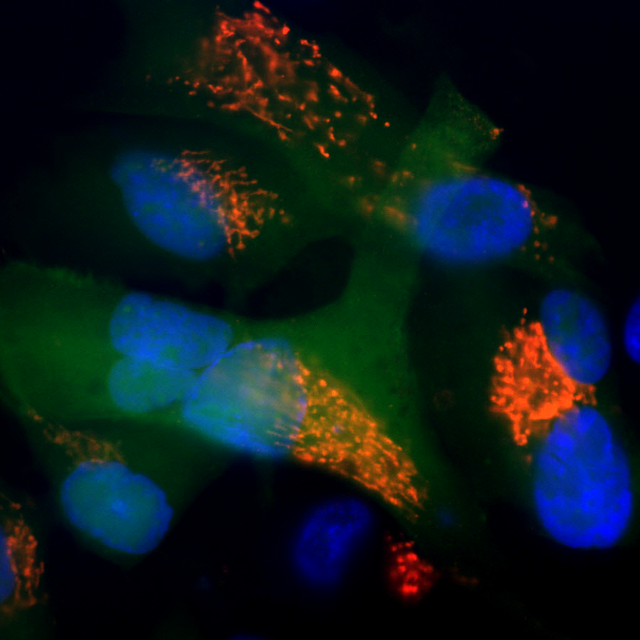
Role of ORF7 in Varicella Zoster Virus Tissue Tropism and Potential for Novel Vaccines
Hua Zhu, Ph.D.
Department of Microbiology, Biochemistry and Molecular Genetics
Rutgers University - New Jersey Medical School
zhuhu@njms.rutgers.edu

Slide 2
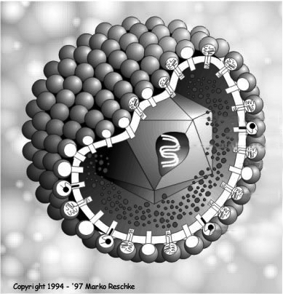
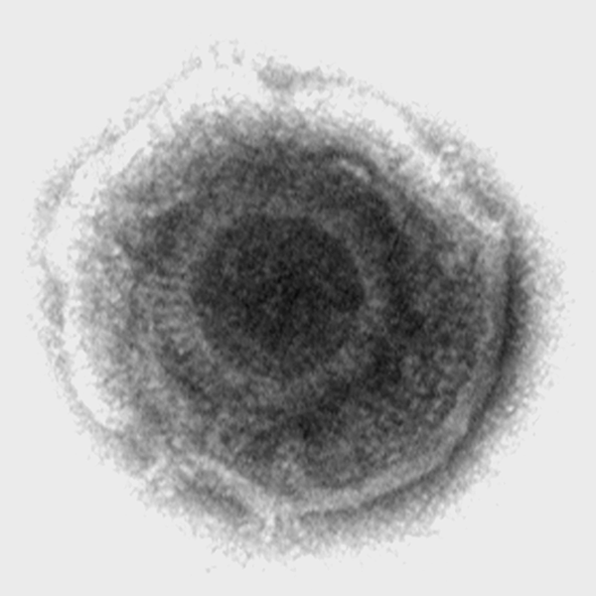
Biology of VZV
Herpesvirus family
Alpha-herpesvirus subgroup (HSV-1, HSV-2)
Typical herpesvirus structure
A linear double-stranded DNA, 125 Kb, 71 ORFs
Clinical strain: pOka
icosahedral
nucleocapsid
dsDNA
envelope
glycoprotein
tegument
H. Zhu

Slide 3
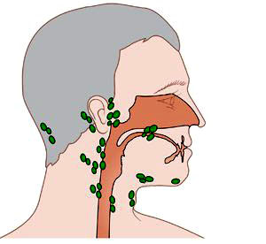
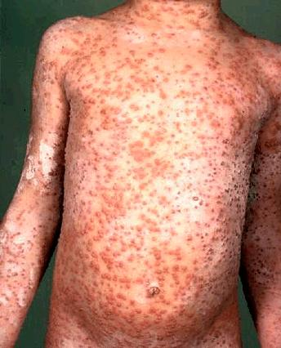
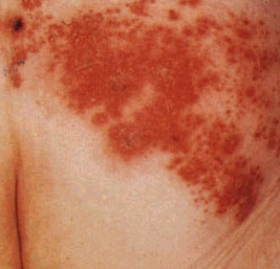
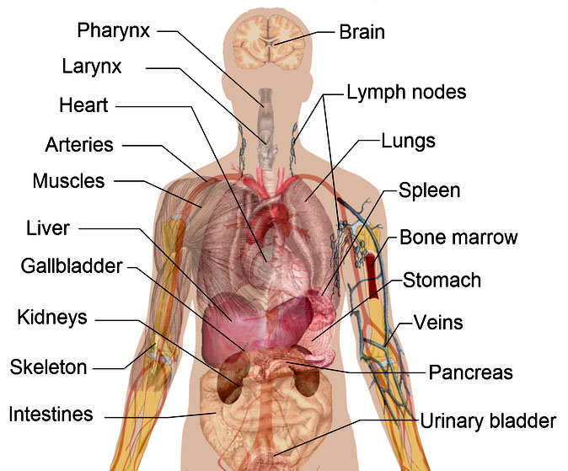
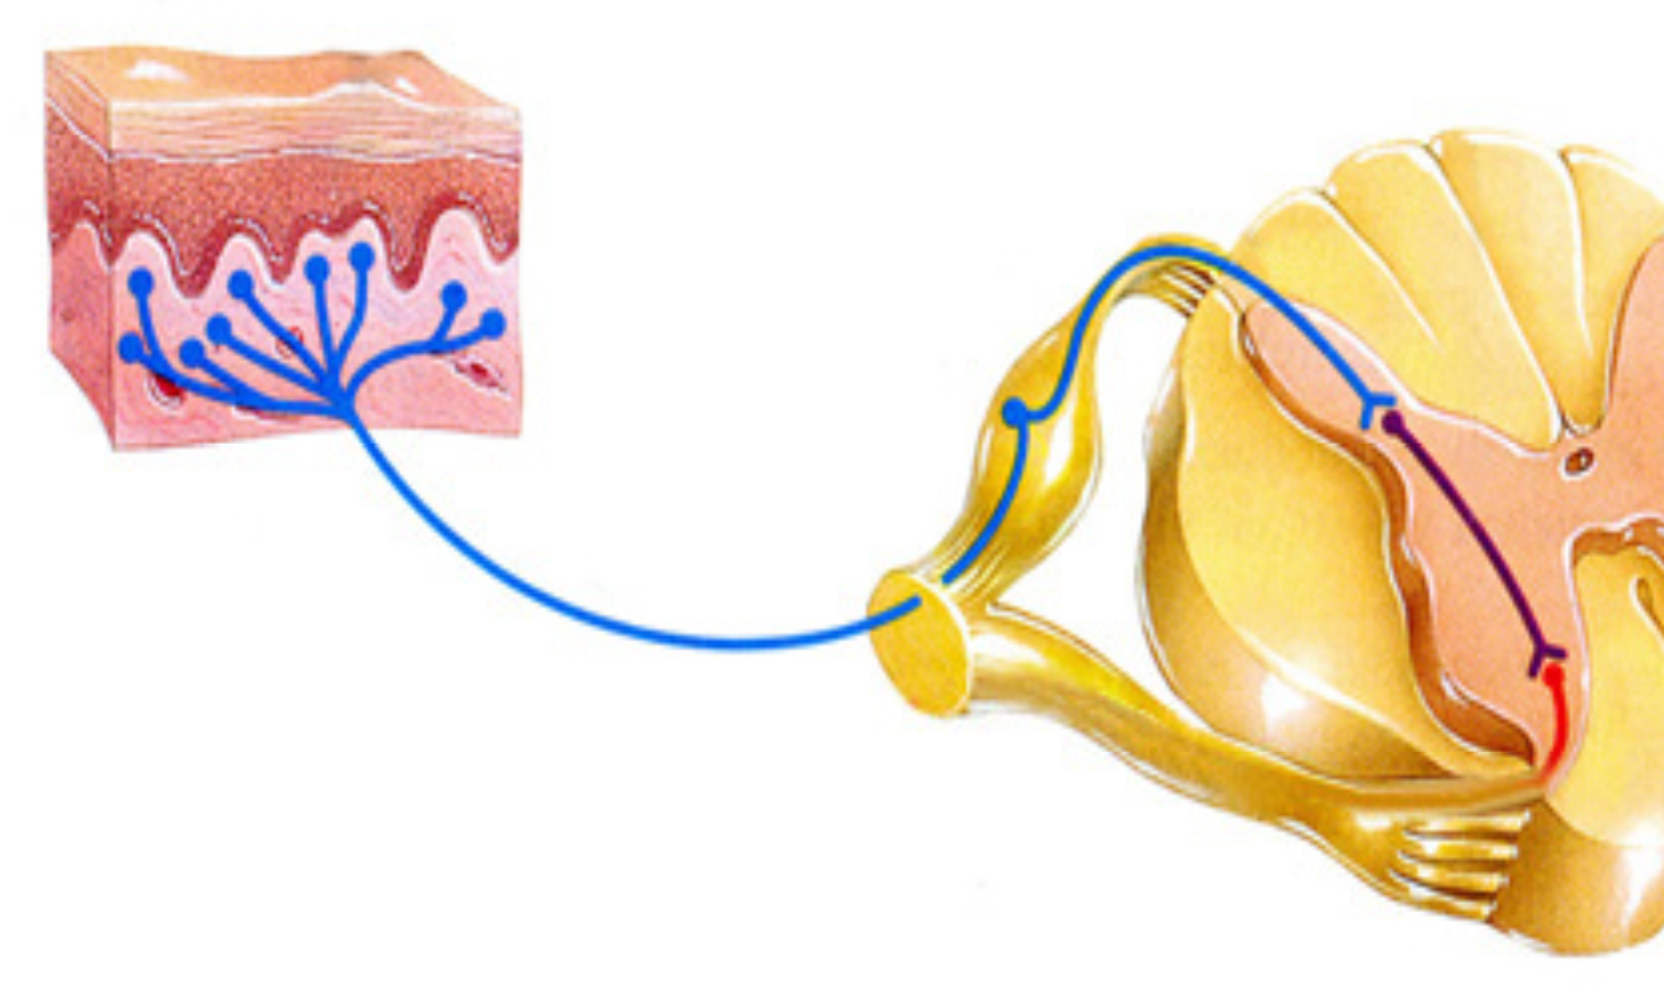
VZV Disease Model
Enter mucosal
surfaces
Dendritic cells
Lymph node
T-cells
Transmitted by infected T cells (1st viremia)
Infect skin
causing chickenpox
Infect skin
causing shingles/PHN
Skin
2nd viremia
DRG
Reactivation
Infect sensory ganlia and establish latent infection
Amplified in the internal organs
Notes:
带状疱疹后遗神经痛(Postherpetic neuralgia,PHN)_

Slide 4
Herpes Zoster
Episodes are almost always accompanied by excruciating pain
~50% chance of experiencing HZ if 85 or older
Nerve damage results in postherpetic neuralgia (PHN) in 10-30% cases
Treatment is only partly effective
Notes:
http://www.merriam-webster.com/audio.php?file=neural03&word=neuralgia&text=\n%3Cspan%20class%3D%22unicode%22%3Eu%CC%87%3C%2Fspan%3E-%3Cspan%20class%3D%22unicode%22%3E%CB%88%3C%2Fspan%3Eral-j%C9%99%2C%20ny%3Cspan%20class%3D%22unicode%22%3Eu%CC%87%3C%2Fspan%3E-\

Slide 5
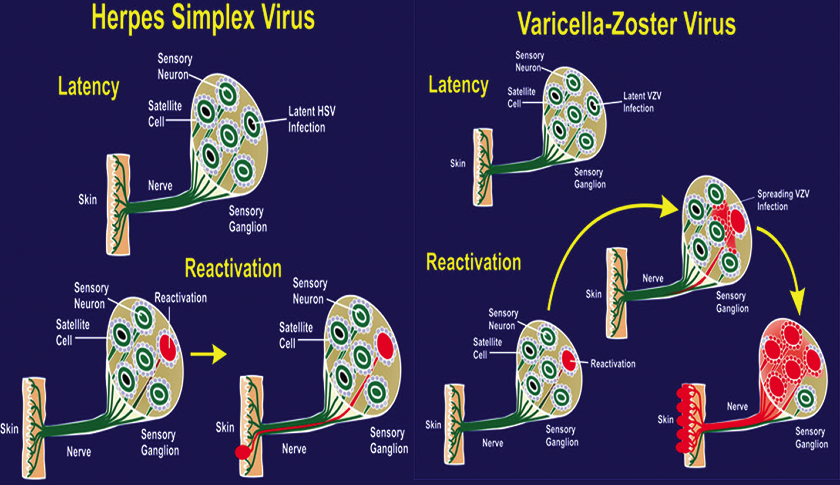
HSV and VZV latency and reactivation in the sensory ganglion
Notes:
Figure 1. Herpes simplex virus (HSV) and varicella-zoster virus (VZV) latency and reactivation in the sensory ganglion. Neurons with black nuclei
are latently infected. Red indicates reactivation and, in the case of VZV, spread of infection within the ganglion. dermatome

Slide 6
VZV Vaccines (vOka)
Chickenpox: Varivax (Merck) and Varilrix (GSK)
  Mandated in US in 1995
  ~70-90% effectiveness
  Live attenuated vOka, 1,350 PFU/dose
Herpes Zoster: Zostavax® (Merck)
  Recommended in 2006
  Used for adults 50 years or older
  ~55% effectiveness
  Live attenuated vOka, 19,400 PFU/dose
  GSK – subunit HZ vaccine (gE) in clinical trials

Slide 7
vOka
Potential Problems:
NEUROVIRULENCE
    vOka is a live neurovirulent mixed strain
INFECTIVITY
    Cases of vOka generated chickenpox and zoster have been reported; breaking through infection chickenpox is ~2%
LIMITED PRODUCTION
CANNOT BE MANIPULATED
CANNOT BE USED AS A VIRAL VECTOR

Slide 8
Goal
Developing the next generation of VZV vaccine
skin and neuroattenuated
genetically defined
easily manipulated
high yield

Slide 9
VZV Genome
0
2
7
9A
9
10
11
12
13
17
21
22
20k
TRL
1 nt
UL
40k
1
3
4
5
6
8
14
15
16
18
19
20
26
27
29
30
31
32
36
37
39
40
41
43
44
46
60k
80k
23
24
25
28
33
34
35
38
42
45
47
Ori
48
49
51
52
55
56
63
64
66
67
68
71
100k
IRL
IRS
120k
US
TRS
125k
50
53
Ori
54
57
59
61
62
65
69
70
58
60

Slide 10
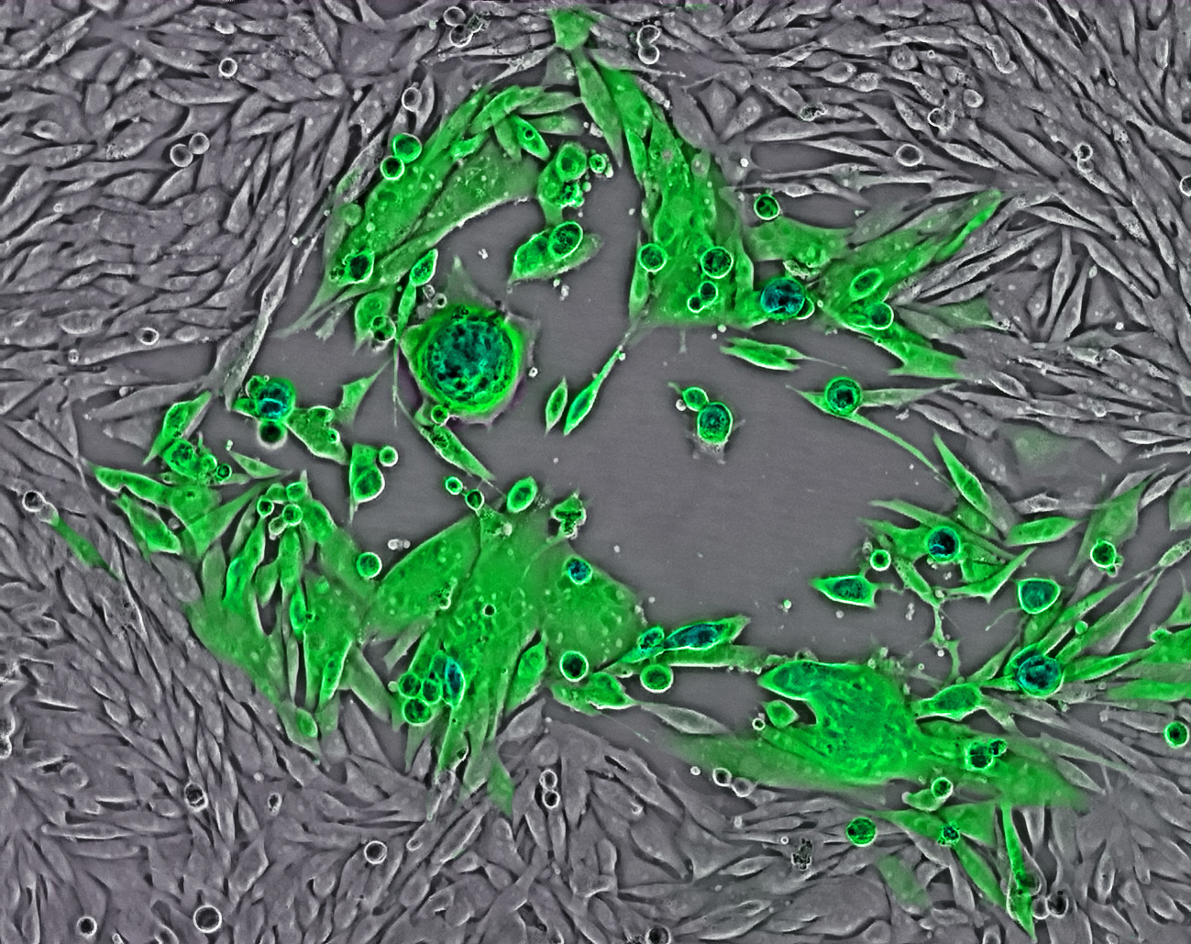
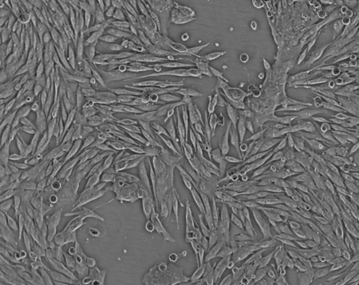
Difficult to study:
Narrow host range
Lack of animal models
Highly cell-associated
Grow by virus-to-cell spread and
cell-to-cell fusion (syncytia formation)
Difficulty in making recombinant virus
Isolate viral
DNA
Co-
transfection
Plaque
purification

Slide 11

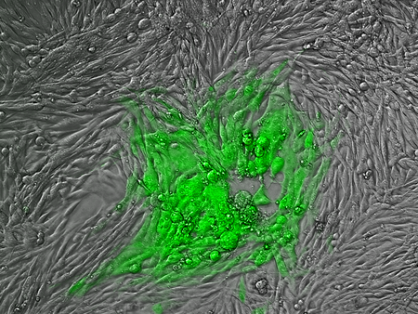
Construction of VZV BAC
UL
US
pOka
0
10
20
30
40
50
60
70
80
90
100
110
125 kb
pvFsp73
pvSpe14
pvPme19
ORF60-61
VZV Cosmids
pvSpe23
BAC (cm^{R} & GFP)/loxP
MeWo
VZV growth curve
6
5
Cm
log (PFU/ml)
4
3
pOka-B
E. coli
2
pOka
Analysis
1
2
3
4
5
6
7
days post infection

Slide 12
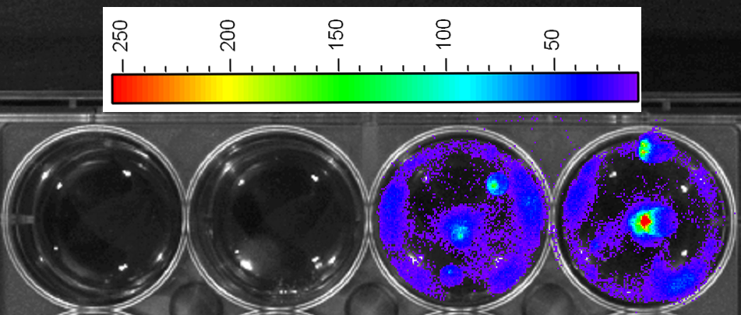

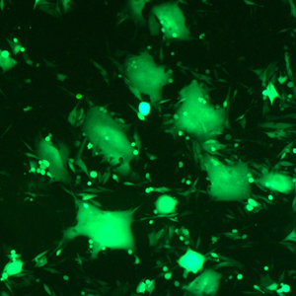
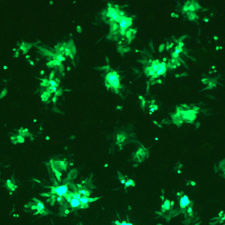
Construction of A VZV with Luciferase Gene
UL
US
pOka
0
10
20
30
40
50
60
70
80
90
100
110
125 kb
ORF65-66
Luciferase
1X10⁵
1X10⁸
1X10⁴
1X10⁷
Titer (PFU/well)
Total photon counts
1X10³
1X10⁶
1X10²
Plaque Assay
1X10⁵
IVIS Luc Assay
1X10¹
0
1
2
3
4
5
6
7
1X10⁴
dpi
pOka-B
pOka-L

Slide 13
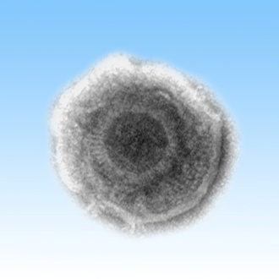
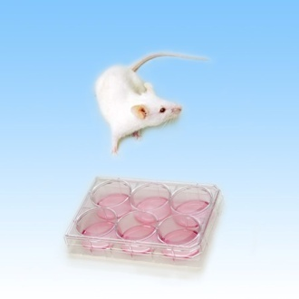
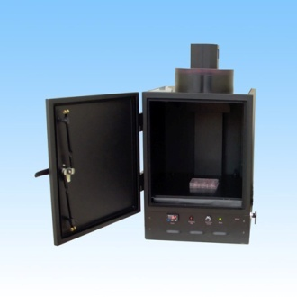
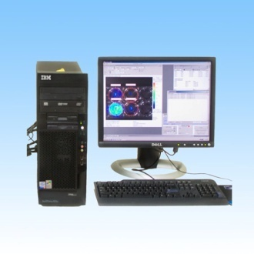
Bioluminescence Imaging Technique
(Xenogen IVIS®)
A. Virus with Luciferase
B. Animal/cell models
C. Image acquisition
D. Data analysis

Slide 14
Functional Profiling
A linear double-stranded DNA, 125-kb, 71 ORFs
0
2
7
9A
9
10
11
12
13
17
21
22
20k
TRL
1 nt
UL
40k
1
3
4
5
6
8
14
15
16
18
19
20
26
27
29
30
31
32
36
37
39
40
41
43
44
46
60k
80k
23
24
25
28
33
34
35
38
42
45
47
Ori
48
49
51
52
55
56
63
64
66
67
68
71
100k
IRL
IRS
120k
US
TRS
125k
50
53
Ori
54
57
59
61
62
65
69
70
58
60

Slide 15
Summary of Genetic Analysis of VZV ORFs
ORF
1
2
3
7
8^{S}
10
11
12
13
14
15
36
47^{S}
57
58
59^{S}
64/69
65
44 ORFs essential
18 ORFs fully dispensable in MeWo cells
70 VZV ORFs
26 ORFs nonessential
8 ORFs with severe growth defect in MeWo cells

Slide 16
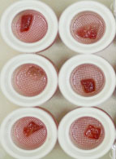
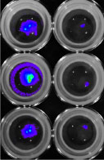
Analysis of VZV Mutant Replication in Human
Fetal Skin Organ Culture (SOC) System
ORF
1
2
3
7
8^{S}
10
11
12
13
14
15
36
47^{S}
57
58
59^{S}
64/69
65
_{MeWo}
1.00E+08
WT
Mu
WT
Mu
1.00E+07
pOka-L
ORF7D
Photon Counts
ORF7R
ORF10D
ORF10R
1.00E+06
ORF47D
Mock
1.00E+05
0
2
4
6
8
DPI
_{SOC}
1.00E+09
1.00E+08
pOka-L
ORF7D
Photon Counts
ORF7R
ORF10D
ORF10R
1.00E+07
ORF47D
Mock
1.00E+06
0
2
4
6
8
DPI

Slide 17
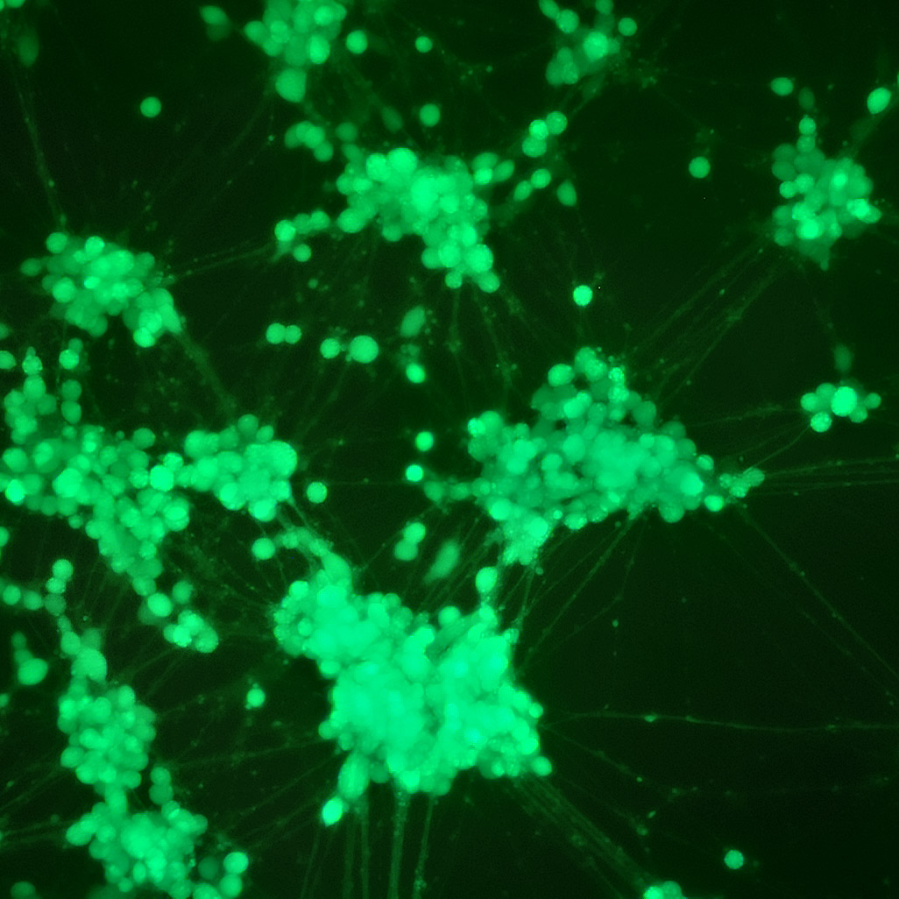
Analysis of VZV Mutant Replication in Human
Nuroblastoma Cell Line (SH-SY5Y)
ORF
1
2
3
7
8^{S}
10
11
12
13
14
15
36
47^{S}
57
58
59^{S}
64/69
65

Slide 18
Screening Neurotropic ORFs
VZV ORF | MeWo | ARPE-19 | SOC | SH-SY5Y
1 | + | + | + | +
2 | + | + | + | +
3 | + | + | + | +
7 | + | + | - | -
8^{S} | + | + | + | +
10 | + | + | - | +
11 | + | + | + | +
12 | + | + | + | +
13 | + | + | + | +
14 | + | + | - | +
15 | + | + | + | +
36 | + | + | + | +
47^{S} | + | + | - | +
57 | + | + | + | +
58 | + | + | + | +
59^{S} | + | + | + | +
64/69 | + | + | + | +
65 | + | + | + | +

Slide 19
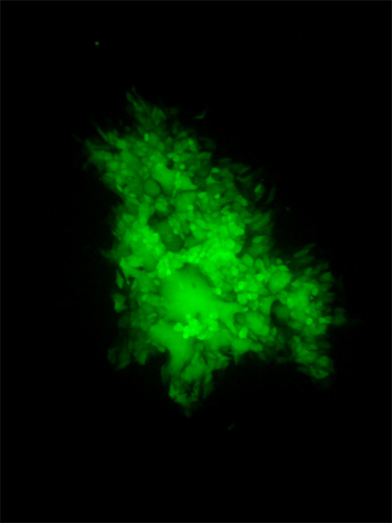
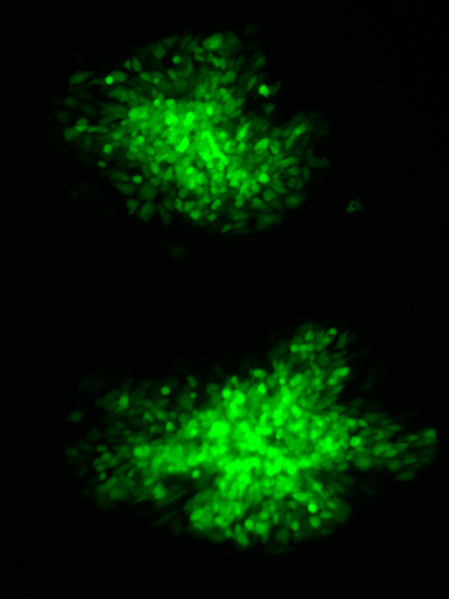
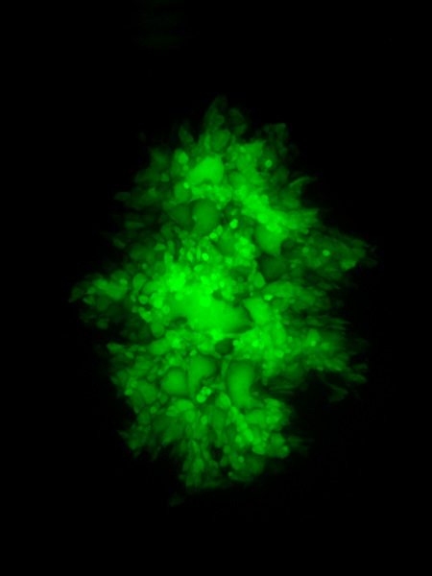
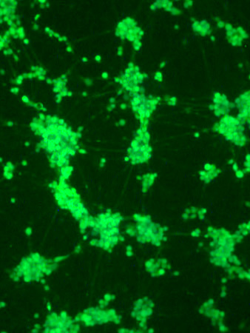
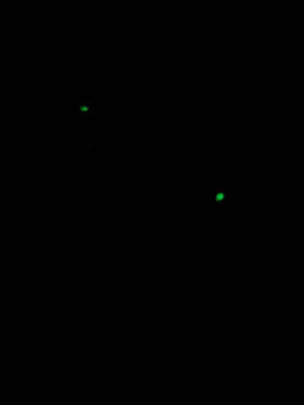
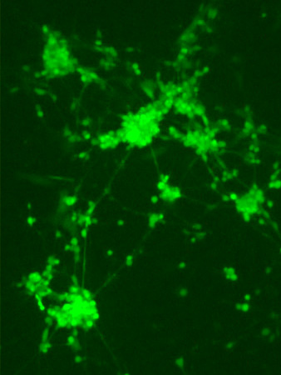
WT
7D
7R
ARPE-19
SH-SY5Y

Slide 20
Summary of Genetic Analysis of VZV ORFs
₀
₂
₇
_{9A}
₉
₁₀
₁₁
₁₂
₁₃
₁₇
₂₁
₂₂
_{20k}
_{40k}
_{TRL}
_{1 nt}
_{UL}
₁
₃
₄
₅
₆
₈
₁₄
₁₅
₁₆
₁₈
₁₉
₂₀
₂₆
₂₇
₂₉
₃₀
₃₁
₃₂
₃₆
₃₇
₃₉
₄₀
₄₁
₄₃
₄₄
₄₆
_{60k}
_{80k}
₂₃
₂₄
₂₅
₂₈
₃₃
₃₄
₃₅
₃₈
₄₂
₄₅
₄₇
₄₈
₄₉
₅₁
₅₂
₅₅
₅₆
_{Ori}
₆₃
₆₄
₆₆
₆₇
₆₈
₇₁
_{100k}
_{IRL}
_{IRS}
_{120k}
_{US}
_{TRS}
_{125k}
₅₀
₅₃
₅₄
₅₇
₅₉
₆₁
₆₂
₆₅
₆₉
₇₀
_{Ori}
₅₈
₆₀
_{44 Essential}
_{8 Severely growth defect}
_{18 Fully} _{dispensable}
_{4 skin tissue tropic}
_{1 skin/neuro tissue tropic}

Slide 21
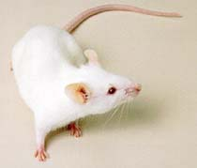

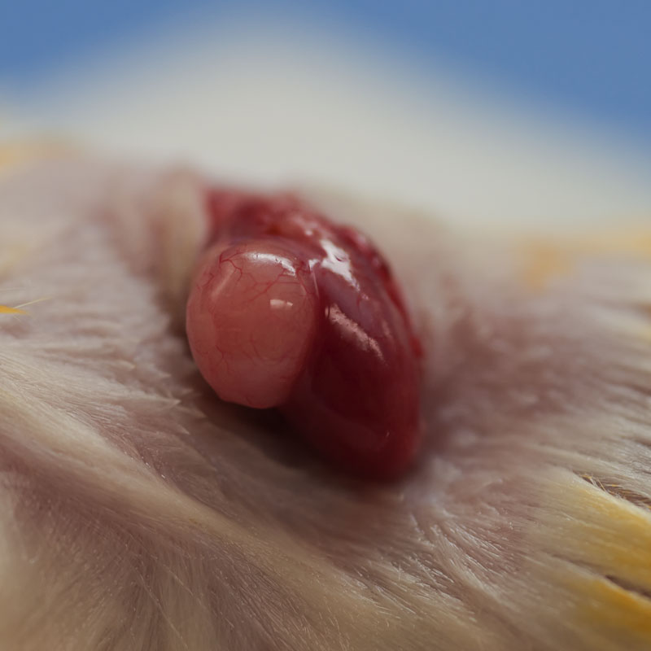









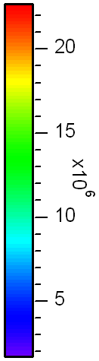
The Severe Combined Immunodeficient (SCID) Mice Model
For Studying HCMV Pathogenesis
Thymus/liver tissues
Kidney capsule
2-3 months
Kidney
Infected implants are harvested at different time and the amount of VZV is measured
VZV replication is monitored using IVIS system
0
1
2
3
4
5
6
7
8
dpi
A thymus/liver implant is surgically
exposed and injected with VZV

Slide 22
ORF7 Dose Not Required for VZV Replication in Thymus (T-cells)
Photon Counts
Days post infection

Slide 23
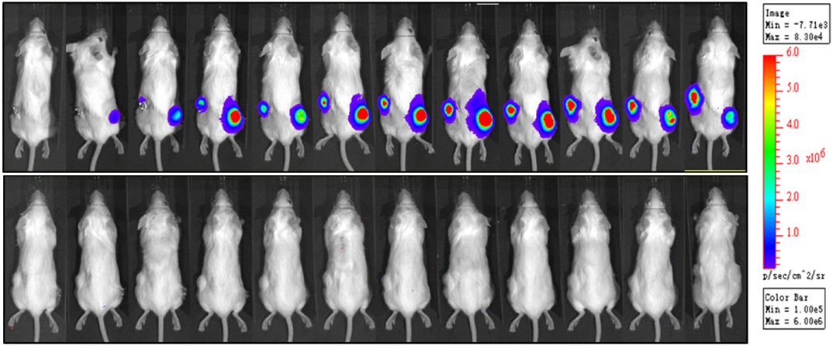
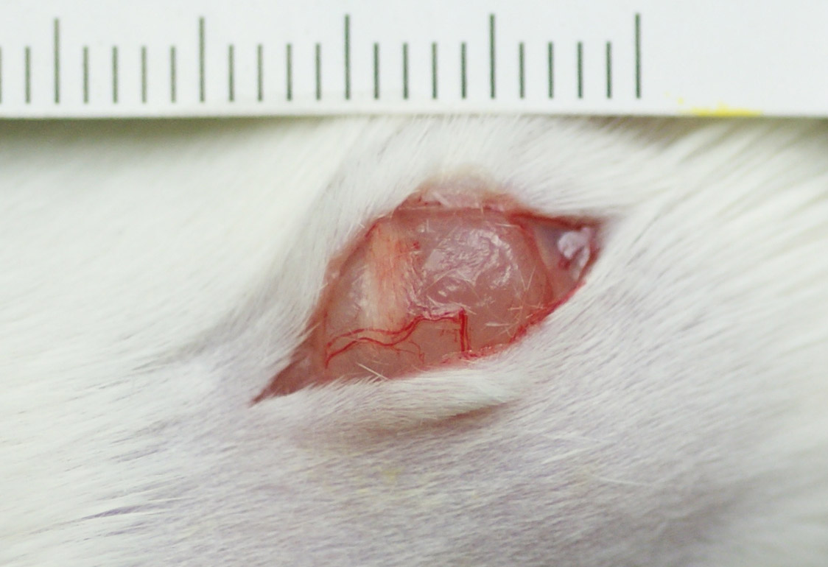
ORF7 is Required for VZV Replication in Skin
WT
7D
2 4 6 8 10 12 14 16 20 22 23 26 dpi

Slide 24
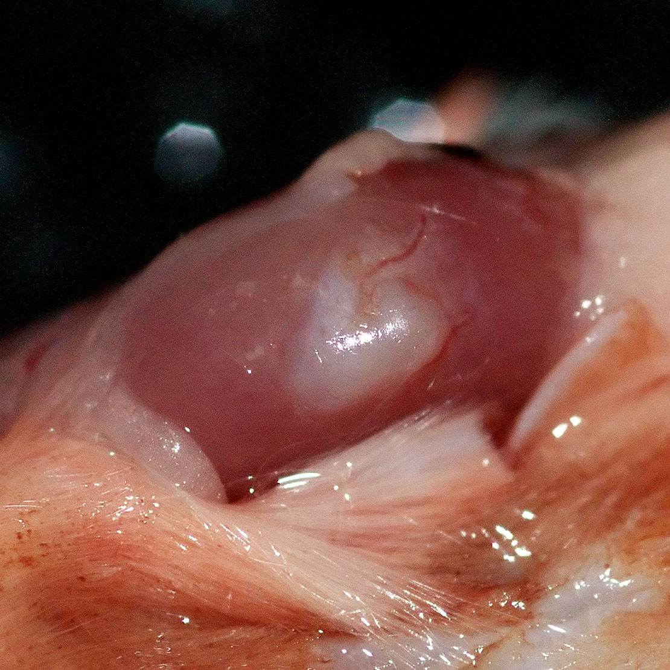
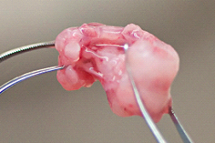
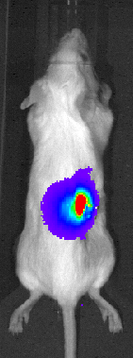
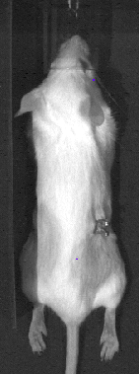
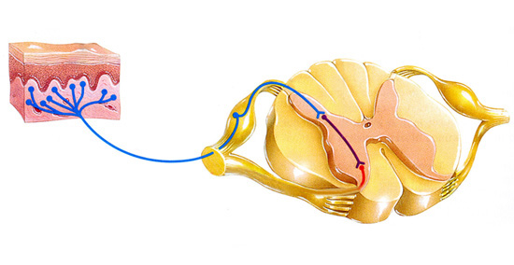
SCID-hu DRG Model
Dorsal Root Ganglia
(DRG)
DRG
Kidney
WT
7D
DRG
Photon Counts
Days post infection

Slide 25
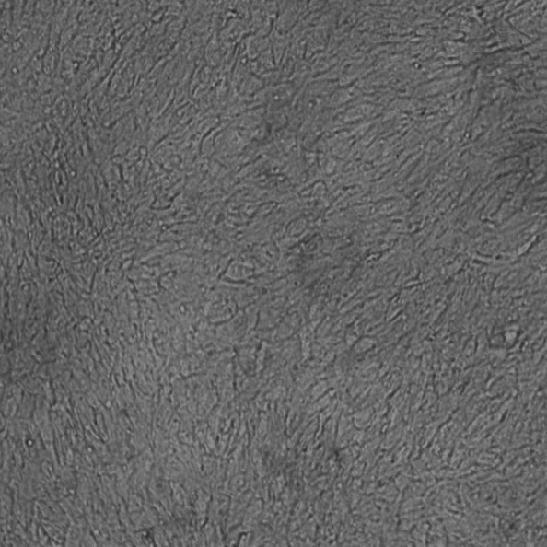
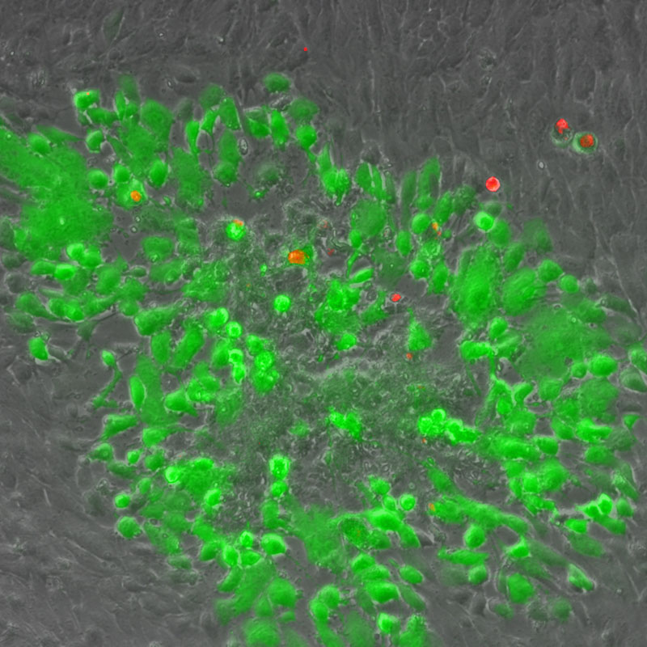
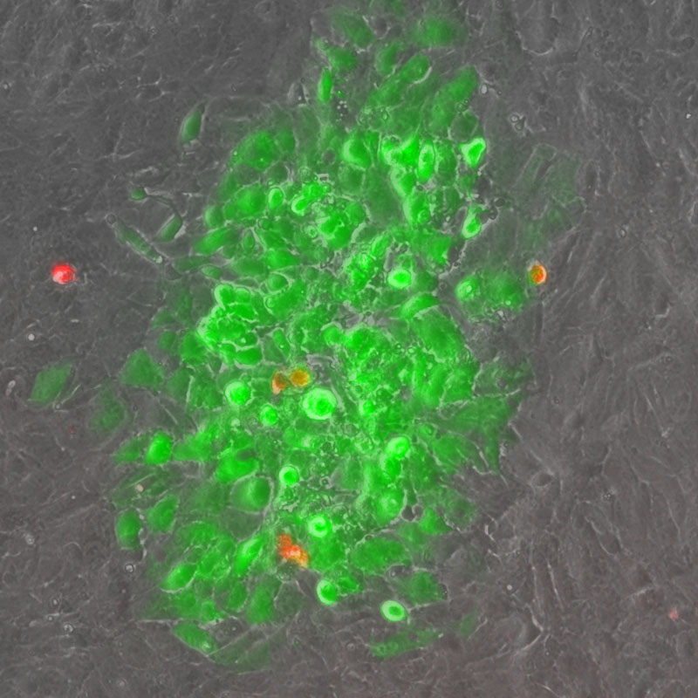
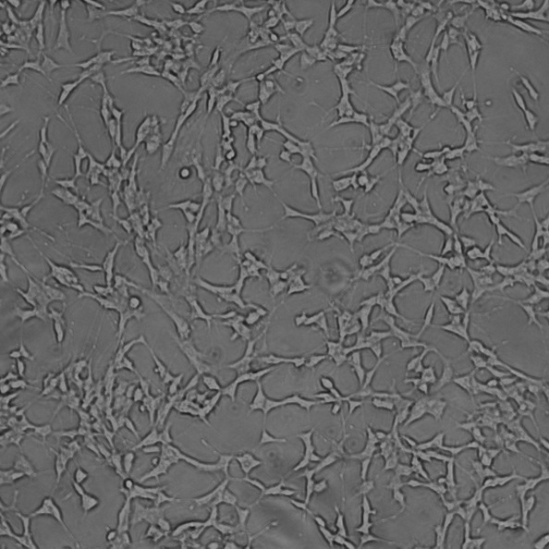
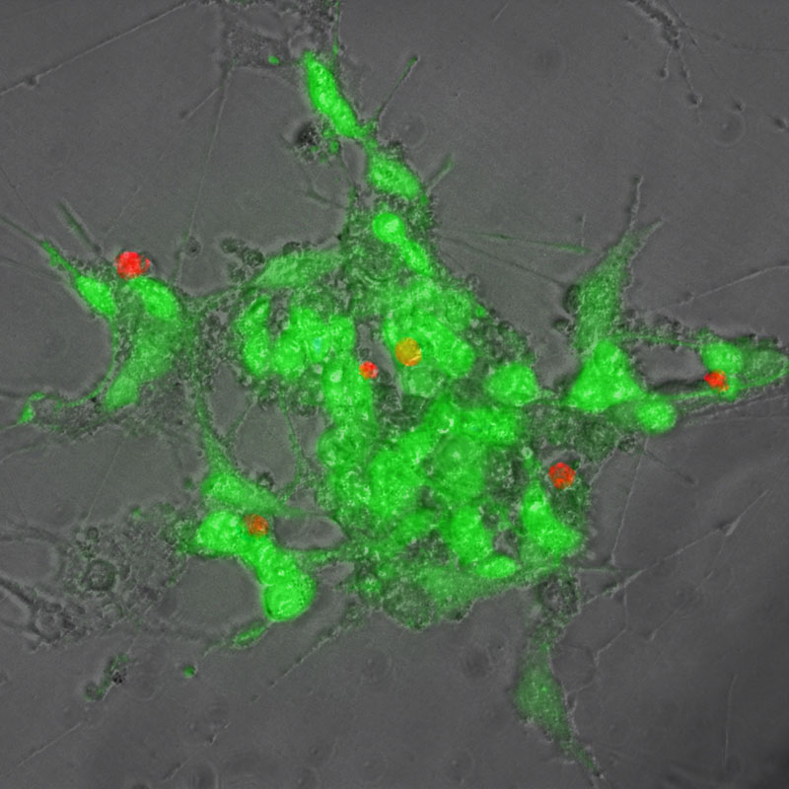
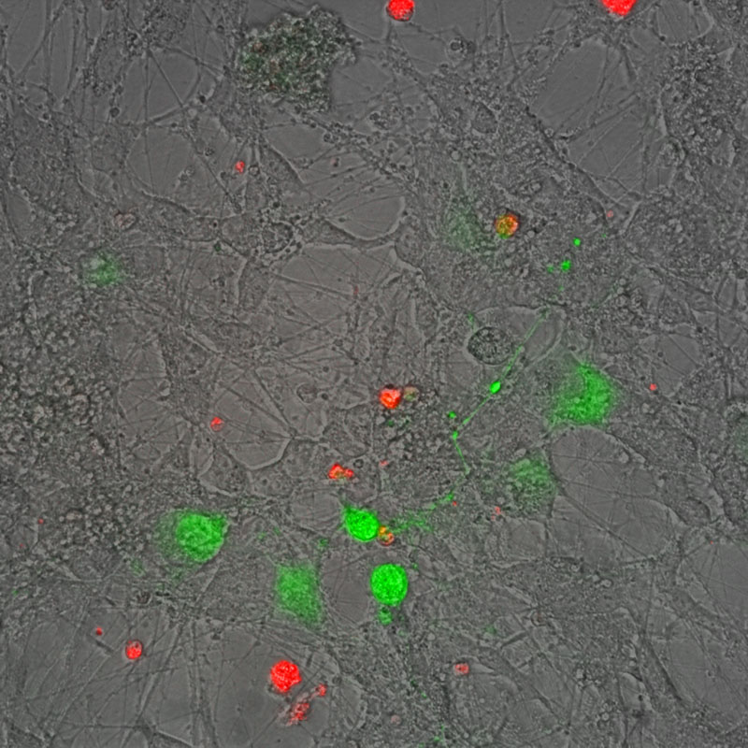
7D-infected DCs can transmit the virus to other cell types
Mock
rOka
7D
ARPE-19
SH-SY5Y

Slide 26
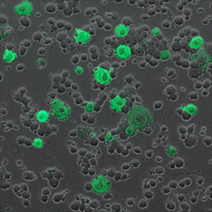
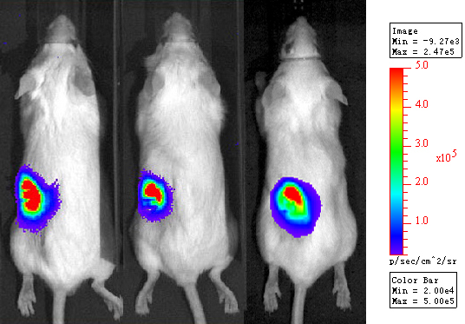

Transition from infected DC to Thymus, Skin and DRG
SCID-hu thy/liv
WT
7D
7R
Infected DC cells
WT
7D

Slide 27
Summary
7D can replicate in MeWo, ARPE-19, MRC-5, DC and T-cells
7D is attenuated in skin and neurons
ORF7 is required for syncytia formation
ORF7 is localized in TGN in infected cells
ORF7 is associated with virion
ORF7 interact with some important viral proteins

Slide 28

Goal
Developing the next generation of VZV vaccine
skin and neuroattenuated
genetically defined
easily manipulated （BAC)
high yield
7D
Sensitive to Freeze-drying

Slide 29



Acknowledgements
Zhu Lab:
Calvin Zhang Anca Salariu
Ying Huang Kalpana Dulal
Grace Huang Charles Warden
Weijia Wang Benjamin Sliver
Dr. Xianing Shao, Tong Cheng (Xiamen University, China)
Dr. Qiyi Tang (Ponce School of Medicine, PR)
Dr. Xiangzhong Ye (Wantai Co., China)
Dr. R. Goldstein (Bar-Ilan University, Israel): hESC-derived neurons
Dr. J. Moffat (Upstate Medical University, Syracuse, NY): VZV BAC and SCID-hu Thy/Liv
Dr. A. Arvin (Stanford University, CA): VZV BAC and SCID-hu DRG
Dr. T. Chang (PHRI, NJMS, Rutgers, NJ): DC

