Slide 1
A strategy for reduction of antibiotic use in new patients admitted to a neonatal intensive care unit— experience in Southern Taiwan
Pediatrics and Neonatology (2012) 53, 245e251
Department of Pediatrics, Kaohsiung Medical University Hospital, Kaohsiung, Taiwan
Hsiu-Lin Chen

Slide 2



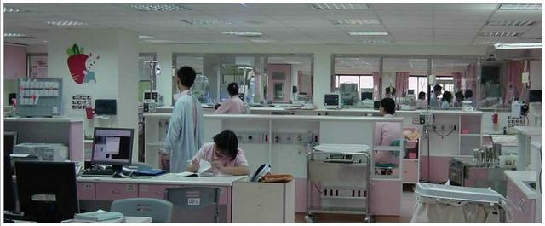
Kaohsiung, Taiwan
Kaohsiung
NICU, 15 beds
Kaohsiung Medical University Hospital
Teritiary medical center, 1712 beds

Slide 3
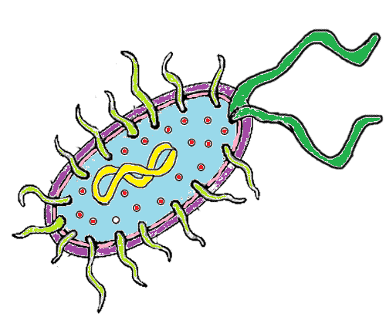
Introduction
Serious BI
In the newborn
Newborn infants are uniquely susceptible to infectious diseases, especially bacterial infections (BI).
Sepsis
Bacteremia
Bacterial meningitis
Urinary tract infections
Pneumonia
Bacterial gastroenteritis.
 Early diagnosis and the rapid administration of antibiotics to sick newborns are necessary in such situations.

Slide 4

However…
BI: bacterial infection
Accurately identifying and distinguishing BI from non-BI cases in newborns remains a difficult problem for physicians.
As a result, there is a high rate of the use of antibiotics to treat sick newborns in the neonatal intensive care unit.
Reality is……..
Only a minority of treated newborns actually has BI.
This could cause an increase in antibiotic-resistant bacteria and healthcare costs

Slide 5

Diagnostic problem in serious BI in neonates
Extremely variable and nonspecific Clinical Manifestations
  Lethargy/irritability
  Apnea/Tachypnea
  Abdominal distension/diarrhea
  Unstable temperature….
No ideal laboratory test for the diagnosis of neonatal infection
  WBC
  IT ratio
  CRP
  Cytokines…

Slide 6
Objective
To reduce unnecessary antibiotics use, we developed a “Neonatal Bacterial Infections Screening scores” (NBIS scores) for each new patient admitted to the neonatal intensive care unit to guide antibiotics use

Slide 7
Neonatal bacterial infections screening (NBIS) scores
Maternal risk factors
Clinical presentations
Laboratory data
Respiratory distress
convulsions, bulging fontanelle
pus draining from the ear
redness around the umbilicus
Fever or hypothermia
lethargy or unconsciousness or reduced movements
inability to feed, inability to suckle at all
cyanosis
Reduced capillary refill time
shock
leukocytosis
leukopenia
I/T ratio > 0.2
CRP > 6 mg/L
IgM > 20 mg/dL
the need to undergo a CSF study
premature or prolonged (>18 hours) rupture of membranes
maternal peripartum fever
positive maternal (GBS) screening
maternal pyuria
meconium-stained amniotic fluid or chorioamnionitis
Total 25 items

Slide 8
Patients and methods - 1
Neonates who were admitted to the NICU of Kaohsiung Medical University Hospital (KMUH) were enrolled
New patients
Clinical data were collected at the first day admitted to NICU to record “Neonatal bacterial infections screening scores” (NBIS scores)
Each item gained one point if it was positive. The total scores for each new patient were calculated at the time of admission
BI group
Positive blood culture
Positive urine culture
Positive CSF culture
Pneumonia diagnosed by chest X ray
According to the results of culture or chest X ray, BI and non-BI groups were defined

Slide 9

Patients and methods - 2
First period of study (Jan. 2009 to Dec. 2009)： Observational period
Second period of study (Jan. 2010 to Dec. 2010): Interventional period
  Using analysis of receiver-operating characteristic (ROC) curves
    ➔ determine the best cut-off values of NBIS scores for diagnosis of BI
  Cut-off values of NBIS scores were provided to guide antibiotics use in new patients
  Physicians could be able to adjust their decision making with using this guideline
NBIS scores: Neonatal Bacterial Infections Screening scores

Slide 10

Results

Slide 11
Characteristics of study infant in 1st period – I
Observational period (Jan. 2009 to Dec. 2009)
BI rate: 11.6%
 | BI (n=29) | Non BI (n=221) | P value
Characteristics Sex (Male,%) Gestational age, wks, mean ± SD Prematurity (%) BBW, g, mean ± SD Admitted Age, Day, mean ± SD Maternal risk factors PROM>18hrs Maternal fever Maternal GBS screen (+)# Maternal pyuria Other$ | 20 (68.9) 37.3 ± 2.4 9 (31.0) 2827 ± 594 3.8 ± 5.5 2 (6.9) 2 (6.9) 4 (13.8) 2 (6.9 ) 2 (6.9) | 125 (56.5) 35.0 ± 3.5 137 (61.2) 2306 ± 778 1.6 ± 1.8 30 (13.6) 5 (2.2) 5 (2.2) 3 (1.3) 11 (4.9) | 0.203 <0.001 * 0.002 * <0.001 * <0.001 * 0.308 0.312 0.002 * 0.045 * 0.112
# With treatment; $ Meconium-stained amniotic fluid or chorioamnionitis
Notes:
There were higher percentages of positive maternal GBS screen and maternal pyuria in the BI group than in the non-BI group.

Slide 12
Characteristics of study infant in 1st period – II
Observational period (Jan. 2009 to Dec. 2009)
 | BI (n=29) | Non BI (n=224) | P value
Clinical presentations Respiratory rate > 60 breaths/min Severe chest retraction Nasal flaring Grunting Convulsions Bulging fontanelle Pus draining from the ear Redness around umbilicus extending to the skin Temperature >37.7C (or feels hot) or <35.5C (or feels cold) Lethargic or unconscious or Reduced movements Not able to feed No suckling at all Cyanosis Reduced digital capillary refill time Shock | 23 (79.3) 9 (31.0) 15 (51.7) 8 (27.5) 2 (6.9) 2 (6.9) 1 (3.4) 1 (3.4) 2 (6.9) 1 (3.4) 1(3.4) 1 (3.4) 5 (17.2) 3 (10.3) 1 (3.4) | 171 (77.3) 97 (43.3) 138 (61.6) 95 (43.3) 3 (1.36) 0 (0) 0(0) 0 (0) 5 (2.2) 24 (10.8) 34(15.3) 15 (6.7) 37 (16.7) 13 (5.8) 8 (3.6) | 0.814 0.188 0.265 0.094 0.045 * <0.001* 0.006* 0.006* 0.155 0.211 0.082 0.490 0.946 0.356 0.963
Notes:
In the items of clinical presentations, only convulsions, bulging fontanelle, pus draining from the ear, and redness around the umbilicus showed significant difference between these two groups.

Slide 13
Characteristics of study infant in 1st period – III
Observational period (Jan. 2009 to Dec. 2009)
 | BI (n=29) | Non BI (n=224) | P value
Laboratory data Leukocytosis or leukopenia Immature neutrophil/total neutrophil (IT ratio) >0.2 CRP > 6 mg/L IgM >20 mg/dL CSF Study Disease at admission Respiratory distress Meconium aspiratory syndrome Sepsis Others# Antibiotic used Original score, mean ± SD Weighted score, mean ± SD | 5 (17.2) 7 (24.1) 9 (31.0) 2 (7.6) 11 (37.9) 20 (68.9) 2 (6.9) 6 (17.2) 1 (3.4) 28 (96.6) 4.2 ± 2.7 7.5 ± 6.1 | 40 (18.1) 38 (18.3) 15 (6.7) 7 (3.1) 34 (13.6) 183 (82.8) 7 (3.1) 21 (9.5) 9 (4.1) 212 (94.6) 3.7 ± 2.3 5.3 ± 4.7 | 0.910 0.458 <0.001 * 0.254 0.003 * 0.073 0.311 0.132 0.872 0.661 0.156 0.015 *
# hypoglycemia, bradycardia, jaundice, gastrointestinal (GI) problems, birth injuries, intrauterine growth retardation, congenital heart disease
Notes:
Laboratory data showed that CRP level was significantly higher in the BI group, but not leukocytosis and I/T ratio. The rates of antibiotics use at admission were more than ninety percent in both groups (Table 1). The total original scores of NBISS did not show significant difference between these two groups, although the BI group had higher mean score (4.2 ± 2.7, 3.7 ± 2.3, P=0.155).

Slide 14
Characteristics of study infant in 1st period – III
Observational period (Jan. 2009 to Dec. 2009)
 | BI (n=29) | Non BI (n=224) | P value
Laboratory data Leukocytosis or leukopenia Immature neutrophil/total neutrophil (IT ratio) >0.2 CRP > 6 mg/L IgM >20 mg/dL CSF Study Disease at admission Respiratory distress Meconium aspiratory syndrome Sepsis Others# Antibiotic used Original score, mean ± SD Weighted score, mean ± SD | 5 (17.2) 7 (24.1) 9 (31.0) 2 (7.6) 11 (37.9) 20 (68.9) 2 (6.9) 6 (17.2) 1 (3.4) 28 (96.6) 4.2 ± 2.7 7.5 ± 6.1 | 40 (18.1) 38 (18.3) 15 (6.7) 7 (3.1) 34 (13.6) 183 (82.8) 7 (3.1) 21 (9.5) 9 (4.1) 212 (94.6) 3.7 ± 2.3 5.3 ± 4.7 | 0.910 0.458 <0.001 * 0.254 0.003 * 0.073 0.311 0.132 0.872 0.661 0.156 0.015 *
26 of 29 were diagnosed with pneumonia by chest X-ray. Two patients were diagnosed as having meningitis due to positive CSF culture, and one had positive urine culture.
# hypoglycemia, bradycardia, jaundice, gastrointestinal (GI) problems, birth injuries, intrauterine growth retardation, congenital heart disease

Slide 15
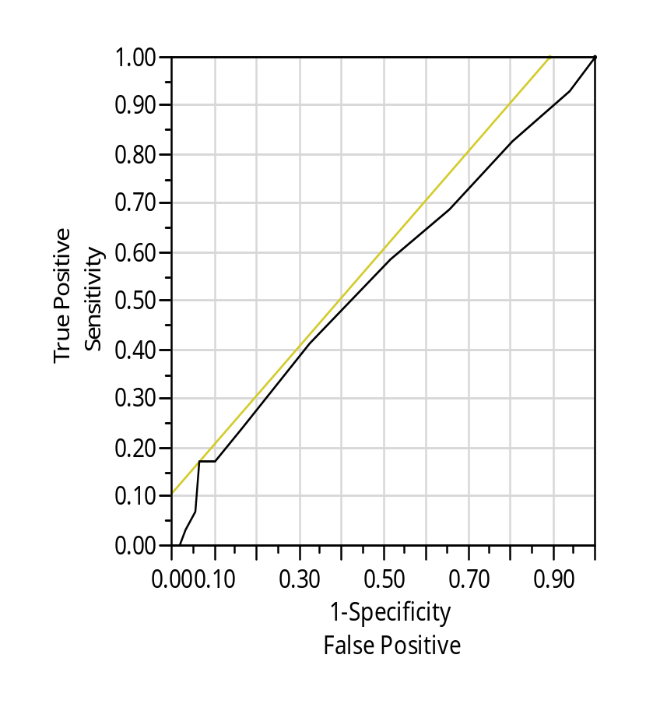
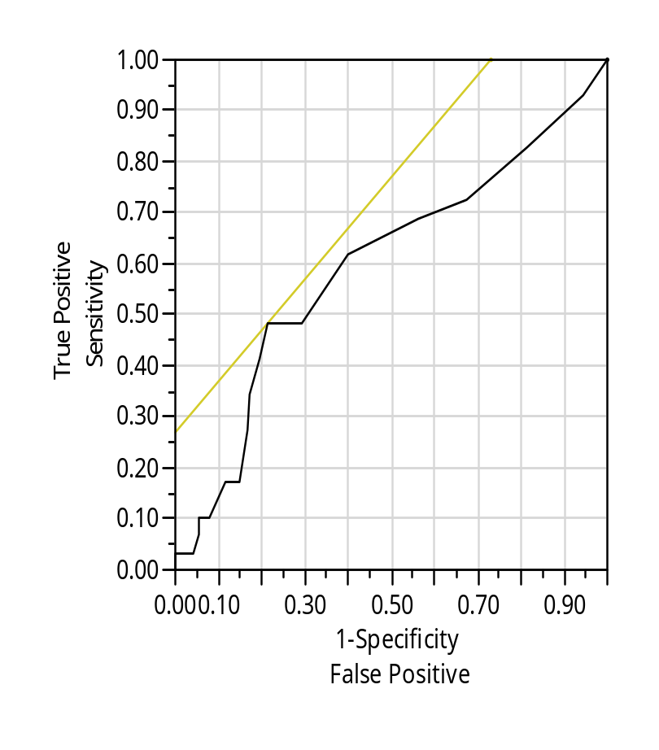
ROC curves in the 1st period
Original score
Weighted score
Weighted 5 times:
bulging fontanelle
pus from ear canal
redness around umbilicus
reduced movement
not able to feed
Weighted 8 times:
CRP
Weighted
Area Under Curve =0.54
Area Under Curve =0.60
The best cut-off value is 8
Notes:
ROC curve analysis revealed the area under the curve (AUC) to be 0.54 (Figure 1A). To improve the accuracy of this scoring system, modification by weighting clinically more important items was performed. CRP was the most statistically significant item associated with BI. Therefore, we weighted 8 times for CRP to guide antibiotics use. Otherwise, the items of bulging fontanelle, pus from ear canal, redness around the umbilicus, reduced movements and not being able to feed (which were significant and critical in a clinical setting) were chosen for their importance of bacterial infections on clinical setting. We then weighted from 2 times, then 3 times, till 8 times to find the best diagnostic accuracy of this scoring system. Finally, weightings of 8 times for CRP and 5 times for each of these five clinical items were chosen. After weighting, the NBISS of the BI group was significantly higher than that of the non-BI group (7.5 ± 6.1, 5.3 ± 4.7, P=0.015), and the AUC reached 0.60 (Figure 1B). The best cut-off value calculated by ROC curve analysis between the BI and non-BI groups was eight points. Weighted scores higher than 8 points had best diagnostic accuracy for BI.

Slide 16
Characteristics of study infant in 2nd period – I
Interventional period (Jan. 2010 to Dec. 2010)
BI rate: 6.3%
 | BI (n=16) | Non BI (n=239) | P value
Characteristics Sex (Male,%) Gestational age, wks, mean ± SD Prematurity (%) BBW, g, mean ± SD Admitted Age, Day, mean ± SD Maternal risk factors PROM>18hrs Maternal fever Maternal GBS screen (+) # Maternal pyuria Other$ | 11 (68.7) 37.2 ± 3.7 4 (25) 2905 ± 825 1.7 ± 1.8 3 (18.7) 1 (6.3) 1 (6.3) 0 (0) 2 (6.9) | 139 (58.2) 36.1 ± 3.2 112 (46.4) 2569 ± 731 1.8 ± 2.5 22 (9.2) 12 (5.0) 19 (8.0) 6 (2.5) 11 (4.9) | 0.405 0.009 * 0.002 * 0.039 * 0.566 0.214 0.829 0.807 0.521 <0.001*
# With treatment; $ Meconium-stained amniotic fluid or chorioamnionitis

Slide 17
Characteristics of study infant in 2nd period – II
Interventional period (Jan. 2010 to Dec. 2010)
 | BI (n=16) | Non BI (n=239) | P value
Clinical presentations Respiratory rate > 60 breaths/min Severe chest retraction Nasal flaring Grunting Convulsions Bulging fontanelle Pus draining from the ear Redness around umbilicus extending to the skin Temperature >37.7C (or feels hot) or <35.5C (or feels cold) Lethargic or unconscious or Reduced movements Not able to feed No suckling at all Cyanosis Reduced digital capillary refill time Shock | 13 (81.3) 11 (68.8) 8 (50.0) 4 (25.0) 0 (0) 0 (0) 0 (0) 0 (0) 0 (0) 7 (43.8) 9(56.3) 2 (12.5) 3 (18.8) 3 (18.8) 1 (6.3) | 177 (74.1) 109 (45.6) 81 (33.9) 64 (26.8) 3 (1.3) 0 (0) 0(0) 1(0.4) 12 (5.0) 45 (18.8) 80(34.5) 14 (5.9) 60 (25.1) 14 (5.9) 9 (3.8) | 0.523 0.073 0.191 0.876 0.652 NA NA 0.795 0.359 0.017* 0.064 0.287 0.568 0.045* 0.620

Slide 18
Characteristics of study infant in 2nd period – III
Interventional period (Jan. 2010 to Dec. 2010)
 | BI (n=16) | Non BI (n=239) | P value
Laboratory data Leukocytosis or leukopenia Immature neutrophil/total neutrophil (IT ratio) >0.2 CRP > 6 mg/L IgM >20 mg/dL CSF Study Disease at admission Respiratory distress Meconium aspiratory syndrome Sepsis Others# Antibiotic used Original score, mean ± SD Weighted score, mean ± SD | 9 (56.3) 1 (6.3) 4 (25.0) 0 (0) 3 (18.8) 11 (68.8) 3 (18.8) 1 (6.3) 1 (6.3) 13 (81.3) 5.6 ± 1.7 11.3 ± 5.7 | 90 (37.7) 20 (8.4) 23 (9.6) 9 (3.8) 33 (13.8) 167 (69.9) 10 (4.2) 33 (13.8) 29 (15.4) 142 (58.9) 3.8 ± 2.2 6.6 ± 4.9 | 0.140 0.762 0.053 0.429 0.583 0.924 0.010 0.389 0.479 0.083 0.001* <0.001 *
# hypoglycemia, bradycardia, jaundice, gastrointestinal (GI) problems, birth injuries, intrauterine growth retardation, congenital heart disease, neonatal abstinence syndrome, thrombocytopenia, maternal systemic lupus erythematosus

Slide 19
Characteristics of study infant in 2nd period – III
Interventional period (Jan. 2010 to Dec. 2010)
 | BI (n=16) | Non BI (n=239) | P value
Laboratory data Leukocytosis or leukopenia Immature neutrophil/total neutrophil (IT ratio) >0.2 CRP > 6 mg/L IgM >20 mg/dL CSF Study Disease at admission Respiratory distress Meconium aspiratory syndrome Sepsis Others# Antibiotic used Original score, mean ± SD Weighted score, mean ± SD | 9 (56.3) 1 (6.3) 4 (25.0) 0 (0) 3 (18.8) 11 (68.8) 3 (18.8) 1 (6.3) 1 (6.3) 13 (81.3) 5.6 ± 1.7 11.3 ± 5.7 | 90 (37.7) 20 (8.4) 23 (9.6) 9 (3.8) 33 (13.8) 167 (69.9) 10 (4.2) 33 (13.8) 29 (15.4) 142 (58.9) 3.8 ± 2.2 6.6 ± 4.9 | 0.140 0.762 0.053 0.429 0.583 0.924 0.010 0.389 0.479 0.083 0.001* <0.001 *
No unfavorable outcome was noted during study period.
# hypoglycemia, bradycardia, jaundice, gastrointestinal (GI) problems, birth injuries, intrauterine growth retardation, congenital heart disease, neonatal abstinence syndrome, thrombocytopenia, maternal systemic lupus erythematosus

Slide 20
The rate of antibiotics use
in new patients to NICU
Lately
2009.1-2009.12 (n=250) | 2010.1-2010.12 (n=255)
2015.01-2015.05 (n=119)
24 (20.2%)
 | 1st period (n=253) | 2nd period (n=131) | P value
Antibiotics used, N (%) | 237 (94.8%) | 155 (60.8%) | <0.001
The suggestion of antibiotics use: weighted scores of new patients > 8 , antibiotics would be prescribed.
Reduced antibiotic used from 94.8 % to 60.8 %, and further decreased to 20.2% lately.
No unfavorable outcome was found by using this strategy during study period

Slide 21
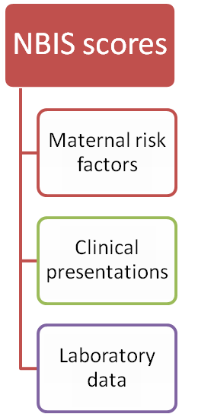
Discussion
NBIS score is a suitable and cheap method to differentiate BI in sick neonates, although it has is low sensitivity.
The rate of unnecessary antibiotic use and the cost of health care might be reduced under the introduction of NBIS scores.
Also, we have provided an additional tool for helping our clinicians decide on the appropriate use of antibiotics, and this might further reduce possible bacterial resistance.

Slide 22
Discussion
This is the first study to combine maternal risk factors, clinical presentations of suspected BI, and abnormal laboratory data to predict BI.
The goal of this study was not to expect a match-up between neonatal BI and rate of antibiotics use, but rather to help create proper guidelines for clinicians to guide prescription of antibiotics for a new patient admitted to the NICU.
Notes:
It is important to note that there were 4 cases in BI groups without antibiotics because their NBISS scores were less than eight points (1 case in the observational period and 3 cases in the interventional period). All these four patients were diagnosed as having meconium aspiratory syndrome by chest X-ray. The role of routine antibiotic therapy in the management of meconium aspiration syndrome remains controversial. Lin et al²⁴ conducted a prospective, randomized, controlled clinical trial in 2005 to compare the infection-related outcome of non-ventilated cases of meconium aspiration syndrome without perinatal risk factors for infection. Because antibiotics treatment did not affect the clinical course and outcome related to infection in meconium aspiration syndrome without perinatal risk factors, antibiotics treatment should not be a routine for every infant with meconium aspiration syndrome.

Slide 23
Limitations of this study
NBIS scores: it took time to derive a detailed history and perform complete physical examinations. Some clinicians might not have completed the NBISS at the time of admission
For the maternal risk factor items: GBS screening is not a routine examination on prenatal check in Taiwan
NBIS score is just an additional tool to guide the use of antibiotics, clinicians decided whether the patient needs antibiotics based on their experience. There was no consistency between clinicians in this study.

Slide 24

Conclusion
Pediatrics and Neonatology (2012) 53, 245e251
Through this simple screening strategy, we achieved a clinically reduction in unnecessary antibiotics use and the cost of health care.
NBIS scores could be additional tool to help clinicians decide whether antibiotic treatment is necessary in such situations.

Slide 25

Thanks for your attention

