Slide 1
Novel strategies for stroke therapy based on targeting of Mitochondrial dysfunction AND ER STRESS signaling pathways.
Howard Prentice
Department of Biomedical Science,
Charles E. Schmidt College of Medicine,
Florida Atlantic University,
Boca Raton
Florida 33431

Slide 2
Overview:
Neuroprotective functions of the amino acid taurine
S-Methyl-N ,N-diethylthiolcarbamate
sulfoxide (DETC-MeSO), a disulfiram metabolite and Taurine as agents for potential stroke treatment.
Multi-drug strategies for stroke therapy.

Slide 3
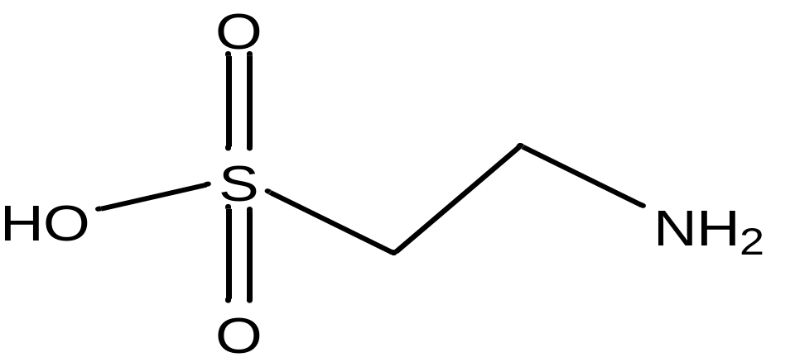
Taurine and its function
Taurine (2-amino-ethanesulfonic Acid)
Osmoregulation
Antioxidation
Neurotransmission

Slide 4
Role of Taurine in the CNS
Essential for neuronal migration
As a neurotransmitter/ modulator
As a neuroprotective agent
To maintain intracellular calcium homeostasis
Role in osmoregulation

Slide 5
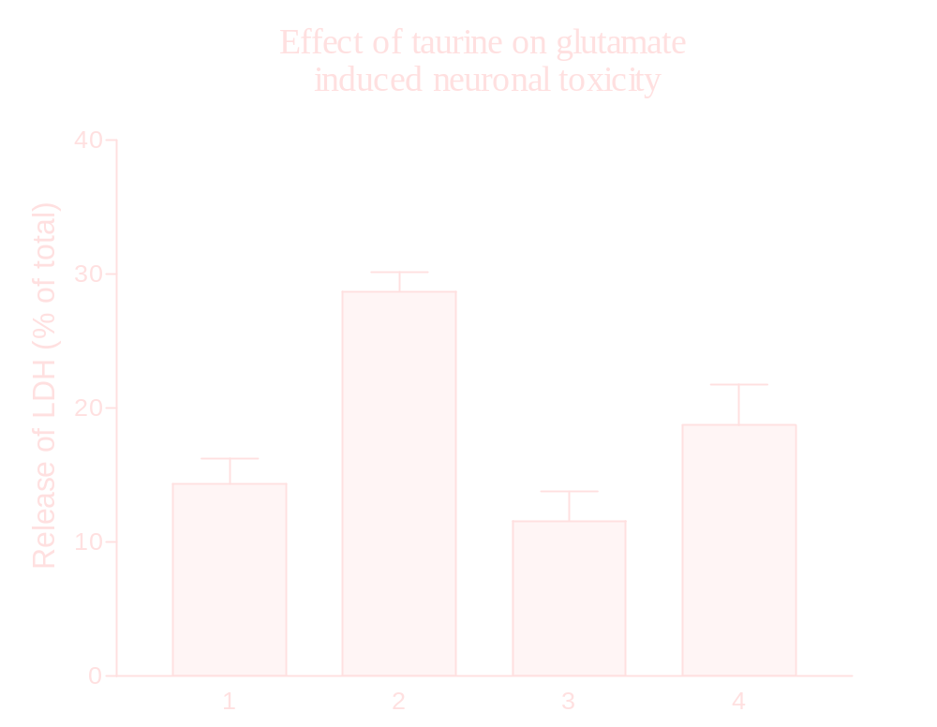
Control
Glu
Tau
Tau+Glu

Slide 6
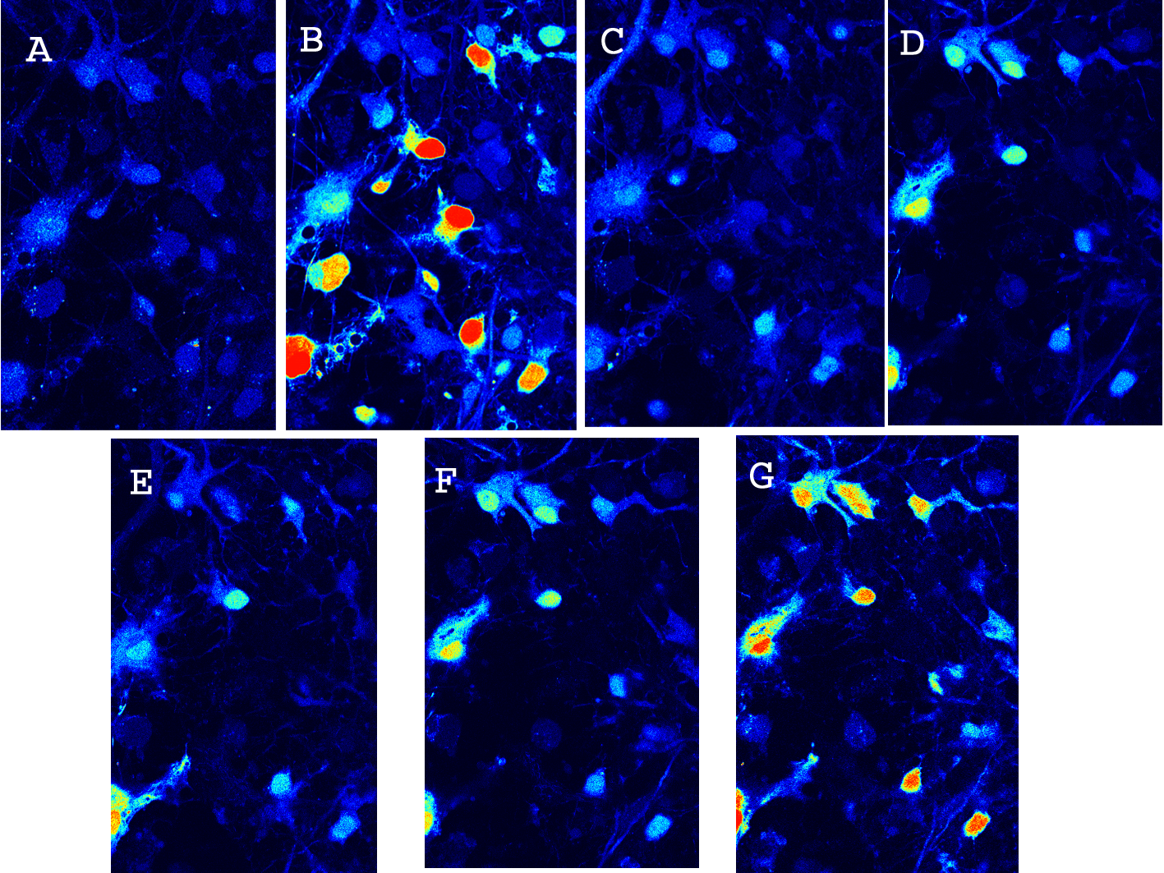
Confocal Microscopic Study
Control
Glu
After Washing
Tau
Tau+Glu
After Washing
Glu
Low
High

Slide 7
EFFECT OF TAURINE ON GLU-INDUCED ELEVATION
OF INTRACELLULAR CALCIUM LEVEL
After 10min
wash
Taurine
Glu
Glu
After 10min
wash
Taurine
Glu
RATIO OF FLUORESCENCE
(346nm/386nm)
Basal Level
TIME (min)

Slide 8
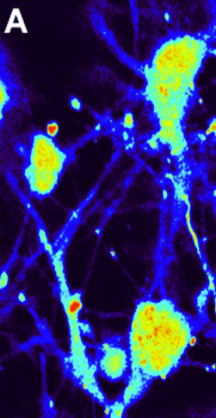
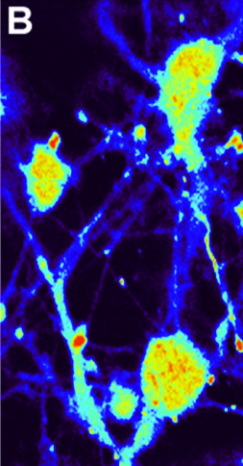
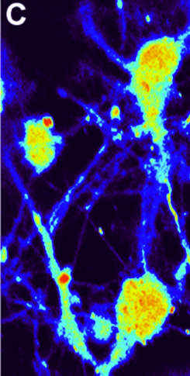
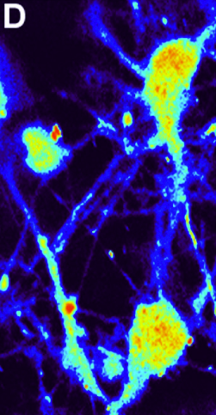
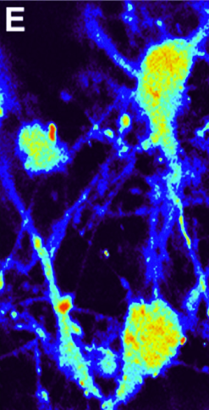
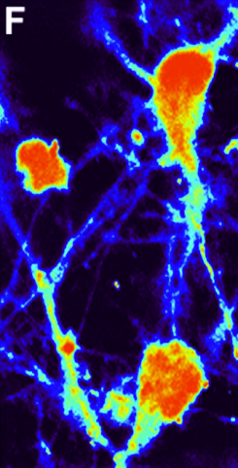
Inhibition of taurine on Glu-induced release of calcium from intracellular storage
Low
High
Neurons were incubated in Ca²⁺-free EBSS
A: Basal Level
B-C: After added 25mM taurine for about 10 min.
D-E: After added 0.25mM Glu at 30”, 1’.
F: Neurons responded to 2.5µg pertussis toxin by releasing Ca²⁺
from internal storage pools.

Slide 9
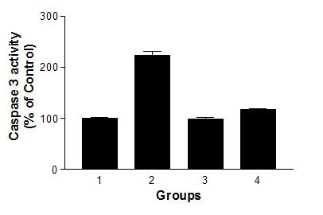
EFFECT OF TAURINE ON THE GLUTAMATE INDUCED
APOPTOSIS
Caspase 3 activity

Slide 10
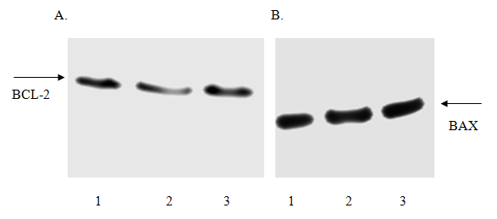
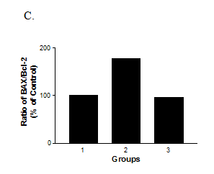
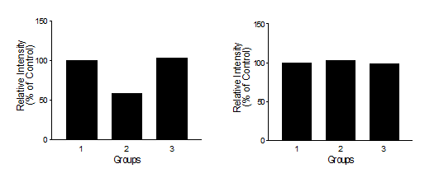
EFFECT OF TAURINE ON THE GLUTAMATE INDUCED CHANGE OF
BAX/ BCL-2

Slide 11
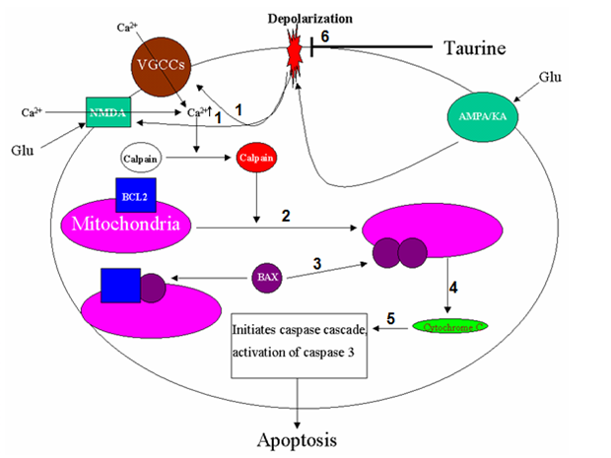
A MODEL DEPICTING A PATHWAY THAT TAURINE EXERTS ITS FUNCTION
AGAINST GLUTAMATE-INDUCED APOPTOSIS

Slide 12
Effect of Taurine treatment on the Endoplasmic Reticulum Stress Pathways.

Slide 13
ER stress and disease processes
Chaperone
ER
disturbed
ER stress
ER stress is involved in stroke, diabetes, Alzheimer, Parkinson

Slide 14
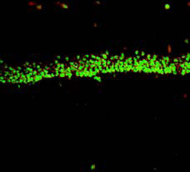
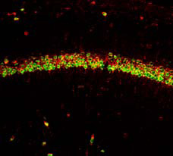
ER stress occurs during ischemia
Sham
1 day after ischemia
GRP78 / NeuN
Y. Oida et al. Neurosci (2008)

Slide 15
Abbreviations
GRP78 Glucose regulated protein 78
PERK PKR-like endoplasmic
reticulum kinase
ATF6 Activating transcription factor 6
IRE1 Inositol requiring enzyme 1
eIF2α Eukaryotic translation initiation factor 2
ATF4 Activating transcription factor 4
XBP-1 X-box binding protein
CHOP C/EBP homologous protein

Slide 16
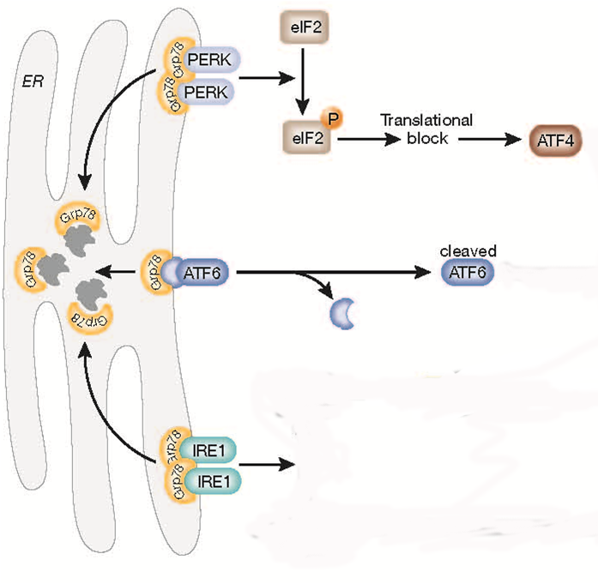
The signaling pathways in ER stress
α
P
P
α
GRP78
Bim
P
XBP-1
CHOP
P
Cell death
Caspase-12
Szegezdi E et al. EMBO reports 2006

Slide 17
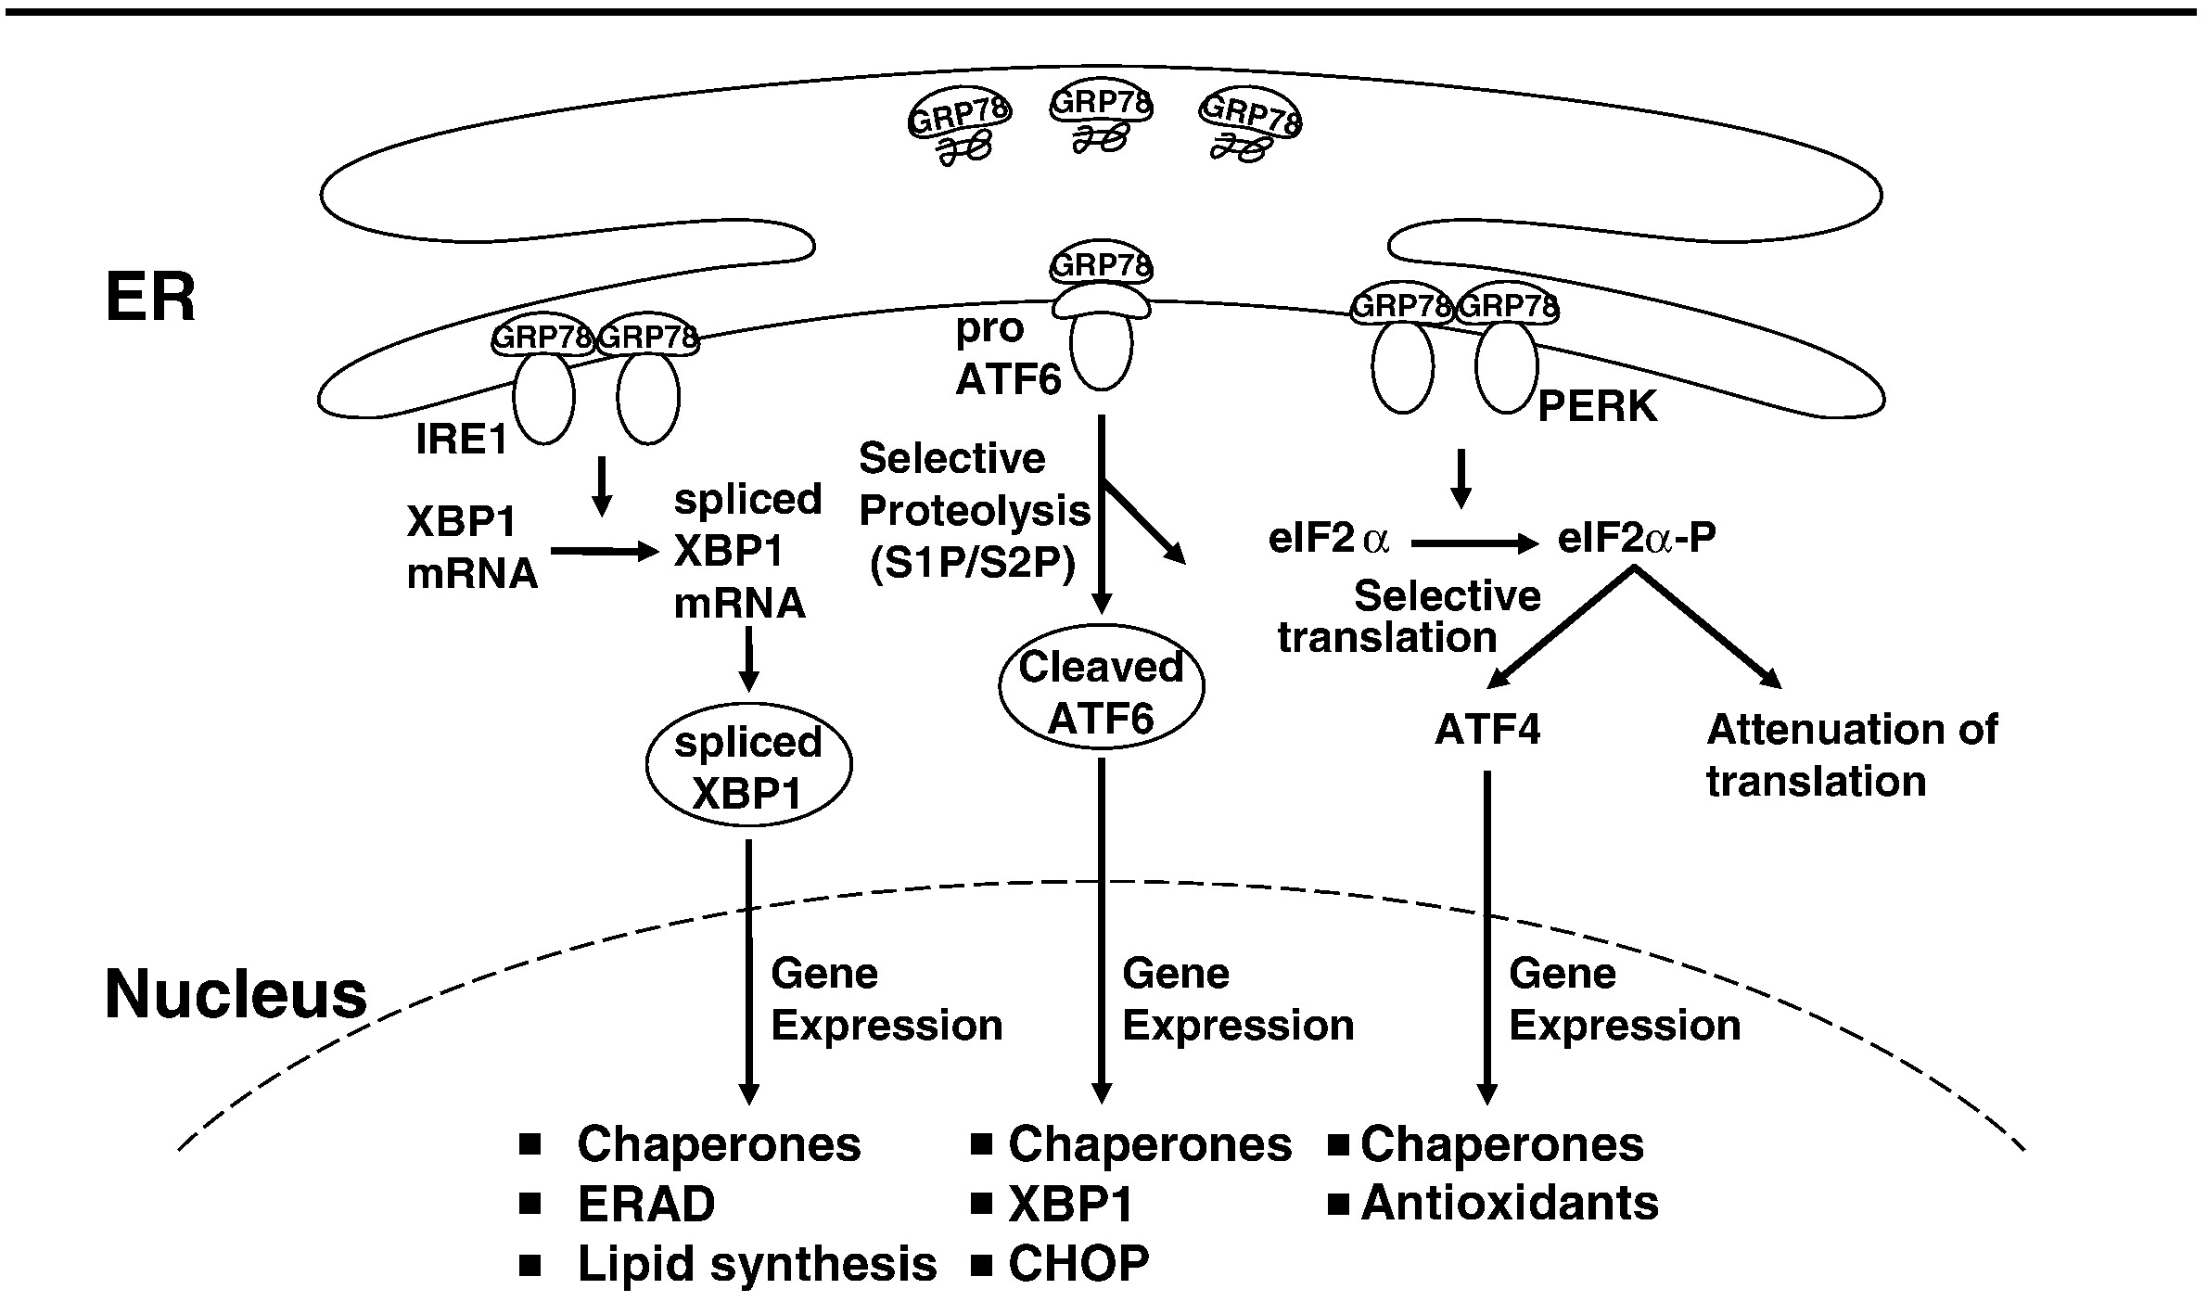

Slide 18




Glutamate promotes ER stress
C 10uM 50uM 100uM 250uM 500uM
GRP78
CHOP
Caspase-12
β-actin
Glutamate: 1 hour

Slide 19

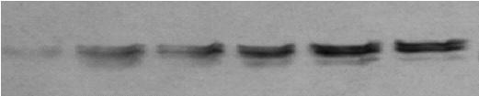


Glutamate activates ER stress pathways
C 10uM 50uM 100uM 250uM 500uM
p-eIF2α
Cleaved
ATF6
β-Actin
C 10uM 50uM 100uM 250uM 500uM 1mM 2mM
p-IRE1
Glutamate: 1 hour

Slide 20
Mechanism of glutamate-induced ER stress
glutamate
[ca²⁺]
ER stess
PERK
ATF6
P90
IRE1
Caspase-12
P
P
P
P
Cleaved
ATF6
eIF2α
XBP-1
Caspase
cascade
P
P
ATF4
Cell death
GRP78
CHOP

Slide 21
Can taurine protect neurons against ER stress induced by glutamate?

Slide 22
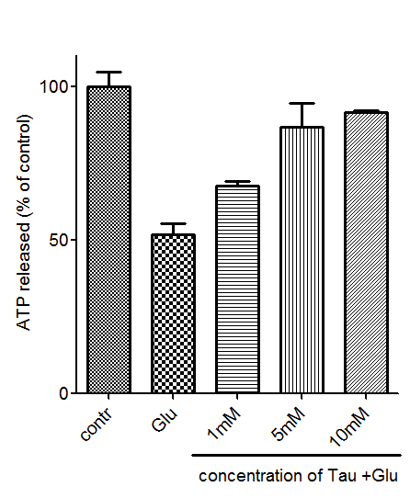
Taurine protects neurons against glutamate toxicity
Taurine: 1 hour
100 µM Glutamate: 1 hour
##
##
##
**

Slide 23
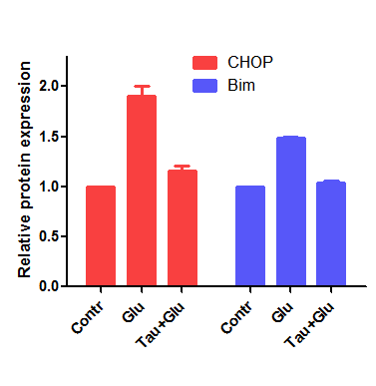
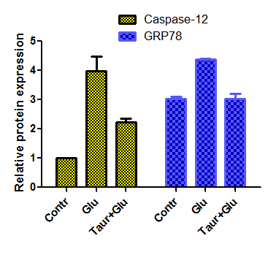
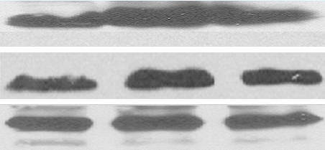



Taurine inhibits glutamate-induced ER stress
Contr
Glu
Tau+Glu
CHOP
**
**
**
Bim
**
##
##
β-actin
##
##
Contr Glu Tau+Glu
Caspase-12
GRP78
β-actin

Slide 24
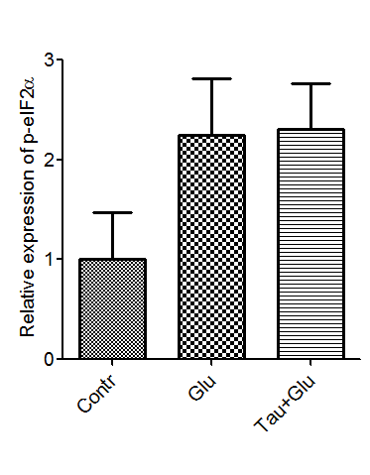
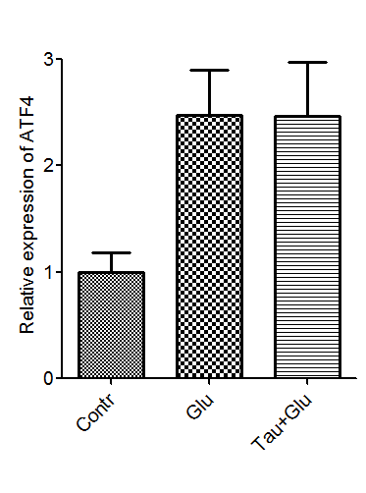


Taurine has no effects on PERK pathway
**
**
Contr Glu Tau+Glu
Contr Glu Tau+Glu
p-eIF2α
ATF4

Slide 25
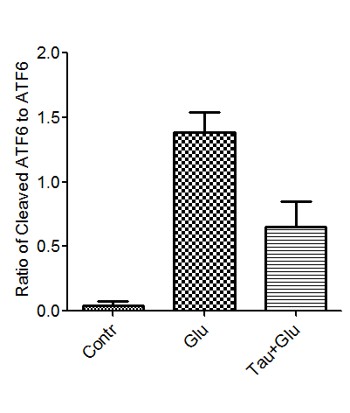
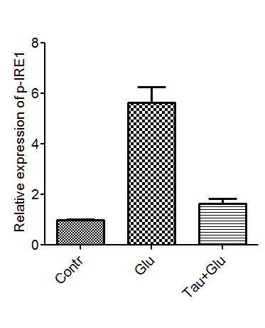
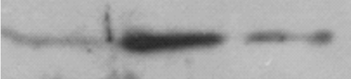
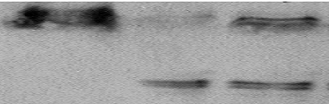

Taurine has significant inhibitory effects on both the ATF6 and IRE1 pathways
**
**
##
##
Contr Glu Tau+Glu
Contr Glu Tau+Glu
p-IRE1
ATF6
Cleaved
ATF6
IRE1

Slide 26
Mechanism of taurine protection
Taurine
Hypoxia or glutamate
Taurine
ER stess
PERK
ATF6
P90
IRE1
Caspase-12
P
P
P
P
Cleaved
ATF6
Caspase
cascade
eIF2α
P
P
ATF4
CHOP
Translational block
Cell death

Slide 27
Summary
Taurine protects neurons against glutamate-induced ER stress by inhibiting ATF6 and IRE1 pathways.
Taurine protects neurons against hypoxia/reoxygenation–induced ER stress by inhibiting ATF6 and IRE1 pathways, but not the PERK pathway.

Slide 29
Stroke
-Major cause of death in the United States
-Brain damage in Stroke:
Ischemia 85% of all stroke (Ischemic-hypoxia)
Hemorrhage
Inflammatory response to tissue injury
Mediators such as TNF
Excessive release of certain Neurotransmitters
Excitotoxicity by glutamate and aspartate neurotransmitters
NMDA receptors
Influx of calcium, sodium, and chloride ions, efflux of potassium ions
Persistent membrane depolarization
Loss of cellular integrity

Slide 30
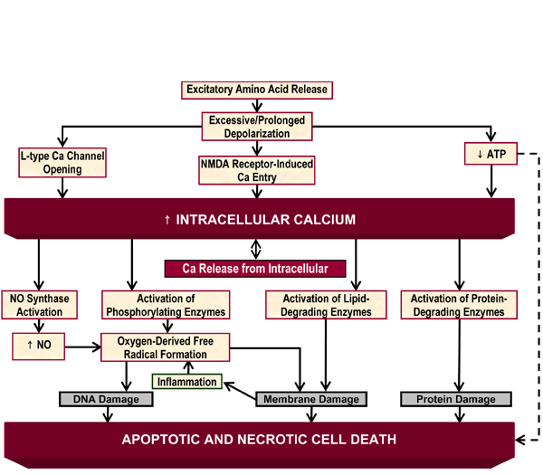

Slide 31
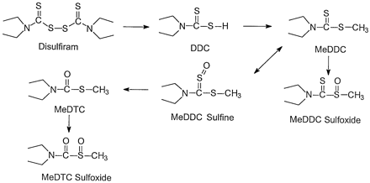
DETC-MeSO
S-Methyl-N ,N-diethylthiolcarbamate sulfoxide
Active metabolite of Disulfiram (FDA approved drug for Alcoholism)
NMDA receptor partial antagonist (anti excitotoxicity agent)
Selective Carbamoylating agent for sulfhydryl group
It prevents glutamate binding to its receptors (in vitro)
Prevents seizures induced by hyper-baric oxygen (in vivo)
Disulfiram & Proposed metabolic pathways of activation in Liver (M. Pike et al., 2001)

Slide 32
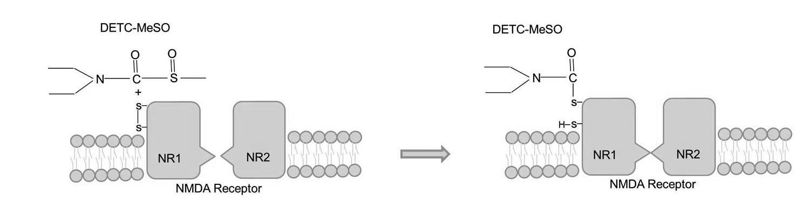
Proposed DETC-MeSO Mechanism

Slide 33
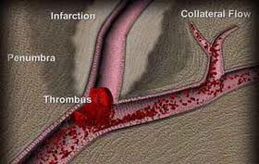
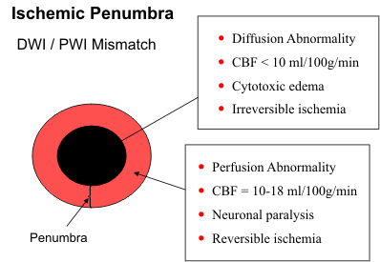
Stroke
Ischemic regions:
-Core of infarction (Lesion center)
-Ischemic Penumbra (Pre-lesion)
Size of penumbra depends on
Excitotoxicity of Glutamate
So using
Glutamate receptor antagonists
may decrease the size of penumbra

Slide 34
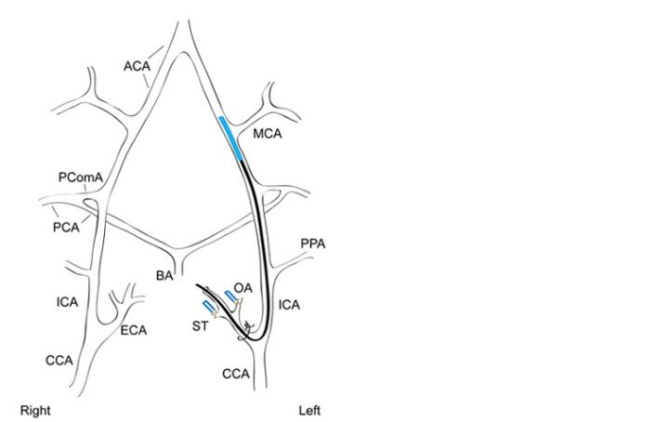
Animal model of stroke
Focal ischaemia (Koizumi et al, 1986)
Transient Middle Cerebral Artery Occlusion
Male rats weight 260-300 gr
Intraluminal suture for 120 min.
Brain Blood flow was controlled by:
The Laser Doppler flow (LDF) Monitor
Temperature control by:
heating pad attached with rectal probe

Slide 35
Drug administration:
DETC-MeSO (5.6 mg/kg)
Subcutaneously (every day)
1 hour before reperfusion
for 4 days
24 hour after reperfusion
for 4 days
24 hour after reperfusion
for 8 days

Slide 36

Measuring of lesion size (by TTC )
Percent infarct was calculated as described by
Swanson et al., 1990
Martha E. O’Donnell et al., 2006
[(VC − VL) / VC ] x 100
VC : volume of control hemisphere
VL : volume of noninfarcted tissue in the lesioned hemisphere.
Penumbra of stroke
Penumbra of contralateral
Core of stroke
Core of contralateral

Slide 37


Analyzing of TTC staining
Control
DETC-MeSO
Percent Infarct
*
*
Distance from Frontal pole
Data represent infarct volume as percent of the total ipsilateral hemisphere volume and are means ± SE of 21 experiments for MCAO and MCAO plus DETC-MeSO.
* : Significant

Slide 38
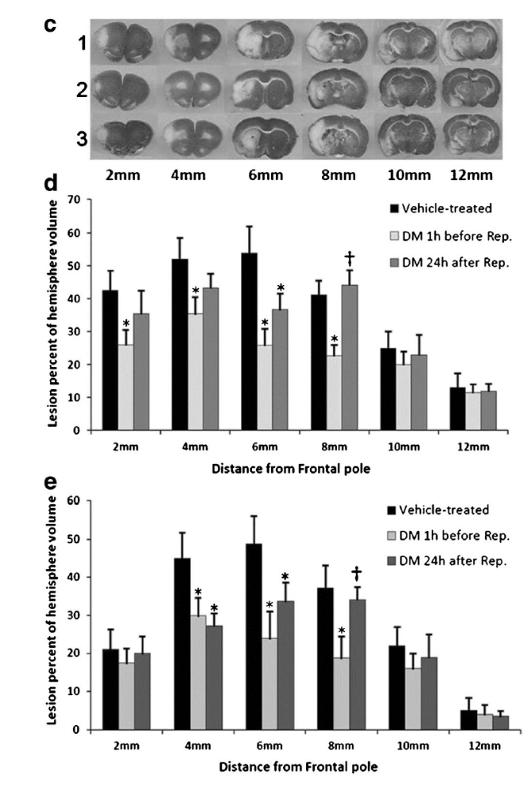
Effect of
DETC-MeSO on
infarct size.
4 days after reperfusion
4 days after reperfusion
8 days after
reperfusion

Slide 39
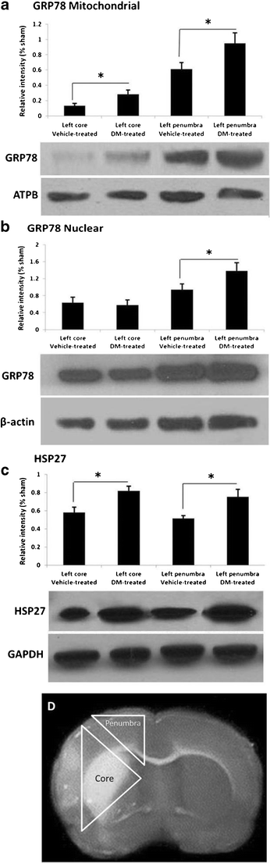

Slide 40
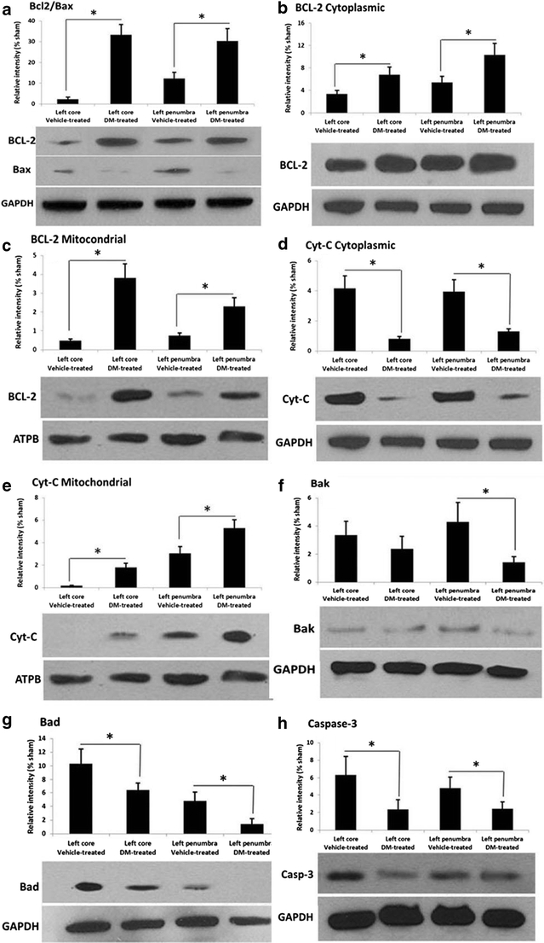

Slide 42
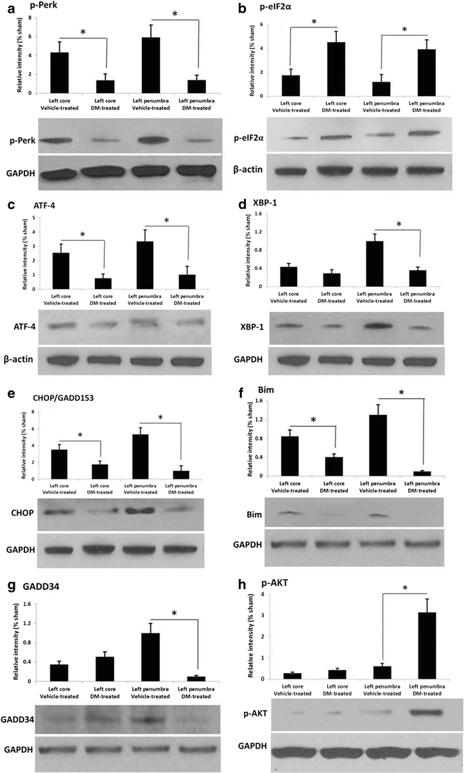
PERK and IRE-1(XBP-1) Pathways:

Slide 44
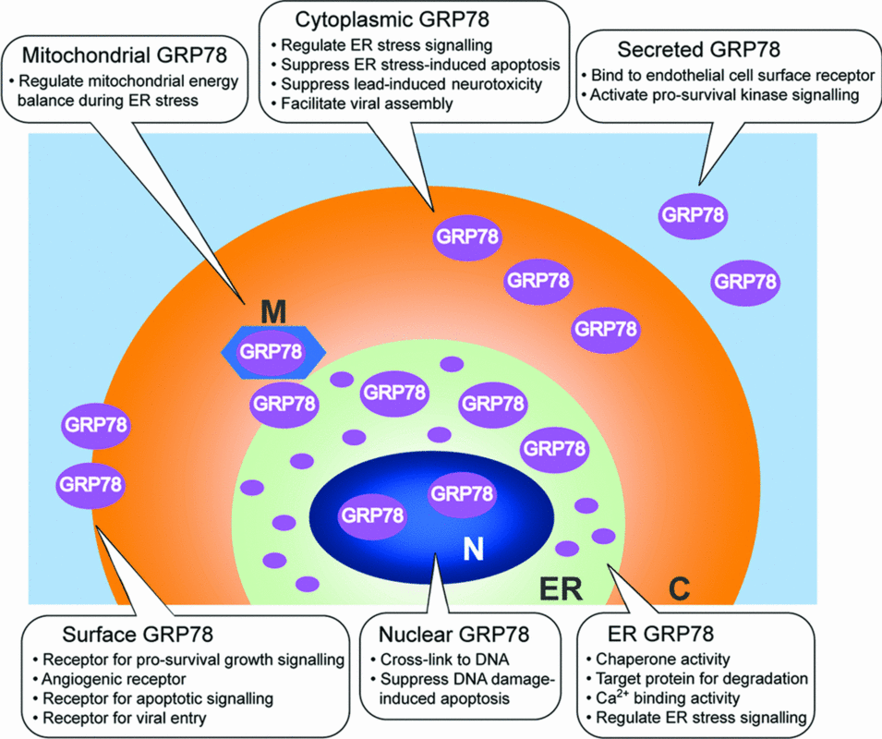

Slide 45
Multi-drug treatment

Slide 46
Multi-drug treatment
Transient Middle Cerebral Artery Occlusion
Male rats weight 260-300 gr (Pre-treatment)
Male rats weight 260-300 gr (Post-treatment)
Intraluminal suture for 90 min.
Brain Blood flow was controlled by:
The Laser Doppler flow (LDF) Monitor
Temperature control by heating pad attached with rectal probe
*Drug administration for Pre-treatment:
DETC-MeSO (0.56 mg/kg) one hour before Surgery and reperfusion
Sulindac (0.2 mg/kg) two days before reperfusion
GCSF (10 µg/kg) one day before reperfusion
*Drug administration for Post-treatment:
Administration of above drugs 24 h after reperfusion
Subcutaneously (every day for 4 days)

Slide 47
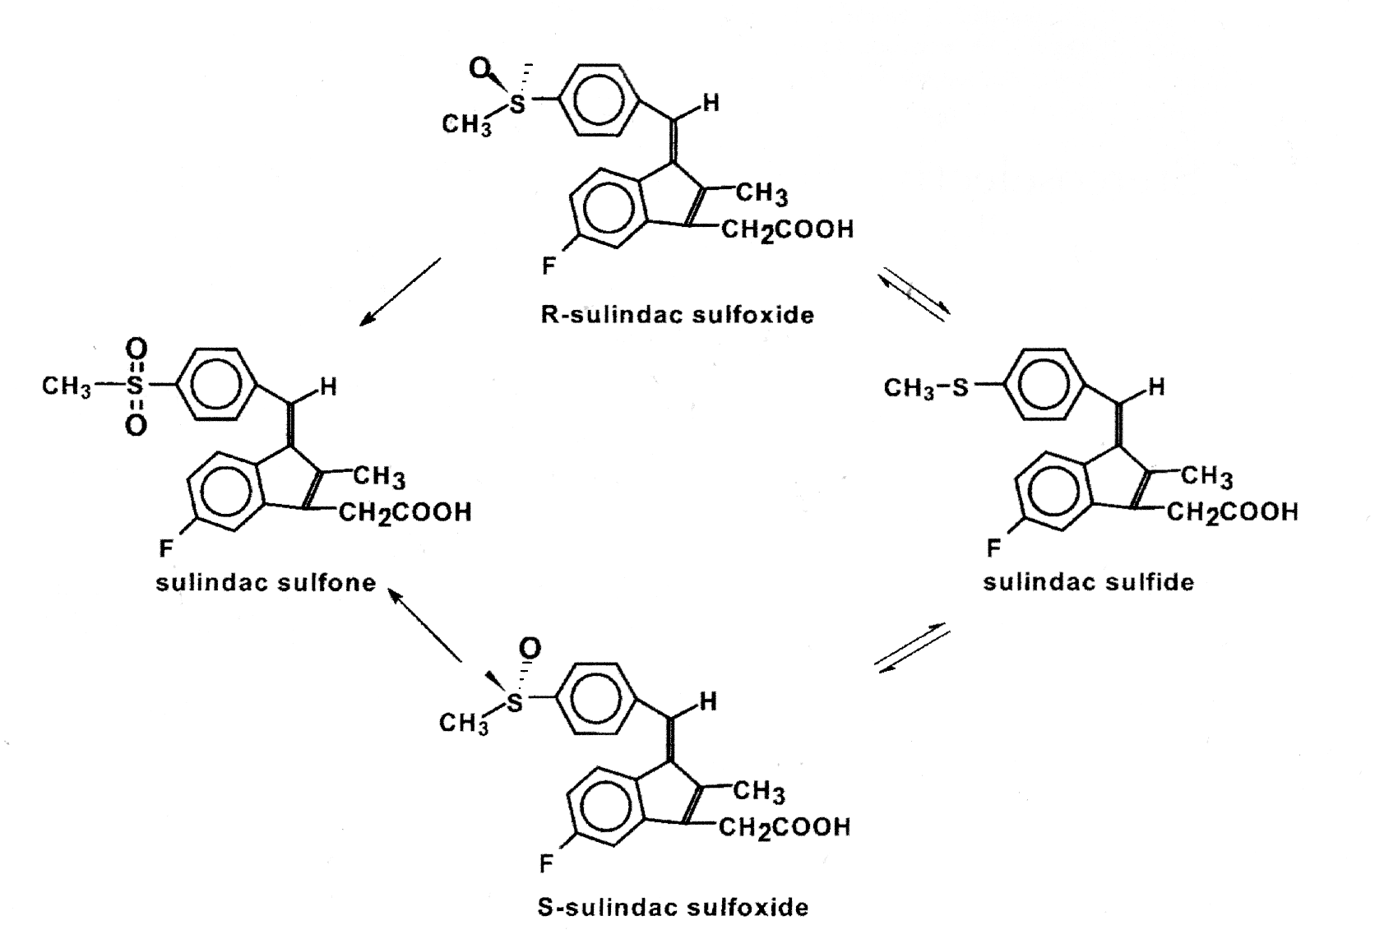
METABOLISM OF SULINDAC
Metabolism of Sulindac

Slide 48
Granulocyte colony stimulating factor (G-CSF):
Granulocyte colony stimulating factor protects in stroke models
through activation of Pim-1 kinase, Akt and STAT3 pathways.
G-CSF receptors expressed in neurons.
Stem cell mobilizing functions.
Protective in models of Parkinson’s through its stem cell
mobilizing actions.

Slide 49
Multi-drug Pre-treatment

Slide 50
Analyzing of TTC staining
Pre-treatment Multi-drug after 4 days
*
*
Percent Infarct
Distance from Frontal pole
Data represent infarct volume as percent of the total ipsilateral hemisphere volume and are means ± SE of 18 experiments for MCAO and MCAO plus DETC-MeSO, GCSF & Sulindac
* : Significant

Slide 51
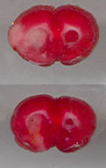
Analyzing of TTC staining of 4mm section
Pre-treatment Multi-drug after 4 days
Percent Infarct
Distance from Frontal pole
Data represent infarct volume as percent of the total ipsilateral hemisphere volume and are means ± SE of 18 experiments for MCAO and MCAO plus DETC-MeSO, GCSF & Sulindac
* : Significant

Slide 52
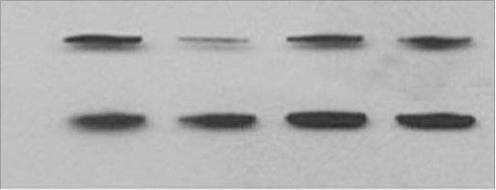
Bax
Bax
GAPDH
*
Fold Increase
N: No drug T: Treated
* : Significant

Slide 53
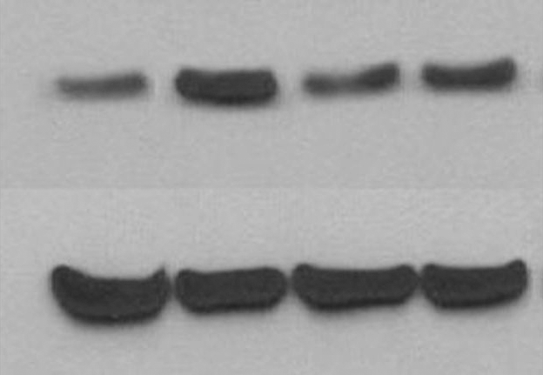
Bcl-2
Bcl-2
GAPDH
*
N: No drug T: Treated
* : Significant

Slide 54
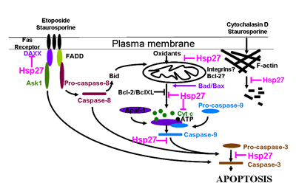
Decrease
Increase
No difference

Slide 55
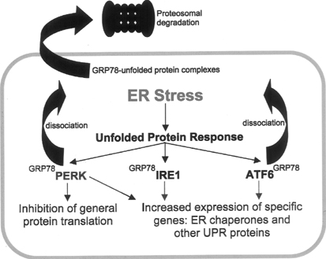

Slide 56
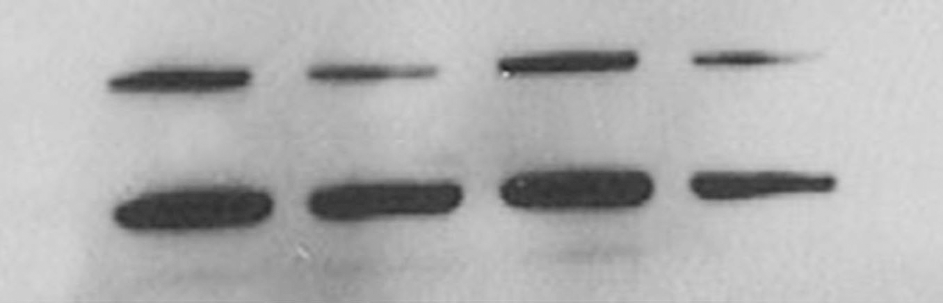
GRP78
GRP78
GAPDH
1 2 3 4
*
Fold Increase
*
N: No drug T: Treated
* : Significant

Slide 57

IRE1
*
*
Fold Increase
N: No drug T: Treated
* : Significant

Slide 58
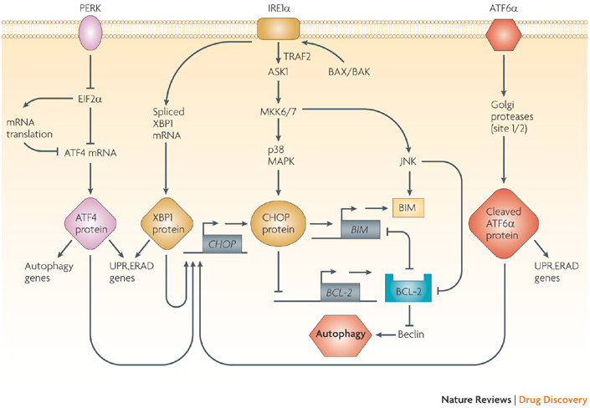
http://www.nature.com/nrd/journal/v7/n12/fig_tab/nrd2755_F1.html
Decrease
Increase
No difference

Slide 59
Multi-drug Post-treatment
Result

Slide 60
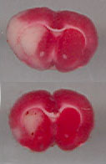
Analyzing of TTC staining of 4mm section
Post-treatment Multi-drug after 4 days
Percent Infarct
Distance from Frontal pole
Data represent infarct volume as percent of the total ipsilateral hemisphere volume and are means ± SE of 9 experiments for MCAO and MCAO plus DETC-MeSO, GCSF & Sulidac
* : Significant

Slide 61

GRP78
*
Fold Increase
N: No drug T: Treated
* : Significant

Slide 62

Bax
*
Fold Increase
N: No drug T: Treated
* : Significant

Slide 63
Bcl-2
*
*
Fold Increase
N: No drug T: Treated
* : Significant

Slide 64

HSP27
Fold Increase
*
*
N: No drug T: Treated
* : Significant

Slide 65
Mechanisms of ER stress
glutamate
[ca²⁺]
ER stess
PERK
ATF6
P90
IRE1
Caspase-12
P
P
P
P
Cleaved
ATF6
eIF2α
XBP-1
Caspase
cascade
P
P
ATF4
Cell death
GRP78
CHOP

Slide 66
SUMMARY:
Taurine in culture and using the in vivo stroke model demonstrates neuroprotection via ATF6 and IRE-1 pathways but not the PERK pathway.
DETC-MeSO protects in stroke via PERK and IRE-1 pathways.
The multidrug strategy employed for the stroke model (pre-treatment) resulted in decreased expression of apoptotic markers and protected via increased Hsp27 and inhibition of the IRE-1 pathway. With post-treatment, protection occurred via Grp78 inhibition and increased Bcl-2/Bax ratio.

Slide 67
FUTURE INVESTIGATIONS
Further pursue mechanisms of protection – including potential modification of autophagy pathways.
Examine stem cell mobilizing aspects in vivo.
Consider additional drug combinations such as DETC-MeSO and Taurine.
FUNDING
Florida Department of Health: James and Esther King.
Florida Atlantic University: Neuroscience Research Theme Award.

Slide 68
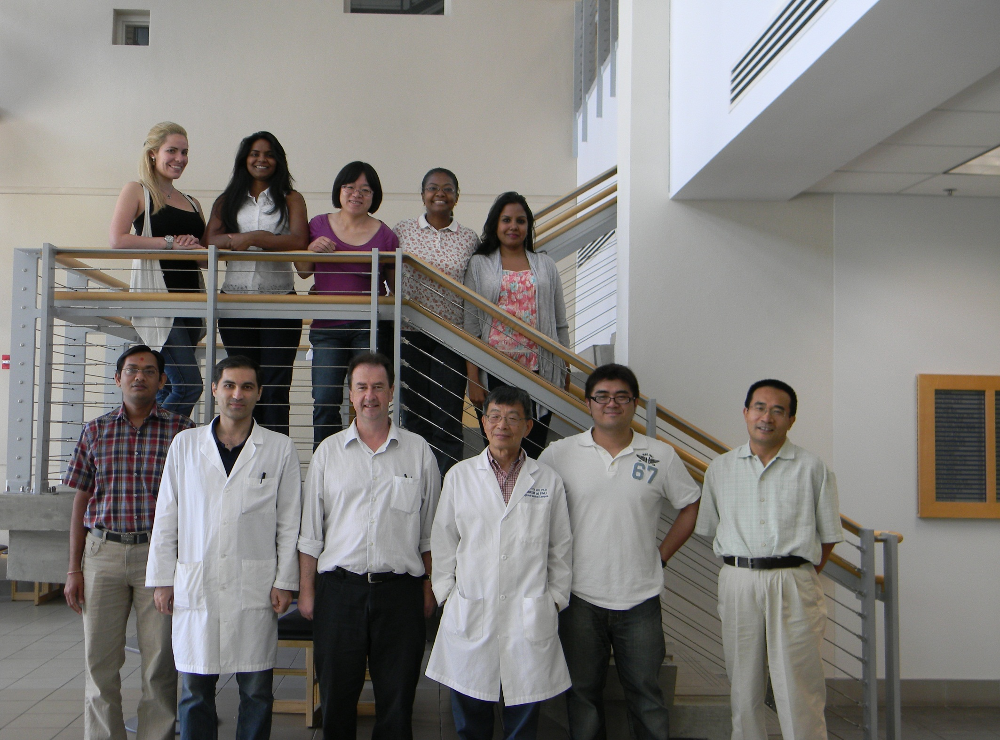

Slide 72


Slide 77


Slide 78


Slide 79


Slide 80


