Slide 1
Role of pelvic lymphadenectomy in stage 1A endometrial carcinoma diagnosed preoperatively by pelvic ultrasonography and CT scan
BY
Hossam El Sokkary
Lecturer of obstetrics and gynecology
Alexandria University, Egypt.

Slide 2

INTRODUCTION

Slide 3
Endometrial cancer
Endometrial cancer is the commonest gynecological cancer mostly affecting women in the postmenopausal age group.
Rates vary around the world but are highest in white women in Western populations.
in developing countries ,it ranks the second after cancer cervix.

Slide 4
Management
Surgery is a fundamental part of the management of endometrial cancer.
The two principal aim of the surgery are :
removal of the cancer.
accurate documentation of the extent of disease (staging).
The former is limited to simple hysterectomy plus Salpingo-Oophorectomy.
The latter is much more involved and includes pelvic washings, omental biopsy or complete omentectomy, pelvic lymph node dissection, and paraaortic lymph node dissection

Slide 5
Lymphadenectomy
TO DO
OR
NOT TO DO

Slide 6
Indication of lymphadenectomy
Tumor size > 2 cm
More than 50% myometrial depth invasion(stage 1B)
Lymph vascular space invasion.
Cervical stromal involvement(stage 2)
Histopathological grade 2 and 3
Histopathological type: papillary serous and clear cell adenocarcinoma
Patient age more than 50 years.

Slide 7
Debate
In many countries as in Canada, there is no guideline regarding extent of surgery for endometrial cancer, and patterns of practice vary across the country.
The 2009 revision of the FIGO staging recommendations further separates patients with pelvic nodal involvement (IIIC1) and para-aortic nodal metastasis (IIIC2), emphasizing the differences in prognosis between these two groups.

Slide 8
Debate
Many studies deny survival benefit for women with stage I ,grade 1 underwent lymphadenectomy (Chan et al)
Other retrospective studies have suggested a therapeutic benefit to lymphadenectomy ( Kilgore et al) for women with stage I or 2.
Lymph node dissection may also assist with postoperative treatment planning in patients with clinical and radiological stage 1A endometrial cancer.

Slide 9
Debate
Selvaggi et al. also found that surgical staging even in clinical stage 1 identified patients with positive lymph nodes who would not have otherwise received postoperative radiation.
Other study found that the pattern and location of recurrences was not different between patients undergoing and not undergoing lymphadenectomy

Slide 10
Debate
A longstanding argument against routine pelvic lymph node dissection in clinical stage 1 is that the procedure can involve risks for the patient as :
vascular injury
Lymphedema
Lymphocyst
Increased operating time

Slide 11
Debate
Risk of lymphadenectomy(continue)
Postoperative ileus
Deep venous thrombosis
Ureteric injury
Wound dehiscence
Increased length of hospital stay.

Slide 12

AIM OF THE WORK

Slide 13
Aim of the work
To evaluate the role of pelvic lymphadenectomy in stage 1A endometrial carcinoma diagnosed preoperatively by pelvic ultrasonography and CT scan as microscopic invasion of pelvic lymph nodes will not be seen by this imaging technique

Slide 14

PATIENTS

Slide 15
Patients
This study was carried out in Alexandria maternity university hospital.
60 cases of stage 1A endometrial cancer diagnosed clinically and radiologically were included in this study that began from June 2009 till October 2012

Slide 16

METHODS

Slide 17
Methods
Following approval by our institutional ethics committee, 60 cases of endometrial carcinoma diagnosed by fractional curettage and proved to be stage 1A preoperatively by:
Clinical examination
Vaginal US and CT scan (negative myometrial invasion, ascites, LN spread and local spread)

Slide 18
Methods
The cases underwent the following:
Total abdominal hysterectomy with salpingo-oopherectomy
Peritoneal wash for cytology
Omentectomy
Pelvic lymphadenectomy (external iliac and obturator groups) after written informed consent

Slide 19
Methods
5. Histopathological examination of the uterus, tubes, ovaries, omentum and pelvic LN
6. Cytological examination of peritoneal wash

Slide 20

RESULTS

Slide 21
Results
Histopathological examination of the cases revealed the following:
52 cases were endometrioid adenocarcinoma
10 grade 1
35 grade 2
7 grade 3
8 cases were serous papillary adenocarcinoma
3 grade 1
5 were grade 2.

Slide 22
Results
As regards myometrial invasion :
13 cases have been proved by histopathology to have myometrial invasion distributed as follow:
9 cases of endometrioid carcinoma
1 case grade 1
3 cases grade 2
5 cases of grade 3
4 cases of papillary serous adenocarcinoma
1 case grade 1
3 cases of grade 2

Slide 23
Results
As regards histopathology of pelvic LN
12 cases out of 60 have been proved to have metastatic lesion
3 of them were serous papillary adenocarcinoma grade 2
9 were endometrioid,
3 grade 2
6 grade 3.

Slide 24
Results
As regards cytology of peritoneal fluid all cases were negative for atypical cells.
Also all cases showed neither spread to tubes and ovaries nor omental affection.

Slide 25
Types of endometrial cancer | Number | Myometrial invasion |  |  |  | Lymph node metastasis
 |  | Yes |  | No |  | Yes |  | No
 |  | No. | % | No. | % | No. | % | No. | %
Endometroid G1 | 10 | 1 | 10.0 | 9 | 90.0 | 0 | 0.0 | 10 | 100.0
Endometroid G2 | 35 | 3 | 8.6 | 32 | 91.4 | 3 | 8.6 | 32 | 91.4
Endometroid G3 | 7 | 5 | 71.4 | 2 | 28.6 | 6 | 85.7 | 1 | 14.3
Serous papillary G1 | 3 | 1 | 33.3 | 2 | 66.7 | 0 | 0.0 | 3 | 100.0
Serous papillary G2 | 5 | 3 | 60.0 | 2 | 40.0 | 3 | 60.0 | 2 | 40.0
Total | 60 | 13 | 21.7 | 47 | 78.3 | 12 | 20.0 | 48 | 80.0
X² P |  | 19.22 0.0074* |  |  |  | 20.3 0.0012*
P Z –test for yes only |  | 0.215 |  |  |  | 0.265
Relation between pathological types of endometrial carcinoma with myometrial invasion and metastatic affection of pelvic lymph nodes

Slide 26
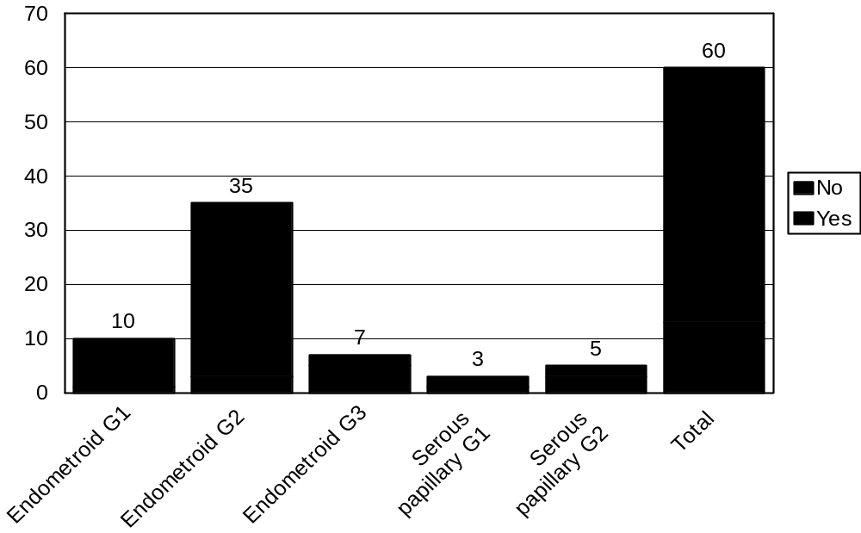
distribution of cases with myometrial invasion in relation to different histological grades of the different pathological types

Slide 27

distribution of cases with lymph nodes metastasis in relation to different histological grades of the different pathological types

Slide 28

CONCLUSION

Slide 29
Conclusion
There is no need for lymphadenectomy in stage 1A diagnosed preoperatively using CT scan and vaginal US, preventing high risk surgical intervention in this early stage.

Slide 30
Thank you

