Slide 1
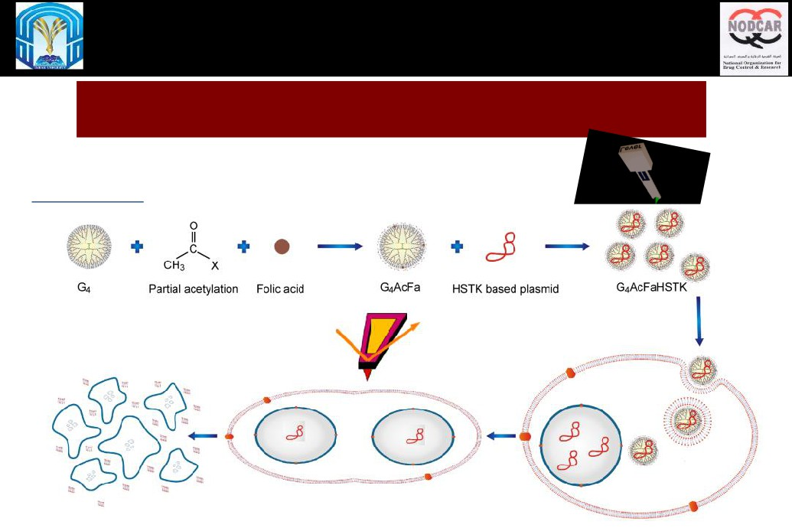
4D molecular imaging of the effect of suicide anticancer Nano-particles
on individual live cancer cells
2nd World Bio Summit & Expo” October 10-12, 2016 in Dubai, UAE.
Recent Advances in Bioscience
Hosam Gharib Abdelhady
Associate Professor - Biophysics & Pharmaceutical Nanotechnologies
College of Pharmacy-Taibah University-Al Madinah Al Munawarrah
Visiting Professor - CENT lab at UFM & Georgia Tech
hhasan@taibahu.edu.sa

Slide 2
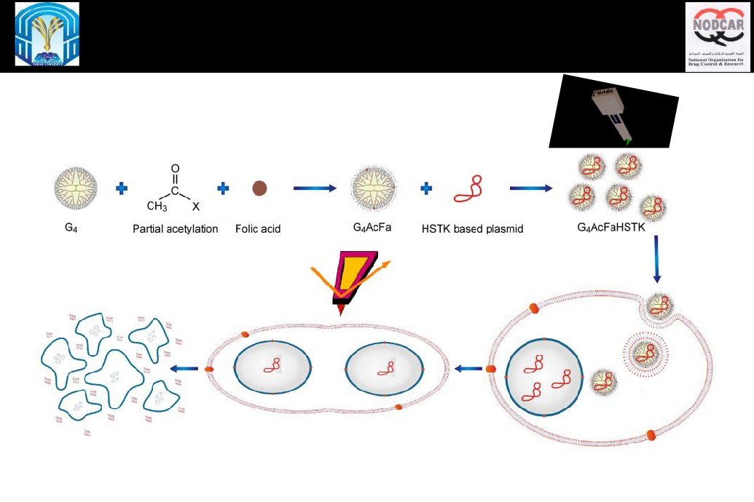
4D AFM imaging - suicide anticancer (HSTK ) NPs (Dendrimers) on
individual live cancer (HeLa) cells

Slide 3
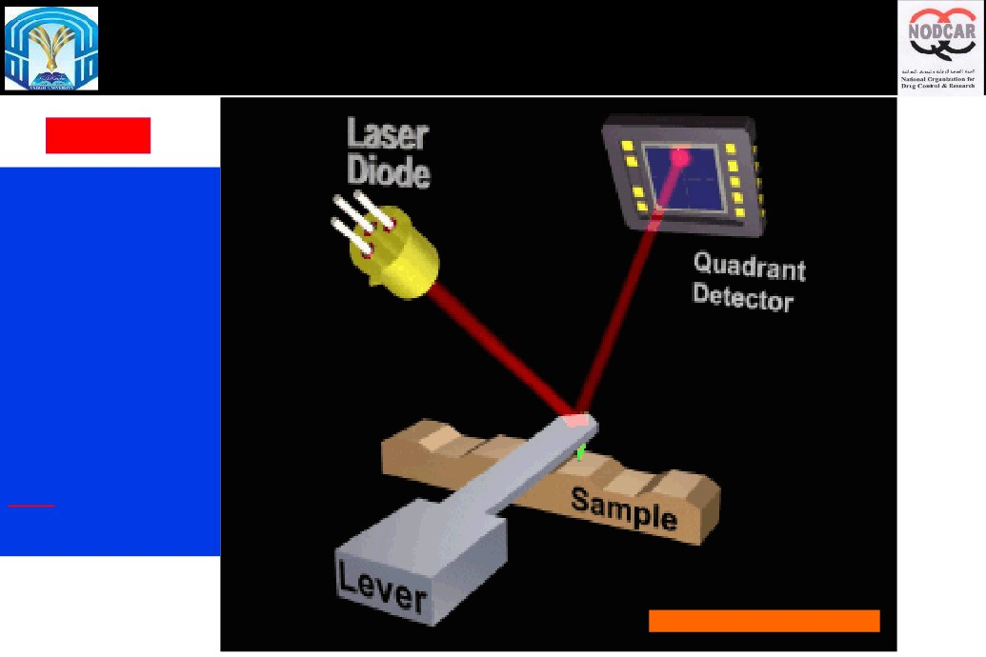
4D AFM imaging of the effect of suicide anticancer Dendritic Nano-
particles on individual live cancer cells
4D AFM
Measures the
sample topography
simultaneously
with its
nanomechanical
properties at high
resolution. No dyes
DNA-binding dyes,
strongly influence
the physical
properties of DNA.
Dietler et al.,
Macromolecules, 2015, 48
(6), pp 1860-1865
www.nano-world.org/Lab/demo/abbilden

Slide 4
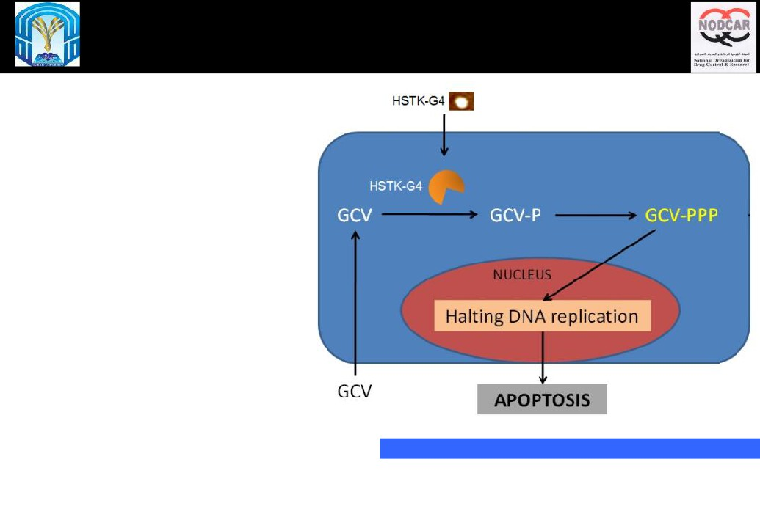
4D AFM imaging of the effect of suicide anticancer Dendritic Nano-
particles on individual live cancer cells
HSTK\GCV used in suicide gene
therapy for cancer treatment.
1- HSTK phosphorylates GCV to
form GCV-P.
Cellular kinases
2- Cellular kinases convert GCV-P to
GCV-PPP.
3- GCV-PPP is integrated into the
DNA, inhibits its replication during
cell division leading to apoptosis.
Apoptosis occurs only in cells transfected with
HSTK while the untransfected cells survive.
http://www.intechopen.com/source/html/18156/media/image5.jpg

Slide 5
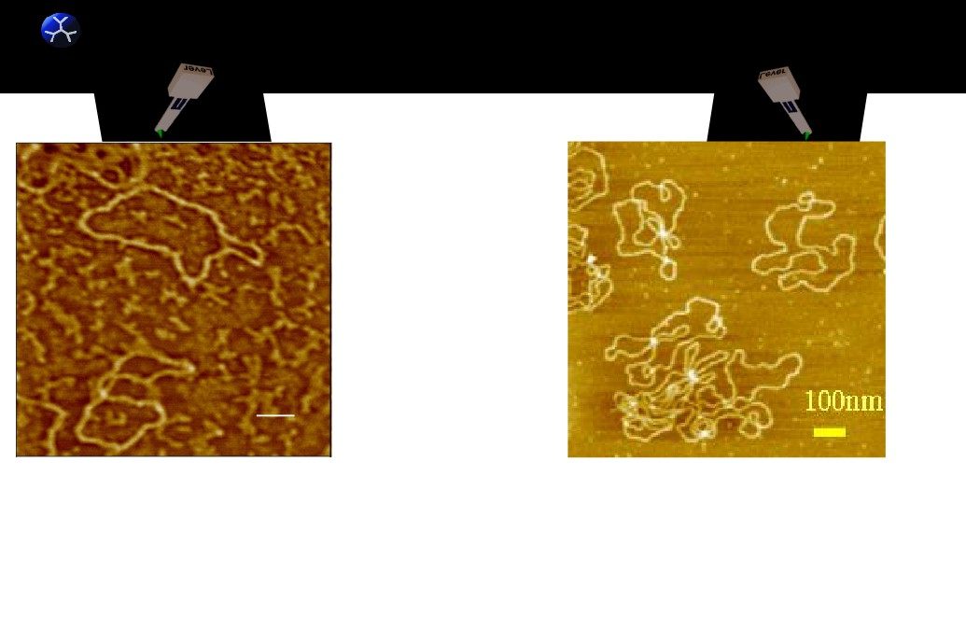
4D AFM imaging of the effect of suicide anticancer Dendritic Nano-
dnt
particles on individual live cancer cells
AFM imaging
in Air vs buffer
Top view AFM image of DNA plasmids in
Top view AFM image of DNA plasmids in
air. The plasmids display relaxed open
PBS. The plasmids display relaxed open
structure on mica. Scale bar = 100 nm.
structure on mica.

Slide 6
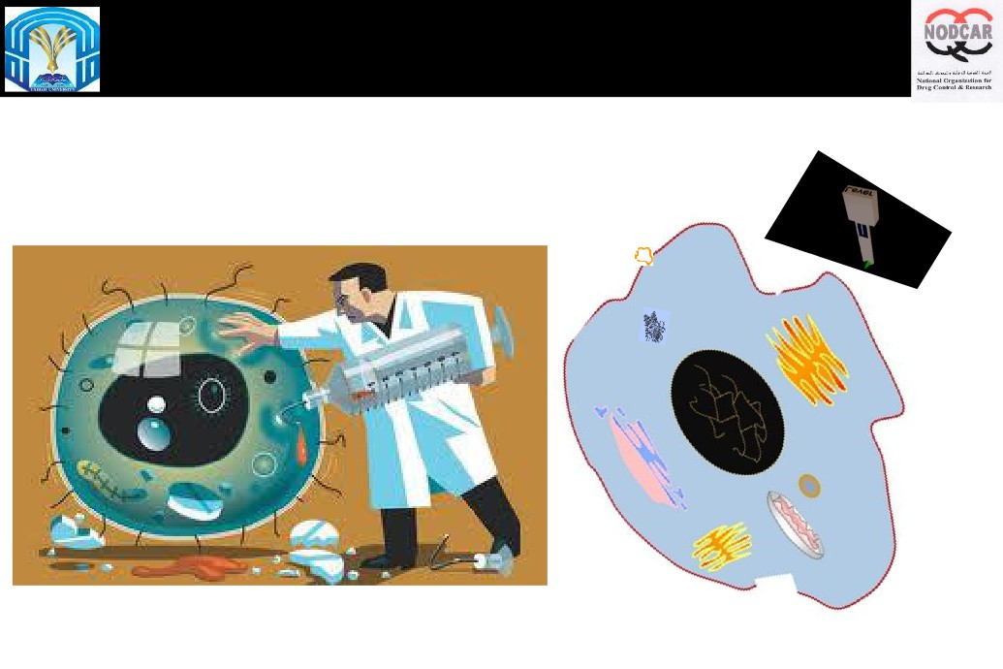
Idea: Transfect the HSTK into cancer cell

Slide 7
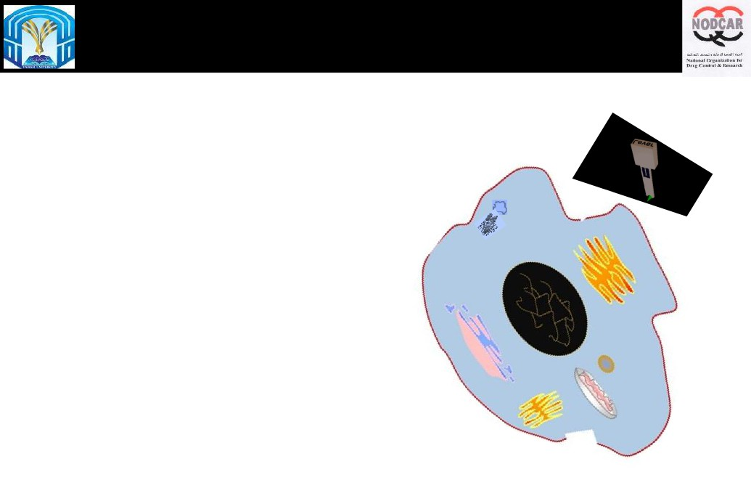
Idea: Transfect the HSTK into cancer cell

Slide 8

Idea: Transfect the HSTK into cancer cell

Slide 9
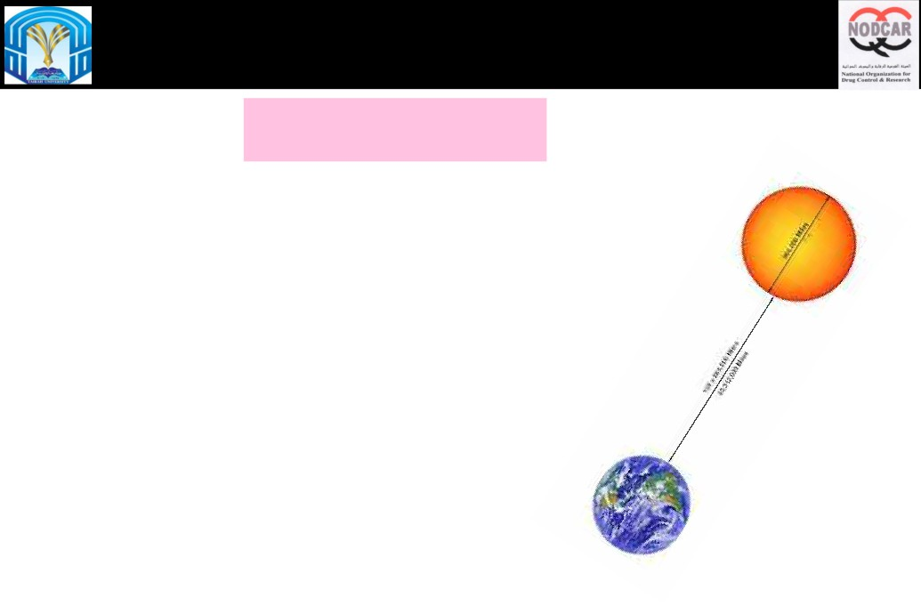
How the DNA is protected in vivo
Learning From God.
DNA Packing
Each diploid cell contains 6 billion bp of DNA = ~ 2 meters of DNA
Each bp ~ 0.34 nm
Estimated: human body contains ~ 50 trillion cells = 100
trillion meters.
The Sun is 150 billion meters from Earth.
= each of us has enough DNA to go from here to the Sun
and back > 300x
Or around Earth's equator 2.5 million times!
Annunziato, A. DNA Packaging: Nucleosomes and Chromatin. Nature Education 1(1):26, 2008.

Slide 10
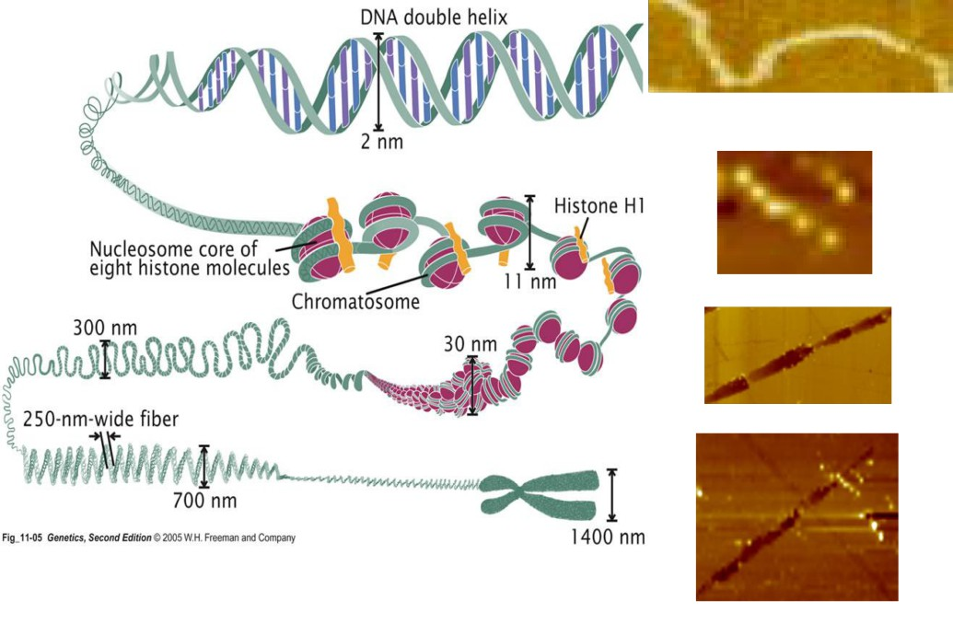
http://www.nature.com/scitable/resource?action=showFullImageForTopic&imgSrc=/scitable/content/18847/pierce_11_5_FULL.jpg

Slide 11
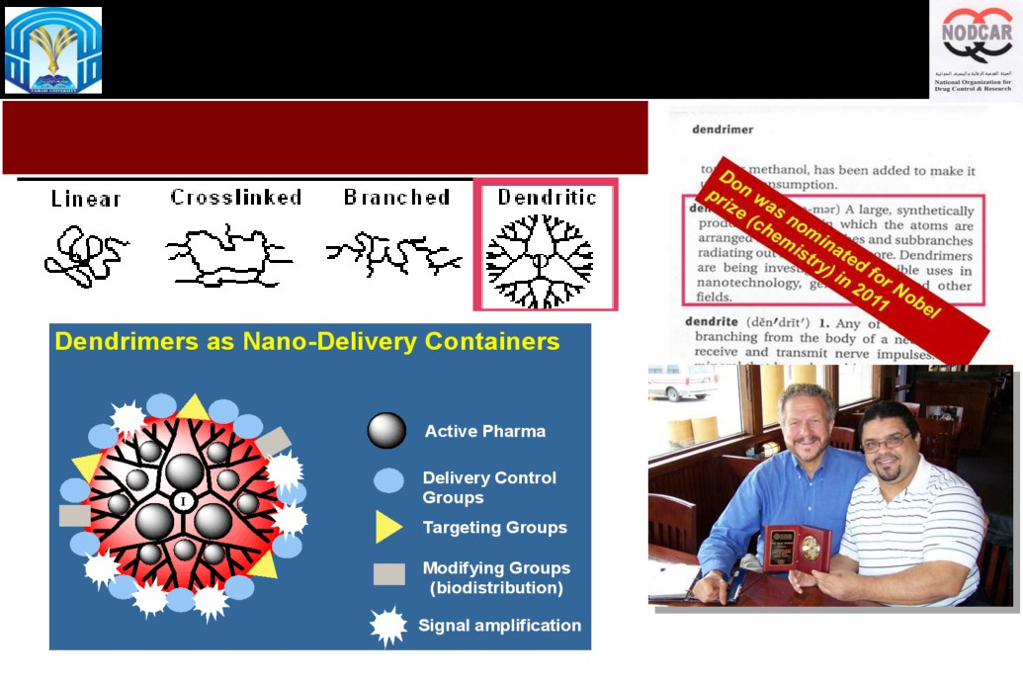
4D AFM imaging of the effect of suicide anticancer Dendritic Nano-
particles on individual live cancer cells
None Viral vectors
Dendrimers vs non-dendritic polymers

Slide 12
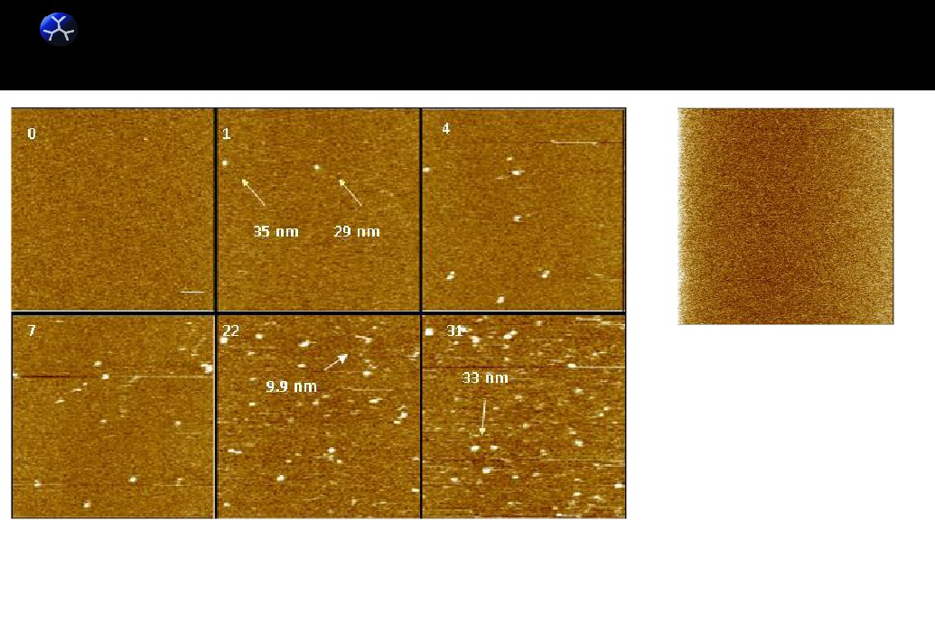
4D AFM imaging of the effect of suicide anticancer Dendritic Nano-
dnt
particles on individual live cancer cells
G4 dendrimers (10-14 M) on mica (in DI water). Numbers represent time lapsed in minutes. Scale bar = 100nm.
Abdelhady, H.G. Dendrimers DNA Nanoplexes, in CRC Concise Encyclopedia of Nanotechnology, 2015.

Slide 13
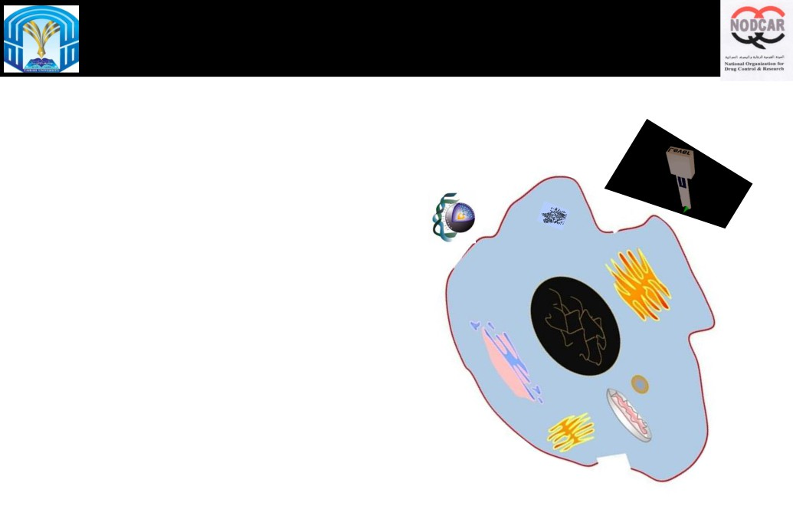
Active Targeting through Folate Ligands

Slide 14
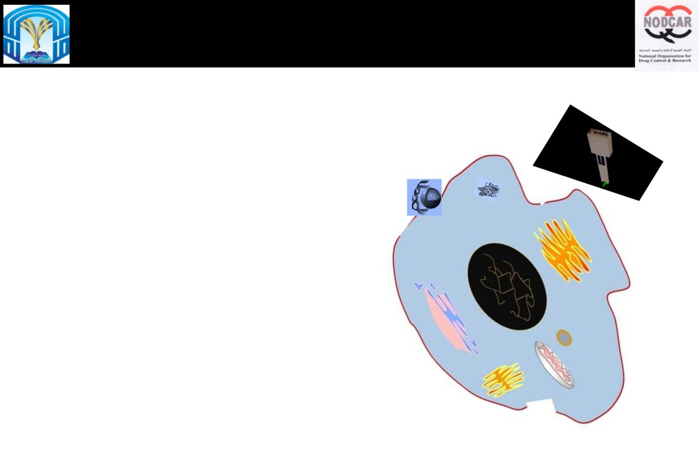
The need for Vectors
Viral vs none viral vectors

Slide 15

The need for Vectors
Viral vs none viral vectors

Slide 16

The need for Vectors
Viral vs none viral vectors

Slide 17

The need for Vectors
Viral vs none viral vectors

Slide 18

The need for Vectors
Viral vs none viral vectors

Slide 19
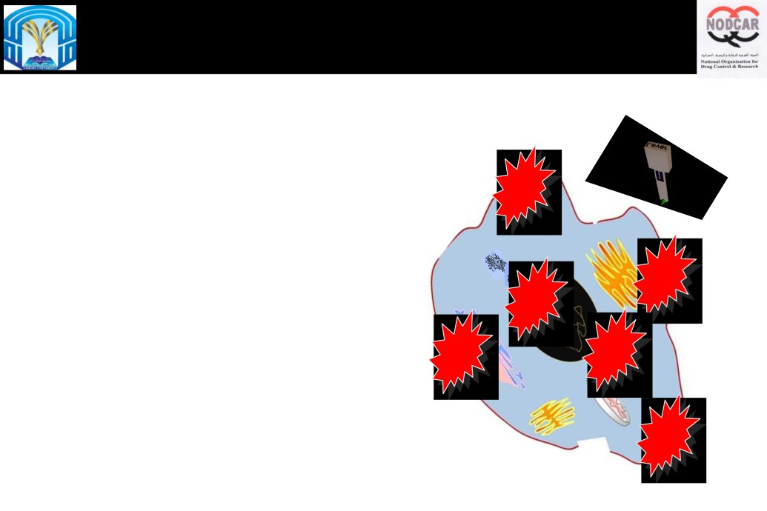
The need for Vectors
Viral vs none viral vectors

Slide 20
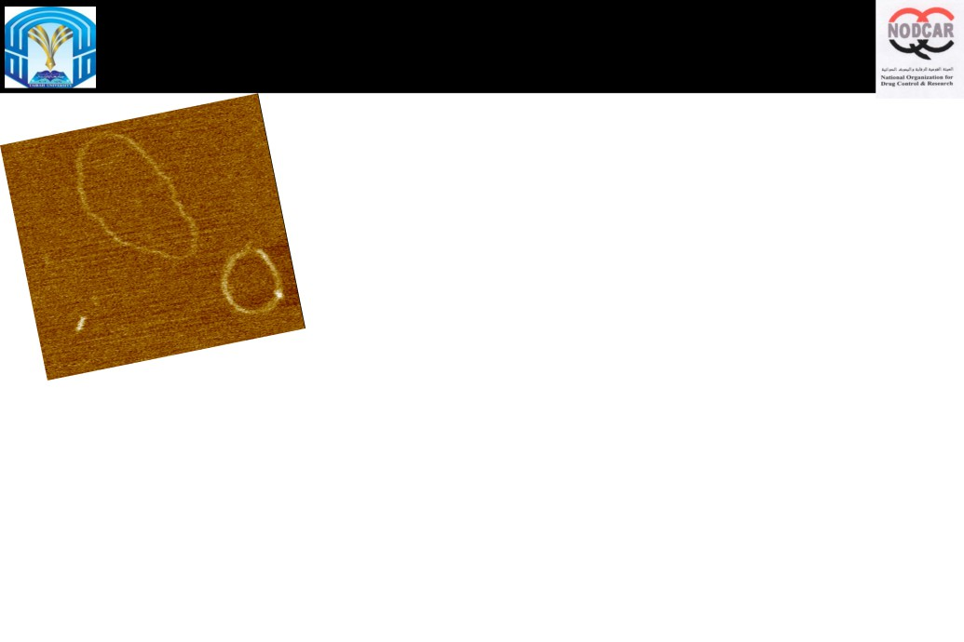
4D AFM imaging of few G4(s) + Few DNA(s)

Slide 21
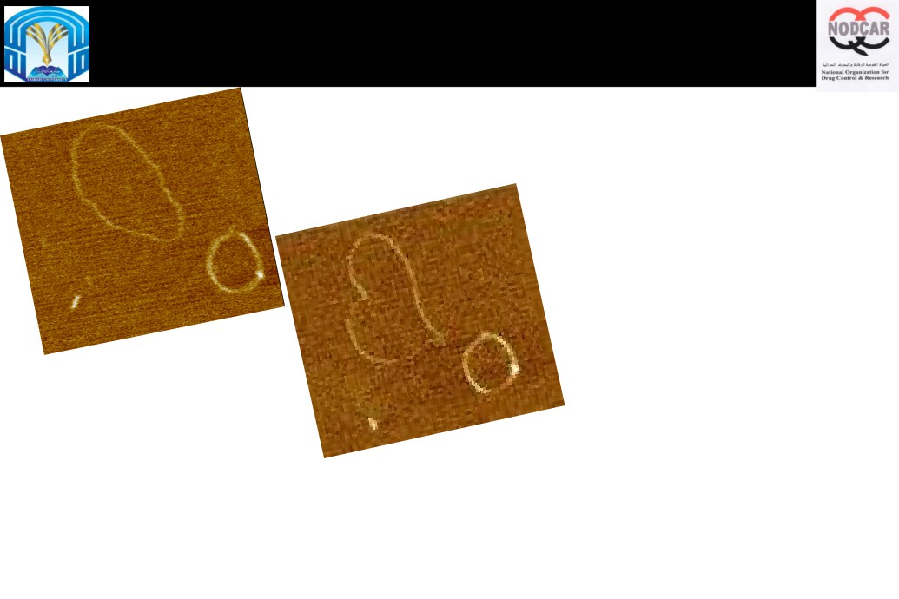
Molecular marriage of Individual DNA molecules
Effect of very small numbers of Dendrimer molecules

Slide 22
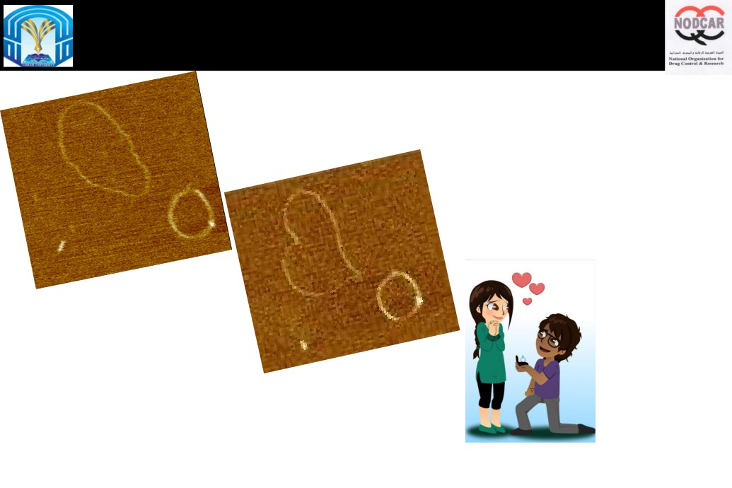
Molecular marriage of Individual DNA molecules
Effect of very small numbers of Dendrimer molecules

Slide 23
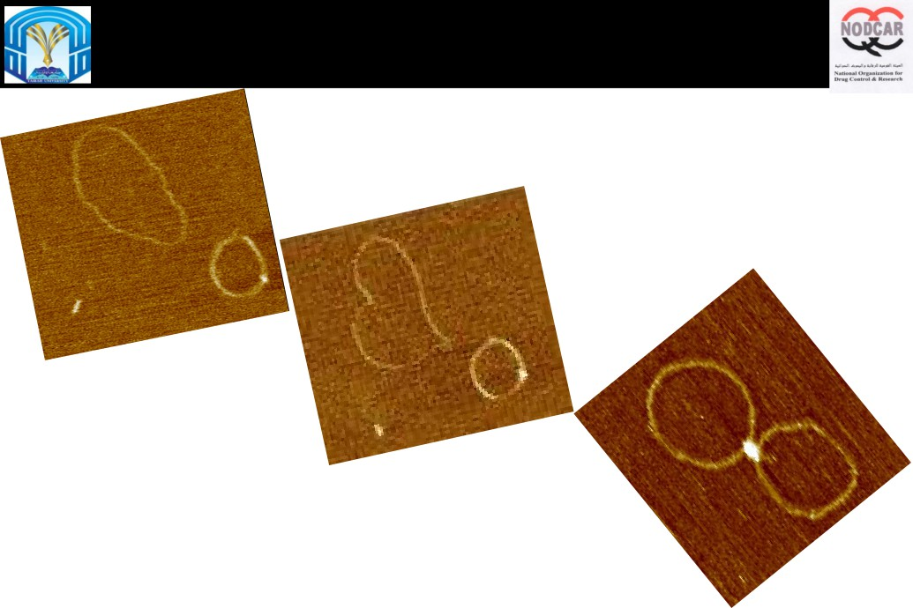
Molecular marriage of Individual DNA molecules
Effect of very small numbers of Dendrimer molecules

Slide 24
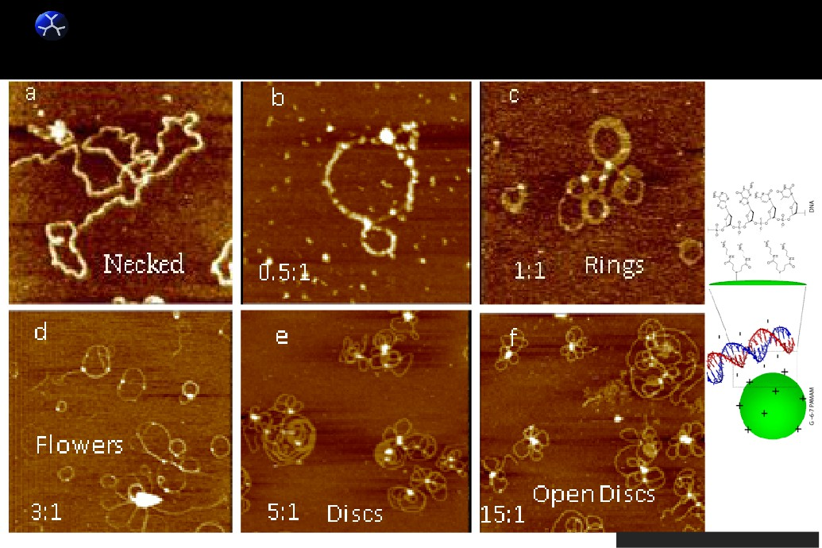
Effect of G4:DNA charge ratio
dnt
Abdelhady et al. Nucleic Acid Research. 31(14) 2003

Slide 25
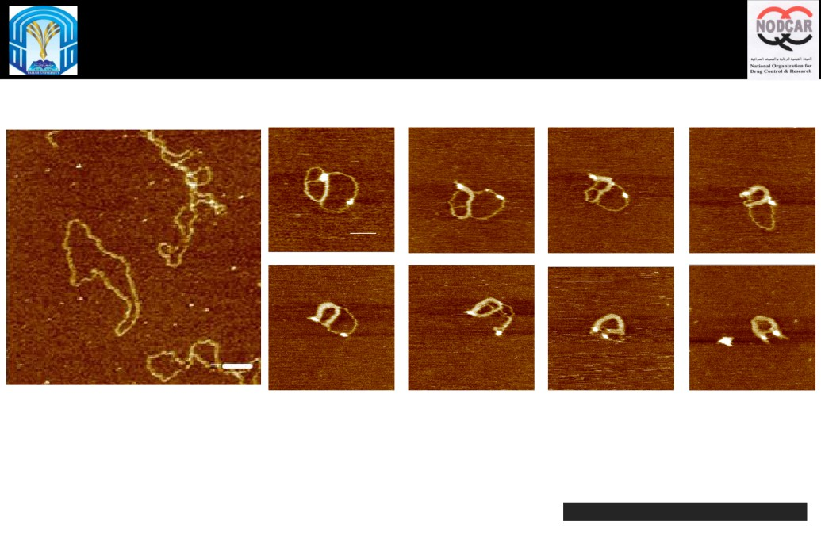
Mechanism of Torus formation with G4 PAMAM dendrimers
0
12
16
20
26
28
35
37
Abdelhady et al. Nucleic Acid Research. 31(14) 2003

Slide 26
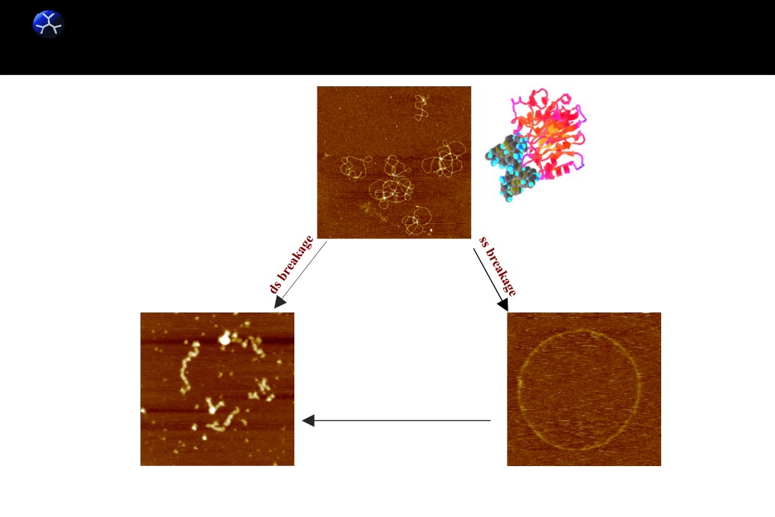
dnt
Protect DNA from enzymatic degradation?
ds DNA
DNase I is divalent cation
dependent exhibiting optimal
activity in the presence of
Ca2+ and Mg2+ or Mn2+
Accumulation
of
ssB
Fragments of ds DNA
Open circular - DNA

Slide 27
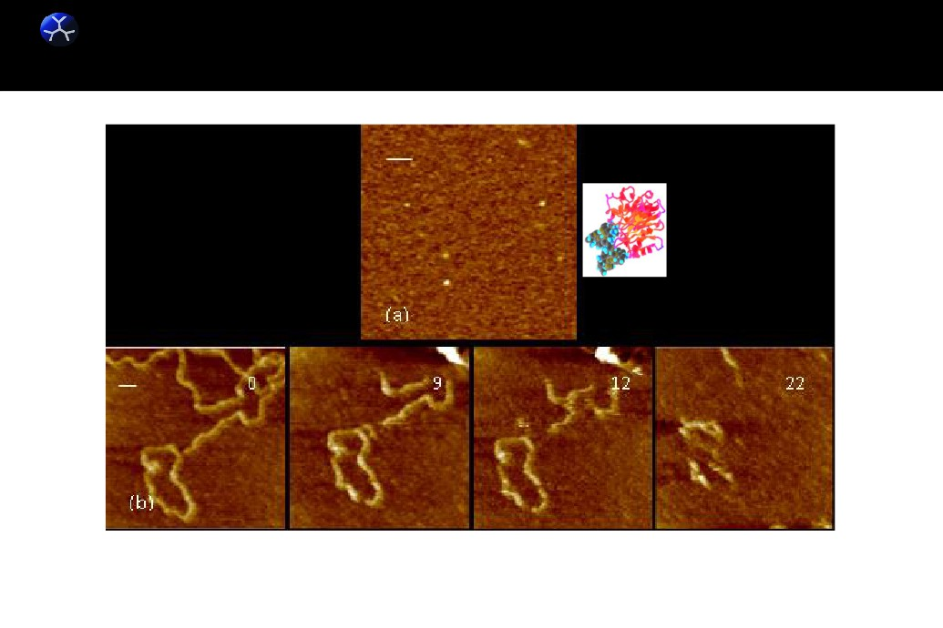
dntEffect of DNase I enzyme on bareDNA adsorbed onto mica surfaces
DNase I
Time-lapse images, in 1mM PBS containing 2mM MgCl2 and 1mM NiCl2

Slide 28
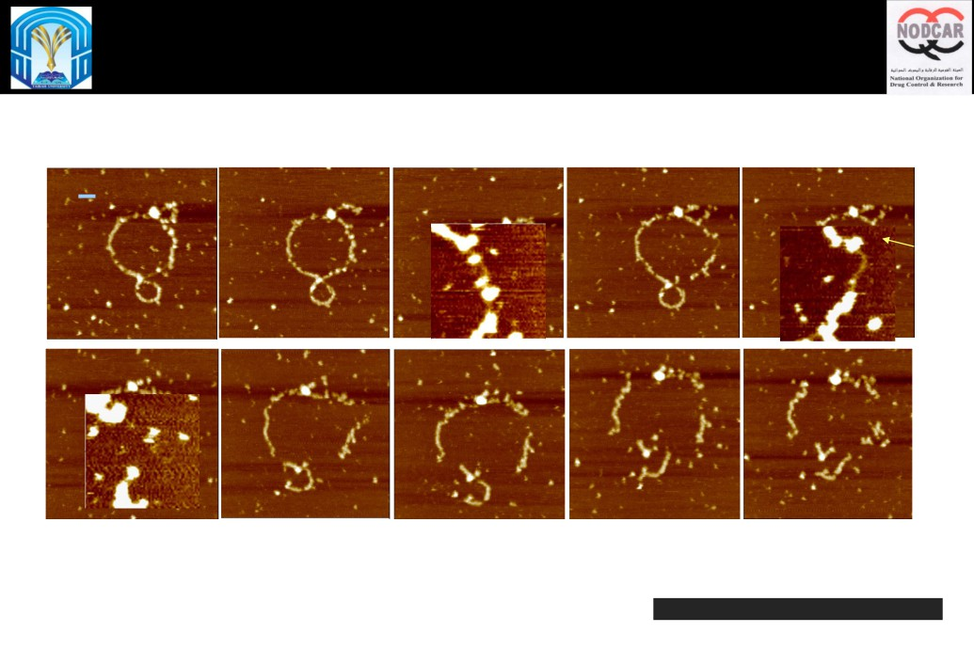
Relating condensate structure to degradation: 0.5:1 G4:DNA
Z = 10 nm
t=0 min
12
19
20
22
70 nm
41
45
48
56
60
Abdelhady et al. Nucleic Acid Research. 31(14) 2003

Slide 29

Relating condensate structure to degradation: 0.5:1 G4:DNA

Slide 30
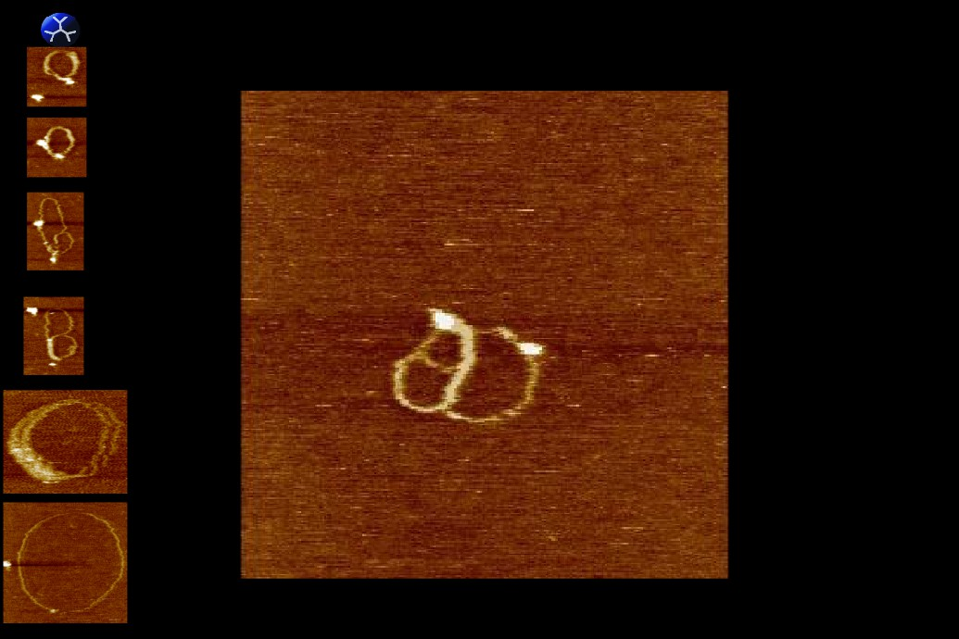
Protection of DNA from enzymatic degradation : effect of complex
incubation time at 1:1 G4:DNA (15 min)
Abdelhady et al. DOI: 10.1371/journal.pone.0061710 2013
Images recorded ca. every ca 30 seconds

Slide 31
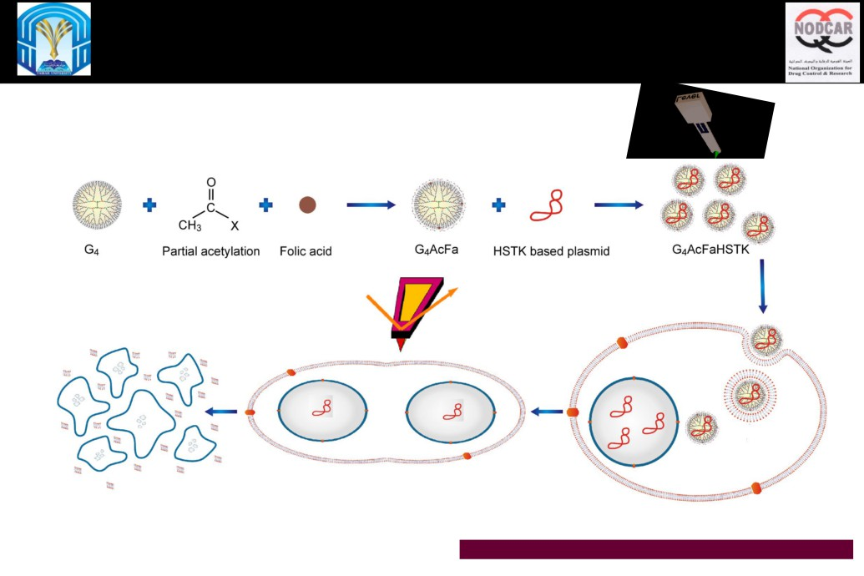
Using the previous information in 4D imaging of the effect of
suicide dendriplexes on dividing HeLa cells
Abdelhady et al. Nanomedicine: Nanotechnology, Biology, and Medicine. 12, 2016.

Slide 32
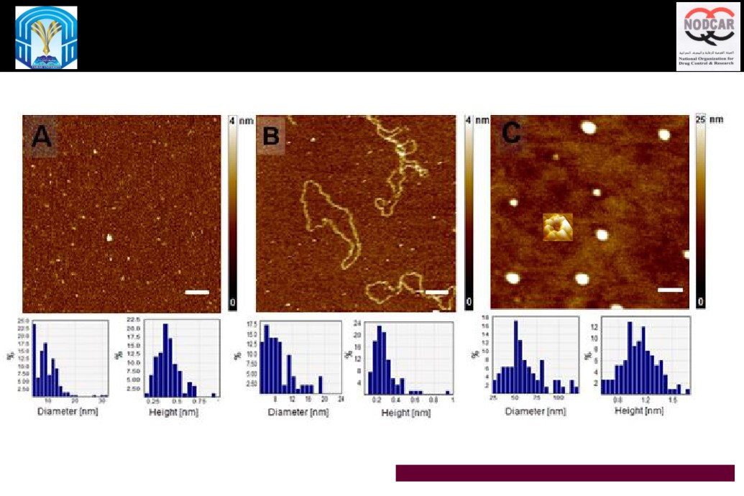
Spatiotemporal PFQNM visualization of the effect of suicide
dendriplexes on dividing HeLa cells
Abdelhady et al. Nanomedicine: Nanotechnology, Biology, and Medicine. 12, 2016.

Slide 33
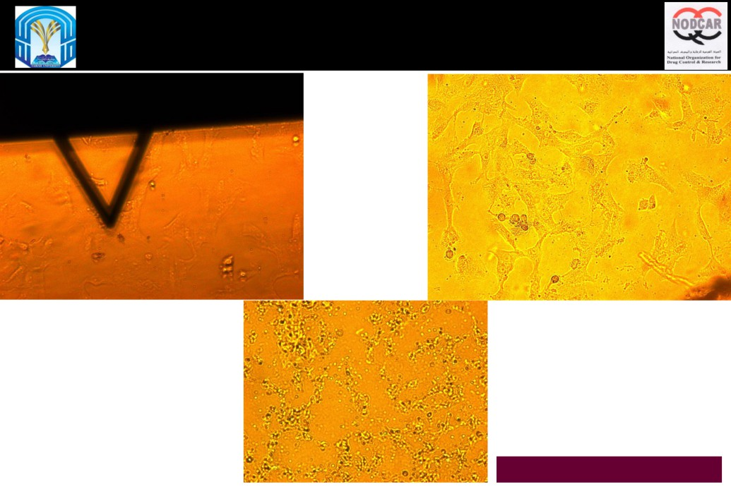
Spatiotemporal PFQNM visualization of the effect of suicide
dendriplexes on dividing HeLa cells
Abdelhady et al. Nanomedicine: Nanotechnology,
Biology, and Medicine. 12, 2016.

Slide 34
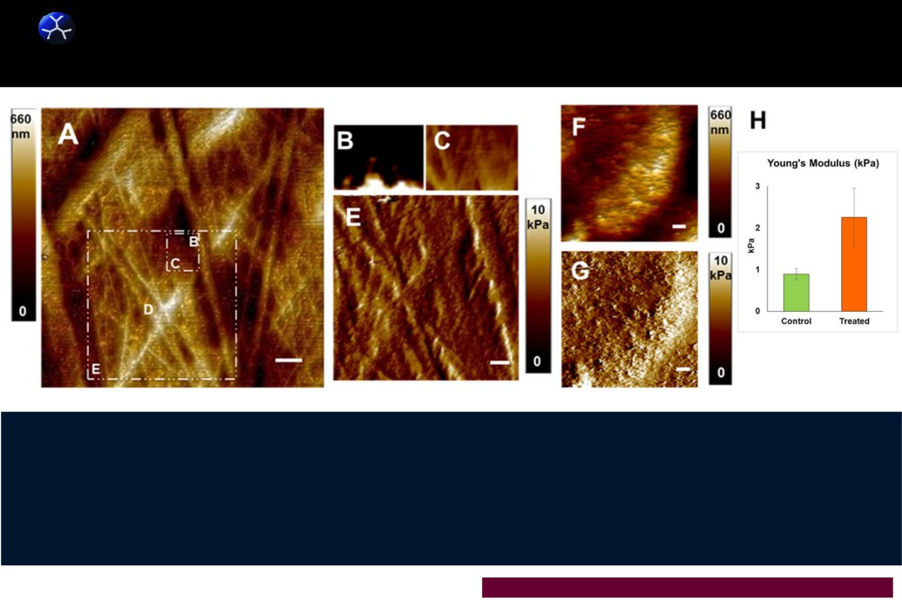
AFM images of Hela cells in their cellular environment.
dnt
No dyes.
Filopodias and lamellipodias
3D of HeLa cells (control)
Nuclei
Nanomechanical image
F: 3D image of an individual HeLa cell, after 40 hrs of exposure to G4AcFaHSTK/GCV. The
cytoskeleton, the nucleus, lamellipodias and filopodias were not visible. (G) nanomechanical image of F.
, F = Dead cell . (H) statistical analysis of the YM at the nucleus zone. Number of cells analyzed = 24.
Abdelhady et al. Nanomedicine: Nanotechnology, Biology, and Medicine. 12, 2016.

Slide 35
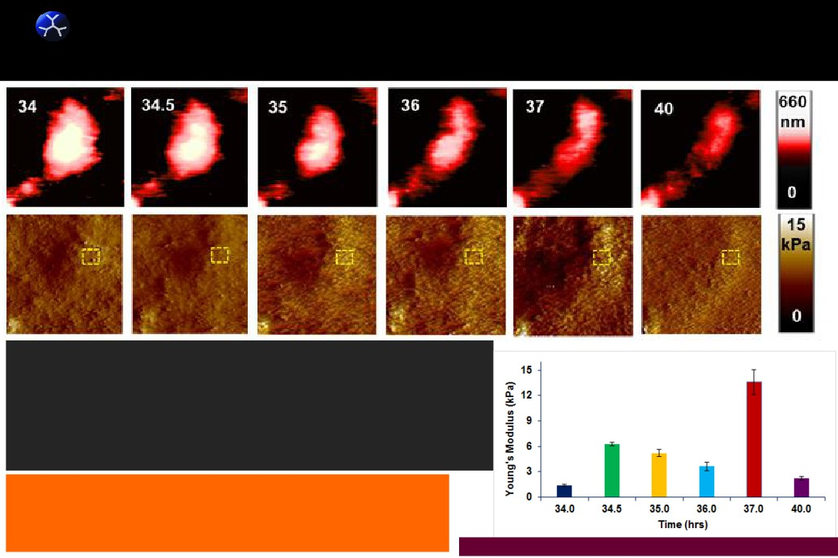
4D AFM Topographic & modulus mapping of an individual Hela cell , in native
dnt
cellular environment, after treatment with G4-HSTK/GCV. A summary of 120 images
Topographic
Modulus
Topographic: Nuclear zones = white contrast.
This cell starts to elongate (34.5 h) when it enters anaphase and
gradually form a cleavage furrow (35 h) at the cell equator.
Telophase begins (36 h) once the nuclear contents spread into two and
pulled to the opposite poles of the cell.
Finally, signs of apoptosis are observed at 37-40 h, including nuclear
fragmentation and cytoplasmic shrinkage.
Modulus: The six 2.5 × 2.5 μm squares, on the nuclear zone
indicate the position from which the YM has been calculated.
Numbers in the images = time lapsed in hrs. Image size =25 μm.
Abdelhady et al. Nanomedicine: Nanotechnology, Biology, and Medicine. 12, 2016.

Slide 36

Thanks
Taibah Al Madinah Al Munawarrah
University
NODCAR
EGYPT

