Slide 1
Resolution-based outlier factor and outlier mining algorithm for engineering applications
Dr. Hongqin FAN
Department of Building and Real Estate
The Hong Kong Polytechnic University
Hong Kong SAR, China
Monday, 26 September, 2016

Slide 2
Outline
Introduction
Resolution-Based (RB) outlier
RB-outlier mining algorithm
Engineering applications
Discussions
Conclusions

Slide 3
1. Introduction
Outlier mining is aimed to identify these observations deviating from the majority or from local data clusters.
Outliers represent some observations of interests:
  Fraud transaction in financial application;
  Detection of natural disasters and climate change;
  Abnormal effects of medical treatment;
  Anomaly due to change of system status or operations;
  Anomaly in work performance due to problematic decisions in management.

Slide 4
1. Introduction
Opportunities in engineering applications:
  A clear need to identify the outliers in system operations or management in real time;
  Implies large chunks of savings in many applications.
Challenges in engineering applications:
  Difficult to define or describe the system due to inherent complexity or complex operational environment;
  Difficult to describe the clusters in the observations;
  No clear demarcation between local outliers and global outliers;
  Difficult to rank the outliers effectively.

Slide 5
1. Introduction
Some outlier mining algorithms:
  Distance-based outlier mining algorithm (Knorr and Ng 1998)
  Local outlier mining algorithm (Breunig et al. 2000)
  Connectivity-based mining algorithm (Tang et al. 2002)
Current outlier definitions and outlier mining algorithms are difficult to be applied to engineering applications.

Slide 6

2. Resolution-Based (RB) outlier
Resolution-based Outlier Factor(ROF) :
  If the resolution of a dataset changes consecutively between maximum resolution where all the points are non-neighbours, and minimum resolution where all the points are neighbours, the resolution-based outlier factor of an object is defined as the accumulated ratios of sizes of clusters containing this object in two consecutive resolutions.
r₁, r₂. . .r_{i} . . . r_{R}. are the resolutions at each step,
R is the total number of resolution change steps from S_{max} to S_{min},
ClusterSize (O, r ) is the number of objects in the cluster containing object O at a resolution r .
r0 is the state before the resolution scaling begins. At that stage all cluster sizes are 1 (i.e. one point) and the ROF of all points is 0.

Slide 7
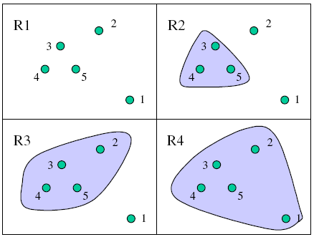
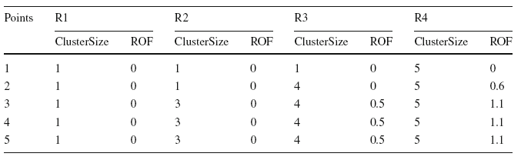
2. Resolution-Based (RB) outlier
Example:
Cluster size at different resolution levels: gradually zoom out.
ROF values are collected and accumulated at each level of resolution.

Slide 8
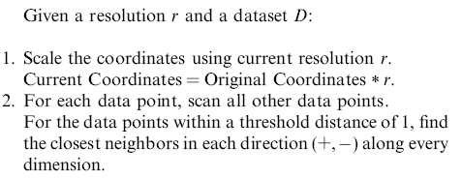
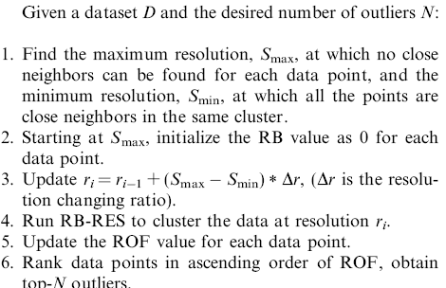
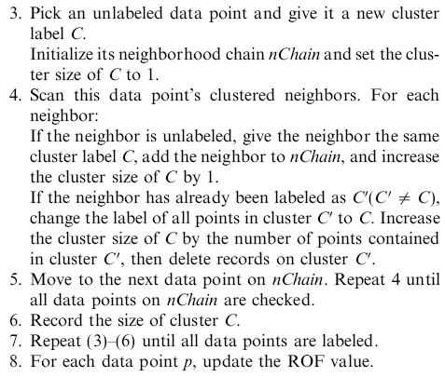
3. RB-outlier mining algorithm
RB-CLUSTER
RB-MINE

Slide 9
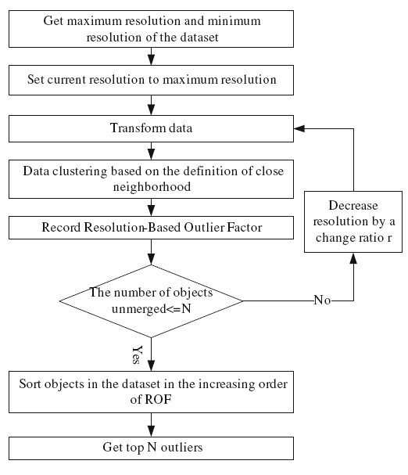
3. RB-outlier mining algorithm
RB-outlier mining algorithm

Slide 10
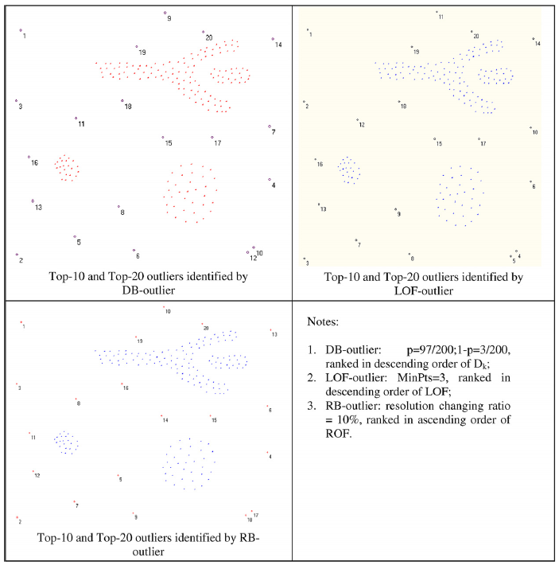
3. RB-outlier mining algorithm
Using a synthetic database, comparison is made with two renowned outlier mining algorithms: distance based (DB) and local outlier factor (LOF) based outlier
DB-outlier
LOF outlier
RB-outlier

Slide 11
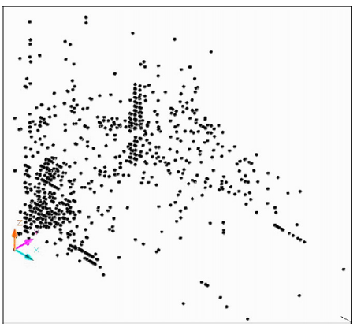
4. Engineering applications
Decision support in construction equipment management:
A contractor’s equipment fleet
Yearly repair and maintenance cost ($ per yr)
Rate of charge ($ per hr)
Age (yrs)
Some combinations of the attribute values show abnormal behavior of equipment
Decisions can be made on equipment repair or disposal/replacement.

Slide 12
4. Engineering applications
Other applications
  Identify abnormal construction equipment operations on the jobsite, based on daily records;
  Abnormal productivity data in construction project management for improving decisions;
  Abnormal sensing data in structure health monitoring;
  Removing noisy data for improved analysis of system operations (focusing on majority only).

Slide 13
5. Discussions
Pros
  No domain dependent parameters of input;
  Handle database of many clusters of arbitrary shapes;
  Take both local and global features of the database into account;
  Ranking top outliers for analysis;
  It is possible to identify the number of outliers automatically based on the change trend of ROF (i.e. point of elbow).
Cons
  Need trial on resolution change step size;
    No significant changes observed if the step size is small enough
  Need to standardize the attributes.
    Important attributes can be given larger weighting through transformation

Slide 14
6. Conclusions
The RB-outlier, ROF, and RB-outlier mining are based on the concept of resolution change;
RB-outlier mining algorithms can be effectively used in engineering applications which are distinct from others;
RB-outlier mining algorithm is easy to use, flexible, and shows good performance in both synthetic and real life data.

Slide 15
Acknowledgement
Special acknowledgement to the following people:
  Professor Osmar Zaiane
  Dr. Andrew Foss
  Mr. Junfeng WU

Slide 16
References
Knorr E, Ng R (1998) Algorithms for mining distance-based outliers in large datasets. In: Proceedings of 24th international conference on very large databases (VLDB), New York, USA.
Breunig M, Kriegel H, Ng R, Sander J (2000) LOF: Identifying density-based local outliers. In: Proceedings of ACM SIGMOD international conference on management of data, Dallas.
Tang J, Chen Z, Fu AW, Cheung DW(2002) Enhancing effectiveness of outlier detections for low density patterns. In: Proceedings of the 6th Pacific-Asia conference on advances in knowledge discovery and data mining, Taipei, Taiwan, pp 535–548
Fan, H., Kim, H, AbouRizk, S. and Han, S. (2008) “Decision support in construction equipment management using a nonparametric outlier mining algorithm." Journal of Expert Systems with Applications, 35(4).
Fan, H., Zaiane, O.,Foss, A. and Wu J. (2009) “Resolution-based outlier factor: detecting the top-n most outlying data points in engineering data.” Journal of Knowledge and Information Systems Springer. 19(1), 31-51.

