Slide 1
New Chemical Approaches to Complete Solvent Removal:
Their Applications in Preparation of Non-porous and Porous PLGA Microspheres
Hongkee Sah
College of Pharmacy, Ewha Womans University
Aug. 22, 2016

Slide 2
Presentation Contents
Introduction to PLGA microspheres
Issues on contemporary microencapsulation technologies
Innovative approach to make non-porous PLGA microspheres
New paradigm in preparation of porous PLGA microspheres

Slide 3
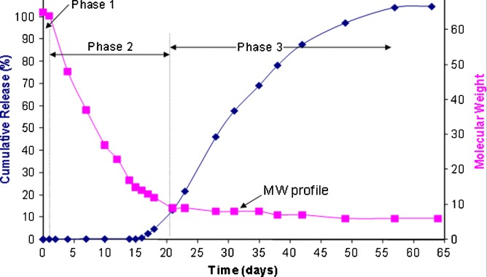
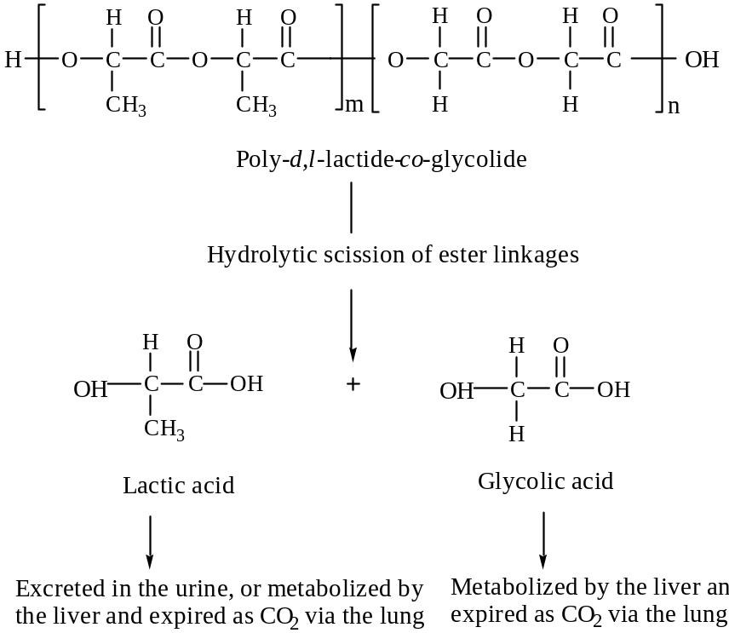
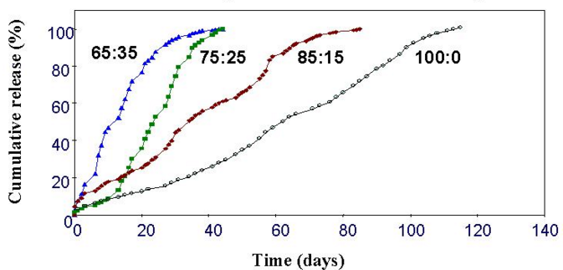
Biodegradable Polymer: Poly-lactide-co-glycolide
Source: AAPS J. 2010 Mar; 12(1): 27–32

Slide 4
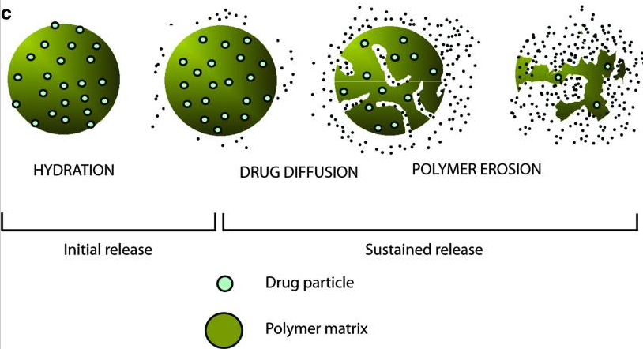
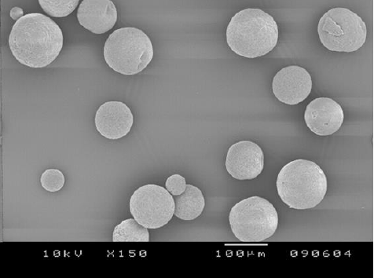
Injectable Long-acting Microspheres

Slide 5
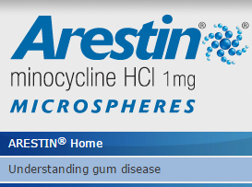
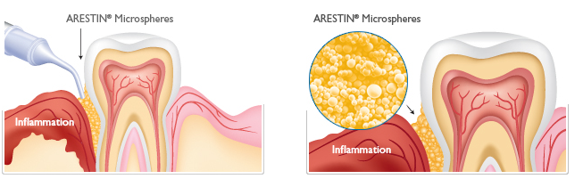
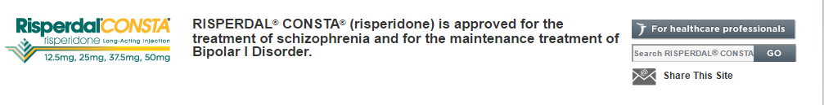

Slide 6



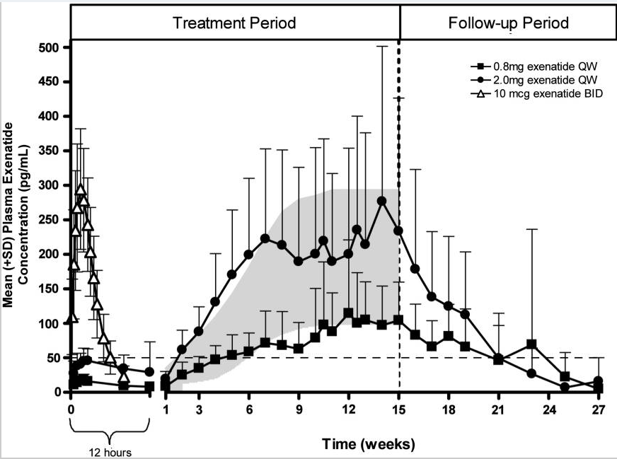
10 μg BID
2 mg QW
0.8 mg QW
minimally effective level to
reduce fasting plasma glucose
Diabetes Technol Ther. 2011 Nov; 13(11): 1145–1154

Slide 7

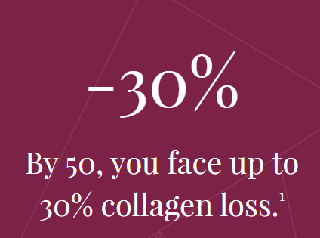
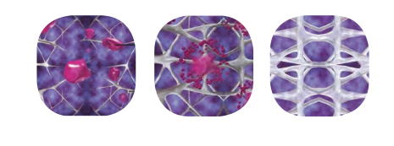
Sculptra® Aesthetic (injectable poly-L-lactic acid)
Unlike hyaluronic acid (HA) fillers, Sculptra Aesthetic helps stimulate your skin’s own natural collagen production to help restore its inner structure and increase facial volume that has been lost to aging.

Slide 8
Presentation Contents
Introduction to PLGA microspheres
Issues on contemporary microencapsulation technologies
Innovative approach to make non-porous PLGA microspheres
New paradigm in preparation of porous PLGA microspheres

Slide 9
Microencapsulation Technology Platforms
Phase separation
Solvent evaporation
Solvent extraction
(Cryogenic) Spray-drying
Spray-drying
Supercritical fluid-based method

Slide 10
Examples of Injectable PLGA Microsphere Products
Brand | Company | API | US Patent | Process technology | Remarks
Decapeptyl SR Neo Decapeptyl Trelstar, Pamorelin LA | Debiopharm | Triptorelin pamoate | 5,192,741 | Hot-melt extrusion technology | Phase separation (W/O₁/O₂ emulsion) is also reported
Sandostatin LAR | Novartis Alkermes | Octreotide acetate | 5,992,682 | (O₁+O₂)/W emulsion solvent extraction | O₁ = MeCl₂ (methylene chloride) O₂ = drug + methanol
Lupron Depot | Abbvie Endocrine Inc Takeda | Leuprolide acetate | 6,036,976 | W₁/O/W₂ emulsion solvent evaporation | MeCl₂, in-water drying by blowing air to the surface of the emulsion
Risperdal Consta | J&J Alkermes | Risperidone | 6,803,055 | O/W emulsion solvent extraction | O = ethyl acetate + BA
Arestin | Orpharma | Minocylcine HCl | 5,500,228 | S/O₁/O₂ emulsion (phase separation) | S= milled drug particles O₁ = MeCl₂ O₂ = silicone oil
Bydureon | Astrazeneca Amylin Alkermes | Exendin-4 | 7,456,254 | W/O₁/O₂ emulsion (phase separation) | O₁ = MeCl₂ O₂ = silicone oil Hardening by heptane/ethanol mixture

Slide 11
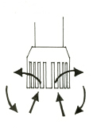
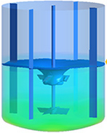
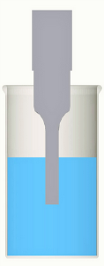
Various Emulsion-templated Microencapsulation Processes
W₁/O/W₂
W₁/O emulsion
emulsification
W₁/O/O₂
aqueous drug solution
organic phase
(PLGA, solvent )
continuous phase (W₂ or O₂)
solvent removal
microspheres
O/W
S/O/W
O/O
S/O/O
organic phase
(PLGA, drug, solvent)
emulsification
continuous phase (W or O)

Slide 12

Typical Emulsion-Based Microencapsulation
Air
Water
Microspheres
Polymeric MeCl₂ droplets
MeCl₂ dissolved in water
Excellent solvation power on PLGA polymers
It has a negligible water solubility (1.32 %)
It easily evaporates to air (39.8 °C)
Toxic halogenated ICH class 2 solvent presenting safety/toxicity issues
Inhalation hazard and a confirmed human carcinogen
One of 200 hazardous pollutants

Slide 13
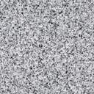
Solvent Extraction Techniques (Ethyl Acetate)
Δ Δ Δ
Δ Δ Δ
Quenching
Organic solvent droplets
Addition of
Excessive H₂O
Δ Δ Δ
Δ Δ Δ
Organic solvent molecules dissolved in H₂O
emulsion droplets microspheres

Slide 14
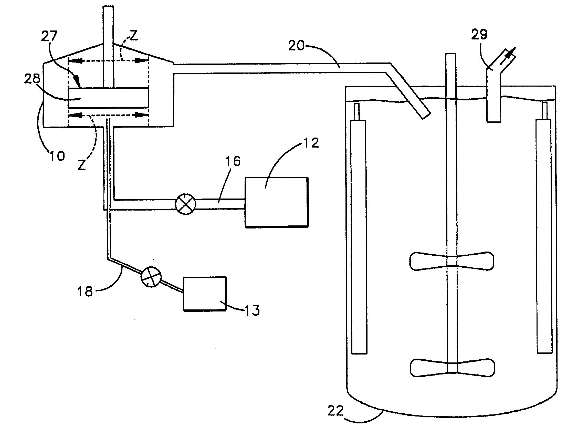
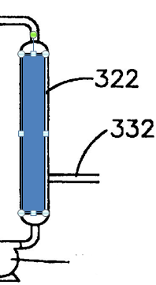
Continuous Microsphere Process
(US Patents 5,945,126 & 6,361,798 )
In-line mixer (L4R/L4RT,
Silverson Machines Inc.)
Continuous phase
Dispersed phase
Solvent extraction
tank

Slide 15
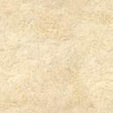
Limitations of Aqueous Quenching Solvent
The volume of an aqueous quenching solution
Disposal problems and cost
The size of tank/reactor
Ethyl acetate is not a perfect sovent

Slide 16
Solvent Removal Techniques
Physical/Engineering approaches (solvent evaporation/extraction)
stirring time, temperature, reduced pressure
solvent composition of a dispersed phase
an excessive amount of a quenching liquid
adding semi-polar solvents into a continuous phase
blowing compressed air to the liquid surface of an emulsion
cryogenic solvent extraction
treating embryonic microspheres with heptane/ethanol mixture
hallow fiber filtration coupled with fluidization
II. New paradigms based on chemical approaches
our lab technology platforms

Slide 17
Presentation Contents
Introduction to PLGA microspheres
Issues on contemporary microencapsulation technologies
Innovative approach to make non-porous PLGA microspheres
New paradigm in preparation of porous PLGA microspheres

Slide 18

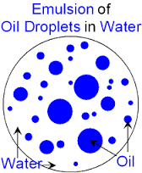
New Concept of Solvent Removal (I)
Dispersed phase
Aqueous phase
(A)
equilibrium
Dispersed phase
Aqueous phase
(B)
Continual solvent diffusion and elimination

Slide 19
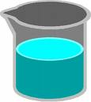


Experimental Design Used to Prove Our Concept
NaOH solution
or
Nothing added
GC analysis
Organic solvent (4 mL)
Aqueous phase (40 mL)

Slide 20

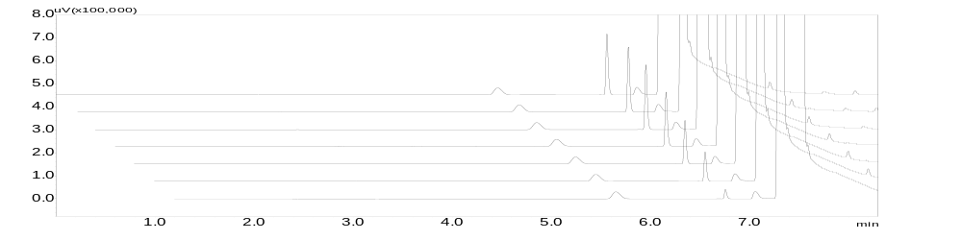

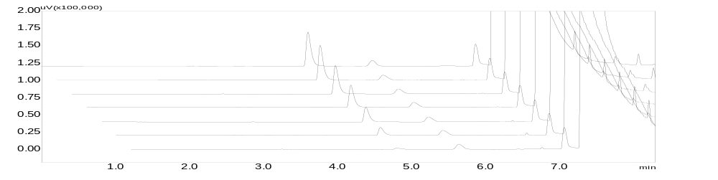
GC Monitoring of Ethyl acetate/Aqueous Phase System
Ethyl acetate
IS
uV(x100,000)
Blank
75 min
60 min
45 min
35 min
25 min
15 min
3 min
0.0
min
Ethanaol
Ethyl acetate
uV(x100,000)
NaOH 5 mL
75 min
60 min
45 min
35 min
25 min
15 min
3 min
0.0
min

Slide 21
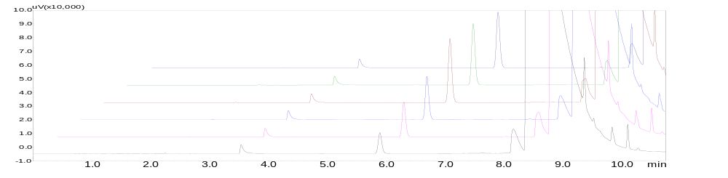
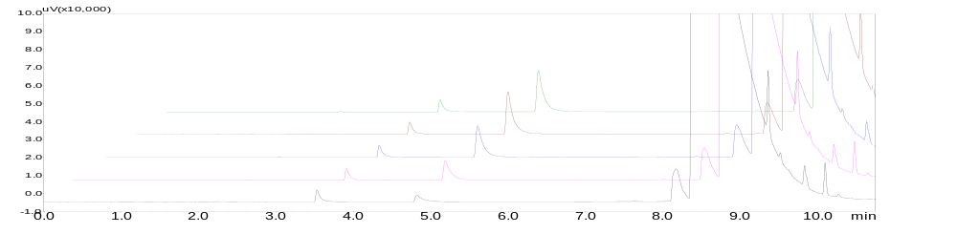
Ethyl Formate/Aqueous Phase System
EF
uV(x10,000)
10.0
Blank
IS
9.0
EtOH
8.0
7.0
60 min
6.0
45 min
5.0
30 min
4.0
15 min
3.0
10 min
2.0
5 min
1.0
0.0
0.0
1.0
2.0
3.0
4.0
5.0
6.0
7.0
8.0
9.0
10.0
min
uV(x10,000)
10.0
9.0
NaOH 6 mL
IS
EtOH
8.0
EF
7.0
6.0
45 min
5.0
30 min
4.0
15 min
3.0
10 min
2.0
5 min
1.0
0.0
0.0
1.0
2.0
3.0
4.0
5.0
6.0
7.0
8.0
9.0
10.0
min

Slide 22
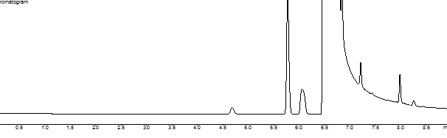
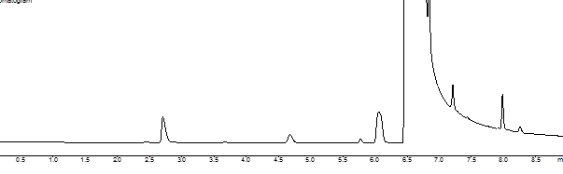
GC Chromatograms of Solvent/Water Composites
(A) methyl propionate/aqueous phase
Methyl propionate
IPF (IS)
(B) methyl propionate/{aqueous phase + NaOH}
Methanol
Methyl propionate
IPF (IS)

Slide 23
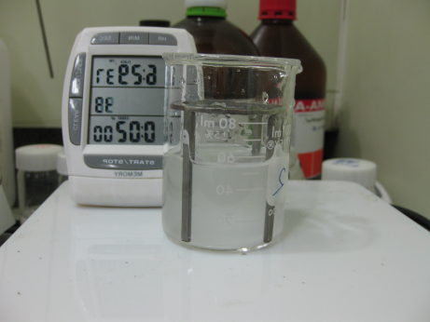
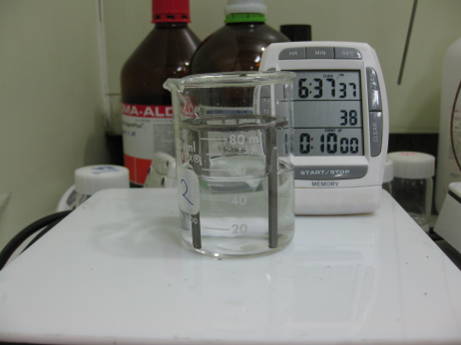
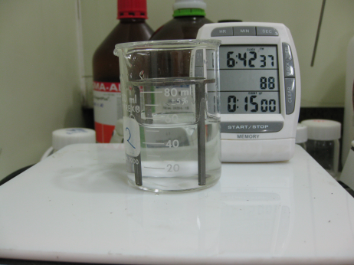
Conversion of O/W Emulsion into Single Aqueous Solution
Saponification (Base-Catalyzed Hydrolysis of Ethyl Acetate)
2-min 10-min 15-min

Slide 24
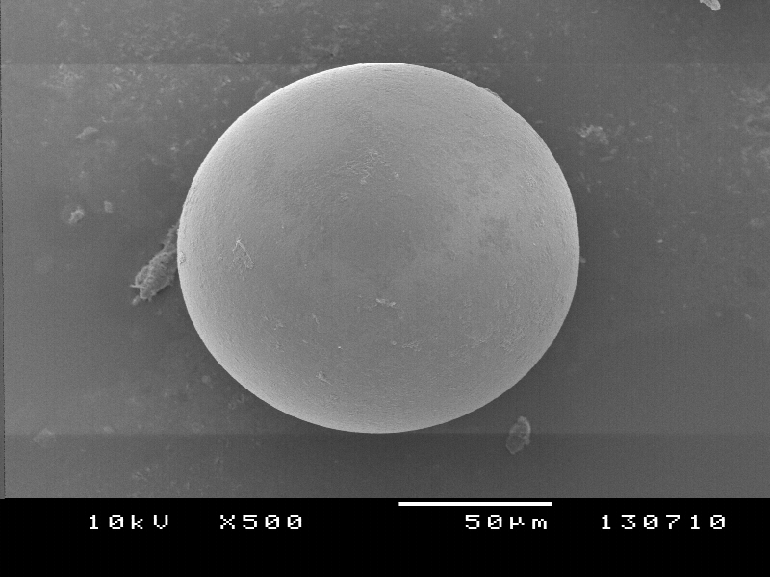
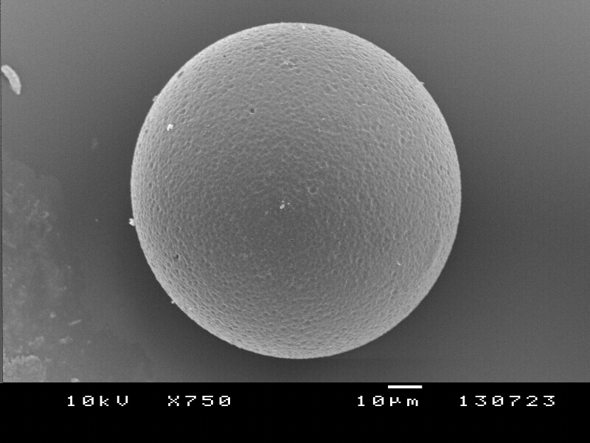
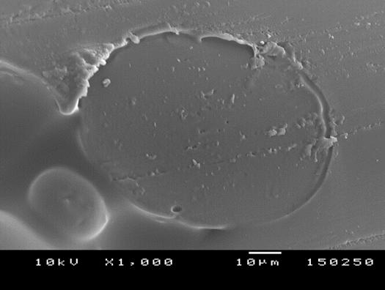
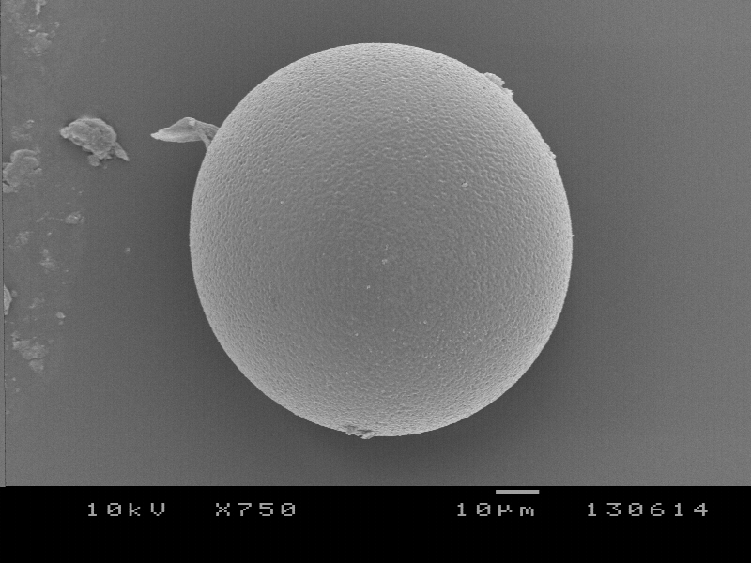
Typical Non-porous Microsphere Morphology
Mestranol
PLGA/organic solvent droplet
microsphere hardening
non-porous microspheres
Solvent diffusion
Ethynyl estradiol
β-Estradiol
Solvent removal

Slide 25
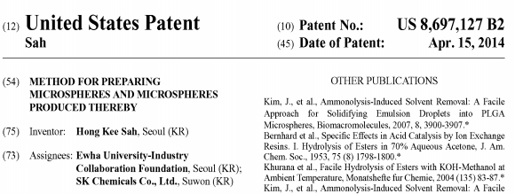
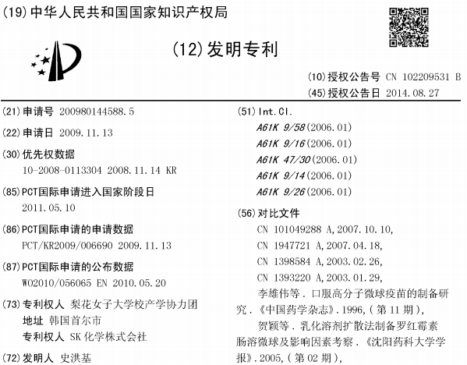
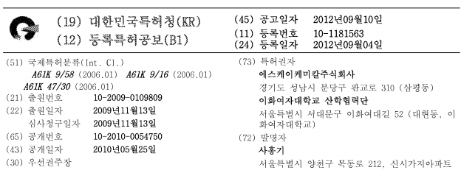
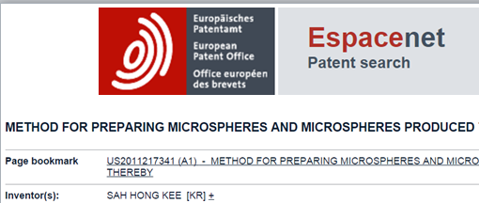
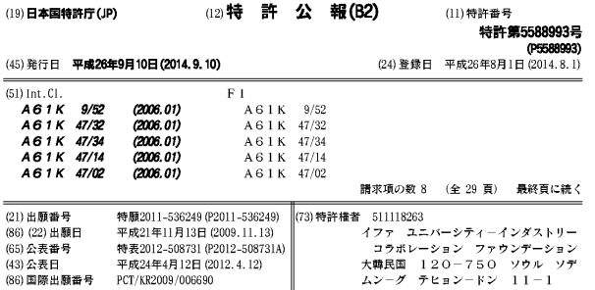
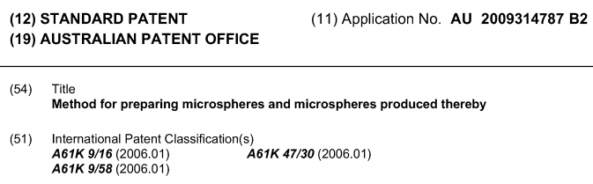

Slide 26
Presentation Contents
Introduction to PLGA microspheres
Issues on contemporary microencapsulation technologies
Innovative approach to make non-porous PLGA microspheres
New paradigm in preparation of porous PLGA microspheres

Slide 27
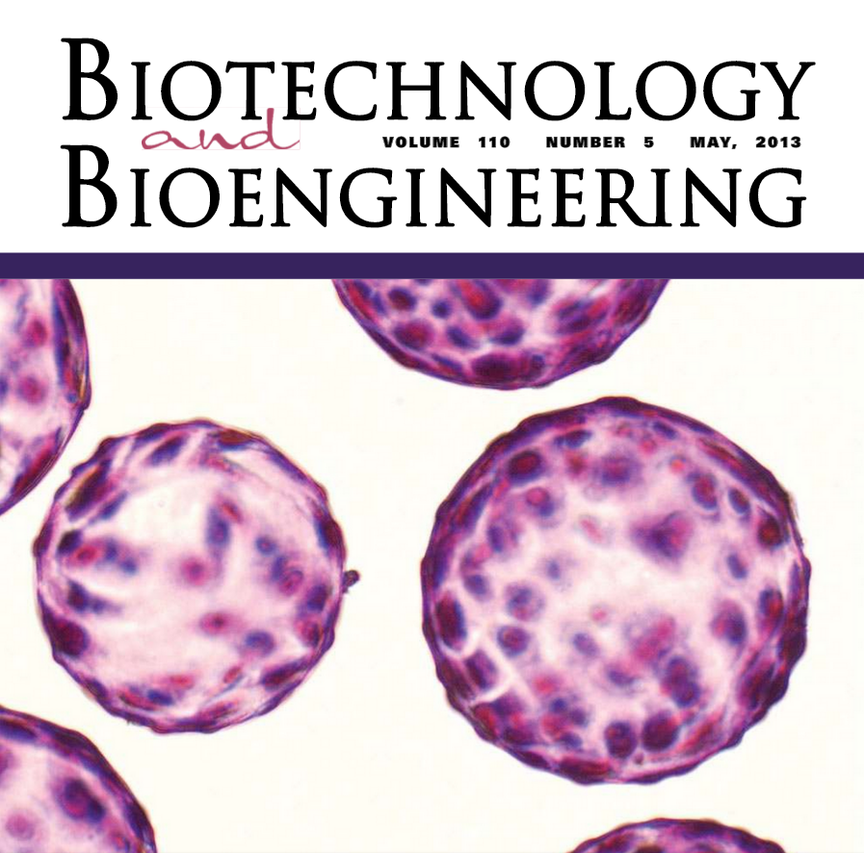
Applications of Porous PLGA Microspheres (III)
long-acting release
depot
porous scaffolds for
tissue engineering
pulmonary drug
delivery system

Slide 28
Preparation of Porous Microspheres by W₁/O/W₂ Emulsion Method Using Various Types of Porogens
W₁/O emulsion
W₁/O/W₂ emulsion
Water phase (porogens)
organic phase (PLGA in MeCl₂)
aqueous phase (W₂)
PLGA
leaching of porogens
PLGA
organic solvent
solvent removal
aqueous solution with porogens
(BSA, NaCl)
pores

Slide 29
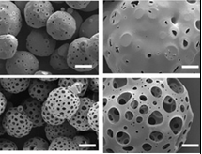
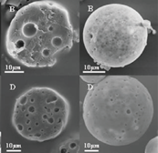
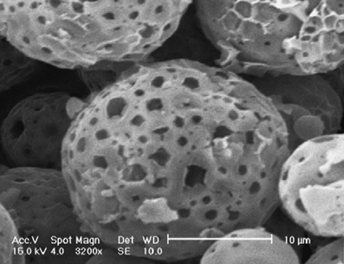
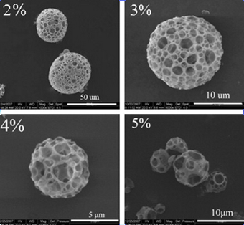
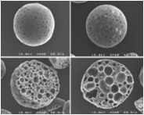
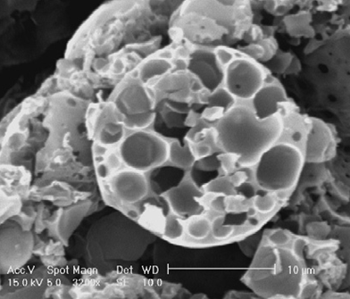
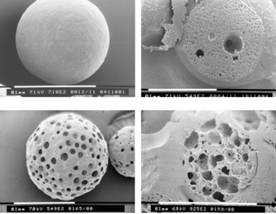
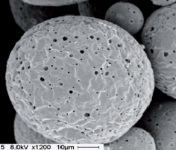
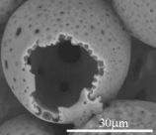
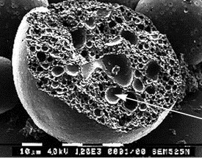


What Are Limitations in Research of
Porous PLGA Microspheres Reported in Literature?

Slide 30

New Paradigm for Preparation of Spongy Microspheres
PLGA-rich domains
PLGA-free reaction products
chemical triggers
Rx
leaching
PLGA/organic solvent droplet phase separation spongelike microspheres
Make microsphere hardening and porosity generation synchronous in operation~!

Slide 31

Mechanisms of Solvent Removal and Porosity Induction
An emulsion droplet consisting of PLGA and isopropyl formate
Reaction of the solvent with ammonia to yield water-soluble products
Their leaching to the aqueous continuous phase

Slide 32








Organic Solvent (4 ml) Containing Sudan Emulsified in
Aqueous Continuous Phase (30 ml)
control
ammonia
0 min 10 min 20 min 30 min

Slide 33


Slide 34

LM Photographs of Emulsions Sampled at 15-min Stirring
(a) Without ammonia, emulsion droplets coalesce together to form films
(b) Treatment with ammonia leads to quick microsphere solidification

Slide 35




Morphology of Spongy Microspheres

Slide 36
Typical Porous PLGA Microspheres Reported in Literature

Slide 37
















Morphology of Our Spongy PLGA Microspheres

Slide 38


Control of Porosity Levels of Our Spongy PLGA Microspheres

Slide 39






Slide 40

Microencapsulation of Biomacromolecules via W₁/O/W₂ Technique
W₁/O/W₂ emulsion
W₁/O emulsion
solvent removal
water phase (biomacromolecules)
organic phase (PLGA in MeCl₂)
aqueous phase (W₂)
hardening reactor
ㅜㅁ
aggregation
(covalent &
noncovalent)
chemical reaction
(e.g., deamination,
acylation)
loss of activity
denaturation
immune response
shear
cavitation
heat
organic
solvent
normal protein
structure
solid-liquid
interface
liquid-liquid
interface
PLGA-protein
interaction

Slide 41



Loading Biomacromolecules into Pre-formed Porous Microspheres
Porous PLGA microspheres
Spontaneous pore-closing
An aqueous solution with biomacromolecules
Non-porous, self-closed PLGA microspheres

Slide 42





























Self-closing of Pores in PLGA Microspheres
0 0.5 hr 1.0 hr 1.5 hr 2.0 hr 4.0 hr

Slide 43


Slide 44






Loading of FITC−Dextran into Microspheres
(Pore-closing Process)
Fluorometer
CLSM
0 1 2
Incubation time (hr)

Slide 45

Loading of Lysozyme into Spongelike Microspheres

Slide 46







Slide 47
What Are Good Points of Our Technology Platforms?
Non-halogenated solvents of 66 esters listed on the Joint FAO/WHO Expert Committee on Food Additives
Listed in the US FDA Everything Added to Food in the United States (EAFUS) database
Development of simple O/W emulsion-based microencapsulation technology platforms to manufacture non-porous and porous PLGA microspheres
new paradigm
originality
no porogens
excels W₁/O/W₂
spongy porosity
pore inter-connectivity
practicability
scalability

Slide 48


