Slide 1

Serum glycoprotein (YKL-40) and high sensitivity C-reactive protein in type 2 diabetic patients in relation to cardiovascular complications
El-Attar HA*, El –Deeb MM**, El-Ghlied LA***
*professor,**lecturer , Chemical Pathology Department
***lecturer, Internal Medicine Department
Medical Research Institute
University of Alexandria

Slide 2
YKL-40

Slide 3

YKL-40
YKL-40 is a human glycoprotein identified in 1989.
The abbreviation YKL-40 is based on the one letter code for the first three N-terminal amino acids, tyrosine (Y), lysine (K) and leucine (L) and the apparent molecular weight of YKL-40.

Slide 4
The protein has several names:
YKL-40
Human cartilage glycoprotein-39(HC gp39)
Breast regressing protein 39 (brp-39)
38-KDa heparin-binding glycoprotein (Gp38k)
Chitinase-3-like-1 protein(CHI3L1)
Chondrex
40 KDa mammary gland protein(MGP-40)

Slide 5
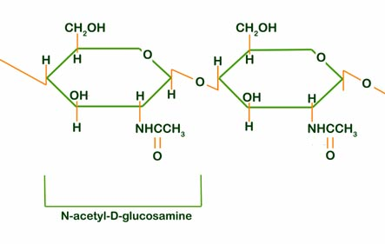
Chitin

Slide 6
Chitin is a polymer of N-acetylglucosamine which has no mammalian counterpart.
Following the cellulose in wood and paper, chitin is the second most abundant polysaccharide in nature.
Chitinases, are key degrading enzymes that have been studied most intensely in lower life forms.

Slide 7
The YKL-40 belongs to the family 18 of glycosyl hydrolases comprising chitinases from various species, but YKL-40 is without any enzymatic properties.

Slide 8
The glycoprotein YKL-40 contains a single polypeptide chain of 383 amino acids and has a calculated molecular mass of 40,476 Da and an isoelectric point of about 7.6.

Slide 9
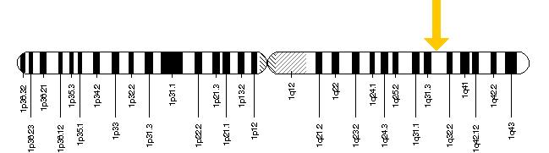
The YKL-40 gene is assigned to chromosome 1q31-q32 and consists of 10 exons and spans about 8 kilobases of genomic DNA.

Slide 10
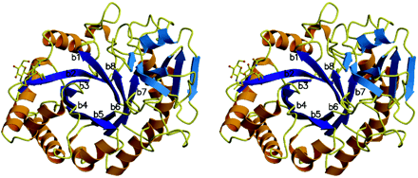
The crystallographic three-dimensional structure of human YKL-40

Slide 11
Secretion of YKL-40
In vivo YKL-40 is secreted from cells with high level of metabolic activity and/or proliferation such as:
macrophages
neutrophils
synovial cells
vascular smooth muscle and endothelial cells
arthritic chondrocytes
•malignant cells from many different solid carcinomas.

Slide 12
YKL-40 receptors
The identity of cellular receptors mediating the biological effects of YKL-40 are currently not known.

Slide 13
Physiological role of YKL-40
YKL-40 plays active roles in human antiparasite, anti-infective defense and repair responses.
1- YKL-40 contributes to tissue remodeling and extracellular matrix degradation.

Slide 14
Physiological role of YKL-40
2-YKL-40 mRNA and protein expression are found in tissues from all germ layers and are present during the early development of the human musculoskeletal system where they seem associated with cell proliferation, differentiation and tissue morphogenesis

Slide 15
Physiological role of YKL-40
3-In normal bone marrow the myelometamyelocyte express YKL-40 protein, and it is stored in the specific granules of neutrophil granulocytes and released from fully activated cells.

Slide 16
Physiological role of YKL-40
4-YKL-40 stimulates the proliferation of human connective tissue cells (fibroblasts, chondrocytes, synovial cells) in a dose-dependent manner.
5-It regulates apoptosis, and contributes to fibrosis and wound healing.

Slide 17
YKL-40 in pathological conditions
1-Role of YKL-40 in inflammation
The YKL-40 induces the maturation of monocytes to macrophages, and is secreted by macrophages during late stages of differentiation and by activated macrophages.

Slide 18
YKL-40 in pathological conditions
The glycoprotein YKL-40 is overexpressed in many inflammatory conditions including:
Meningitis
Rheumatoid arthritis
Osteoarthritis
Inflammatory bowl disease
Giant cell arthritis
sarcoidosis

Slide 19
YKL-40 in pathological conditions
2- Role of YKL-40 in malignancy
The YKL-40 may play a role in cancer cell proliferation, differentiation, survival, invasiveness, metastasis, angiogenesis and the inflammation and remodeling of the extracellular matrix surrounding the tumor.

Slide 20
YKL-40 in pathological conditions
Serum YKL-40 has been shown to be a helpful diagnostic and prognostic indicator in various types of cancers, which include:
Colorectal
Breast
Lung
Head and neck
Prostate
Ovarian cancer
Malignant melanoma

Slide 21
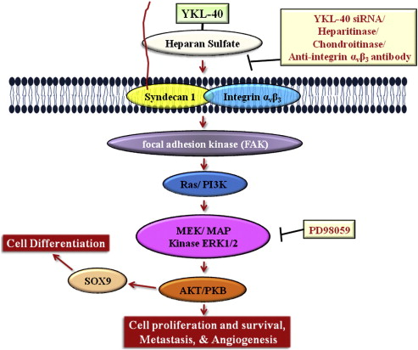
Involvement of YKL-40 in pathways pertaining to cell proliferation and survival

Slide 22
Role of YKL-40 in oncogenic programming process
the heparin-binding protein YKL-40 was found to induce the co-activation of membrane receptor Syndecan1 (S1) with integrin α_{v}β₃ through binding to heparan sulfate (HS) and then trigger intracellular signaling cascades that involve focal adhesion kinase (FAK) and mitogen activated protein (MAP) Kinase.

Slide 23
YKL-40 exerts antiapoptosis and function in angiogenesis through the activation of 2 major signaling pathways associated with mitogenesis and cell survival: Mitogen-activated protein kinase (MAPK) and phosphoinositide 3-kinase (PI-3K) mediated pathways.

Slide 24
Diabetes Mellitus

Slide 25
Diabetes mellitus is a group of chronic metabolic conditions, all of which are characterized by elevated blood glucose levels resulting from the body’s inability to produce insulin or resistance to insulin action, or both.

Slide 26
It is the most common non-communicable disease worldwide and the fourth to fifth leading cause of death in developed countries.

Slide 27
Prevalence of DM

Slide 28
Worldwide, it is estimated that 366 million people have diabetes and half of them are not aware that they have the disease. If the current trend is maintained the number of people living with diabetes is expected to reach 522 million by 2030.

Slide 29
Complications of diabetes mellitus

Slide 30
Acute complications
1-Hypoglycemia secondary to treatment overdose.
2-Ketoacidosis.
3-Nonketotic hyperosmolar coma.

Slide 31
Chronic complications
Microvascular
Macrovascular
1-Diabetic retinopathy
2- Diabetic nephropathy
3- Diabetic neuropathy
1- Coronary artery disease
2-Peripheral arterial disease
3-Thromboembolic stroke

Slide 32
Diabetes mellitus (DM) is a powerful and independent risk factor for cardiovascular disease which remains to be the major cause of death in type 2 diabetic patients.

Slide 33
The central pathological mechanism in cardiovascular disease is the process of
atherosclerosis

Slide 34
Chronic perturbation of the vasculature, which occurs in diabetes, leads to increased incidence, size, and complexity of atherosclerotic plaques with increased incidence of cardiovascular complications.

Slide 35
The inflammatory marker YKL-40 and cardiovascular complications of diabetes

Slide 36
Subclinical inflammation induces endothelial dysfunction which appears to be the earliest event in atherogenesis, and plays a pivotal role in all phases of atherosclerosis from the initiation of the fatty streak to plaque rupture with culmination in acute coronary syndrome.

Slide 37
YKL-40 is a marker of inflammation and endothelial dysfunction. It is closely related to both the early and late phases in the development of atherosclerosis.

Slide 38
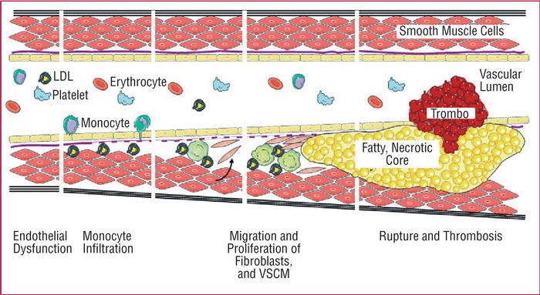
Stages of development of atherosclerosis

Slide 39
YKL-40 in the early stage of atherosclerosis
YKL-40 is produced and secreted by monocytes during differentiation to macrophages and is also secreted by activated macrophages.

Slide 40
YKL-40 in the late stage of atherosclerosis
YKL-40 promotes migration of vascular endothelial cells, suggesting that YKL-40 promotes the process of atherosclerotic plaque formation, in which vascular smooth muscle cells (VSMCs) are induced to migrate through the intima in response to exogenous signals.

Slide 41
Thus YKL-40 may be of pathogenic importance in the low-grade inflammation that precedes the development of cardiovascular disease in Type 2 DM.

Slide 42
AIM OF THE WORK

Slide 43
The aim of the present work was to study serum YKL-40 in Type 2 diabetic patients in relation to cardiovascular complications.

Slide 44
SUBJECTS AND METHODS

Slide 45
GROUP 1
GROUP 2
GROUP 3
16 apparently healthy volunteers
16 patients suffering from Type 2 DM without clinically evident cardiovascular complications
80 subjects were divided into 3 groups
48 patients suffering from Type 2 DM with cardiovascular complications

Slide 46
Subjects with acute or chronic inflammation, autoimmune disease or malignancy were excluded.

Slide 47
To all subjects the following was done:
I-Full clinical examination
Full history taking
Complete physical examination

Slide 48
II-Investigations
ECG
CIMT
Fundus examination
Lab investigations

Slide 49
To all studied subjects, the following laboratory investigations were done:
Complete urine analysis
Urinary albumin, creatinine and calculation of urinary albumin to creatinine ratio
Fasting and postprandial glucose
Glycated hemoglobin
Creatinine and uric acid
ALT

Slide 50
• Total cholesterol, HDL-C, TG and calculation of LDL-C
• eGFR
• hsCRP.
• YKL-40

Slide 51
RESULTS

Slide 52
Distribution of Coronary artery disease (CAD), stroke, peripheral arterial disease (PAD), nephropathy, neuropathy and retinopathy in the group of diabetic patients with cardiovascular complications
Item | IHD | Stroke | PAD | Nephropathy | Neuropathy | Retinopathy
percent | 100% | 8.3% | 4.16% | 66.67% | 81.25% | 68.75%

Slide 53
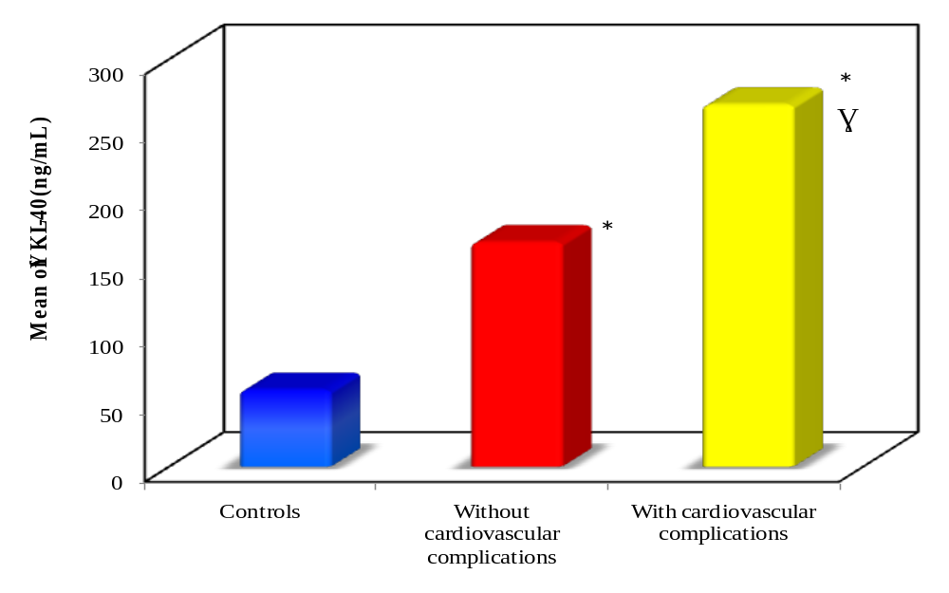
Bar chart showing YKL-40 levels in both diabetic groups in relation to the control group.

Slide 54
It was found that YKL-40 level was significantly higher in both the diabetic groups without and with cardiovascular complications when compared to the control group (p=0.017, 0.000) respectively.

Slide 55
Moreover YKL-40 levels were significantly elevated in the diabetic group with cardiovascular complications when compared to the diabetic group without cardiovascular complications (p=0.005)

Slide 56
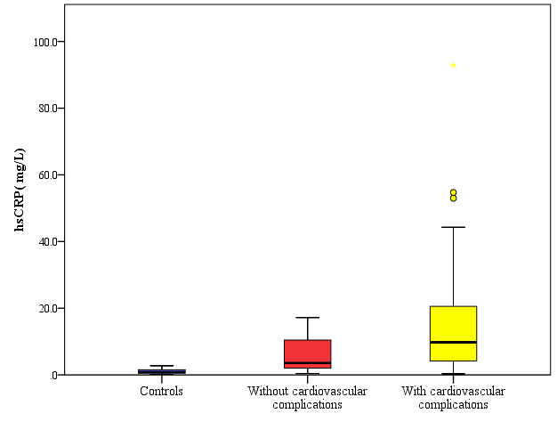
Box plot presentation showing median levels and interquartile range of hsCRP in both diabetic groups in relation to the control group.

Slide 57
As regard hsCRP its level was significantly higher in both the diabetic groups without and with cardiovascular complications when compared to the control group (p=0.000) for both.

Slide 58
Also hsCRP levels were significantly elevated in the diabetic group with cardiovascular complications when compared to the diabetic group without cardiovascular complications (p=0.024)

Slide 59
Some significant correlations

Slide 60
Significant positive correlation between YKL-40 (ng/ml) and systolic blood pressure (mmHg) and in the group of diabetic patients without cardiovascular complications.

Slide 61
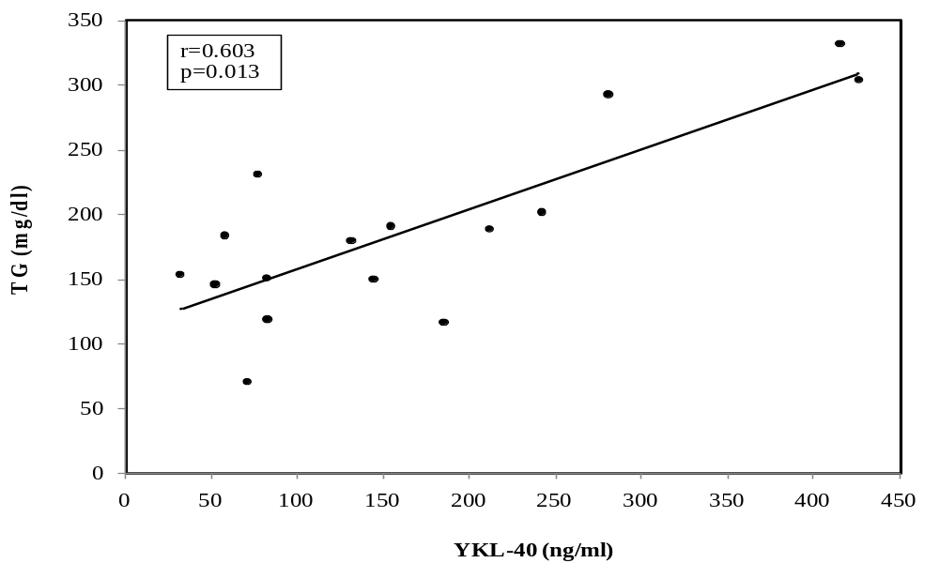
Significant positive correlation between YKL-40 (ng/ml) and TG (mg/dl) in the group of diabetic patients without cardiovascular complications.

Slide 62
Significant negative correlation between YKL-40 (ng/ml) and eGFR (ml/min/1.73m²) in the group of diabetic patients with cardiovascular complications.

Slide 63
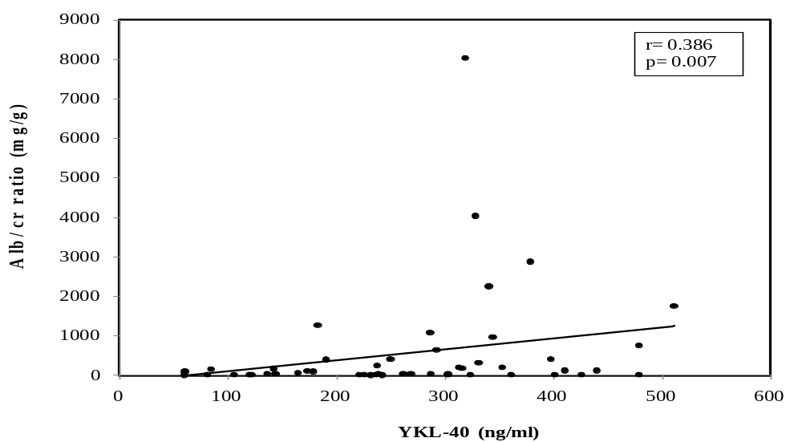
Significant positive correlation between YKL-40 (ng/ml) and Alb/cr ratio (mg/g) in the group of diabetic patients with cardiovascular complications.

Slide 64
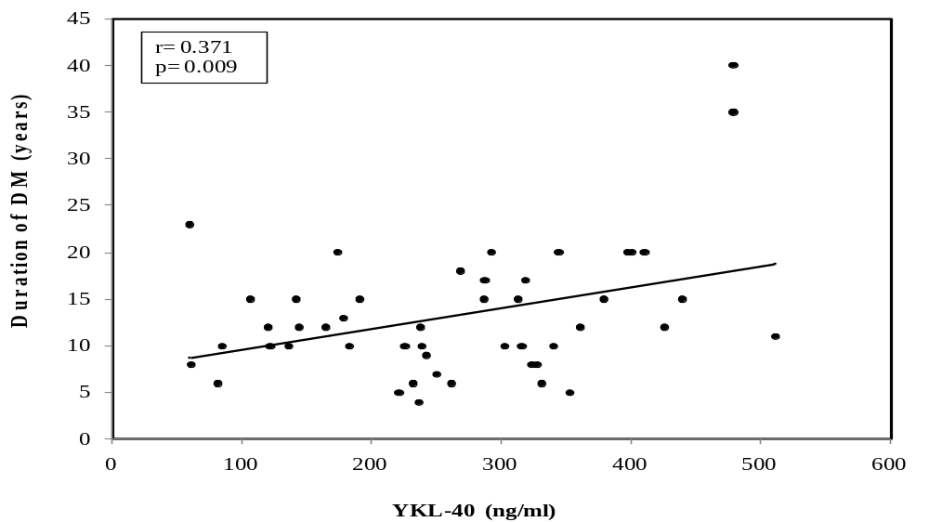
Significant positive correlation between YKL-40 (ng/ml) and duration of DM (years) in the group of diabetic patients with cardiovascular complications.

Slide 65
Clinical (sensitivity, specificity, positive predictive value, negative predictive value and efficiency) for hsCRP and YKL-40 in diabetic patients
 |  | Diabetic without cardio vascular complications | Diabetic with cardio vascular complications | Sensitivity % | Specificity % | PPV % | NPV % | Efficiency %
hsCRP | ≤3.93 | 10 | 11 | 77.08 | 62.50 | 86.05 | 47.62 | 73.44
 | >3.93 | 6 | 37
YKL-40 | ≤211.42 | 12 | 15 | 68.75 | 75.0 | 89.19 | 44.44 | 70.31
 | >211.42 | 4 | 33

Slide 66
It can be noticed that YKL-40 had better specificity and positive predictive value than hsCRP in discriminating between diabetic patients without and with cardiovascular complications

Slide 67
In the present work, by drawing receiver operating characteristic (ROC) curve between diabetic patients without and with cardiovascular complications the AUC for hsCRP was 0.676, p=0.036 and for YKL-40 was 0.743, p=0.004.

Slide 68
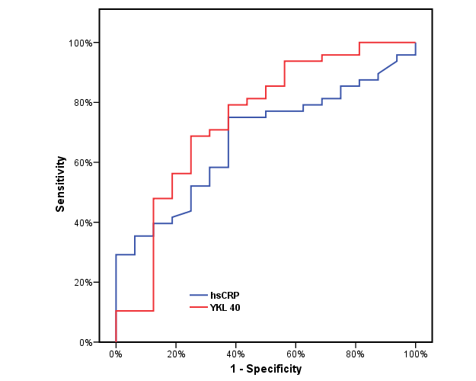
 | AUC | p
hsCRP | 0.676* | 0.036
YKL-40 | 0.743* | 0.004
ROC curve for hsCRP and YKL-40 between diabetic patients without and with cardiovascular complications.

Slide 69
CONCLUSION

Slide 70
The inflammatory glycoprotein YKL-40 was significantly higher in patients with type 2 diabetes mellitus than controls and cardiovascular complications contributed to its greater elevation.

Slide 71
YKL-40 was positively correlated with several cardiovascular risk factors such as triglycerides, systolic blood pressure and mean blood pressure in the group of diabetic patients without cardiovascular complications.

Slide 72
In the group of diabetic patients with cardiovascular complications YKL-40 showed positive correlation with duration of diabetes mellitus and urinary albumin to creatinine ratio denoting that longer duration of inflammation leads to increased YKL-40 levels with subsequent generalized vascular damage reflected by albuminuria.

Slide 73
There was no correlation between both inflammatory markers YKL-40 and hsCRP implying that they are produced and secreted independently of each other.

Slide 74
YKL-40 had a better specificity and positive predictive value than hsCRP in discriminating between diabetic patients without cardiovascular complications from those with cardiovascular complications.

Slide 75
Recommendations

Slide 76
An extension of the work on a larger sample size of Egyptian patients with type 2 DM with and without cardiovascular complications in order to collect more data to find out whether YKL-40 can be considered as a marker of early inflammation in relation to hsCRP.

Slide 77
2. Conducting a genetic study aiming at the discovery of possible polymorphisms in the YKL-40 gene among Egyptians that could influence its serum level and biological action.

Slide 78


