Slide 1
About OMICS Group
OMICS Group International is an amalgamation of Open Access publications and worldwide international science conferences and events. Established in the year 2007 with the sole aim of making the information on Sciences and technology ‘Open Access’, OMICS Group publishes 400 online open access scholarly journals in all aspects of Science, Engineering, Management and Technology journals. OMICS Group has been instrumental in taking the knowledge on Science & technology to the doorsteps of ordinary men and women. Research Scholars, Students, Libraries, Educational Institutions, Research centers and the industry are main stakeholders that benefitted greatly from this knowledge dissemination. OMICS Group also organizes 300 International conferences annually across the globe, where knowledge transfer takes place through debates, round table discussions, poster presentations, workshops, symposia and exhibitions.

Slide 2
About OMICS Group Conferences
OMICS Group International is a pioneer and leading science event organizer, which publishes around 400 open access journals and conducts over 300 Medical, Clinical, Engineering, Life Sciences, Pharma scientific conferences all over the globe annually with the support of more than 1000 scientific associations and 30,000 editorial board members and 3.5 million followers to its credit.
OMICS Group has organized 500 conferences, workshops and national symposiums across the major cities including San Francisco, Las Vegas, San Antonio, Omaha, Orlando, Raleigh, Santa Clara, Chicago, Philadelphia, Baltimore, United Kingdom, Valencia, Dubai, Beijing, Hyderabad, Bengaluru and Mumbai.

Slide 3
















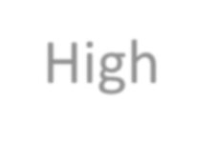
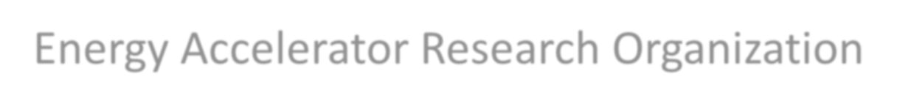

Biosensor & Bioelectronics:
Track 10-4 Electrochemical biosensors
On Exotic Nanostructure
for bio-FET
Hiroshi Watanabe*, Andy Lee*, Ikuo Kurachi**
*Dept. Elec. & Comp. Eng., National Chiao Tung University
**High Energy Accelerator Research Organization

Slide 4
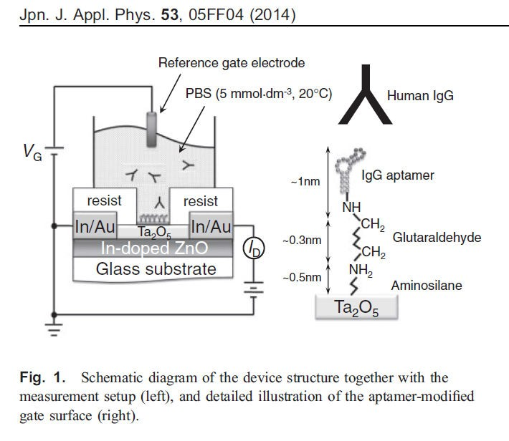
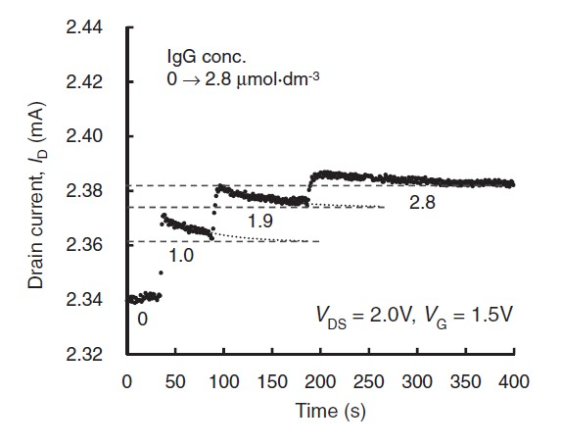
Motivation
25μm long
and 2.4mm wide
Koike, et.al.
N-Semi.
Ta2O7 (6nm) : K=27
tailing
~2nm
EOT=0.9nm
EOT+1.8nm = 2.7nm

Slide 5
Surface Charge
Sensitive!
Charge
ʹͷݑ݉ × ʹ.Ͷ݉݉
ʹ.Ͷ݉݉
S
D
In-doped ZnO
ʹͷݑ݉
Hiroshi Watanabe, NCTU

Slide 6
Surface Charge
Sensitive?
Charge
ʹͷݑ݉ × ʹ.Ͷ݉݉
ʹ.Ͷ݉݉
S
D
In-doped ZnO
ʹͷݑ݉
Hiroshi Watanabe, NCTU

Slide 7
SNW
Sensitive
Charge
ʹͷݑ݉ × ʹ.Ͷ݉݉
ࡺ nanowires are configured.
S
D
ʹͷݑ݉
Hiroshi Watanabe, NCTU

Slide 8
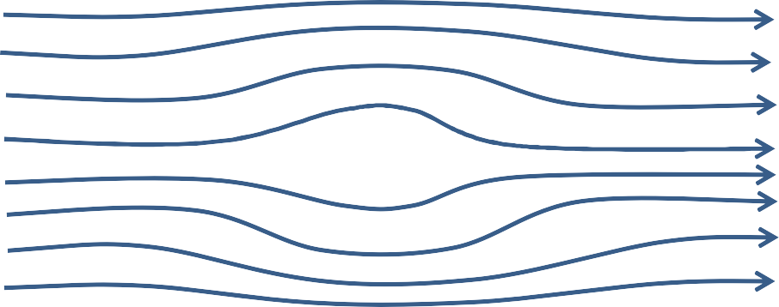
Get Around
S |  | D
Not Get Around
Speed down
S
D

Slide 9
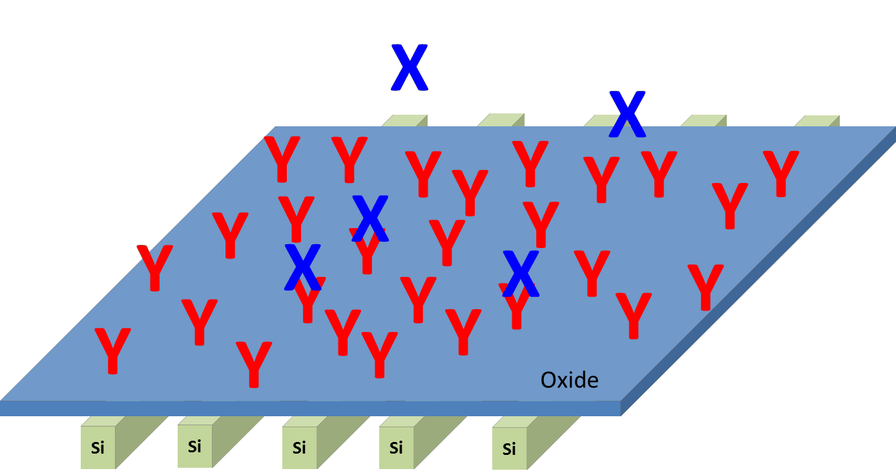
X: Target Y: Receptor
⇆ X_{Y}
ʹ.Ͷ݉݉
X + Y
ʹͷݑ݉
Sense it!!

Slide 10
Limit Of Detection (LOD)
ܭ
⇆ X_{Y}
X + Y
K: dissociation Const.
∆�
ௗ௦
�
௑
ܺ
= ∆ܸ =
ܻ ×
+ ܾܽܿ݇�ݎ݋ݑ݀
�௠
௧
ܥ₀
ܺ + ܭ
ܭ
�� �0 ௒ ೘��
�೙೚��� ௚೘− ௕௔௖�௚௥௢௨௡ௗ
Macroscopic
ܮܱܦ =
— ͳ
M. A. Reed, IEDM2013-208

Slide 11
Independent Sense, ε ≔ ௠ �
Sensitive!
Charge
ʹͷݑ݉ × ʹ.Ͷ݉݉
ࡹ nanowires are configured.
S/A S/A
Ͳ
ͳ
ʹ
S/A S/A S/A S/A S/A S/A
S
ܯ −2 ܯ − ͳ
࢓ ሺ= ૜ሻ nanowires detected the charge by Human IgG.

Slide 12
Independent Sense, ε ≔ ௠ �
�ܹ
Gate Width (GW) = ʹ.Ͷ݉݉
Line (L), SNW∅ = ͵݊݉
ܯ =
ܮ + ܵ
Space (S), SNW-to-SNW = ͷ͹݊݉
= ͶͲK
Rev. LOD = � × LOD
ε = Ͳ.ͳ%;
݉ = ͶͲ
40 “/A’s detect the signal change.

Slide 13
SOI (∼20nm)
N-type (ͳͲ^{ଶ0}ܿ݉^{−ଷ})

Slide 14
Line / Space by 30nm Tech.
L=30nm S=30nm

Slide 15
Sliming
< ∅ >= ͵݊݉
<S> = 57nm

Slide 16
SGS
SNW (~um)
BL - Decoder
CSL=0V
SGD
VDD=1V
Y Y Y Y Y YY YY Y Y Y Y
S/A
N-type
SGS
SGD
VDD=1V
Y Y Y Y Y YY YY Y Y Y Y
S/A
N-type
SGS
SGD
VDD=1V
Y Y Y Y Y YY YY Y Y Y Y
S/A
N-type
SGS
SGD
VDD=1V
Y Y Y Y Y YY YY Y Y Y Y
S/A
N-type

Slide 17

15
BL - Decoder
CSL=0V
ܰ݀
ܰ݀
ܰ݀
ଶ
ܸ = ܸ +
� �
ln
+
+ ͳ
௘௙௙
�
௤
݊�^{ଶ}
|ܰ݀|
ʹ݊�
nMOSFET
SGS
pMOSFET
SGD
X
Y Y Y Y Y YY YY Y Y Y Y
VDD=1V
S/A
N-type
Self-Heating
Rhyner, IEDM13-790
Ͳ.ͺ݊݉
X
−ܸ௘௙௙ /ʹ
ܧܱܶ = ݏ݁ݒ݁ݎ݈ܽ ݊ܽ݊݋݉݁ݐ݁ݎݏ
+ܸ௘௙௙/ʹ
Semi. Nano-Wire (N-type)

Slide 18

Modeling for Device Simulation
N=0
N=2
We may sense this change.
Id
Vd
−ܸ௘௙௙ /ʹ
+ܸ௘௙௙/ʹ
Semi. Nano-Wire (N-type)

Slide 19
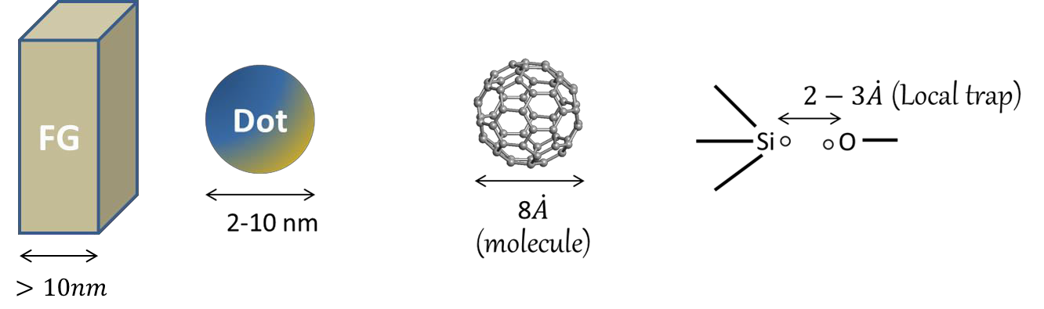
Electrically Floating Island
How to determine the potential?
Adopted ͞Capacitance͟ so far.
૛
ܭ
�� �0 ௒ ೘��
�೙೚��� ௚೘− ௕௔௖�௚௥௢௨௡ௗ
∆E=�
ܮܱܦ =
૛�
— ͳ
How to know ͞Capacitance͟?

Slide 20
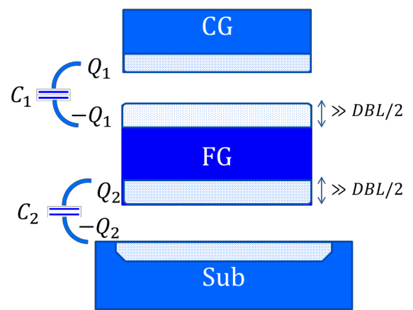
Electrically Floating Island
DBL ≅ �࢔࢓
Know the potential without
͞Capacitance͟.
How to know ͞Capacitance͟?

Slide 21
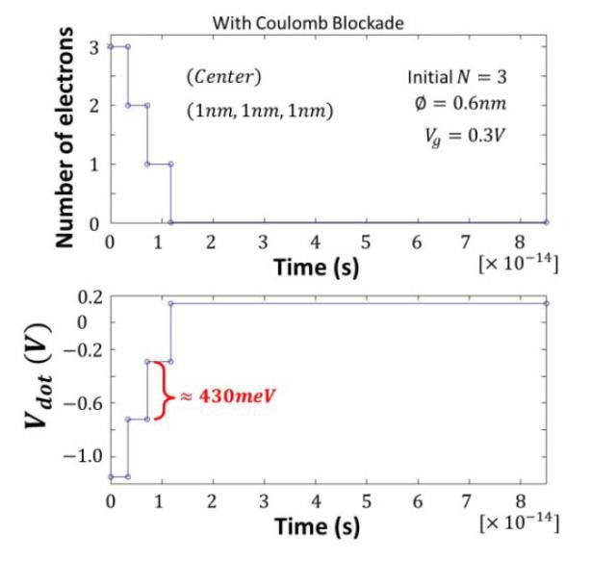
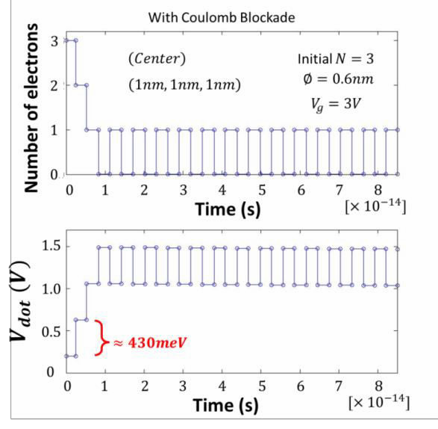
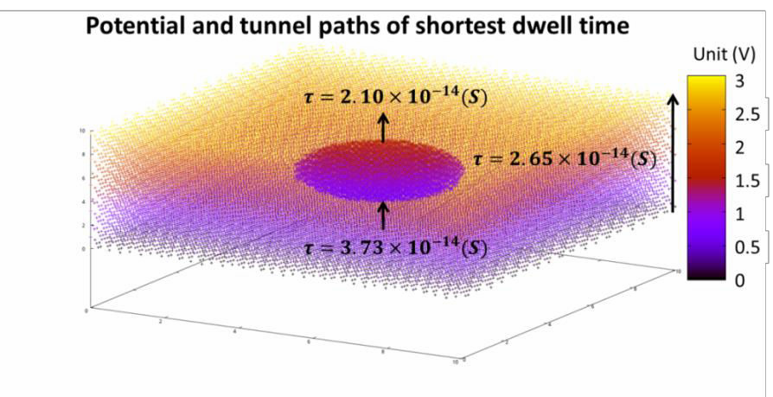
Electrically Floating Island
H. Watanabe, et. al., IEEE TED vol. 61, pp. 1145-1152, 2014.

Slide 22
Sim. Results
1.8
1.6
(nm)
1.4
EOT=2.0 EOT=1.6 EOT=1.4
❒
1.2
^{J} elec ^{(N )}
❒
1
J _{elec} (N = 0)
0.8
0.6
0.4
1-order
reduction
0.2
0
-6
-4
-2 0 2
N, stored in dot
4
6

Slide 23
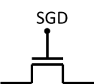
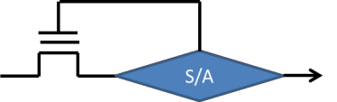
On fabrication Tolerance
Before exposed to solution
Width fluctuation
program
program
Too thin,
too high resistivity
Error Correction is easy.

Slide 24
By Thinking Exp. & Device Simulation
Independent Sense System
Powerful Error Correction
Optimization of bio-FETs
Acknowledgement:
The authors appreciate Prof. Koike (OIT) for helpful discussions.

Slide 25
Let Us Meet Again
We welcome you all to our future conferences of OMICS Group International
Please Visit:
www.omicsgroup.com
www.conferenceseries.com
www.pharmaceuticalconferences.com

