Slide 1

Attention of cancer care for totally implantable venous-access ports associate complications the latest 6 years analysis of 400 cancer chemotherapy patients
Hiroshi Osawa MD, PhD
Edogawa Hospital
Department of Oncology and Hematology
E-mail: oosawa@edogawa.or.jp
Phone: +81-3-3673-1221 ; Fax: +81-3-3673-1229
Notes:
First off, l really appreciate that I was given this opportunity. Thank you to the president and the congress officer
Let’s get started with my presentation. The title is Attention of cancer care for totally implantable venous-access ports associate complications the latest 6 years analysis of 400 cancer chemotherapy patients

Slide 2
Oncology Nursing 2016
Conflict of interest statement
Corresponding Author HIROSHI OSAWA
None of the authors of this presentation have conflicts of interests to declare.

Slide 3
Introduction 1
Totally implantable venous-access ports (TIVAPs) are useful for long-term nutrition management, intra-artery or intra-venous infusion of cancer chemotherapy, blood transfusion, and blood sampling. Furthermore, TIVAPs is frequently used for colon cancer in oxaliplatin, irinotecan, and 5-fluorouracil combination chemotherapy (FOLFOX, FOLFIRI) and pancreatic cancer for FOLFIRINOX. However, there are several early and late complications due to TIVAPs insertion. The early complications are as follows; 1) pneumothorax, 2) hematothorax, 3) Blood vessel damage, 4) air embolus. The late complications are as follows; 1) pinch-off, 2) fibrin sheaths and fibrin sleeve, 3) occlusion, 4) catheter damage, 5) infection. In addition, an infusion drug, catheter indwelling position and use reason of the catheter and various TIVAPs troubles such as the condition of a patient, management of a patient’s oneself, malfunction of degree of achievement and situation, port catheter in itself for the handling of a maneuver, the person of medical care of the management are reported. Recently, there are several reports regarding the use of TIVAPs problems in the world. Here we report to single institute research of the 400 TIVAPs complications, total 89,568 days insertion, with a median follow up of 388 days in the last 6 years.

Slide 4
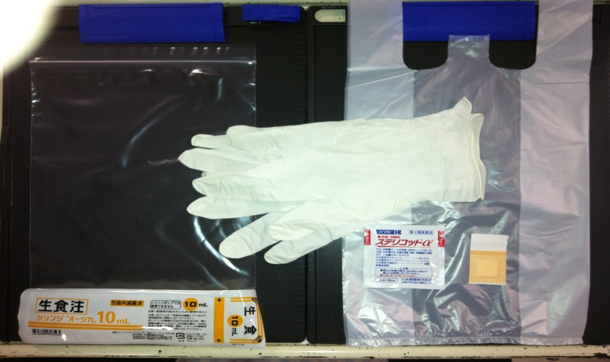
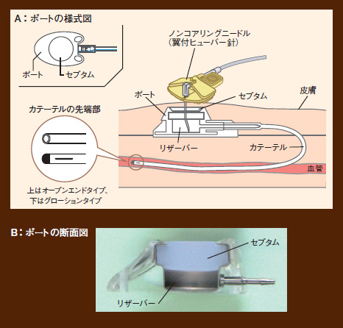
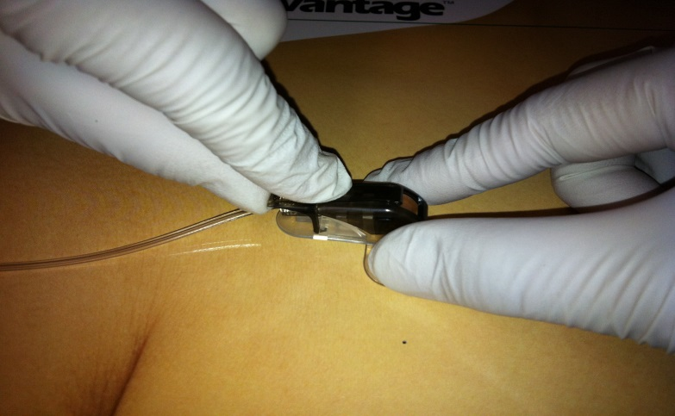
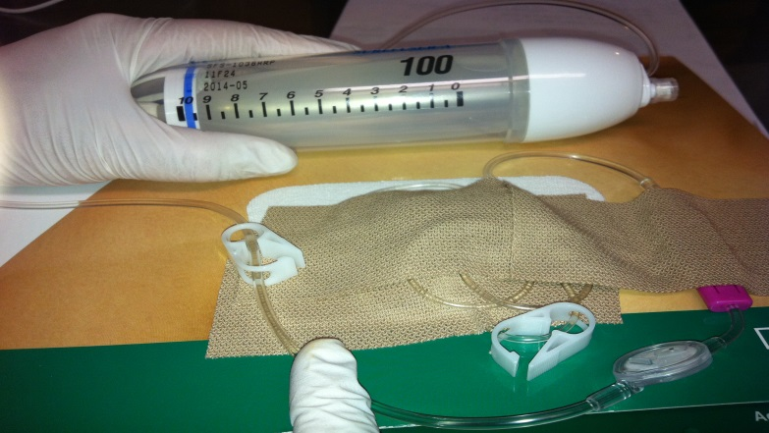
Introduction 2
TIVAPs access system
Port system
Needle
Port Septum
Port
Septum
Skin
Tip of Catheter
Resever Catheter
Vessel
Upper: Open end type
Lower: Groshong type
Sagittal
Septum
Resever
Notes:
As you are well known TIVAPs access system. There are several types such as Open end type and Groshong type.

Slide 5
Aim
To investigate the early and late complications by totally implantable venous-access ports in single institute study
Notes:
This is our aim, To investigate the early complications and late complications by totally implantable venous-access ports

Slide 6
Patients and Methods
1. Eligibility criteria
1) over 20 yrs old, 2) Major organ function preserved, 3) ECOG Performance status
(PS):0–2, 4) Confirmed solid tumor or hematological malignancies as a histologically,
5) No serious complications (intestinal obstruction, diarrhea, fever),
6） Provided written consent based on informed consent.
2. Evaluation
1) The early complications occurred within 30 days.
2) The late complications occurred over 30 days.
3. Observation period
Patient entered: 400 cases. January 2009～December 2014
The end of observation period: January 1st 2015
Notes:
1. Eligibility criteria
1) over 20 yrs old, 2) Major organ function preserved, 3) ECOG Performance status (PS):0–2,
4) Confirmed solid tumor or hematological malignancies as a histologically, 5) No serious
complications (intestinal obstruction, diarrhea, fever), 6） Provided written consent based on
informed consent.
2. Evaluation
1) The early complications occurred within 30 days.
2) The late complications occurred over 30 days.
3. Observation period
Patient entered: 400 cases. January 2009～December 2014
The end of observation period:2015/1/1

Slide 7
Patients Characteristics | Total=400 | No. of Patients
Gender | Male Female | 237 (59%) 163 (41%)
Age | Median Range | 62 years 31-84 years
Time of catheter insertion | Median Range | 388 days 31-2035 days
No. of TIVAPs | 2009 2010 2011 2012 2013 2014 | 90 (23%) 64 (16%) 52 (13%) 69 (17%) 56 (14%) 69 (17%)
Access route | Right subclavian Light subclavian Right internal jugular Light internal jugular Femoral | 150 (37%) 102 (25%) 91 (23%) 54 (14%) 3 (1%)
Solid cancer Hematological malignancies | Colorectal Stomach Esophageal Pancreas Lung Breast Head & Neck Lymphoma Myeloma Myelodysplastic syndrome Leukemia | 134 (33%) 80 (20%) 53 (13%) 35 (9%) 23 (8%) 9 (2%) 3 (1%) 28 (7%) 19 (4%) 13 (3%) 3 (1%)
Notes:
As you can see patients characteristics. Gender was similar. Median age was 62 years old.
The optimal purpose of these TIVAPs was to fulfill requirements for long term chemotherapy or hyper alimentation.
The operations on these patients were undergone by surgeon, who chose the insertion position according to patients’ condition.
The patients underwent to TIVAPs in internal jugular or subclavian vein via the Seldinger technique under fluoroscopic control.
We used two different devices, which were the Bard X-Port™, used from 2009 to 2012 and the Power Port™ from 2012 to present.
These devices are composed of a titanium and silicone rubber port connected to an 8Fr silastic Groshong™ catheter tube.
When they finished insertions of the TIVAPs, the device was filled with a saline solution. If a patient received bevacizumab™ combined chemotherapy, TIVAPs use was avoided for at least four weeks.

Slide 8
Available curve
Total 89,568 days insertion
Median follow up of 388 days (31-2035days)
Notes:
Four hundred TIVAPs, total 89,568 days insertion, with a median follow up of 388 days.
The available curve means that TIVAPs complications occurred within 2 year.

Slide 9
Results
 |  | No. of Patients
Complication ratio Early Complication Late Complication | Total=400 Pneumothorax Occlusion Pocket infection Pinch-off Slip-off Bacteremia (MRSA) Disconnection Wound dehiscence Rubber port rotation | 30 (7.5%) 3 (0.75%) 11 (2.75%) 8 (2%) 2 (0.5%) 2 (0.5%) 1 (0.25%) 1 (0.25%) 1 (0.25%) 1 (0.25%)
Notes:
Four hundred TIVAPs, total 89,568 days insertion, with a median follow up of 388 days. There were 30 idiopathic complications.
The early complications were Pneumothorax.
The late complications consisted of eleven complete occlusions (2.75%), eight pocket infections (2%), two pinch-offs (0.5%), two slip-off due to pedunculated breast (0.5%), one catheter-related bacteremia (0.25%), one wound dehiscence due to bevacizumab™ (0.25%), one rubber port disconnection (0.25%), and one rubber port rotation (0.25%) in pocket.

Slide 10
Late complication cases
Notes:
I would like to show a couple of late complication cases. I’m glad if a reference for everyone this presentation.

Slide 11
Pinch off

Slide 12

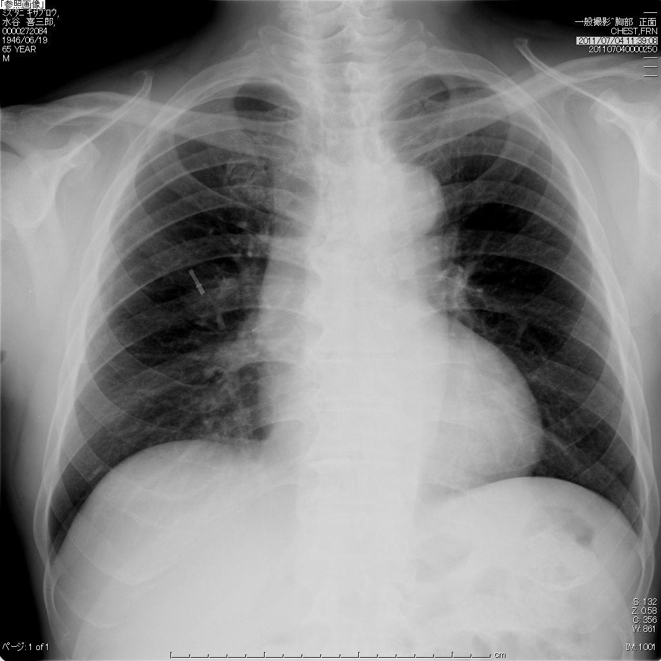
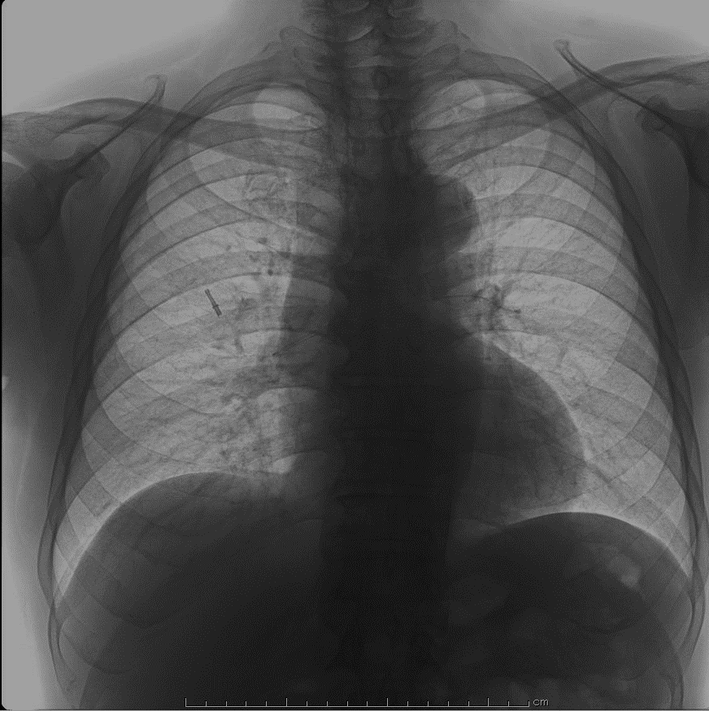
Pinch off
Chest XP
Notes:
A 62 years old man who had advanced colon cancer inserted catheter 1 month later. The catheter goes into pulmonary artery

Slide 13
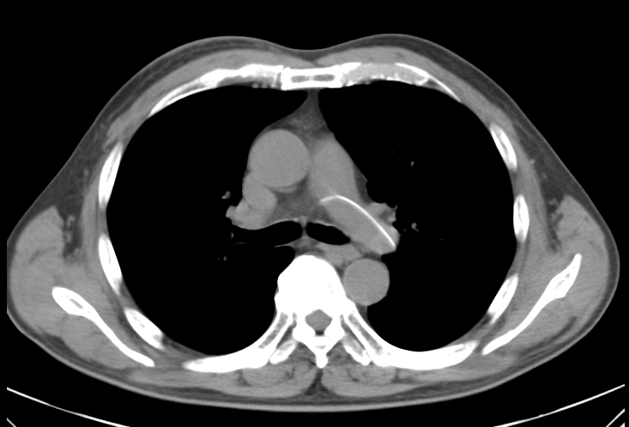
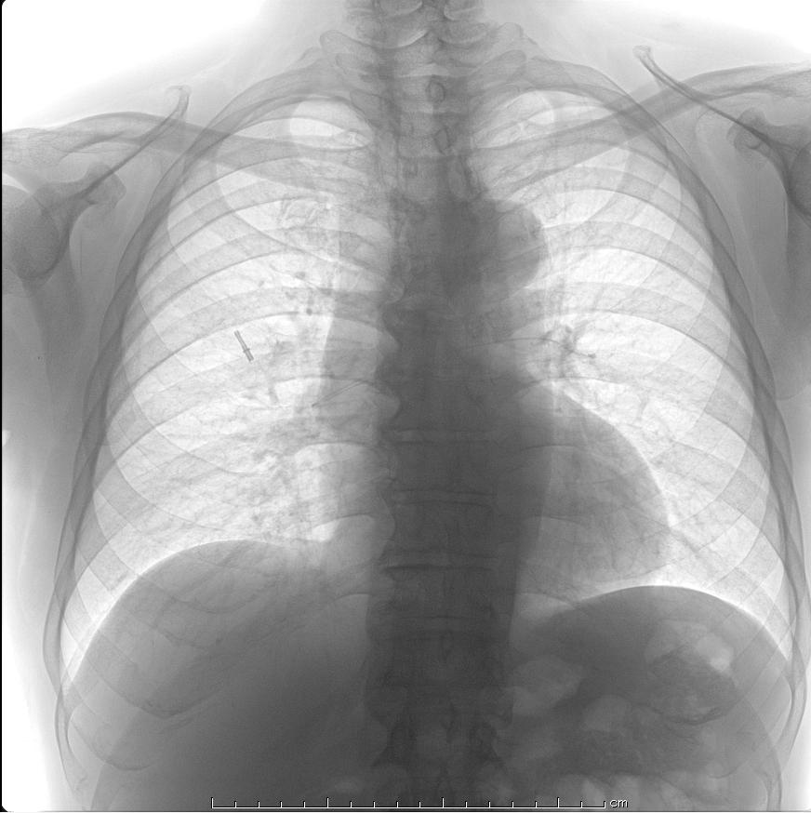
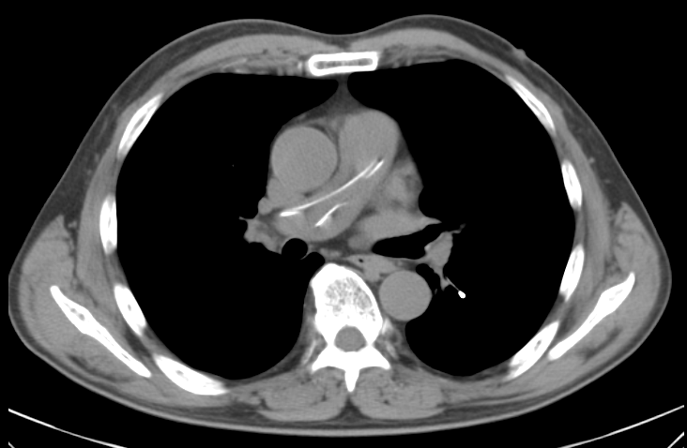
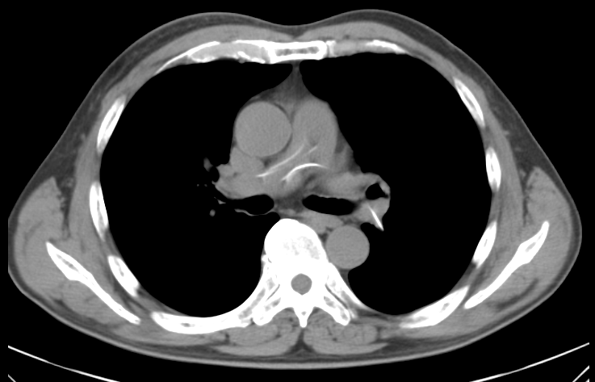
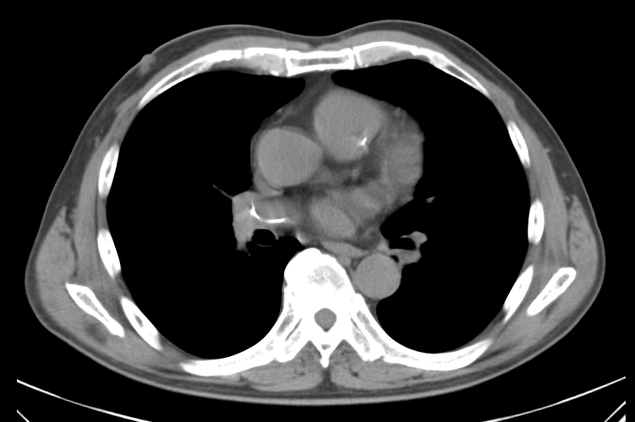
Pinch Off
Chest CT
Chest XP
Notes:
This is his CT scan. You can see a catheter into pulmonary artery clearly.

Slide 14
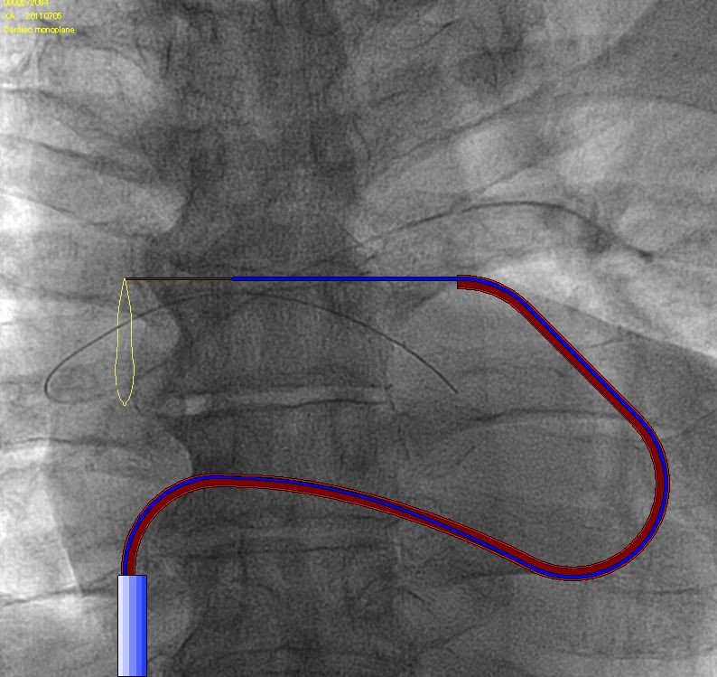
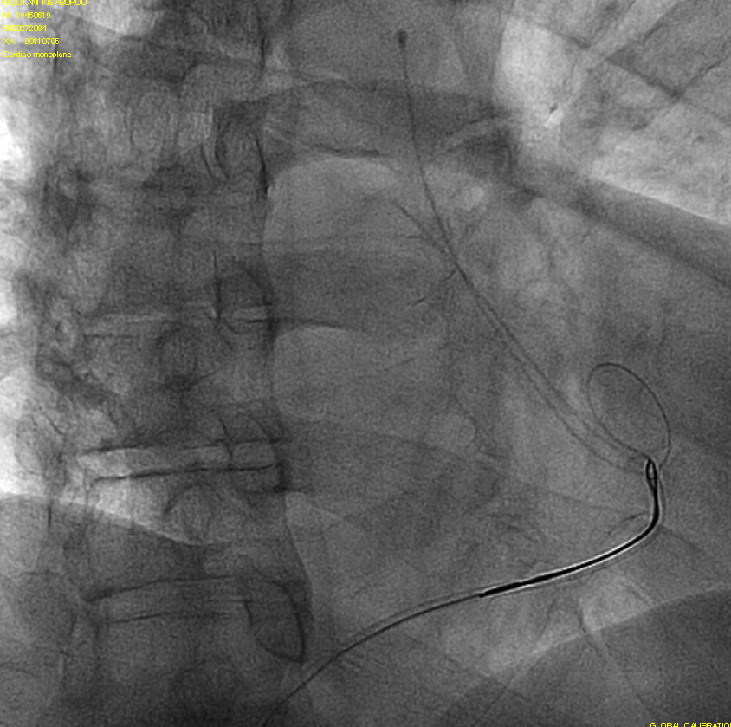
How to unplug the catheter
Notes:
These images showed the fall of their catheters into the pulmonary artery. We inserted 14 French (Fr.) 45cm sheath from a right femoral vein.
I derived a catheter in pulmonary artery with the Burman catheter with the tip aperture and derived 4Fr. multi-purpose catheter in pulmonary artery with a 0.025 guide wire and derived Heartrail II JR4.0 in pulmonary artery with a 0.035mm spring wire. A tip got into the catheter which I deviated from. I held the catheter which I got into in right pulmonary artery with a snare and I drew it out and removed it outside a sheath. I removed a sheath and pressed it and stopped bleeding, confirmed it, and was finished.

Slide 15
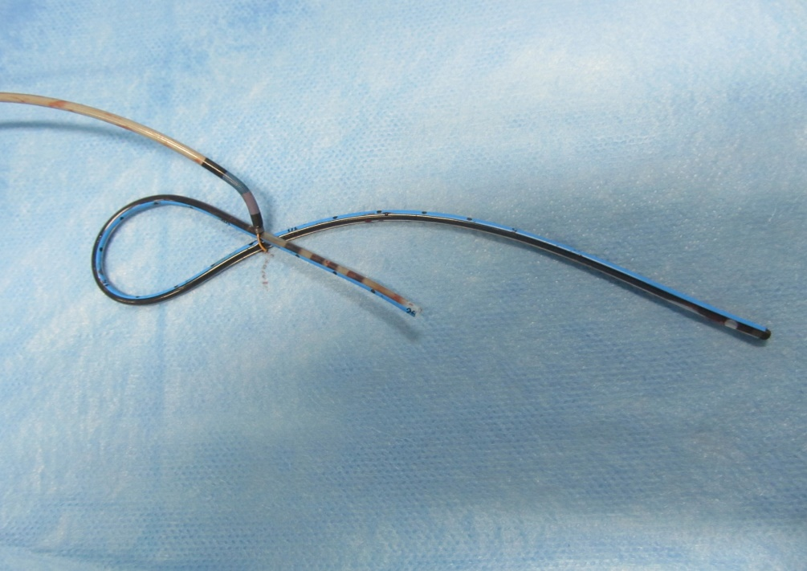
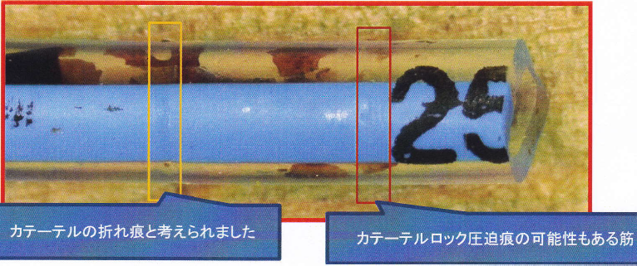
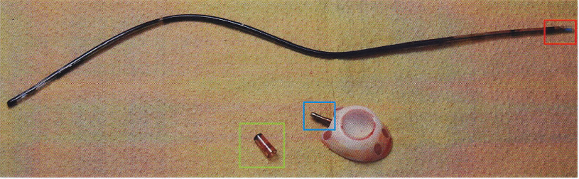
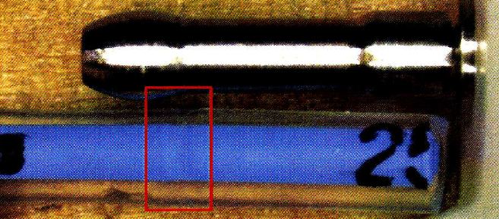
Catheter and snare
Bent mark of the catheter
Pressure marks of the
catheter lock ?
Control Vehicle
Pressure mark of the
catheter lock
Notes:
This is removed catheter and septum. You can see Bent mark of the catheter and weak pressure marks of the catheter lock.
Below photo is Control Vehicle, you recognized strong pressure mark of the catheter lock

Slide 16
Slip off

Slide 17
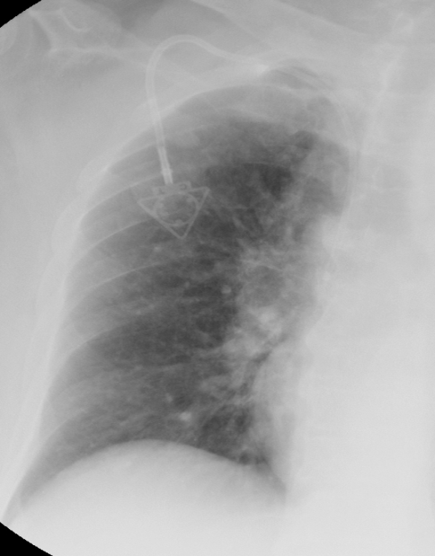
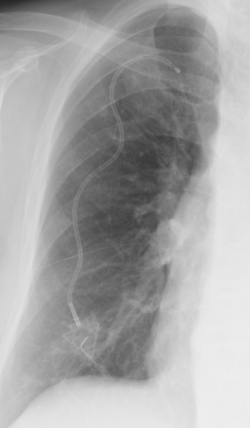
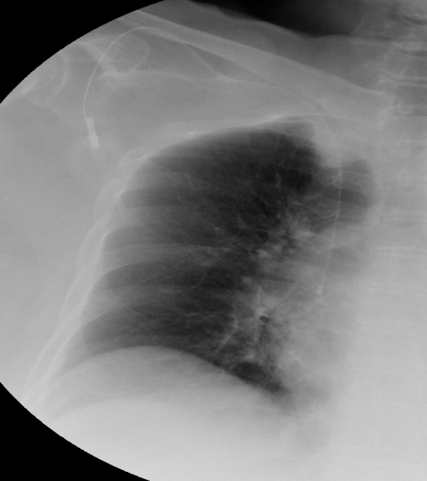
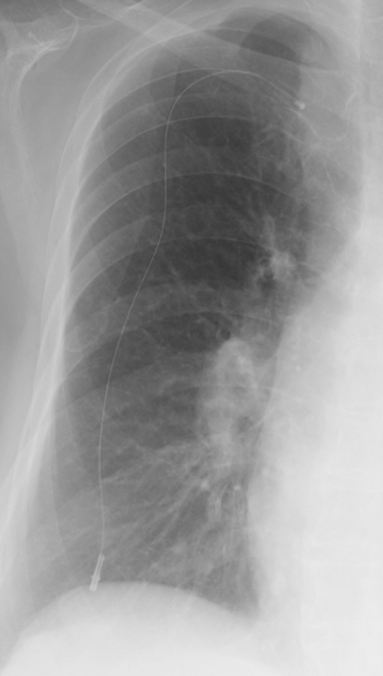
Slip off
A B
Notes:
A 68 year-old in case A and a 80 year-old women in case B who had advanced colon cancer.
The catheter of A in 7 months and case B in 46 months could not inject any infusion solution. We took a chest X-ray, which showed the catheter slip-off from central venous.
We thought that these were due to pedunculate breast because their catheter was pulled towards the direction of gravity and a catheter had slipped off.

Slide 18
Disconnection

Slide 19
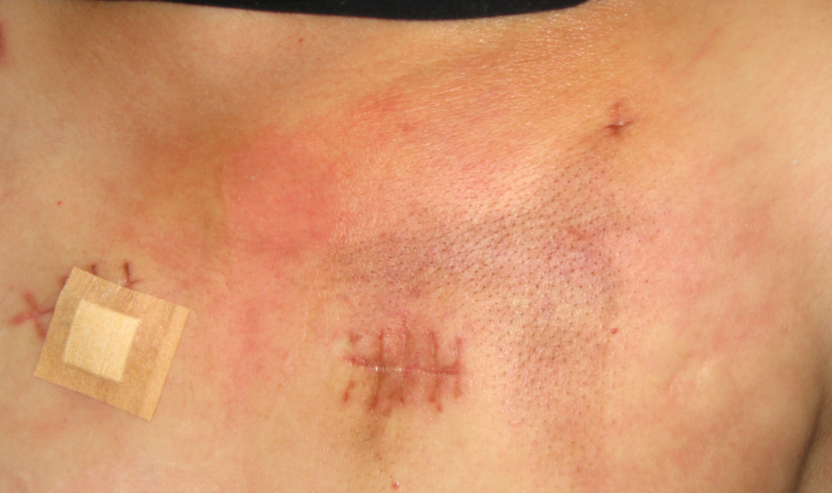
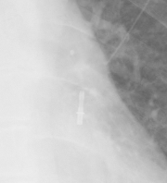
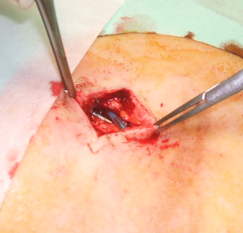
Disconnection
A
B
C
Notes:
A 62 year-old woman who had advanced colon cancer. When her catheter in 24 months could not inject any infusion solution, she felt pain and her cutaneous color had gradually turned red (A). As soon as we imaged chest X-rays, we are difficult to find chest X-ray which is expanding the rubber port, Finally we found disconnect between port and catheter, (C) we decided to remove the catheter immediately.

Slide 20
Occlusion
TIVAPs causes complete occlusion due to Trousseau syndrome

Slide 21
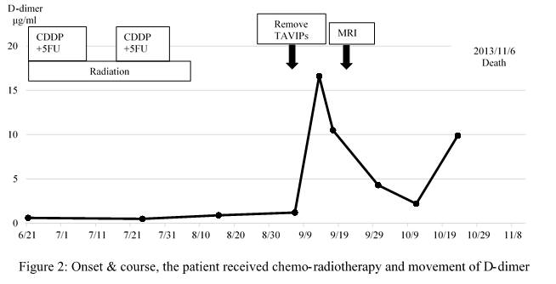
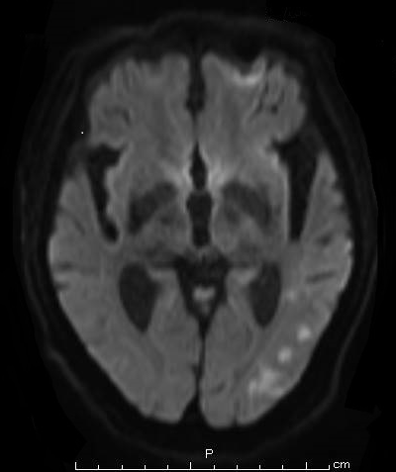
Onset & course
CDDP： 70mg/m², day1 & 29, 2 hr, div
5FU： 700mg/ m² day1-4, 29-32, civ
XRT： 50.4 Gy/28Fr, in short-T area included supraclavicular lymph nodes.
Notes:
A 63-year-old man, who was admitted to our hospital with the chief complaint of a swallow disturbance, was diagnosed as having esophageal cancer. Our diagnosis was upper thoracic esophagus T3N2 (104R) M0 StageⅢ, squamous cell carcinoma (moderately) which was an inoperable case. We decided to insert TIVAP due to the swallow disturbance. The operation on this patient was performed by surgeon.
The patient underwent TIVAPs in the internal jugular vein via the Seldinger technique under fluoroscopic control.
The patient’s device was the Power Port™. This device is composed of a titanium and silicone rubber port connected to an 8Fr silastic Groshong™ catheter tube.
When he finished insertion of the TIVAP, the device was filled with a saline solution. The patient was treated through chemo-radiotherapy. The treatment regimen follow as; cisplatin and 5-fluorouracil with concomitant with radiotherapy (50.4 Gy/28 Fr) in short-T area included supraclavicular lymph nodes.
The patient treated above chemo-radiotherapy was administered from 2013/6/21 to 2013/11/6
Computed tomographic follow-up revealed to shrink esophageal cancer for which the evaluation was partial response. Therefore, the patient was supported nutrition by hyper-alimentation and the patient presented abdominal fullness and anuria. He was diagnosed as having peritonitis carcinomatosa and post renal failure caused by cancer progression. Regardless, although his TIVAP was always maintained by pulsing flash and continuous hyper-alimentation, his TIVAPs could not inject any solutions four months later. Although we imaged chest X-rays, we could not find a pinch-off and disconnection, so we removed this catheter immediately. We found complete occlusion of 12cm length red thrombus in pathologically (data not shown). Additionally, the patient felt a speech disturbance and gait disturbance who had brain infarction . We showed his onset and course, which revealed his D-dimer elevating gradually. Finally, the patient died on 11/6/2013 due to multiple organ failure.

Slide 22
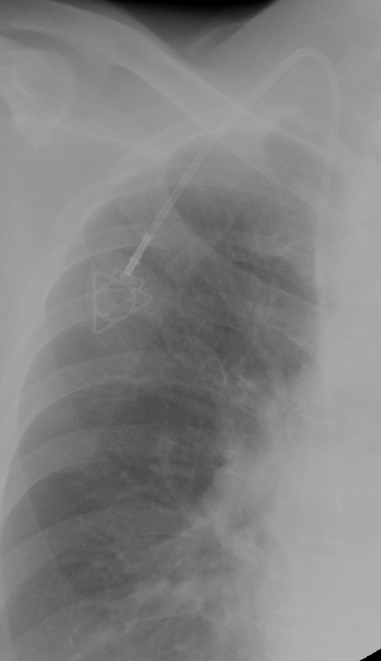
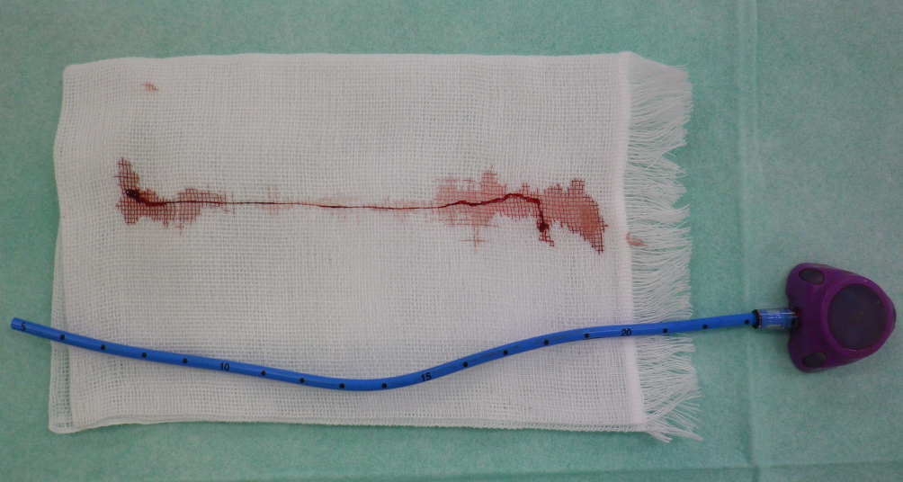
Complete Occlusion
A
C
B
12㎝
Cerebral infarction due to
Trousseau syndrome
Notes:
A: His TIVAPs could not inject any solutions four months later. Otherwise, his TIVAPs did not pinch off or disconnection.
B: We found complete occlusion of 12cm length red thrombus in pathologically (data not shown).
C: He had felt a speech disturbance and gait disturbance who had brain infarction .

Slide 23
In order to prevent the complications?

Slide 24
General Maintenance and Access Procedures
1. Accessing Central Venous Catheters
This procedure applies only to PICCs and tunneled catheters, including apheresis catheters. Refer to Part D.1. below for accessing implanted ports. In general, closed catheter access systems should be used preferentially over open systems.
Maintain aseptic technique
Perform hand hygiene and assemble the necessary equipment
Wear clean gloves
Scrub the injection cap (e.g., needleless connector) with an appropriate antiseptic (e.g., chlorhexidine, povidone iodine, or 70% alcohol), and allow to dry (if povidone iodine is used, it should dry for at least 2 minutes)
Access the injection cap with the syringe or IV tubing (opening the clamp, if necessary)
Perform hand hygiene when done
2. Blood Draws from Central Venous Catheters
Access the catheter as outlined above, maintaining aseptic technique
Remove the first 3-5 mL of blood and discard
Obtain specimen
Flush with 10-20 mL of normal saline (clamping the catheter as flushing is completed, if necessary) and promptly dispose of used syringe(s)
Perform hand hygiene when done

Slide 25
General Maintenance and Access Procedures
3. Flushing technique
Refer to the manufacturer’s instructions of the catheter and the needleless connector for the appropriate technique to use; unless otherwise specified, perform the following:
Single-use flushing systems (e.g., single-dose vials, prefilled syringes) should be used
Access the catheter as outlined above, maintaining aseptic technique
In general, avoid using a syringe less than 3 mL in size to flush, preferably use 10 mL by pulsing flush
Flush the catheter vigorously using pulsating technique and maintain pressure at the end of the flush to prevent reflux Positive pressure technique (may not apply to neutral-displacement or positive-displacement needleless connectors):
Flush the catheter, continue to hold the plunger of the syringe while closing the clamp on the catheter and then disconnect the syringe
For catheters without a clamp, withdraw the syringe as the last 0.5-1 mL of fluid is flushed
Promptly dispose of used syringe(s)
Perform hand hygiene when done
4. Changing Catheter Site Dressing
This procedure applies only to PICCs and tunneled catheters, including apheresis catheters.
Supplies for site cleansing and dressing changes should be single-use; refer to manufacturer’s recommendations to ensure compatibility with the catheter material
Maintain aseptic technique
Perform hand hygiene
Wear clean or sterile gloves (additional precaution per Infusion Nursing Society includes use of facemasks and sterile gloves)
Remove existing dressing and inspect the site visually
Apply antiseptic to the site using >0.5% chlorhexidine preparation with alcohol; if there is contraindication to chlorhexidine, use tincture of iodine, an iodophor, or 70% alcohol as alternative
Do not apply topical antibiotic ointment or creams to catheter site
Cover with either sterile gauze or sterile, transparent, semipermeable dressing (refer to catheter-specific recommendations for frequency of dressing changes)
Perform hand hygiene when done

Slide 26
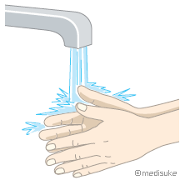
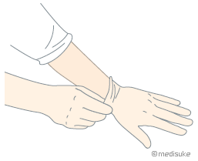
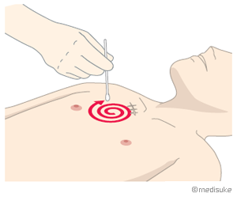
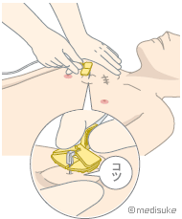
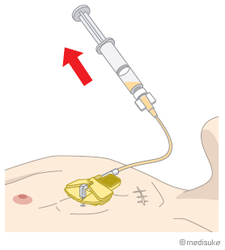
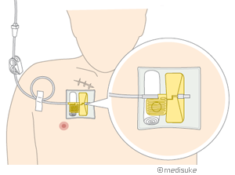
General Maintenance and Access Procedures
5. Changing the Injection Cap (e.g., Needleless Connector)
This procedure applies only to PICCs and tunneled catheters, including apheresis catheters. Refer to manufacturer’s instructions for how frequently to change the injection cap; if information is not available, in general, change every week or when there are signs of blood, precipitate, cracks, leaks, or other defects, or when the septum is no longer intact.
Maintain aseptic technique
Perform hand hygiene and assemble the necessary equipment
Wear clean gloves
Scrub the injection cap and catheter hub with appropriate antiseptic agent; clamp the catheter if necessary as cap is removed
Attach new cap to catheter hub using aseptic technique
Perform hand hygiene when done
Wash hands Wear clean gloves Perform sterilization puncture by needle
by povidone iodine make sure metal sound
3-5 mL of blood and discard Fix the needle Flush with 10-20 mL of normal saline
Blood Draws by pulsing flush

Slide 27
Summary
The total complication rate was 7.5% (30/400)
The early complication rate was 0.75% (3/400) which reason was pnuemothorax under the Seldinger technique even used ultrasonic machine.
The late complication rate was 6.75% (27/400) such as occlusion, pocket infection, pinch-off, slip-off, bacteremia (MRSA), disconnection, wound dehiscence, rubber port rotation.
Notes:
I did not explain Wound dehiscence due to bevacizumab.
We experienced wound dehiscence of insertion of TIVAPs three months later in an advanced colon cancer patient who was treated by bevacizumab combined chemotherapy. We do not pay attention to only standardized bevacizumab complications such as thrombosis, hypertension and proteinuria, but also insertion of TIVAPs scar.
Especially bevacizumab and ramcirumnab are a anti-VEGF monoclonal antibodies which are central play of role cancer chemotherapy such as colon, lung, and breast.

Slide 28
Conclusion
Totally implantable venous-access ports are useful and safe for cancer patients who need to receive long time chemotherapy and nutrition. We experienced early and late complications rate was 7.5% of TIVAPs, otherwise medical staff should recognize these complications associated to TIVAPs system justifying its use even low complication rates.
Notes:
Totally implantable venous-access ports are useful and safe for cancer patients who need to receive long time chemotherapy and nutrision. We experienced early and late complications rate was 7.5% of TIVAPs, otherwise we should recognize these complications associated to TIVAPs system even low rates, justifying its use even low complication rates.

Slide 29

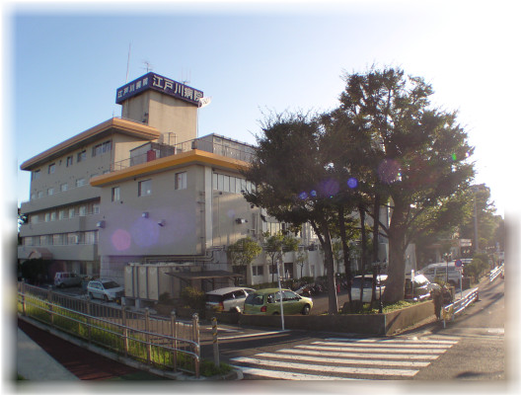
Thank for your attention

