Slide 1
International Conference on Pharmaceutical Chemistry-2016
September 6, 2016@ Frankfurt, Germany
Promissing clinical outcome of HPMA-polymer conjugated-pirarubicin (THP) [P-THP], which exerts three steps for cancer selective delivery
Hiroshi Maeda
Professor, Institute of Drug Delivery Science,
Sojo University,
Professor Emeritus, Kumamoto University
Kumamoto, Japan

Slide 2
What is enhanced permeability and retention (EPR) effect for tumor targeting using nanomedicines
[Definition]
Molecular size dependent (> 40 KDa) /Extravasation at tumor vassel
Plasma concentration/time dependent (> 6 hrs for permeation)
Biocompatible particles
  Charge (weakly acidic-neutral) / no RES clearance
  Lipid particle [Lipiodol] given ia exhibits >2000 fold of T/B
[Phenomenon]
• Heterogeneity may exists in EPR by thrombus/occlusion formation,
blood flow blockade, avascular nature, thus poor drug delivery.
• The EPR effect can be augumented by NO, ACE-inhibitors (BK ),
CO, PGs-agonist, high blood pressure, hyperthermia, etc.

Slide 3
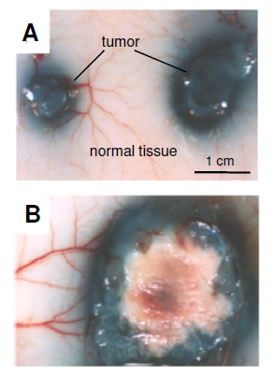
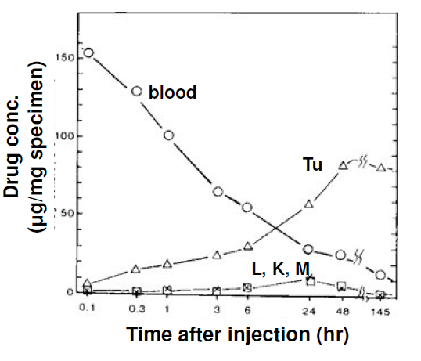
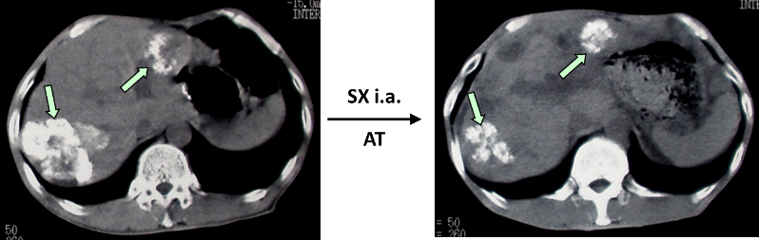
EPR effect visualized by blue- and rhodamine-albumins in primary and metastatic cancer
S180 tumor
D
Size 1cm
Tumor concentration
Heterogeneity
Size 3cm
C
(Matsumura, Maeda, Cancer Res. 1986)

Slide 4
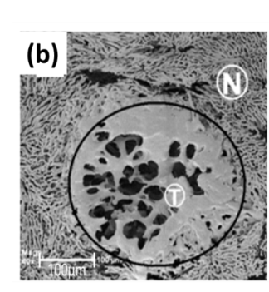
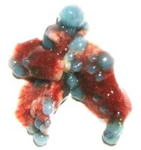
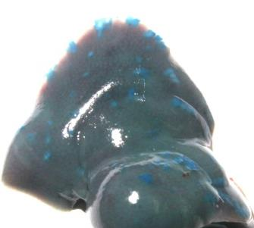
(a) Colon 26 cancer to the lung of mouse, (b) to the liver.
Both (a) and (b) are metastatic tumor nodules seen as blue albumin spots (arrows). (c) Micrometastatic nodules of MoCR tumor in the liver of CBA mouse seen by SEM by using vascular cast after iv infusion of plastic resin.
The EPR effect in metastatic cancers
(a)
(b)
(c)

Slide 5
Application of EPR effect
in metastatic solid tumor is possible
EPR is effective not only for the primary tumor, but also in the metastatic tumors. Thus, control of metastatic tumors is possible by EPR, which is crucial in cancer treatment. Great advantage!

Slide 6
Application of EPR effect in solid tumor :
Development of nano-photosensitizer for PDT
It has a great value in PDT using fluorescent nanoprobes. Singlet oxygen will be generated predominantly in tumor by EPR based delivery of PS.
Development of fluorescent endoscope will improve tumor detection, 10-50 fold better for tumors of oral, esophageal, stomach, colorectal, urinary bladder, cervical, omentum, diaphragm, lung, pleural cavity, peritoneal cavity, as well as the skin.

Slide 7
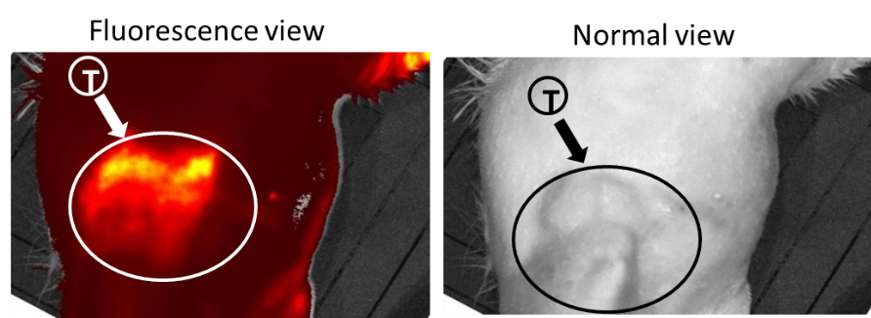
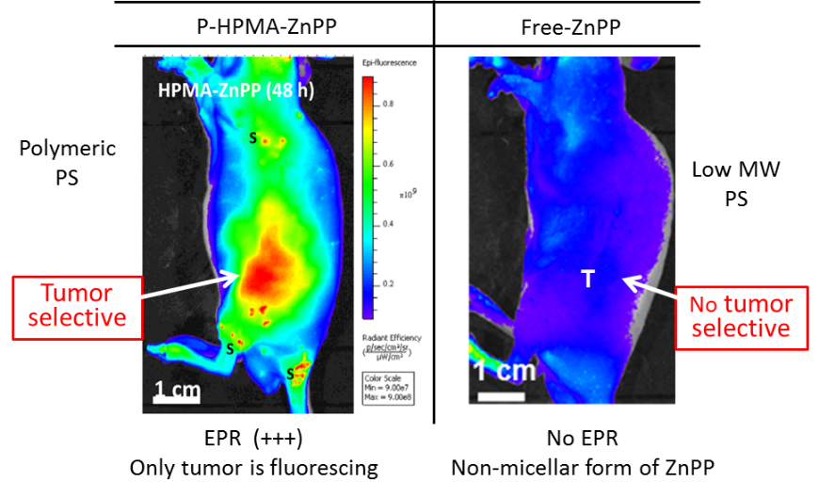
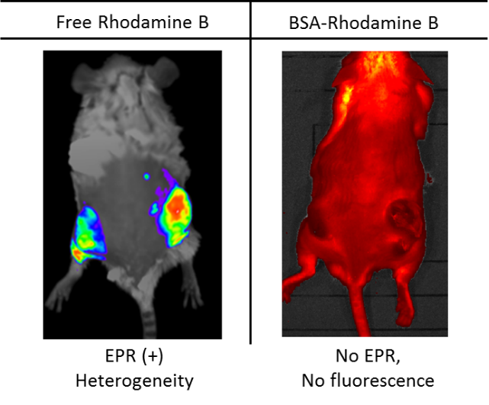
FL imaging of breast cancer of rat
and tumor of mouse after iv P-HPMA-ZnPP
DMBA induced autochthonous breast cancer in rat.
PS accumulate in tumor selectively

Slide 8
Part Ⅰ. Example of P-THP.
Three steps of tumor selective nanomedicine.
Polymer conjugated THP (= poly(HPMA))hydrazone-pirarubicin,THP). ⇒ P-THP
Amazing in vivo effect without toxicity.
Covering from basics to clinical results.

Slide 9
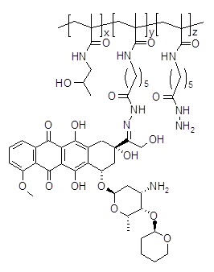
Pilot clinical study: Compassionate use of
P(HPMA)-conjugated THP
HPMA(hyd) = poly (hydroxypropyl metaacrylamide) hydrazone
< P-THP >
Cleavable by tumor pH
THP (pirarubicin)
P-THP ＝ Polymer conjugate drug with THP

Slide 10
Drug distribution in various organs in mice
bearing S-180 tumor quantified by HPLC
(low MW vs poly-HPMA-THP)
B
Polymeric drug, P-THP
Tumor
A
Parental Free THP, low MW
T
Arbitrary fluorescence intensity
T
T
Arbitrary fluorescence intensity
T
5 h
24 h
48 h
72 h
A: Control, free drug of THP
B: Released free THP concentration
5 h
24 h

Slide 11
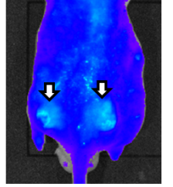
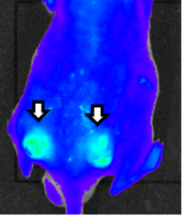
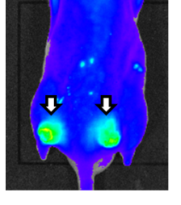
Arrows show location of tumor, which are fluorescent.
Demonstration of EPR in polymeric drug, P-THP.
Fluorescence detection of P-THP in the tumor
6hr
9hr
24hr

Slide 12
Factors affecting the EPR-effect of macromolecular drugs in solid tumor
Extensive production of vascular mediators
eg. NO, BK etc that facilitate extravasation
a) Bradykinin c) VPF/VEGF e) Collagenase (MMPs) g) Carbon monoxide (CO/ HO-1) i) TNF-α k) Heat | b) Nitric oxide (NO) d) Prostaglandins f) Peroxynitrite h) Inflammatory cells and H₂O₂ j) Anticancer agent l) TGFβ inhibitor

Slide 13
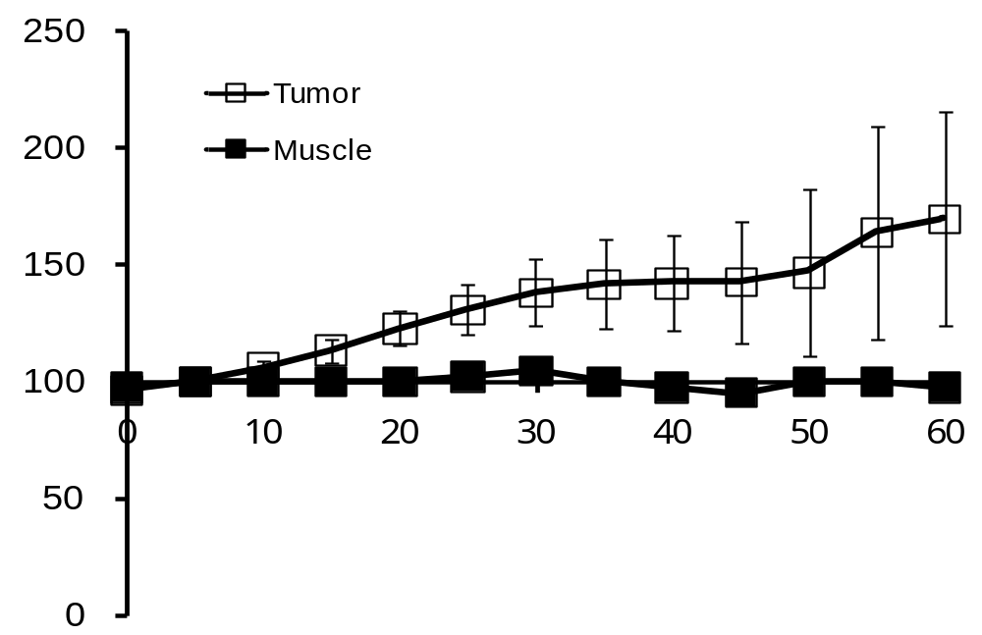
Enhancement of the EPR effect by NG application
A
Tumor tissue
(hypoxic/low pH)
Enhanced
Drug Delivery
EPR
effect
—
Nitroglycerin (NG)
NO●
NO₂
Normal tissue
(normoxic/neutral pH)
B
Change in tumor blood flow (100% = no NG)
P = 0.028
NG application at distant site
Time before and after NG ointment application (min)
(Cancer Sci., 2009)

Slide 14
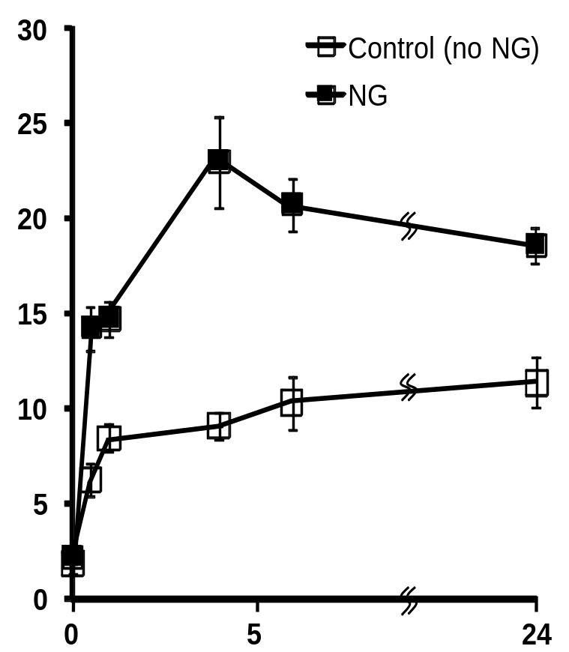
Enhancement of the EPR by NG : Dose / Time
(C)
(D)
12
P = .023
P = .001
P = .006
10
P = .004
P = .040
Amt of EB (μg/g of tumor tissue)
P = .002
Meth-A
P < .001
8
C38
P < .001
Amt of EB (μg/g of tumor tissue)
6
4
2
0
0
0.01
0.001
1.0
Hours after injection of Evans blue
NG (mg)/tumor site
Notes:
14

Slide 15
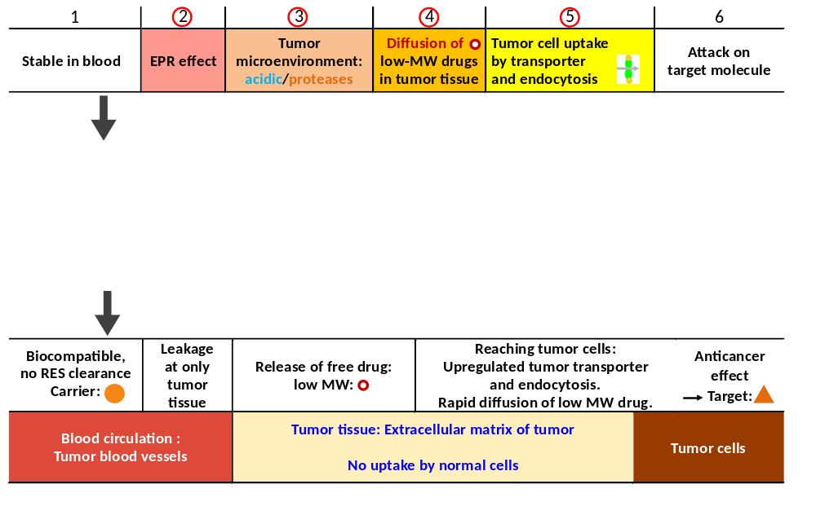
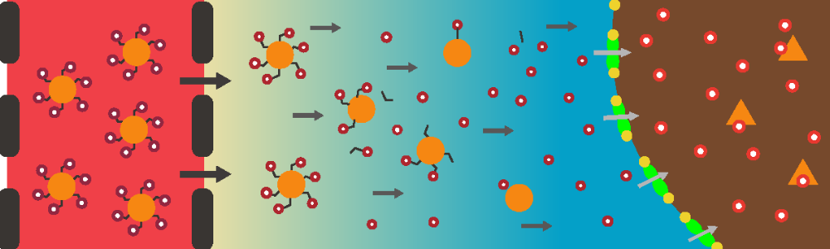
Three steps of tumor selective targeting by P-THP

Slide 16
Free drug release from polymer conjugated-THP
at different pHs: Acid environment dependency
in vitro (cf. tumor pH)
pH
Release of THP (%)
5.0
5.5
6.0
6.5
8.0/7.4
Hrs of incubation

Slide 17
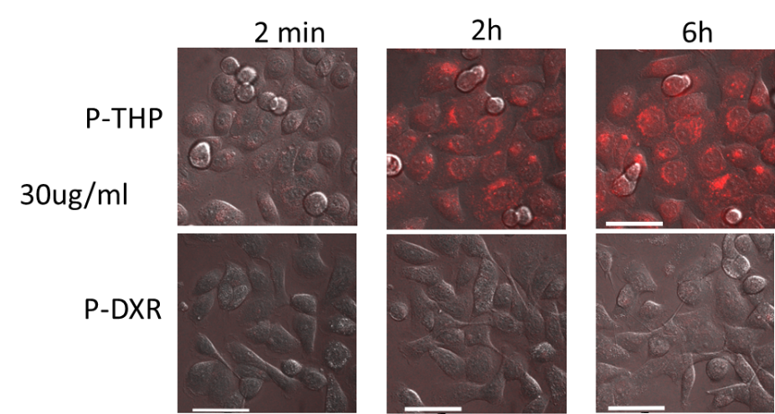
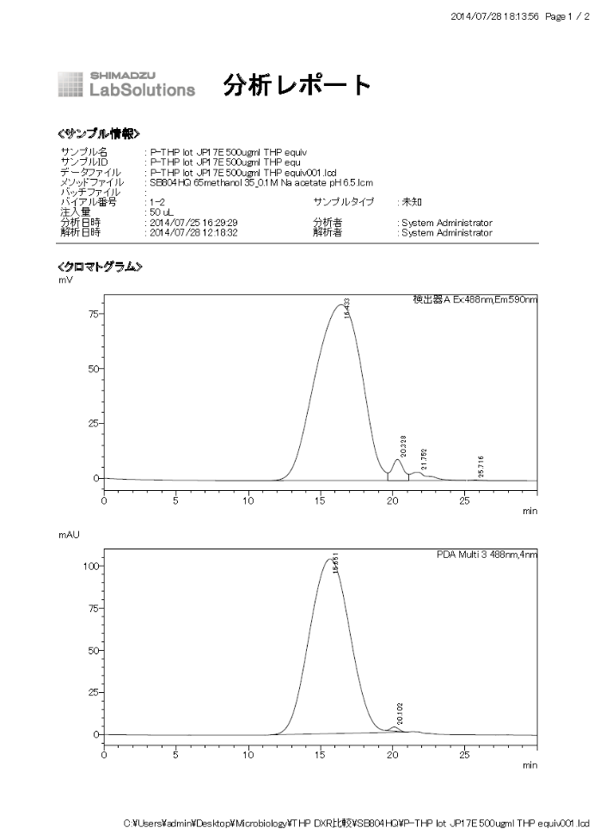
Cell uptake and cytotoxicity of THP, DOX, P-THP and P-DOX,
against human pancreatic tumor cells (SUIT-2) in vitro
Comparison of IC₅₀ in vitro
THP vs DOX
 | 5 min | 30 min | 72h
THP | 0.004 | 0.048 | 0.1
Dox | 0.045 | 1.05 | 6.0
Potency ↑ fold | x 11 | x 21 | x 60
P-THP vs P-DOX
 | 30 min | 3h | 72h
P-THP | 1.59 | 0.35 | 0.06
P-Dox | 52.78 | 5.54 | 0.44
Potency ↑ fold | x 33.2 | x 15.8 | x 7.3
Purity of P-THP/HPLC
> Purity 99.5%

Slide 18
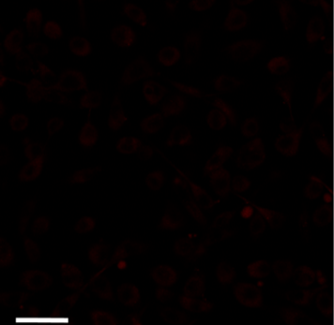
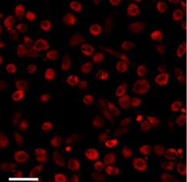
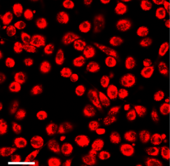
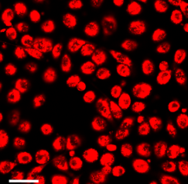
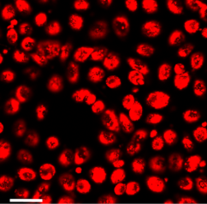
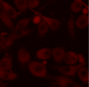
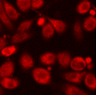
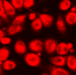
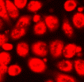
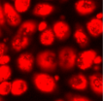
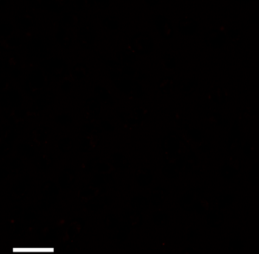
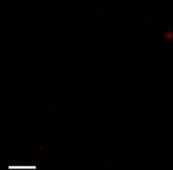
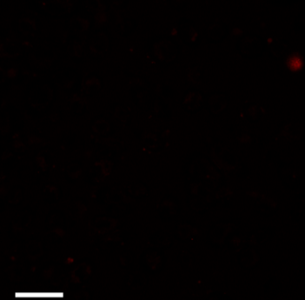
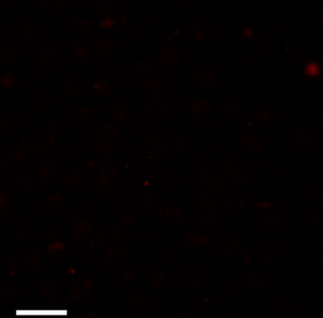
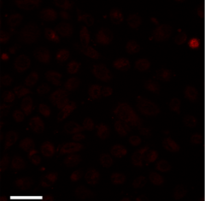
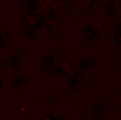


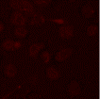
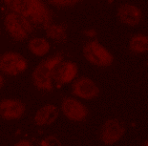

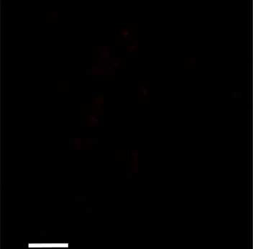
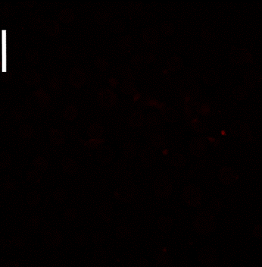
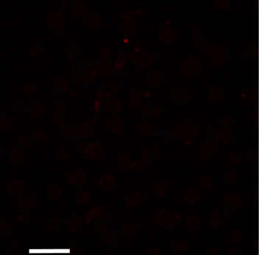
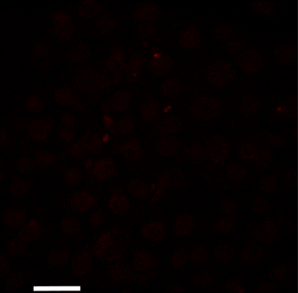
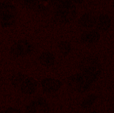

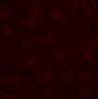

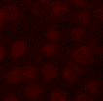
Cellular uptake of Anthracyclines: THP, DOX, EPI in human pancreatic cell at 5µg/ml each.
2 min
10 min
30 min
60 min
120 min
Saturated
Saturated
Saturated
THP
Pirarubicin
Free THP
Free DOX
DOX
Doxorubicin
Free EPI
EPI
Epirubicin
18

Slide 19
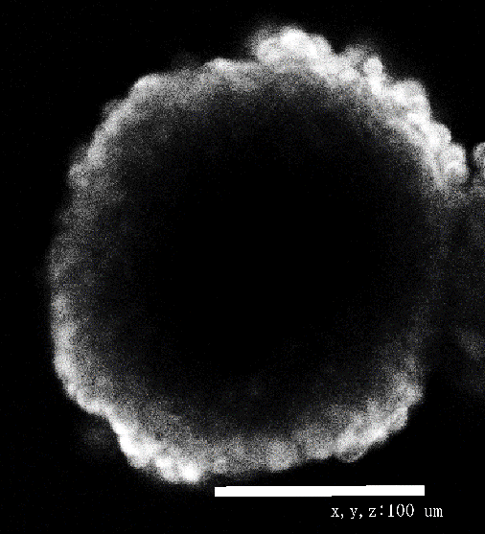
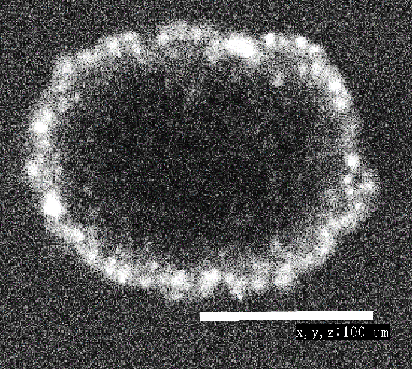
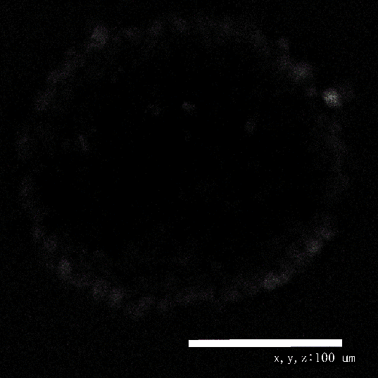
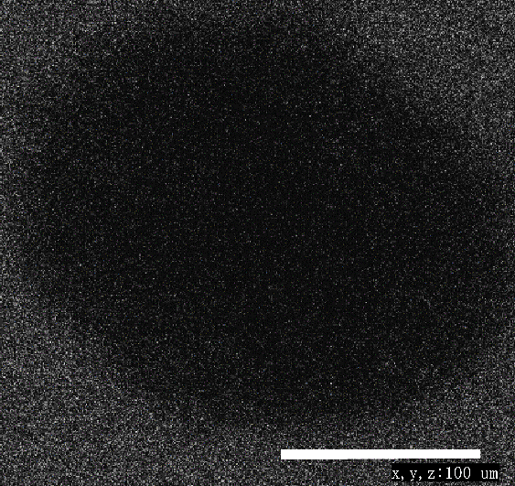
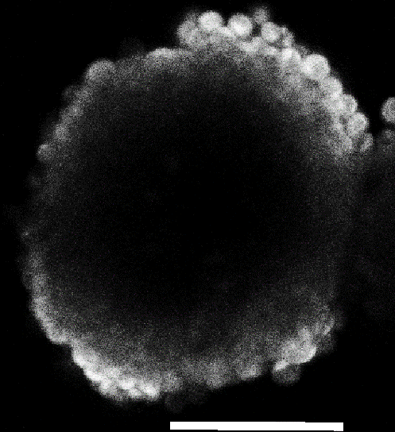
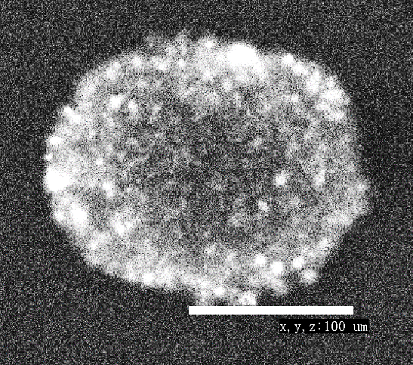






Penetrating effect of THP, Dox, P-THP, P-Dox
in spheroid tumor (HCT116 human colon ca). Confocal image
Free THP
P-THP
Free DOX
P-DOX
(30µg/ml)
(30µg/ml) equiv.
(30µg/ml)
(30µg/ml) equiv.
Bar =
100µm
15min
60min
120min
19

Slide 20
Effect of P-THP given i.v. on colorectal cancer in mice
Model tumor: Azoxymethane / Na dextransulfate given ip generate autocutaneous colorectal ca. 15mg/kg of P-THP, equivalent to free THP, was given iv. once/wk×3 times. The result was obtained at day 21.

Slide 21

Treatment of metastatic liver cancer by SMA-THP
Metastatic Liver Cancer
No drug control
100 mg/kg
150 mg/kg
200 mg/kg

Slide 22

Tumor bearing mice survival after treatment
with 20 mg/kg of anthracyclins and Its SMA micelles
100
SMA-THP/1/5 MTD
80
60
40
SMA-DOX/1/5 MTD
20
Free DOX > MTD
Free THP > MTD
0
0
20
40
60
80
100
120
140
160
180
Survival (Days)

Slide 23
Clinical Prospect of P-THP iv.
A pilot study of compassionate use of P-THP in terminal patients.

Slide 24






Remarkable effect of P-THP in stage IV prostate cancer patient with lung and bone metastases (1)
Prostate cancer patient, Stage IV with lung metastasis (M62)
Before P-THP June, 2013 （PSA Value 1472）
After×5 iv Feb. 13, 2014
Mar. 2, 2015
White nodules are metastatic tumor
in the lung
No new tumor nodules appeared 4 months.
After×2 iv Oct. 2013 (PSA Value 0.67)
After×6 iv Mar. 3, 2014
(Dozono et al, Targeted Oncology, 2015)
Almost all tumor nodules are disappeared.
No recurrence > 1.5 yrs

Slide 25



Compassionate trial of P-HPMA conjugated THP in stage IV prostate cancer patient (2)
Bone scintigraphy
20 mon.
2013.6.7
2014.3.4
2015.3.6
Resume medication of P-THP:
2013.10.2
Bone fracture
Bone met
Bone met
Almost disappeared
Disappeared
P-THP iv ×4 （30, 30, 50, 50mg)
[PSA] 964.2→1242
→102→0.067ng/ml

Slide 26

Case 1. Prostate Cancer 1 (O.S., 62 M, Kagoshima)
Normal level: under 4 ng/mL

Slide 27

Case 2. Prostate Cancer 2 (S.K., 77 M, Oita)
Normal level: under 4 ng/mL
250
200
150
100
50
40
30
20
10

Slide 28

Case 3. Stomach cancer (Y. F. 69 M, Fukuoka)
Normal level
CEA: under 5 ng/mL
CA125: under 35 U/mL
operation

Slide 29

Case 4. Stomach cancer (A.Y. 73 M. Fukui)
Normal level
CEA: under 5 ng/mL
CA19-9: under 37 U/mL

Slide 30

Case 5. Ovarian cancer (Y.K. 66F, Fukuoka)
Under 37 U/mL Under 35 u/mL
operation
Tumor laptured. Temporarily increased.

Slide 31







Pathological examination of ovarian ca. (clear cell carcinoma)
A. Resected cancer cut surface
B. HE staining
C. FL microscopy of THP
T5
N
T8
Clinical effect of P-THP against ovarian cancer, clear cell carcinoma. Pt: 66
P-THP: 2/1. 75mg, 2/8. 50mg, 2/16. 50mg.
Operation: 2/25, tumor raptured on 2/18.
As of 8/20, 2016, tumor marker is low normal. Best QOL. No side effect.
N
T7
N

Slide 32








Histological examination of LNs after P-THP iv: Ovarian ca.
N1
N3
N5
N8
N9
N10
N11
N14
3 wks after P-THP iv 50mg×2, 75mg×1 THP equiv. weekly.
No metastatic LN was observed in all 35 resected LNs.

Slide 33

Case 6. Ovarian cancer ( H.K. 70F, Kasukabe City)

Slide 34
Part Ⅱ. Innovation in PDT based on EPR effect
Development of polymeric photosensitizers and advantage of EPR based tumor targeting.
Wider wavelength energy input by xenon light.

Slide 35
PDT and major problems in present system
Low MW PS does not show EPR effect and distribute throughout body and the skin. Whereas fluorescent nano-PS particles show tumor selective accumulation by EPR effect; →fluorescent tumor-detection by imaging becomes possible. Thus tumor selective oxygen radical generation, thereby results in antitumor effect.
A current main stream of PDT uses He/Ne laser, which emits at 633 nm, and it does not use Soret band-irradiation at 400-450nm. Thus excitation at 633nm yields no useful fluorescence image of tumor,
or little ¹O₂ generation at tumor.

Slide 36

Chemical structure of P-ZnPP
ZnPP loading: 20%
EPR
Tumor
P-ZnPP
36
ミセル化

Slide 37

Antitumor effect by PDT with P-HPMA-ZnPP
Control, no drug
P-HPMA-ZnPP (20mg/kg)+irradiation
(10 J/cm²)
Tumor Volume (mm₃)
Blue light (Panasonic FL20S-B),
60min × 3 irradiation
Control
Mouse S-180 tumor model
(Implanted sarcoma dorsal)
Drug 20mg/kg
+ light
Drug dose dependency
Control
Light only
Tumor Volume (mm₃)
D 5mg only
Low dose
Control
Light only
Light + D
5mg
10mg
20mg
D 20mg only
Light dependency
Tumor Volume (mm₃)
D+ light
20%
40%
60%
Complete cure by 60% output
Light

Slide 38

Therapeutic effect of P-ZnPP given iv + blue light irradiation, 7cm, 30min x3 (lower column). Control, no drug (upper column).
On days 50-60, no tumor could be seen after 20mg/kg iv.
Similar result were seen by endoscopic light irradiation twice.
Rat Brest cancer treated by PDT with P-HPMA-ZnPP + light
No treatment
Treatment
P-HPMA-ZnPP
+
Light

Slide 39





Light irradiation probe optics in mice
A
Before insertion
B
Applied infuse rectum
C
As light on in B
D
Fluorescence of colon cancer in mouse
AOM/DSS induced cancer

Slide 40
Regression of colon tumor by PDT
（A）
21 days p.i
（B）
21 days p.i
・ Tumor: autochthonous mouse tumor induced by azoxymethane + Na dextran sulfate, ip.
・ Most closest to natural tumor.
・ P-ZnPP was given at 15mg/kg i.v. once weekl×3: light fiber was placed in the rectum, and xenon light
(400-700 nm) irradiation 10-15 min each time (×3). NG, nitroglycerin as EPR enhanced treatment.
L, light irradiation.

Slide 41
Summary: Proof of concept
The EPR effect is also valid in both metastatic tumors and autochthonous/natural tumors.
Polymer conjugates (P-HPMA-THP) showed remarkably high accumulation in the metastatic tumor nodules, and thus anti-metastatic effect in lung and liver metastasis are seen.
Multiple tumor selective properties can be conferred to the polymer conjugates, which utilizes EPR effect, acidic tumor pH, and upregulated transporter for cell uptake etc.
Polymer conjugated THP showed remarkable preclinical/clinical results in a stage IV prostate cancer patients with lung and bone metastasis.
Innovation in PDT seems possible using polymer conjugates by EPR effect ; thus fluorescent tumor imaging, and clear therapeutic effect were seen in breast and colon cancers.
No laser is needed. No side effect is anticipated.

Slide 42
Acknowledgments
I am most grateful for my colleagues here and abroad including Drs. J. Fang, H. Nakamura, H. Dozono, K. Ulbrich, V. Subr and T. Etrych, K. Tsukigawa, et al as well as previous coworkers, Y. Matsumura, L. Seymour, R. Duncan and late T. Konno and S. Maki, A. Nagamitsu and others. Also research grants from Japanese Government (MEXT and MHLW) up to 2014 to HM and JSPS-CAS Bilateral Joint Research Project (2016-2017).

