Slide 1
Effects of MicroRNA 146α in Tumor Microenvironment
ECSU Dept. of Natural Sciences
Monet Stevenson
Dr. H. Banerjee

Slide 2
Background
Cancers are the biggest killer
In 2012, 8.2 million died and 14 million new cases reported
It is expected that annual cancer cases will rise from 14 million in 2012 to 22 within the next 2 decades
World Cancer Report (2014). Cancer. Retrieved from http://www.who.int/mediacentre/factsheets/fs297/en/

Slide 3
Background
Tumor Microenvironment (TME)
Normal cellular environment in which the tumor exists and receives nourishment
Includes surrounding blood vessels, immune cells, fibroblasts, other cells, signaling molecules, and the extracellular matrix (ECM)

Slide 4
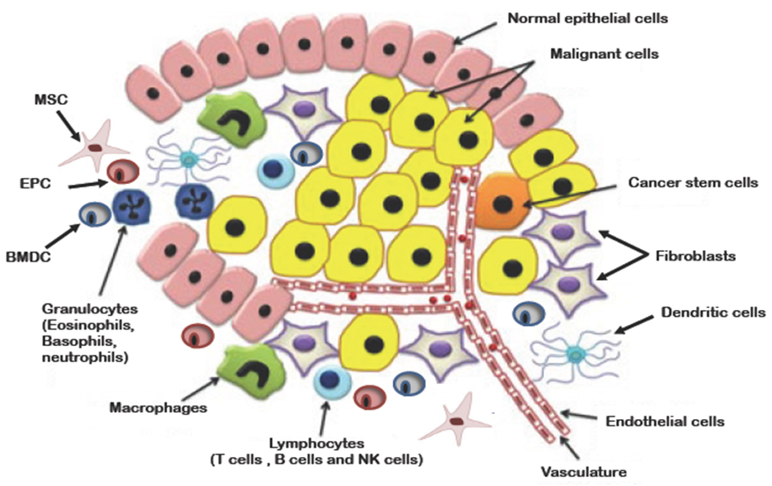
Background
TME
Figure 1: Schematic representation of the tumor microenvironment including malignant cells, malignant stem cells, normal cells, macrophages, mesenchymal stem cells (MSCs), endothelial progenitor cells (EPCs), bone marrow-derived dendritic cells (BMDCs), fibroblasts, and blood vessels.
(Source: http://www.thetcr.org/article/view/1549/html)

Slide 5
Background
Nitric Oxide Synthases and Nitric Oxide (NO)
Nitric Oxide Synthases family of enzymes that catalyze the production of NO
3 isoforms in mammals
Neural and endothelial NOS are constitutive
Increase in cellular calcium levels or stimuli (stress)

Slide 6
Background
Inducible Nitric Oxide Synthase (iNOS)
iNOS protein very low in most cell types
Large NO amounts produced on stimulation by cytokines
High levels of NO lead to cell toxicity
Enables iNOS to participate in anti-tumor activities

Slide 7
Background
Macrophages and Tumor-associated Macrophages (TAMs)
Large phagocytic bodies formed through differentiation of monocytes
Specialized cells that recognize, engulf, and destroy targets cells
First line of defense against infection

Slide 8
Background
Macrophages and Tumor-associated Macrophages (TAMs)
Polarized into classical M1 or alternative M2 activation
M1 killer macrophages; contain iNOS
Infiltrate and accumulate in tumors

Slide 9
Background
Macrophages and Tumor-associated Macrophages (TAMs)
In TME, alternatively activated M2 phenotype
M2 characterized by low amounts of NO
Promote tumor growth and develop
TAMs

Slide 10
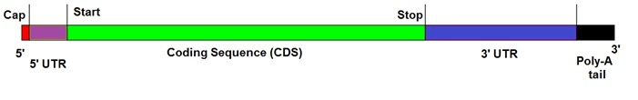
Background microRNA 146a
20-24 nucleotides in length (average mRNA transcript range from 60-4000 nucleotides)
MicroRNAs (miRNA) are special RNA molecules that inhibit transcripts by binding to the 3’ untranslated region (UTR) of the mRNA
Figure 2. Messenger RNA. http://blog-biosyn.com/2013/04/11/what-are-microrna-mirna-mimics/

Slide 11
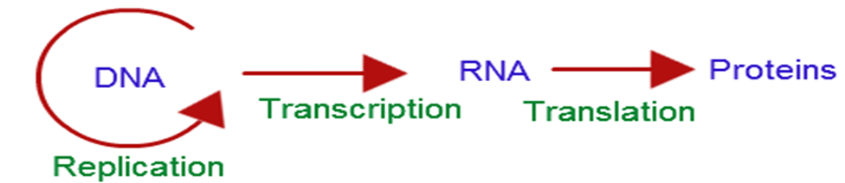
Background microRNA 146a
Figure 3. Central Dogma. http://biology.tutorvista.com/cell/central-dogma.html

Slide 12
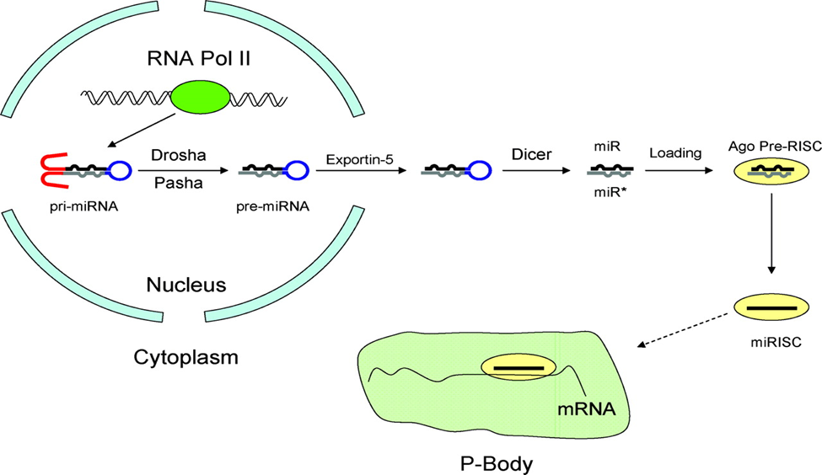
Background microRNA 146a
Figure 4: Biogenesis of miRNAs and assembly into RISC complex. RNA Pol II creates capped and polyadenylated pri-miRNAs which are processed by Drosha in the nucleus to generate pre-miRNAs. After translocation into the cytoplasm by Exportin-5, pre-miRNAs are processed by Dicer to form the mature miRNA/miRNA* duplex. After processing, miRNA strands are loaded into the RISC complex and the miRNA* strand is destroyed. The mature miRNA directs repression of mRNA containing partially complementary miRNA binding sites with the 3’ UTR within a processing body (P-body).
(Source: http://circ.ahajournals.org/content/119/16/2217/F1.expansion.html)

Slide 13
Background
Exosomes
Small vesicles containing RNA and protein
Involved in intercellular communication

Slide 14
Hypothesis
miRNA 146α is upregulated and delivered in exosomes by the cancer cells in the tumor microenvironment (TME) to inhibit the iNOS transcript of the macrophages
By this, cancer cells escape macrophage-mediated cell death and obtain a survival advantage

Slide 15
Specific Aims
Investigate expression of iNOS gene in various cancer and primary cell lines
Study/compare iNOS protein expression and NO Assay results in cancer and primary cell lines
Study/compare miRNA 146α expression in cancer and primary lines
Study roles of miRNA 146α in the TME

Slide 16
Materials and Methods
Cell Culture
Cells requiring CO2 were incubated at 37°C and maintained at 5% CO2
Non-CO2 cells were incubated at 37°C in absences of CO2
Cells were split or medium was changed 2 to 3 times a week for maintenance

Slide 17
Materials and Methods
Trypan Blue Assay
Confluent Cells
Centrifuge 14,000 x g for 10 min
Resuspended in 350 µl 1X PBS
Equal amounts of cells in PBS and 0.4% Trypan Blue Dye
10 µl mixture pipetted into Countess Slide
Slide placed into machine for viability results

Slide 18
Materials and Methods
Nitric Oxide Assay
Griess reagents were allowed to equilibrate to room temperature
50 µl of experimental sample and 50 µl of Sulfanilamide Solution
Incubate at room temperature 5-10 min protected from light
50 µl of NED Solution
Incubate at room temperature 5-10 min protected from light
Absorbance measured within 30 min at 540 nm

Slide 19
Materials and Methods iNOS ELISA
Solid-phase antibody pre-coated onto microplate
Sample was added and target protein and monoclonal antibody were incubated
After series of washing to remove non-specific binding enzyme was added to form an antibody-antigen-enzyme complex

Slide 20
Materials and Methods iNOS ELISA
Tetramethylbenzidine (TMB) substrate incubated in dark at 37°C for 30min
Produces a blue color when catalyzing with streptavidin labeled horse-radish peroxidase
Causes a more blue color wherever more protein exists
Add stop solution
Absorbance measure at 450 nm in microplate reader

Slide 21
Materials and Methods iNOS and MIRNA 146A gene expression via Applied Biosystems Real-time qPCR
Production of cDNA (no introns)
Heating reactions occurred at 95°C for 30 seconds and then the reaction took place for 40 cycles as follows:
Denaturation- 95°C for 15 seconds and annealing- 55°C for 50 seconds.
Elongation step was not performed because it was just necessary to see where the SYBRgreen intercalated between the annealing DNA strands

Slide 22
Materials and Methods
Translational Studies by Western Blotting (Simon System)
Reagents and samples loaded into assay plate
Proteins loaded into capillary
Separated by size as they migrated through stacking and separation matrixes
Separate proteins immobilized to capillary wall via photoactivated capture chemistry

Slide 23
Materials and Methods
Translational Studies by Western Blotting (Simon System)
Target proteins identified using a 1:50 diluted primary antibody (iNOS) and HRP-conjugated secondary antibody and chemiluminescent substrate (Streptavidin)
Chemiluminescent signal was detected and quantified for band production

Slide 24
Materials and Methods
Total Exosome Isolation
Centrifuge 14,000 x g 10 min
Grow pellet in FBS depleted media ≥ 12hrs
Centrifuge 14,000 x g 10 min
Place supernatant in 1.5 ml Eppendorf tubes
Centrifuge 2,000 x g 30 min
0.5 volume exosome isolation reagent added
Vortex until homogenous
Incubate overnight at 4°C
Centrifuge 10,000 x g 1 hour at 4°C
Discard supernatant resuspend in 1X PBS

Slide 25
Materials and Methods miRNA 146A expression levels via Enzyme-linked Immunosorbent Assay (ELISA) based system
Solid-phase antibody pre-coated onto microplate
Sample was added and target protein and monoclonal antibody were incubated
After series of washing to remove non-specific binding enzyme was added to form an antibody-antigen-enzyme complex

Slide 26
Materials and Methods
Single Cell RNA Isolation
Isolate protein from exosomes
Isolate RNA
Purify RNA
Bind the RNA
Wash the RNA
Elute RNA
Evaluate RNA concentration
(OD260 * 40 ng/µl *dilution factor)/ 1000 = [RNA] µg/µl
Agilent® 2100 Bioanalyzer® with an RNA 6000 Pico Kit

Slide 27
Materials and Methods miRNA 146A expression levels via Enzyme-linked Immunosorbent Assay (ELISA) based system
Tetramethylbenzidine (TMB) substrate incubated in dark at 37°C for 30min
Produces a blue color when catalyzing with streptavidin labeled horse-radish peroxidase
Causes a more blue color wherever more protein exists
Add stop solution
Absorbance measure at 450 nm in microplate reader

Slide 28
Materials and Method
Plasmid Isolation
Grow Bacterial Culture
Luria Broth Media and Ampicillin (Antibiotic)
E. Coli and MIRNA 146A plasmid
Harvest and Lyse Bacteria
Centrifugation
Detergent
Purify Plasmid DNA
Plasmid retained on silica-gel membrane of filter column
Ethanol washes to remove salts
Perform 3 empty washes to remove residual ethanol
Elute DNA
Add Elution Buffer to center of column and let stand 1 minute
Releases DNA from silica-gel membrane

Slide 29
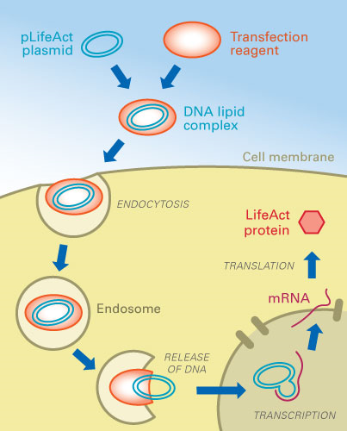
Materials and Methods
Transfection Studies via NO Assay with Inhibition and Up-regulation of miRNA 146A
Figure 5. Transfection http://www.google.com/imgres?imgurl=http://ibidi.com/uploads/pics/transfection.jpg&imgrefurl=http://ibidi.c
om/applications/transfection-transduction-and-proteofection/transfection/&h=250&w=201&tbnid=KpaU69crvWHVNM:&zoom=1&tbnh=160&tbnw=128&usg=__zdjpZiKG8QCfiUkDE8k_-1CbUKQ=&docid=auku5W9QJ0YNGM&itg=1

Slide 30
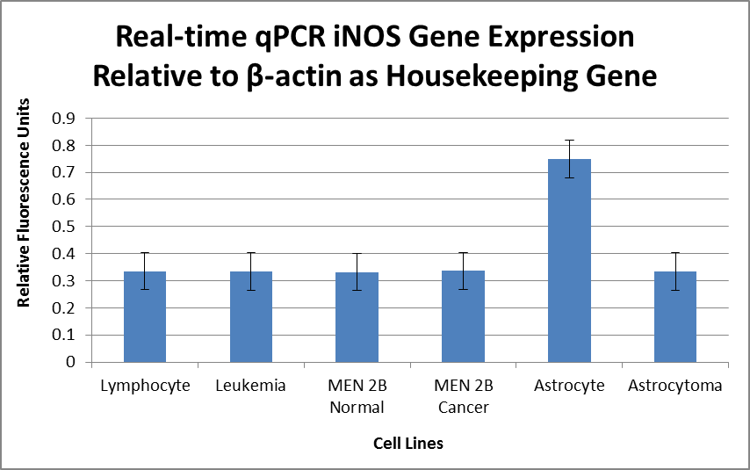
Results and Discussion
Real-time iNOS Expression

Slide 31

Results and Discussion
Tukey-Kramer Statistical Test
One Factor ANOVA P-value =6.382E-07
TUKEY-KRAMER | Numerator df = 6 | Denominator df = 12 | Q_{u} = 4.7500
Comparison | Absolute Difference | Critical Range | Result
Lymphocyte to Leukemia | 0.0020 | 0.1317 | MNSD
Lymphocyte to MEN 2B Normal | 0.0030 | 0.1317 | MNSD
Lymphocyte to MEN 2B Cancer | 0.0070 | 0.1317 | MNSD
Lymphocyte to Astrocyte | 0.4147 | 0.1317 | MSD
Lymphocyte to Astrocytoma | 0.0020 | 0.1317 | MNSD
Leukemia to MEN 2B Normal | 0.0010 | 0.1317 | MNSD
Leukemia to MEN 2B Cancer | 0.0027 | 0.1317 | MNSD
Leukemia to Astrocyte | 0.4167 | 0.1317 | MSD
Leukemia to Astrocytoma | 0.0000 | 0.1317 | MNSD
MEN 2B Normal to MEN 2B Cancer | 0.0037 | 0.1317 | MNSD
MEN 2B Normal to Astrocyte | 0.4177 | 0.1317 | MSD
MEN 2B Normal to Astrocytoma | 0.0010 | 0.1317 | MNSD
MEN 2B Cancer to Astrocyte | 0.4140 | 0.1317 | MSD
MEN 2B Cancer to Astrocytoma | 0.0027 | 0.1317 | MNSD
Astrocyte to Astrocytoma | 0.4167 | 0.1317 | MSD

Slide 32
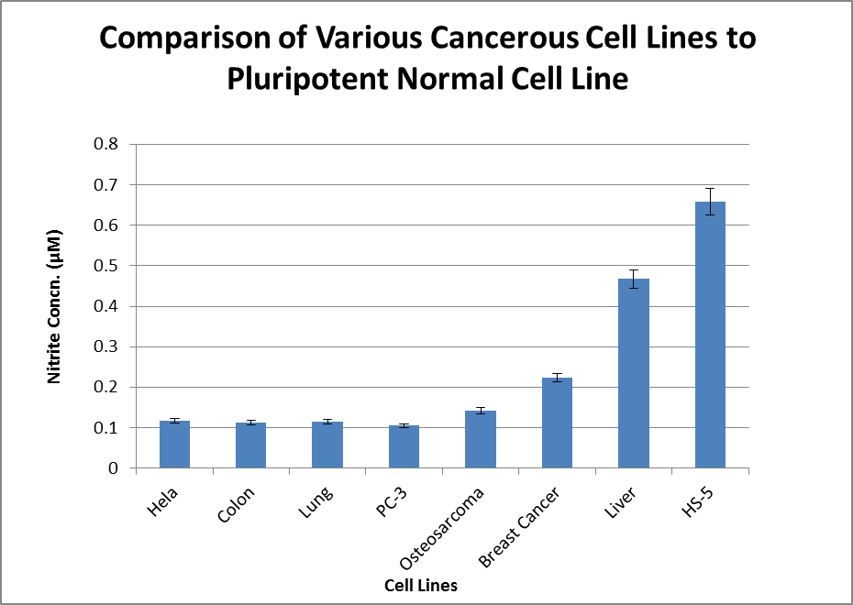
Results and Discussion
NO Assay

Slide 33
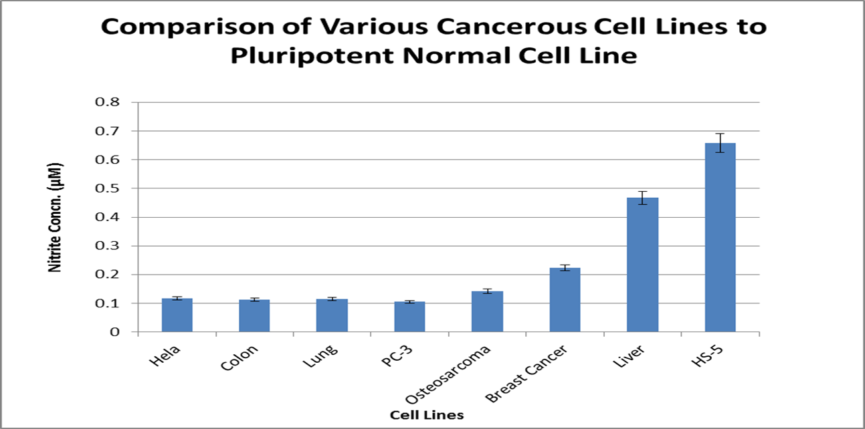
Results and Discussion
Tukey-Kramer Statistical Test
One Factor ANOVA P-value = 0.0003
TUKEY-KRAMER | Numerator df = 8 | Denominator df = 16 | Q_{u} = 4.8960
Comparison | Absolute Difference | Critical Value | Results
Liver to Colon | 0.3555 | 0.3595 | MNSD
Liver to Lung | 0.3515 | 0.3595 | MNSD
Liver to PC-3 | 0.3622 | 0.3595 | MSD
Liver to Osteosarcoma | 0.3255 | 0.3595 | MNSD
Liver to Breast Cancer | 0.2438 | 0.3595 | MNSD
Liver to Hela | 0.3508 | 0.3595 | MNSD
Liver to HS-5 | 0.1915 | 0.3595 | MNSD
Colon to Lung | 0.0040 | 0.3595 | MNSD
Colon to PC-3 | 0.0067 | 0.3595 | MNSD
Colon to Osteosarcoma | 0.0300 | 0.3595 | MNSD
Colon to Breast Cancer | 0.1117 | 0.3595 | MNSD
Colon to Hela | 0.0047 | 0.3595 | MNSD
Colon to HS-5 | 0.5470 | 0.3595 | MSD
Lung to PC-3 | 0.0107 | 0.3595 | MNSD
Lung to Osteosarcoma | 0.0260 | 0.3595 | MNSD
Lung to Breast Cancer | 0.1077 | 0.3595 | MNSD
Lung to Hela | 0.0007 | 0.3595 | MNSD
Lung to HS-5 | 0.5430 | 0.3595 | MSD
PC-3 to Osteosarcoma | 0.0367 | 0.3595 | MNSD
PC-3 to Breast Cancer | 0.1183 | 0.3595 | MNSD
PC-3 to Hela | 0.0113 | 0.3595 | MNSD
PC-3 to HS-5 | 0.5537 | 0.3595 | MSD
Osteosarcoma to Breast Cancer | 0.0817 | 0.3595 | MNSD
Osteosarcoma to Hela | 0.0253 | 0.3595 | MNSD
Osteosarcoma to HS-5 | 0.5170 | 0.3595 | MSD
Breast Cancer to Hela | 0.1070 | 0.3595 | MNSD
Breast Cancer to HS-5 | 0.4353 | 0.3595 | MSD
Hela to HS-5 | 0.5423 | 0.3595 | MSD

Slide 34
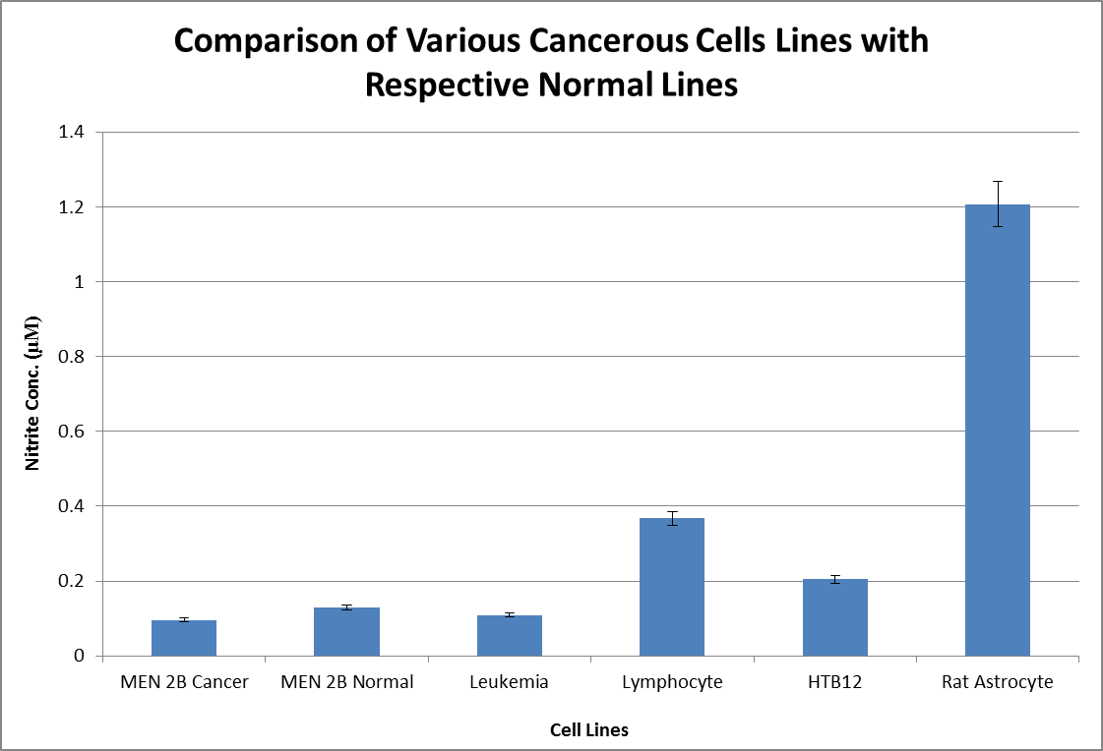
Results and Discussion
NO Assay

Slide 35
Results and Discussion
One Factor ANOVA
ANOVA
Source of Variation | SS | df | MS | F | P-value | F crit
Between Groups | 0.8221 | 5 | 0.1644 | 2.3252 | 0.0854 | 2.7729
Within Groups | 1.2728 | 18 | 0.0707
Total | 2.0949 | 23

Slide 36
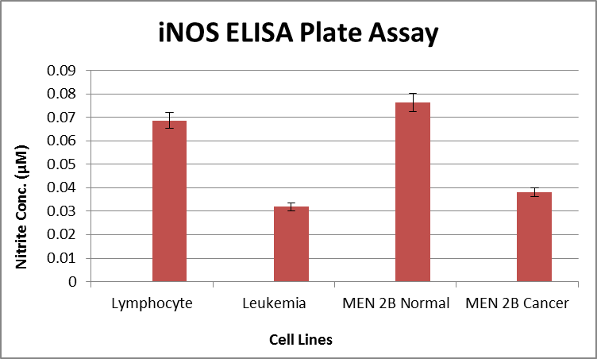
Results and Discussion

Slide 37
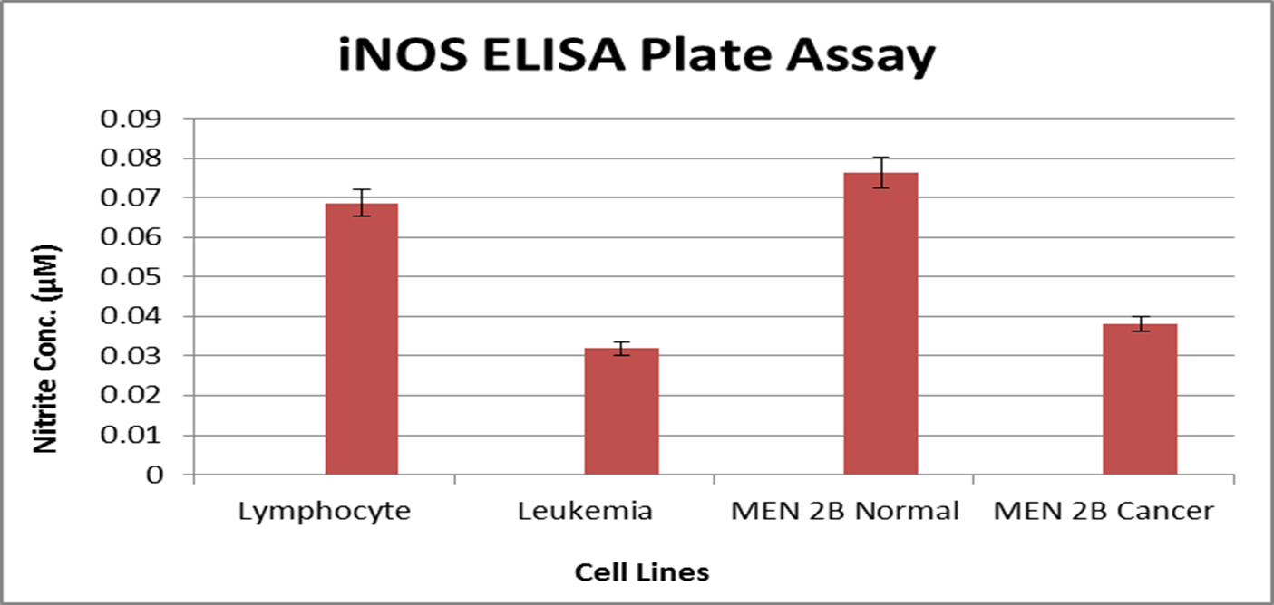
Results and Discussion
Tukey-Kramer Statistical Test
One Factor ANOVA P-value= 0.0016
TUKEY-KRAMER | Numerator df = 4 | Denominator df = 8 | Q_{u} = 4.529
Comparison | Absolute Difference | Critical Range | Result
Leukemia to Lymphocyte | 0.0368 | 0.0268 | MSD
Leukemia to MEN 2B Cancer | 0.0063 | 0.0268 | MNSD
Leukemia to MEN 2B Normal | 0.0445 | 0.0268 | MSD
Lymphocyte to MEN 2B Cancer | 0.0305 | 0.0268 | MSD
Lymphocyte to MEN 2B Normal | 0.0077 | 0.0268 | MNSD
MEN 2B Cancer to MEN 2B Normal | 0.0382 | 0.0268 | MSD

Slide 38
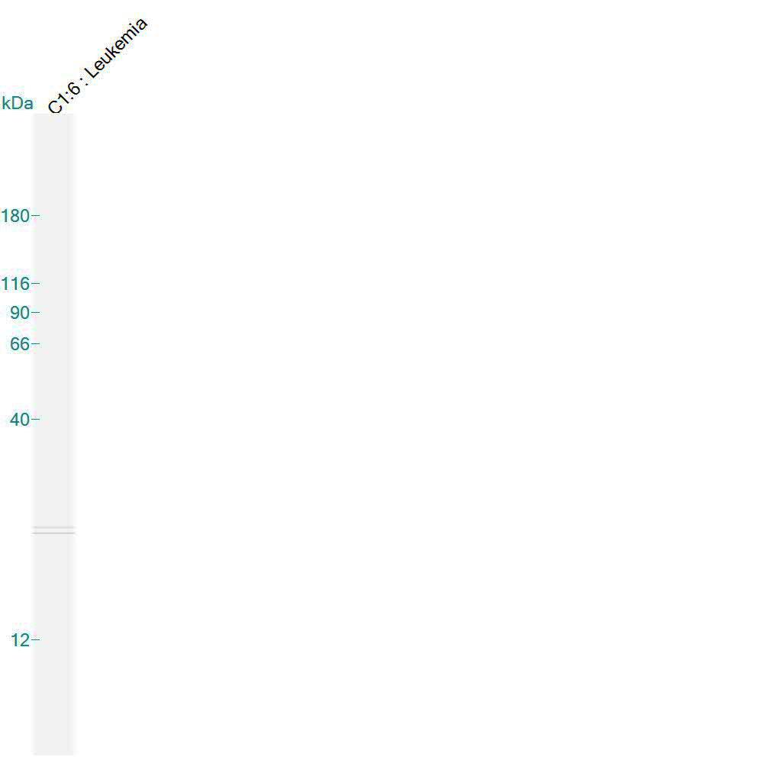
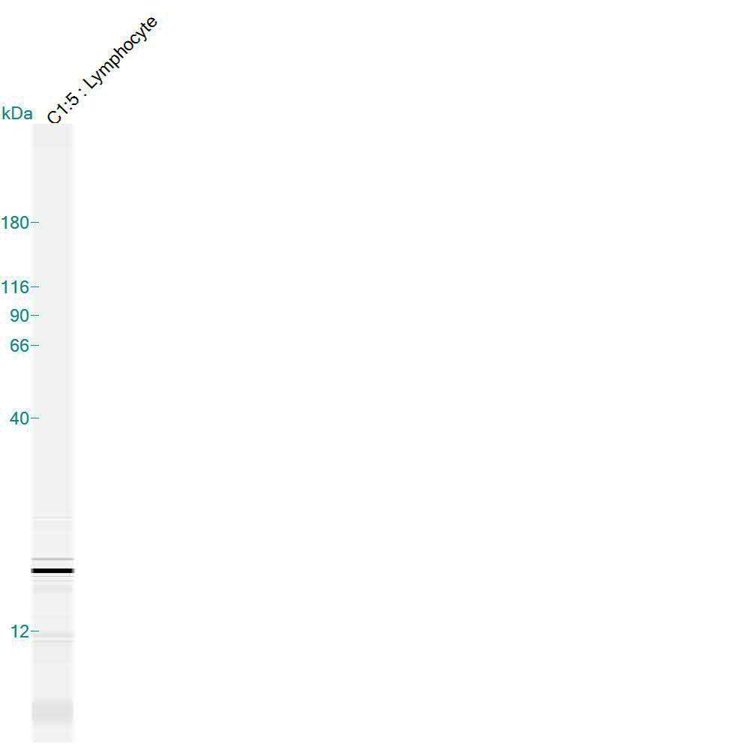
Western Blot
Leukemia iNOS Expression
Lymphocyte iNOS Expression

Slide 39
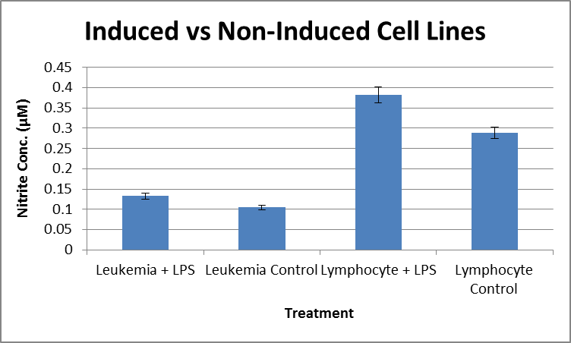
Results and Discussion
NO Assay

Slide 40

Results and Discussion
Tukey-Kramer Statistical Test
One Factor ANOVA P-value =7.89E-08
TUKEY-KRAMER | Numerator df = 4 | Denominator df = 8 | Q_{u} = 4.529
Comparison | Absolute Difference | Critical Range | Result
Leuk+LPS to Leuk Control | 0.0277 | 0.0424 | MNSD
Leuk+LPS to Lymph+LPS | 0.2493 | 0.0424 | MSD
Leuk+LPS to Lymph Control | 0.1560 | 0.0424 | MSD
Leuk Control to Lymph+LPS | 0.2770 | 0.0424 | MSD
Leuk Control to Lymph Control | 0.1837 | 0.0424 | MSD
Lymph+LPS to Lymph Control | 0.0933 | 0.0424 | MSD

Slide 41
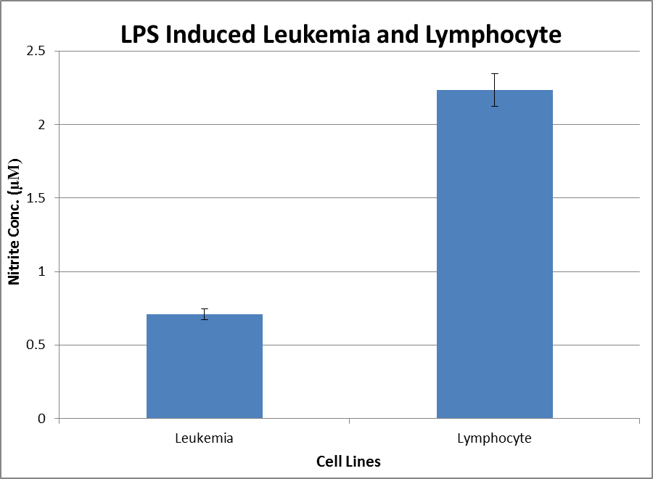
Results and Discussion
NO Assay

Slide 42

Results and Discussion
Tukey-Kramer Statistical Test
One Factor ANOVA P-value = 0.0025
TUKEY-KRAMER | Numerator df = 2 | Denominator df = 4 | Q_{u} = 3.9260
Comparison | Absolute Difference | Critical Range | Result
Leukemia to Lymphocyte | 1.5247 | 0.6296 | MSD

Slide 43
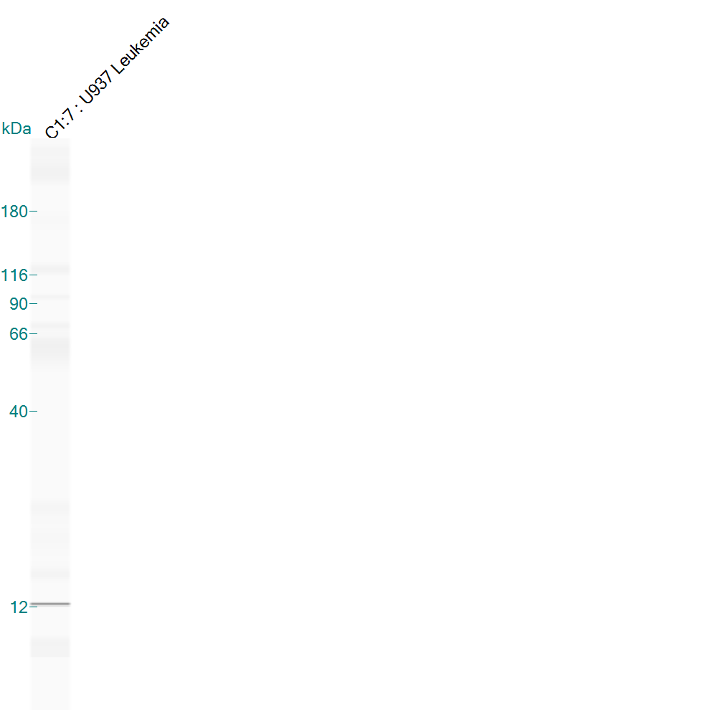
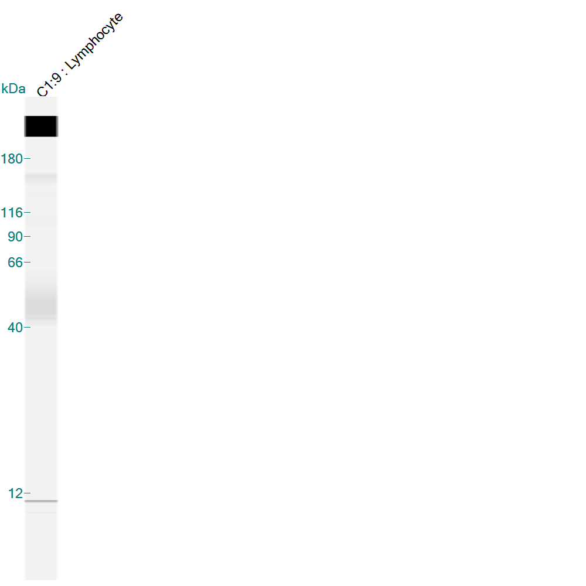
Western Blot
iNOS Protein Expression of Induced Leukemia
iNOS Protein Expression of Induced Lymphocyte

Slide 44
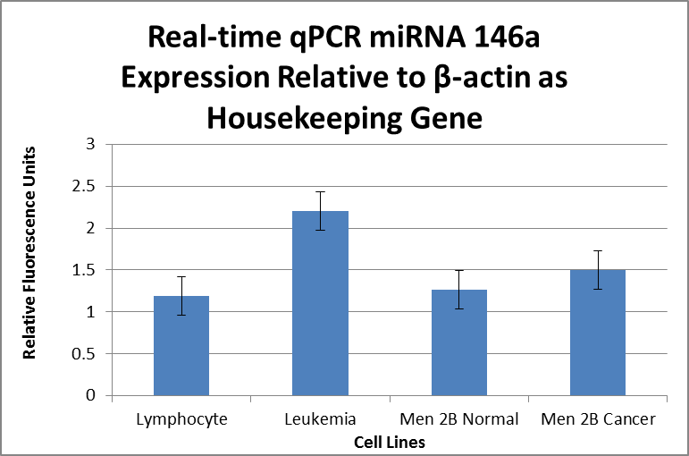
Results and Discussion

Slide 45
Results and Discussion
One Factor ANOVA
ANOVA
Source of Variation | SS | df | MS | F | P-value | F crit
Between Groups | 1.9033 | 3 | 0.6345 | 1.3036 | 0.3385 | 4.0662
Within Groups | 3.8935 | 8 | 0.4867
Total | 5.7969 | 11

Slide 46
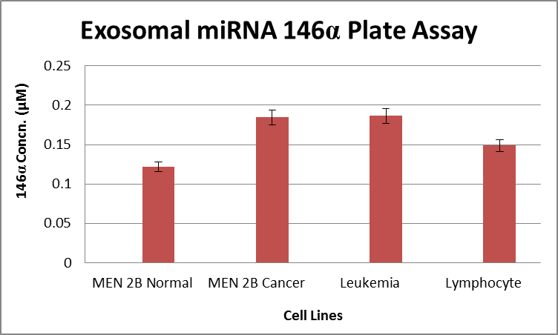
Results and Discussion
MiRNA 146α Expression via ELISA

Slide 47
Results and Discussion
One Factor ANOVA
ANOVA
Source of Variation | SS | df | MS | F | P-Value | F crit
Between Groups | 0.0115 | 3 | 0.0038 | 2.1128 | 0.1520 | 3.4903
Within Groups | 0.0217 | 12 | 0.0018
Total | 0.0332 | 15

Slide 48
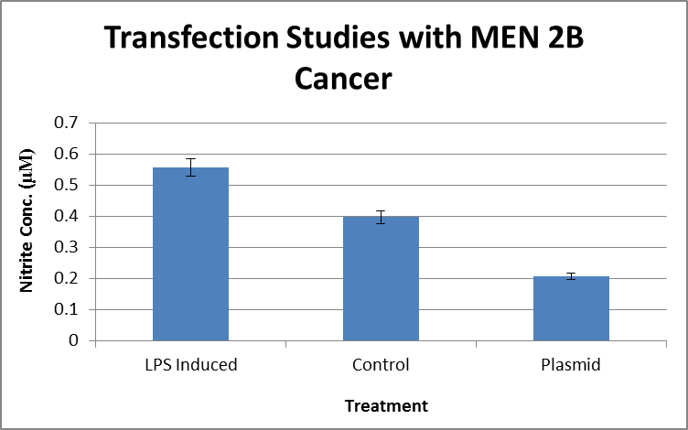
Results and Discussion

Slide 49
Results and Discussion
One Factor ANOVA
ANOVA
Source of Variance | SS | df | MS | F | P-value | F crit
Between Groups | 1.9034 | 3 | 0.6345 | 1.3036 | 0.3385 | 4.0662
Within Groups | 3.8935 | 8 | 0.4867
Total | 5.7969 | 11

Slide 50
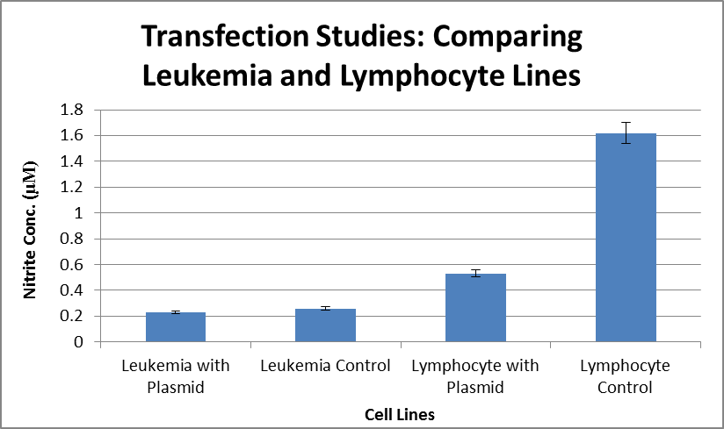
Results and Discussion

Slide 51

Results and Discussion
One Factor ANOVA P-value = 5.87E-09
TUKEY-KRAMER | Numerator df = 4 | Denominatr df = 8 | Q_{u} = 4.529
Comparison | Absolute Difference | Critical Range | Result
Leuk+Plasmid to Leuk Control | 0.0283 | 0.1523 | MNSD
Leuk+Plasmid to Lymph+Plasmid | 0.3003 | 0.1523 | MSD
Leuk+Plasmid to Lymph Control | 1.3897 | 0.1523 | MSD
Leuk Control to Lymph+Plasmid | 0.2720 | 0.1523 | MSD
Leuk Control to Lymph Control | 1.3613 | 0.1523 | MSD
Lymph+Plasmid to Lymph Control | 1.0893 | 0.1523 | MSD

Slide 52
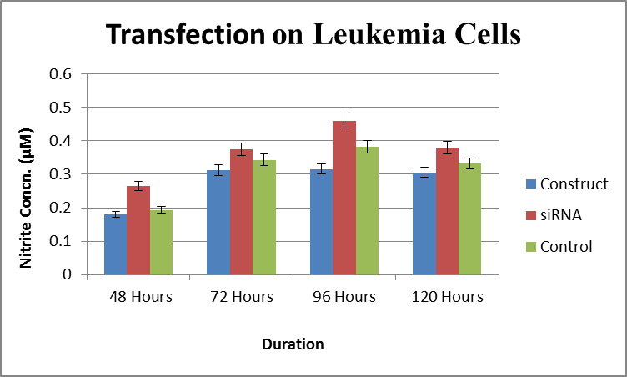
Results and Discussion

Slide 53
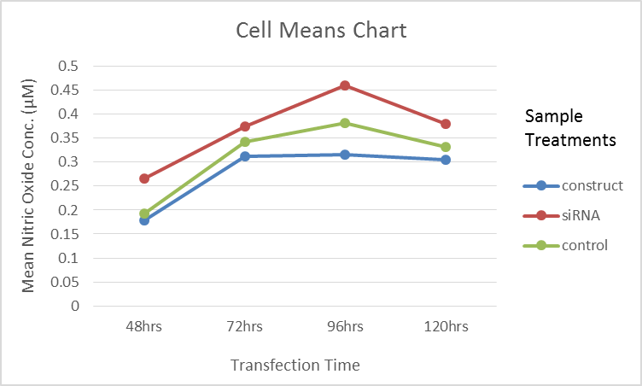
Results and Discussion
Cell Means Chart
Summary | 48 Hours | 72 Hours | 96 Hours | 120 Hours | Total
Construct
Count | 3 | 3 | 3 | 3 | 12
Sum | 0.5380 | 0.9360 | 0.9480 | 0.9160 | 3.3380
Average | 0.9317 | 0.3120 | 0.3160 | 0.3053 | 0.2782
Variance | 0.0003 | 9.1E-05 | 4.3E-05 | 1.63E-05 | 0.0036
siRNA
Count | 3 | 3 | 3 | 3 | 12
Sum | 0.7960 | 1.1220 | 1.3810 | 1.1390 | 4.4380
Average | 0.2653 | 0.3740 | 0.4603 | 0.3797 | 0.3698
Variance | 3.03E-05 | 0.0001 | 0.0001 | 8.23E-05 | 0.0053
Control
Count | 3 | 3 | 3 | 3 | 12
Sum | 0.5790 | 1.0300 | 1.1480 | 0.9950 | 3.7520
Average | 0.1930 | 0.3433 | 0.3827 | 0.3317 | 0.3127
Variance | 2.8E-05 | 0.0007 | 7.43E-05 | 0.0001 | 0.0058
Total
Count | 9 | 9 | 9 | 9
Sum | 1.9130 | 3.0880 | 3.4770 | 3.0500
Average | 0.2126 | 0.3431 | 0.3863 | 0.3389
Variance | 0.0017 | 0.0009 | 0.0040 | 0.0011

Slide 54
Results and Discussion
Two Factor ANOVA
Source of Variance | SS | df | MS | F | P-value | F crit
Sample | 0.0514 | 2 | 0.0257 | 22.1474 | 0.0017 | 5.1433
Columns | 0.1515 | 3 | 0.0505 | 43.4864 | 0.0002 | 4.7571
Interaction | 0.0070 | 6 | 0.0012 | 2.7209 | 0.0368 | 2.5082
Total | 0.2133 | 35

Slide 55
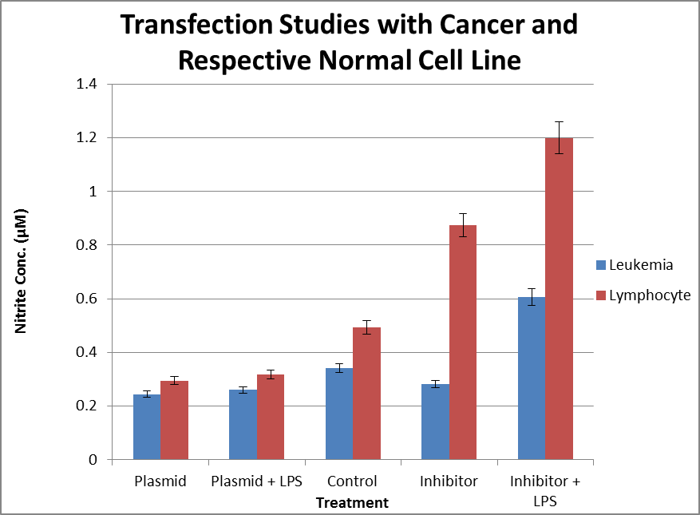
Results and Discussion

Slide 56
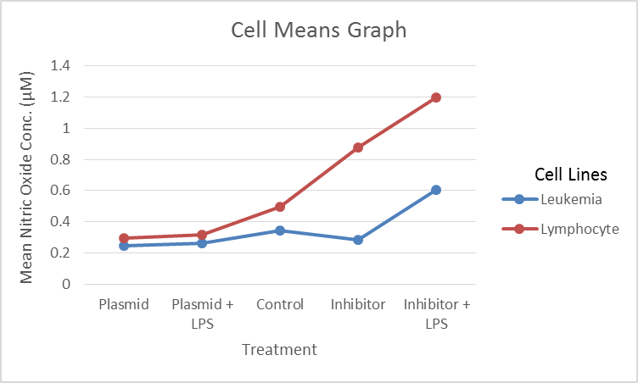
Results and Discussion
Cell Means Chart
SUMMARY | Plasmid | Plasmid + LPS | Control | Inhibitor | Inhibitor + LPS | Total
Leukemia
Count | 3 | 3 | 3 | 3 | 3 | 15
Sum | 0.7310 | 0.7790 | 1.0240 | 0.8450 | 1.8190 | 5.1980
Average | 0.2437 | 0.2600 | 0.3413 | 0.2817 | 0.6063 | 0.3465
Variance | 1.03E-05 | 0.0011 | 1.73E-05 | 8.13E-05 | 0.0002 | 0.0195
Lymphocyte
Count | 3 | 3 | 3 | 3 | 3 | 15
Sum | 0.8820 | 0.9510 | 1.4800 | 2.6240 | 3.5970 | 9.5340
Average | 0.2940 | 0.3170 | 0.4933 | 0.8747 | 1.1990 | 0.6356
Variance | 2.8E-05 | 4.9E-05 | 0.0001 | 0.0001 | 0.0002 | 0.1314
Total
Count | 6 | 6 | 6 | 6 | 6
Sum | 1.613 | 1.7300 | 2.5040 | 3.4690 | 5.4160
Average | 0.2688 | 0.2883 | 0.4173 | 0.5782 | 0.9027
Variance | 0.0008 | 0.0015 | 0.0070 | 0.1056 | 0.1055

Slide 57
Results and Discussion
Two Factor ANOVA
ANOVA
Source of Variation | SS | df | MS | F | P-value | F crit
Rows | 0.6267 | 1 | 0.6267 | 3.4805 | 1.2293E-23 | 4.3512
Columns | 1.6376 | 4 | 0.4094 | 5.3302 | 5.3442E-26 | 2.8661
Interaction | 0.4710 | 4 | 0.1178 | 619.2105 | 1.2939E-20 | 2.8661
Within | 0.0038 | 20 | 0.0002
Total | 2.7391 | 29

Slide 58
Inference
Research, thus far, supports the hypothesis by showing:
NO concentrations are higher in non-cancerous cells (NO ASSAY)
iNOS is expressed in cancer and normal cells (iNOS qPCR)

Slide 59
Inference
146α is present in higher amounts in cancer cells (miRNA Plate Assay)
146α plays a role in NO production (Transfection Studies)

Slide 60
References
Aktan, F. (2004). iNOS-mediated nitric oxide production and its regulation. Life Science, 75, 639–653. Retrieved from http://www.ncbi.nlm.nih.gov/pubmed/15172174
American Cancer Society (2012). Cancer Facts & Figures 2012. Retrieved from http://www.cancer.org/research/cancerfactsstatistics/cancerfactsfigures2012/
American Heart Association (2009). MicroRNAs. 119 (6), 2217-2224. Retrieved from http://circ.ahajournals.org/content/119/16/2217/F1.expansion.html
Balkwill, F. R., Capasso, M., & Hagemann, T. (2012). Tumor microenvironment at a glance. Journal of Cell Science, 125, 5591-5596. doi: 10.1242/jcs.116392
Dai, R., Phillips, R. A., Zhang, Y., Khan, D., Crasta, O., & Ahmed, S. A. (2008). Suppress of LPS-induced Interferon-gamma and nitric oxide in splenic lymphocytes by select estrogen-regulate microRNAs: a novel mechanism of immune modulation. Blood Journal, 112(12), 4591-4597. doi: 10.1182/blood-2008-04-152488
Davis & Hata (2009). Biogenesis of miRNAs and assembly into RISC complex. Cell Communication and Signaling, 7, 18. doi: 10.1186/1478-811X-7-18
Exosomes: Tiny Packets of RNAs with Major Significance and Potential (2013). Retrieved from http://zon.trilinkbiotech.com/2013/09/23/exosomes-tiny-packets-rnas-major-significance-potential/
Förstermann, U. & Sessa, C. W. (2011). Nitric oxide synthases: regulation and function. European Heart Journal, 33(7), 829-837. doi: 10.1093/eurheartj/ehr304
Kent, O. A. & Mendell, J. T. (2006). A small piece in the cancer puzzle: microRNAs as tumor suppressors and oncogenes. Oncogene, 25, 6188–6196. Retrieved from http://www.ncbi.nlm.nih.gov/pubmed/17028598
Lee, V. Y., McClintock, D. S., Santore, M. T., Budinger, G. R., & Chandel, N. S. (2002). Hypoxia sensitizes cells to nitric oxide-induced apoptosis. Journal of Biological Chemistry, 277, 16067–16074
Le, X., Wei, D., Huang, S., Lancaster, J. R., & Xie, K. (2005). Nitric oxide synthase II suppresses the growth and metastasis of human cancer regardless of its up-regulation of protumor factors. Proceedings of the National Academy of Sciences of the United States of America, 102(24), 8758-8763. doi: 10. 1073/pnas.0409581102

Slide 61
References
Linse, K. (2013). What are microRNAs (miRNAs) mimic? Retrieved from http://blog-biosyn.com/2013/04/11/what-are-microrna-mirna-mimics/
MediLexicon International Ltd, Bexhill-on-Sea, UK. (2015). What is cancer? What causes cancer? Retrieved from http://www.medicalnewstoday.com/info/cancer-oncologyLe, X., Wei, D., Huang, S., Lancaster, J. R., & Xie, K. (2005). Nitric oxide synthase II suppresses the growth and metastasis of human cancer regardless of its up-regulation of protumor factors. Proceedings of the National /
Murdoch, C., Giannoudis, A., & Lewis, C. E. (2004). Mechanisms regulating the recruitment of macrophages into hypoxic areas of tumors and other ischemic tissues. Blood Journal, 104, 2224–2234. Retrieved from http://www.bloodjournal.org/content/bloodjournal/104/8/2224.full.pdf?sso-checked=true
NCS Pearsons. (2014). Central Dogma. Retrieved from http://biology.tutorvista.com/cell/central-dogma.html
Perske, C., Lahat, N., Levin, S. S., Bitterman, H., Hemmerlein, B., & Rahat, M. A. (2010). Loss of inducible nitric oxide synthase expression in the mouse renal cell carcinoma cell line renca is mediated by microrna miR-146a. The American Journal of Pathology, 177(4), 2046-2054. doi: 10.2353/ajpath.2010.091111
Taganov, K. D., Boldin M. P., Chang K. J., & Baltimore D. (2006). NF-kappaB-dependent induction of microRNA miR-146, an inhibitor targeted to signaling proteins of innate immune responses. Proceedings of the National Academy of Sciences USA, 103(33), 12481-12486. doi: 10.1073/pnas.0605298103
Upreti, M., Jyoti, A., & Sethi, P. (2013). Tumor microenvironment and nanotherapeutics. Translational Cancer Research, 2(4). Retrieved from http://www.thetcr.org/article/view/1549/html
Weigert, A. & Brune, B. (2008). Nitric oxide, apoptosis and macrophage polarization during tumor progression. Nitric Oxide, 19, 95–102. doi: 10. 1016/j.niox.2008.04.021
World Cancer Report (2014). Cancer. Retrieved from http://www.who.int/mediacentre/factsheets/fs297/en/
Xu, W., Liu, L. Z., Loizidou, M., Ahmed, M., & Charles, I. G. (2002). The role of nitric oxide in cancer. Cell Research, 12, 311–320. doi: 10.1038/sj.cr.7290133

Slide 62
Acknowledgements
I would like to thank my advisor and committee chair Dr. Hirendra Banerjee for all of his time, energy, instruction, and guidance and allowing me the opportunity to work in his laboratory. I would like to express my appreciation to my committee members, Dr. Vinod P. Manglik, Dr. Gloria E. Payne, and Dr. Jeffrey Roucsh for their patience, cooperation, and instruction throughout my research. I am grateful for The Office of Graduate Education for their strong commitment in allowing this program to run successfully and for the Historically Black Colleges and Universities (HBCUs) Master’s Degree Program Grant, funded by the U.S. Department of Education, in providing tuition and laboratory materials as needed. I would like to thank Dr. Fisher, Dr. Viltz, Mr. George Cox, Ms. Trina Gregory, and Ms. Ella Holly for always being willing and ready to help. Everyone who has shared Dr. Banerjee’s lab with me during my time at Elizabeth City State University has been helpful, entertaining, and understanding, and, for that, I would like to thank each of them. I would especially like to show my love for my parents, Michael N. Stevenson and Bernice K. Stevenson, for their encouragement, words of wisdom, monetary support, and unconditional love throughout all of my life’s endeavors. I give all the praise, glory, and honor to my Lord and Savior, Jesus Christ because without Him, I would have given up a long, long time ago. When things seem unbearable and I feel all hope is lost, I remember this scripture: “Yet what we suffer now is nothing compared to the glory He will reveal to us later”, Romans 8:18 (NLT).

