Slide 1


Novel anti-microbial drugs based on mixed ligand zinc(II) complexes with
bioactive carboxylates and nitrogen-donor ligands. Synthesis, structure and biological properties
H. Abu Ali¹, M. Darawsheh¹, S. Omar¹, H. Fares¹, B. Jabali¹, A. Shalash¹, S. Maloul¹, E. Rappocciolo², Y. Hussein², M. Akkawi³, S. Jaber³
¹Department of Chemistry, Birzeit University, West Bank, Palestine
²Department of Biology and Biochemistry, Birzeit University, West Bank, Palestine
³Department of Life Sciences, Al-Quds University, West Bank, Palestine
Presenting author: habuali@birzeit.edu
By
Hijazi Abu Ali

Slide 2
Aim of the research
The main purpose was to synthesize and characterize new mixed ligand zinc(II) complexes and
To study and evaluate their biological activity
To enrich the chemical community with new compounds that might be used as precursors in chemical reactions, industry, medicine and other fields.

Slide 3
Zinc in biology and medicine
Zinc is one of the most important trace elements in the body because of its biological functions.
It is found throughout the human body in a variety of tissues, such as skin, bone, liver, muscles or brain. In fact, this element is the most abundant transition metal in the brain after iron.
Zinc may also possess an anti-bacterial, anti-viral activity and the wound healing effect of zinc containing ointments have been known for several centuries.
Zinc also used in the treatment of Alzheimer disease, Wilsons disease, gastrointestinal disorders and other diseases.

Slide 4
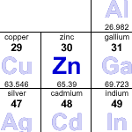
Why Zinc?
[Ar] 4s²3d¹⁰
No LFSE
Border line H-S acid
Not redox active
Labile

Slide 5
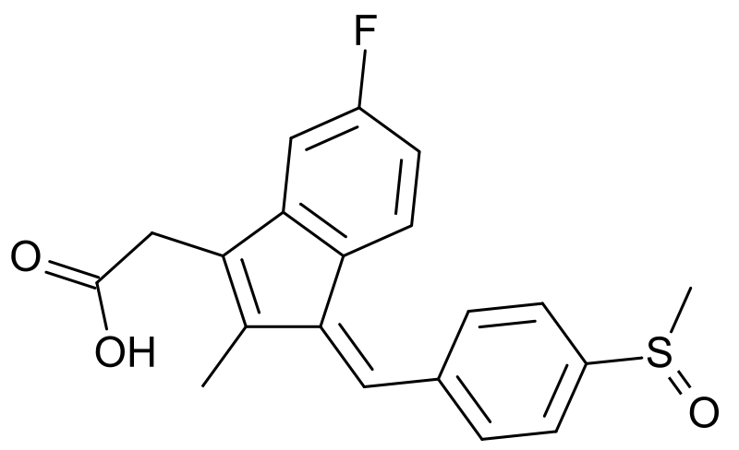
Carboxylic acids
Valproic acid
Naproxen
Sulindac
Ibuprofin
Indomethacin
Diclofenac

Slide 6
Nitrogen donor ligands

Slide 8
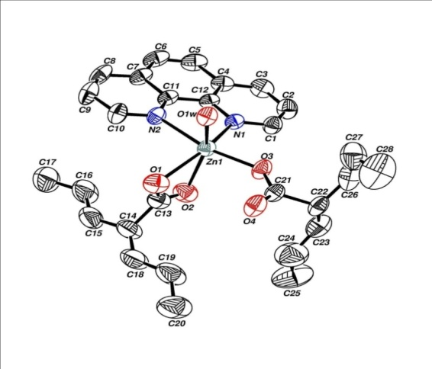
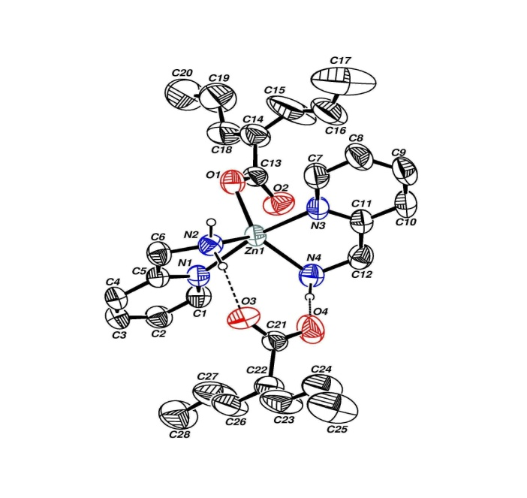
Table 1: In-vitro anti-bacterial activity data of complexes 2 and 3.
 | Diameter of zones showing complete inhibition of growth (mm)ª
 | 2 | 3 | valp | ZnCl₂
M. luteus | 21.3 ± 1.2 | - | - | -
S. aureus | 17.8 ± 2.2 | 12.3 ± 2.1 | - | -
B. subtilis | 18.0 ± 1. 6 | 9.5 ± 0.7 | - | -
E. coli | 22.0 ± 1.6 | 10.0 ± 1.0 | - | -
K. pneumoniae | 21.6 ± 2.6 | 10.5 ± 0.7
P. mirabilis | 27.4 ± 2.5 | -
a: The data stated as average ± standard deviation (N = 3), the concentration was 10 mmol/L in DMSO, - dashes indicated zero inhibition, all microorganisms were resistant to DMSO.
2
3
Abu Ali, H.; Darweesh, M.; Rappocciolo, E. Polyhedron 2013, 61, 235.

Slide 9
Table 2: In-vitro anti-bacterial activity data at different concentrations and the MIC values of complexes 2 and 1,10-phenª.
 | Complex 2 |  |  |  | 1,10-phen
 | 10^{b} 5^{b} 2.5^{b} MIC^{c} |  |  |  | 10^{b} 5^{b} 2.5^{b} MIC^{c}
M. luteus | 22 | 17 | 9 | 2 | 30 | 26 | 18 | 0.6
S. aureus | 18 | 15 | 11 | 0.8 | 26 | 19 | 11 | 0.8
B. subtilis | 18 | 15 | 10 | 0.8 | 27 | 23 | 18 | 0.3
E. coli | 22 | 18 | 13 | 1 | 29 | 24 | 19 | 0.6
K. pneumoniae | 20 | 15 | 10 | 1 | 27 | 22 | 17 | 0.6
P. mirabilis | 30 | 23 | 16 | 1 | 33 | 28 | 20 | 0.6
a: The data are the rounded average of two trials, all microorganisms were resistant to DMSO. The parent ligand valproate did not show anti-bacterial activity at 10 mmol/L. b: Inhibition zone diameter (mm) at three different concentrations 10, 5 and 2.5 mmol/L in DMSO. c: MIC: minimum inhibition concentration (mmol/L).

Slide 10
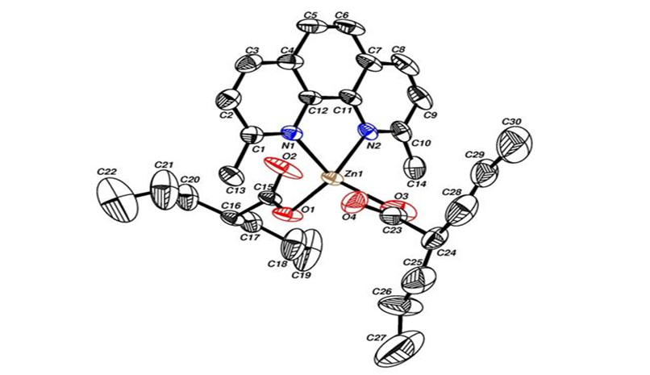
5
Fig 1. Antibacterial activity of Complex 5 at different concentrations.
Fig 2. Antibacterial activity of 2,9-dmphen at different concentrations.
MIC
Notes:
2

Slide 11
Fig 3. MIC values of complex 5 and 2,9-dmphen
Darweesh, M.; Abu Ali, H.; Rappocciolo, E.; Abuhijleh. A. Latif; Akkawi, M.; Jaber, S.; Maloul, S.; Hussein, Y.
E. J. Med. Chem. 2014, 82, 152.
Notes:
MIC 2

Slide 12
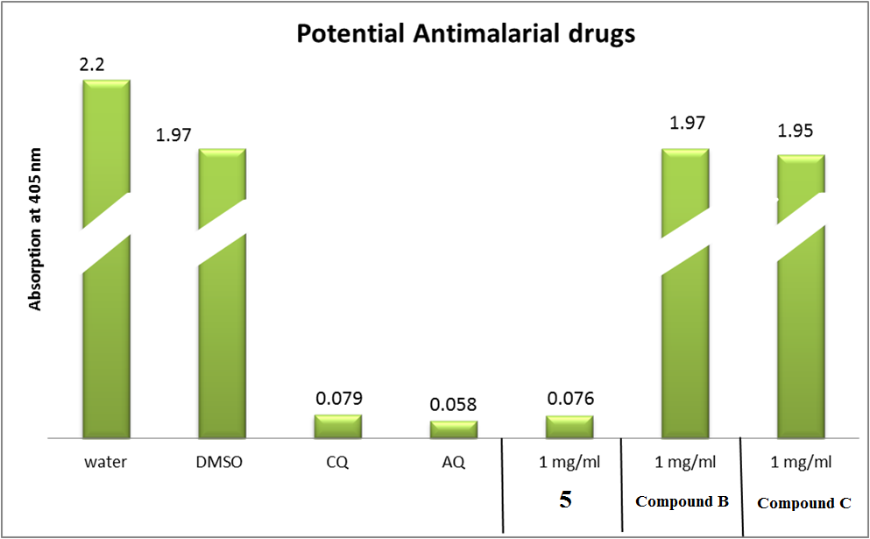
In-vitro testing for anti-malarial activity using Semi-Quantitative method
5
Fig. 4: Column diagram representing Semi-Quantitative test results of potential anti-malarial drugs (complex 5): Zn(valp)₂-2,9-dimethyl-1,10-phenanthroline, (compound B): Zn(valp)1,10-phenanthroline, and (compound C): 1,10-phenanthroline, compared to Chloroquine, (CQ) and Amodiaquine, (AQ) as positive controls (0.1 mg/ml) while water and DMSO used as negative controls, absorption is inversely proportional to drugs efficiency, the lower the absorption is, the drug is considered to be more efficient

Slide 13
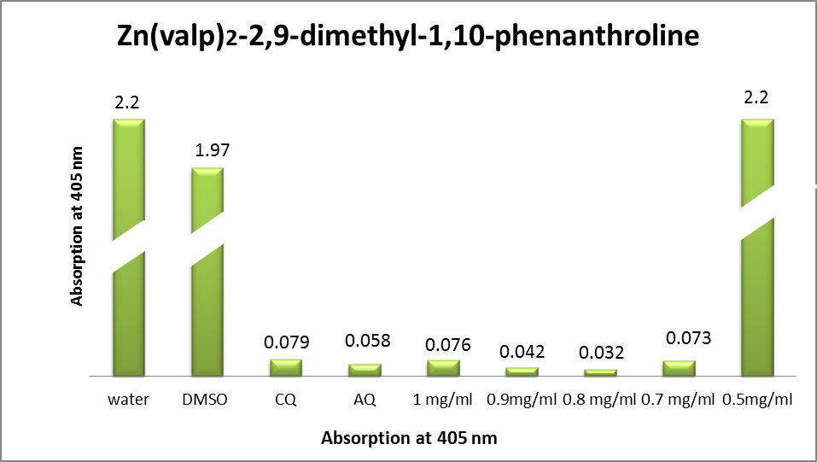
Fig. 5: Column diagram representing the efficiency of the complex, Zn(valp)₂-2,9 dimethyl-1,10phenanthroline compared to the negative and positive controls, showing the absorption values of dissolved β-Hematin (alkaline hematin) at 405 nm using ELISA reader, according to E. Deharo semi-quantitative method. The absorption is inversely proportional to drugs efficiency, the lower the absorption is, the drug is considered to be more efficient..

Slide 14
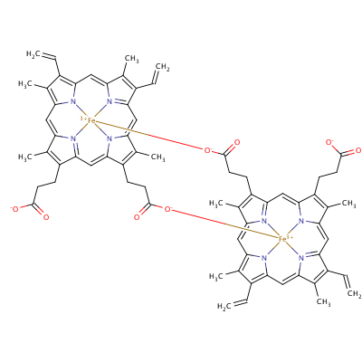
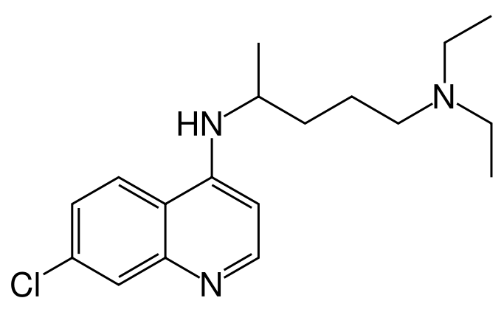
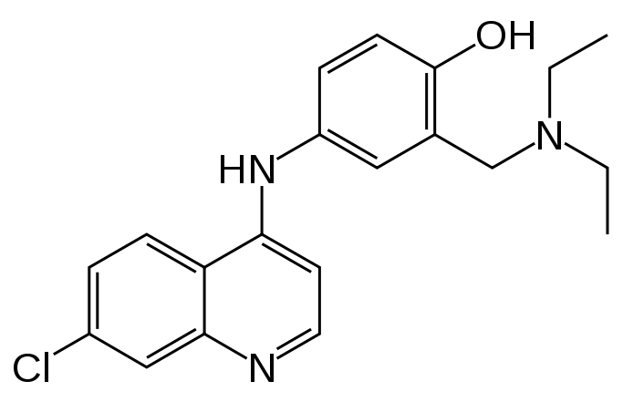
Chloroquine
Amodiaquine
β-Hematin

Slide 15
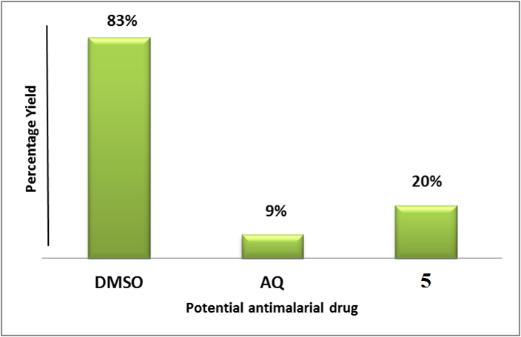
Fig. 6. Column diagram representing the percentage yields of complex (5): Zn(valp)₂-2,9-dimethyl-1,10-phenanthroline as potential anti-malarial drug, compared to Amodiaquine and DMSO at 0.4 mM. Yields are inversely proportional to drugs efficiency, the lower the yield is, the drug is considered to be more efficient.

Slide 16
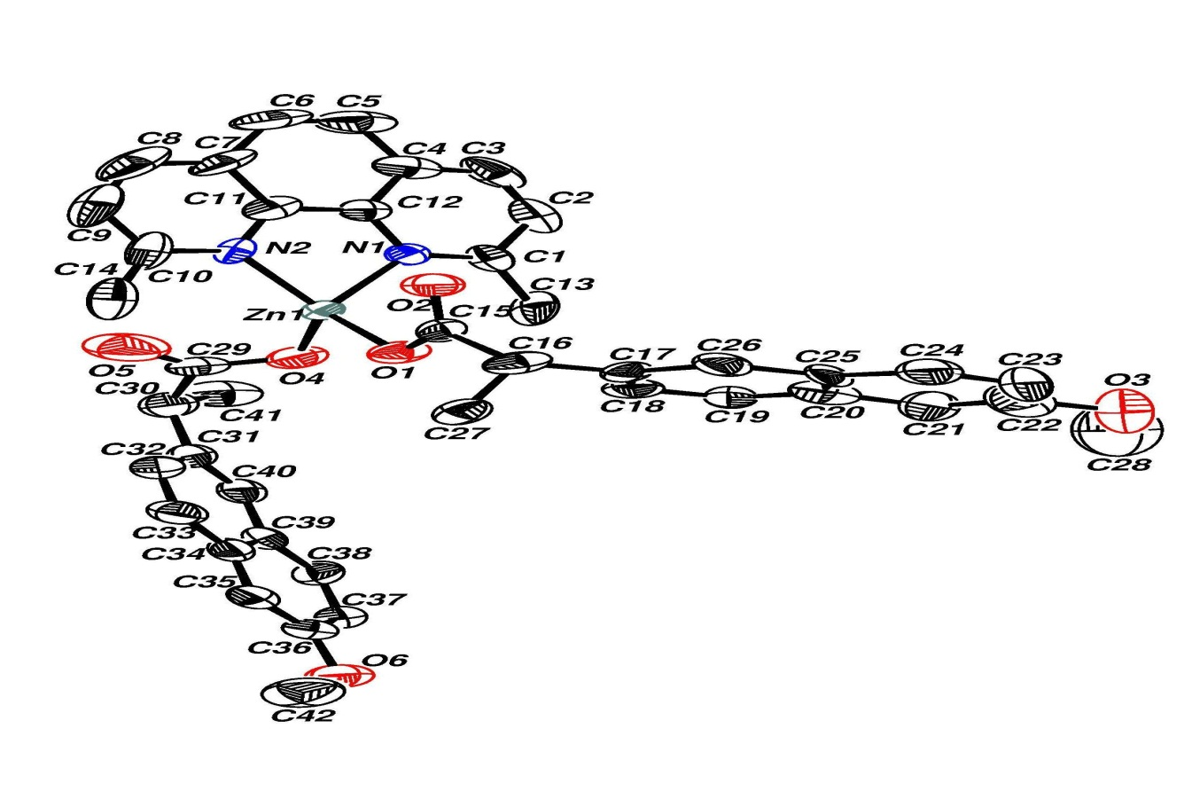
Table 3: Anti-bacterial activity data of complexes 4 in (mm)/8.5 mmol
Complex | M. luteus (G⁺) | S. aureus (G⁺) | P. aeruginosa (G⁻) | E. coli (G⁻) | K. pneumoniae (G⁻) | P. mirabilis (G⁻)
4 | 20.0 ± 1.5 | 20.0 ± 1.0 | ----------- | 7.7 ± 1.2 | 11.0 ± 1.2 | -------------
4
Abu Ali, H.; Fares, H.; Darweesh, M.; Rappocciolo, E.; Akkawi, M.; Jaber, S.
E. J. Med. Chem. 2015, 89, 67.

Slide 17
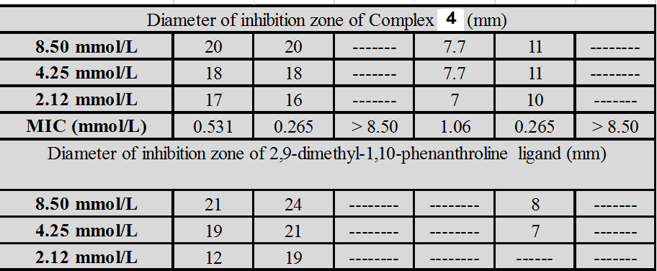
Table 4: In-vitro anti-bacterial activity data at different concentrations and the MIC values of complex 4 and its parent ligand.
M. luteus (G⁺) | S. aureus (G⁺) | P. aeruginosa (G⁻) | E. coli (G⁻) | K. pneumoniae (G⁻) | P. mirabilis (G⁻)

Slide 18
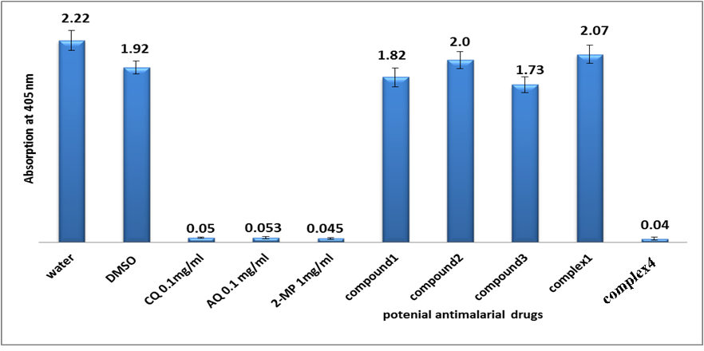
Fig. 7: Column diagram representing Semi-Quantitative test results of potential anti-malarial drugs, (compound 1): Zn(nap), (compound 2): 1,10-phenanthroline, (compound 3): 2,9 dimethyl-1,10-phenanthroline (complex 1): Zn(nap)1,10-phenanthroline and (complex 4): Zn(nap)-2,9-dimethyl-1,10-phenanthroline, all at concentration 1 mg/ml –dissolved in DMSO, compared to Chloroquine(CQ) Amodiaquine(AQ) and 2-mercaptopyramidine (2-MP) as positive controls, while water and DMSO were used as negative controls, absorption is inversely proportional to drugs efficiency, the lower the absorption is, the drug is considered to be more efficient.

Slide 19
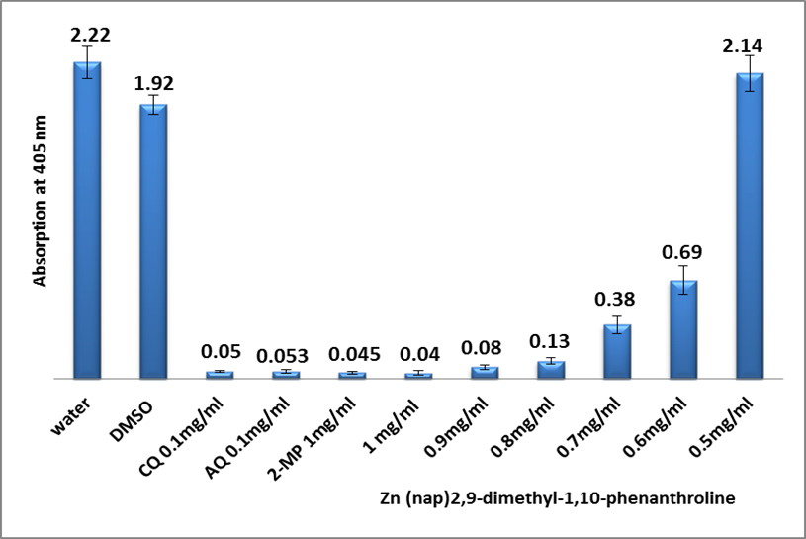
Fig. 8: Column diagram representing the Semi-Quantitative test results of potential anti-malarial drug Zn(nap)-2,9-dimethyl-1,10-phenanthroline dissolved in DMSO , compared to Chloroquine, Amidoquine and 2-mercaptopyrimidine as positive controls. while water and DMSO used as negative controls, showing the absorption values of dissolved β-Hematin (alkaline hematin) at 405 nm using ELISA reader, absorption is inversely proportional to drugs efficiency, the lower the absorption is, the drug is considered to be more efficient.

Slide 20
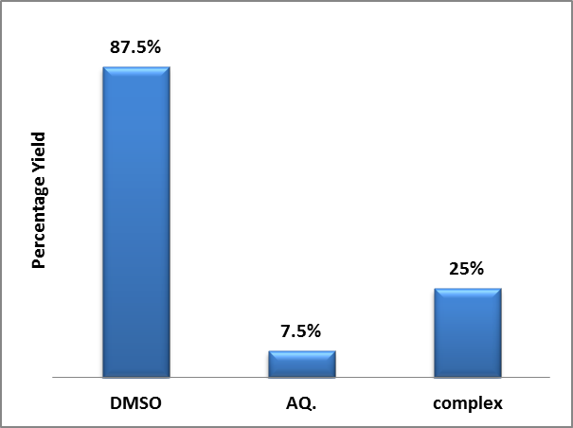
Fig. 9: Column diagram representing the percentage yields of complex: Zn(nap)-2,9-dimethyl-1,10-phenanthroline as potential anti-malarial drug, compared to Amidoquine and DMSO at 0.4 mM. Yields are inversely proportional to drugs efficiency, the lower the yield is, the drug is considered to be more efficient.

Slide 21
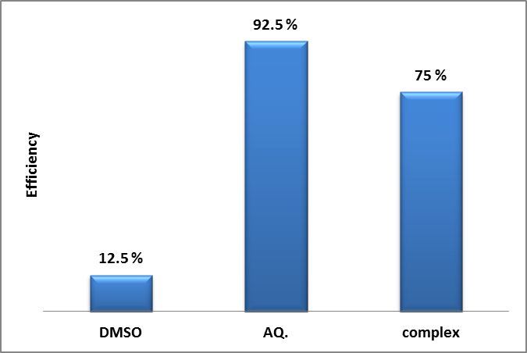
Fig. 10: Column diagram representing the efficiencies of potential anti-malarial drug, complex; Zn (nap)-2,9-dimethyl-1,10-phenanthroline compared to Amidoquine, all at a concentration of 0.4 mM.

Slide 22
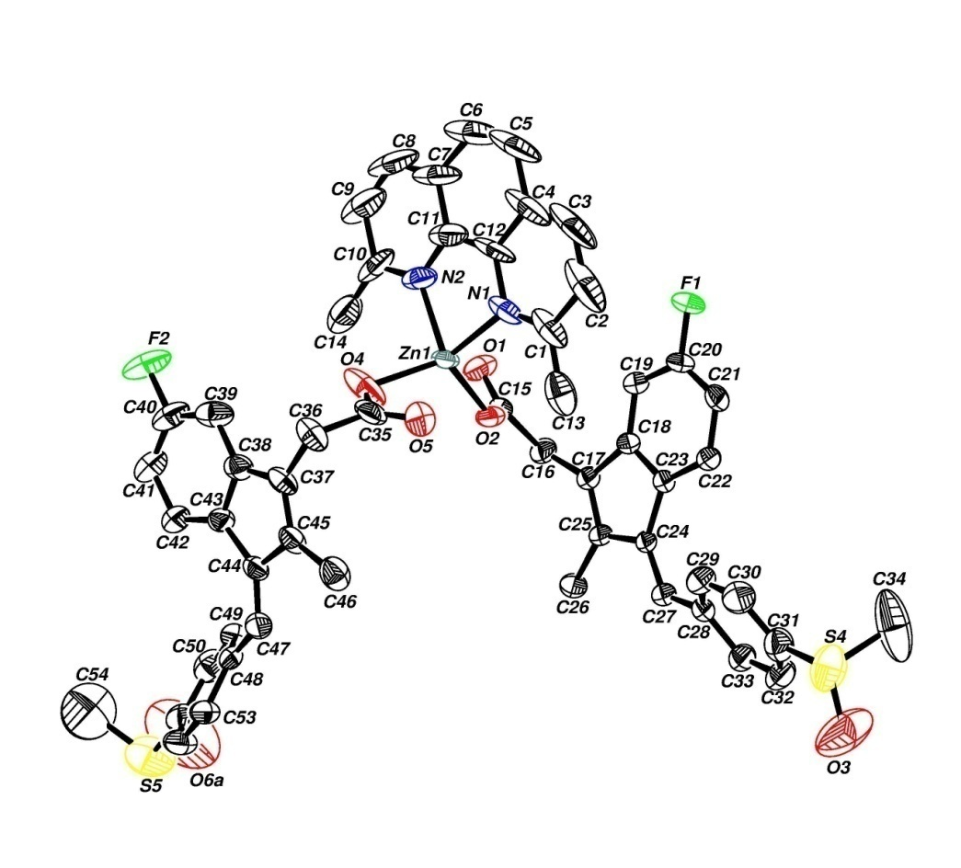
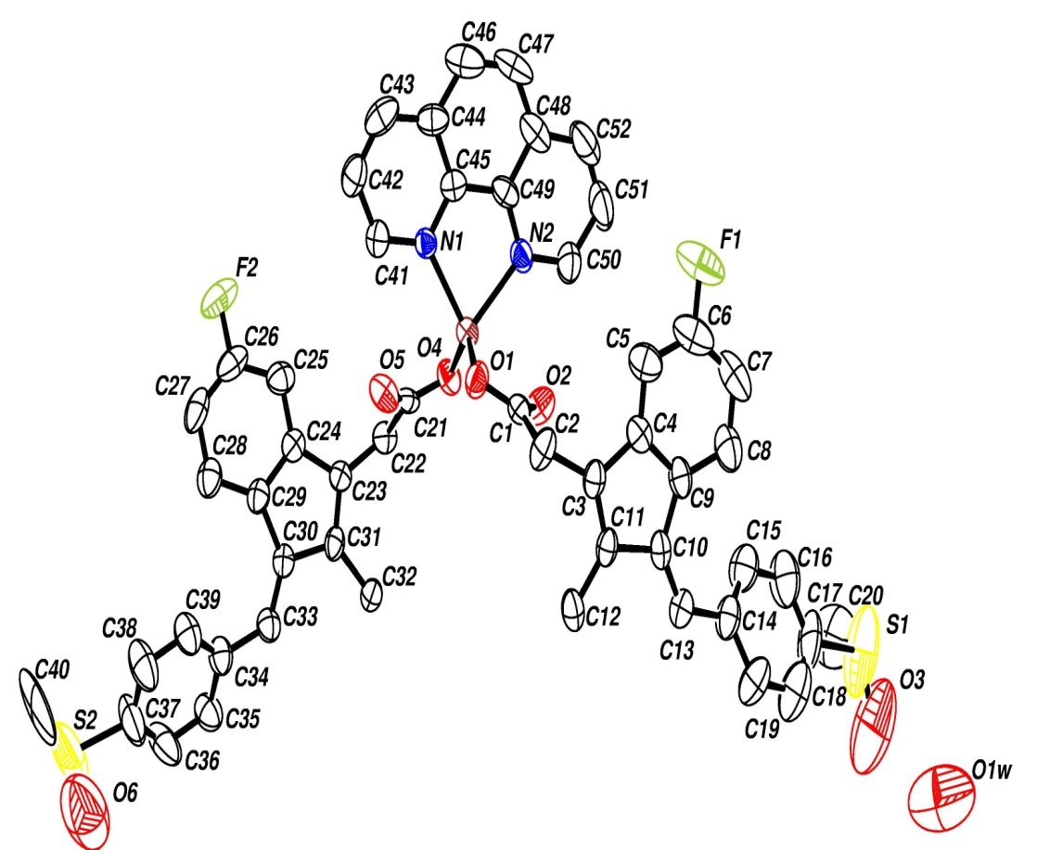
Cobalt-sulindac complexes
6

Slide 23
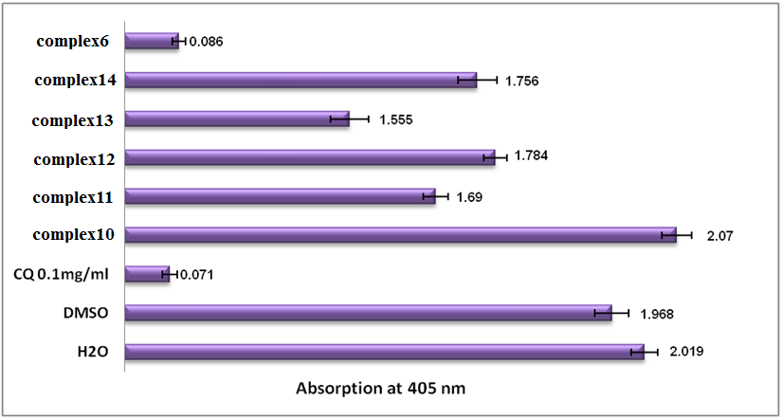
Fig. 11: Column diagram representing Semi-Quantitative test results of potential anti-malarial drugs, complex10 Zn(Sulindac)1,10-phenanthroline, complex11 Zn(Sulindac) in MeOH, complex12 Zn(Sulindac)₂,aminopy complex13 Zn(Sulindac)₂,2-amino methylpy, complex14, Zn(Sulindac) 1,2-dimethyl imidazole, complex6 Zn(Sulindac)2,9-dimethyl-1,10-phenanthroline, all at concentration 1mg/ml –dissolved in DMSO, compared to Chloroquine(CQ as positive control, while water and DMSO were used as negative controls, absorption is inversely proportional to drugs efficiency, the lower the absorption is, the drug is considered to be more efficient.

Slide 24
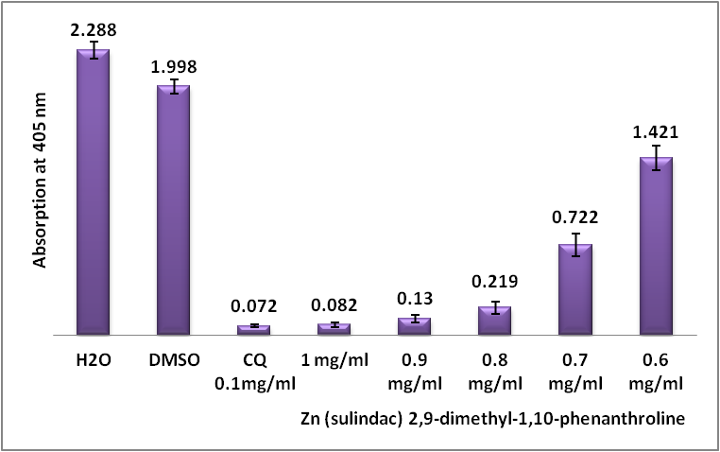
Fig. 12: Column diagram representing the Semi-Quantitative test results of potential anti-malarial drug Zn(Sulindac)₂2,9-dimethyl-1,10-phenanthroline dissolved in DMSO, compared to Chloroquine as positive control. while water and DMSO used as negative controls, showing the absorption values of dissolved β-Hematin (alkaline hematin) at 405 nm using ELISA reader, absorption is inversely proportional to drugs efficiency, the lower the absorption is, the drug is considered to be more efficient.

Slide 25
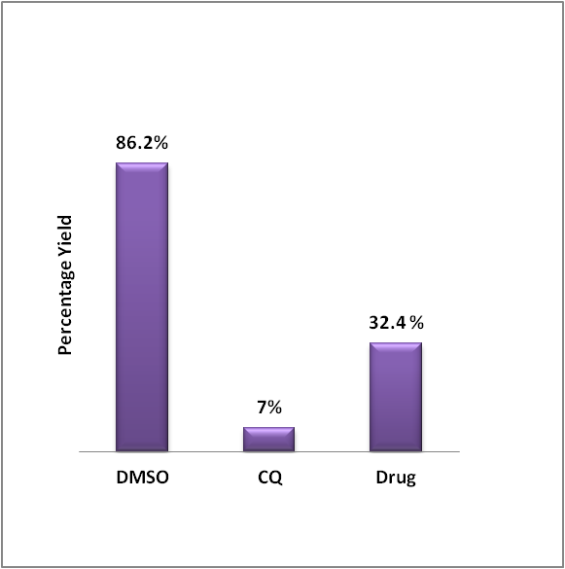
Fig. 13: Column diagram representing the percentage yields of the complex: Zn(sulindac)₂2,9-dimethyl-1,10-phenanthroline as potential anti-malarial drug, compared to Chloroquine and DMSO at 0.4 mM. Yields are inversely proportional to drugs efficiency, the lower the yield is, the drug is considered to be more efficient.

Slide 26
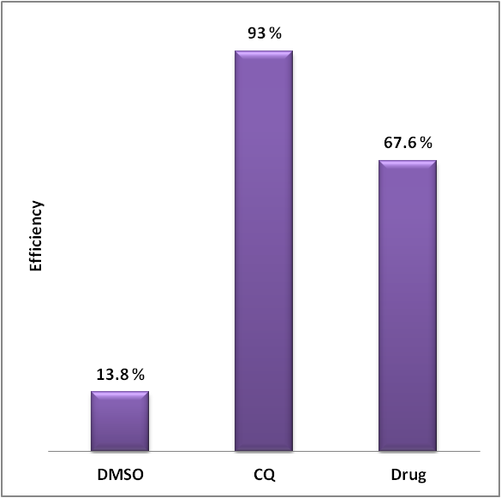
Fig. 14 : Column diagram representing the efficiencies of potential anti-malarial drug, complex; Zn(sulindac)₂2,9-dimethyl-1,10-phenanthroline compared to Chloroquine, all at a concentration of 0.4 mM.

Slide 27
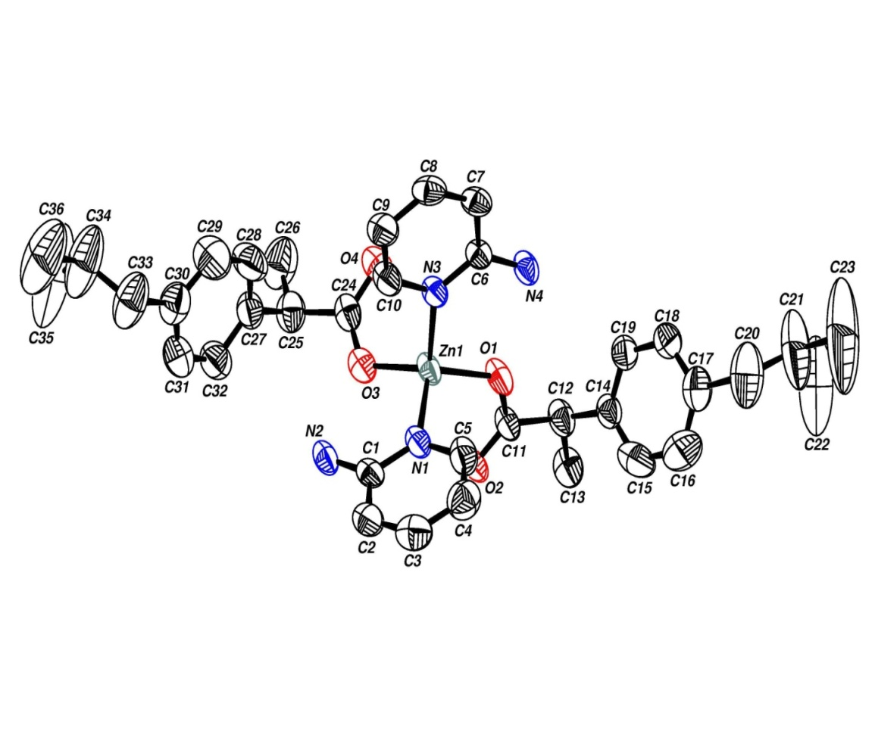
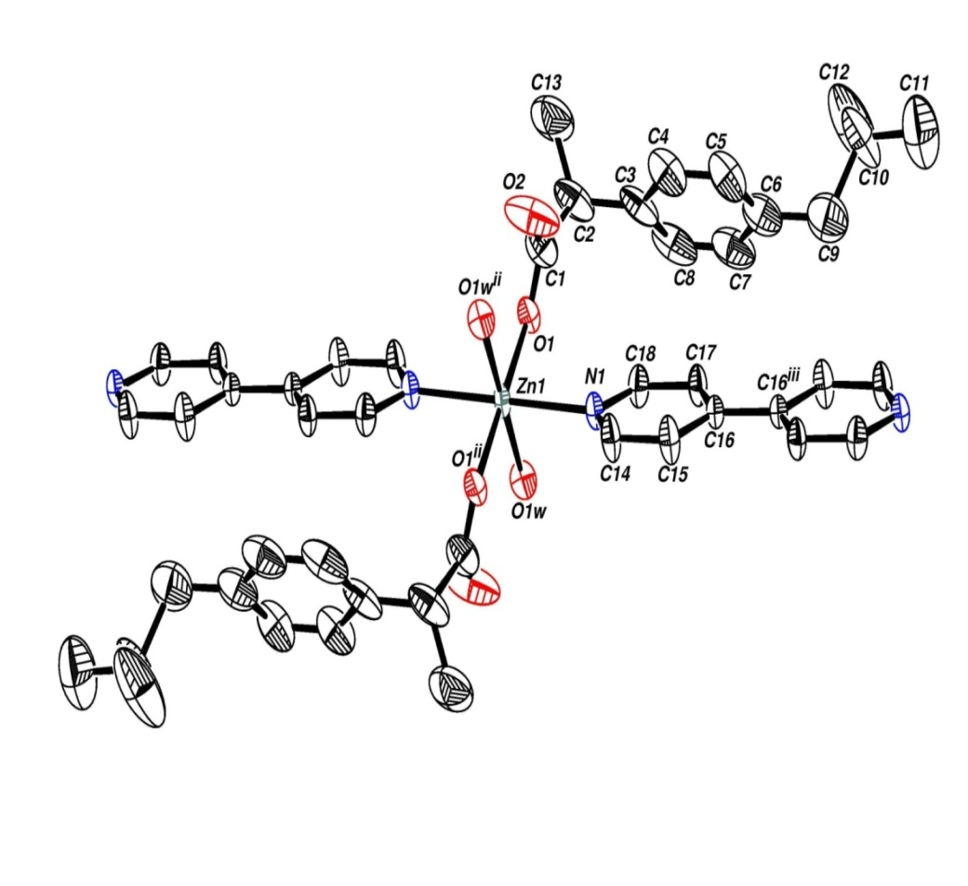
Ibuprofen complexes

Slide 28
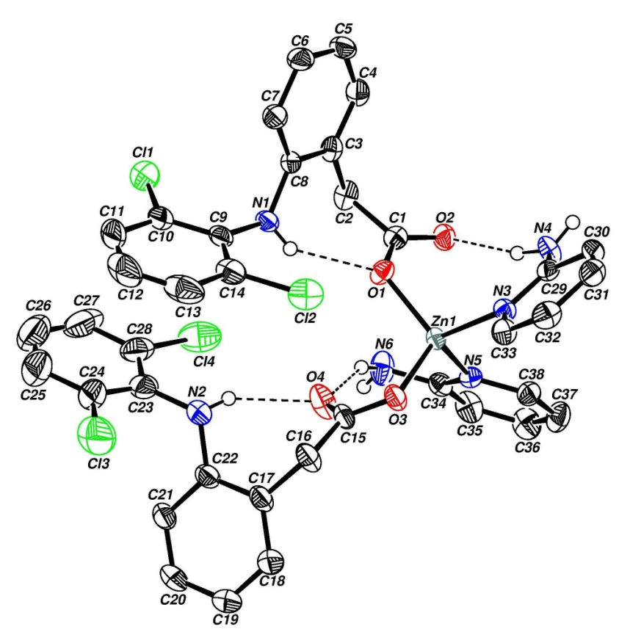
Diclofenac complexes

Slide 29
