Slide 1

August 17, 2015
World Drug Delivery Summit 2015
Keynote Forum
Development of nanoDDS for DNA：
Analysis, control of the intracellular trafficking
and beyond…
Faculty of Pharmaceutical sciences,
Hokkaido University
Hidetaka Akita
Notes:
Thank you chairman. First of all, I would like to express my sincere thanks to the organizing committee to give me a chance to make a keynote lecture. And I’m so honored to have this opportunity. It is my first time to have a keynote lecture, especially in English. This two weeks, I’m so nervous. But, I’ll try my best to attract you to our research.
Today, I’ll talk about the development of DNA carrier. Especially, we focus on the importance of the control of intracellular trafficking and, further challenges

Slide 2





21st century:
Paradigm shift of medical product
Protein
Genes
mRNA
Low-molecular
compounds
Antibody
Nucleic Acids
1-1
1000
1800
2000
B.C.E
C.E
Year
Notes:
Now, in the 21th century, a category of medicine is now widely expanding from low-molecular drugs to macromolecules such as the recombinant protein, antibody, nucleic acids, and genes.

Slide 3
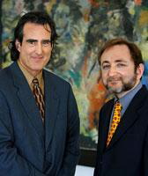
21st century:
Paradigm shift of medical product
1998
2004
Discovery of RNAi
Macugen® (Aptamer)
Pfizer
Age-related maculopathy
Protein
Protein
2013
Genes
mRNA
Nucleic Acids
Low-molecular
compounds
Kynamro® (Antisense）
Isis Pharmaceuticals, Inc.
Familiar hypercholesterolemia
Low-molecular
compounds
Antibody
Antibody
Dr. Andrew Fire
Dr. Craig Mello
2006 Nobel Prize in medicine and physiology
Nucleic Acids
1-1
1000
1800
2000
B.C.E
C.E
Year
Notes:
Now, in the 21th century, a category of medicine is now widely expanding from low-molecular drugs to macromolecules such as the recombinant protein, antibody, nucleic acids, and genes.
Especially, in the end of 20th centry, RNAi phenomena was discovered, and the discoverers won a nobel Prize. Now, the development of nucleic acid-based medication is a hot topic in world’s pharmaceutical company and bio-venture companies.

Slide 4
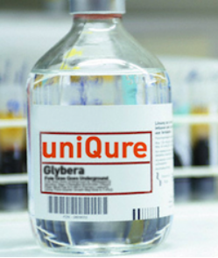
21st century:
Paradigm shift of medical product
2012
First gene-based medication
European Medical Agency (EMA)
Glybera®
（Adeno-associated virus）
uniQure
Lipoprotein lipase deficiency
(LPLD)
1998
2004
Discovery of RNAi
Macugen® (Aptamer)
Pfizer
Age-related maculopathy
Protein
2013
Genes
mRNA
Nucleic Acids
Low-molecular
compounds
Kynamro® (Antisense）
Isis Pharmaceuticals, Inc.
Familiar hypercholesterolemia
Antibody
Dr. Andrew Fire
Dr. Craig Mello
2006 Nobel Prize in medicine and physiology
Nucleic Acids
1-1
1000
1800
2000
B.C.E
C.E
Year
Notes:
While the gene therapy approach has faced technical and/or regulatory impediments, a large number of clinical trials are still ongoing worldwide. One crucial success is the first approval of the viral gene-medicine, Glybera® (UniQure) by the European Medicinal Agency (EMA). While success is now limited to ultra-orphan situation, this historical achievement promises to reinforce the scientific community to realize the significance of the gene therapy.

Slide 5
Paradigm shift of medical products
Discovery of siRNA
1953 Drs. Watson and Crick
Elucidation of DNA structure
Opening of Molecular Biology
Discovery of
restriction
enzymes
Invention of
hybridoma
preparation
Completion of
the map of the
human genome
Invention
of PCR
・・・・・1950
1960
1970
1980
1990
2000
In early of 1800s Purification of morphine
Beginning of the
research on
antibody drug
First research on
Gene Therapy
Beginning of the
research on
siRNA Drugs
Low Molecular-Drugs
1880～
Prophylactic immunization
Success of serum therapy
DNA vaccine
Antibody Drugs
ＤＮＡ
Protein Drugs
（Growth Factors etc…）
Vaccine
siRNA
Category of medicine is expanding
from low-molecular compounds to high-molecular weight molecules
Requirements in DDS (Drug delivery system)
Control of pharmacokinetics
in the body
Control of pharmacokinetics in the body
+ Control of intracellular trafficking
Notes:
In this trend of the times, more high-level technology is now required in the research field of drug delivery system. Previously, control of pharmacokinetics is a main issue when we consider the delivery of a low molecular drugs. However, recently, especially for the delivery of DNA and siRNA, control of intracellular trafficking become additional mission.

Slide 6
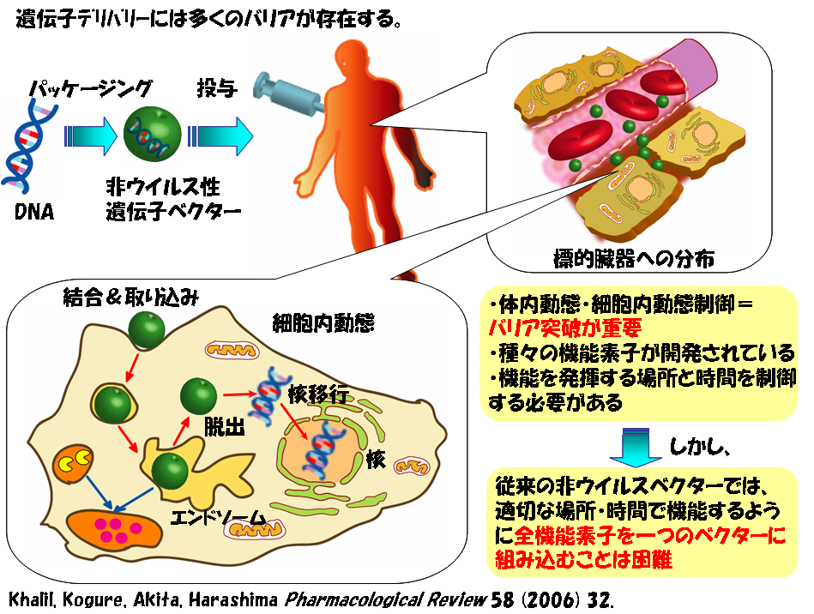
For the development of novel gene/siRNA delivery
Administration
Packaging
Non-viral
Gene/siRNA vector
DNA
Pharmacokinetics in the systemic circulation
Cellular Binding & Uptake
Nuclear delivery
Control of pharmacokinetics
･Targeting of organ
･Stability in systemic circulation
→Improvement of tissue selectivity
Escape
Nucleus
Control of intracellular trafficking
･Cellular uptake
･Endosomal escape
･Cytoplasmic transport
･Nuclear delivery
→Improvement of the function of vector
Endosome
Control of intracellular trafficking
Khalil IA. et al. Pharmacological Review (2006) 58: 32-45
Notes:
For example, when we consider the in vivo application of gene delivery via i.v., we need to control the pharmacokinetics, that is targeting or stability. As well as the pharmacokinetics, intracellular trafficking must taken into the consideration; cellular uptake, endosomal escape and nuclear delivery. How are we to meet these criteria? It is crucial topic in the research field of DDS.

Slide 7
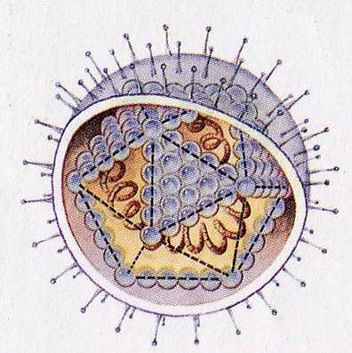
Multifunctional envelope-type nano device （MEND）
Condensed DNA
Lipid envelope
Targeting ligand
pH-Sensitive fusogenic peptide
(Pharmacokinetics)
Tissue targeting
(Intracellular trafficking)
Endosomal escape
Envelope-type virus
(i.e. Influenza)
Polycation
Protein transduction domain peptide (R8)
PEG-lipid
(Pharmacokinetics)
Stability in systemic circulation
(Intracellular trafficking)
Cellular uptake
Functional elements
Hydrophobic group
Functional peptide etc…
The structure is advantageous to integrate various devices with topology control such that each devices represents its function at appropriate place and appropriate timing.
Kogure et al., J Control Release (2004)98: 317-323
Kogure et al., J Contol Release (2007)122: 246-251
Notes:
In our laboratory, we are developing a liposomal nanoparticle that encapsulated the pDNA or siRNA. This particle design (has great advantage to integrate )is reasonable since it can integrates various types of the functional devices onto the lipid envelope structure. My major concern is how we can control the intracellular trafficking of the nanoparticles.
または
This particle design has great advantage to various types of the functional devices

Slide 8
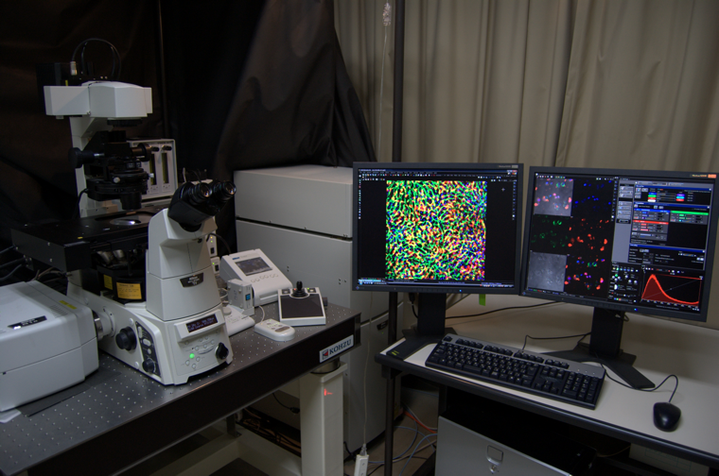
Concept: Development of artificial gene vectors based on the comparison of
intracellular trafficking with viral vector
Intracellular space is black box
“What is going well??” and “What is bad??”
Virus
Non-viral
vector
Feedback for the development
of gene carriers
??
Nucleus
効率的な
核輸送
Effective
Nuclear delivery
Imaging
(Sensing)
Quantitative analysis of the intracellular distribution
⇒ Confocal laser scanning imaging (CLSM)
Akita et al., Mol Ther (2004), Hama et al. Mol Ther (2006)
Hama et al., Nucleic Acid Res (2007)
Analysis of the microtubule-dependent and/or vesicular of plasmid DNA
⇒ Multi-color real-time imaging
Akita et al., Mol Ther (2010), Akita et al. Mol Ther (2013)
Analysis of the dispersity of nanoparticle and intra-nuclear disposition
⇒ Single molecular (particle)-imaging
Akita et al., Nucleic Acid Res (2011)
・Which process?
・To What extent?
・Why?
Comparison
with virus
Notes:
Another view point of my research is an imaging of intracellular trafficking of nanoparticle. As you know, in parallel with a revolution of life during past hundreds of million of years, viruses have evolved and developed an elegant machinery to deliver their genome DNA into the nucleus. If we can understand why and to what extent current non-viral vectors are inferior to the viral ones, the information is quite valuable information towards the development of the next generation of gene carrier. We introduced a various types of imaging equipment to analyze an intracellular.

Slide 9
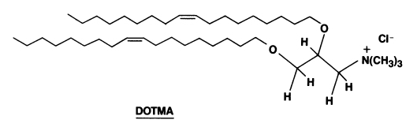
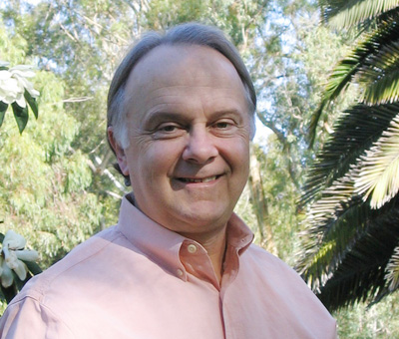
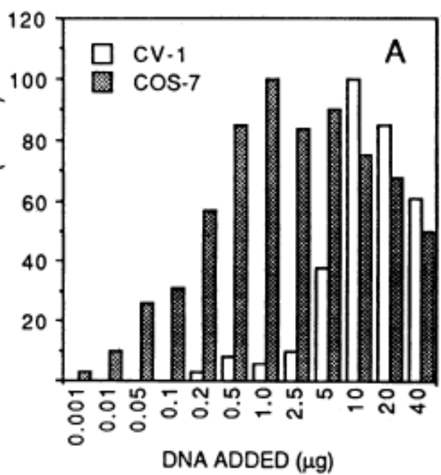
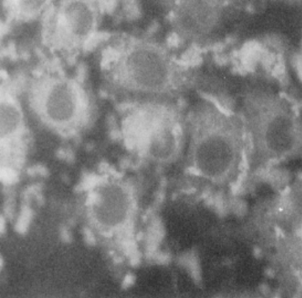
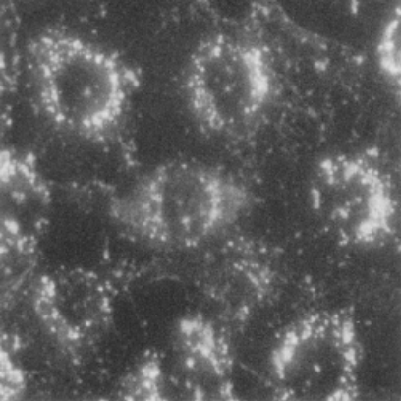
The first gene transfer by cationic lipid
● 1987 First report on gene delivery by using Cationic lipid（DOTMA）
DOTMA
N-[1-(2,3,-dioleyoxy)propyl]-N,N,N-trimethylammonium chloride
Dr. Philip L Felgner
Transfection activity of Lipid-DNA complex
Uptake of Lipid-DNA complex
DOTMA：DOPE=1：1
DOTMA：DOPC=1：1
Transfection activity
(% vs max)
5 ug of lipid-DNA complex labeled with
1% Rho-DOPE. ( 4 hr after transfection)
Felger PL et al. PNAS 84: 7413-17 (1987)
Notes:
Since the first success of the gene delivery using a cationic liposomes by Dr. Felger’s group, many types of cationic liposomes or polymers were developed as a DNA carrier.
The rational strategy to overcome this drawback is to condense DNA with cationic liposomes. World’s first demonstration was reported by Dr, Felgner in 1987.

Slide 10
Quantitative comparison of the intracellular disposition
between adenovirus and lipoplex
Viral :
Adenovirus vector
Non-viral :
Cationic Lipoplex
(LipofectAMINE PLUS)
cationic liposome
fiber
Penton base
+
+
+
core
+
+
DNA
+
+
-
DNA
+
+
+
hexon
+
-
-
+
+
-
DNA-bound
-
-
+
+
-
-
+
+
+
Stabilizing
+
mu
-
-
-
+
+
Ⅶ
Ⅲa
+
+
+
+
+
+
Ⅹ
Ⅵ
+
+
Terminal
Ⅸ
+
+
Ⅷ
+
90 nm
Hama et al. Mol Ther (2006)
Notes:
First, let me briefly summarize my previous research concerning a quantitative comparison with the intracellualr disposition of adenovirus and lipoplex, that is lipofectamine PLUS since the result of this analysis is closely related to our current concept or design of our carrier. (7min)

Slide 11
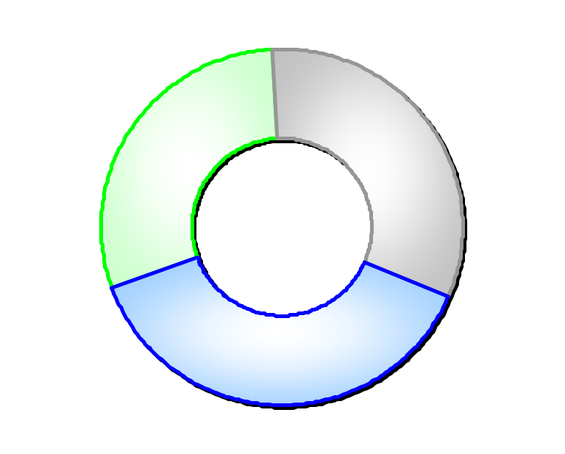
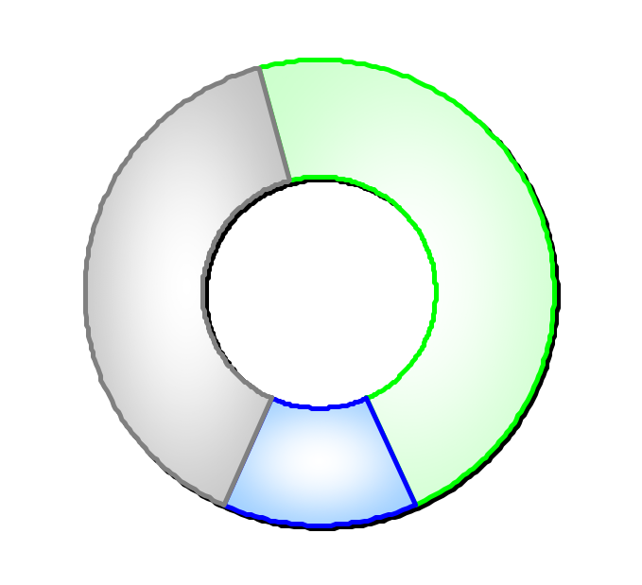
Quantitative comparison of intracellular trafficking between Ad and LFN
Dose
Ad
Lipoplex
Dose
3000 fold
200 copies/cell
6.7×10⁵
copies/cell
extracellular
intracellular
end/lys
30.3 %
cyt
33.1 %
end/lys
47.4 %
Total uptake
cyt
39.1 %
Total uptake
20
3.0×10⁵
copies/cell
copies/cell
Cytoplasm
nuc
36.6 %
nuc
13.5 %
expression
expression
5.3×10⁵
nucleus
nucleus
3.7×10⁵
RLU / mg protein
7.3
4.1×10⁴
RLU / mg protein
copies/cell
copies/cell
Nucleus
Post-nuclear delivery process
Post-nuclear delivery process
7.3×10⁴
8100 fold
9.0
RLU / mg protein/copy
RLU / mg protein/copy
Hama et al. Mol Ther (2006)
Notes:
The summary of my result is shown here, First, to exhibit the comparable gene expression, LFN needs approximately 3-thousand larger amount of pDNA. In other word, the transfection efficiency of adenovirus per 1 copies of genomic DNA was 3 order of magnitude higher than those of plasmid DNA. In contract, the nuclear distribution of the adenovirus seems to be only 3-fold higher than pDNA. This result means that the difference of the large difference in transfection efficiency cannot explained in terms of the intracellular trafficking. Collectively, lower transfection efficiency of LFN was dominantly rate-limited by the post-nuclear delivery process.
An important question is why the transcription and/translation activity is poor in lipoplex.

Slide 12
Development concept
A neutral envelope-type nanoparticle containing pH-responsive and
SS-cleavable lipid-like materials
Cationic liposomes and polymers
Hama et al. Mol Ther. (2006)
Hama et al., Nucleic Acids Res. (2007)
Neutral
-Exclusion of
cationic components-
Akita et al. Adv Healthc Mat. (2013)
Cationic !!
Post-nuclear
delivery
Cellular
uptake
Cellular
uptake
Post-nuclear
delivery
Cellular uptake (Good)
Cellular uptake (Poor)
Minimum charge ratio
Endosome
Endosome
Collapse
Protein
Release (Poor)
Protein
Cationic
components
inhibition
Low cationic components
Translation
(Poor)
Decapsulation
(Good)
Translation
(Good)
inhibition
AAA
AAA
mRNA
DNA
mRNA
DNA
Minimum charge ratio
Transcription
(Poor)
Transcription
(Good)
Nucleus
Release(Poor)
Nucleus
Decondensation
(Good)
Notes:
Today, time is limited. Thus, we just show the answer of this queston. We have commonly used the cationic vector under the assumption that catioic charge is a crucial driving force for the cellular uptake of the particle. However, our data correctively showed that the cationic materials sometimes inhibit the transcripton process and translation processes by the electrostatic interaction between the cargo DNA or mRNA, respectively.
To overcome this drawback, we are currently developing a nanoparticle which are designed to be neutral in the physiological pH in cytoplasm to avoid the electrostatic interaction with mRNA, and to be actively degradable for the effective decapsulating of pDNA.
Also, the cationic charge is an key driving force for the endosomal escape. Thus, the particles are designed to be charged positive in acidic pH in endosome/lysosome.
没
Collectively, an improvement in nuclear or maybe cytoplasmic release, and the diminution of the interaction between vector and mRNA is essential for the development of new generations of non-viral vectors. How we can accomplish these issues?
12

Slide 13
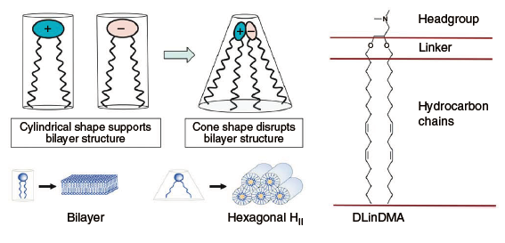
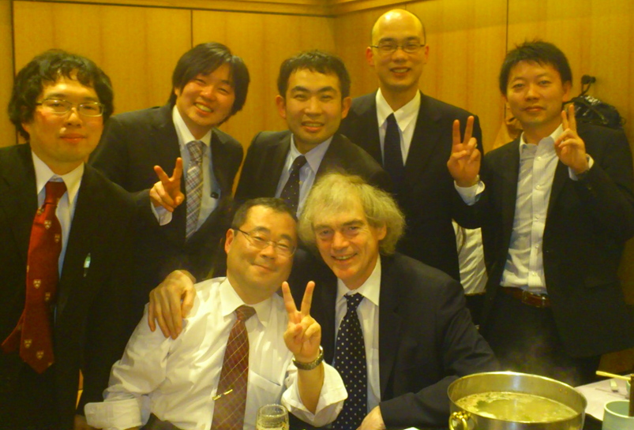
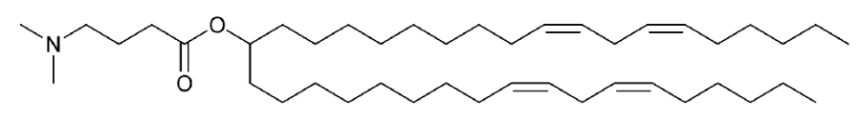
SNALP
～Neutralized particles formed with ionizable aminolipids
Rational design of cationic lipids for siRNA delivery
Nat Biotechnol. 28(2):172-6 (2010)
Dr. Y. Yamada
(Tomorrow, Track1)
Dr. H. Hatakeyama
(MD. Anderson
cancer center)
Akita
Maximizing the Potency of siRNA Lipid Nanoparticles for Hepatic Gene Silencing In Vivo
Angew Chem Int Ed Engl.51: 1-6 (2012)
Dr. H. Harashima
Dr. P. Cullis
DLin-MC3-DMA
March 2012 (Sapporo)
Notes:
To overcome this drawback, we are currently developing a nanoparticle which are designed to be neutral in the physiological pH by using a ionizable materials.
As you know, Prof. Cullis and their collaborators are pioneers for the gene or siRNA delivery by means of neutralized particles using ionizable aminolipid.
SNALP technology is one of the most promissing carrier.
.

Slide 14
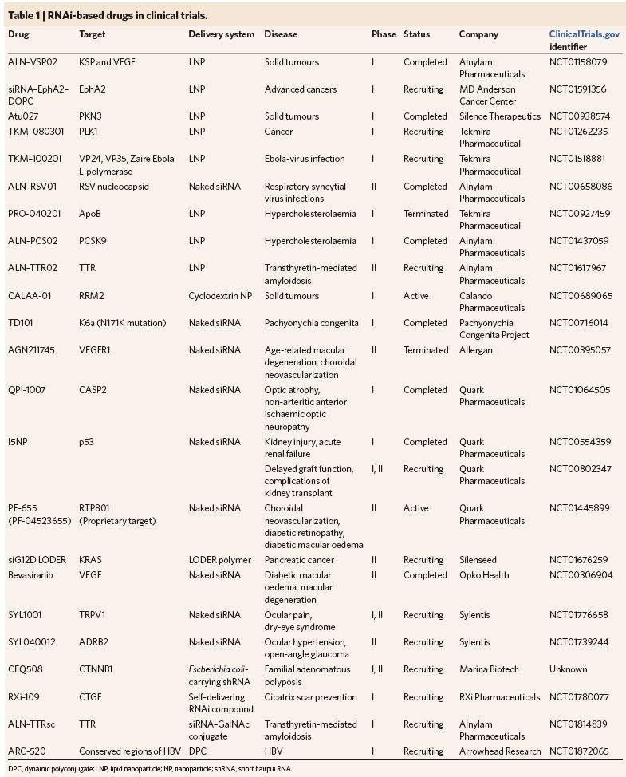
RNAi-based drugs in clinical trials.
Kanasty R et al. Nature Materials
12: 967-977 (2013)
Notes:
In fact several clinical trials are ongoing

Slide 15
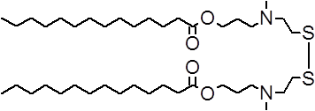
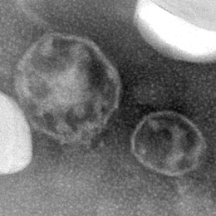
Design of lipid-like surfactant responsive
to the low pH and reductive environment
ss-cleavable Proton-Activated
Lipid-like Material (ssPalm)
(endosome)
(cytoplasm)
1st generation：fatty acid
Neutral Charge
Disulfide bonding
Cleavable unit in reductive environment(Cytoplasm)
_{PEG}
Acidic pH
in cytoplasm
SS
Positive charging
⇒Driving force for
endosomal escape
ssPalmM
N N
SS
N
N N
SS
S
SS
N N
C₁₃H₂₇
（Myristic acid）
N N
SS
SS
S
N N
N N
N
SS
N N
Tertiary amines
Proton-sponge units(Endosome)
SS
SS
N N
N N
pＤＮＡ
Nucleic acid （siRNA）
(Negatively charged)
SS
Endosome
N N
Cytoplasm
Acidic environment
⇒Positive Charging
Reductive environment
Endosomal
Escape
Collapse
Nucleus
mRNA
knockdown
Gene
expression
100 nm
pDNA
siRNA
Akita H* and Ishiba R et al. Adv Healthc Mat. 2013
Notes:
As an alternative material, we recently developed a lipid like material where we refer to it as ss cleavable and pH-activated lipid like materials. This material have two hydrophobic chains in one molecule. This, materials can form a liposome-like envelope structure.
Also, this lipid-like material mounts dual sensing motifs that can response to the intracellular environments; two ternary amines as proton-sponge units which become charged positive in response to low pH environment in endosome for destabilization of the endosomal membrane, and another is disulfide bonding than can be cleaved in reductive environment in cytoplasm. By the cleavage of the disulfide bonding, the ssPalm with two-hydrophobic chains were converted into a product with one hydrophobic chain that functions as a surfactant. Thus, it triggers the destabilization of the envelope structure.

Slide 16
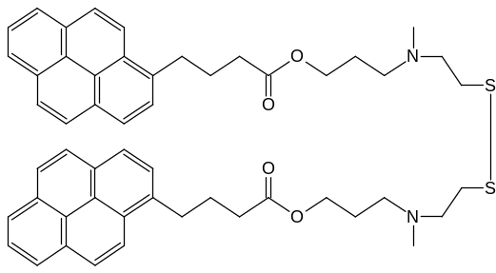
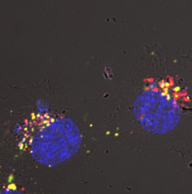
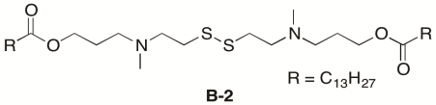
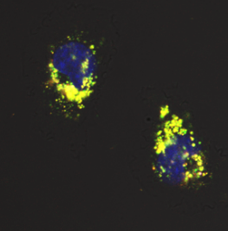
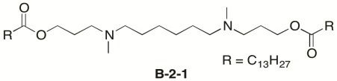
Tertiary amines
Proton-sponge units(Endosome)
Evaluation of the particle-collapse activity in reductive environment
SS-cleavage sensing probe (Pyrene-scaffold ssPalm)
Pyrene
PBS
Excimer(480 nm)
Monomer (370 nm)
N
S
SS
SH
10 mM
Glutathione
Reduction
Cleavage
N
S
Within
2 min
Within
16 min
Reductive
environment
Decay of
excimer formation
Dithiothreitol
334 nm
480 nm
370 nm
Decapsulation efficiency of pDNA in the cell (3 h)
**;p<0.01：
Non-parametric Mann-Whitney test
ssPalm
Tertiary amines
Proton-sponge units
**
1.0
0.8
0.6
Decapsulation efficiency(%)
Disulfide bonding
R＝C₁₃H₂₇
ccPalm
(Non-cleavable)
Tertiary amines
Proton-sponge units
0.4
0.2
Nucleus (Hoechst33342)
Lipid envelope(NBD)
pDNA (Rhodamine)
0
ssPalm
ccPalm
Akita H* and Ishiba R et al. Adv Healthc Mat. 2013
Notes:
To clarify the kinetics of the cleavage process cleavage, we synthesized a ssPalm in that pyrene was employed as a hydrophobic scaffold as a probe. When two pyrene molecule was linked by SS boding, the pyrene structure are fixed mutually in close proxy(‘)mity. In this situation, these units emit the red-shifted eximer fluorescence that are peaked at approximately 480 nm. However, when ss-bonding were cleaved, the intermolecular distance was increased by the lateral diffusion in lipid bilayer. Then, the eximer fluorescence decayed since the pyrene became to a monomer. When the particle was incubated in 10 mM GSH, the cleavage reaction was rapidly terminated within 20 min, while this reaction was slower than that measured in strong reductive reagent; DTT.
Furthermore, we evaluated an intracellular decapsulation process by visualizing a pDNA and lipid envelope structure by confocal laser scanning microscopy. When SS-bonding was replaced to the cc-bonding, the pDNA colored in red signals were colocalized with the envelope structure colored in green more extensively. This means the decapsulation process can acce(‘)lerated when we used ssPalm materials. Therefore, the SS-cleavage plays a key role in the acceleration of the release of pDNA.
14 min
没
Typically, cytoplasmic reduction by glutathione is a major driving force for the intracellular cleavage of SS-bonding.

Slide 17
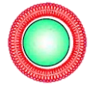
Physicochemical characters and in vitro transgene expression
Tertiary
amines
Cationic lipid
quaternary amine
in vitro translation
 | ssPalm | ccPalm | DODAP | DOTAP
Size (nm) | 156.3 | 150.3 | 151.1 | 235.8
PDI | 0.14 | 0.07 | 0.09 | 0.30
ξ-potential (mV) | -0.08 | +12.4 | -3.18 | +57.9
LNP_{ssPalm} or LNP_{DOTAP}
+
AAA
Luciferase mRNA
Rabbit
Retilulocyte
Lysate
Neutral
Cationic
Luciferase
activity
Cellular uptake
Gene expression
in vitro translation
**; p<0.01
**; p<0.01
**
10⁹
1.2
pDNA
pDNA
200
**
**
**
**
1.0
150
*
0.8
0.6
Uptake (Geo Mean: arbitrary unit)
Gene expression (RLU/mg protein)
Translation efficiency(% of control)
100
10⁸
0.4
**
50
0.2
**
0
10⁷
0
ssPalmM
DOTAP
ssPalm
ccPalm
DODAP
DOTAP
ssPalm
ccPalm
DODAP
DOTAP
Neutral
Cationic
Neutral
Cationic
Neutral
Cationic
Akita H* and Ishiba R et al. Adv Healthc Mat. 2013
Notes:
In this slide, we will show the in vitro activity. As a simple explanation, we just focus on the comparison between ssPalm and DOTAP, a conventionally used cationic lipid with quaternary amine. As shown here, the particle formed with ssPalm was quite neutral. Therefore, the cellular uptake in ssPalm is smaller than DOTAP. Nevertheless, the transfection activity was comparable between two groups. Therefore the less cellular uptake in ssPalm was complemented by the well-refined intracellular processesing.
In fact, the ssPalm shows marginal inhibitory effect against the in vitro translation reaction, while the cationic particle impaired so drastically.
（ここまで6分）

Slide 18
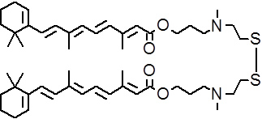
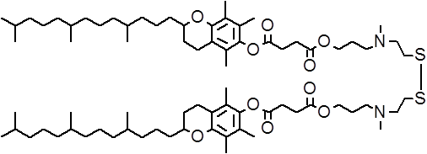
2nd Generation ssPalm
2G: fat-soluble vitamin-scaffold ssPalm
N
S
1G Myristic acid-scaffold ssPalm
Vitamin A
Tertiary amines
Proton-sponge units(Endosome)
N
S
N
ssPalmA
S
C₁₃H₂₇ （Myristic acid）
N
S
S
N
Vitamin E
ssPalmM
N
S
Disulfide bonding
Cleavable unit
(Cytoplasm)
Akita H and Ishiba R et al.
Adv. Healthc Mat. 2013
ssPalmE
Why Vitamin?
LogP
Myristic acid(C₁₄)
Vitamin A(C₁₆)
Vitamin E(C₂₈)
ssPalmM: 14.2
ssPalmA: 16.1
ssPalmE: 22.5
Hydrophobicity
Unique physicochemical
property
More stable
particle formation
2. Unique transport system
Vitamin A; Nuclear transport
Notes:
Currently, we have developed a 2nd generation ssPalm in those fat soluble vitamin was used as a hydrophobic scaffold. Here, we’ll name them as ssPalmM, ssPalmA and ssPalmE. Then, why vitamin??
First, the vitamins has unique physicochemical properties. For example, vitamin E is more hydrophobic than other vitamin and lipid. Then, we can control the stability of the particle by selecting the proper hydrophobic scaffold because hydrophobic interaction is a main driving force for the self-assembly.
Second, The vitamin uses the unique transport system. For example, nuclear transport system is available for the endogenous vitamin A molecule.

Slide 19
2nd Generation ssPalm
2G: fat-soluble vitamin-scaffold ssPalm
N
S
1G Myristic acid-scaffold ssPalm
Vitamin A
Tertiary amines
Proton-sponge units(Endosome)
N
S
N
ssPalmA
S
C₁₃H₂₇ （Myristic acid）
N
S
S
N
Vitamin E
ssPalmM
N
S
Disulfide bonding
Cleavable unit
(Cytoplasm)
Akita H and Ishiba R et al.
Adv. Healthc Mat. 2013
ssPalmE
Function of LNP_{ssPalmA}
Inhibition of gene expression and nuclear
accumulation in the presence of retinoic acid (RA)
Blue: Nucleus (Hoechst33342)
Green: Lysosome (LysotrackerGreen)
Red: pDNA (Rhodamine)
3.0
(x10⁶)
ssPalmM
Gene expression
0 μM
0 μM
10 μM
2.0
5.0 μM
Luciferase activity
(RLU/2 min)
7.5 μM
4.0
(x10⁷)
1.0
10.0 μM
No
change
3.0
ssPalmA
0
30
0
10
20
40
2.0
Time (hr)
Luciferase activity (RLU/2 min)
6.0
(x10⁷)
ssPalmA
0 μM
10 μM
1.0
ssPalmM
0 μM
DOTAP
4.0
5.0 μM
0
7.5 μM
Inhibition
of nuclear
delivery
0
10
20
Luciferase activity
(RLU/2 min)
10.0 μM
30
40
2.0
Time （hr）
0
10
20
30
40
Nuclear delivery by vitamin A-transport
System in host cell
Tanaka H and Akita Het al. Biomaterials. 2014
0
Time (hr)
Notes:
In fact, when vitamin A was used as a hydrophobic scaffold, gene expression was enhanced by 1 order of magnitude. In this situation, the ssPalmA particle extensively accumulated to the nuclear periphery. Of note, the gene expression and nuclear accumulation was impaired in the presence of excess amount of the retinoic acid. Therefore, the PalmA particle can ride on the endogenous nuclear transport system.

Slide 20
2nd Generation ssPalm
2G: fat-soluble vitamin-scaffold ssPalm
N
S
1G Myristic acid-scaffold ssPalm
Vitamin A
Tertiary amines
Proton-sponge units(Endosome)
N
S
N
ssPalmA
S
C₁₃H₂₇ （Myristic acid）
N
S
S
N
Vitamin E
ssPalmM
N
S
Disulfide bonding
Cleavable unit
(Cytoplasm)
Akita H and Ishiba R et al.
Adv. Healthc Mat. 2013
ssPalmE
Why Vitamin?
LogP
Myristic acid(C₁₄)
Vitamin A(C₁₆)
Vitamin E(C₂₈)
ssPalmM: 14.2
ssPalmA: 16.1
ssPalmE: 22.5
Hydrophobicity
Unique physicochemical
property
More stable
particle formation
2. Unique transport system
Vitamin A; Nuclear transport
3. Unique pharmacological
activity
Vitamin E; ・Immune-stimulative activity
(adjuvant function)
・Anti-tumor activity
Notes:
Finally, vitamin has unique pharmacological activity. For example, vitamin E has immuneactive function, anti-tumor activity and anti-oxidant activity. The merit to use vitamin E will be shown later.

Slide 21
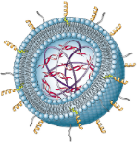
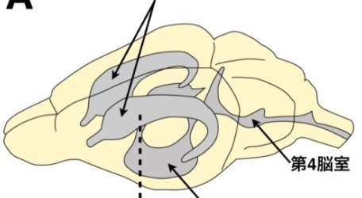
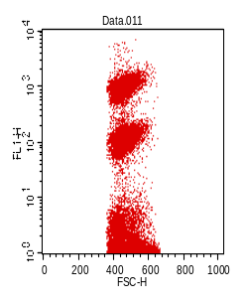
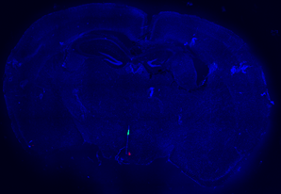
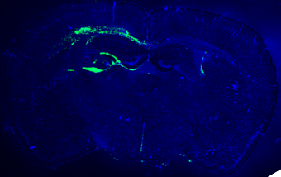
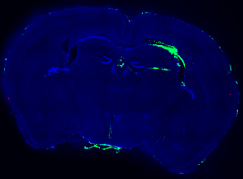
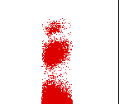
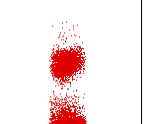
Topical administration
Subcutaneous administration
（DNA vaccine）
intracerebroventricular
(ICV) injection
Effect of the hydrophobic
scaffold on the gene expression
Antigen-specific Cytotoxic T-lymphoma (CTL) activity
Lateral
ventricle
(x10⁶)
30-folds
ssPalm encapsulating
an antigen-encoding pDNA
^{★１}
Single immunization
at a dose of
2.4 μg / mouse
5
4
15-folds
Luciferase activity
(RLU/mg protein)
3
2
1 weeks
Fourth
ventricle
Antigen peptide
Third ventricle
1
Intravenous injection
0
M
A
E
ssPalmX
Control
cells
Target
cells
Uptake of the particle
ssPalmM
ssPalmA
ssPalmE
Target
cells
Control
cells
Hoechst33342 (Nucleus)
ssPalm particle
Cytotoxic T lymphoma activity (%Lysis)
Gene expression was
observed mainly in
astrocytes
ssPalmE
particle
ssPalmE
(Modified)
Lipofectamine
2000®
（Cationic Lipoplex）
mCherry (Gene expression) GRAP(Astrocyte)
^{★１}Conventional technology
Multiple injection of pDNA (50～100 μg/mouse)
Akita et al. Int J Pharm. 490: 142-5 (2015)
Notes:
Here, we shows an example of the in vivo administration. When the pDNA encapsulating LNP was administered by intracerebrove(‘)ntricular injection, the uptake of LNP prepared with ssPalm M was under the detection limit, most probably because the particles were washed away by spi(‘)nal fluid. In contrast, the ssPalm A or E was used, the particles were taken up to a certain kind of cells, and exhibited a transfection activity. Immunofluorescence revealed that the gene expression was highly achieved in astrocyte.
Another application is DNA vaccine. When the particle encapsulating a antigen-encoding pDNA was injected subcutaneously, the immunized mice can reject almost all of the target cells specifically 1 week later. It is worthwhile to emphasize that in conventional technology, such a immunological response can be achieved by repeated injection of 50-100 micro gram of pDNA. In our case, single injection of 2.4 microgram DNA is sufficient to induce such a high immunological reaction.

Slide 22
August 17, 2015 (Today!!)
Track 4: Nanotechnologies for Drug Delivery
14:10~14:35
Particle formed by ssPalm as a nanoDDS platform
for the genes and nucleic acids
Application of ssPalm via Intravenous administration will be presented
Notes:
Today, I have additional presentation in Track 4. In this presentation, I’ll focus on the in vivo application of ssPalm via intravenous administration.
(18min)

Slide 23
DNA vaccine
Other strategy to enhance transcription
“Switch-on” function
Notes:
In my last part, I’ll propose another strategy to induce transcription efficiency by using switch-on function. We found this phenomena serendipitously when we attempted to developed a DNA vaccine technology.
19min

Slide 24
Principle of DNA vaccine
Antigen presentation
to T-lymphocyte
Transfection with
gene carriers
Antigen-encoding DNA
ex vivo
Gene delivery
Lymph node
Tumor
Antigen-specific
activation
Gene expression
antigen presentation
on MHC Class I
Dendritic
cells (DC)
Cytotoxic
T-lymphocyte
Antigen
Exclusion of
antigen-presenting
tumor cells
Adjuvant
(CpG oligonucleotide etc…)
Tumor cells
Virus-infected cells
Stimulation of DCs with adjuvant treatment
Stimulated DC
Advantages of DNA vaccine
1. Correct post-translational modifications (glycosylation and folding) is achieved
2． Purification of antigen proteins are not necessary
⇒Highly potent in the protection against viral infection
Notes:
In the body, dendritic cells plays a ley role in the initiation and regulation of the immune responses. Therefore, the dendritic cell is one of the major target for the delivery of antigen-encoding gene in DNA vaccine. Once the gene transfection was succeeded in the dendritic cells, we can educate them what is a foreign substances. Also, to confer the adequate function of the dendritic cells, a certain kinds of method is required to stimulate these cells.
When the antigen gene transfection and subsequent immune activation was both satisfied, the dendritic cells move to the lymph node, and activate the cytotoxic T cells, that finally kill the tumor or virus-infected cells in antigen-dependent manner.
For a long period, we tried to developed a gene carrier for the dendritic cells.

Slide 25
Transfection activity of R8-MEND in dividing and non-dividing cells
10⁹
Dividing cells
R8-MEND
10⁸
HeLa
10⁷
（Octaーarginine）
Transfection activity
(RLU/mg protein)
Lipid envelope
10⁶
10⁵
RRRRRRRR
(R8) peptide
5x10³
1x10⁵
R8-MEND
Adenovirus (particles/cell)
Khalil IA et al. Gene Ther. (2007) 14(8):682-689
Transfection activity in dividing and non-dividing cells
10⁹
10⁸
Condensed DNA core
Stearyl-R8
10⁷
CH₃(CH₂)₁₆CONHR8
Transfection activity
(RLU/mg protein)
10⁶
Kogure K et al. J Control Release. (2004) 2 : 317-323.
10⁵
10⁴
HeLa
DC (JAWSII)
Notes:
But it was too challenging work. Originally, our laboratory has developed a particle modified with octaarginine, a cell penetration peptide. This particle can exhibit high transgene expression in a various types of cultured cells. However, when these MEND were applied to the dendritic cell, the gene expression is so miserable. This is a starting point of our research.

Slide 26
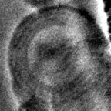
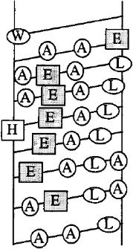
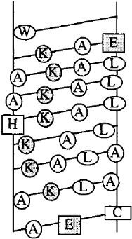
KALA: Key technology
GALA
Membrane
fusion
Conventional
～GALA～
Advanced
～KALA～
Random coil
α-helix
100 nm
pH↓
Endosome
/Lysosome
pH7.4
pH7.4
Plasma
membrane
Endosome
Key design:
Fusion with plasma/nuclear membrane
at neutral pH
KALA
pH↓
Membrane
fusion
Random
coil
α-helix
pH7.4
pH7.4
pH↓
Membrane
fusion
？
Lysosome
(Degradation pathway)
Transcription
Wyman TB et al., Biochemistry 36: 3008-3017 (1997)
Surface display of KALA
Nuclear
membrane
Stearyl-KALA
Nucleus
KALA
Lipid (Stearyl）
Lipid
envelope
Notes:
After the trial and error and error and error for 10 years, we finally found promising particle. Conventionally, we had used GALA peptide as an inducer of the endosomal escape. This peptide are designed to form an random-coil structure in physiolofical pH, and forms an alfa-helical structure in acidic pH for induction of membrane fusion. In this case, we don’t have a strategy for the nuclear delivery. Therefore, we alternatively used a KALA peptide that forms a alfa-helical structure in physiological pH. We postulated that the KALA can overcome the plasma membrane and nuclear membrane via step-wise membrane fusion.

Slide 27
Transgene expression activity in
dendritic cell-derived cell line
10⁷
GALA-MEND
10⁶
10⁵
10⁴
10³
Modification(%)
0
1
2
5
8
1
2
5
8
Peptide type GALA KALA
KALA modification drastically improved the transfection activity
Notes:
Here, transfection activity is shown. When GALA was modified, transfection activity was only slightly increased by 5 fold. In contrast, when KALA was modified, the transfection activity jumped by 2 order of magnitude.

Slide 28
Quantitation of cellular uptake and nuclear delivery of pDNA by realtime-PCR
R8
R8/KALA
R8
R8/KALA
R8
R8/KALA
Cellular uptake and nuclear delivery was comparable between R8-MEND and R8/KALA-MEND
Improvement of transgene expression (>2 order of magnitude) cannot be explained by intracellular trafficking
10⁷
10⁶
10⁵
10⁴
KALA may also enhance post-nuclear delivery processes (i.e. transcription and translation)
10³
R8
R8/KALA
Notes:
However, when we investigated the intracellular trafficking of KALA-modified particle, we found that the actual mechanism of the drastic enhancement of gene transfection was completely different from our initial concept . That means cellular uptake and nuclear transport of pDNA was comparable regardless of the with and without KALA modification.
These data collectively indicate that KALA may also enhance post-nuclear delivery processes such as transcription.

Slide 29
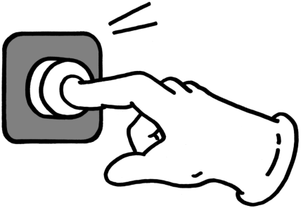


Proposal of the novel strategy to control the
intra-nuclear gene transcription
”Switch on” function
Nucleus
Nucleus
zZZ…
(@_{o}@)/
(ー_ー)
Protein synthesis
i.e. transcription
translation
Cells is sleeping to avoid
an excess immune-response
Notes:
Here, we propose a “switch on” function. In the case of the immune-responsive cells, the cells are sleeping to avoid an excess immune-stimulation. However, when the switch were turned on, the cells wake-up, and then transcription and translation process will be activated.

Slide 30
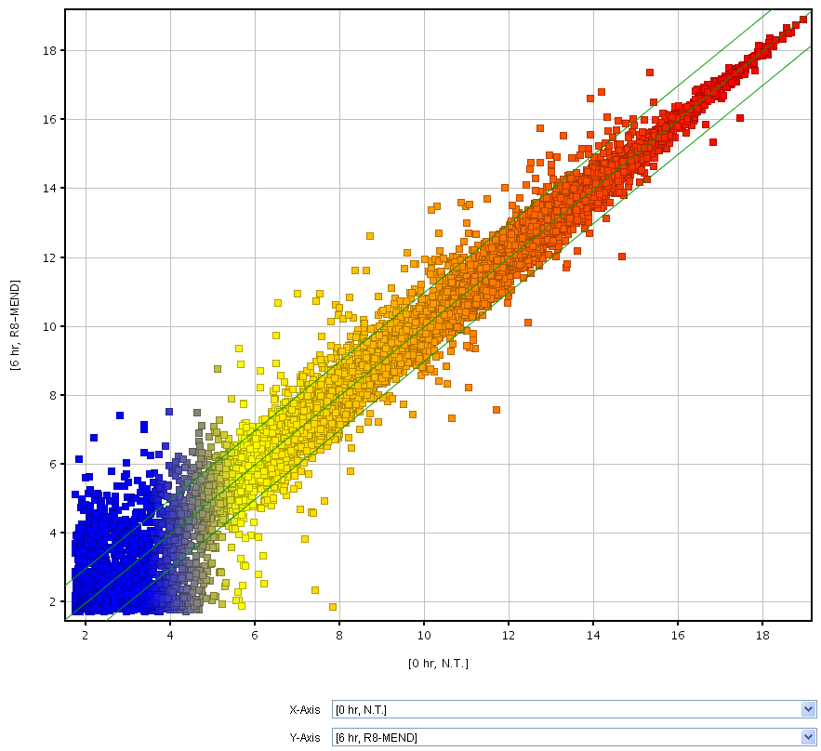
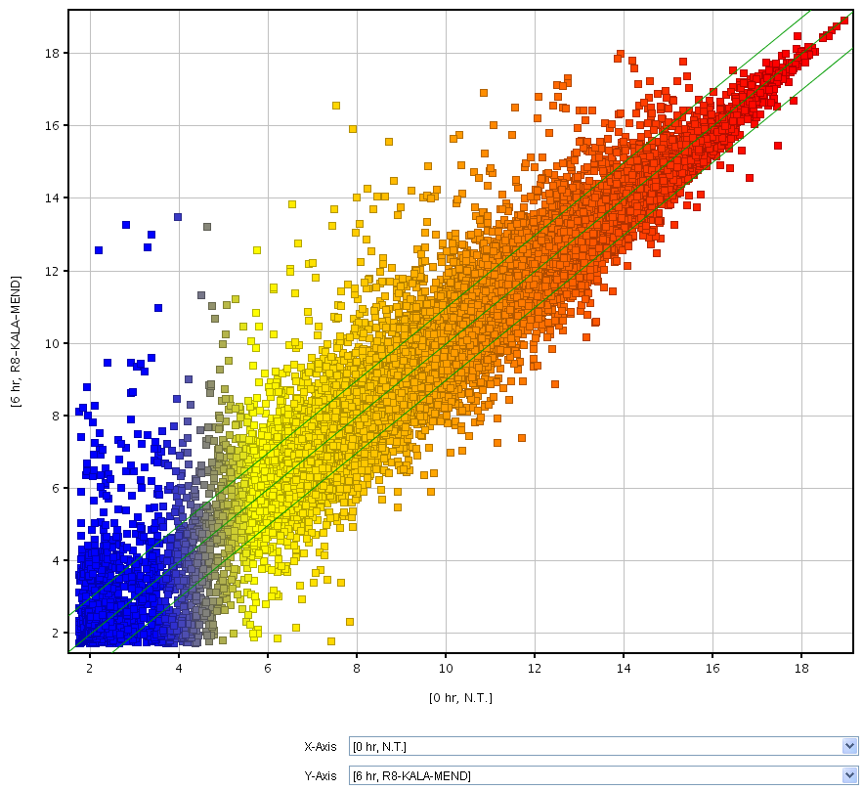
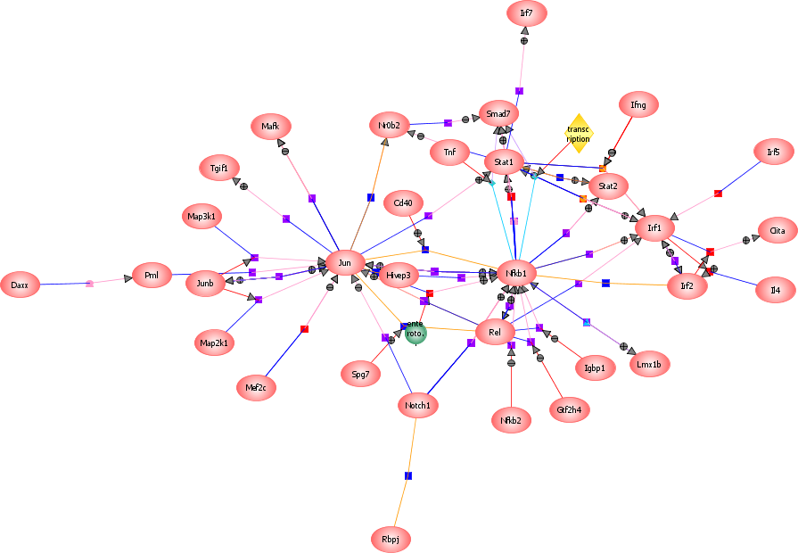
Microarray analysis to investigate the response of dendritic cells to the nanoparticles
JAWS II cells
(dendritic cells derived cell line)
N.T. vs MEND
N.T. vs KALA-MEND
KALA-
MEND
MEND
mRNA expression
in transfected cells
: MEND(Log_{２}Raw)
mRNA expression
in transfected cells
: KALA-MEND (Log_{２}Raw)
mRNA expression in non-treated cells (Log₂Raw)
mRNA expression in non-treated cells (Log₂Raw)
Microarray Analysis
Pathway analysis
Number of genes which varied
> 3 folds against non-treated cells
STAT2
STAT1
KALA-free
MEND
(181 genes)
Common
(275 genes)
KALA-modified
MEND
(1187 genes)
Arrows finally falls into
3 transcription factors:
STAT1, STAT2, NF-kB
KALA-MEND triggers the immune-stimulation as likely be an adjuvant!!
NF-κB
Akita et al., Biomaterials 2013
Notes:
To prove the switch on function of KALA-modified particle, we analyzed the cellular response of the dendritic cells against the particles. Here, we shows the scattered scattered plot to show the correlation of the expression levels of individual mRNA between non-treated cells and cells after the transfection with KALA-unmodified MEND or KALA-modified MEND. In KALA-unmodified particle, major part of dots were plotted closed to the 1-to-1 correlation line. Thus, mRNA expression was not perturbed even after the transfection with KALA-unmodified MEND. In contrast, after the transfection with KALA-MEND, many dots were plotted far from the 1-to-1 correlation line.
In fact, when we count the number of mRNA whose expression was varied more than 3 folds, it reached above 1 thousand.
The purpose of this analysis is to investigate the mechanism for high gene expression. Thus, we pick up the transcription-related genes, and then were subje(‘)ct to the pathway analysis.
As a result, we found that these arrows finally falls into the three kinds of transcription factors (Stats and NF-kB). As you may know, these are the typical transcription factors when the dendritic cells were immune-activated.

Slide 31
Issues to be clarified…
1. What is a trigger of
“switch-on”??
2. What is a
“switch”??
Nucleus
zZZ…
(ー_ー)
Notes:
So, important question is what is a cellular switch, and what is a trigger of the switch on?

Slide 32
Schematic diagram illustrating a possible mechanism for the multi-function of KALA-modified LNP: Adjuvant activity and Enhanced transgene expression
Autocrine/Paracrine
Toll-like
receptors
IFN-β
IL-1β
IFN-IR
IL-1βR
JAK
STAT
MyD88
?
?
?
IRAK
cGAS
DDX41
IFI11
SWITCH
B-form DNA
TRAF6
STING
AIM-2
inflammasome
IkBα
AIM−2
NF-κB
ASC
P
Caspase−1
STAT
P
RelA
p50
TBK1
P
P
IRF3
P
IL-1β
NF-κB
IkBα
IRF3
pro-IL-1β
NF-κB
P
P
P
: Phosphorylation
P
NF-κB
IRF3
P
Promoter
P
Plasmid DNA
Akita et al., Biomaterials 2013
Miura et al. Nucleic Acid Res. 2015
IRF7
IL-6
IFN-β
Enhanced
transgene expression
(Transcription)
IFN-α
IFN-β
Immune-stimulative effect
(adjuvant activity)
Notes:
Today, time is so limited. Thus, we show the answer here. First, the MEND deliver their plasmid DNA to the cytoplasm. This cytoplasmic delivery of long DNA is a trigger. While the actual switch was not identified yet, our data strongly support that STING/TBK1 pathway is a key signaling pathway for the signal transduction to induce the immune activation. The secreted cytokines activate the dendritic cells theirselves in autocrine manner. Finally, the activated STAT pathways or other transcription factors activated the transcription of transgenes.
Thus, we are thinking that the adjuvant activity of KALA-MEND is closely related to the induction of transgene expression.
Here, we shows a whole picture. First, the MEND can deliver their plasmid DNA to the cytoplasm, and they triggers the signal transductions to induce the immune activation. The secreted cytokines activate the dendritic cells theirselves in autocrine manner. Finally, the activated STAT pathways or other transcription factors activated the transcription of transgenes.
Thus, we are thinking that the adjuvant activity of KALA-MEND is closely related to the transgene expression.

Slide 33
Intracellular signal transduction-inducible gene carrier
Suomalainen M et al. EMBO J (2001)
Meier O et al. J Cell Biol (2002)
Induction of
macropinocytosis
Improvement of
transcription
Receptor
Nuclear transport
Virus
Signal transduction
PKA, p38/MAPK etc…
Uptake
Promotion
Signal transduction
Immune-stimulation
Microtubule-dependent
transport
Nuclear transport process of Ad
Endosomal
escape
Docking
Collapse
Entry of DNA
Cytosol
Nucleus
Nuclear
Pore
complex
Trotman LC et al. Nat Cell Biol (2001)
Signal transduction-inducible DDS to engineer a cellular perturbation
・Improvement of intracellular trafficking
(Cellular uptake, Nuclear transport)
・Improvement of transcription
Notes:
Such a signal transduction-inducible property was also reported in virus. For example, when adenovirus infected to the cells, it induced the signal transduction, that can promote the microtubule-dependent transport, and cellular uptake.
In this presentation, we showed that the induction of the signal transduction trigger the immunostimulaion and improvement of transcription processes.
Therefore, development signal transduction-inducible DDS is a one of the attractive approach that can engineer the cellular perturbation to facilitate the intracellular trafficking and transcription.

Slide 34
Summary
Identification of rate-limiting process of cationic lipoplex based on the
quantitative comparison of intracellular trafficking with adenovirus
Virus
Lipoplex
??
Nucleus
Drawbacks in use of cationic carriers:
Electrostatic interaction with DNA cargo and mRNA
⇒Rate-limiting process is transcription and translation
Efficient
nuclear transfer
Strategy1:
Avoidance to use cationic materials
Strategy 2：
Introduction of switch-on function
Neutral particle responsive to
intracellular environment
Switch on the signal transduction
Neutral
charge
Plasma membrane
Plasma membrane
Endosomal
Escape
Collapse
Switch-on
Nucleus
Nucleus
DNA sensor
(Cytoplasm)
DNA
Release
Decapsulation
Decondensation
Signal transduction
(Immune-stimulation)
Activation of
transcription
Acidic environment
⇒Positive
Charging
Notes:
In summary, in the first part, we found that transcription and translation processes are crucial rate-limiting process for the transgene expression in cationic vectors. Important point is that electrostatic interaction with cationic carrier and DNA cargo or mRNA is a major reason for them.
To overcome this drawback, I today show two strategies; 1st strategy is quite simple. Let’s try to develop a neutralized particle by minimizing the cationic component. And the other strategy is to development of the carrier that can switch on the signal transduction to engineer the cellular perturbation.
Based on these two concept, we are developing various types of gene carriers. I hope I can show additional application in other opportunity.

Slide 35



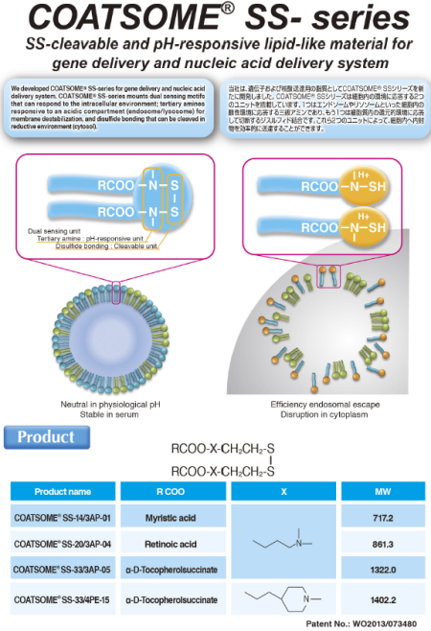

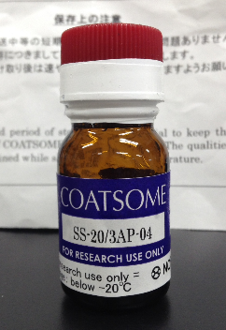
Acknowledgement
Academic
Hokkaido University
Prof. Hideyoshi Harashima
Dr. Kazuaki Kajimoto
Dr. Hiroto Hayakeyama
Dr. Yuma Yamada
Dr. Mamoru Hyodo
Dr. Yasuhiro Hayashi
Dr. Masami Ukawa
Dr. Mina Tamaru
Dr. Yu Sakurai
Dr. Yusuke Sato
Dr. Mohammad Shaheen
Kyoto University
Prof. Mitsuru Hashida
Dr. Yuriko Higuchi
Prof. Shiro Futaki
Mr. Ryohei Ishiba
Mr. Ryohei Togashi
Mr. Hiroki Tanaka
Mr. Yuki Noguchi
Miss. Sarochin Santiwarangkool
Mr. Naoya Miura
Mr. Taichi Nakatani
Mr. Mio Maeta
Miss. Ayaka Watanabe
Nagoya University
Prof. Yoshinobi Baba
Dr. Noritada Kaji
Companies
Mr. Kota Tange
Mr. Masaya Arai
Mr. Kazuhiro Kubo
Mr. Shoichi Yokoyama
Notes:
Finally, we thanks to the colloborators, sturents. Also, development of the ssPalm is based on the colloaboration with NOF corporation. Here, I’m glad to anounce that a series of the ssPalm molecules are now commercially available.

Slide 38
Rate-limiting processes determining a transgene expression efficiency of nucleus-delivered DNA (PD)
Transcription
Ad > LFN
16-folds
DNA
A549 cells
Ad > LFN
8100-folds
mRNA
Nucleus
Translation
(Nuclear export)
Ad > LFN
460-folds
HeLa cells
Ad > LFN
7000-folds
Protein
 | Ad | LFN
Nuclear DNA (Copies/cell) | 4.1 | 1.7 x 10⁴
mRNA expression （Copies/cell) | 1.6 x 10⁴ | 4.3 x 10⁶
Transgene expression （RLU/mg protein) | 2.3 x 10⁷ | 1.3 x 10⁷
Transcription efficiency
mRNA production
Nuclear delivery
Translation efficiency
Transgene expression
mRNA production
Notes:
一般的に、核内に導入された DNA は転写された後, mRNA の核外移行並びに翻訳過程を得て, タンパク質発現に至ります。
本研究で得られた, 核内移行後の発現活性が, Ad の方が7000から8000倍高いのはこれらのセントラルドグマのどの過程への寄与が高いのか、まずmRNA発現量を調べることにより, 両ベクターの転写過程について検討しました.

Slide 39
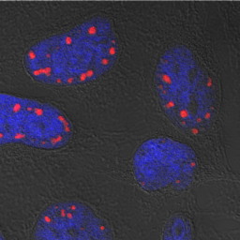
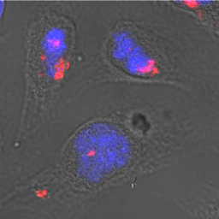
Detection of decondensed transgene in the nucleus by FISH
Detection of Ad genome DNA
Detection of pDNA
Key issue:
Release, Decapsulation, Decondensation
1.
Total nuclear delivery
Ad
<
LFN
Poor decondensation efficiency is responsible for the low transcription efficiency
Decondensed DNA
Ad
>
LFN
2.
Ad genome is specifically localized in euchromatin region.
Notes:
この図は、HeLa 細胞にAd感染 10時間後、FISH を行い、核をDAPIで染色し、共焦点レーザー顕微鏡で観察したものです。
青がDAPI で、赤がAd genome を示しております.
Ad genome は、淡い青で染まったユークロマチン領域のみに特異的に局在していることが明らかとなりました。

Slide 40
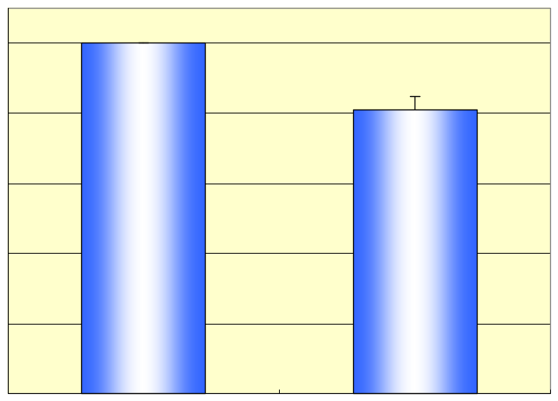
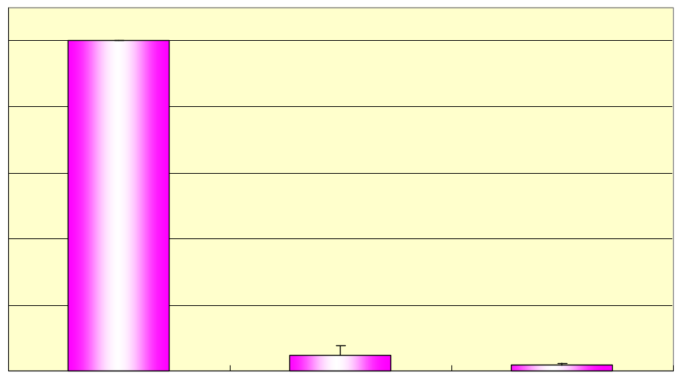
Inhibitory effect of Ad and LFN on in vitro translation activity
Ad
LFN
LipofectAMINE
or
or
+
Rabbit reticulocyte
lysate
Luciferase Activity
A
A
A
Key issue:
Avoid an electrostatic interaction with RNA
Luciferase mRNA
（4.3×10⁸ copies）
in vitro translation
(%)
Ad
(%)
LFN
100
100
80
80
60
60
40
40
20
20
0
0
control
Ad
control
LFN
LipofectAMINE
( buffer)
( buffer)
Notes:
次に翻訳阻害仮説について in vitro 翻訳系を用いて検証しました。
AdまたはLipofectAMINEとpDNA とのcomplex, またはLipofectAMINE試薬単独とLuciferase mRNA をプレインキュベーションした後、ウサギ網状赤血球を用いたin vitro 翻訳系に添加し、タンパク質を合成させ、その合成量をルシフェラーゼ活性により評価しました。
その結果、Adを添加した場合、添加していない場合に比べて、約20％しかタンパク質合成が抑制されませんでした。
一方、LipofectaMINE とpDNA とのcomplex を添加した場合, 添加していない場合に比べて90％以上抑制されました。この抑制効果は、LipofectAMINE試薬単独の場合でも同様であったことから、mRNA とLipofectAMINEとの相互作用により、翻訳過程が抑制されることが示唆されました。

Slide 41
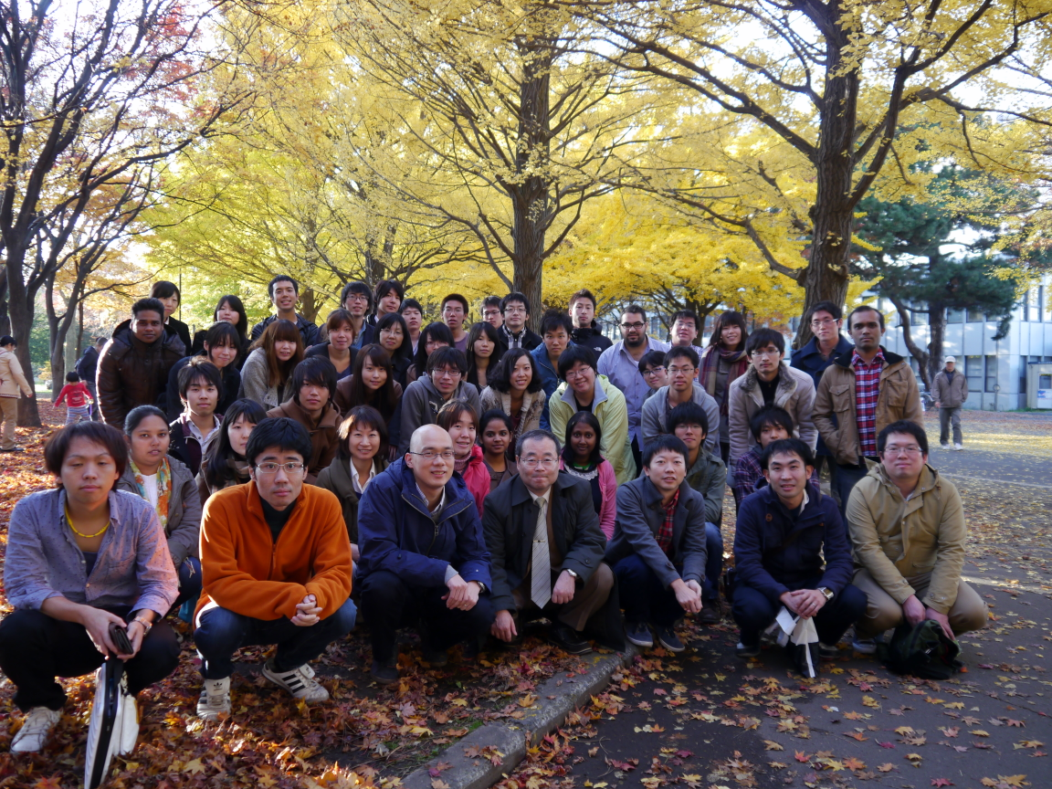

Slide 43
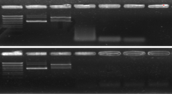

Feasible features of neutral LNP_{ssPalm} toward the application
via i.v. administration
Low cytotoxicity
( in vitro transfection in HT1080)
2. High stability in serum
M
pDNA
0
1
3
6
24
（ｈ）
Doses in general transfection condition
Naked
pDNA
ssPalm
100
pDNA/
polycation
Core Particle
0.4 μg
(pDNA)
Conventional cationic lipid
（DOTAP/DOPE/Chol)
Protein amount
(% of non-treatment)
Time-dependent and rapid degradation
50
Encapsulation
into LNP_{ssPalm}
0.8 μg
(pDNA)
Lipofectamine
PLUS
ccPalm
M
pDNA
0
1
3
6
24
（ｈ）
2 μg
(pDNA)
0
0
2
4
6
8
10
LNP_{ssPalm}
Concentration (Lipid mM)
pDNA is retained in the serum for at least 24 h
⇒ Effective packaging (>80% of packaging efficiency)
Stable envelope structure in serum
Akita H and Ishiba R et al. Adv Healthc Mater. in press
Notes:
Our ssPalm particle is neutral particle. Therefore, it is inhe(‘)rently feasible towards the application via i.v. administration. 1st, ssPalm particles have low toxicity against cells.
As shown here, the protein amount after the in vitro transfection remains unchanged even when the dose was increased by 10 folds than general transfection condition. In contrast, the corresponding values in cationic was drastically decreased in dose dependent manner. Interestingly, the ccPalm particle shows high cytotoxicity, Thus, biodegradation is also an important factor for the biosafety.
Second, advantage in use of this carrier is high stability in serum. Wnen naked pDNA or core particles were incubated with mouse serum, they are rapidly degraded within 1h. In contrast, the pDNA remains intact for at least 24 h when it is encapsulated in ssPalm particle.

Slide 44
Hypothesis: KALA turn on the switch to induce
an intracellular signaling pathway??
R8-MEND
R8/KALA-MEND
Switch
Intracellular signaling
Transcription
Investigation of the variations of mRNA expression in response to the KALA-modified MENDs by microarray analysis
Notes:
Here, we propose a switch on mechanism.

Slide 45
Physicochemical characters and in vitro transgene expression
Tertiary
amines
Cationic lipid
quaternary amine
 | ssPalm | ccPalm | DODAP | DOTAP
Size (nm) | 156.3 | 150.3 | 151.1 | 235.8
PDI | 0.14 | 0.07 | 0.09 | 0.30
ξ-potential (mV) | -0.08 | +12.4 | -3.18 | +57.9
Neutral
Cationic
Cellular uptake
Gene expression
**; p<0.01
200
**
10⁹
**
**; p<0.01
**
**
**
150
Uptake (Geo Mean: arbitrary unit)
Gene expression (RLU/mg protein)
100
10⁸
50
0
ssPalm
ccPalm
DODAP
DOTAP
10⁷
ssPalm
ccPalm
DODAP
DOTAP
Neutral
Cationic
Neutral
Cationic
Akita H* and Ishiba R et al. Adv Healthc Mat. 2013
Notes:
In this slide, we will show the in vitro activity. As a simple explanation, we just focus on the comparison between ssPalm and DOTAP, a conventionally used cationic lipid with quaternary amine. As shown here, the particle formed with ssPalm was quite neutral. Therefore, the cellular uptake in ssPalm is smaller than DOTAP. Nevertheless, the transfection activity was comparable between two groups. Therefore the less cellular uptake in ssPalm was complemented by the well-refined intracellular processesing.
In fact, the ssPalm shows marginal inhibitory effect against the in vitro translation reaction, while the cationic particle impaired so drastically.
（ここまで6分）

Slide 46
Concept of the control of intracellular trafficking by the
step-wise membrane fusion
GALA
Membrane
fusion
Conventional
～GALA～
Novel
～KALA～
Random-coil
α-helix
pH↓
Endosome
/Lysosome
pH7.4
pH7.4
Plasma
membrane
KALA
Endosome
Induction of membrane fusion with plasma- and nuclear membranes
pH↓
Random
-coil
α-helix
Membrane
fusion
pH7.4
pH7.4
pH↓
Membrane
fusion
？
Wyman TB et al., Biochemistry 36: 3008-3017 (1997)
transcription
Surface modification
Lysosome
(Degradation pathway)
Stearylated-KALA
Nucleus
KALA
Lipid （Stearyl）
Lipid
envelope
Nuclear membrane
（C-terminal CEA is excluded）

Slide 47
樹状細胞由来細胞株における遺伝子発現活性
10⁷
R8-GALA-MEND
10⁶
10⁵
10⁴
10³
修飾量(%) 0 1 2 5 8 1 2 5 8
修飾 GALA KALA
R8-MEND
KALAを修飾したMENDでは遺伝子発現活性が大きく上昇した

Slide 48
Schematic diagram illustrating a possible mechanism for the multi-function of KALA-modified LNP: Adjuvant activity and Enhanced transgene expression
Autocrine/Paracrine
Toll-like
receptors
Akita et al., Biomaterials 2013
Miura and Akita et al.
manuscript in preparation
IFN-β
IL-1β
IFN-IR
IL-1βR
JAK
STAT
MyD88
?
?
?
IRAK
cGAS
DDX41
IFI11
SWITCH
B-form DNA
TRAF6
STING
AIM-2
inflammasome
IkBα
AIM−2
NF-κB
ASC
P
Caspase−1
STAT
P
RelA
p50
TBK1
P
P
IRF3
P
IL-1β
NF-κB
IkBα
IRF3
pro-IL-1β
NF-κB
P
P
P
P
P
NF-κB
IRF3
Promoter
Plasmid DNA
P
: Phosphorylation
IRF7
IL-6
Enhanced
gene Expression
(Transcription)
IFN-β
IFN-α
IFN-β
Immune-stimulative effect
(adjuvant activity)

Slide 49
Mechanism of intracellular dsDNA recognition
Cytoplasm
Endosome
?
B-form DNA
cGAS, DDX41, IFI11, etc...
AIM−2
STING
TLR9
ASC
AIM-2
inflammasome
Caspase−1
TBK1
Ac-YVAD
-CMK
?
?
BX795
IL−1β
IL−6
IFN−β
Barber G. N., Curr. Opin. Immunol., 23(2011), 10-20

Slide 50
Evaluation of IL-6 and IL-1β production under presence of caspase-1 inhibitor
Evaluate IL-1β and IL-6 production under the presence of
caspase-1 inhibitor (component of inflammasome).
Non-Repeated Measures ANOVA
followed by Bonferroni test
vs inhibitor 0 μM
*P < 0.05 **P < 0.01
Mean ± SD (n = 3)
*
**
**
Inhibitor
Conc.
Inhibitor
Conc.
KALA MEND R8 MEND Poly (dA:dT)
(Positive Control)
KALA MEND R8 MEND Poly (dA:dT)
(Positive Control)
Inflammasomes involve in IL-1β production by KALA-MEND.
Caspase-1 and/or IL-1β partly involve in IL-6 production by KALA-MEND.

Slide 51
Evaluation of IL-6 and IFN-β production under presence of TBK1 inhibitor
Evaluate IFN-β and IL-6 production under the presence
of TBK1 inhibitor (component of STING/TBK1 pathway).
Non-Repeated Measures ANOVA
followed by Bonferroni test
vs inhibitor 0 μM **P < 0.01
Mean ± SD (n = 3)
**
**
Inhibitor
Conc.
Inhibitor
Conc.
KALA MEND R8 MEND
KALA MEND R8 MEND
STING/TBK1 pathway involves in IL-6 and IFN-β production by KALA-MEND

Slide 52
Multi-functions of KALA-MEND
1h 3h 6h
Enhancement of
transgene expression
2. Immune-stimulation
：KALA-free MEND
：KALA-modified MEND
primary cultured mouse bone marrow-derived dendritic cells (BMDCs)
10⁸
Relative mRNA expression
(NT=1)
10⁷
IL-1β IL-6 IL-1 IFNβ TNFα
Relative Luciferase Activity
(RLU / mg protein)
10⁶
Immuno-stimulation occurred regardless of the presence or absence of CpG-motif
10⁵
IL−6 Production (pg/mL)
Toll-like receptor (TLR)-independent signal transduction
10⁴
Shaheen SM and Akita et al. Biomaterials 2011
Akita et al., Biomaterials 2013
CpG(−) CpG(+) CpG(−) CpG(+)
KALA R8
Notes:
The surface modification of KALA drastically improved the gene expression in primary mouse bone marrow-derived dendritic cells by more than 2 order of magnitude.
Furthermore, as an unexpected function, the KALA-modieid particle inherently situmulated the dendritic cells. In fact various kinds of cytokines were produced prominantly.
(Interestingly, these cytokine production was not impaired even when the CpG motifs are completely deleted from the plasmid DNA. Therefore, this immune-acitivation is caused by the novel mechanism except for the toll like receptor-mediated pathway.)

Slide 53
Mechanism of intracellular DNA recognition
Cytoplasm
Endosome
?
B-form DNA
cGAS, DDX41, IFI11, etc...
AIM−2
STING
TLR9
ASC
AIM-2
inflammasome
Caspase−1
TBK1
Ac-YVAD
-CMK
?
?
BX795
IL−1β
IL−6
IFN−β
Barber G. N., Curr. Opin. Immunol., 23(2011), 10-20

Slide 54
Evaluation of IL-6 and IL-1β production under presence of caspase-1 inhibitor
Evaluate IL-1β and IL-6 production under the presence of
caspase-1 inhibitor (component of inflammasome).
Non-Repeated Measures ANOVA
followed by Bonferroni test
vs inhibitor 0 μM
*P < 0.05 **P < 0.01
Mean ± SD (n = 3)
*
**
**
Inhibitor
Conc.
Inhibitor
Conc.
KALA MEND R8 MEND Poly (dA:dT)
(Positive Control)
KALA MEND R8 MEND Poly (dA:dT)
(Positive Control)
Inflammasomes involve in IL-1β production by KALA-MEND.
Caspase-1 and/or IL-1β partly involve in IL-6 production by KALA-MEND.

Slide 55
Evaluation of IL-6 and IFN-β production under presence of TBK1 inhibitor
Evaluate IFN-β and IL-6 production under the presence
of TBK1 inhibitor (component of STING/TBK1 pathway).
Non-Repeated Measures ANOVA
followed by Bonferroni test
vs inhibitor 0 μM **P < 0.01
Mean ± SD (n = 3)
**
**
Inhibitor
Conc.
Inhibitor
Conc.
KALA MEND R8 MEND
KALA MEND R8 MEND
STING/TBK1 pathway involves in IL-6 and IFN-β production by KALA-MEND

Slide 56
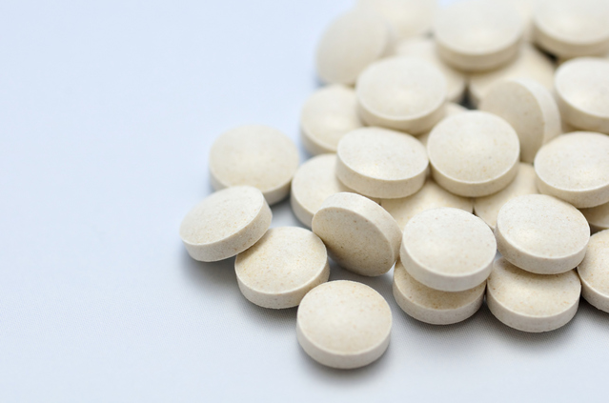
Medicines are essential for human prosperity and well-being
Notes:
In the long history, medicines have brought a large degree of human prosperity and well-being. As an introduction, let’s look back into history of medicine.

Slide 57



Pedanius Dioscorides
(40-90)
The first pharmacopoeia
De materia medica
Published in around the year 77
1-1
1000
1800
2000
B.C.E
C.E
Year
Notes:
According to the historical report, the world’s earliest pharmacopoeia is published in 77th.

Slide 58
Pedanius Dioscorides
(40-90)
The first pharmacopoeia
De materia medica
Published in around the year 77
The era of
herbal medicine
1-1
1000
1800
2000
B.C.E
C.E
Year
Notes:
Until the end of 18th century, human healthcare had been supported by herbal medicines. However, nobody identified what kind of molecular component actually functioned in the body.

Slide 59












The era of
scientific medicine
from 19th century
1-1
1000
1800
2000
B.C.E
C.E
Year
Notes:
The era of scientific medicine starts from 19th century. That is human succeeded in the isolation of the biologically active constituent from the herbal medicine (Morphine) and furthermore, synthesize them in parallel with a progress in the field of organic chemistry.

Slide 60


Difference of the cellular uptake mechanism
between low-molecular drug and plasmid DNA
Low-molecular drug
Plasmid DNA(7 kbp)
M.W. ～500
・ M.W. 4,620,000
average M.W. of 1 nucleotide: 330 x 2(bp) x 7000 (bps)
・ Number of negative charge: 14,000
phosphate group(pKa~2.0)
caramel
9,000 caramels
hydrophilic
Electrostatic
repulsion
hydrophobic
Transporters
Proteoglycan
（Negatively charged)
Notes:
First, we focused on the cellular uptake process. The low molecular drugs were taken up into cells via membrane penetration, or passing though the transporters. However, the DNA molecule is huge molecule. We can eat one caramel. However, it is impossible to eat 9 thousand caramel without any cooking.
Furthermore, the DNA is a highly anionic polymer. Thus, the cellular binding of DNA is also hampered by the electrostatic repulsion with proteoglycan on the cellular surface.

Slide 61

Cationic gene/siRNA carriers
Transfection activity of lipoplex
in proteoglycan-deficient CHO cells
Lipoplex
Polyplex
Plasmid
DNA
Plasmid
DNA
Transfection Activity
Cationic
liposomes
lipoplex
Cationic polymer
(polycation)
polyplex
Polyion complex
Complex type
Plasmid
DNA
Polyethylene
glycol (PEG)
Proteoglycan
-deficient
Wild-type
Plasmid
ＤＮＡ
Cationic
Polymer
Cellular Uptake
Naked DNA
Liposome
Polyion complex
Cationic unit
Hydrophilic polymer
(PEG）
Lipopolyplex
Envelope-type
nanoparticle
Wild-type
Electrostatic
repulsion
Proteoglycan
（Negatively charged)
Proteoglycan-
deficient
Endocytosis
Miskick K et al., Proc Natl Acad Sci,
93: 12349-12354 (1996)
Notes:
Thereafter, a large variety of the cationic carriers and polymers were developed as a gene carriers. Of note, the transfection and cellular uptake of DNA was impaired in proteoglycan-deficient cells. Thus, the electrostatic interaction between cationic pariticle and proteoglycan is a crucial driving force of cellular uptake process.
Later, complex type nanoparticles composed of liposome and polymers are developed.

Slide 62
Procedures for the evaluation of anti-tumor effect by DC-cell therapy (Prevention effect)
Antigen (ovalbumin; OVA)
-encoding plasmid DNA
C57BL/6
ex vivo
Gene transfection
(0.4 μg pDNA/
4 x 10⁵ cells)
Isolation of bone
marrow cells
Tumor challenging
(8 x 10⁵ cells of E.G.7-OVA)
Bone marrow-derived dendritic cells (BMDCs)
ＫＡＬＡ－ＭＥＮＤ
Subcutaneous immunization
(4 x 10⁵ cells/mouse)
Expression of antigen
(OVA)
Antigen presentation
Notes:
Then, we challenged to apply in DNA vaccination against cancer. In this study, the mouse bone marrow-derived dendritic cells were isolated, and then transfected with KALA-MEND that encapsulated the pDNA encoding model antigen (OVA). Thereafter, the cells were again immunized into mice, then tumor expressing OVA antigen is inoculated.

Slide 63
Anti-tumor effect by DNA-vaccination
(Prevention effect)
Day 30
(x 10⁴)
3.5
(x 10⁴)
Control (PBS-)
3.5
CｐG DNA (Adjuvant)
3.0
Kala MEND (without OVA)
3.0
Kala MEND (+OVA)
2.5
Kala MEND (+OVA)
plus Adjuvant (CpG)
2.5
One-way ANOVA,
followed by
Dunnett's Multiple
Comparison Test
Tumor volume (mm³)
2.0
2.0
Tumor volume (mm³)
**: p<0.01
(vs control)
1.5
**: p<0.01
(vs control)
1.5
One-way ANOVA,
followed by
Dunnett's Multiple
Comparison Test
1.0
**
1.0
0.5
**
0.5
0
E.G.7-OVA
**
**
**
**
Control(PBS-)
Kala MEND (+OVA)
CｐG DNA(Adjuvant)
Kala MEND (+OVA)
plus Adjuvant (CpG)
0
Kala MEND(without OVA)
0
5
10
15
20
25
30
Days after tumor inoculation
High antitumor effect was achieved regardless of adjuvant treatment
Notes:
As we expected, the preliminal immunization of antigen-gene transtected dendritic cells strongly suppress the tumor growth.
(没）
As shown here, the preliminary immunization of antigen-transfected BMDC strongly prevented the tumor growth. Of note, this anti-tumor activity was achieved regardless of the additional treatment with adjuvant. This data also support our conclusion that the KALA-MEND particle inherently have adjuvant activity.

Slide 64
Investigation of essential components for immune activation
Miura N, Shaheen SM, Akita H et al.,
Nuc Acid Res, 43(2015), 1317-31
**
Non-Repeated
Measures ANOVA
followed by
Bonferroni test
vs DOPE / PA
**P < 0.01
Mean ± SD (n = 3)
Immune-stimulation
(Cellular activation)
DOPE/PA
(highly fusiogenic)
EPC/Chol
(low fusiogenic)
pDNA/KALA complex
(no-lipid envelop)
Highly fusiogenic lipid envelop is necessary for immune activation
(suggesting that endosomal escape is essential)
Notes:
When the lipid envelope structure of KALA-MEND was replaced with non-fusogenic one or removed, the cellular activation was drastically impaired. Therefore, highly fusogenic lipid envelope is prerequisite for the cellular activation.

Slide 65
Investigation of essential components for immune activation
Miura N, Shaheen SM, Akita H et al.,
Nuc Acid Res, 43(2015), 1317-31
**
Immune-stimulation
(Cellular activation)
Non-Repeated
Measures ANOVA
followed by
Bonferroni test
vs CpG (−) pDNA
**P < 0.01
Mean ± SD (n = 3)
CpG (−) pDNA pDNA Free AT 20 mer ODN
plasmid DNA (long length DNA) is necessary for immune activation
Notes:
Furthermore, when the long plasmid DNA was removed, or replaced with short oligonucleotide, the cellular activation was again impaired. Therefore, long DNA is also a key component for the cellular activation.

Slide 66

Mechanism of the transfection and immune-stimulation by KALA-modified LNP
1. Fusogenic lipid
Miura N, Shaheen SM, Akita H et al.,
Nuc Acid Res, 43(2015), 1317-31
2. KALA
Uptake
3. pDNA
(Long DNA)
Plasma membrane
Endosome
Endosomal escape
Membrane fusion
or disruption
Cytosol
Switch
Nucleus
核輸送
cGAS
B-DNA(pDNA)
ATP+GTP
cGAMP
Antigen gene
expression
Agonist
STING
Immune-stimulation
Antigen presentation
Notes:
Collectively we found that fusogenic lipid, KALA peptide and long DNA; all is important to activate the cells. In this case, it is most plausible that cytoplasmic delivey of pDNA is a key event for the cellular activation. Very recently, some cytoplasmic sensors were reported in the highly ranked journals such as Nature, cell and PNAS. Today, time is limited. However, we found that these cytoplasmic sensors actually functions as a switch.

