Slide 1

Evaluation of Cracking Resistance and Durability of 100% Reclaimed Asphalt Pavement Mixtures
Hesham Ali, PhD, PE.
Mojtaba M. Afzali

Slide 2



2.7 Million Miles
Reclaimed Asphalt Pavement
(RAP)
100,000,000 Tons
93% Asphalt
20,000,000 Tons
Base
Sub-base
Shoulders
Landfill
Introduction
Research Objectives
Methodology
Mixtures Tests
Binder Tests
Conclusions

Slide 3


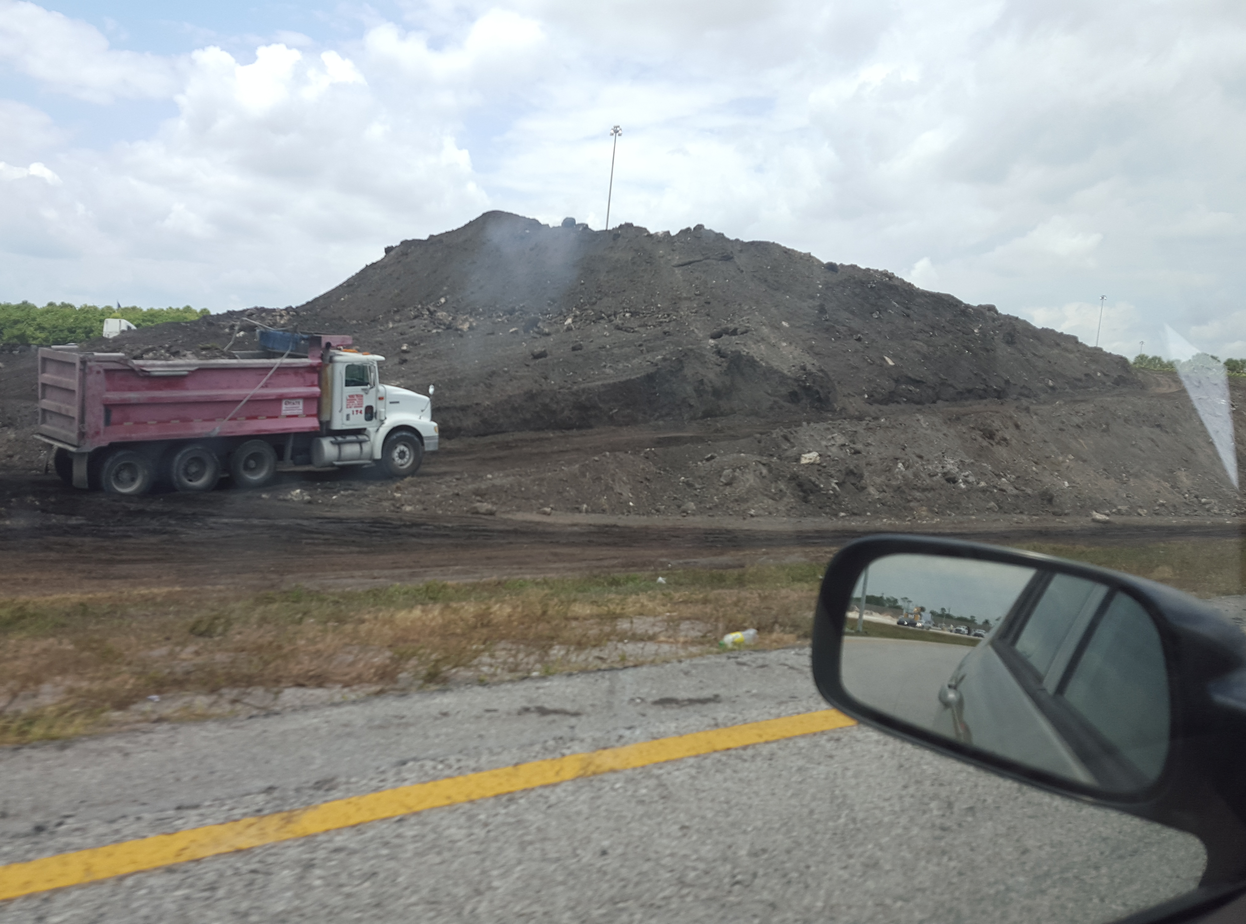
2000 Lane Miles Resurfacing per Year
2.25 inch
Average Milling Depth
1.8 Million Tons
RAP
Introduction
Research Objectives
Methodology
Mixtures Tests
Binder Tests
Conclusions

Slide 4
The average RAP content is under 25%
Why?
Lack of Confidence
Need for More Effective Design and Performance Verification Procedures High RAP Content Mixtures
Introduction
Research Objectives
Methodology
Mixtures Tests
Binder Tests
Conclusions

Slide 5
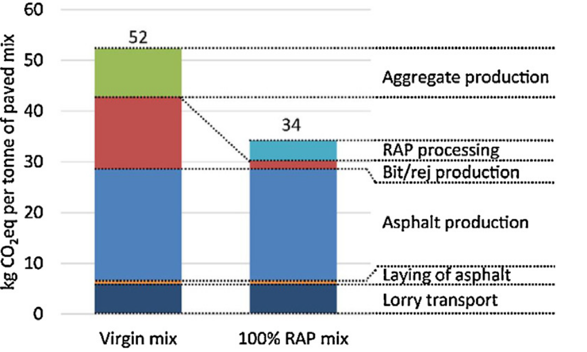
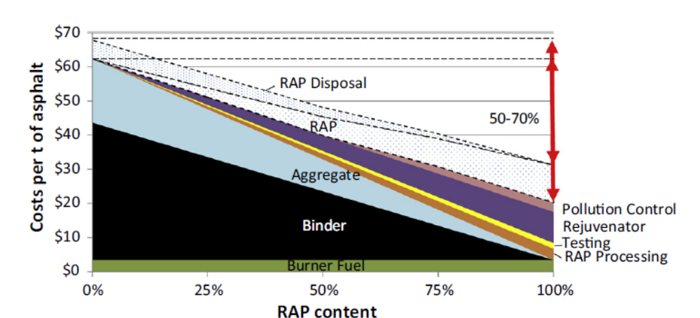
Zaumanis, Mallick,& Frank
(2014)
Introduction
Performance Grade
Durability
Summary
Homogeneity

Slide 6
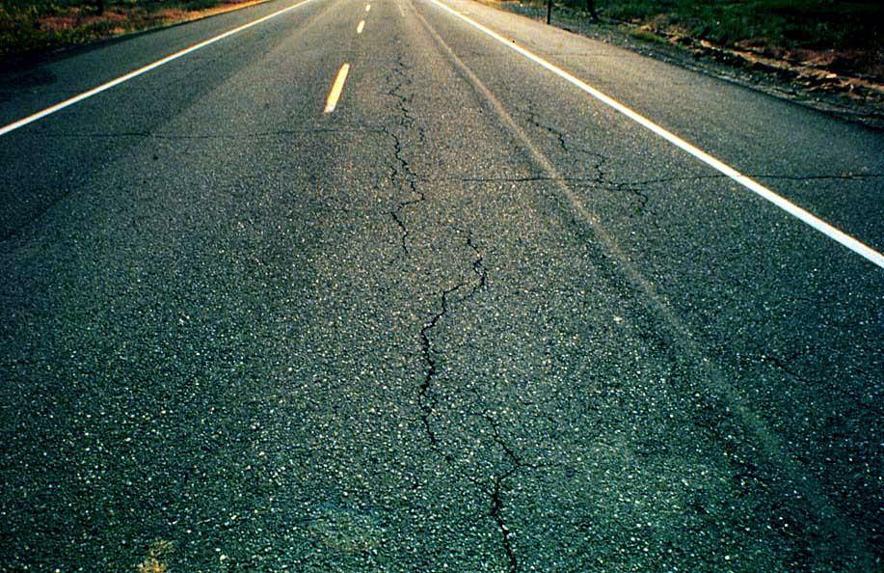
Cracking Resistance
Fast Aging
Premature Cracking
Insufficient Design
Introduction
Research Objectives
Methodology
Mixtures Tests
Binder Tests
Conclusions

Slide 7
PERFORMANCE
Asphalt Binder
Aggregates
Mix Design
Construction
Asphalt Aging:
Asphalt hardens and gets brittle and prone to cracking due to weathering and construction heating
Rejuvenation:
Adding a recycling agent (rejuvenator) to aged asphalt to cure aging and restore its original properties
Effective rejuvenation has a major role in successful recycling
Asphalt
Asphaltenes
Maltenes
Introduction
Research Objectives
Methodology
Mixtures Tests
Binder Tests
Conclusions

Slide 8

Recycled Binder Durability
Introduction
Research Objectives
Methodology
Mixtures Tests
Binder Tests
Conclusions

Slide 9
How to verify effectiveness of rejuvenation?
Current practice:
Viscosity or penetration or performance grade requirements
FDOT: Pen. : 40 – 80 dmm ; Viscosity @ 160 º C : 5000 – 15000 Poises
Virgin Binder
Aging
RAP Binder
Rejuvenation
Recycled Binder
Durability
Cracking Resistance
Introduction
Research Objectives
Methodology
Mixtures Tests
Binder Tests
Conclusions

Slide 10
Research Objectives:
Evaluate Cracking Resistance and Durability of 100% RAP mixtures
Compare the cracking resistance of several samples of recycled binder and mixture to that of non-recycled samples
Monitor changes in the cracking resistance over the life of the pavement
Investigate the effect of rejuvenators on crackling resistance and durability
Introduction
Research Objectives
Methodology
Mixtures Tests
Binder Tests
Conclusions

Slide 11
Methodology:
 | Cracking Resistance | Aging
Binder | Bending Bean Rheometer (BBR) | Pressure Aging Vessel (PAV)
Mixture | Texas Overlay Test | Accelerated Pavement Weathering System (APWS)
Introduction
Research Objectives
Methodology
Mixtures Tests
Binder Tests
Conclusions

Slide 12
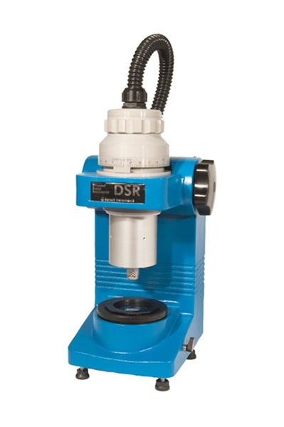
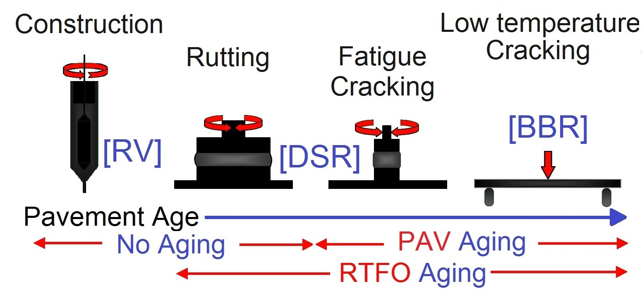
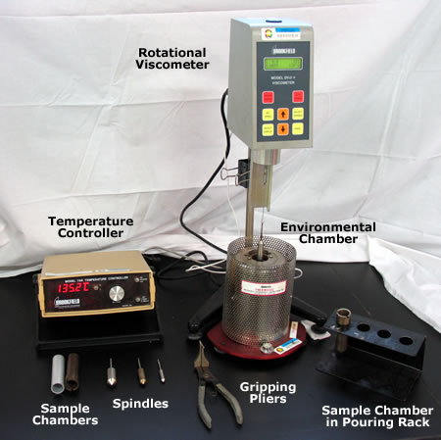
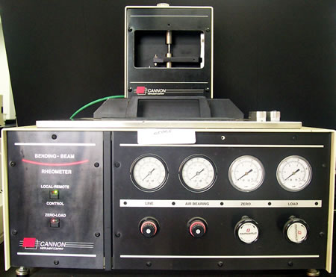
Methodology
Superpave Performance Grade (PG) System
Introduction
Research Objectives
Methodology
Mixtures Tests
Binder Tests
Conclusions

Slide 13
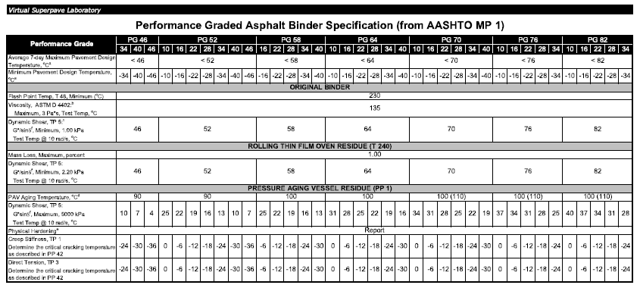
Florida: PG 67-22
PG 64 -22
Introduction
Research Objectives
Methodology
Mixtures Tests
Binder Tests
Conclusions

Slide 14
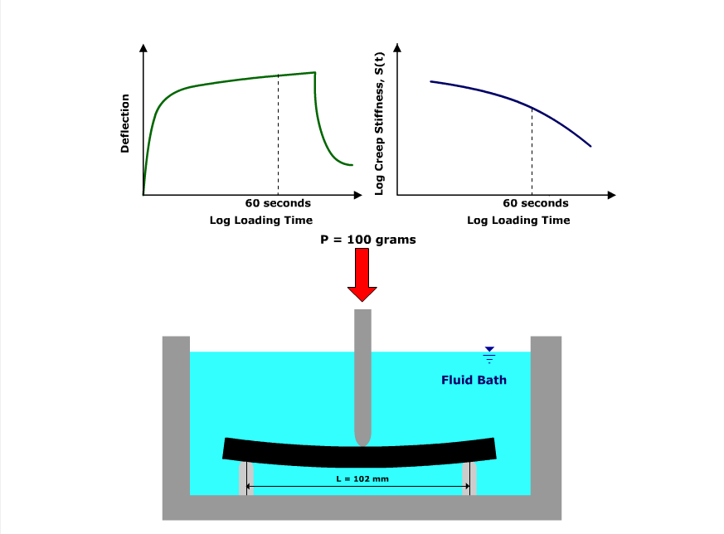
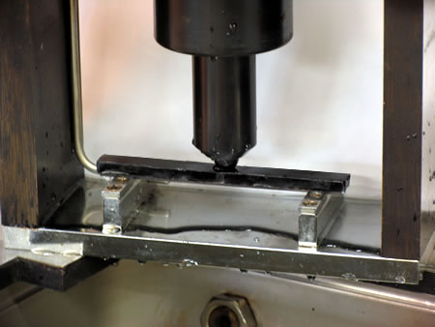
Bending Beam Rheometer (BBR)
Introduction
Research Objectives
Methodology
Mixtures Tests
Binder Tests
Conclusions

Slide 15
Bending Beam Rheometer (BBR)
Parameters
Creep Stiffness
(S)
The stiffness at 60 second
stress relaxation parameter
(m-value)
The slope of master stiffness curve at 60 s
PG requirement: S ≤ 300 Mpa
Indicate the amount of thermal stresses
PG requirement: m-value ≥ 3.00
Indicates the ability to relax stresses
Introduction
Research Objectives
Methodology
Mixtures Tests
Binder Tests
Conclusions

Slide 16
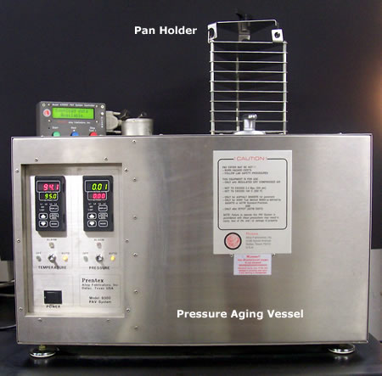
Pressure Aging Vessel (PAV)
Simulates long-term aging of the binder using heat and pressure
Temperature: 90, 100, or 110 °C
Pressure: 2.1 Mpa
Time : 20 hours
Simulate 7-10 years in service aging
Introduction
Research Objectives
Methodology
Mixtures Tests
Binder Tests
Conclusions

Slide 17
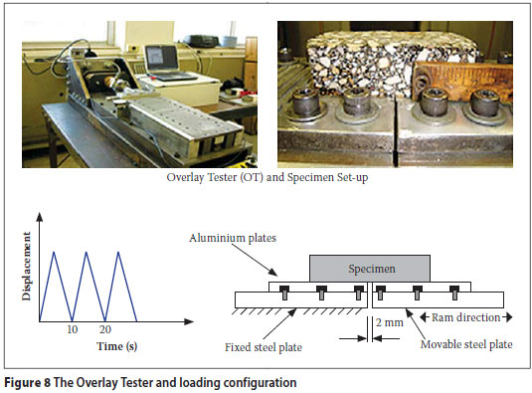
Texas Overlay Test
Evaluates the susceptibility of asphalt mixtures to fatigue and reflective cracking
Applies repeated tension loads to the specimen to simulate repeated opening and closing of pavement joints and cracks due to temperature variations and traffic loading
Designed by Texas Department of Transportation
Introduction
Research Objectives
Methodology
Mixtures Tests
Binder Tests
Conclusions

Slide 18
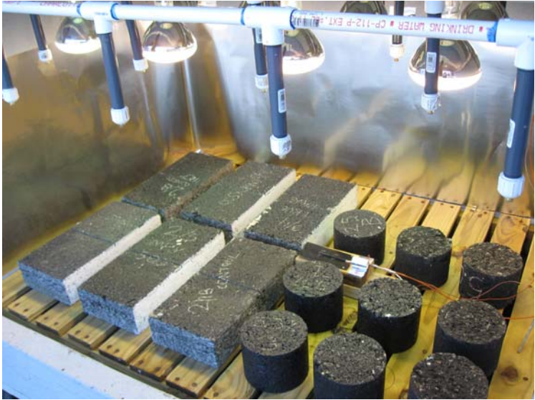
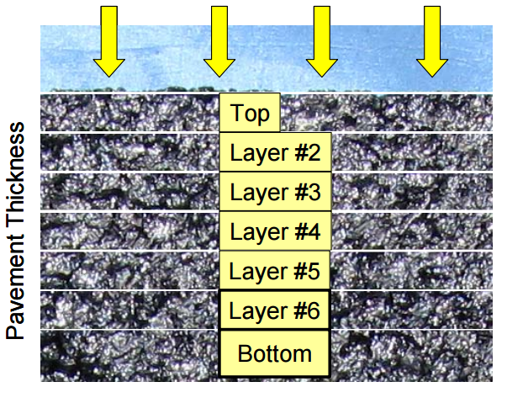
Asphalt Pavement Weathering System (APWS)
Accelerated pavement weathering
Simulates natural pavement weathering (top to down) with parameters such as moisture (rain), UV (sunshine) and temperature
Incorporates full-depth samples
Introduction
Research Objectives
Methodology
Mixtures Tests
Binder Tests
Conclusions

Slide 19
Binder Tests
Aging (PAV):
  Standard: 20 hours (Plus RTFO)
  Extended: 60 hours
Virgin Binder: Two samples PG 67-22
  True High Temperature Grade: Binder 1: 68.36 °C; Binder 1: 71.63°C
Rejuvenators:
  HPE: Heavy Paraffinic Distilled Solvent Extract
  CWE: Water-based Emulsion From Wax Free Naphthenic Crude With Residue Content Of 60%
Introduction
Research Objectives
Methodology
Mixtures Tests
Binder Tests
Conclusions

Slide 20
Binder Tests
Softening Curves
Introduction
Research Objectives
Methodology
Mixtures Tests
Binder Tests
Conclusions

Slide 21
Aging | Binder | Rejuvenator | Temp. (⁰C) | Creep Stiffness (MPa) | m-value | Stiffness Critical Temp. (°C) | m-value Critical Temp. (°C) | High Temp. True Grade (°C)
Standard Aging RTFO + 20 hours PAV | Binder1 | Original | -12 | 190 | 0.309 | -25.4 | -22.7 | 87.7
 |  |  | -18 | 430 | 0.228
 |  | HPE | -12 | 72.8 | 0.353 | -31.5 | -25.9 | 83.4
 |  |  | -18 | 178 | 0.27
 |  | CWE | -12 | 81.1 | 0.346 | -31.4 | -26.8 | 81.9
 |  |  | -18 | 187 | 0.288
 | Binder2 | Original | -12 | 159 | 0.313 | -27.5 | -24.2 | 91.4
 |  |  | -18 | 319 | 0.277
 |  | HPE | -12 | 62.3 | 0.342 | -30.9 | -24.2 | 88.2
 |  |  | -18 | 180 | 0.229
 |  | CWE | -12 | 80.3 | 0.332 | -33.5 | -27.8 | 86.7
 |  |  | -18 | 160 | 0.299
Extended Aging 60 hours PAV | Binder1 | Original | -6 | 143 | 0.299 | -23.3 | -15.8 | 96.6
 |  |  | -12 | 263 | 0.258
 |  |  | -18 | 475 | 0.202
 |  | HPE | -6 | 46.1 | 0.319 | -33.5 | -19.9 | 93.4
 |  |  | -12 | 89.8 | 0.29
 |  |  | -18 | 169 | 0.258
 |  | CWE | -6 | 55.3 | 0.311 | -31.3 | -19.0 | 93.0
 |  |  | -12 | 112 | 0.289
 |  |  | -18 | 212 | 0.241
 | Binder2 | Original | -6 | 105 | 0.31 | -26.0 | -17.9 | 101.4
 |  |  | -12 | 191 | 0.279
 |  |  | -18 | 374 | 0.223
 |  | HPE | -6 | 36.5 | 0.372 | -29.4 | -22.6 | 94.6
 |  |  | -12 | 79.8 | 0.309
 |  |  | -18 | 233 | 0.205
 |  | CWE | -6 | 58.4 | 0.309 | -32.4 | -18.0 | 96.3
 |  |  | -12 | 112 | 0.282
 |  |  | -18 | 198 | 0.265
Introduction
Research Objectives
Methodology
Mixtures Tests
Binder Tests
Conclusions

Slide 22
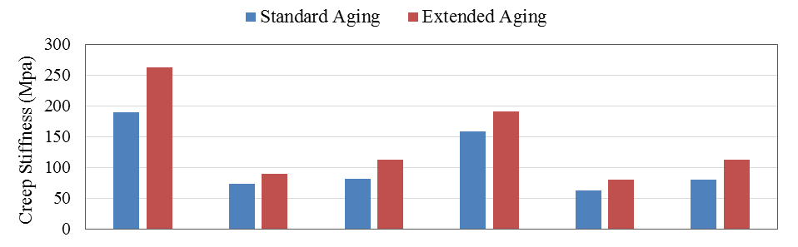
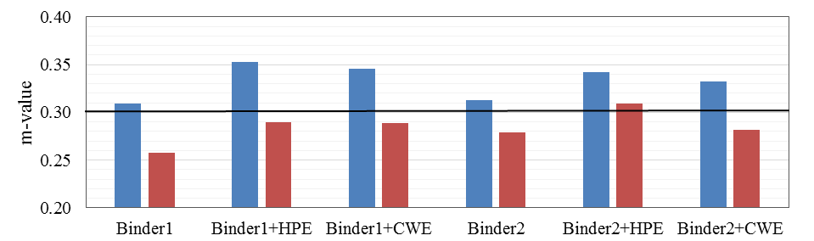
Introduction
Research Objectives
Methodology
Mixtures Tests
Binder Tests
Conclusions

Slide 23
Discussions:
Recycled samples had significantly lower creep stiffness than virgin binders. Also the m-value was generally higher for recycled samples.
By increasing the aging from the standard to the extended aging, the stiffness of all samples increased and their m-value dropped.
Even after 60 hours of PAV aging, the stiffness of recycled binders was lower than the stiffness limit for PG67-22 (S≤ 300 MPa at -12°C). However, in most cases the m-values were too low and did not meet the requirement (m ≥ 0.300 at -12⁰C)
Both Rejuvenators enhanced the cracking resistance as characterized by a lower creep stiffness and higher m-value.
Introduction
Research Objectives
Methodology
Mixtures Tests
Binder Tests
Conclusions

Slide 24
Mixture Tests
Texas Overlay Test for:
    Recycled and new mixture
    Before and after APWS aging
  Two recycled mixtures and two Control (new) mixtures
  APWS aging for 3000 and 6000 hours
  A 3,000-hour APWS exposure simulates the aging that occurs in the field in 7 to 10 years
Introduction
Research Objectives
Methodology
Mixtures Tests
Binder Tests
Conclusions

Slide 25
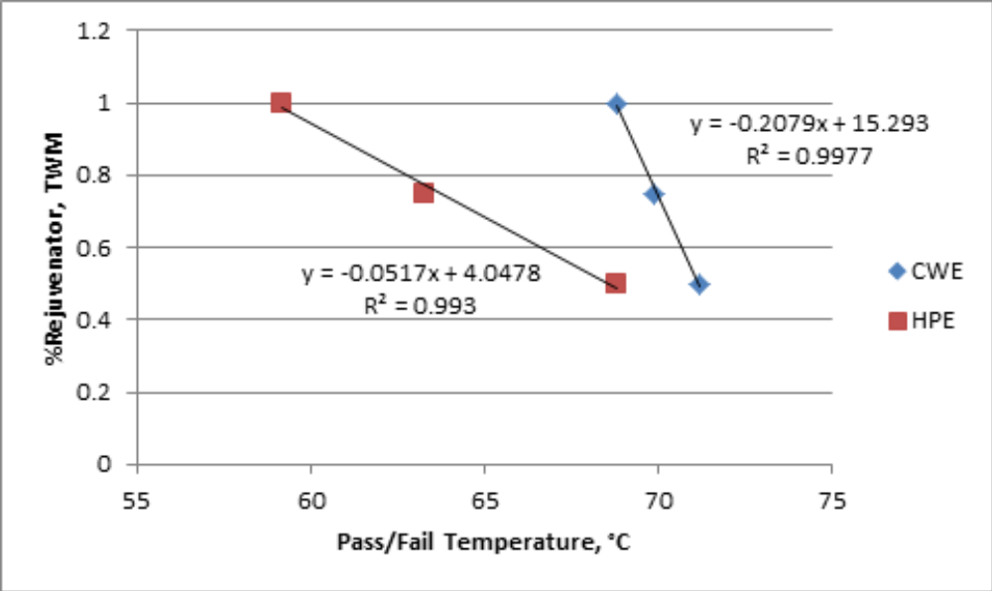
Sample Preparation
Recycled Mixtures
    Two recycled samples (CWE and HPE)
    RAP obtained from a hot in-place recycling project in Florida, USA
    Rap binder recovered to characterize and establish softening curves
    The same rejuvenators used for binder test used for rejuvenating the RAP
    3% screening sand
Introduction
Research Objectives
Methodology
Mixtures Tests
Binder Tests
Conclusions

Slide 26
Sample Preparation
Control Mixtures
Control I:
    Aggregate extracted from the RAP using ignition oven
    Mixed with PG 67-22 virgin binder with a binder content similar to the RAP (6.3%)
Control II: Mixtures commonly used in Florida
    All pills prepared using Gyratory Compactor with 50 gyrations
Introduction
Research Objectives
Methodology
Mixtures Tests
Binder Tests
Conclusions

Slide 27
Results
Mixture | Replicate | Starting Load, kN | Final Load, kN | Decline in Load, % | Cycles to Failure | Average Number of Cycles to Failure (ANCF)
0 Hours
Control I | 1 | 2.185 | 0.153 | 93 | 55 | 71
 | 2 | 1.724 | 0.117 | 93.2 | 72
 | 3 | 2.325 | 0.159 | 93.2 | 86
Control II | 1 (SP) | 4.230 | 0.282 | 93.3 | 104 | 63
 | 2 (SP) | 0.155 | 0.008 | 94.7 | 62
 | 3 (FC) | 2.582 | 0.175 | 93.2 | 24
HPE | 1 | 1.653 | 0.112 | 93.2 | 384 | 239
 | 2 | 1.759 | 0.12 | 93.2 | 145
 | 3 | 1.797 | 0.119 | 93.4 | 189
CWE | 1 | 1.576 | 1.109 | 93.1 | 347 | 267
 | 2 | 1.742 | 0.118 | 93.2 | 144
 | 3 | 1.707 | 0.118 | 93.1 | 310
1000 Hours
Control I | 1 | 2.435 | 0.167 | 93.1 | 36 | 58
 | 2 | 2.438 | 0.168 | 93.1 | 79
HPE | 1 | 2.213 | 0.151 | 93.2 | 186 | 186
 | 2 | 2.135 | 0.147 | 93.1 | 98
 | 3 | 2.386 | 0.167 | 93 | 275
CWE | 1 | 2.53 | 0.174 | 93.1 | 153 | 253
 | 2 | 2.721 | 0.19 | 93 | 256
 | 3 | 2.526 | 0.174 | 93.1 | 349
3000 Hours
HPE | 1 | 2.987 | 0.23 | 93.2 | 75 | 71
 | 2 | 2.55 | 0.17 | 93.4 | 66
CWE | 1 | 2.927 | 0.199 | 93.2 | 58 | 98
 | 2 | 2.663 | 0.18 | 93.3 | 137
Introduction
Research Objectives
Methodology
Mixtures Tests
Binder Tests
Conclusions

Slide 28
Results
Introduction
Research Objectives
Methodology
Mixtures Tests
Binder Tests
Conclusions

Slide 29
Discussions
The Average Number of Cycles to Failure (ANCF) was considered an indication of susceptibility of mixtures to fatigue and reflective cracking
Both recycled samples performed much better than both control samples at the initial stage (before aging) . Their ANCF was significantly higher, meaning that they had much better cracking resistance
The ANCF decreases with increased APWS aging time.
The rate of decrease in the ANCF with APWS time was considerably faster for recycled mixtures than for the control I.
However, even at the end of 3,000 hours, recycled samples had an equally good or better resistance to cracking when compared with un-aged control samples.
Introduction
Research Objectives
Methodology
Mixtures Tests
Binder Tests
Conclusions

Slide 30
Discussions - Continued
The recycled samples which were rejuvenated by CWE were found to have a better performance than those rejuvenated by HPE
Limitations:
The variability of Texas Overlay Test results
The variability of the air voids between the control and recycled samples
The relatively small size of this experiment.
Introduction
Research Objectives
Methodology
Mixtures Tests
Binder Tests
Conclusions

Slide 31
Conclusions
Generally, recycled binders had significantly better cracking resistance than virgin binders. This fact was observed in both binder and mixture testing. This observation confirms that a properly recycled pavement can be even more resistant to cracking than a new pavement
In the binder testing, no consistent trend was observed in comparing the rate of decrease in cracking resistance of rejuvenated and virgin binders due to aging.
The cracking resistance of recycled samples dropped faster. But because of the significant difference in the initial values, even after aging recycled samples had a better cracking resistance
The cracking resistance of recycled mixtures was affected by the type of rejuvenator.
Introduction
Research Objectives
Methodology
Mixtures Tests
Binder Tests
Conclusions

Slide 32
Thank You

