Slide 1

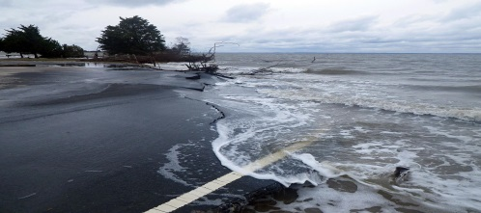
Macro Level Analysis of the Impacts of Sea-level Rise on Pavements Structural Capacity
Mostafa Batouli, PhD
And
Hesham Ali, PhD, PE

Slide 2
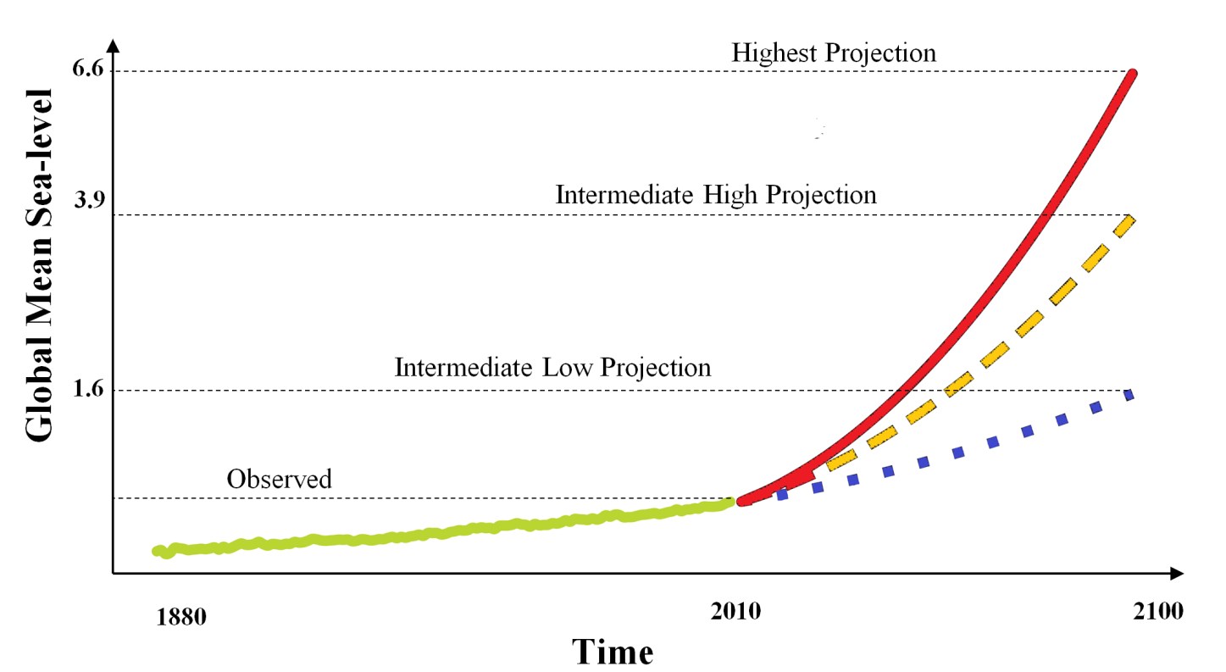
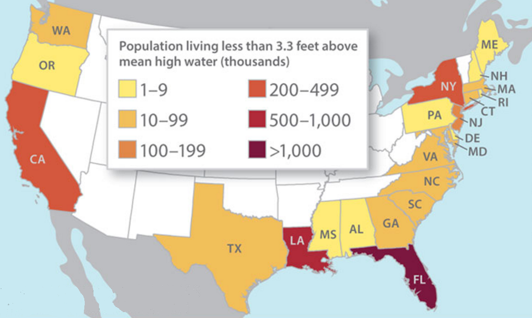
2
1
Problem Statement
Sea-level is rising due to climate change which will increasingly affect densely populated communities in low-lying coastal regions (IPCC 2014).
(Climate Central 2011)
(NOAA 2015)
Problem Statement
Research Objectives
Research Framework
Research Hypotheses
Research Method
Research Design
Proof of Concept
Future Steps
Expected Contributions

Slide 3
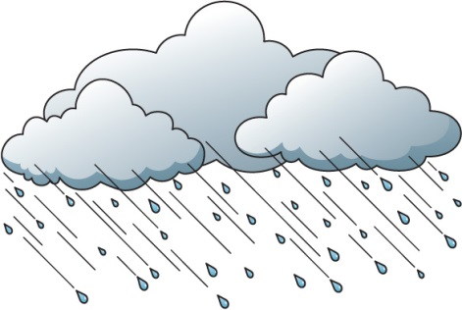

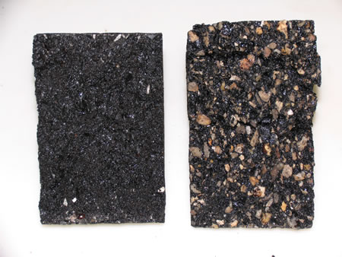
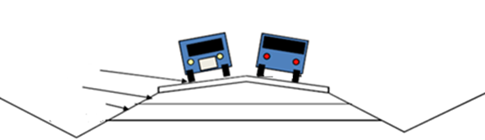

3
1
Problem Statement
Loss of Functionality & Performance of Roadway Infrastructure is one of the most remarkable impacts of sea-level rise (SLR) (Compact 2012).
Asphalt
Base
Subbase
Drainage
Water Table
Water Table
Problem Statement
Research Objectives
Research Framework
Research Hypotheses
Research Method
Research Design
Proof of Concept
Future Steps
Expected Contributions
Notes:
Excessive water content in the pavement base, sub-base and sub-grade soil can cause early distress and lead to a structural or
functional failure of pavement. Asphalt binder is dissolved and washed away. Hence the aggregates remain uncoated which leads to road damages.

Slide 4
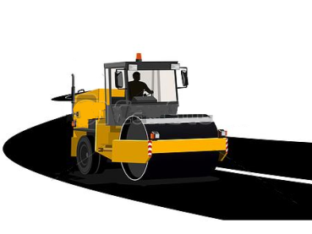




4
1
Problem Statement
Adaptation means anticipating the adverse effects of climate change and taking appropriate action to prevent or minimize the damage they can cause (IPCC 2014).
Economic Impact
More frequent M&R
Environmental Impact
Roadway Damage
Social Impact
Traffic disruption
“If we don’t adapt to sea level rise, the consequences will be quite dramatic through the 21st century”
(Climate Central 2014)
Problem Statement
Research Objectives
Research Framework
Research Hypotheses
Research Method
Research Design
Proof of Concept
Future Steps
Expected Contributions
Notes:
Excessive water content in the pavement base, sub-base and sub-grade soil can cause early distress and lead to a structural or
functional failure of pavement.

Slide 5
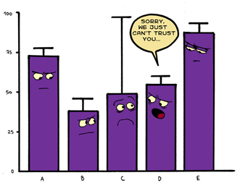


5
1
Problem Statement
Effective adaptation to SLR requires an understanding of the long-term impacts of SLR and adaptation on roadway infrastructure.
Uncertainty in the Magnitude and Frequency of SLR
Adaptive Behavior of Social Actors
Complexity of Evaluating Impacts of SLR
Problem Statement
Research Objectives
Research Framework
Research Hypotheses
Research Method
Research Design
Proof of Concept
Future Steps
Expected Contributions

Slide 6


6
1
Problem Statement
The existing approaches for evaluating the impacts of SLR do not consider the evolving conditions of roadway networks.
Assess the impacts based on the existing conditions of assets.
Asset conditions will evolve due to deterioration and dynamic decision making of social actors.
Problem Statement
Research Objectives
Research Framework
Research Hypotheses
Research Method
Research Design
Proof of Concept
Future Steps
Expected Contributions

Slide 7
7
2
Research Objective
To provide a better understanding of sea-level rise adaptation by answering the following important questions:
Question #1
What are the long-term impacts of SLR on economic, environmental, and social performance of roadway infrastructure systems?
Question #2
What adaptation strategies can mitigate the long-term impacts of SLR on roadway infrastructure?
Question #3
What adaptation planning approach is more effective for dealing with the SLR uncertainty?
Problem Statement
Research Objectives
Research Framework
Research Hypotheses
Research Method
Research Design
Proof of Concept
Future Steps
Expected Contributions

Slide 8
8
3
Research Framework
SLR affects the economic, environmental, and social performance of roadway infrastructure by influencing the interactions between agency and network.
Physical Damage
Roadway Network
Economic Impacts
Environmental Impacts
Social Impacts
Sea-Level Rise
Functional & Structural Conditions
Business as Usual Decisions
Adaptation Actions
Agency Behaviors
Risk Perception
Problem Statement
Research Objectives
Research Framework
Research Hypotheses
Research Method
Research Design
Proof of Concept
Future Steps
Expected Contributions

Slide 9
9
4
Research Hypotheses
This research tests the following three hypothesis:
Hypothesis 1
The long-term performance of roadway infrastructure is sensitive to future scenarios of SLR.
Hypothesis 2
A set of adaptation actions exist that could mitigate the impacts of SLR on roadway infrastructure across different SLR scenarios.
Hypothesis 3
An adaptation planning approach based on periodic evaluation of uncertainty reduces SLR impacts on a roadway network.
Problem Statement
Research Objectives
Research Framework
Research Hypotheses
Research Method
Research Design
Proof of Concept
Future Steps
Expected Contributions

Slide 10

10
5
Research Method
A simulation approach is adopted to capture the behaviors and interactions of physical network and agency.
Long-term Impacts
Direct Observation
Not
Feasible
Sea-level Rise
Problem Statement
Research Objectives
Research Framework
Research Hypotheses
Research Method
Research Design
Proof of Concept
Future Steps
Expected Contributions

Slide 11
10
5
Research Method
A simulation approach is adopted to capture the behaviors and interactions of physical network and agency.
Long-term Impacts
Agent-based Modeling
Dynamic Mathematical Simulation
Decision making behavior of the agency
Functional and structural condition of the road assets
Perception of Risk
Sea-level Rise
Physical Damage
Problem Statement
Research Objectives
Research Framework
Research Hypotheses
Research Method
Research Design
Proof of Concept
Future Steps
Expected Contributions

Slide 12
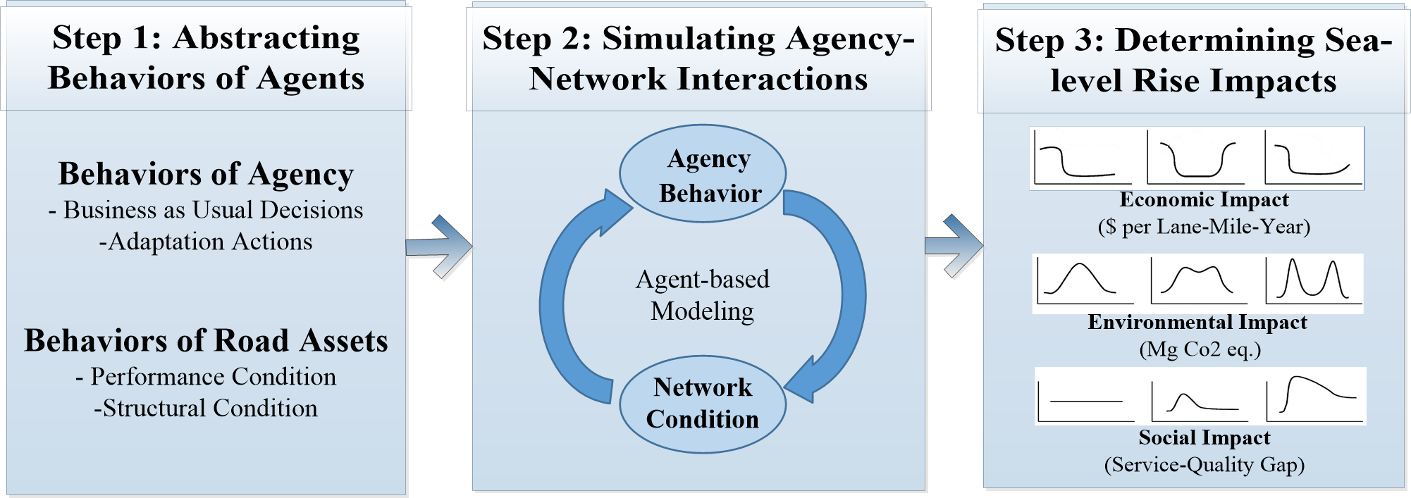
11
6
Research Design
Design for Testing Hypothesis #1
Design for Testing Hypothesis #2
Design for Testing Hypothesis #3
A three step process is followed to test hypothesis 1.
Decision Rules
Agency Behavior
Conditions of Roads
Decision Constraints
Perception of SLR risk
Problem Statement
Research Objectives
Research Framework
Research Hypotheses
Research Method
Research Design
Proof of Concept
Future Steps
Expected Contributions

Slide 13
11
6
Research Design
Design for Testing Hypothesis #1
Design for Testing Hypothesis #2
Design for Testing Hypothesis #3
A three step process is followed to test hypothesis 1.
Maintenance, Rehabilitation
Assets Behaviors
Structural
Design
Level of Traffic
Flooding Damage
Problem Statement
Research Objectives
Research Framework
Research Hypotheses
Research Method
Research Design
Proof of Concept
Future Steps
Expected Contributions

Slide 14
11
6
Research Design
Design for Testing Hypothesis #1
Design for Testing Hypothesis #2
Design for Testing Hypothesis #3
A three step process is followed to test hypothesis 1.
Problem Statement
Research Objectives
Research Framework
Research Hypotheses
Research Method
Research Design
Proof of Concept
Future Steps
Expected Contributions

Slide 15
11
6
Research Design
Design for Testing Hypothesis #1
Design for Testing Hypothesis #2
Design for Testing Hypothesis #3
A three step process is followed to test hypothesis 1.
Timing & type of M&R and Construction activities
Annual Level of Service & Performance of Roads
Problem Statement
Research Objectives
Theoretical Framework
Research Hypotheses
Research Method
Research Design
Proof of Concept
Research Plan
Expected Contributions

Slide 16
11
6
Research Design
Design for Testing Hypothesis #1
Design for Testing Hypothesis #2
Design for Testing Hypothesis #3
A three step process is followed to test hypothesis 1.
Life Cycle Cost Analysis
Life Cycle Assessment
Service-Quality Gap Model
Timing & type of M&R and Construction activities
Annual Level of Service & Performance of Roads
Problem Statement
Research Objectives
Research Framework
Research Hypotheses
Research Method
Research Design
Proof of Concept
Future Steps
Expected Contributions

Slide 17
11
6
Research Design
Design for Testing Hypothesis #1
Design for Testing Hypothesis #2
Design for Testing Hypothesis #3
A three step process is followed to test hypothesis 1.
Problem Statement
Research Objectives
Research Framework
Research Hypotheses
Research Method
Research Design
Proof of Concept
Future Steps
Expected Contributions

Slide 18
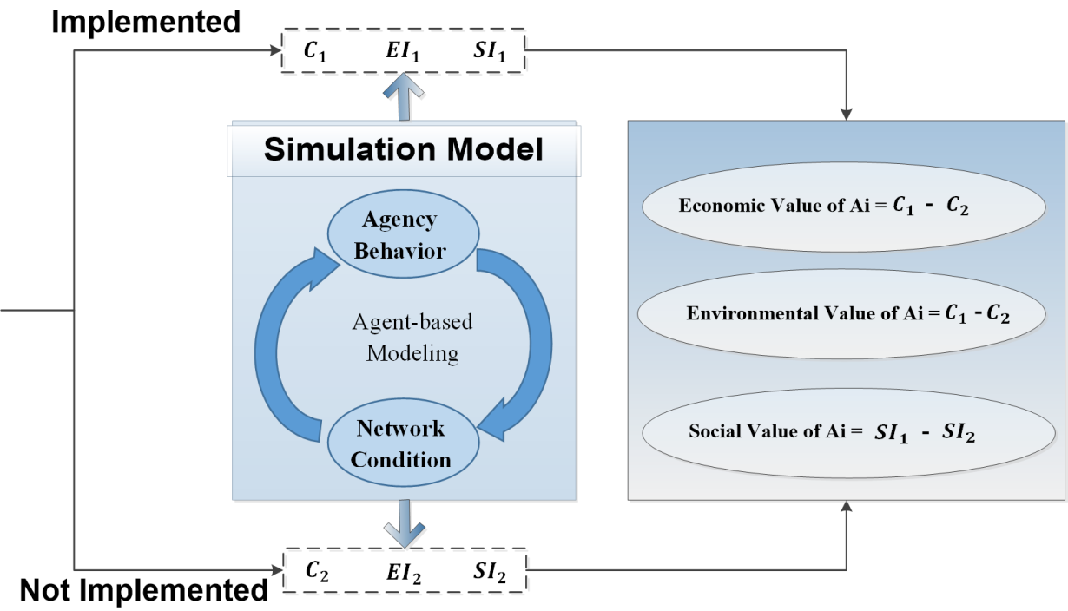

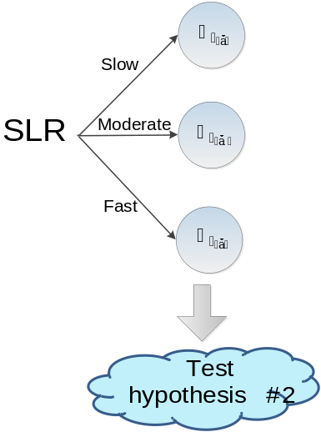
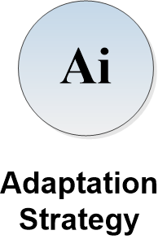

12
6
Research Design
Design for Testing Hypothesis #1
Design for Testing Hypothesis #2
Design for Testing Hypothesis #3
A four step process is followed to test hypothesis 2.
Step 1: Identify Adaptation Action Space
Step 2: Generate Adaptation Strategies
Step 3: Assess the value of Strategies
Step 4: Test the Hypothesis 2
$$A_{i}⊆\left\{a_{i},a_{2},{…, a}_{n}\right\}$$
Problem Statement
Research Objectives
Research Framework
Research Hypotheses
Research Method
Research Design
Proof of Concept
Future Steps
Expected Contributions

Slide 19


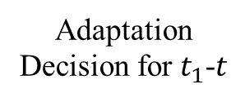
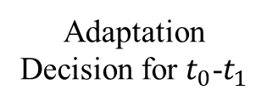
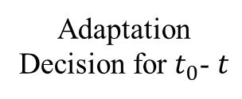



13
6
Research Design
Design for Testing Hypothesis #1
Design for Testing Hypothesis #2
Design for Testing Hypothesis #3
Non-flexible Adaptation Strategy
Flexible Adaptation Strategy
Adaptation Decision for $t_{1}$-$t$
Fast SLR
High Uncertainty
Adaptation Decision for $t_{0}$- $t$
Adaptation Decision for $t_{0}$-$t_{1}$
Slow SLR
Observation
Low Uncertainty
$$t_{0}$$
$$t$$
Time
$$t_{0}$$
$$t_{1}$$
$$t$$
Time
Advantage: Higher Return on Investment
Advantage: Lower Value at Risk
Limitation: Lower Return on Investment
Limitation: Higher Value at Risk
Problem Statement
Research Objectives
Research Framework
Research Hypotheses
Research Method
Research Design
Proof of Concept
Future Steps
Expected Contributions

Slide 20
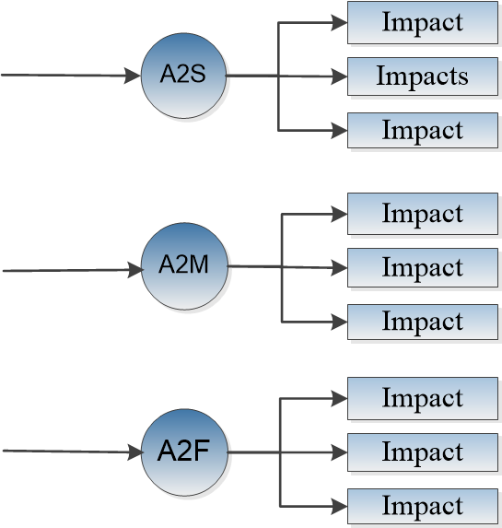
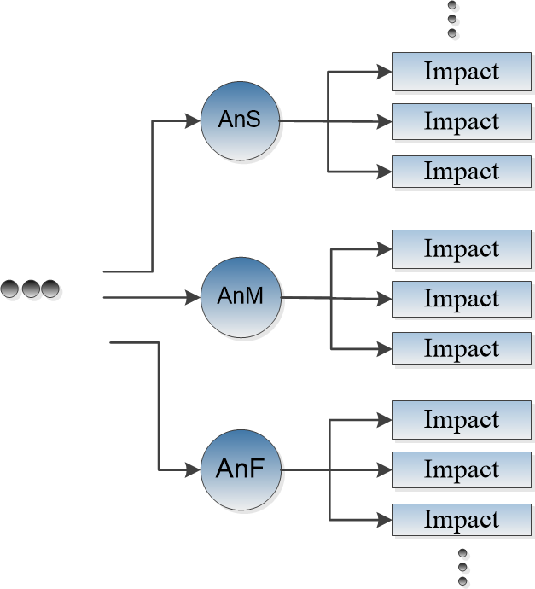
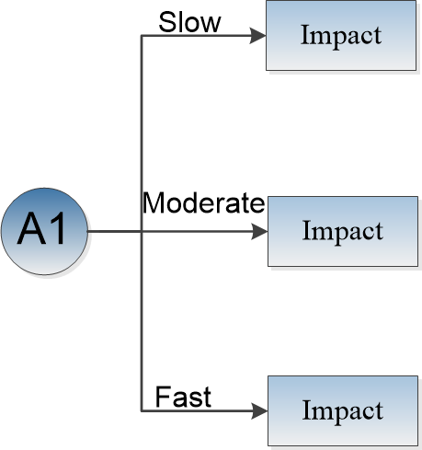
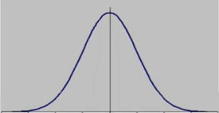
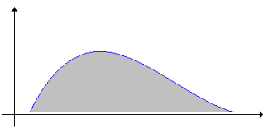




14
6
Research Design
Design for Testing Hypothesis #1
Design for Testing Hypothesis #2
Design for Testing Hypothesis #3
Monte Carlo Simulation
Flexible Approach
First Decision Window
Second Decision Window
nth Decision Window
Monte Carlo Simulation
Non-Flexible Approach
$$t_{0}$$
$$t_{1}$$
$$t_{2}$$
$$t$$
Problem Statement
Research Objectives
Research Framework
Research Hypotheses
Research Method
Research Design
Proof of Concept
Future Steps
Expected Contributions

Slide 21
12
6
Research Design
Design for Testing Hypothesis #1
Design for Testing Hypothesis #2
Design for Testing Hypothesis #3
A three step process is followed to test hypothesis 3.
Step 1: Simulate long-term planning strategy
Step 2: Simulate flexible planning strategy
Step 3: Compare the two planning approaches
Problem Statement
Research Objectives
Theoretical Framework
Research Hypotheses
Research Design
Proof of Concept
Research Schedule
Expected Contributions

Slide 22
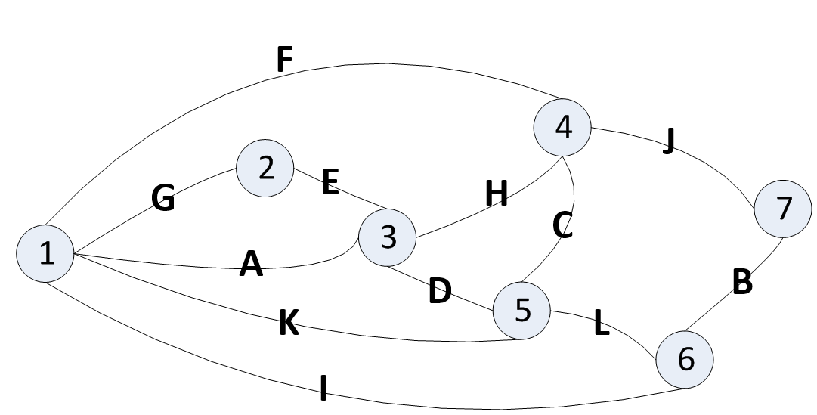
15
7
Proof of Concept
A Pavement Network Is Studied to Test Feasibility of the Proposed Research Method.
Road Name | Road Type | Pavement Type | Length (Miles) | Width (Yards) | Elevation (Feet) | STR | ESAL/Day (in base year)
A | R | Flex | 1.55 | 12.03 | 2 | 3.53 | 224
B | I | Com | 0.50 | 12.47 | 3 | 14.57 | 1185
C | I | Flex | 0.68 | 13.67 | 4 | 4.35 | 1645
D | I | Flex | 0.19 | 12.47 | 5 | 7.22 | 1756
E | R | Flex | 0.43 | 14.22 | 4 | 4.79 | 864
F | R | JPCP | 2.73 | 13.78 | 3 | 11.02 | 688
G | I | JPCP | 0.62 | 15.53 | 6 | 17.72 | 1142
H | R | JRCP | 1.06 | 17.94 | 3 | 13.39 | 1785
I | R | JRCP | 2.80 | 13.01 | 3 | 13.39 | 1785
J | I | Com | 1.37 | 13.56 | 4 | 14.57 | 1185
K | I | Flex | 1.68 | 12.90 | 3 | 5.60 | 1479
L | I | Flex | 0.62 | 18.15 | 4 | 7.71 | 1756
Source: The ICMPA7 Investment Analysis and Communication Challenge for Road Assets (Haas 2008)
Problem Statement
Research Objectives
Research Framework
Research Hypotheses
Research Method
Research Design
Proof of Concept
Future Steps
Expected Contributions

Slide 23
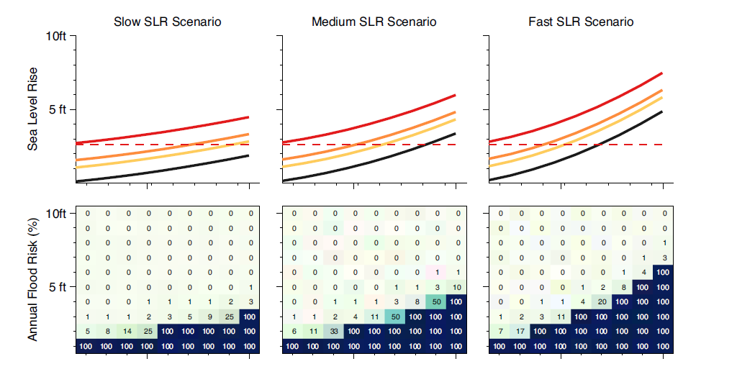
16
7
Proof of Concept
The network is exposed to flood damage caused by sea-level rise scenarios related to Southeast Florida.
2020
2060
2100
2020
2060
2100
2020
2060
2100
(Strauss et al. 2013).
Problem Statement
Research Objectives
Research Framework
Research Hypotheses
Research Method
Research Design
Proof of Concept
Future Steps
Expected Contributions

Slide 24
17
7
Proof of Concept
Proof of Concept for Hypothesis #1
Proof of Concept for Hypothesis #2
Proof of Concept for Hypothesis #3
Asset Behaviors
Cash Flows
Cost Annuities
Structure
Performance
(Lee et. al. 1993)
(Zhang et. al. 2008)
Asset 1
Simulation Model
Asset 1
Asset 2
Asset 2
Adaptation action
Business as Usual
Asset n
Asset n
(Berry et. al. 2009)
(Chootinan et. al. 2008)
Unit Cost of paving activities
(Batouli et. al. 2015)
Agency Behaviors
Problem Statement
Research Objectives
Research Framework
Research Hypotheses
Research Method
Research Design
Proof of Concept
Future Steps
Expected Contributions

Slide 25
18
7
Proof of Concept
Proof of Concept for Hypothesis #1
Proof of Concept for Hypothesis #2
Proof of Concept for Hypothesis #3
The results show potential of the proposed framework and computational model for assessing the long-term costs of SLR on a roadway network respective to first question and hypothesis.
Problem Statement
Research Objectives
Research Framework
Research Hypotheses
Research Method
Research Design
Proof of Concept
Future Steps
Expected Contributions

Slide 26
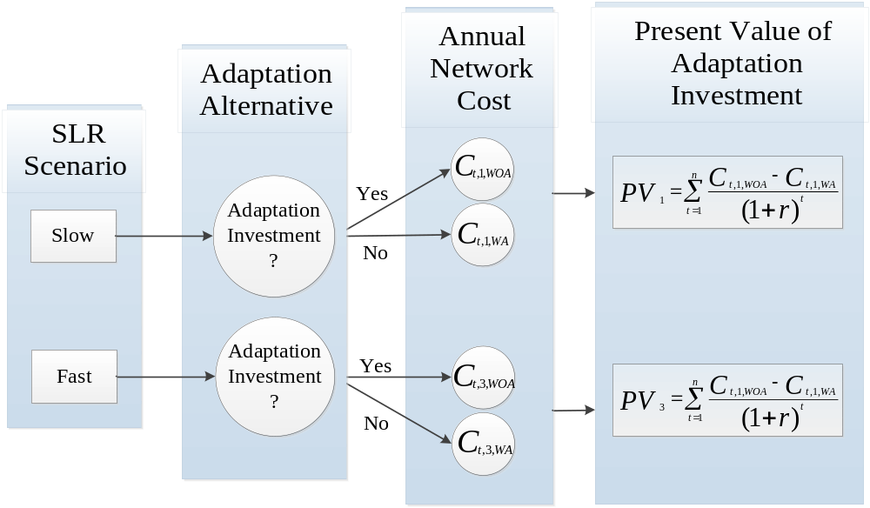
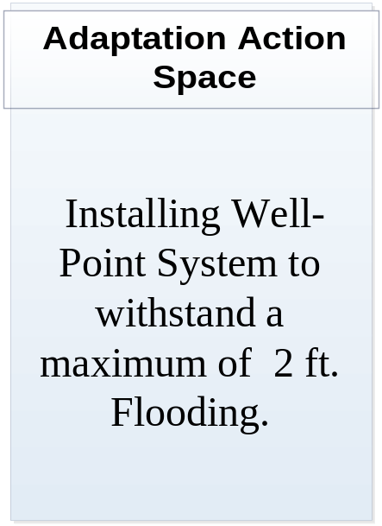
19
7
Proof of Concept
Proof of Concept for Hypothesis #1
Proof of Concept for Hypothesis #2
Proof of Concept for Hypothesis #3
Problem Statement
Research Objectives
Research Framework
Research Hypotheses
Research Method
Research Design
Proof of Concept
Future Steps
Expected Contributions

Slide 27
20
7
Proof of Concept
Proof of Concept for Hypothesis #1
Proof of Concept for Hypothesis #2
Proof of Concept for Hypothesis #3
The results show potential of the proposed framework and computational model for evaluating the impacts of adaptation on network cost respective to second question and hypothesis.
Annual value of Adaptation
Annual value of Adaptation
Problem Statement
Research Objectives
Research Framework
Research Hypotheses
Research Method
Research Design
Proof of Concept
Future Steps
Expected Contributions

Slide 28
21
7
Proof of Concept
Proof of Concept for Hypothesis #1
Proof of Concept for Hypothesis #2
Proof of Concept for Hypothesis #3
The results show potential of the proposed framework and computational model for evaluating the impacts of adaptation on network cost respective to second question and hypothesis.
Problem Statement
Research Objectives
Research Framework
Research Hypotheses
Research Method
Research Design
Proof of Concept
Future Steps
Expected Contributions

Slide 29
22
7
Proof of Concept
Proof of Concept for Hypothesis #1
Proof of Concept for Hypothesis #2
Proof of Concept for Hypothesis #3
The results motivated development of hypothesis 3.
Problem Statement
Research Objectives
Research Framework
Research Hypotheses
Research Method
Research Design
Proof of Concept
Future Steps
Expected Contributions

Slide 30
19
7
Proof of Concept
Proof of Concept for Hypothesis #1
Proof of Concept for Hypothesis #2
Proof of Concept for Hypothesis #3
Additional stormwater systems
  Useful in short term
  Requires means to discharge the added stormwater
Well point systems
  More permeant solution
  A series of pump stations may be required (Typical dewatering systems are confined to areas less than 500 feet long)
  The cost could exceed $1 million per lane mile (the cost has the potential to double)
Problem Statement
Research Objectives
Research Framework
Research Hypotheses
Research Method
Research Design
Proof of Concept
Future Steps
Expected Contributions

Slide 31
19
7
Proof of Concept
Proof of Concept for Hypothesis #1
Proof of Concept for Hypothesis #2
Proof of Concept for Hypothesis #3
Exfiltration trenches or French drains
  will cease to work as they become submerged so this technology will be abandoned.
Elevating the road
  Solves the problem at root
  Huge impact on adjacent properties
  Exceed the cost of new roads.
Problem Statement
Research Objectives
Research Framework
Research Hypotheses
Research Method
Research Design
Proof of Concept
Future Steps
Expected Contributions

Slide 32
17
7
Proof of Concept
Proof of Concept for Hypothesis #1
Proof of Concept for Hypothesis #2
Proof of Concept for Hypothesis #3
The agency behaviors are modeled using action charts in a Java based programming platform.
PSR< M&R is considered
M&R is applied only if it restores performance to PSR>4
Roads with lower PSR are prioritized for M&R funding
Decision Rules
Annual M&R budget=$300K
Urban and rural roads are irremediable with PSR values of 2.2 and 2, respectively
No link could be left failed
Agency Behavior
Conditions of Roads
Decision Constraints
PSR values are taken from the simulation model.
The flooding risk respective to Southeast Florida as projected in Strauss et al. (2013).
Perception of SLR risk
Problem Statement
Research Objectives
Theoretical Framework
Research Hypotheses
Research Design
Proof of Concept
Research Schedule
Expected Contributions

Slide 33

15
7
Proof of Concept
Proof of Concept for Hypothesis #1
Proof of Concept for Hypothesis #2
Proof of Concept for Hypothesis #3
The behaviors of road assets are extracted from literature.
Routine Maintenance
Surface Treatment
Overlay
Rehabilitation
Maintenance, Rehabilitation
(Chootinan et al. 2008)
Assets Behaviors
CSAL: Cumulative Equivalent Single Axle Load.
Structural
Design
Level of Traffic
$$STR=a_{1}.D_{1}+a_{2}.D_{2}+a_{3}.D_{3}$$
Flooding Damage
Percentage reduction of STR due to flooding
(Zhang et al. 2008)
Problem Statement
Research Objectives
Theoretical Framework
Research Hypotheses
Research Design
Proof of Concept
Research Schedule
Expected Contributions

Slide 34
16
7
Proof of Concept
Proof of Concept for Hypothesis #1
Proof of Concept for Hypothesis #2
Proof of Concept for Hypothesis #3
A simplified performance prediction model is used to simulate the performance conditions of road assets..
${PSR}_{j}={PSR}_{i}−A.F∗a∗$ ${STR}^{b}∗{{Age}_{j}}_{}^{C}∗{{CESAL}_{j}}^{d}$+${MR}_{j}$
Performance Improvement due to M&R activities
Initial PSR
Existing Pavement Structure
Adjustment factor for climate zone
Cumulative 18-kip Equivalent Single-axle loads
(Lee et al. 1993)
Problem Statement
Research Objectives
Theoretical Framework
Research Hypotheses
Research Design
Proof of Concept
Research Schedule
Expected Contributions

Slide 35
23
8
Future Steps
The research plan includes four major tasks:
Data Collection from Case Study
Interviews with agency personnel & review documents
Computation Model
Develop Computational Model
Simulation Experiments
Design experiments
Theoretical Constructs
Test Hypotheses using Monte Carlo simulation
Verification and Validation
Conduct Simulation Experiments
Theoretical Constructs Validation
Existing published data
Problem Statement
Research Objectives
Research Framework
Research Hypotheses
Research Method
Research Design
Proof of Concept
Future Steps
Expected Contributions

Slide 36
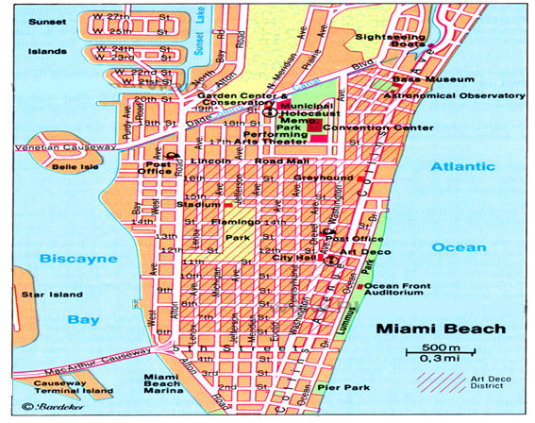
24
8
Future Steps
A Sub-portion of the roadway network in the City of Miami beach will be studied.
Problem Statement
Research Objectives
Research Framework
Research Hypotheses
Research Method
Research Design
Proof of Concept
Future Steps
Expected Contributions

Slide 37
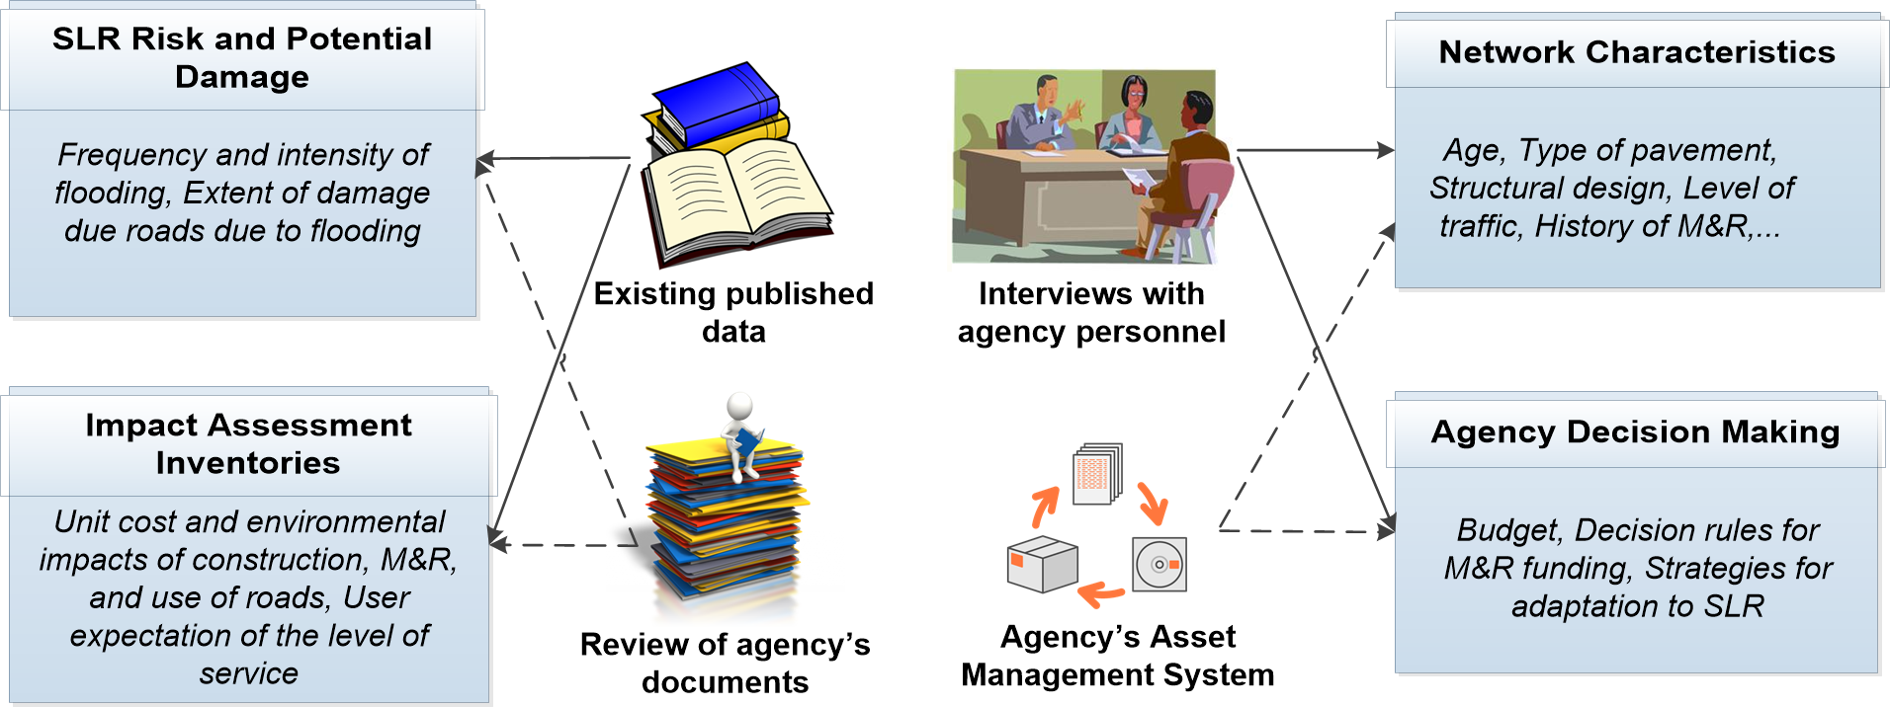
25
8
Future Steps
Different methods will be used to collect required data sources.
Problem Statement
Research Objectives
Research Framework
Research Hypotheses
Research Method
Research Design
Proof of Concept
Future Steps
Expected Contributions

Slide 38
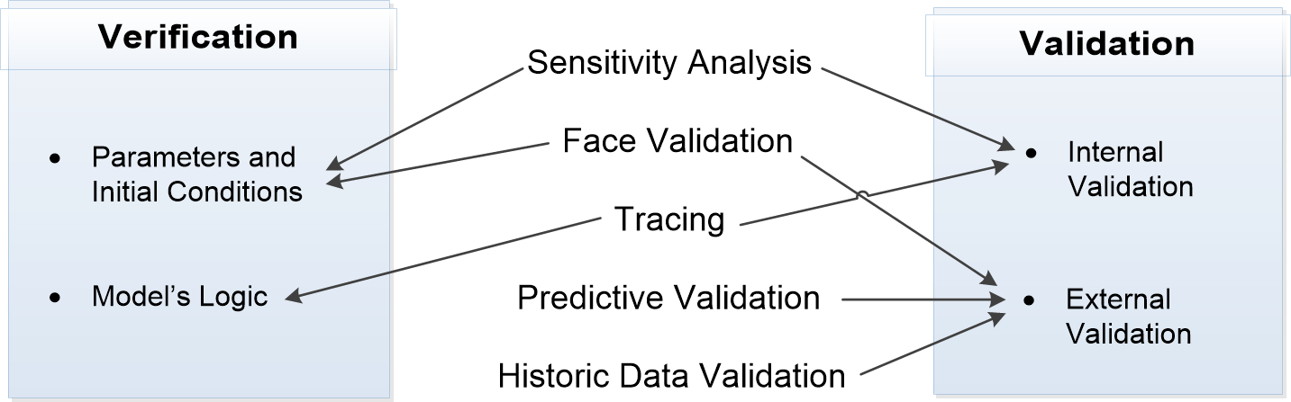
26
8
Future Steps
The simulation model will be verified and validated to ensure the completeness, consistency, coherence, and correctness of the model and its outcomes.
Problem Statement
Research Objectives
Research Framework
Research Hypotheses
Research Method
Research Design
Proof of Concept
Future Steps
Expected Contributions

Slide 39
28
9
Expected Contributions
Theoretical Contribution
Create theoretical constructs required for assessing long-term impacts of SLR on roadway infrastructure and evaluate adaptation strategies
Practical Implication
Enable assessing the long-term impacts of SLR on the environmental, economic and social performance of roadway infrastructure.
More informed decision-making for adaptive design, operation, and management of roadway infrastructure.
Contribute to the development of the theory of sustainable & resilient infrastructure
Capture dynamic interactions of social systems and physical networks as related to assessment of SLR impacts and adaptation
Problem Statement
Research Objectives
Research Framework
Research Hypotheses
Research Method
Research Design
Proof of Concept
Future Steps
Expected Contributions

Slide 40
References
Batouli, M., Swei, O. A., Zhu, J., Gregory, J., Kirchain, R., & Mostafavi, A. (2015, June). “A Simulation Framework for Network Level Cost Analysis in Infrastructure Systems”. In 2015 International Workshop on Computing in Civil Engineering.
Berry, L., Arockiasamy, M., Bloetscher, F., Kaisar, E., Rodriguez-Seda, J., Scarlatos, P., Teegavarapu, R., and Hammer, N. (2012). Development of a Methodology for the Assessment of Sea Level Rise Impacts on Florida's Transportation Modes and Infrastructure.
Chootinan, P., A. Chen, M. R. Horrocks and D. Bolling. 2006. “A Multi-year Pavement Maintenance Program Using a Stochastic Simulation-based Genetic Algorithm Approach.” Transportation Research Part A: Policy and Practice 40(9): 725-743
Compact, Southeast Florida Regional Climate Change. (2011). “Analysis of the Vulnerability of Southeast Florida to Sea Level Rise.” SFRCC Inundation Mapping and Vulnerability Assessment Work Group.
Lee,Y., A. Mohseni and M.I. Darter. 1993. “Simplified Pavement Performance Models.” Transportation Research Record 1993: 7-7.
Parris, A., Bromirski, P., Burkett, V., Cayan, D. R., Culver, M., Hall, J., Horton, R., Knuuti, K., Moss, R., and Obeysekera, J. (2012). Global sea level rise scenarios for the United States National Climate.
Strauss, B., Tebaldi, C., Kulp, S., Cutter, S., Emrich, C., Rizza, D., and Yawitz, D. (2013). Florida and the Surging Sea: A Vulnerability Assessment With Projections for Sea Level Rise and Coastal Flood Risk. Climate Central, Princeton, NJ.
Zhang, Z., Wu, Z., Martinez, M., and Gaspard, K. (2008). “Pavement structures damage caused by Hurricane Katrina flooding.” J.Geotech.Geoenviron.Eng., 134(5), 633-643.

Slide 41
Publications out of Dissertation
Other Publications in FIU
Conference Publication:
1.Batouli, M., & Mostafavi, A. (2015). Assessment of network-level environmental sustainability in infrastructure systems using service and performance adjusted life cycle analysis, ICSC15 – The Canadian Society for Civil Engineering’s 5th International/11th Construction Specialty Conference
2.Batouli, M., Swei, O. A., Zhu, J., Gregory, J., Kirchain, R., & Mostafavi, A. (2015, June). A Simulation Framework for Network Level Cost Analysis in Infrastructure Systems. In International Workshop on Computing in Civil Engineering.
3.Batouli, M., Mostafavi, A. (2014). A hybrid simulation framework for integrated infrastructure management, Winter Simulation Conference 2014.
4.Batouli, M., Mostafavi, A. (2015) A Simulation Framework for Sustainability Assessment in Evolving Socio-Technical Infrastructure Systems, Accepted for CONVR 2015
5.Batouli, M., Mostafavi, A. (2016) Assessment of Sea-Level Rise Adaptation in Coastal Infrastructure Systems: Robust Decision-Making under Uncertainty, Submitted to Construction Research Congress 2016
Journal Publication:
[1] Batouli, S. M., Zhu, Y., Nar, M., & D’Souza, N. A. (2014). Environmental Performance of Kenaf-fiber Reinforced Polyurethane: a Life Cycle Assessment Approach. Journal of Cleaner Production, 66, 164-173.
Conference Publication:
1.Orgut, R. E., Zhu, J., Batouli, M., Mostafavi, A., & Jaselskis, E. J. (2015). A review of the current knowledge and practice related to project progress and performance assessment, The Canadian Society for Civil Engineering’s 5th International/11th Construction Specialty Conference
2.Batouli, S. M., Zhu, Y. (2013). Comparative Life-Cycle Assessment Study of Kenaf Fiber-Based and Glass Fiber-Based Structural Insulation Panels. In ICCREM 2013@Construction and Operation in the Context of Sustainability (pp. 377-388). ASCE.
3.Batouli, S. M., & Zhu, Y. (2014). A Framework for Assessing Environmental Implications of an Urban Area, Construction Research Congress 2014
4.Batouli, S. M., & Zhu, Y. (2014). Using Accrual Accounting Life Cycle Assessment as an Indicator of Urban Sustainability, International Conference on Computing in Civil and Building Engineering 2014
5. Orgut, R. E., Batouli, M., Zhu, J., Mostafavi, A., & Jaselskis, E. J. (2016) Metrics that Matter: Evaluation of Best Practices for Project Progress Measurement, Performance Assessment, and Forecasting, Submitted to Construction Research Congress 2016

Slide 42
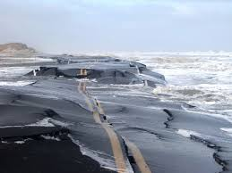
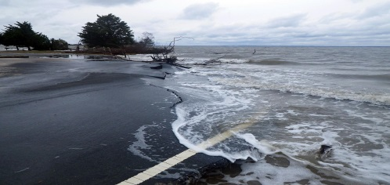
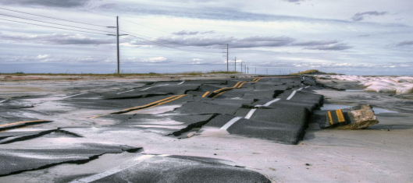
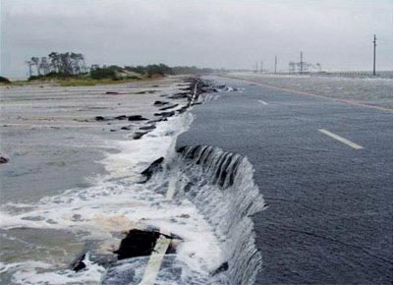
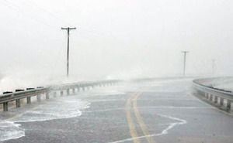
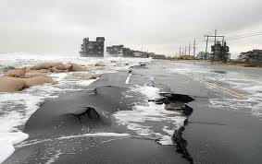

THANK YOU!

