Slide 1
CyberFLEX
Robot based product flexible Cyber Physical EOL test systems
Automation and Robotics 2016 Philadelphia 13th of June 2016
Herbert Pichlik
CTO
Lecturer at the University of Applied Sciences Georg-Simon Ohm in Nuremberg
President of the LabVIEW Usergroup Central Europe e.V.
SYSTEC GmbH Schreiberhauer Str. 5 90475 Nuremberg www.systec-gmbh.com
Phone: +49 (0)911 998955-631 FAX: +49 (0)911 998955-633 Mobile: +49 (0)175 242 18 20
Email: hpichlik@papp-gruppe.de

Slide 2
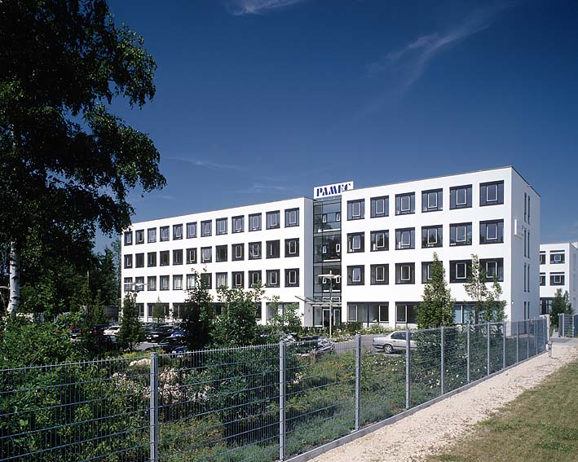
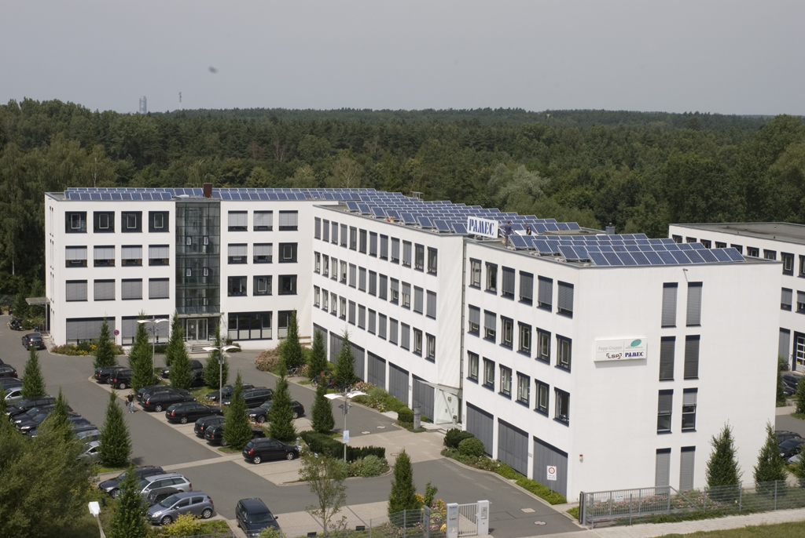
SYSTEC GmbH
  Founded 1990 in Nuremberg
  Part of the Papp Group
  CEO Peter Endres
  CTO Herbert Pichlik
Notes:
Die Firma wurde im Jahr 1990 gegründet und 2002 in die Papp-Firmengruppe eingegliedert.
Anfang diesen Jahres entschloss man sich – die quasi hauseigenen Konkurenz - den Bereich Pamec-Engineering in die Firma Systec einzugliedern.

Slide 3
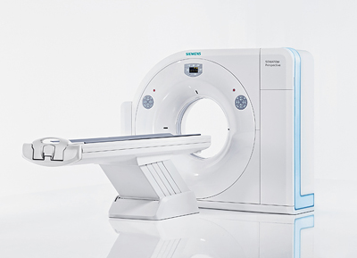



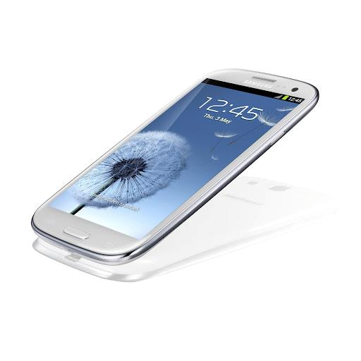
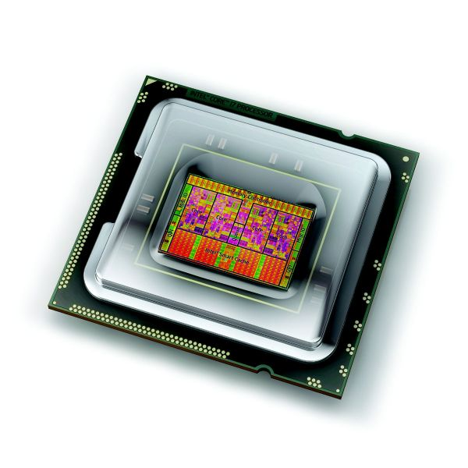

Markets

Slide 4










Partners

Slide 5
SYSTEC at a glance
Laboratories: Haptics, Image Acquisition, Lighting, Robotics, Motion, Electronics
National Instruments Alliance Partner, Mitsubishi Automation Center
ISO 9001 certified
Leading edge technologies in haptics test, image acquisition, robotics, motion, software engineering, realtime, FPGA, lighting ans image acquisition
Torque measurement systems
High Performance Test and Automation Framework
Torque Measurement and key haptics Transfer Standards
About 120 customers and more than 1300 solutions worldwide

Slide 6
Software
Toolchain
Platforms
Tools
Allication Frameworks
Notes:
Durch die Leistungsfähigkeit von LabVIEW lassen sich die Branchen, in denen LabVIEW eingesetzt wird, in einem Wort zusammenfassen: everywhere oder überall.

Slide 7
SYSTEC Software Solutions
Testsequencer
Application Frameworks
MES + ERP Integration
SAP, Qstats, QDAS
CUDA-based algorithms
Image Acquisition
Motion
Haptics
Robotics
Microcontrollers
FPGA
Realtime

Slide 8
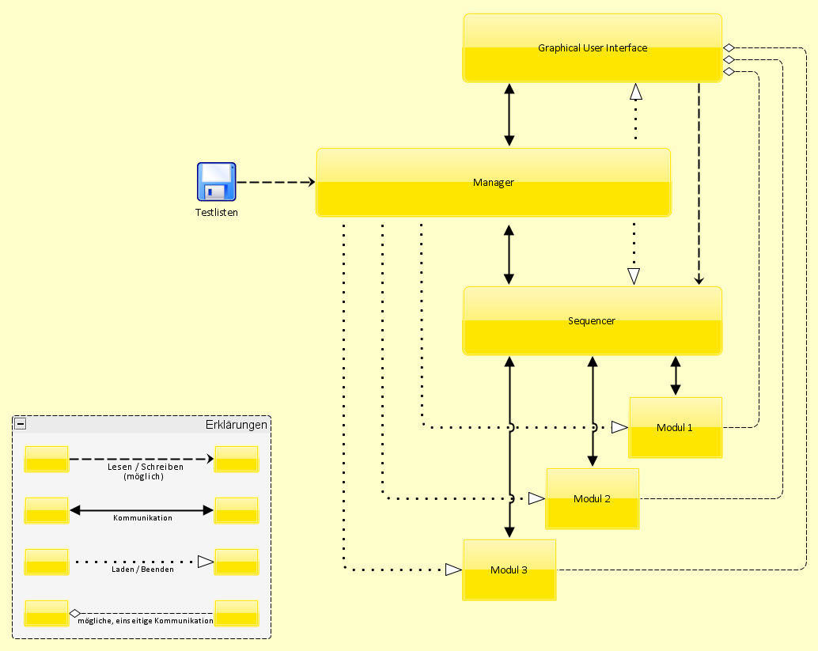
SYSTEC Test- and Automation Framework 2015

Slide 9
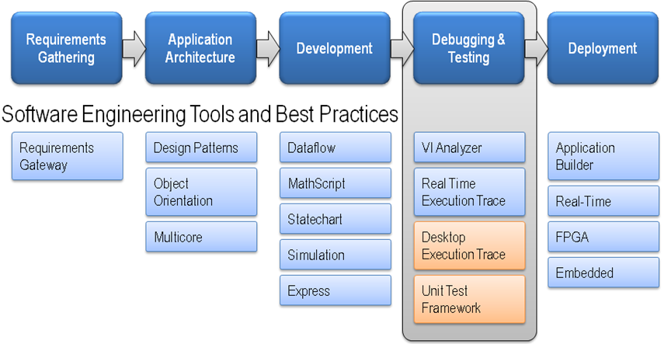
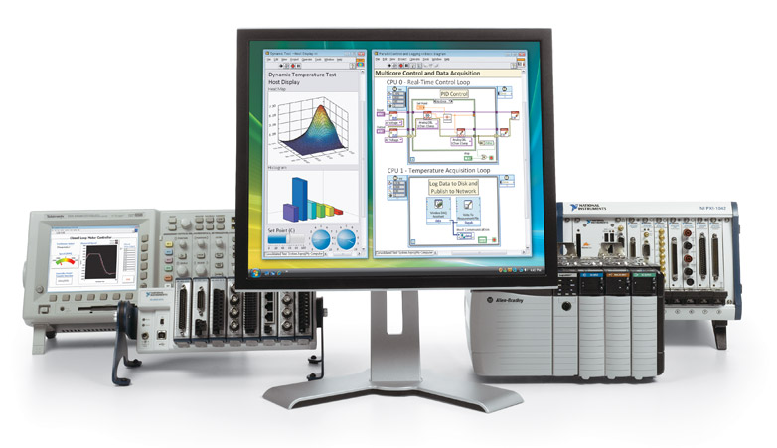
LabVIEW 2015 Windows 10/Realtime/FPGA

Slide 10
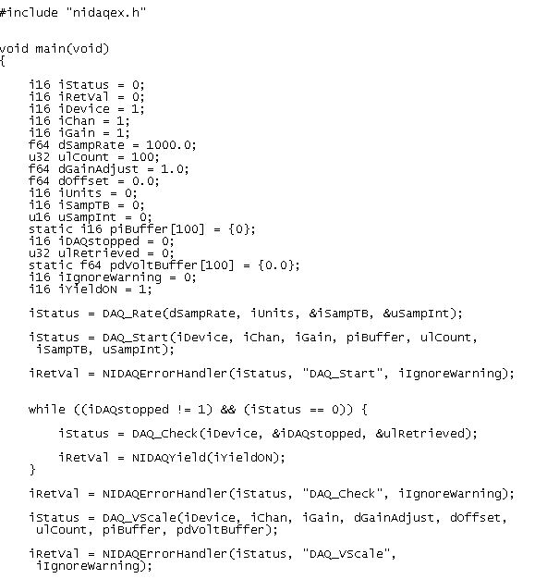
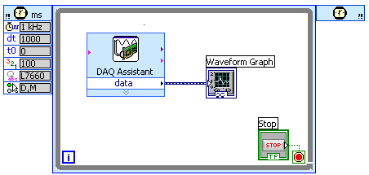
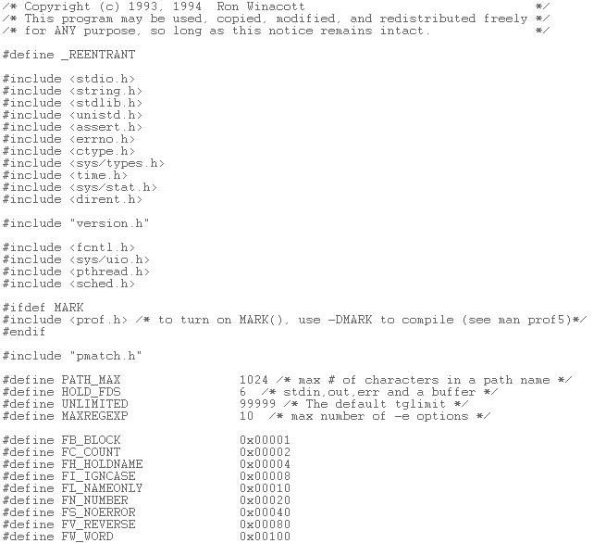
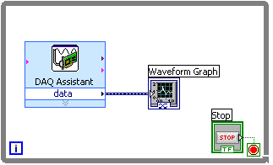
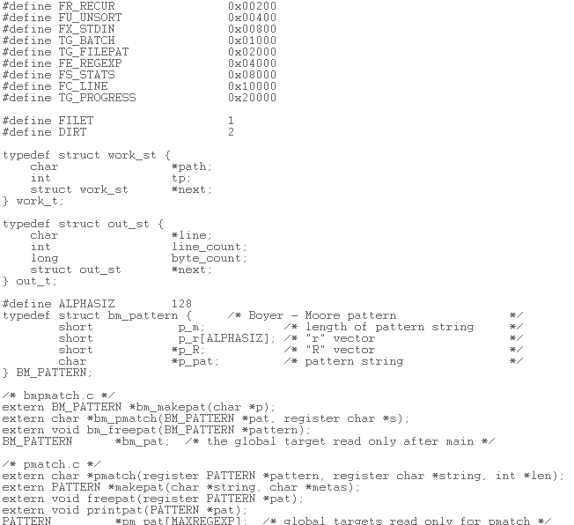
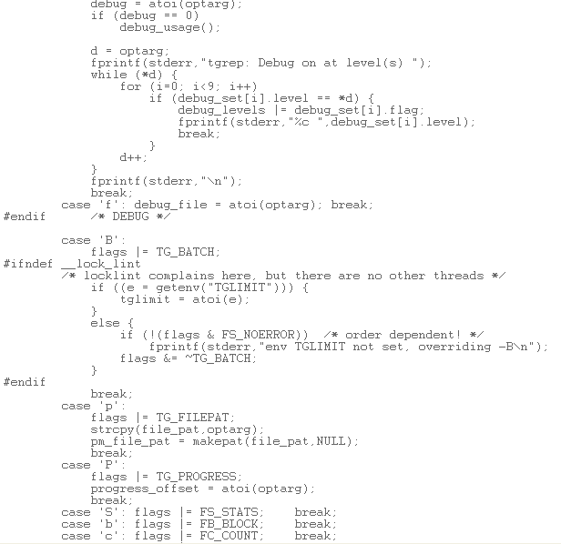
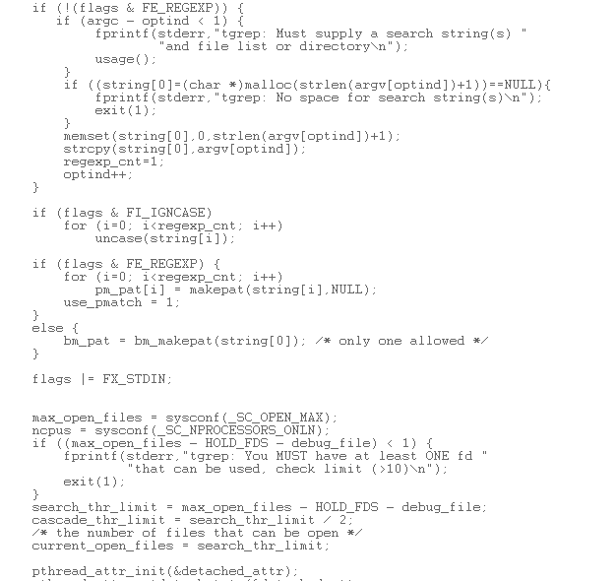
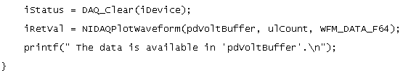
LabVIEW Dealing with complexity
LabVIEW
C*
* ohne Code für die Benutzerschnittstelle
Notes:
10
Einfacher Vergleich von LabVIEW mit einer textbasierten Programmiersprache anhand von Datenerfassung in einer Schleife. Der LabVIEW Code umfasst auch die Darstellung der Messdaten in der Benutzerschnittstelle. Das Beispiel in C ist vergleichsweise übersichtlich. In diesem Zustand der Implementierung ist die Wahl der Programmiersprache eine Frage der Vorliebe.
Bei höherer Komplexität profitiert die Produktivität von der Abstraktion in LabVIEW. Das Hinzufügen einer zweiten Schleife mit Datenerfassung soll eine parallel laufende Erfassungsoperation realisieren. Hier ist die grafische Programmierung der textbasierten deutlich überlegen, da die zweite Schleife automatisch in einem weiteren Thread realisiert wird.

Slide 11

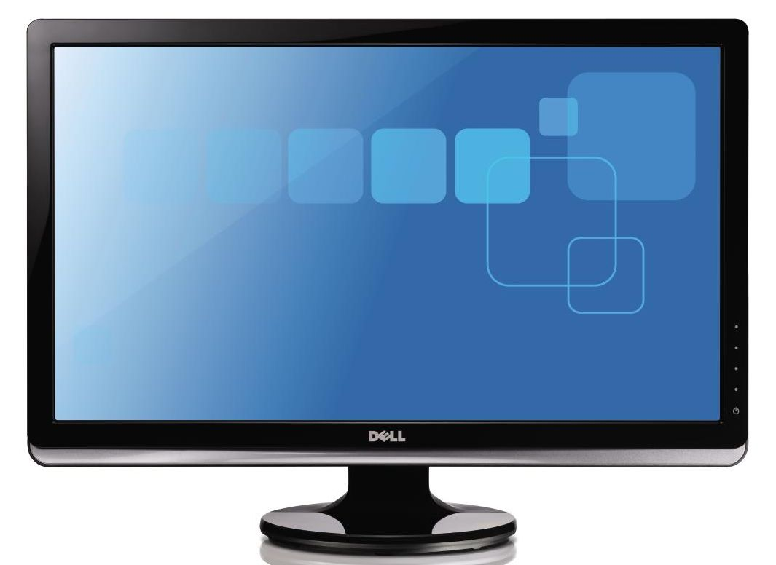
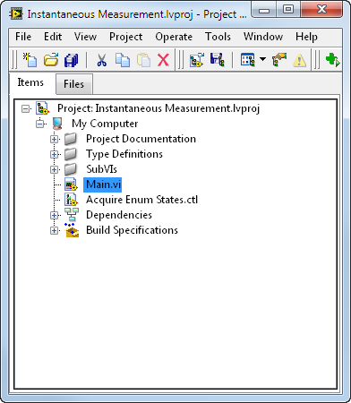
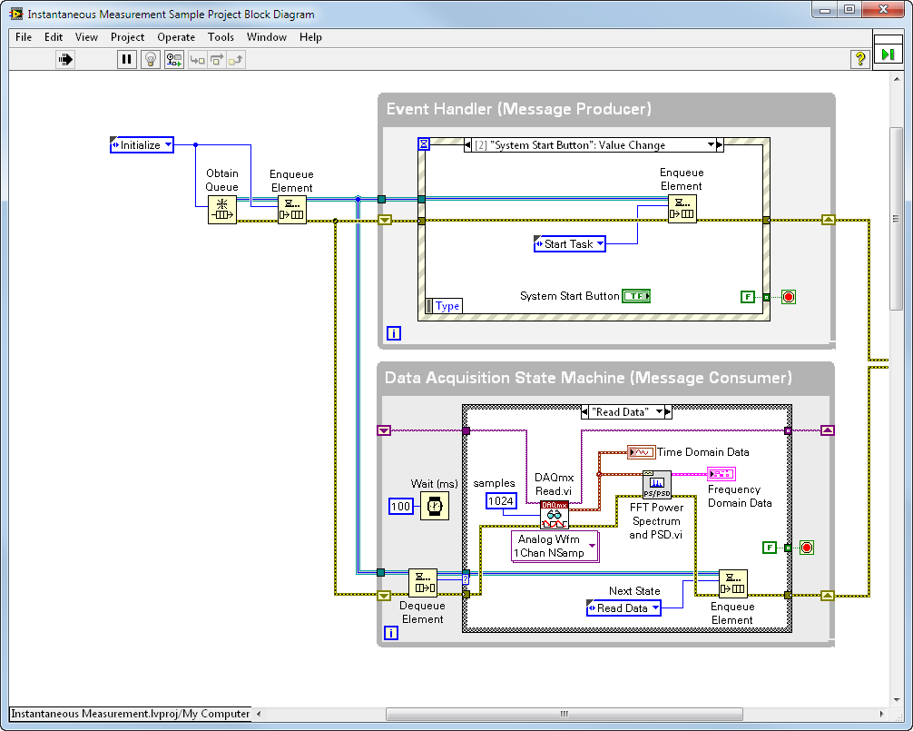
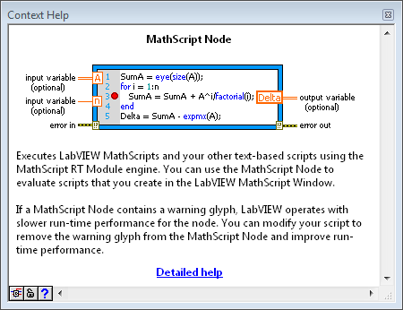
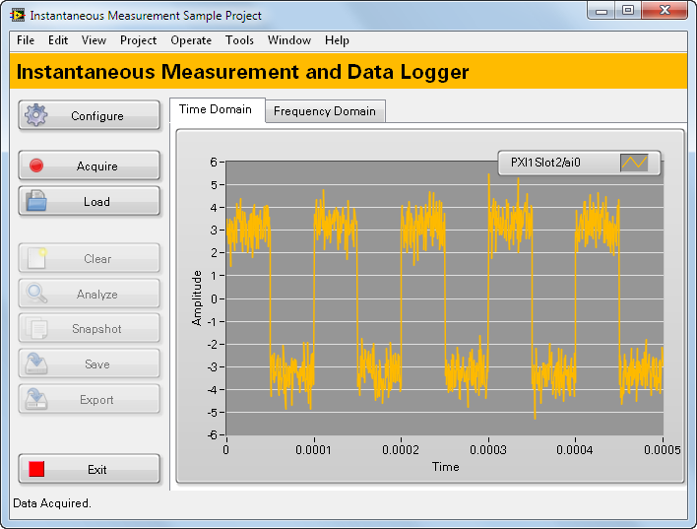
High-Level Software
Flexible Hardware
Integrated Hardware and Software Platform
System Design Software
Project Explorer
Manage and organize all system resources, including I/O and deployment targets
Hardware Connectivity
Bring real-world signals into LabVIEW from any I/O on any instrument
Deployment Targets
Deploy LabVIEW code to the leading desktop, real-time, and FPGA hardware targets
Parallel Programming
Create independent loops that automatically execute in parallel
Instant Compilation
See the state of your application at all times, instantly
Block Diagram
Define and customize the behavior of your system using graphical programming
Front Panel
Create event-driven user interfaces to control systems and display measurements
Analysis Libraries
Use high-performance analysis libraries designed
for engineering and science
Models of Computation
Combine and reuse .m files, C code, and HDL with graphical code
Timing
Define explicit execution order and timing with sequential data flow
Accelerates Your Success
By abstracting low-level complexity and integrating all of the tools you need to build any measurement or control system
Notes:
For over 26 years, LabVIEW has made engineers more productive by ensuring that they can take full advantage of hardware products, and that they are able to use them with all of the analysis and UI capabilities necessary for any measurement or control system. LabVIEW allows users to develop their application IP, build their user interface, and manage all of your hardware from a single location.
LabVIEW increases productivity by abstracting low-level complexity and integrating all of the technology engineers and scientists need into a single, unified development environment, unlike any other text-based alternative.
Each new version of LabVIEW is designed with features to further enhance and accelerate productivity.
High level description of LabVIEW.
Just call out the basics here, no need to go into deep detail. This will happen on the next slides.

Slide 12
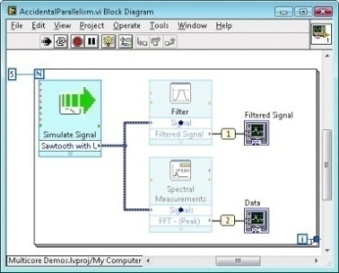
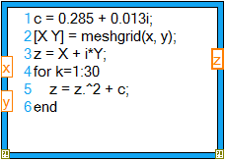
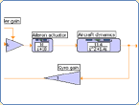
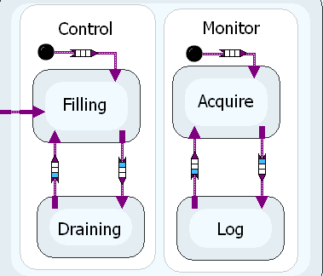
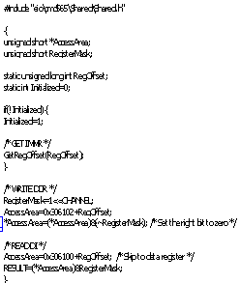



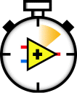
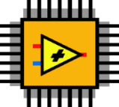
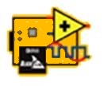



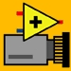


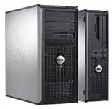
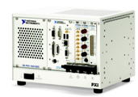
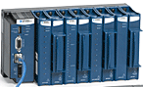

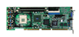
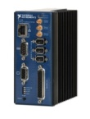
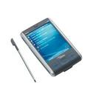
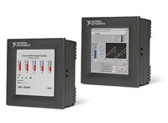
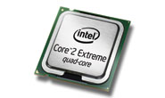
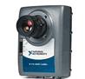
Dataflow
Text based Programming/OOP
Textbased Mathematics
Simulation
State Charts
Desktop
Real-Time
FPGA
Microprozessor/DSP
Vision
PDA
Touchpanel
Notes:
Mit all seinen Möglichkeiten hat sich LabVIEW über die Jahre hinweg zu einem universellen Engineering-Werkzeug entwickelt, welches jedem Anwender die Möglichkeit bietet das von ihm bevorzugte Verarbeiutungsmodell zu wählen. Für National Instruments ist LabVIEW die wichtigste Entwicklung, da es sich hier um den Kern des Konzepts der virtuellen Instrumente handelt. Es beruht auf der Idee, dass LabVIEW als Entwicklungs- und Engineering-Plattform überall eingesetzt werden kann – sei es auf einer Workstation oder einem PC, auf industriellen PCs, einem Embedded-Controller, auf verteilten I/O-Geräten wie FieldPoint oder auf vernetzten oder schnurlosen Geräten. Verfügbar sind ferner Module für LabVIEW, welche die Portierung von LabVIEW-Anwendungen auf Echtzeitsysteme, Handheld-Pocket-PC, Touchpanel PCs, auf Mikroprozessoren und FPGAs ermöglichen.

Slide 13
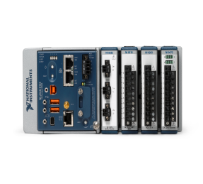
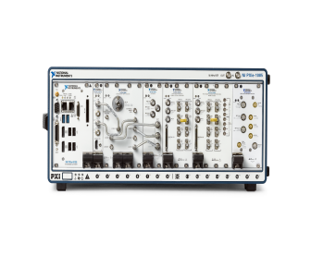
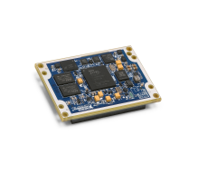

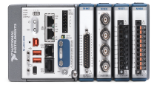
Key Application Areas
Test and Measurement
Embedded Monitoring and Control
Design
Design
Validation & Verification
Prototype
Production
Deploy
Notes:
The two primary application areas in which engineers use our products are test and measurement, and embedded monitoring and control. This platform can be used throughout the entire product design lifecycle, from design through production and deployment.

Slide 14
Hardware
SYSTEC Multifunktion Testrack
PC Technology (PCIe)
NI PXI
NI RIO+FPGA
Adapter
Complete Solutions
Cameras
Measurement systems
Power Supplies, Electronic Loads
Notes:
Durch die Leistungsfähigkeit von LabVIEW lassen sich die Branchen, in denen LabVIEW eingesetzt wird, in einem Wort zusammenfassen: everywhere oder überall.

Slide 15
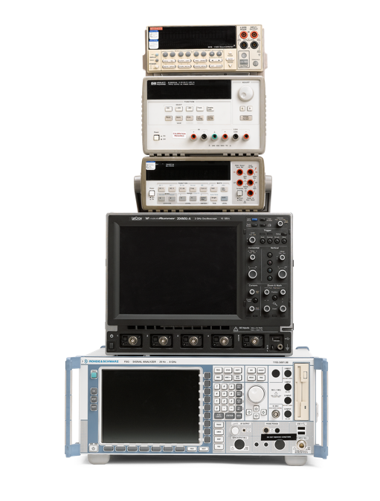

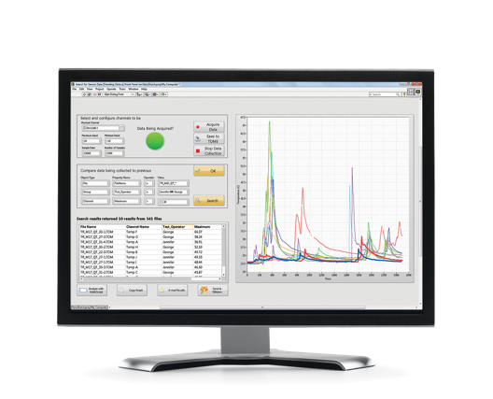
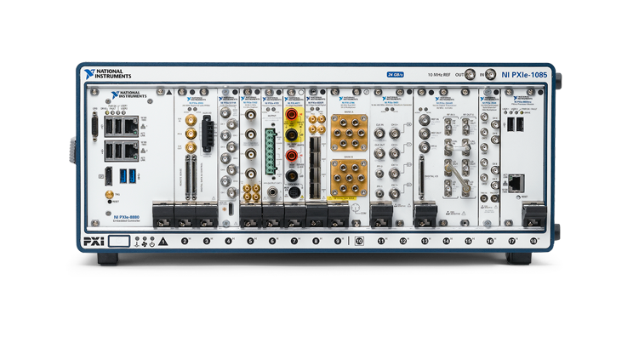
NI’s Platform-Based Approach to Automated Test
Traditional Instruments
PXI Modular Instruments
 | Previous ATE | PXI System | Reduction
Cost | $450k | $40k | 11X
Footprint | 277 ft³ | 1.75 ft³ | 158X
Weight | 4000 lbs. | 60 lbs. | 66X
Energy | 10 kW | 0.6 kW | 16X
VS.
Notes:
Increasing device complexity and technology convergence are driving test systems to become more flexible, while cost pressures are demanding longer system lifetimes. A software-defined, modular architecture is the only way to accomplish these objectives. Modular instrumentation uses shared components, high-speed buses, and open, user-defined software to meet the needs of automated test equipment (ATE) today and in the future.
CLICK TO PROGRESS SLIDE: Here is a great example of how Analog Devices greatly reduced their footprint and costs by leveraging PXI. As you can see, these are not small improvements; they are orders of magnitudes (i.e., more than 10X improvement).

Slide 16
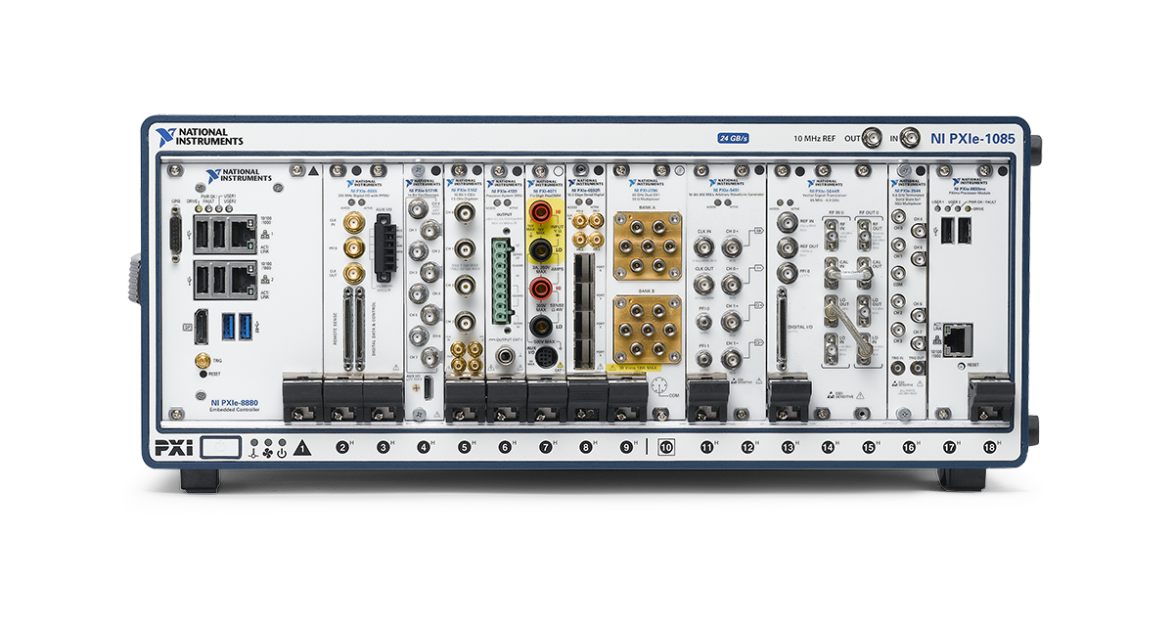
Industry Leading NI PXI Platform
Arbitrary
Waveform Generator
PXI Chassis
SMU
High-Speed
Serial
Data
Acquisition
Oscilloscope
Embedded
Controller
Digitizer
Switch/MUX
Multi-Computing
Module
Digital I/O
DMM
Vector Signal
Transceiver (SDI)
Notes:
Our PXI modular instrument platform combines mainstream PC software and PCI hardware with advanced instrumentation capabilities. We continue to expand our PXI product offerings with new modules, which address a wide variety of measurement and automation applications. We offer a variety of modular instrument devices used in general purpose test and communication test applications. These devices include digitizers, digital multimeters, signal generators, RF analyzers/generators, power supplies, source measurement units and switch modules that users can configure through software to meet their specific measurement requirements.

Slide 17
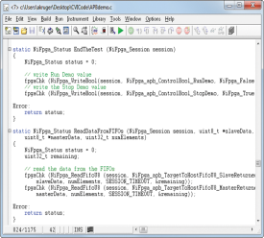
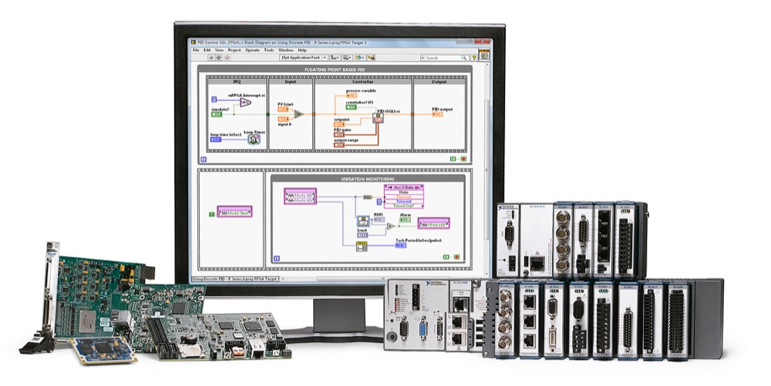
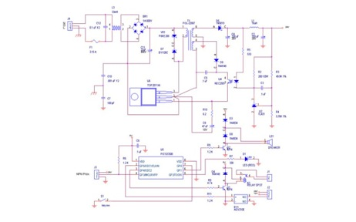






NI’s Platform-Based Approach to Embedded Design
Individual Components
Customizable Off-The-Shelf Platform
Application Software
Get a 4X Advantage
114 Months LESS to Complete a Project
$950K LESS to Complete a Project
3 MORE Projects Per Year
Driver API
VS.
Device Drivers
Board Support Package (BSP)
Notes:
When developing more complex systems, rather than selecting discrete components and performing traditional, from scratch custom circuit design, or integrating very disparate tool chains, go up one level of integration and outsource the low level engineering work to NI engineers, who provide embedded control and I/O subsystems that are designed and proven by industry for operation in heavy industrial operating environments with completely integrated software development tools, drivers and libraries. Whether you’re designing a test system, a control system, or one that needs to do both, you have an integrated software and hardware approach to get to finished systems faster. The high-level programming tools enable the use of reconfigurable, all-programmable FPGA and SoC technology for low-level and high performance customization, and the NI reconfigurable, modular and extensible embedded platforms are designed to integrate with custom board designs. Because of this, the NI platform enables design teams to focus a majority of their engineering expenses on delivering features that their end customers truly value, instead of validating and revving board designs.
By making NI an extension of your development team, you’re able to utilize the very latest embedded technologies, like Xilinx Reconfigurable System on a Chip (RSOC) devices with ARM microprocessors or extremely high performance Intel Atom microprocessors alongside Xilinx FPGAs. You’ll also be able to leverage a prevalidated RTOS based on Linux, with built in kernel support for Security Enhanced SELinux, and program the processor with LabVIEW or C/C++ with native support for Eclipse (or any other Linux-compatible development tools, i.e., Perl, Python, etc.).
CLICK TO PROGESS SLIDE: Based on data from Wilson Research Group (2012 National Instruments/UBM Survey of Embedded Markets, January – April 2012), using NI’s platform for embedded design saves you, on average, 114 months and $950,000 per project. It also allows you to complete three more projects per year.
Disclaimers:
$950K Less to Complete a Project:
Assumes $100K per engineer fully burdened cost/year and a $1M/year R&D budget
Does not include additional costs such as high-end EDA tools required for high layer count, high speed custom PCB design, level of design and validation for high EMC, wide temperature, high shock/vibration, long lifetime field deployment, etc.
The UBM/EETimes study included 1,648 responses from embedded engineers from Americas, Europe and Asia (margin of error +/- 2.0%).
The Wilson Research study included 443 responses from NI embedded design customers from Americas, Europe and Asia (margin of error +/- 3.9%).
Additional data point:
Achieve 74X higher performance per dollar than with conventional monolithic DSPs by graphically programming the programmable logic fabric using LabVIEW FPGA with no knowledge of Verilog or VHDL.

Slide 18










Embedded Hardware Options
Board-Level and Packaged Controllers
PXI and PC-based Devices
Single-Board RIO
CompactRIO
R Series and FlexRIO
Expansion I/O
MXI-Express RIO
Ethernet RIO
EtherCAT RIO
Wireless
Notes:
National Instruments’ comprehensive, integrated hardware and software platform empowers your team and allows you to focus on the engineering tasks that matter most. NI offers a wide variety of board-level controllers, re-configurable PXI and PC-based devices, and expansion I/O, all based on the LabVIEW RIO Architecture.

Slide 19
SYSTEC IO Systems

Slide 20

SYSTEC AOI-Workstation
19“ Professional Workstation
High End Cuda Graphics
Intel XEON Architecture
Server Industry Mainboards
DDR4 Memory
10GE Interface

Slide 21
Haptics Technologies and Standards
Keyhaptics
Balcony Key Haptics
Rotary Haptics
Force Sense
Force Feedback
Notes:
Durch die Leistungsfähigkeit von LabVIEW lassen sich die Branchen, in denen LabVIEW eingesetzt wird, in einem Wort zusammenfassen: everywhere oder überall.

Slide 22

Torque Measurement Analysistool

Slide 23

Torque Haptics Measurent System

Slide 24

Torque Haptics Measurent System

Slide 25


Rotary Haptic Module + Transfer Standard

Slide 26


Combined Keyhaptics and Force Feedback Module and Force Feedback Transfer Standard

Slide 27
Lighting, Image Acquisition
Luminance
Dominant Wavelength
Cromticity coordinates
Flicker
Shapematching
Patternmatching
Homogeneity
Pixelmeasurements
Black Mura
White Mura
Notes:
Durch die Leistungsfähigkeit von LabVIEW lassen sich die Branchen, in denen LabVIEW eingesetzt wird, in einem Wort zusammenfassen: everywhere oder überall.

Slide 28



Laboratory
CS2000 Spectroradiometer
Ulbricht Sphere with satellite sphere
Robot based laboratory „in a nutshell“
SYSTEC Light Standard (TFT)
Jai AT-200 GE 3CCD Cameras
Softwarealgorithms based on CUDA-Technologies from Nvidia (> 5 Tflops)
Future: FPGA based algorithms

Slide 29

Light Measurement Standard
8 Wavelenghts
Programmable Luminance
Plug&Play

Slide 30
Camera System
3 CCD / 3 CMOS
4 CCD / 4 CMOS
Linescan
Notes:
Durch die Leistungsfähigkeit von LabVIEW lassen sich die Branchen, in denen LabVIEW eingesetzt wird, in einem Wort zusammenfassen: everywhere oder überall.

Slide 31

SYSTEC FlexCAM
Jai AT-200 GE 3CCD Camera with FlexLense
Ultrafast
Precise
Cost effective
Manufaturing and laboratory
3CCD Technology
EOL proof FlexLENSE
Colour
Luminance
Pattern Matching
Shape Matching

Slide 32


SYSTEC FlexLense
Robotic lense with unrivaled features
Precise diaphragm (round, no iris)
Huge amount of switching cycles
Excellent repeadability
EOL proof
Telecentric implementation
Calibrated with AT200GE camera

Slide 33

JAI TECHNOLOGY
1 CCD / CMOS (BAYER PATTERN)
OR
MULTIPLE CCD/CMOS (PRISM BASED SOLUTIONS

Slide 34

PRISM BASED TECHNOLOGY
34

Slide 35

PRISM BASED TECHNOLOGY
35

Slide 36

SINGLE IMAGER TECHNOLOGY

Slide 37


SINGLE IMAGER TECHNOLOGY

Slide 38

SINGLE vs. MULTI IMAGER

Slide 39


ADDITIONAL CONSIDERATIONS

Slide 40

ADDITIONAL CONSIDERATIONS

Slide 41
Universal Laboratory System
Robot based
AOI
Haptics
Communication
Electrical Measurements
Simulation
Notes:
Durch die Leistungsfähigkeit von LabVIEW lassen sich die Branchen, in denen LabVIEW eingesetzt wird, in einem Wort zusammenfassen: everywhere oder überall.

Slide 42

SYSTEC Universal test stand (customer: ALPS)

Slide 43
EOL System
Robot based
AOI
Haptics
Communication
Electrical Measurements
Simulation
Notes:
Durch die Leistungsfähigkeit von LabVIEW lassen sich die Branchen, in denen LabVIEW eingesetzt wird, in einem Wort zusammenfassen: everywhere oder überall.

Slide 44

Robot based test cell

Slide 45

Universal EOL Testsystem

Slide 46


Robot based haptics testsystem (EOL)

Slide 47
EOL System (Roundtable)
Robot based
AOI
Haptics
Communication
Electrical Measurements
Simulation
Notes:
Durch die Leistungsfähigkeit von LabVIEW lassen sich die Branchen, in denen LabVIEW eingesetzt wird, in einem Wort zusammenfassen: everywhere oder überall.

Slide 48



Roundtable solution

Slide 49
EOL System Cluster
2 Roundtables
Logistics
Robot based handling and screwing
Notes:
Durch die Leistungsfähigkeit von LabVIEW lassen sich die Branchen, in denen LabVIEW eingesetzt wird, in einem Wort zusammenfassen: everywhere oder überall.

Slide 50

Test-Cluster with two Roundtables

Slide 51

Testcluster Footprint

Slide 52


RoundtableOverview

Slide 53
Hardware Schematics

Slide 54
Screening Systems
Notes:
Durch die Leistungsfähigkeit von LabVIEW lassen sich die Branchen, in denen LabVIEW eingesetzt wird, in einem Wort zusammenfassen: everywhere oder überall.

Slide 55
Universal adapter (12 years old)

Slide 56

Screening systems

Slide 57

Screening systems

Slide 58

Screening systems

Slide 59
Cyberphysical Testsystem
Notes:
Durch die Leistungsfähigkeit von LabVIEW lassen sich die Branchen, in denen LabVIEW eingesetzt wird, in einem Wort zusammenfassen: everywhere oder überall.

Slide 60

CyberFLEX
Virtual 6 Axis Robot
  Mitsubishi Scara (6kg)
  Servo based panning unit
  Servo based turning unit
Haptics testing units
Lighting /Image Acquisition Unit
  Jai AT-200 GE 3CCD Camera
  SYSTEC/Sill FlexLense Subsystem
  LED based lamps

Slide 61

CyberFLEX

Slide 62

CyberFLEX

Slide 63

CyberFLEX

Slide 64

CyberFLEX

Slide 65

Cyberphysical Testsystem Roundtable Implementation
Notes:
Durch die Leistungsfähigkeit von LabVIEW lassen sich die Branchen, in denen LabVIEW eingesetzt wird, in einem Wort zusammenfassen: everywhere oder überall.

Slide 66
References
[1] Herbert Pichlik, Rahman Jamal; LabVIEW: Programmiersprache der vierten Generation / München [i.e. Haar]; London; Mexico [City]; New York; Singapur; Sidney; Toronto:Prentice Hall; ISBN 3-8272-9542-4; September 1997
[2] Herbert Pichlik, Rahman Jamal; LabVIEW: Das Anwenderbuch /.- München [i.e. Haar]; London; Mexico [City]; New York; Singapur; Sidney; Toronto: Prentice Hall;ISBN 3-8272-589-0; Oktober 1999
[3] Herbert Pichlik, Rahman Jamal; LabVIEW Applications and Solutions / Upper Saddle River[NJ]; London; Mexico [City]; New York; Singapur; Sidney; Toronto: Prentice Hall; ISBN 0-13-096423-9; September 1998
[4] Herbert Pichlik, „Networkcentric test and measurement system“, Best application of virtual instrumentation, NI-Week 97 Proceedings, Austin TX 8/97
[5] Herbert Pichlik, Universal Test- and Automation System using an event driven object oriented LabVIEW approach (UTAS), NI-Week 2001 Proceedings, Austin TX 8/01
[6] Herbert Pichlik, Tobias Postler, Roboter- und LabVIEW-basiertes Universaltestsystem für KFZ-Bedienkomponenten, Paper VIP 2010
[7] Herbert Pichlik, Tobias Postler, LabVIEW-FPGA-gesteuerte Rundtakteinheiten, Paper VIP 2010
[8] Herbert Pichlik, Die Architektur roboterbasierter haptischer Prüfsysteme und deren Technologien; VDMA Frankfurt, 4/2008
[9] Herbert Pichlik, High Speed High Resolution Analog / Digital Converter Circuit; Patent 4.999.624 U.S. Philips Corporation, New York, N.Y., June 13, 1989
[10] Herbert Pichlik, Subranging AD-Converter; Philips Corporation, New York 1988
[11] Herbert Pichlik, [DE] SCHALTUNGSANORDNUNG ZUR ANALOG-DIGITAL-UMSETZUNG; Europäisches Patent; Philips Kommunikations Industrie AG; Nürnberg 1986
[12] Herbert Pichlik, G++ New Directions in Information Technology, NI-Week 2001 Proceedings, Austin TX 8/01
[13] Herbert Pichlik, Object Technology Toolsets for LabVIEW; August 2001
[14] Herbert Pichlik, Zuverlässigkeitsanalyse an komplexen Baugruppen; Philips Kommunikations Industrie AG; Nürnberg 1987
[15] Herbert Pichlik, Tobias Postler, Matthias Thüringer, Reduzierung der Zykluszeiten von Pincheck- und Hochspannungsprüfungen für Automotive-Steckverbinder unter Verwendung modularer NI-FPGA-Technologie, Paper VIP 2011
[16] Herbert Pichlik, G++ - Neue Wege in der Informationstechnologie
[17] Toni Roos, Entwicklung und Qualifizierung eines LabVIEW-basierten universellen Haptikprüfsystems; Masterarbeit TH Nürnberg/SYSTEC, September 2013
[18] Matthias Leininger, Entwicklung und Konstruktion eines Drehmoment-Transfernormal für Drehhaptik-Prüfstände; Bachelorarbeit Friedrich-Alexander Universität Erlangen/SYSTEC, August 2011
[19] Matthias Leininger, Eine universelle Plattform für Haptikprüfsysteme; Masterarbeit Technische Universität München/SYSTEC, Juli 2014
www.systec-gmbh.com

