Slide 1
About Omics Group
OMICS Group International through its Open Access Initiative is committed to make genuine and reliable contributions to the scientific community. OMICS Group hosts over 400 leading-edge peer reviewed Open Access Journals and organize over 300 International Conferences annually all over the world. OMICS Publishing Group journals have over 3 million readers and the fame and success of the same can be attributed to the strong editorial board which contains over 30000 eminent personalities that ensure a rapid, quality and quick review process.

Slide 2
About Omics Group conferences
OMICS Group signed an agreement with more than 1000 International Societies to make healthcare information Open Access. OMICS Group Conferences make the perfect platform for global networking as it brings together renowned speakers and scientists across the globe to a most exciting and memorable scientific event filled with much enlightening interactive sessions, world class exhibitions and poster presentations
Omics group has organised 500 conferences, workshops and national symposium across the major cities including SanFrancisco,Omaha,Orlado,Rayleigh,SantaClara,Chicago,Philadelphia,Unitedkingdom,Baltimore,SanAntanio,Dubai,Hyderabad,Bangaluru and Mumbai.

Slide 3
An optical Fiber based Sensing System
for Label-free Real-time Biomedical/Environmental Diagnosis
by using Surface Plasmon Polaritons
2nd International Conference and Exhibition on
Lasers, Optics & Photonics, Sep. 08-10, Philadelphia, USA
Dr. Heongkyu Ju
Associate Professor
Department of Nano-Physics, Gachon University, Korea
Email: batu@gachon.ac.kr
Talk at Optics-14
1

Slide 4


Contents
Introduction1 - Label-free bio/environmental Sensors
Introduction2 - Evanescent field sensing
Introduction2 - Surface Plasmon Resonance (SPR)
The Working Principle of our Sensing Device
Experimental Apparatus and Techniques
  Sensing Device - Optical Fibers with Bimetallic SPR Coating
  Detection System
Mathematical Description
Results and Discussion
The Sensing System Characteristics
Conclusion
Acknowledgement to Contributors
Talk at Optics-14
2

Slide 5

Label-free Bio/Environmental Sensors - Introduction1
Sensors using labels
Sensors without using labels
Avoid label-induced alteration of analyte molecular structure
Continuous measurement possible (real-time monitoring)
→ Able to observe kinetic progress of binding interactions
of biomolecules
Avoid multi-step preparation for labeling
  Cost-effectiveness
  Time saving → real time monitoring
  Avoid contamination
  Reproducibility (irrespective of user’s hand skill)
Remote sensing (e.g. using optical fibers carrying signals)
for inaccessible (hazardous) sensing site
Robustness to outer disturbance (e.g. to external EM wave)
Relatively compact size
Point-of-Care-Test (POCT) and portability
Can be integrated into a small sized single chip for
multiplexed bioassay
Detection limit restricted
Non-specific bonding induced noise
Label/Tag (QD, Dye, Radioactives)
Analyte Molecule
Sample
Pumping
Emission
Light
source
Detector
Talk at Optics-14
3

Slide 6


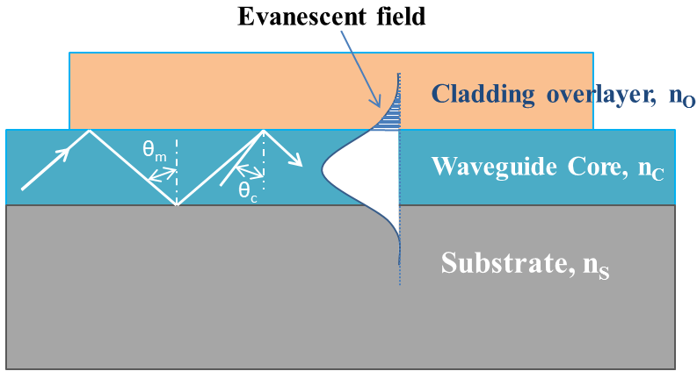


Evanescent Field Sensing - Introduction2
Concept
: Analyte
: Receptor
Light
source
Optical Properties
Change
TIR based Evanescent Field
Characteristic penetration depth
Talk at Optics-14
4

Slide 7
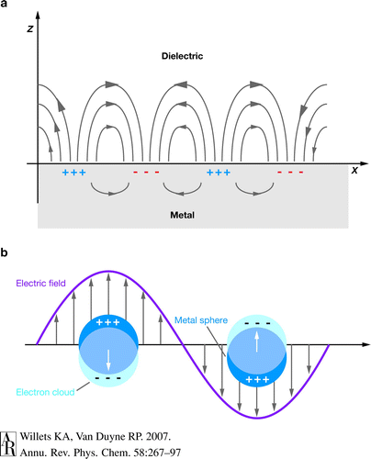
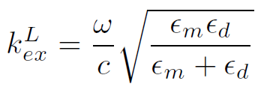
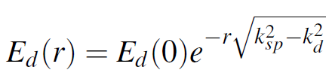
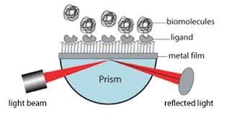
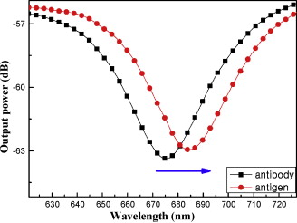
Surface Plasmon Resonance (SPR) - Introduction3
Concept
Collective oscillation of electrons at a metal-dielectric interface at a characteristic frequency
Surface Plasmon Polariton (SPP) mode: longitudinal mode of EM field coupled with surface plasmon
TM polarization can provide longitudinal EM field for SPP generation and forced oscillation of surface electrons
Enhancement of wave-vector via higher refractive index light line
→ Prism method, diffraction method or waveguide method
Phase matching condition →
SPR E-field distribution in the surface normal direction →
Applications
Talk at Optics-14
5

Slide 8

Working Principle of the Sensing Device
Simple Concept Diagram
SPP
Sensed medium
Metal
Waveguide
Input Light
with Circular Polarization
Output Light
With Polarization Change
TE polarization → No SPR excitation
TM polarization → SPR excitation
  Intensity Change
  Phase Change → Polarization Change
Talk at Optics-14
6

Slide 9
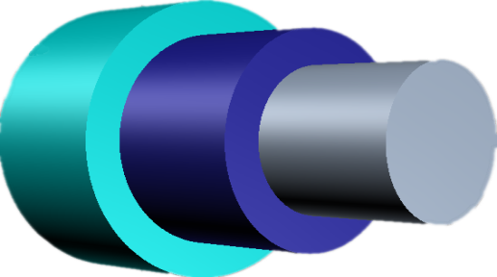
Experimental Apparatus and Techniques (1)
Sensing Device Building Block: polymer-clad multimode fiber
Hard Polymer Cladding
NA=0.37,
JFTLH, Polymicro Technologies
Jacket
230µm
500µm
200µm
Core
Bimetallic SPR Coating
Expected Cross-section Profile
Al coating for avoiding chemical
instability of Ag
High enough sensitivity by SPR
Avoid too much SPR attenuation
Enhanced birefringence
Various penetration depth of
evanescent field
→ wide operating RI range
Various SPR angle
→ wide operating RI range
Metal Vapor Deposition (Thermal Evaporator)
Silica Core
Al
Ag
2 cm
Jacket
Core
Polymer Cladding
Talk at Optics-14
7

Slide 10
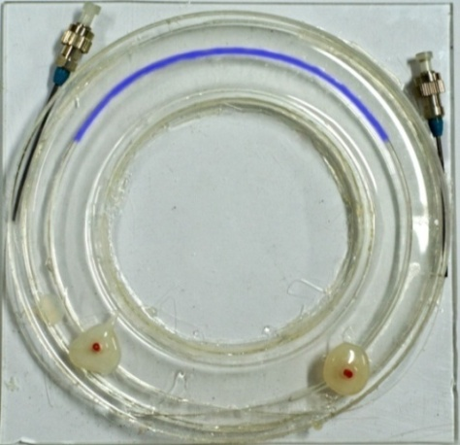
Experimental Apparatus and Techniques (2)
Bimetalic coating of Ag and Al
Non-golden coating to avoid too much attenuation of signal → operating RI range widened
High enough sensitivity and signal-to-noise ratio
The coated Ag-Al thickness: 7nm-30nm, 30nm-10nm, 20nm-5nm, 36nm-4nm
Fiber Device Installed at the Ring Shaped Flow Cell
Polydimethylsiloxane (PDMS) used for the flow cell
An inlet and an outlet ports extracted for the analyte
solution input and output, respectively
Ring shaped fiber ensuring many reflections
→ enhanced sensitivity
Wide distribution of incident angle to the multimode fiber
→ wide operating RI range
Talk at Optics-14
8

Slide 11
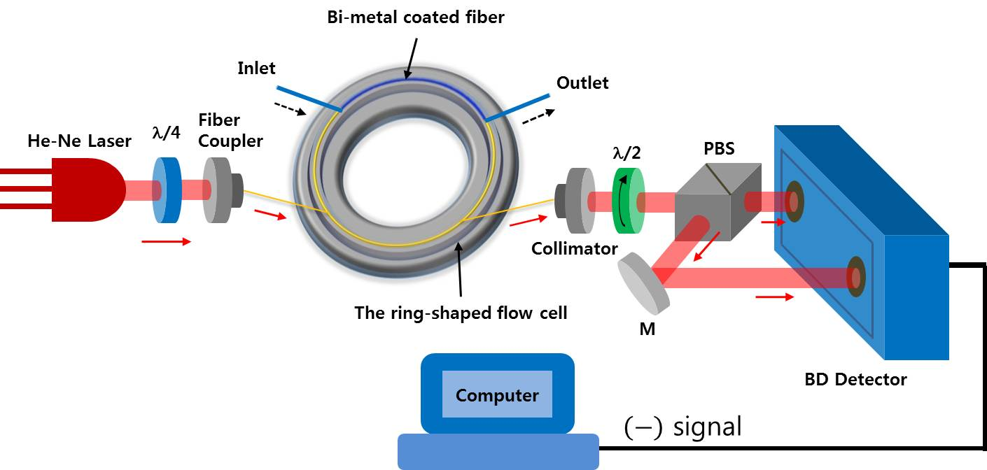
Experimental Apparatus and Techniques (3)
Schematic of Experimental Setup
Talk at Optics-14
9

Slide 12
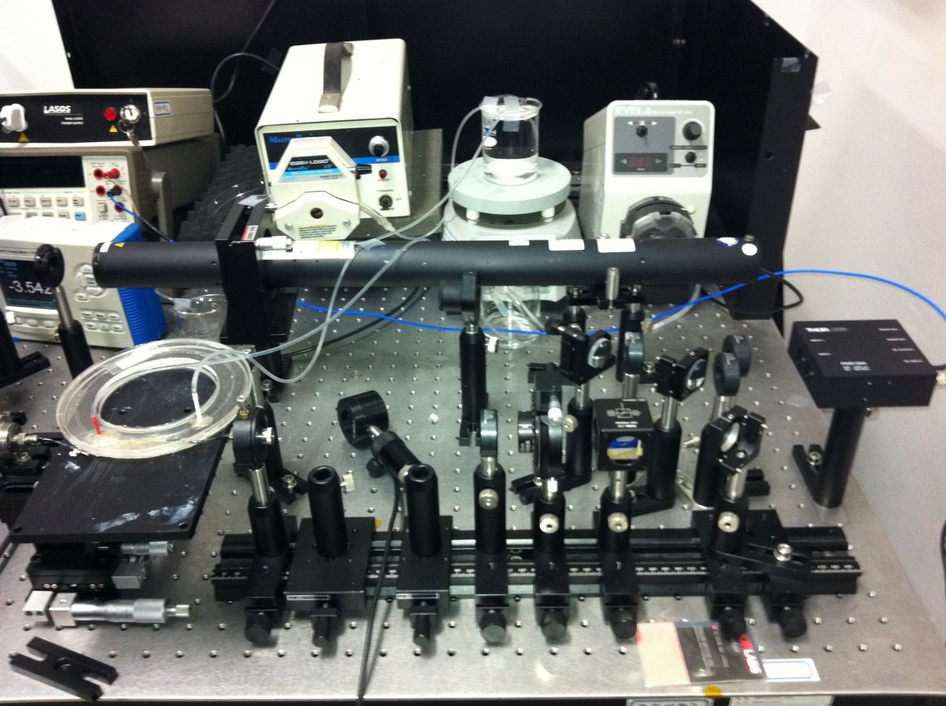
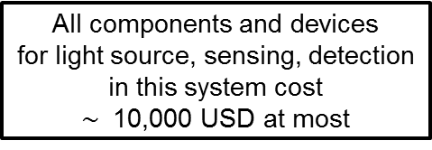

Experimental Apparatus and Techniques (4)
Experimental Setup (photo)
Talk at Optics-14
10

Slide 13
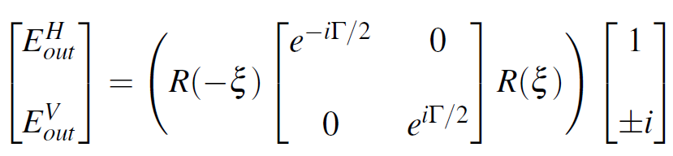
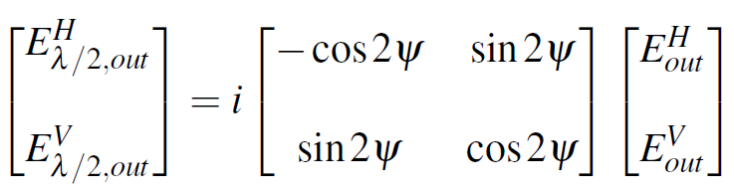
Mathematical Description (1)
Birefringence Detection Principle
Circular polarization
Talk at Optics-14
11

Slide 14




Mathematical Description (2)
Birefringence Detection Principle
The two ports of the PBS output (s-port and p-port)
The balanced detector output
Talk at Optics-14
12

Slide 15
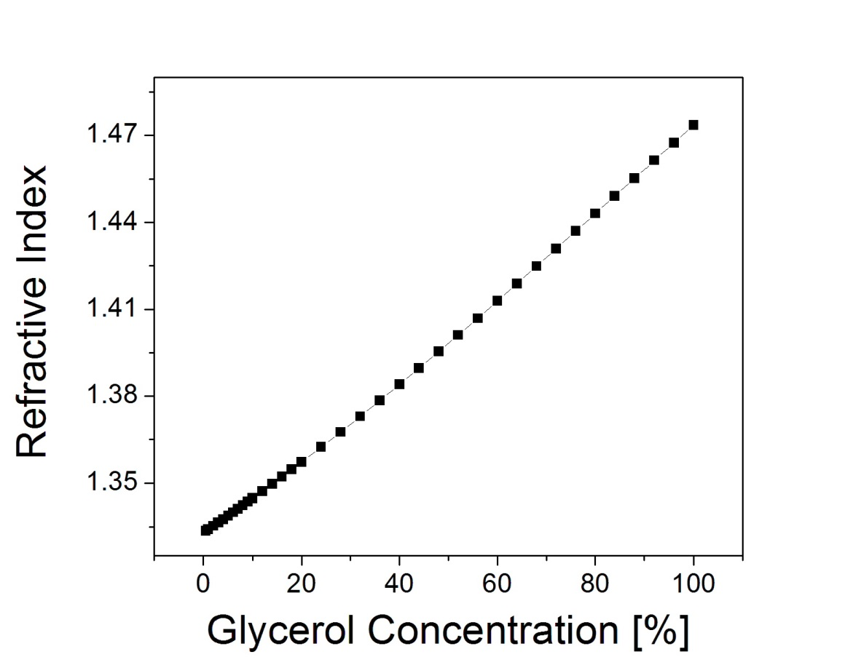
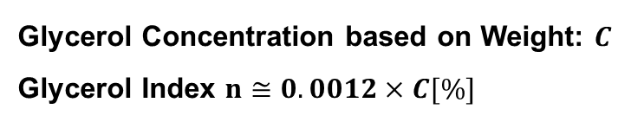
Results and Discussion (1)
Glycerol Refractive Index
Talk at Optics-14
13

Slide 16
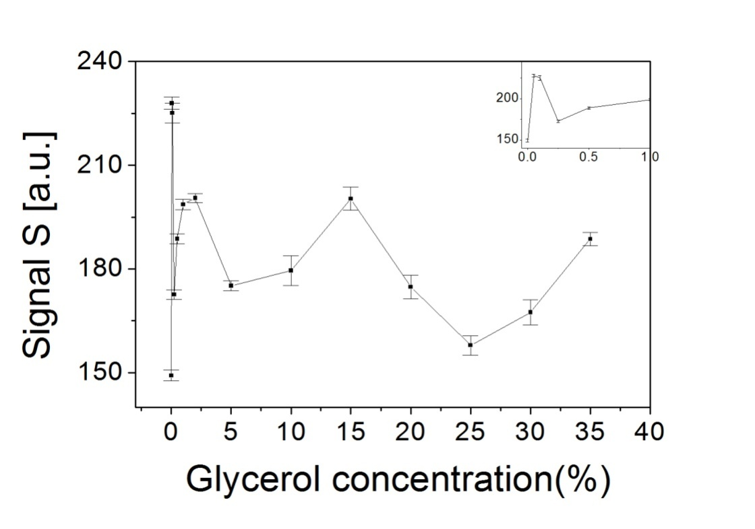
Results and Discussion (2)
No metal coated fiber device
No metal coated fiber device
Highly nonlinear over the entire range of glycerol concentration used
Talk at Optics-14
14

Slide 17
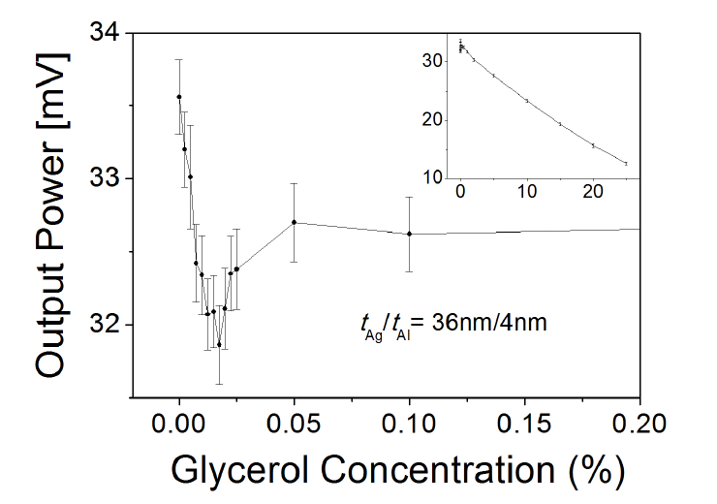
Results and Discussion (3)
Glycerol Measurement
Measurement of optical power only at the fiber output
Highly nonlinear behavior at near zero
Restricted operating range of concentration (RI)
Talk at Optics-14
15

Slide 18
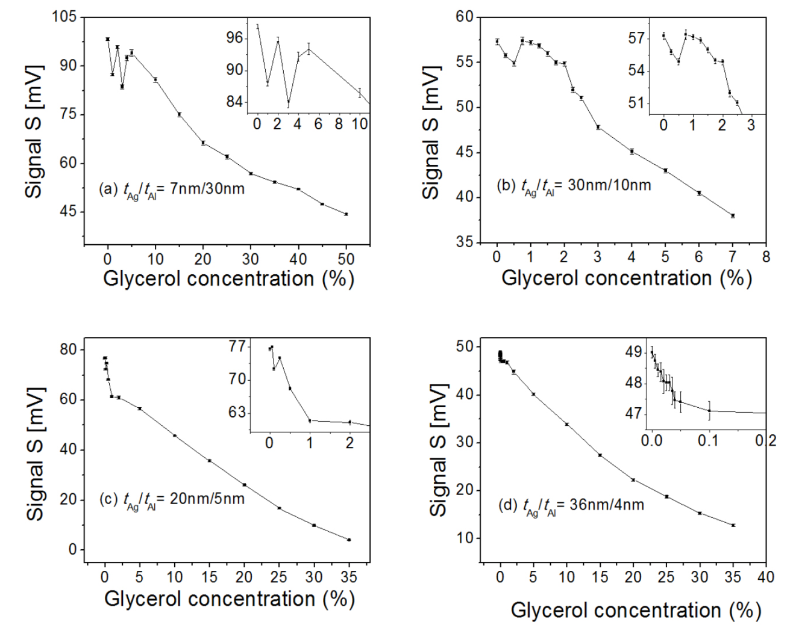





Results and Discussion (4)
Fiber devices with SPR birefringence
As Ag composition increases, i.e., (a)→(d), less nonlinear behavior appears
Two different sensitivity slopes appear at around 1% and 0.05%
for (c) and (d)
Sensitivity at concentration C near zero
Minimum detectable C
Minimum resolvable refractive index
as experimentally achievable
Enlarged RI operating range: 0.05
(c)
(d)
Talk at Optics-14
16

Slide 19

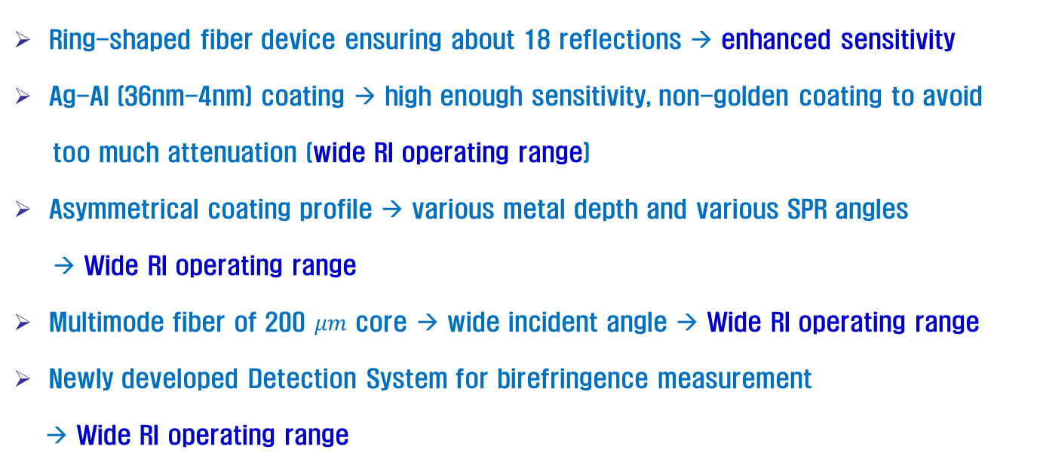
The Sensing System Characteristics (1)
Good Sensitivity and Wide Operating Range
Talk at Optics-14
17

Slide 20
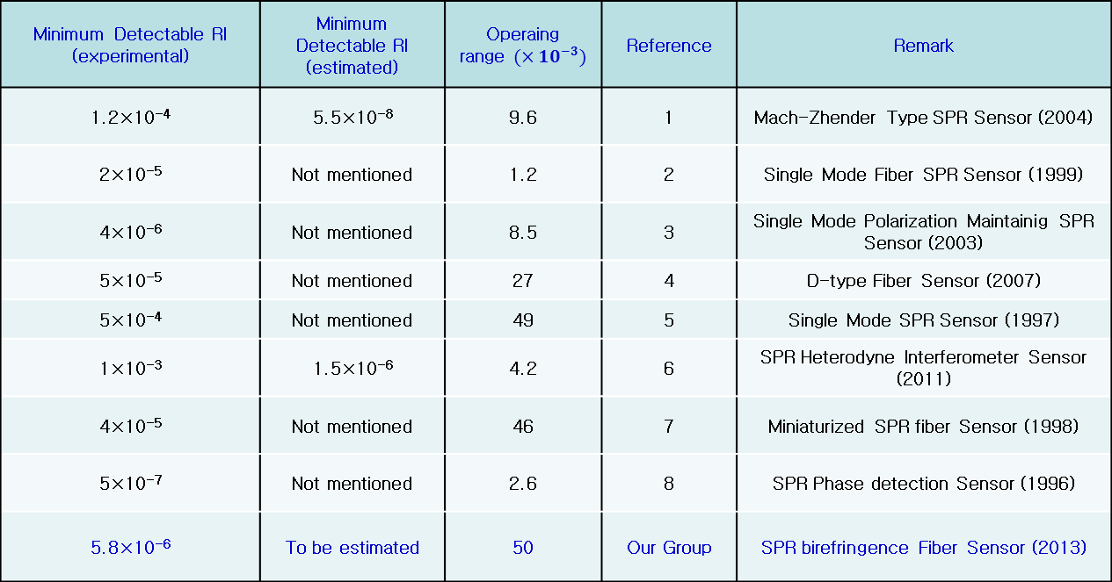
The Sensing System Characteristics (2)
Comparison with the other group results
Minimum Detectable RI (experimental) | Minimum Detectable RI (estimated) |  | Ref. | Remark
1.2×10⁻⁴ | 5.5×10⁻⁸ | 9.6 | 1 | Mach-Zhender Type SPR Sensor (2004)
2×10⁻⁵ | Not mentioned | 1.2 | 2 | Single Mode Fiber SPR Sensor (1999)
4×10⁻⁶ | Not mentioned | 8.5 | 3 | Single Mode Polarization Maintaining SPR Sensor (2003)
5×10⁻⁵ | Not mentioned | 27 | 4 | D-type Fiber Sensor (2007)
5×10⁻⁴ | Not mentioned | 49 | 5 | Single Mode SPR Sensor (1997)
1×10⁻³ | 1.5×10⁻⁶ | 4.2 | 6 | SPR Heterodyne Interferometer Sensor (2011)
4×10⁻⁵ | Not mentioned | 46 | 7 | Miniaturized SPR fiber Sensor (1998)
5×10⁻⁷ | Not mentioned | 2.6 | 8 | SPR Phase detection Sensor (1996)
5.8×10⁻⁶ | To be estimated | 50 | Our Group | SPR birefringence Fiber Sensor (2013)
Talk at Optics-14
18

Slide 21
The Sensing System Characteristics (3)
References used for comparison
References
[1] S. Y. Wu, H. P. Ho, W. C. Law, C. L. Lin, S. K. Kong. Highly sensitive differential phase-sensitive surface plasmon resonance biosensor based on the Mach-Zehnder configuration. Optics Letters, 29, 2378-2380 (2004).
[2] R. Slavík, J. Homola, J. Čtyroký. Single mode optical fiber surface plasmon resonance sensor. Sensors and Actuators B: Chemical, 54, 74-79 (1999).
[3] M. Piliarik, J. Homola, Z. Manikova, J. Čtyroký. Surface plasmon resonance based on a single mode polarization maintaining optical fiber. Sensors and Actuators B: Chemical, 90, 236-242 (2003).
[4] M. H. Chiu, C. H. Shih, M. H. Chi. Optimum sensitivity of single mode D-type optical fiber sensor in the intensity measurement. Sensors and Actuators B: Chemical, 123, 1120-1124 (2007).
[5] A. J. C. Tubb, F. P. Payne, R. B. Millington, C. R. Lowe. Single-mode optical fibre surface plasmon wave chemical sensor. Sensors and Actuators B: Chemical, 41, 71-79 (1997).
[6] J. Y. Lee, S. K. Tsai. Measurement of refractive index variation of liquids by surface plasmon resonance and wavelength-modulated heterodyne interferometry. Optics Communications, 284, 925-929 (2011).
[7] R. Slavík, J. Homola, J. Čtyroký. Miniaturization of fiber optic surface plasmon resonance sensor. Sensors and Actuators B: Chemical, 51, 311-315 (1998).
[8] S. G. Nelson, K. S. Johnston, S. S. Yee. High sensitivity surface plasmon resonance sensor based on phase detection. Sensors and Actuators B: Chemical, 35, 187-191 (1996).
Talk at Optics-14
19

Slide 22
The Sensing System Characteristics (4)
The Benefits of our Sensing System
Straightforward to Fabricate the Fiber Device (polymer-cladding)
Ag-Al Combination for SPR Coating – No Need to Use Expensive Gold
Relatively Simple Detection System
No Need of angular adjustment for SPR excitation
No Need to Realize an Interferometer by Beam Recombination
→ Easy Alignment (in-line polarization interferometer)
Robustness to External Disturbance due to the Use of a Single Beam of Light
compared to Dual Beam Interferometer scheme
Relatively Compact Size compared to Prism based Optical Sensing System
Talk at Optics-14
20

Slide 23

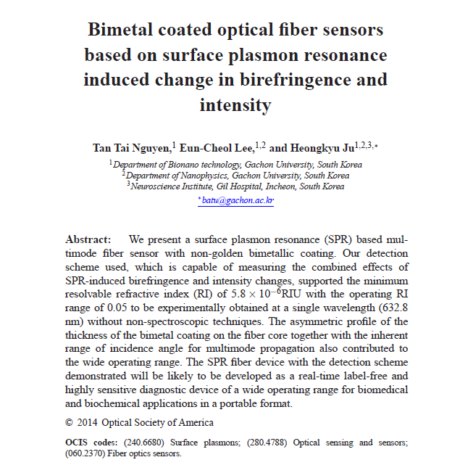
Relevant Publication
Talk at Optics-14
21

Slide 24
Additional Results Obtained Recently (1)
The Group Recent Results
Ni
Histidine tagged Peptide
Al
Ag
Fibrinogen
Antibody
Blocking Solution
His.tag.
Peptide (HP)
Fiber Core
Fiber Core
Fiber Core
Fiber Core
Immobilization of Antibody
Blocking Solution Coating
Fibrinogen Capture
Immidazole
Rinsing
+
Acid Rinsing
Reusable Surface
Fiber Core
Fiber Core
Fiber Core
Talk at Optics-14
22

Slide 25
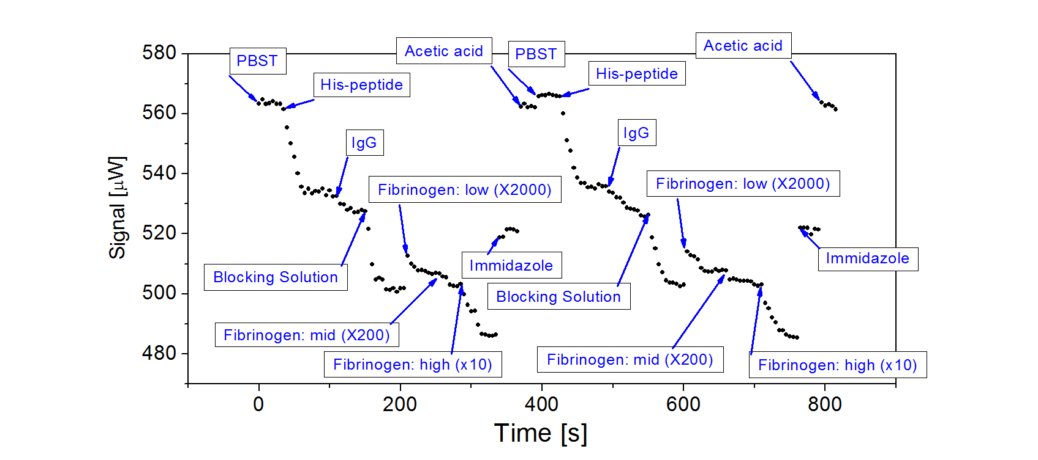
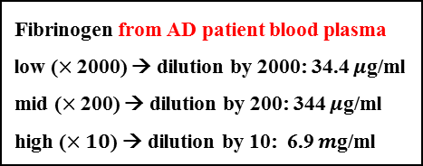
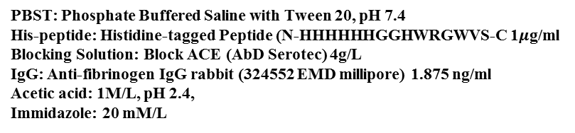
Additional Results Obtained Recently (2)
The Group Recent Results
PBST: Phosphate Buffered Saline with Tween 20, pH 7.4
His-peptide: Histidine-tagged Peptide (N-HHHHHHGGHWRGWVS-C 1$μ$g/ml
Blocking Solution: Block ACE (AbDSerotec) 4g/L
IgG: Anti-fibrinogen IgG rabbit (324552 EMD millipore) 1.875 ng/ml
Acetic acid: 1M/L, pH 2.4,
Immidazole: 20 mM/L
Fibrinogen from AD patient blood plasma
low ($×$2000) → dilution by 2000: 34.4 $μ$g/ml
mid ($×$200) → dilution by 200: 344 $μ$g/ml
high ($×10$) → dilution by 10: 6.9 $m$g/ml
Talk at Optics-14
23

Slide 26
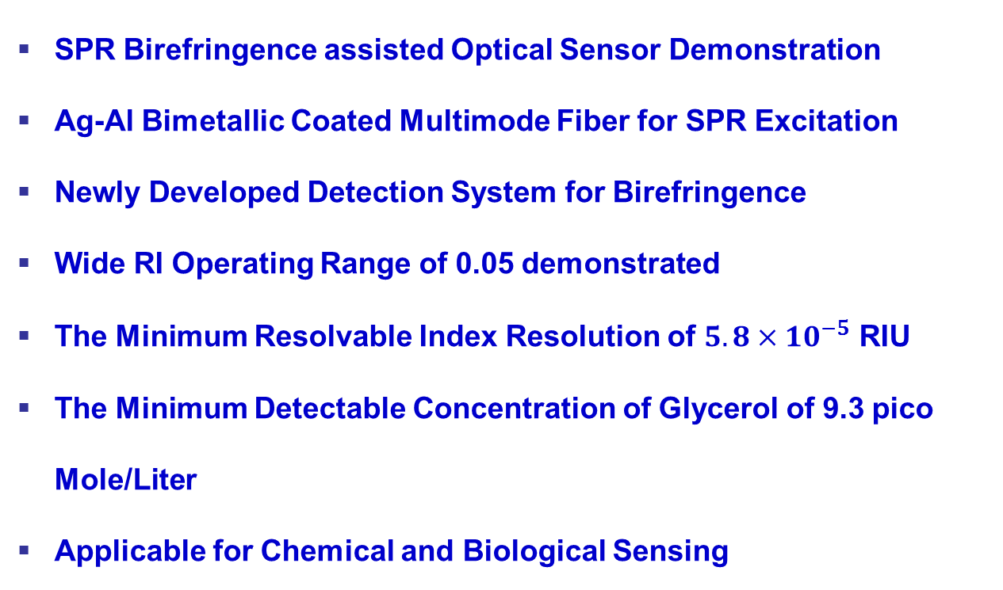
Conclusion
Summary
Talk at Optics-14
24

Slide 27

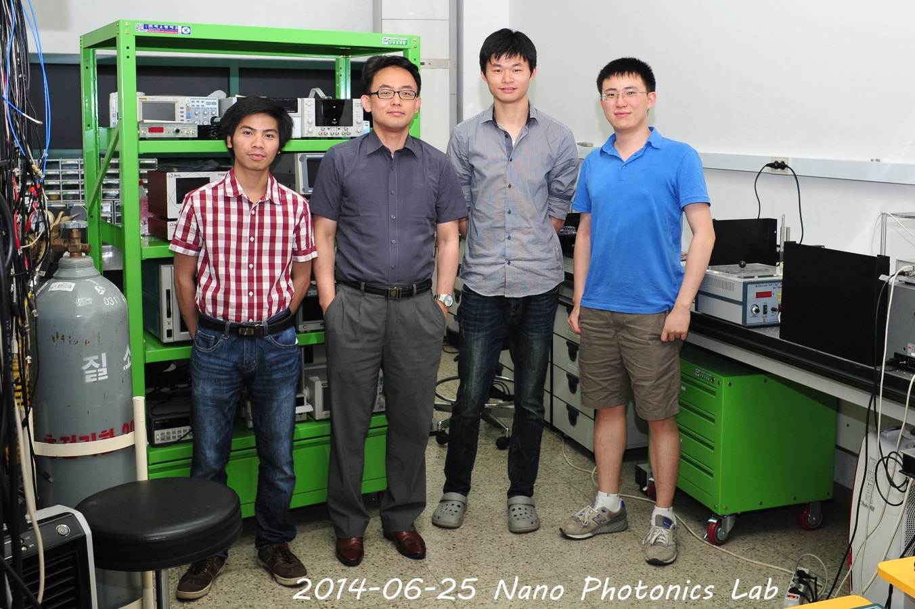
Contributors

Slide 28

End
Thanks for your attention
Questions?

Slide 29
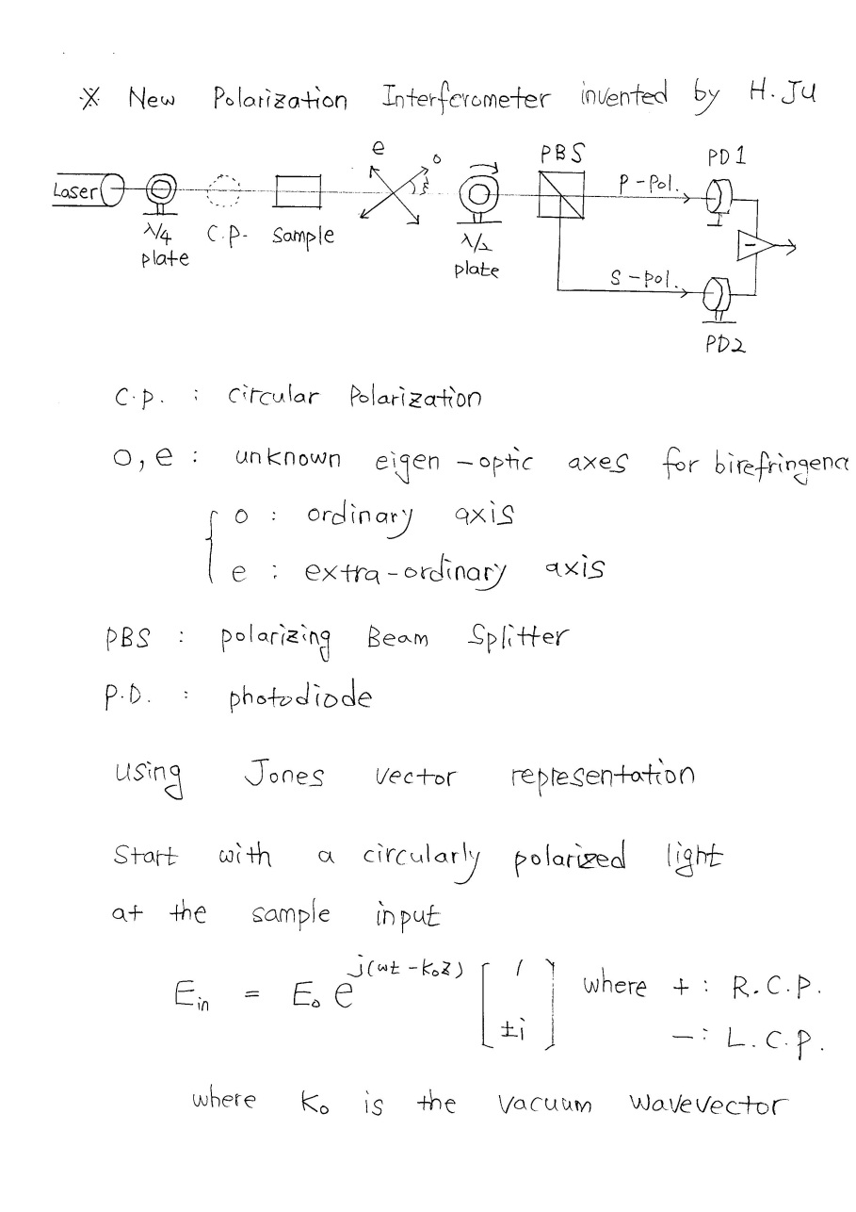
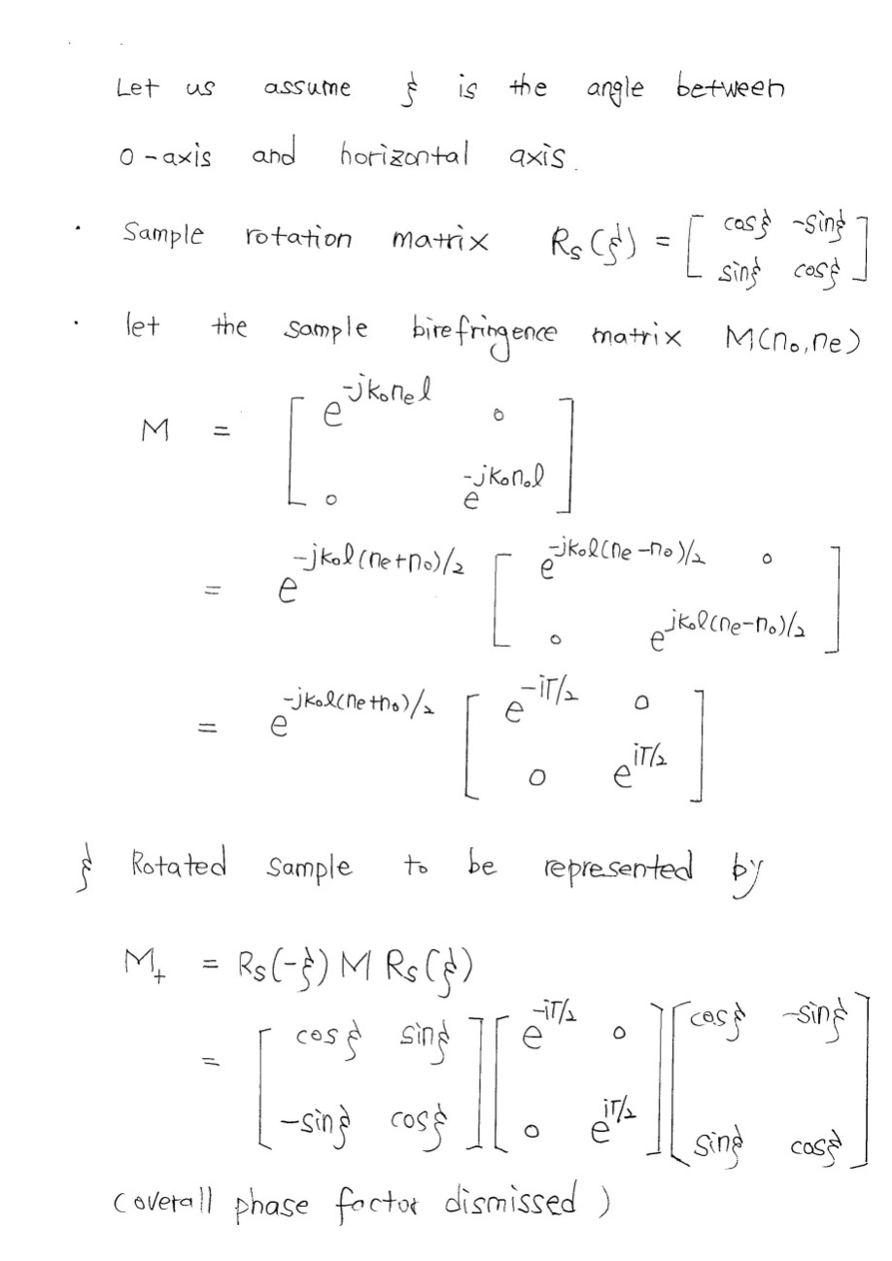
Appendix- New Polarization Interferometer Detection (1)

Slide 30
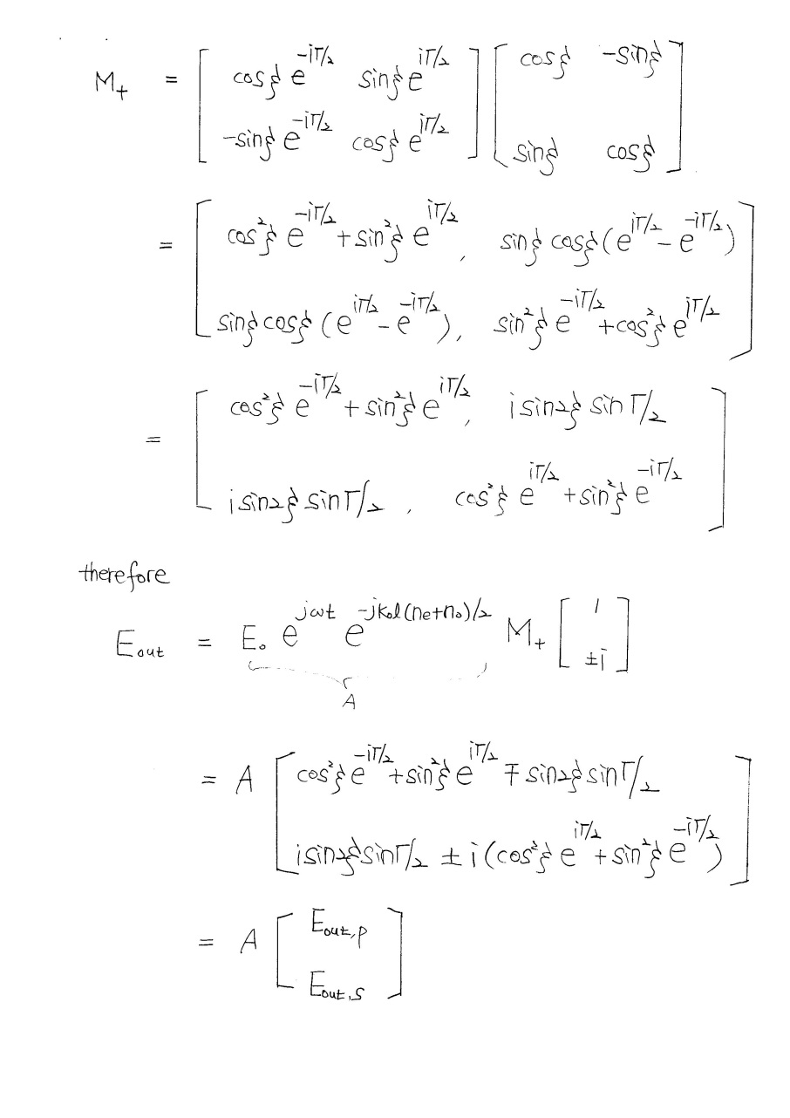
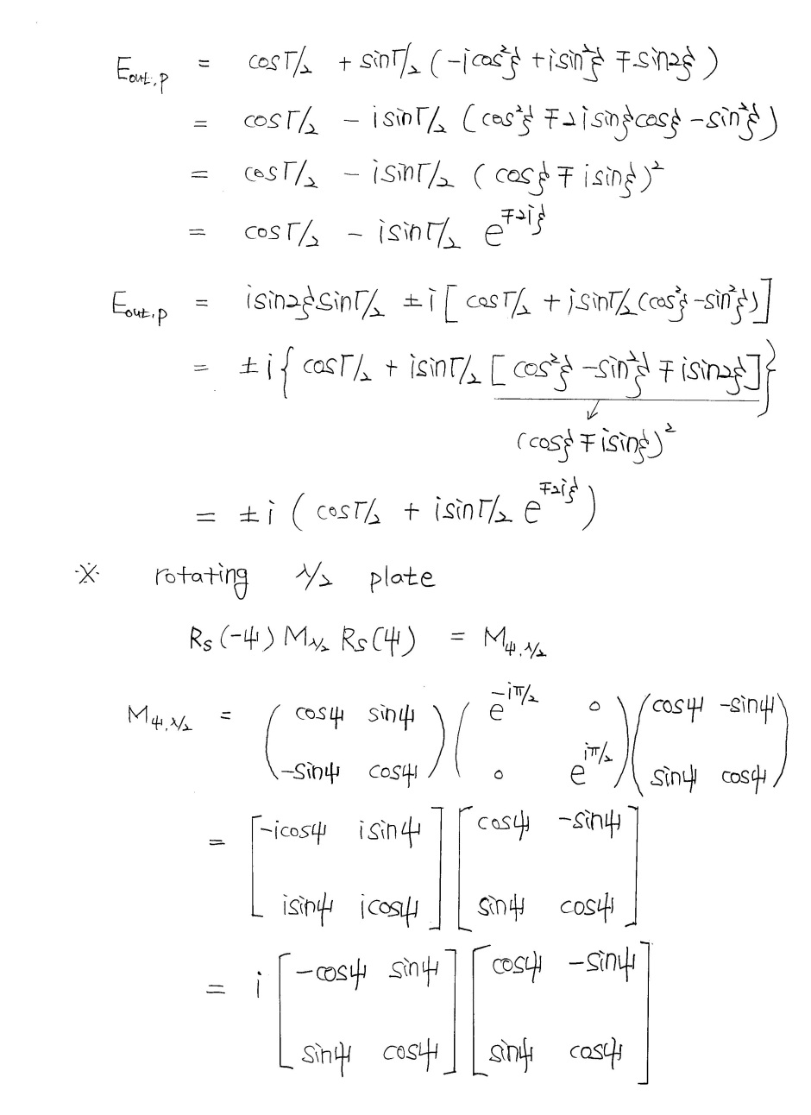
Appendix- New Polarization Interferometer Detection (2)

Slide 31
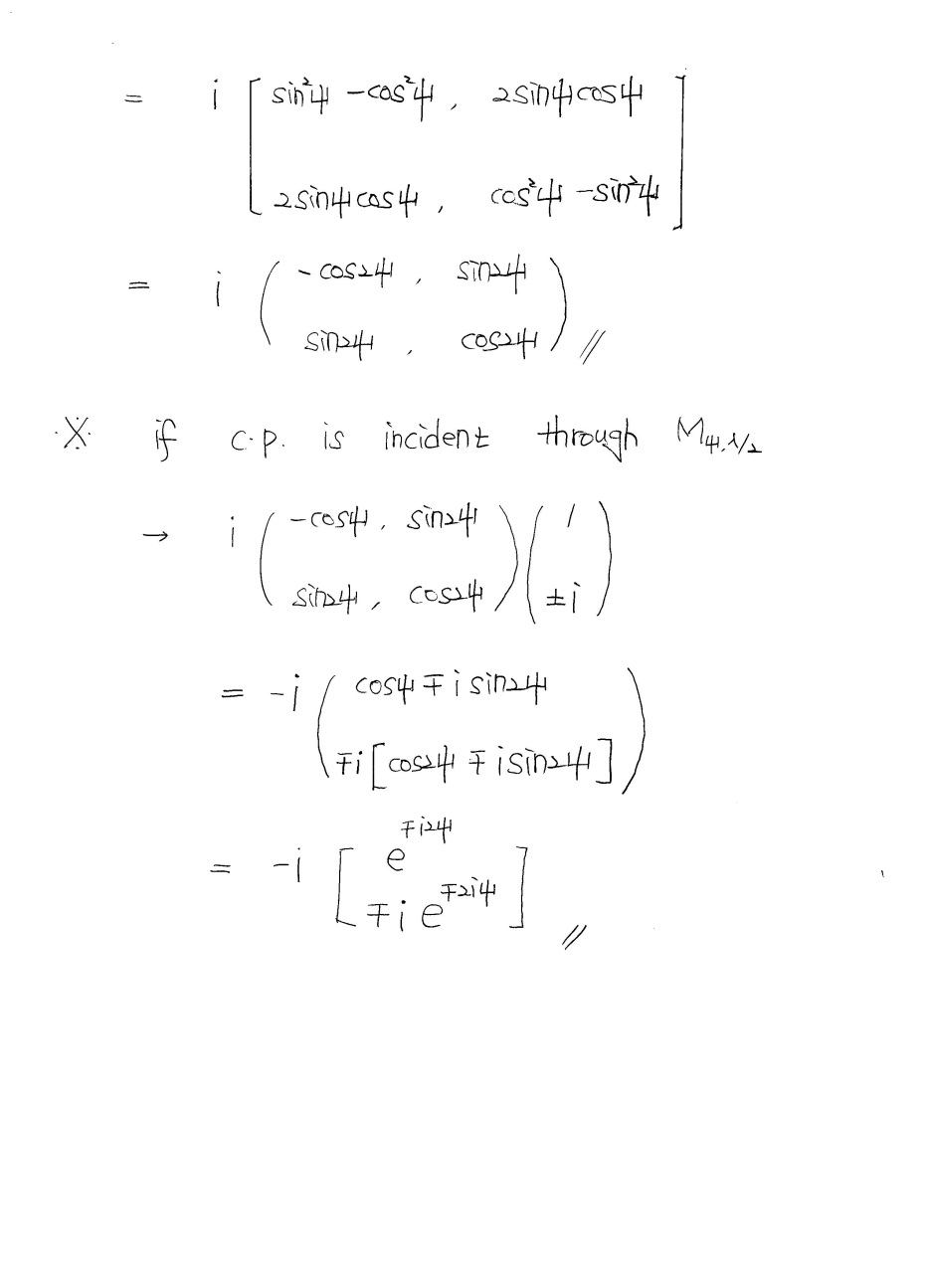
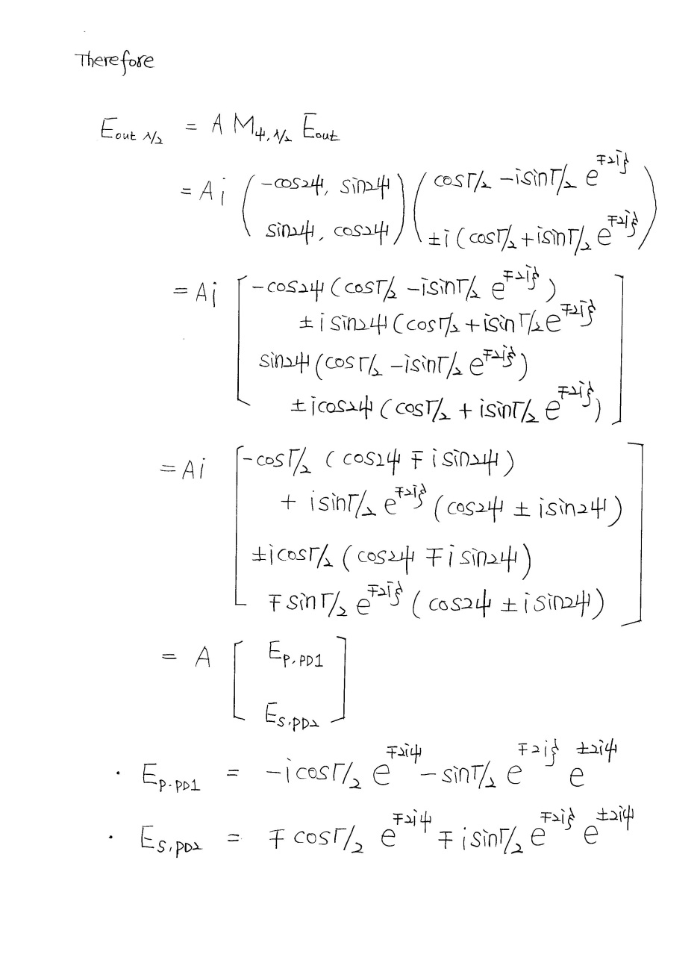
Appendix - New Polarization Interferometer Detection (3)

Slide 32
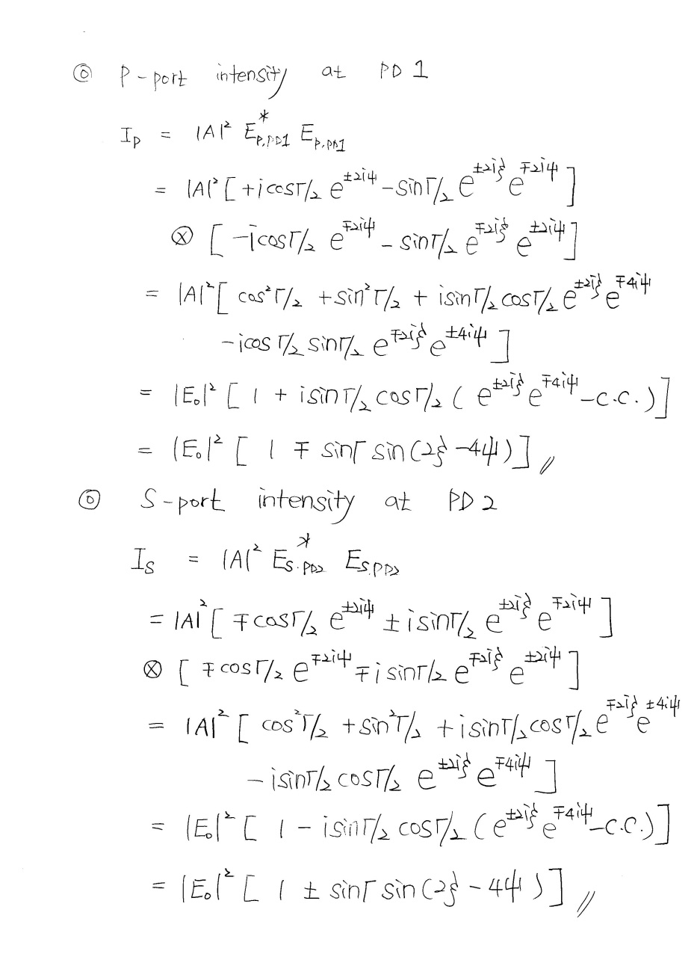
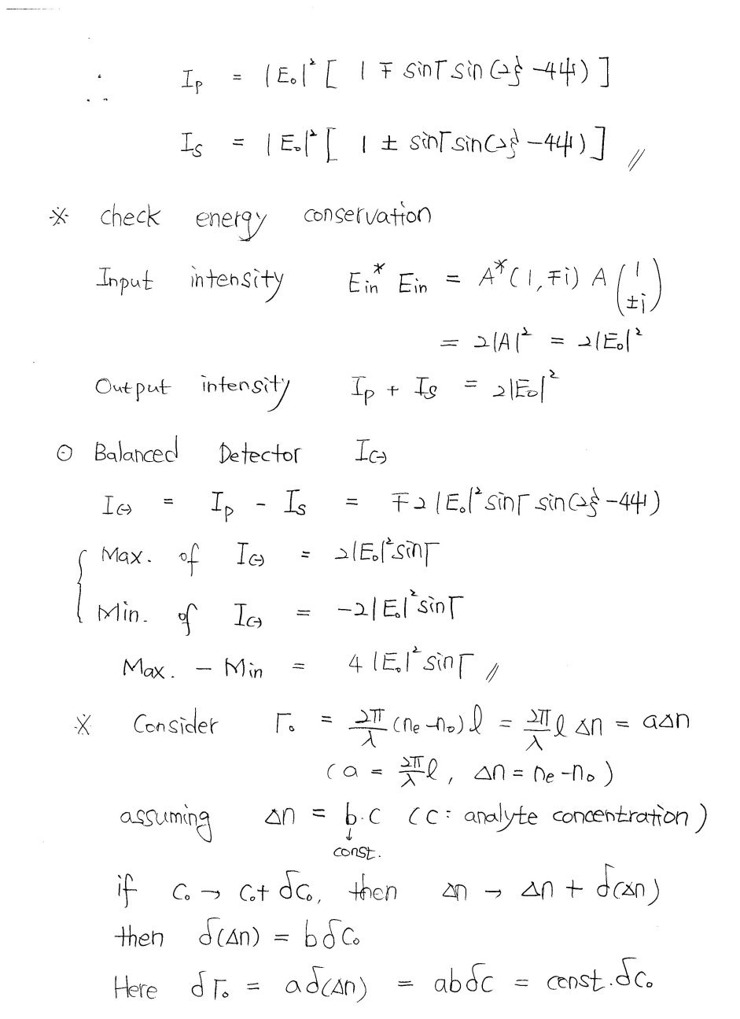
Appendix - New Polarization Interferometer Detection (4)

Slide 33
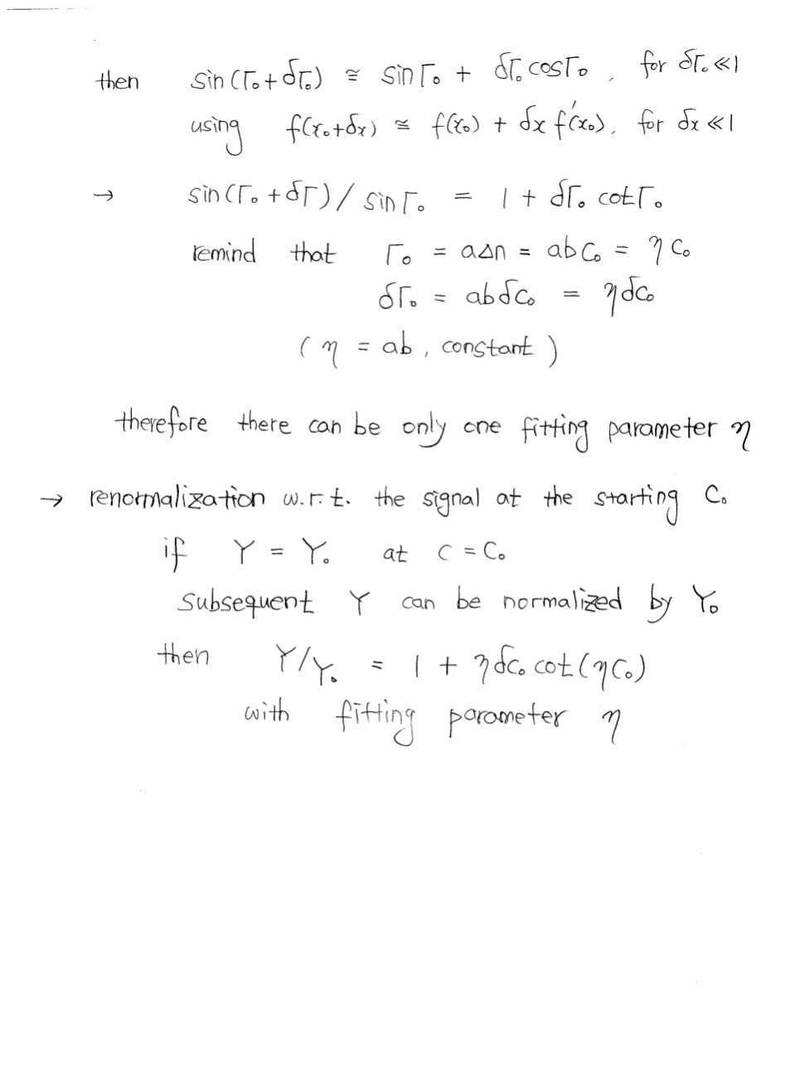
Appendix - New Polarization Interferometer Detection (5)

Slide 34
Let Us Meet Again
We welcome all to our future group conferences of Omics group international
Please visit:
www.omicsgroup.com
www.Conferenceseries.com
http://optics.conferenceseries.com/

