Slide 1
SANGUINATETM Toxicology and Safety Determination
October 20, 2014
Hemant Misra, PhD
hmisra@prolongpharma.com

Slide 2
SANGUINATE™: Therapeutic Need
Conditions in patients with hemoglobulinopathies are more complex and variable than in healthy humans due to the cascade of injury from hypoxia.
Resulting complications can lead to tissue death, organ dysfunction and even death.
Multi-faceted treatment is need to address the array of hypoxic complications.

Slide 3
SANGUINATE™: Background
PEGylated bovine carboxyhemoglobin
  Pegylated to prevent harmful damage of vasoconstriction and vascular damage.
  Pegylated hemoglobin (PEG-Hb) is saturated in carbon monoxide to make a stable drug product (PEG-Hb-CO) with vaso-protective properties.
Mechanism of Action:
  Carbon monoxide (CO) releasing molecule
  Oxygen (O₂) transfer agent.

Slide 4

SANGUINATE™: Background
SANGUINATE Effects:
  Infiltrate the microvasculature, even across thrombosis or vasoconstriction, to perfuse oxygen-poor tissue.
    Carries oxygen for release only to the regions of low oxygen partial pressure
  Provides a low-level release of carbon monoxide into the vasculature that can provide anti-inflammatory protection of the endothelium and suppress vasoconstriction.
Has a greater affinity for oxygen (lower p50) than does hemoglobin within human red blood cells (p50 = 24-28 mmHg), which means that SANGUINATE (p50 = 7-16 mmHg) can facilitate the transfer of oxygen between the patient’s red blood cells and hypoxic tissues (pO2 = 3-5 mmHg), even when the erythrocytes are trapped by a vascular blockage.

Slide 5
SANGUINATE™: Overall Preclinical Strategy
Previous hemoglobin based oxygen carriers (HBOCs) were under development in the 1990s until they were discontinued due to safety-related problems.
The preclinical toxicology program was designed to address the following product-specific issues:
  Traditional toxicology and safety concerns
  Pharmacokinetics (PK)
  Inflammation
  Vaso-activity
  Cardiac and nephrotoxicity
  Pro-coagulant activity

Slide 6
SANGUINATE™: Overall Preclinical Strategy
Challenge | Testing Approach
Inflammation and Oxidative Stress | Immunohistochemistry for TNF-α and MDA in kidneys, myocardium, vasculature, and brain
Cardiac Toxicity | Electrocardiograms, clinical chemistry including Troponin, histopathology, and full cardiovascular and pulmonary assessment in telemetered monkeys
Nephrotoxicity | Renal glomerular filtration rate and renal blood flow study; clinical chemistry; urinalysis; histopathology; measured presence of hemoglobin in urine
Safety Margin | High dose/high volume groups included to maximize dosing levels
Clinical Pathology Interference | Interference assessment and correction for affected parameters

Slide 7
SANGUINATE™: Overall Preclinical Strategy
Unique features of the preclinical program:
  Renal glomeruler filtration rate and renal blood flow study;
  Immunohistochemical staining for tumor necrosis factor alpha (TNF-α, inflammatory marker), malondialdehyde (MDA, oxidative marker) and Prussian Blue iron staining for kidneys, mycardium, vasculature and brain (cerebrum and cerebellum)
  Troponin I (cardiac diagnostic marker);
  Elimination determination by hemoglobin levels in the urine;
  High dose/high volume groups to study an increased safety margin;
  Cardiovascular study in monkeys included additional clinical pathology and histopathology toxicity assessments.

Slide 8
SANGUINATE™: Overall Preclinical Strategy
Unique features of the preclinical program:
  Cardiovascular study in monkeys included additional clinical pathology and histopathology toxicity assessments.
  Interference studies were used to identify and correct for the interference of hemoglobin with the proper assessment of clinical pathology parameters that are based on colorimetric methods, and is a complex analysis that will be elaborated upon in a separate manuscript.
  Studies completed in 3 species:
    Sprague Dawley Rats
    Gottingen Minipigs
    Cynomolgus Monkeys

Slide 9
SANGUINATE™: Overall Preclinical Strategy
Study | Animals (n) | SANGUINATE Dose Levels/Regimen | Parameters
Determination of Glomerular Filtration Rate and Renal Blood Flow Following Single Intravenous Administration of SANGUINATE in Rats | Rat (n=222) | 160, 280, 400 mg/kg Single dose IV | Glomerular Filtration Rate (GFR) and Renal Blood Flow (RBF)
Five−Day Repeat Dose Toxicity Study of SANGUINATE (PEGylated Bovine Hemoglobin) in Rats with a 14 Day Recovery Period | Rat (n=294) | 100, 200, 400 mg/kg 5-day repeat dose; 5 minute infusion | Food consumption, body and organ weight measurements, clinical observations, functional observational battery, hematology, blood chemistry, coagulation, urinalysis, immunogenicity, and histopathology including special staining.
Maximum Feasible Dose Study of SANGUINATE in Rats | Rat (n=20) | 2400 mg/kg 5-day repeat dose (MFD); slow iv push | Body weights and clinical observations, blood and urine collected for clinical pathology, gross necropsy and select target organs for histopathology.
Six Months Repeat Dose Toxicity Study of SANGUINATE (PEGylated Bovine Hemoglobin) in Rats With a 30−Day Recovery Period | Rat (n=506) | 100, 200, 400, 2400 mg/k 6-mo monthly, repeat dose; 5 min iv infusion | Food consumption, body and organ weight measurements, clinical and ophthalmic observations, clinical signs of neurotoxicity, hematology, serum chemistry, coagulation, urinalysis, immunogenicity, and histopathology including special staining.

Slide 10
SANGUINATE™: Overall Preclinical Strategy
Study | Animals (n) | SANGUINATE Dose Levels/Regimen | Parameters
Nine Months Repeat Dose Toxicity Study of SANGUINATE (PEGylated Bovine Hemoglobin) in Minipigs with a 30−Day Recovery Period | Pig (n=86) | 100, 200, 400, 1600 mg/kg 9-mo monthly; 10-15 min iv infusion | Food consumption, body and organ weight measurements, clinical and ophthalmic observations, electrocardiographic exams, hematology, serum chemistry, coagulation, urinalysis, immunogenicity, and histopathology including special staining.
Evaluation of Cardiovascular (Hemodynamic) and Pulmonary Function Following Intravenous Administration of SANGUINATE™ (PEGylated Bovine Hemoglobin) in Conscious Telemetered Male Cynomolgus Monkeys | Monkey (n=4) | 100, 200, 400, 1200 mg/kg 5-day repeat dose; 5-10 min iv injection | Clinical observations, clinical pathology, histopathology, toxicokinetics, ECG, hemodynamics, and pulmonary parameters
Chromosomal Aberration Assay in Human Peripheral Blood Lymphocytes | Peripheral Blood Lymphocytes | 0.06, 0.18, 0.55, 1.66, and 5 mg/ML | Range Finding Assay, Definitive Assay, and Confirmatory Assay
Reverse Mutation Assay | Salmonella typhimurium and Escherichia coli | 0.02, 0.06, 0.18, 0.55, 1.66, and 5 mg/ML | Range Finding Assay, Reverse Mutation Assay, and Confirmatory Assay
Rodent Bone Marrow Micronucleus Assay | Mice (n=80) | 0.024, 0.074, 0.222, 0.666 and 2 g/kg | Range Finding Assay, Main Assay

Slide 11
SANGUINATE™: Study 11-1479-N4-Maximum Feasible Dose
Study Number | 11-1479-N4
Study: | Maximum Feasible Dose Study of SANGUINATE in Rats
Test Item: | SANGUINATE
Control: | Purified Bovine Hemoglobin (PBH) (positive control) Deoxy-peglyated bovine hemoglobin (DPH) (negative control) Hextend (negative control) USP 0.9% Sodium Chloride for Injection (negative control)
Route: | Intravenous
Dose: 5-Day Repeat Dose | 2.4 g/kg SANGUINATE 2.4 g/kg BPH 2.4 g/kg DPH N/A Hextend™ (6% hetastarch in 0.9% lactated sodium chloride solution)
N. Of Animals/ Group: | N= 20: 2M/2F per group
Purpose: | The purpose of this study was to determine the potential toxicity using repeat dose effects of a maximum feasible high dose 2.4 g/kg of SANGUINATE at a dose volume of 60 mL/kg/day for 5 consecutive days.

Slide 12
SANGUINATE™: Study 09-0748-G1- 6 Month Toxicology Study in Rats
Study Number: | Study 09−0748−G1
Study: | Repeat Dose Toxicity Study of Sanguinate (PEG−Hemoglobin) in Rats with a 14−Day Recovery Period
Test Item: | SANGUINATE
Control: | Purified Bovine Hemoglobin (PBH) (positive control) Deoxy-peglyated bovine hemoglobin (DPH) (negative control) Hextend (negative control) USP 0.9% Sodium Chloride for Injection (control)
Route: | Intravenous (iv)
Dose: 6-Monthly Repeat Doses | 100 (low), 200 (mid), 400 (high), or 2400 mg/kg of SANGUINATE 200 mg/kg BPH 200 mg/kg DPH 5.0 mL/kg Hextend™ (6% hetastarch in 0.9% lactated sodium chloride solution)
No. of Animals/ Group: | N = 506: Please see next slide for animals per treatment group
Purpose: | The purpose of this study was to evaluate the potential toxicity and the toxicokinetic profile of the test article, SANGUINATE, after once-monthly intravenous administration for six months to Sprague Dawley rats, and to observe the reversibility of any toxic effects after a 30-day recovery period.

Slide 13
SANGUINATE™: Study 09-0748-G1- 6 Month Toxicology Study in Rats
Results:
  Clinical Signs:
    Extended duration of bleeding, associated with the retro-orbital blood collection procedure, resulting in increased morbidity.
    Incidences of morbidity resulting from prolonged bleeding were higher in all treatment groups relative to the vehicle control groups.
    There were a greater percentage of moribund animals due in all treatment groups (test, as well as positive and negative controls) as compared to the vehicle controls.
  No statistically significant differences in body weight or in overall body weight gain among the control or test article treated groups were noted.
  Recovery groups presented no significant clinical chemistry parameter abnormalities, indicating full recovery from all treatment related effects.

Slide 14
SANGUINATE™: Study 09-0748-G1- 6 Month Toxicology Study in Rats
Results:
  Hematology:
    No statistically significant differences were observed for most of the hematological parameters tested during post treatment among the groups.
    Males in the low dose group showed statistically significant increase in WBC, compared to control and mid dose groups on Day 15.
    Females in the high dose group showed statistically significant increases in the RBC, hemoglobin and hematocrit, compared to control and mid dose groups on Day 25.
    Males in the high dose group showed statistically significant increase in reticulocyte count compared to control, low, and mid dose groups on Day 25.
  Chemistry:
    Statistically significant differences in clinical chemistry included many parameters.
    Given the moderate and transient effect of some observations, most of these differences are not considered biologically significant.
    Significant, dose dependent albumin, total protein, total bilirubin, AST, ALP, amylase, calcium, creatinine and BUN effects were seen in both sexes, although not on all days.
    Microscopic assessment of the kidneys for test and control animals showed no specific renal findings to account for serum creatinine increase.

Slide 15
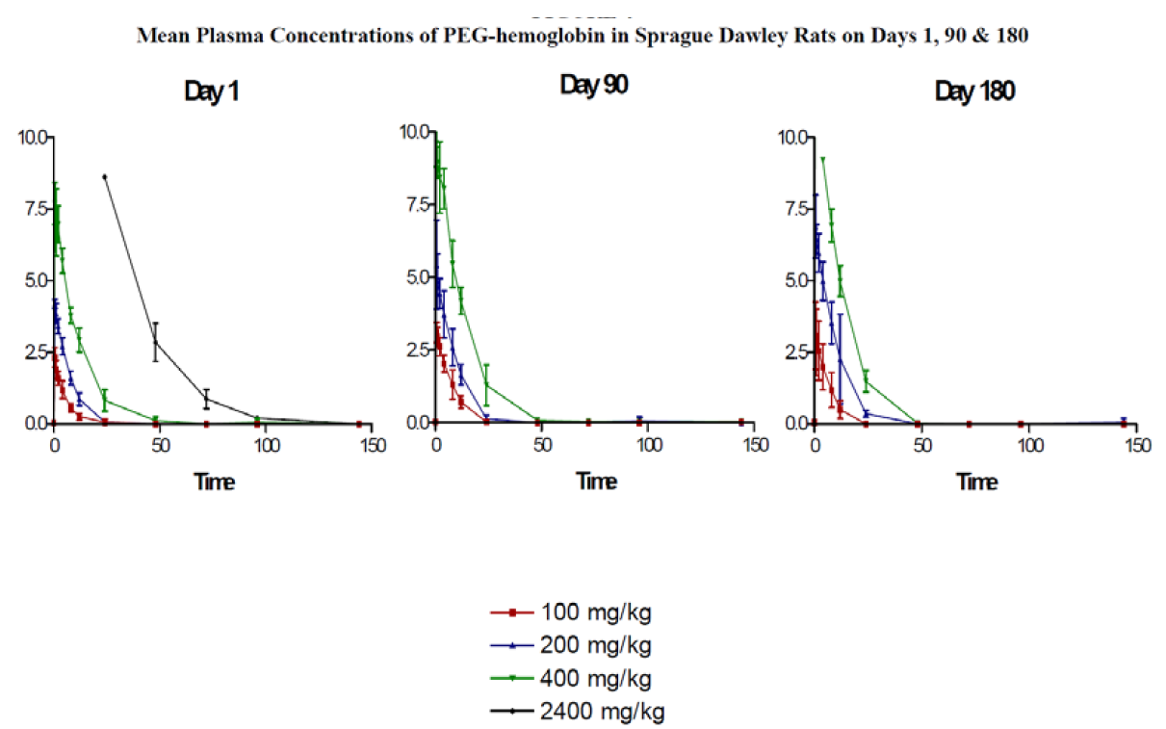
SANGUINATE™: Study 09-0748-G1- 6 Month Toxicology Study in Rats
Toxicokinetic Results:

Slide 16
SANGUINATE™: Study 09-0748-G1- 6 Month Toxicology Study in Rats
Toxicokinetic Results:
  A dose-dependent increase in the mean plasma concentrations of SANGUINATE (PEG-Hemoglobin, see figures below) was observed.
  The mean plasma concentration was significantly higher in 400 mg/kg animals as compared to 100 mg/kg animals on Days 90 and 180.
  There was a dose-dependent pattern in terms of Cmax and AUC, with both reaching peaks in the 2400 mg/kg SANGUINATE (PEG-Hemoglobin or PEG-Hb) dose group on Day 1 and in the 400 mg/kg SANGUINATE dose group on Days 90 and 180.
  When adjusted for dose, there appeared to be a linear response in both C_{max} and AUC.
  Detection of PEG-hemoglobin at the 144 hour timepoint in the 2400 mg/kg dose group suggested the possibility of accumulation following a 5 minute infusion.

Slide 17
SANGUINATE™: Study 09-0748-G2- 9 Month Toxicology Study in Pigs
Study Number: | Study 09−0748−G12
Study: | Repeat Dose Toxicity Study of Sanguinate (PEG−Hemoglobin) in Common Pigs with a 30−Day Recovery Period
Test Item: | SANGUINATE
Control: | Purified Bovine Hemoglobin (PBH) (positive control) Deoxy-peglyated bovine hemoglobin (DPH) (negative control) Hextend (negative control) USP 0.9% Sodium Chloride for Injection (control)
Route: | Intravenous (iv)
Dose: 5-Day Repeat Doses | 100 (low), 200 (mid), 400 (high), or 1200 mg/kg of SANGUINATE 200 mg/kg BPH 200 mg/kg DPH 5.0 mL/kg Hextend™ (6% hetastarch in 0.9% lactated sodium chloride solution)
No. of Animals/ Group: | N = 86: Please see next slide for animals per treatment group
Purpose: | The purpose of this study was to evaluate the potential toxicity and the toxicokinetic profile of the test article, SANGUINATE, after once a month IV administration for nine months to Gottingen minipigs, and the reversibility of any toxic effect after a 30-day recovery period.

Slide 18
SANGUINATE™: Study 09-0748-G2- 9 Month Toxicology Study in Pigs
Parameters Evaluated for Assessment:
  Food consumption,
  Body and organ weight measurements,
  Clinical and ophthalmic observations,
  Electrocardiograms
  Hematology, blood chemistry and coagulation,
  Urinalysis,
  Immunogenicity,
  Histopathology.

Slide 19
SANGUINATE™: Study 09-0748-G2- 9 Month Toxicology Study in Pigs
Results:
  Clinical and ophthalmic observations:
    The only clinical sign considered related to treatment with SANGUINATE was diarrhea, observed in 3 of the 12 animals assigned to the 1600 mg/kg SANGUINATE group.
    Three animals died during the study (unscheduled death): one animal in the vehicle control group, one animal in the 200 mg/kg SANGUINATE group, and one animal in the negative control DPH group.
    Ophthalmic Exam: No findings test article related.
    No statistically significant differences in body weight among the control or test article treated groups were noted.
  Electrocardiograms:
    No systematic change in heart rate that might indicate a treatment cardioactive effect of SANGUINATE when administered once per month at the doses studied.
    There was no evidence of a systematic change in QT interval, or corrected QTc calculated by Bazett’s formula, as a result of administration of SANGUINATE.

Slide 20
SANGUINATE™: Study 09-0748-G2- 9 Month Toxicology Study in Pigs
Toxicokinetic Results:
  Mean plasma concentrations of SANGUINATE increased in a dose dependent manner across dose groups.
  On Day 1, quantifiable levels of SANGUINATE were detected in samples out to 24, 48, 96 and 144 hours post-dose in the 100, 200, 400, and 1600 mg/kg groups, respectively.
  On Day 90, quantifiable levels of SANGUINATE were detected in the 100, 200, and 400 mg/kg groups out to 24, 72, and 96 hours post-dose, respectively.
  On Day 270, quantifiable levels of SANGUINATE were detected out to 24, 96, and 144 hours post-dose in the 100, 200, and 400 mg/kg groups, respectively.

Slide 21
SANGUINATE™: Study 11-1479-G3- Evaluation of Cardiovascular (Hemodynamic) and Pulmonary Function in Cynomolgus Monkeys
Toxicokinetic Results:
  Response was dose-dependent in terms of C_{max} and AUC, with both reaching peaks in the 1600 mg/kg dose group on Days 1 and 90, and in the 400 mg/kg dose group on Day 270.
  When adjusted for dose, there appeared to be a solid linear response in both C_{max} and AUC.
Conclusion:
  According with the parameters for the study, there were no adverse effects identified for any dose in this study; therefore, a no observed adverse effects level (NOAEL) could not be determined.

Slide 22
SANGUINATE™: Study 11-1479-G3- Evaluation of Cardiovascular (Hemodynamic) and Pulmonary Function in Cynomolgus Monkeys
Study Number: | Study 11-1479-G3
Study: | Evaluation of Cardiovascular (Hemodynamic) and Pulmonary Function Following Intravenous Administration of SANGUINATE™ (PEGylated Bovine Hemoglobin) in Conscious Telemetered Male Cynomolgus Monkeys
Test Item: | SANGUINATE
Control: | Purified Bovine Hemoglobin (PBH) (positive control) Deoxy-peglyated bovine hemoglobin (DPH) (negative control) Hextend (negative control) USP 0.9% Sodium Chloride for Injection (control)
Route: | Intravenous (iv)
Dose: 5-Day Repeat Doses | 100 (low), 200 (mid), 400 (high), or 1600 mg/kg of SANGUINATE 200 mg/kg BPH 200 mg/kg DPH 5.0 mL/kg Hextend™ (6% hetastarch in 0.9% lactated sodium chloride solution)
No. of Animals/ Group: | N = 4 (same animals for all doses; all male)
Purpose: | The purpose of this study was to determine the potential acute and repeat dose, intermittent dose effects of SANGUINATE on cardiac, circulatory and pulmonary functions and electrocardiograms (ECG) of conscious telemetered male cynomolgus monkeys.

Slide 23
SANGUINATE™: Study 11-1479-G3- Evaluation of Cardiovascular (Hemodynamic) and Pulmonary Function in Cynomolgus Monkeys
Parameters Evaluated for Assessment:
  Clinical observations
  Body weight
  Cardiovascular Parameters:
    Continuous recordings for 22 hours post-dose.
    Recording of telemetry parameters was performed on the first and last dosing of each treatment, (i.e.. Day 1, 5, 8, 12, 15, etc.).
    Cardiovascular Parameters:
      Systolic Arterial Pressure (SAP)
      Diastolic Arterial Pressure (DAP)
      Mean Arterial Pressure (MAP)
      Heart Rate (HR)
      P duration
      PR Interval
      QRS Interval
      R amplitude
      QT Interval

Slide 24
SANGUINATE™: Study 11-1479-G3- Evaluation of Cardiovascular (Hemodynamic) and Pulmonary Function in Cynomolgus Monkeys
Parameters Evaluated for Assessment:
  Respiratory Parameters:
    Breath Rate, minimum, maximum, inspiration time, expiration time, depth
    Minimum inspiration time
    Maximum inspiration time
    Expiration time
    Depth
  Toxicokinetic:
    Completed on Day 114
    Collection Times:
      Pre-dose, 0.5, 1, 2, 4, 6, 8, 12, 24, 48, and 72 hours post-dose.
  Clinical Chemistry
  Histopathology

Slide 25
SANGUINATE™: Study 11-1479-G3- Evaluation of Cardiovascular (Hemodynamic) and Pulmonary Function in Cynomolgus Monkeys
Results:
  Clinical Observations:
    Following administration of the positive control (PBH) all four animals had red substance in the cage pans.
    Loose or soft feces were noted in two of four animals on Day 44, 24 hours following the first administration of SANGUINATE at 400 mg/kg.
    Following the repeat administration of the highest total dose of SANGUINATE (1200 mg/kg) on Days 93-97, observations included delayed/prolonged bleeding times, facial and inguinal erythema, pink skin color, petechiae on the leg, decreased activity and white foamy/frothy feces.
    Following the additional total high dose of 1200 mg/kg/day on Day 114, clinical observations were limited to small red areas on the abdomen and extremities.

Slide 26
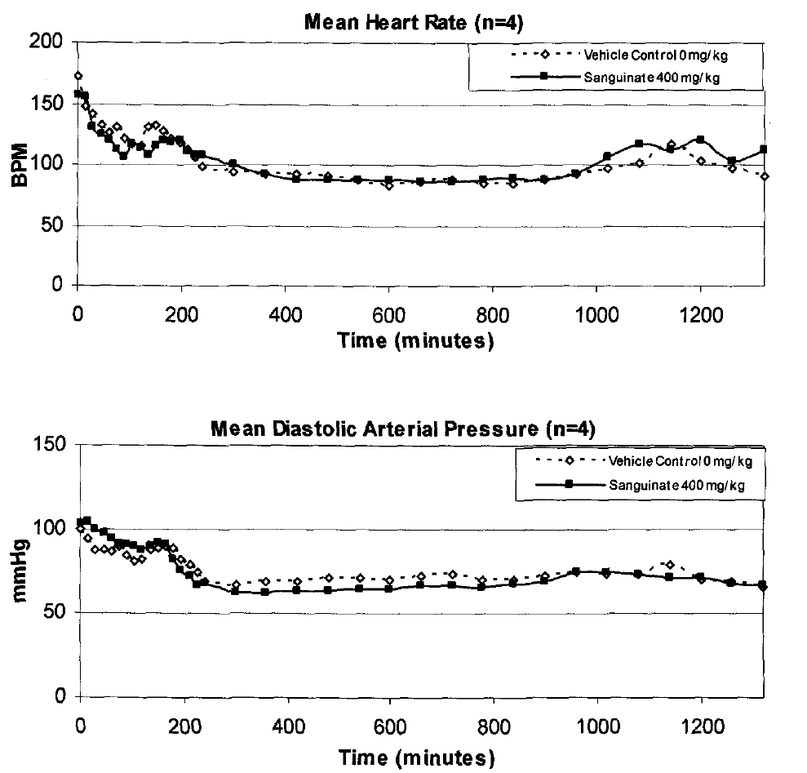
SANGUINATE™: Study 11-1479-G3- Evaluation of Cardiovascular (Hemodynamic) and Pulmonary Function in Cynomolgus Monkeys

Slide 27
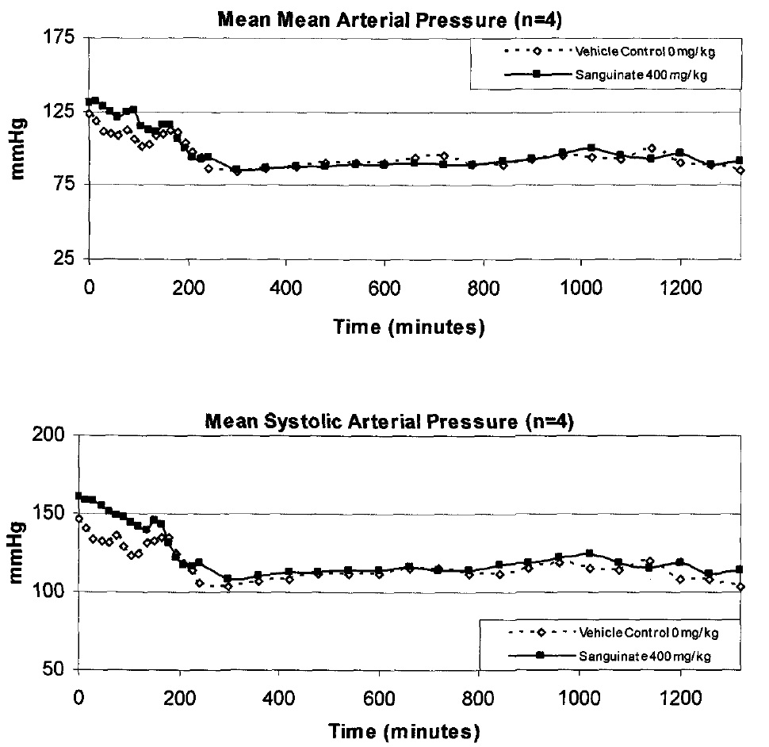
SANGUINATE™: Study 11-1479-G3- Evaluation of Cardiovascular (Hemodynamic) and Pulmonary Function in Cynomolgus Monkeys

Slide 28
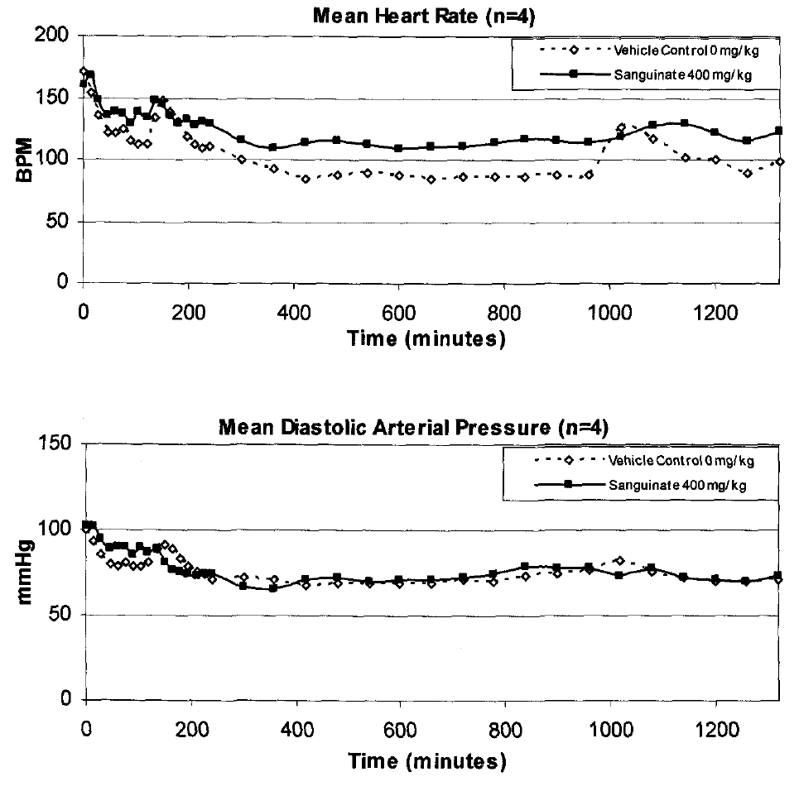
SANGUINATE™: Study 11-1479-G3- Evaluation of Cardiovascular (Hemodynamic) and Pulmonary Function in Cynomolgus Monkeys

Slide 29
SANGUINATE™: Study 11-1479-G3- Evaluation of Cardiovascular (Hemodynamic) and Pulmonary Function in Cynomolgus Monkeys
Results:
  Cardiovascular and Respiratory Parameters:
    1200 mg/kg:
      The first day of dosing of the total high dose of SANGUINATE (1200 mg/kg/day) was associated with decreased heart rate and increased arterial pressure but no biologically relevant changes in ECG or pulmonary pressures.
      Following the fifth day of dosing at 1200 mg/kg/day, increases in heart rate, arterial pressure and QTc were noted as well as decreases in respiratory rate.
      The additional doses of 1200 mg/kg/day on Day 127 were associated with increased heart rate and pressure but no definitive changes in ECG or pulmonary parameters.

Slide 30
SANGUINATE™: Study 11-1479-G3- Evaluation of Cardiovascular (Hemodynamic) and Pulmonary Function in Cynomolgus Monkeys
Results:
  Histopathological:
    There were no microscopic findings in any tissues examined that indicate direct test article toxicity in these instrumented animals.
    One sample (animal #4, Day 97) had detectable troponin levels.
  Toxicokinetic:
    SANGUINATE concentrations were detectable in plasma up to 72 hours post-dose.
    Based on calculations from the AUC_{all}, the mean t_{½} of SANGUINATE in cynomolgus moneys was 27 hours.

Slide 31
Clinical Program of SANGUINATE™
Completed
51 subjects/patients treated to date.
2 INDs and 3 eINDs (compassionate) approved by FDA.
Phase I trial in healthy volunteers (Australia) completed and submitted to FDA.
Phase 1b studies in stable SCD patients (safety) are completed.
On-Going Studies
Phase 2 study in SCD VOC
Phase 2 study in SCD leg ulcers
Phase 2 study in Delayed Cerebral Ischemia
Phase 2 study in β-Thalassemia

