Slide 1
A Laboratory Interference study of PEGylated Carboxyhemoglobin Bovine (SANGUINATE™) on Assays of Serum Chemistry, Hematology, Coagulation and Blood Gases
October 20, 2014
Hemant Misra, PhD
hmisra@prolongpharma.com

Slide 2
Objective
PEGylated carboxyhemoglobin bovine (SANGUINATE™ is a dual action carbon monoxide releasing / O₂ transfer agent in development for treatment of ischemic/inflammatory indications such as congenital or acquired hemoglobinopathies and vasculopathies, including Sickle Cell Disease, the α-/β-Thalassemia, and cerebrovascular or peripheral vascular diseases.
Previous studies have demonstrated that hemoglobin-based solutions and PEGylated proteins exhibit interference in clinical laboratory assays due to the heme groups of hemoglobin which absorb strongly in the visible spectrum. The objective of the current study was to examine clinically-relevant concentrations of SANGUINATE in assays of clinical chemistry, hematology, coagulation, and blood gas measurements.

Slide 3

SANGUINATE™ Overview
An intravenous therapeutic which combines the beneficial functions of:
  “Targeted” Oxygen Transfer to hypoxic tissues
  Carbon Monoxide for release into vasculature (anti-inflammatory and vasodilatory)
  Enhanced blood/plasma flow dynamics
  that act together to reverse the effects of vascular ischemia and improve perfusion and oxygenation.

Slide 4
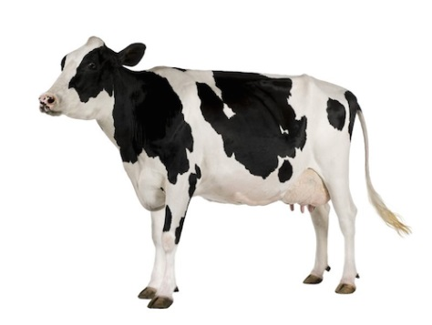
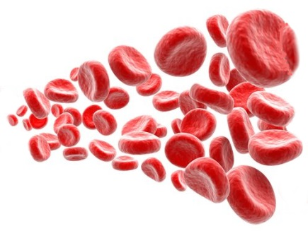
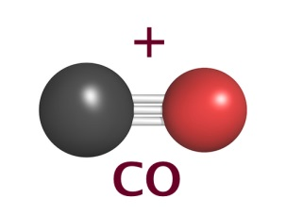
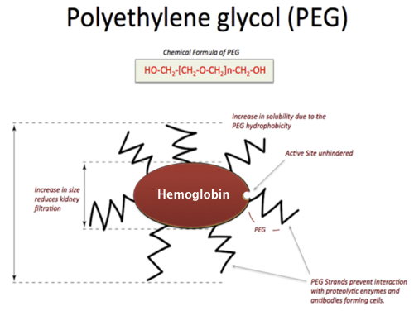
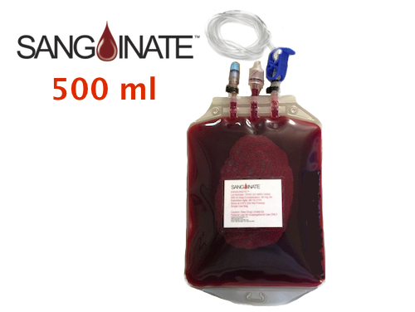
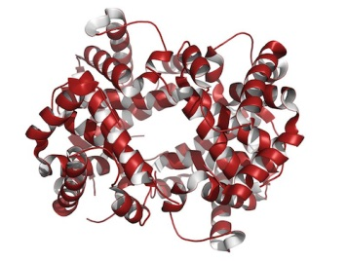
SANGUINATE™ What is it?
(PEGylated carboxyhemoglobin bovine)
Hemoglobin
Molecule
  To treat Anemia, Ischemia and Hypoxia caused by Diseases such as:
  Stroke, Subarachnoid Hemorrhage, Myocardial infarction, Vaso-Occlusive Crisis, Sickle Cell Disease & Comorbidities, Thalassemia

Slide 5
Methods
The EP7-A2 CLSI guideline was used as a basis for the interference studies
The guidance requires two parts of an interference study (a) identify interference (b) Characterize interference
According to guidelines, the observed values were used to calculate the interference, and if the value was greater than the confidence interval then the parameter was considered to have interference
Human Interference study was performed at National Jewish Health Advanced Diagnostics Laboratory (Denver, CO) and interference studies with three species (rat, pig and monkey) were performed at Toxikon Corp., Bedford MA
The blood samples were collected from healthy volunteers after IRB approval

Slide 6
Methods
The multispecies study (12-3330-N4) was used in order to show species equivalence
The multispecies study was also used to characterize interference
A confidence interval was set using manufacturers guidelines as well as instrument control data
In general, there were very few differences among the species.
Any differences that were found were adjusted for by using species specific correction factors.

Slide 7
Instrumentation
Clinical chemistry parameters were tested on an Olympus AU480 instrument (Beckman Coulter, Brea, CA).
SANGUINATE or diluent was diluted into QC control materials of varying concentrations of analytes (BioRad Multiqual Levels 1, 2 and 3) to determine whether interference differs with varying concentration of analyte.
Troponin I, Creatinine, BUN were analyzed on the iSTAT® 1 Analyzer (Abbott).
Hematology parameters were evaluated on a Beckman Coulter LH 750 instrument (Beckman Coulter, Brea, CA) using whole blood drawn in to EDTA and prepared to final SANGUINATE concentrations of 1, 5, or 8mg/mL or equivalent diluent volumes.
Coagulation parameters were evaluated on an ACL 1000 instrument (Beckman Coulter, Brea, CA) using both QC materials (Instrumentation Labs, HemosIL Controls 1, 2, and 3) and pooled citrated plasma.
Blood gas parameters were tested using a Radiometer ABL 800 Flex (Radiometer, Copenhagen Denmark) on heparinized whole blood samples. Specimen for blood gas screening were prepared to final SANGUINATE concentrations of 1, 5, or 8mg/mL.

Slide 8
Results
SANGUINATE elicited a concentration-dependent interference in nine of twenty-eight chemistry assays, with five assays affected with elevated measurements (albumin, A/G ratio, cholesterol, total iron, percent iron saturation), and four assays exhibiting decreased measurements (GGT, globulin, total iron binding, unsaturated iron binding).
The observed results matched closely the manufacturer’s technical documents for hemoglobin interference and correlated well with the reported H-index for hemolysis.
There was a decrease in automated and manual platelet count due to in vitro clumping of platelets, and a slight increase in aPTT observed.
Other hematology, coagulation, and blood gas indices were not affected.

Slide 9
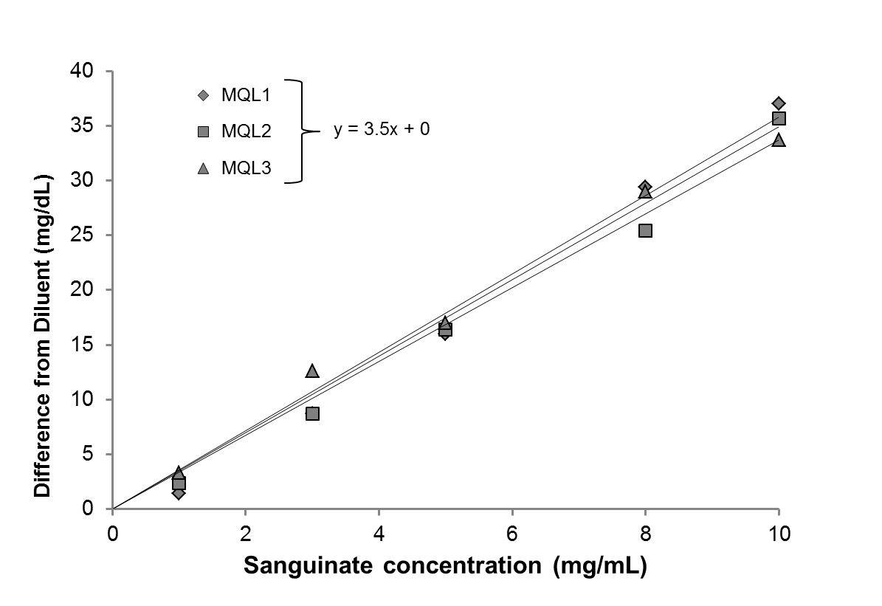
Interference analysis for cholesterol

Slide 10
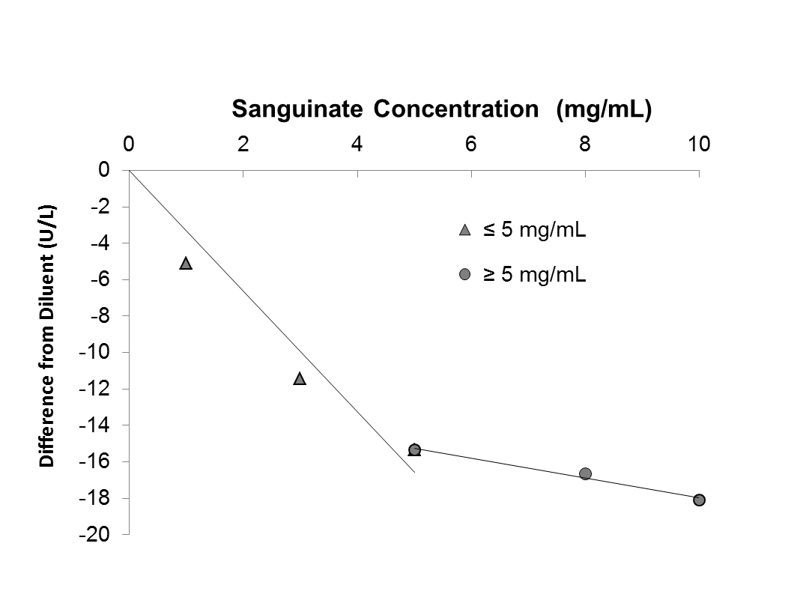
Interference of gammaglutamyl transferase
y = -3.3x + 0
y = -0.5x – 12.5

Slide 11
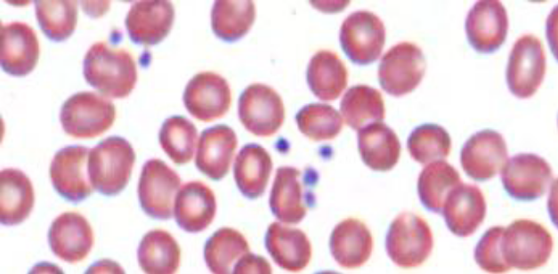
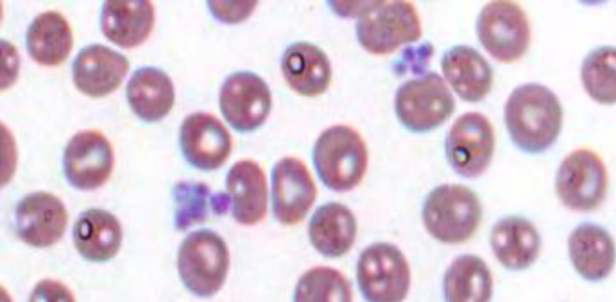
Clumping of platelets in samples spiked with SANGUINATE™

Slide 12
Hemolytic and Ischemic Pathways
SCD Crisis
Cerebral Hemorrhage
Allosensitization
Hemolysis
Ischemia
Vaso-occlusive crisis
Cardiac disease
Stroke
Diabetic ischemia
Acute wound
Acellular oxyHb
Hypoxia
NO depletion
ROS
Inflammation
Vasoconstriction
SCD: VOC pain, ACS, retinopathy, stroke
Organ dysfunction
Neurological deficits
Chronic wounds
Anemia
SCD: pulmonary hypertension, priapism, leg ulcers, stroke
Vasospasm/Delayed cerebral ischemia
Organ damage/hemolytic anemia

Slide 13

SANGUINATE™
Interrupts both the Hemolytic and Ischemic Pathways at multiple points with multiple mechanisms
Hemolysis

Ischemia
O₂
Acellular oxyHb
Hypoxia
PEG
NO depletion
CO
ROS
Inflammation
Vasoconstriction

Slide 14
Clinical Program of SANGUINATE™
Completed
51 subjects/patients treated to date.
2 INDs and 3 eINDs (compassionate) approved by FDA.
Phase I trial in healthy volunteers (Australia) completed and submitted to FDA.
Phase 1b studies in stable SCD patients (safety) are completed.
On-Going Studies
Phase 2 study in SCD VOC
Phase 2 study in SCD leg ulcers
Phase 2 study in Delayed Cerebral Ischemia
Phase 2 study in β-Thalassemia

Slide 15
SANGUINATE™ Therapeutic Targets
Loss of Blood (trauma-Injury)
Acquired Anemia's - disease based
Genetic / Congenital anemia's
Thalassemia
Acute Sickle Cell Disease
Acute chest syndrome
Pulmonary Hypertension
Allo-immunization
Hyperhemolysis
Vaso-occlusive crisis (pain)
SCD ulcers
Priapism
Dactylitis
Stroke
Cardiovascular Disorders
Anemia
Comorbidities of Sickle Cell Disease
Hypoxia/Ischemia
Stroke, Myocardial Infarcts
Delayed Cerebral Ischemia
Subarachnoid Hemorrhage
TBI
Organ Transplant related ischemia

Slide 16
Conclusion
We conclude that none of the analytes used for critical care evaluation exhibits interference due to SANGUINATE, and that the profile of interference requires testing on specific instruments to be used in clinical evaluation of patients.
Good correlation of the H-index with spiked SANGUINATE concentrations, should provide confidence that clinical laboratory data can be interpreted safely in the presence of SANGUINATE.

