Slide 1

Valuing Professional Citizenship
Hellen Mary Checker
Dentistry 2015
18th March 2015
Crowne Plaza Dubai UAE

Slide 2
Objectives
Describe the 3 components of professional citizenship
Recognise the FDI ‘ Principles of Volunteering’
Discuss challenges faced by volunteer programs and volunteers and provide some useful tips for international volunteers learned from the Long Tan Dental Project Vietnam.
Describe collaborative partnerships, give practical examples and challenges encountered
Introduction to Oral Health for Those Who Care educational package

Slide 3
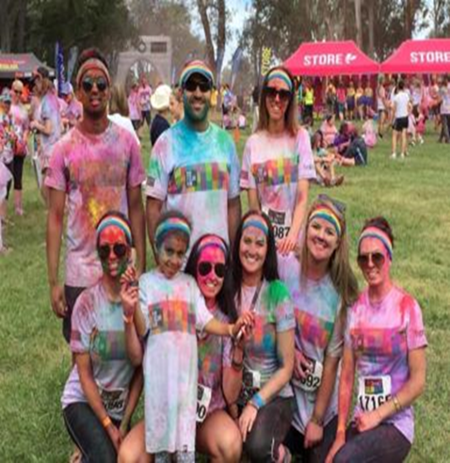

What is Professional Citizenship?
As oral health professionals we have a broad responsibility to the community in which we choose to practice and assist our communities with health issues and donate our time and or services to improve the health of the community.
ba
Colour Run 2015, ACT Dental practice raises money for children’s heart disease

Slide 4

As dental health professionals we should demonstrate leadership with in the community regarding health issues.
Professional citizenship may include active membership of a dental society working to improve community health by developing and facilitating dental programs for the community

Slide 5
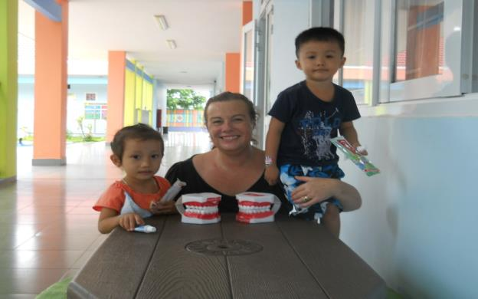

FDI Principles of Volunteering
www.fdiworldental.org/media/.../Guidelines-for-dental-volunteers-2005.
Preference should be to work in an established programme or project
Apply dental professional ethics in all settings.
Long Tan Dental Project Vietnam Project established in 2007
2-3 years olds waiting for dental screening Long Tan Kindergarten 2014

Slide 6
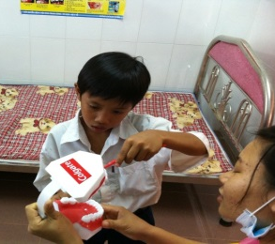
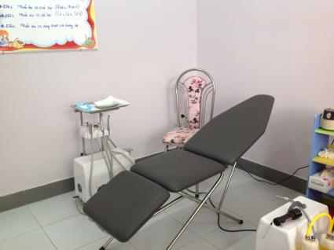
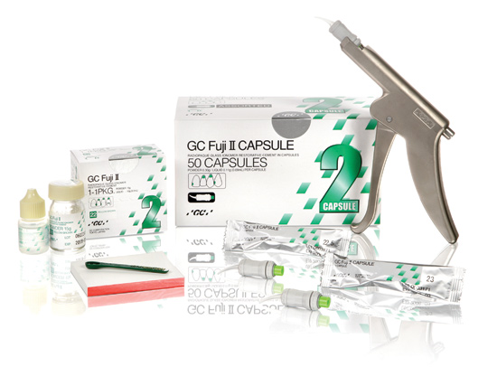
Emergency care and service provision are important however it is essential to ensure long term sustainability and improvement in community health
A volunteer should be cautious about introducing new material and equipment without prior consultation
Dental health education in Long Tan Primary School 2011
Australian dental hygienists’ society donates a percentage of proceeds from CPD events annually to the Long Tan fund to purchase mobile equipment for the project in Vietnam

Slide 7
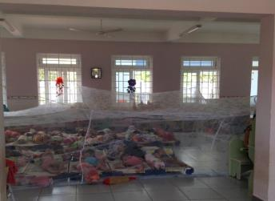
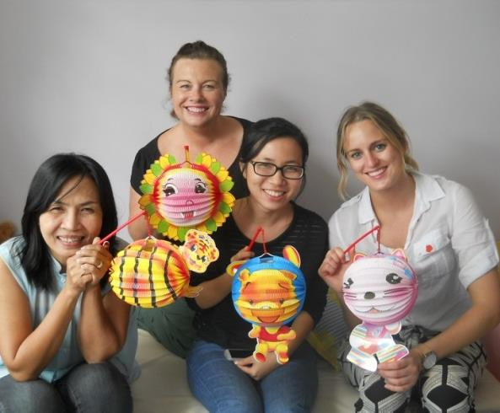
General principles such as project planning, reporting and evaluation are essential to the success of a project.
Any volunteer should respect the culture of the host community and try to adapt as much as possible.
Long Tan pre-schoolers rest from 10.30- 1pm and then have their lunch until 2pm. Clinic does not operate between these hours.
Celebrating Vietnam’s National Day in the clinic 2014

Slide 8

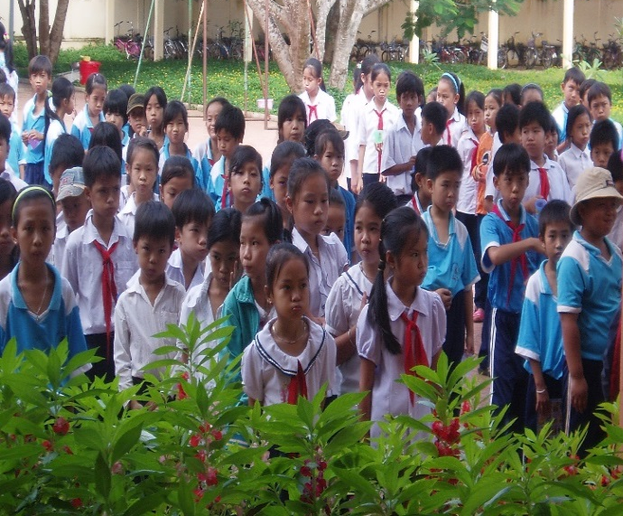
Challenges facing volunteer programs and volunteers
Objectives and agenda of the volunteer
Behaviour of volunteers
Adherence to project objectives
Sustainability of the project
Continued community/ government support for the project
The project objective is to provide preventive services to school children in Long Tan
Australian Dental Association
Volunteer Handbook http://www.ada.org.au
The local government actively support the
Fluoride Rinsing Program at Long Tan Primary School

Slide 9
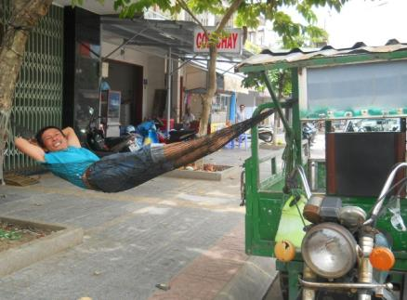
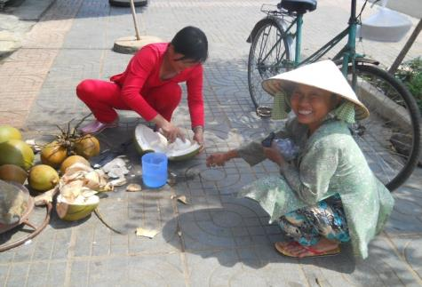
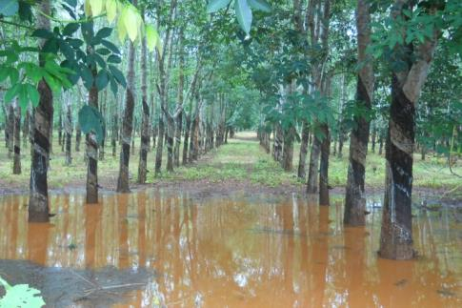
Challenging clinical environments, including power outages, extreme weather conditions, unreliable equipment, transport and storage of materials.
Infection control challenges
Simple bathroom and hygiene challenges

Slide 10
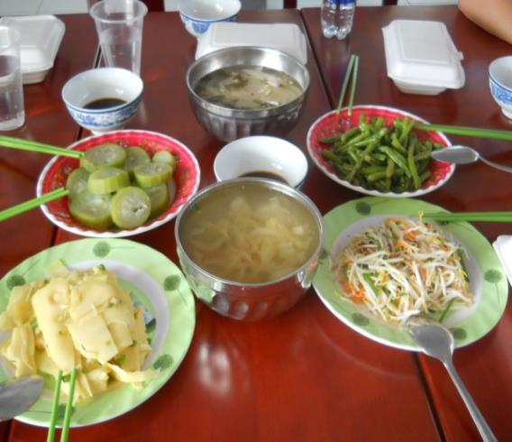
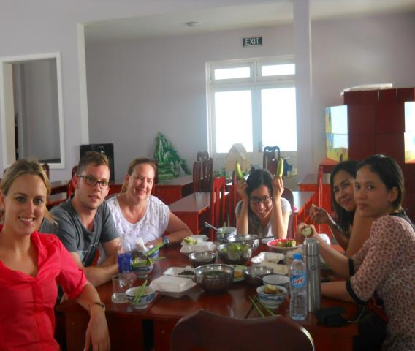
Unsafe environments,(wild dogs & wildlife) transport breakdowns and pick-pockets
Managing safe food and water, supplies and unfamiliar cuisines
Infectious disease
Regional instabilities
Lack of leadership & experience
Lunch time is always a great opportunity for cultural exchange and enjoy fantastic food!

Slide 11

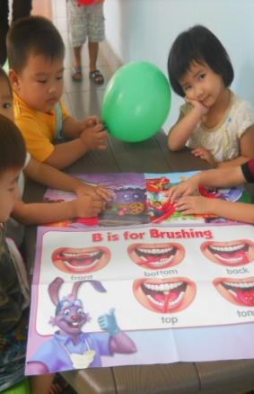

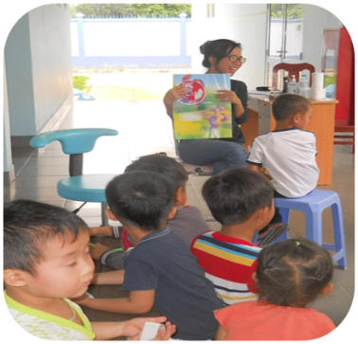

language, names unfamiliar, repetition, formatting, dates of birth un-known,
record keeping and consent
No access to social media
Long Tan Pre-school
www.allianceforacavityfreefuture.org
www.gcdfund.org
internationalvolunteer.ada.org/.../ADA_International_Dental_Volunteer

Slide 12
Ethics and Communication
http://www.aphra.gov.au

Slide 13
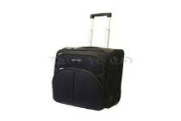

Pre-planning Tips
Research the country, people and culture and learn a little of the language & read the volunteer guidelines
Carry essentials in carry-on luggage & a change of clothes
Ensure gloves are the next size up working in humid conditions, take a torch.
Bring measure of humility, a smile and an open mind and your dental ethics
Remember notify your indemnifier!

Slide 14



Tips on your Arrival
Expect to meet authorities and go through local processes and meeting/ greet with schools, health authorities & principles before you commence clinic
Expect unscheduled visits from authorities
Always operate within your scope of practice
Remember quality not quantity, understand clinicians may work at different paces.
Respect all team members, they have each have a role

Slide 15

International volunteering does not suit everyone and there are many other options to develop citizenship within your own community

Slide 16
Collaborative Partnerships
Collaborative advantage describes strategic alliances between organisations and the realisation of achievements which cannot be achieved by one association exclusively. (Huxham & Vangen 2010 p.72)
Common interests for oral health societies may include improved health outcomes and searching for innovative solutions and achieving results that could not be achieved without successful strategic alliances and oral health societies. (Huxham & Vangen 2010 p.72)
Opportunities to collaborate and focus on on upstream public health measures as well as downstream measures

Slide 17
Challenges facing Collaborative Partnerships
In
There is a complexity to collaborative partnerships and even the most successful partnerships may experience inertia. Collaborative inertia describes the impeded progress of alliance outcomes (Huxham & Vangen 2010 p .72 )
Contributing factors to inertia may include; inability to agree to common goals, lack of trust, partnership fatigue and an environment of continual change (Huxham & Vangen 2010 p.72-84 )

Slide 18

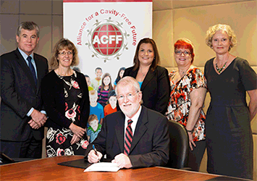
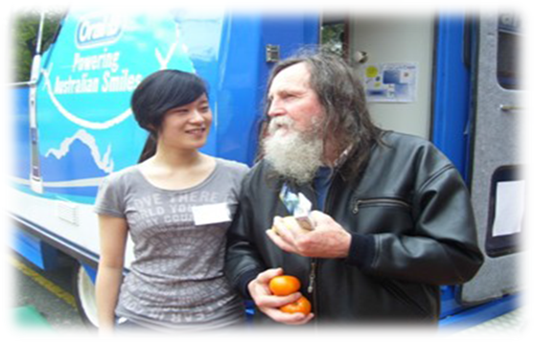
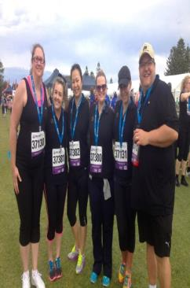
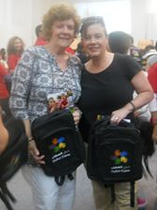
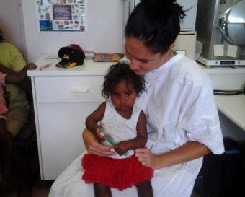
Collaborative Partnerships
Oral Health Professional Society
Regulatory Bodies
Alliance for Cavity Free Future
Universities
Governments
Consumers Groups
Allied Health Professionals
Health Care Associations
Other Oral Health Professional Societies
Volunteer Organizations
Educators
Aged care facilities
Health Insurers
Schools
Medical Indemnifiers
Community Groups
Industry

Slide 19
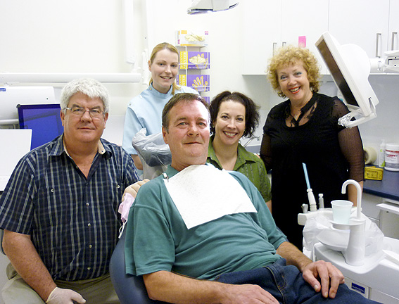
Developing your citizenship with Universities
Tutoring
Mentoring
Clinical placements
Research
Innovation
University community outreach projects and research projects
http://health.adelaide.edu.au/dentistry/community-outreach/
Medical and dental students University of Adelaide ACH

Slide 20
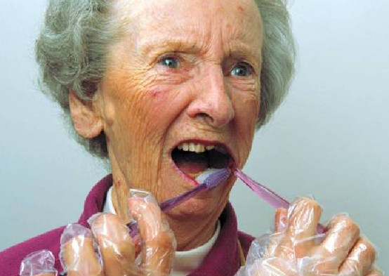
There were also 185,200 permanent residents in Australian aged care facilities and more than 52% of these elderly Australians had been diagnosed with dementia. (AIHW 2011)

Slide 21

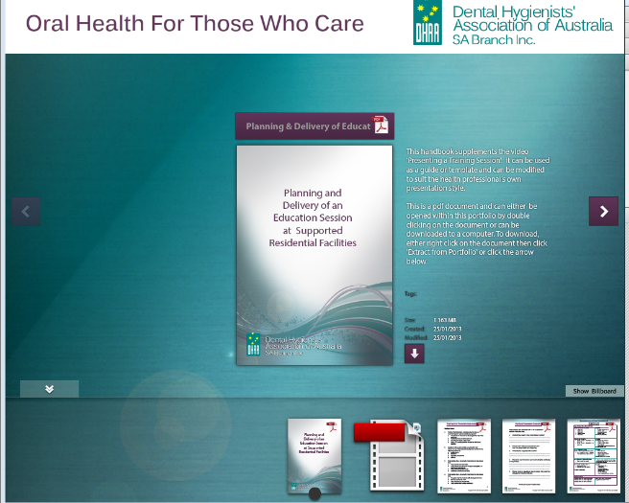
www.dhaa.info/store/
Oral Health For Those Who Care Package
Resources for Carers in Aged care facilities
Videos
Information and instructional videos on
Needs Assessment
Preparation
Delivery and Presentation
Teaching methods
Evaluation
Costing and Fees
Oral care video for staff ( 15 mins duration)
Handouts
When to refer guide
Special product list
Feedback Forms
Video: Oral care for acute care

Slide 22
Acknowledgements
DHAA
AVVRG
Dr Colin Twelftree
ACFF
University of Adelaide
Margie Steffans, dental hygienist
National Dental Foundation, Kellie McDonald, dental hygienist and Renee Allen, dental hygienist
Rokeby Dental Surgery WA
Crystal –Lee Harris, dental therapist
Royal Flying Doctor Service NT
West Lakes Dental Surgery SA
ARROWH
Thank you to the patients who have given their consent for their images to be used in this presentation

Slide 31
Long Tan Pre-school Vietnam 2014

