Slide 1
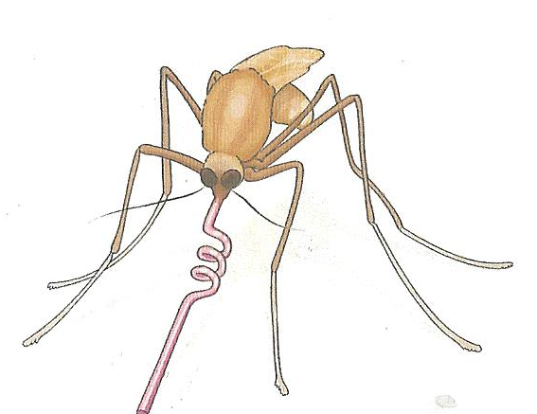
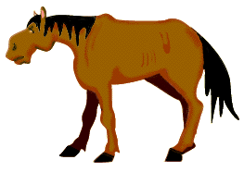


Advax-adjuvanted killed Japanese encephalitis virus (JEV) vaccine is safe in pregnant mares and in foals and induces robust immunological memory
Helle Bielefeldt-Ohmann
School of Veterinary Science &
Australian Infectious Diseases Research Centre
University of Queensland

Slide 2
JEV-Vaccine Studies in Pregnant Mares & Foals: Study Objectives
To conduct safety and immunogenicity trials in pregnant mares and young foals for development and regulatory approval of the JE-ADVAX™ vaccine.
Assess cross-protective immune responses to MVEV and WNV_{KUN}

Slide 3
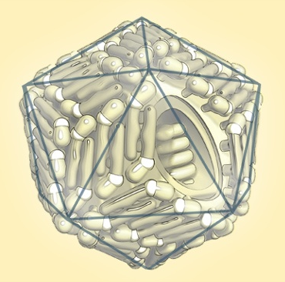
Japanese encephalitis virus
Family: Flaviviridae
Genus: Flavivirus; Japanese encephalitis antigenic complex
Complex includes: Alfuy, Cacipacore, Japanese encephalitis, Koutango, West Nile, Kunjin, Murray Valley encephalitis, Rocio, St. Louis encephalitis, Usutu and Yaounde viruses.
Flaviviruses: 40-60 nm particles, enveloped, icosahedral nucleocapsid, positive-sense, single stranded RNA approximately 10,000-11,000 bases

Slide 4
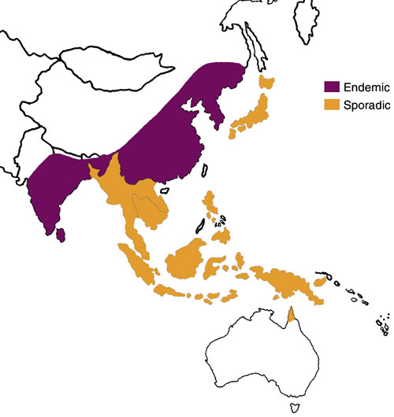
Japanese Encephalitis Virus
Asia, Papua New Guinea, Torres Strait
Encephalitis in horses, humans.
Transplacental infection followed by abortion in humans and pigs.
Horses “dead-end” hosts.

Slide 5
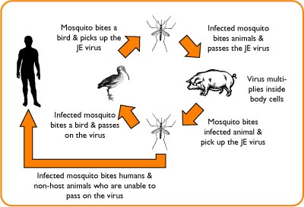
Japanese Encephalitis Virus
Mosquito-bird or mosquito-pig cycles.
Water birds such as herons and egrets = maintenance hosts.
Pig = most important amplifier host, developing a viremia that is sufficient to infect mosquitoes = ”bridge host”.

Slide 6
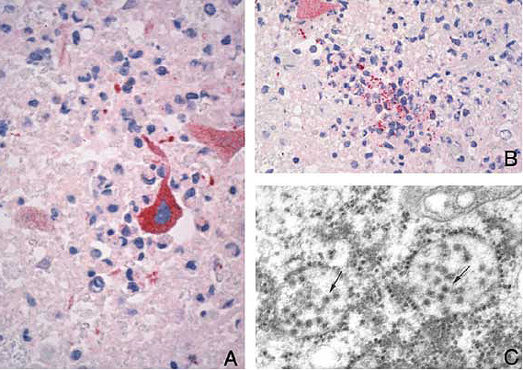
Japanese Encephalitis Virus
Horses and donkeys develop clinical encephalitis; severe epidemics have occurred in Japan
Lympho-histiocytic encephalitis, gliosis and areas of malacia with haemorrhage.

Slide 7
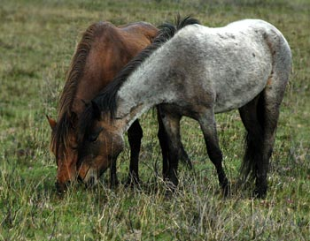
Reporting of Horses with Nervous Signs in SE-Australia January – June 2011
Widespread areas in Victoria
Across South Australia, from the Riverland, down the length of the Murray, areas north & south of Adelaide
Various locations in NSW: west of Great Divide, from Mungindi to Murray River.
Significant cluster in Hawkesbury Valley west of Sydney and in the Upper Hunter Valley

Slide 8
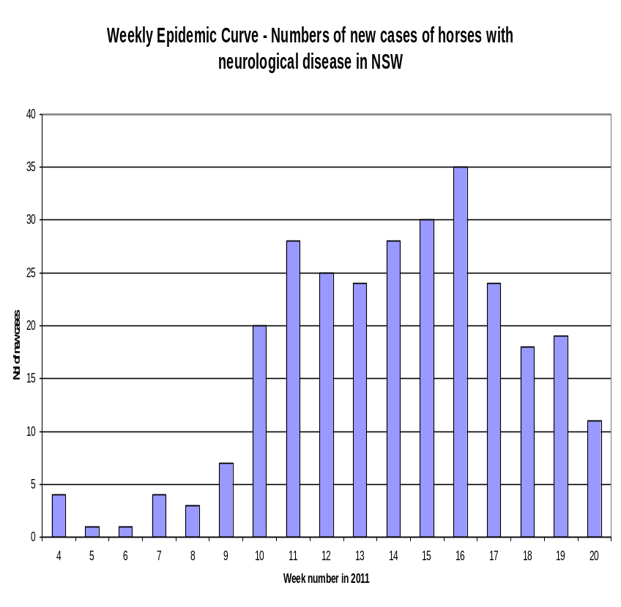
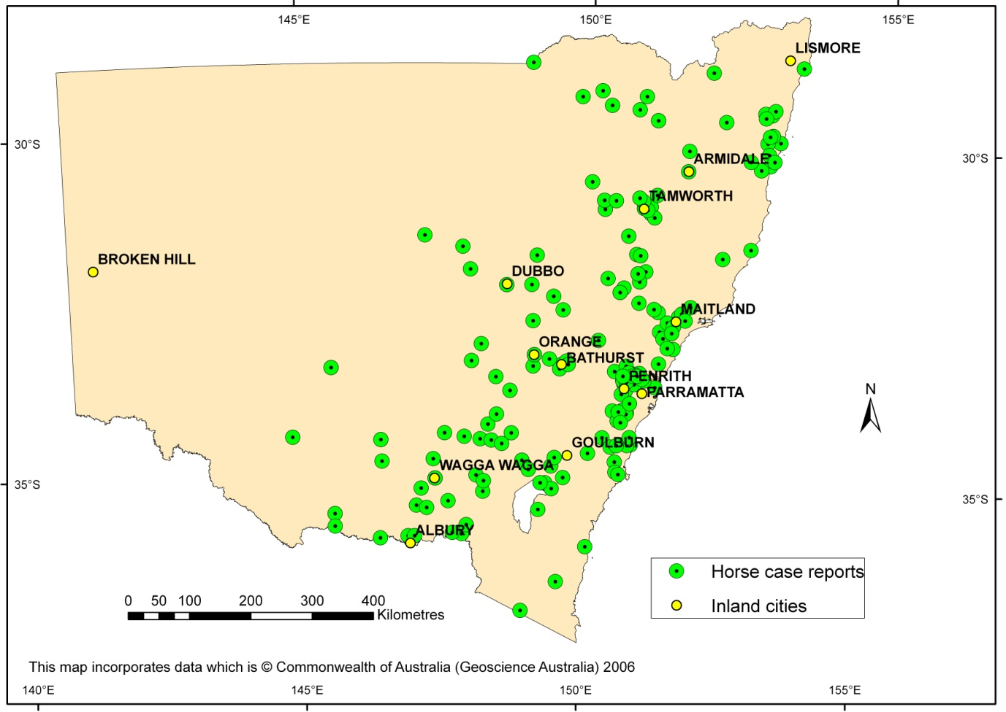
Neurological Disease in Horses in NSW February-May 2011
Source: NSW Primary Industries

Slide 9
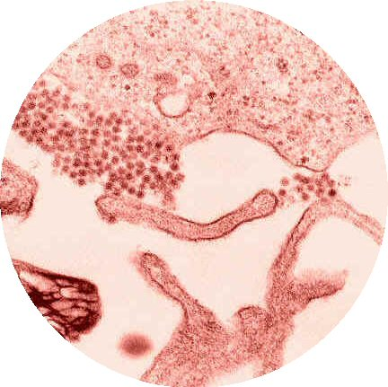
WNV_{NSW2011}
Virus isolated from brains of fatal cases
Sequencing showed virus is variant of WNV, most closely related to WNV_{KUN} (WNV lineage 1, clade 1b)
NO HUMAN CASES REPORTED
No birds “dropping out of the sky”
CSU

Slide 10
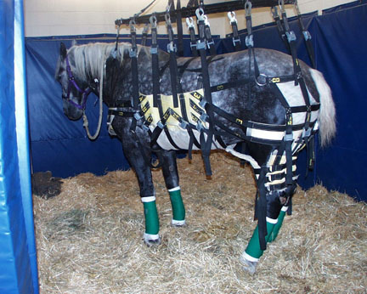
Summary of 2011 Outbreak of Equine Encephalitis in SE Australia
More than 1,000 horses were affected
Most horses with clinical signs recovered over several weeks with good husbandry & veterinary care
Case fatality rate was 10-15% in NSW, Vic, SA
No recurrence of event in 2012 or later
CSU

Slide 11
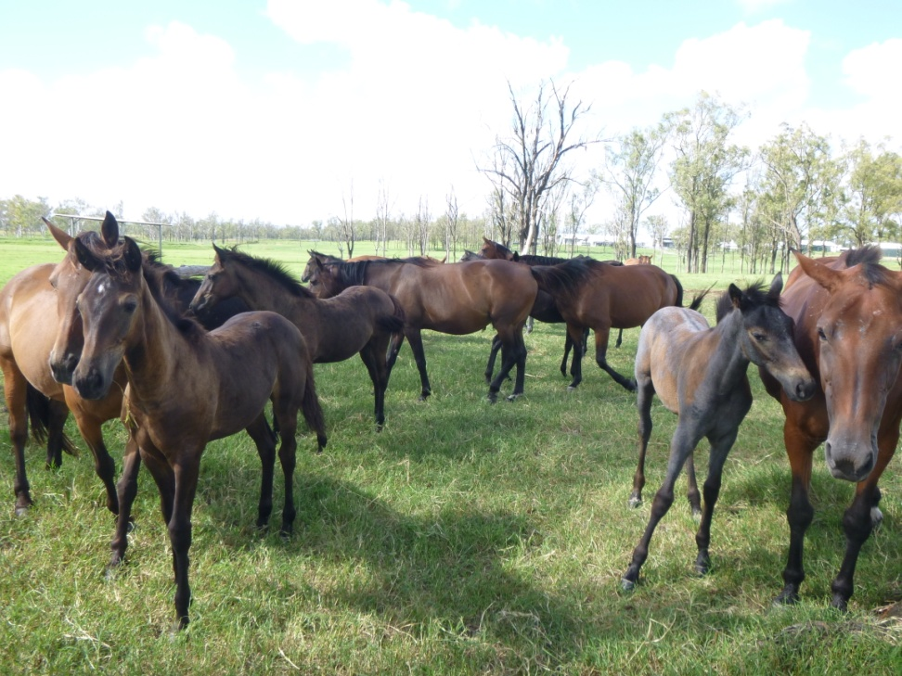
Flavivirus Seroprevalence in SEQ Equine Population 2010-2012
Immunity to Australian flaviviruses is acquired relatively slowly over lifetime of horses
Kokobera virus the more frequently encountered, but no cross-protection to JEV-serocomplex viruses.
Pre-existing immunity in SEQ horses not the “exclusion-factor” in the 2011 epidemic (< 16% FV-positive).
Horses < 10 years of age may be good sentinels

Slide 12
JEV-Vaccine Studies in Pregnant Mares & Foals: Study Objectives
To conduct safety and immunogenicity trials in pregnant mares and young foals for development and regulatory approval of the JE-ADVAX™ vaccine.
Assess cross-protective immune responses to MVEV and WNV_{KUN}
Studies approved by the UQ Animal Ethics Committee.

Slide 13
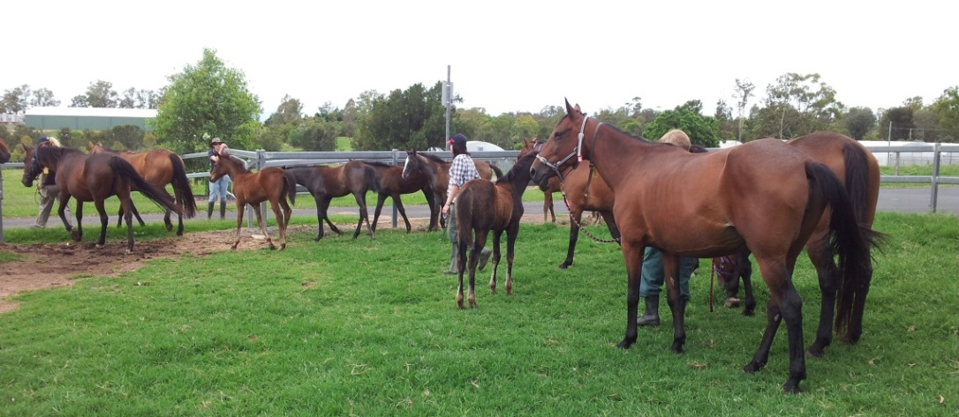
JEV-Vaccine & Advax Adjuvant
Vaccine antigen characteristics:
  Inactivated Vero cell-grown JE virus
  Virus strain: Beijing-1
Adjuvant characteristics:
  Microparticulate delta inulin in sterile PBS, pH 7
  prepared from inulin [β-d-(2→1)polyfructofuranosyl α-d-glucose], a natural plant-derived polysaccharide found in nature mainly as a storage polysaccharide in the roots of the Compositae family of plants

Slide 14
JEV-Vaccine Studies in Pregnant Mares & Foals: experimental outlines
Phase 1: foals of naive mares
28
56
308
Phase 2: pregnant mares
28
56
196
230
331
Phase 3: foals of vaccinated mares
28
56
77
105
252
308
350
392
vaccination
booster
bleed
Foaling/birth
Bielefeldt-Ohmann et al. 2014, Vet Res.. 45: 130

Slide 15
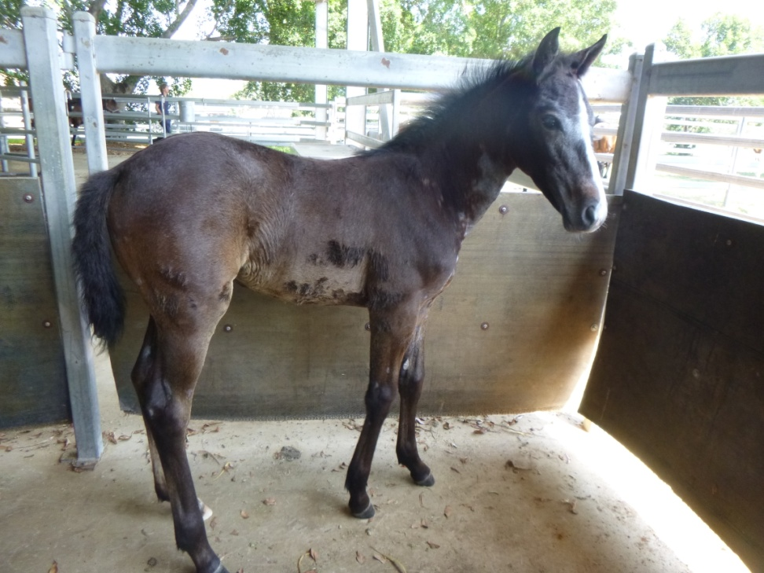
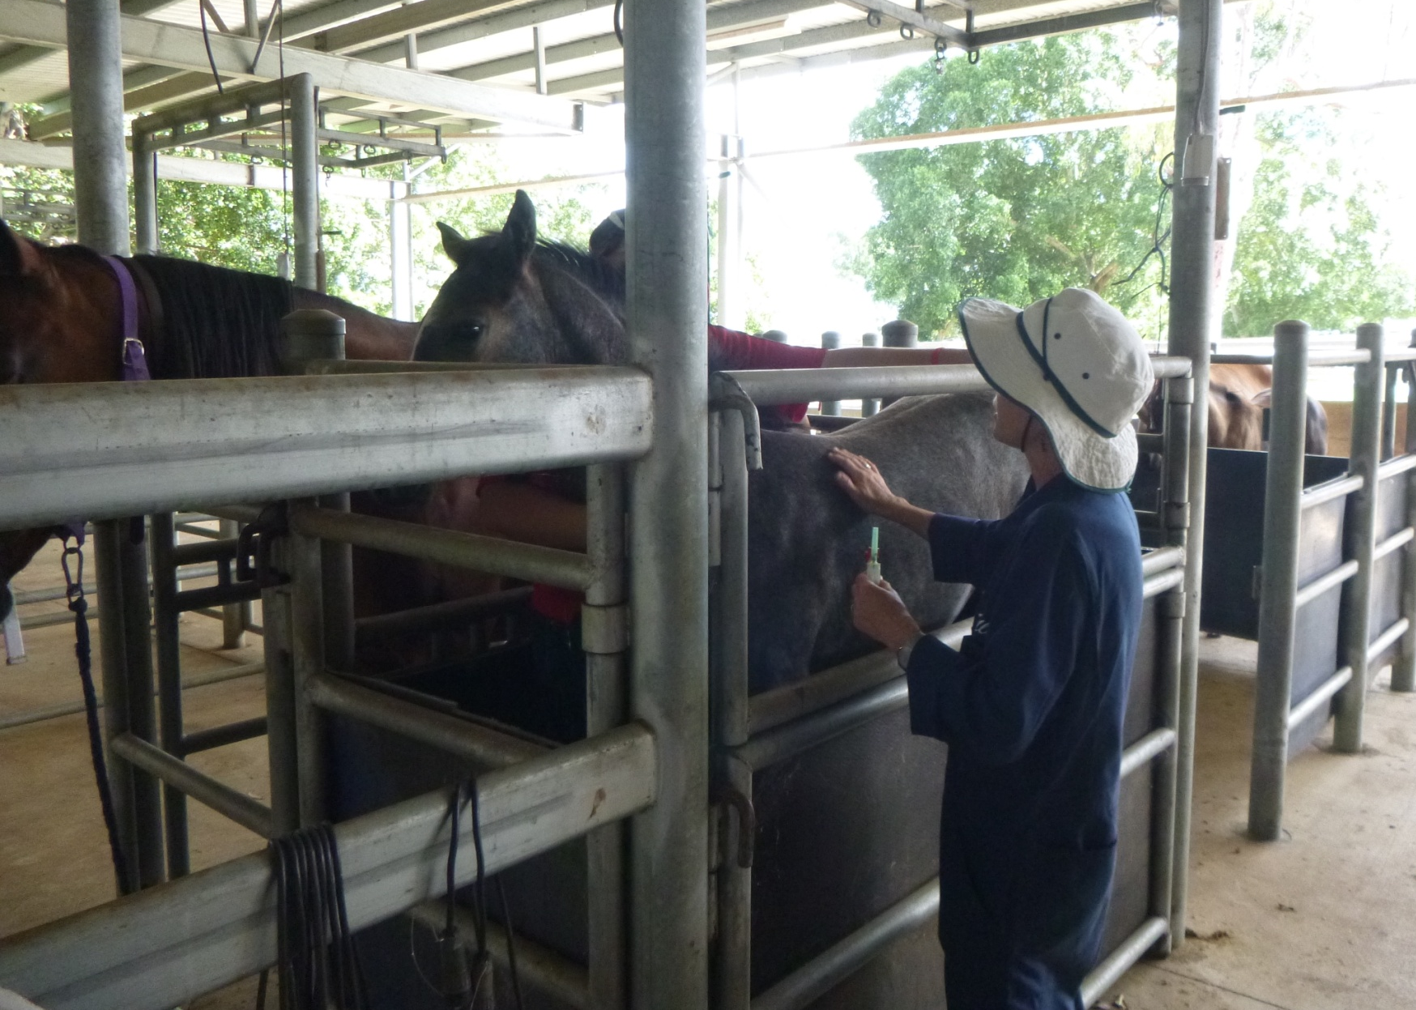
Experimental Design – Foal Trial 1
19 foals, 74-152 days old at start of trial.
12 received JEV+Advax
7 received Advax only
Initial vaccination: 12 µg JEV-Ag + 10 mg Advax
Booster vaccination 4 weeks later: 6 µg JEV-Ag + 10 mg Advax
Bled on each occasion and on day 56 and 308.

Slide 16
JEV-Vaccine Trial in Foals I
 | Age at | JEV neutralising antibodies |  |  | MVEV neutralising antibodies |  |  | WNV_{KUN} neutralising antibodies
Foal # | Day 0 | Day 28 (boost) | Day 56 | Day 308 | Day 28 (boost) | Day 56 | Day 308 | Day 28 (boost) | Day 56 | Day 308
1F11 | 74 |  | 80 | 20 |  | <20 | < 20 |  | < 20 | 20
5F11 | 115 | 40 | 160 | 160 | <20 | <20 | 20 | <20 | < 20 | < 20
7F11 | 108 |  | 160 | 40 |  | <20 | < 20 |  | 40 | < 20
8F11 | 132 |  | 160 | < 20 |  | 20 | < 20 |  | 40 | < 20
11F11 | 119 |  | 160 | 80 |  | 20 | < 20 |  | 40 | < 20
12F11 | 81 | 40 | 1280 | 80 | <20 | 80 | < 20 | <20 | 80 | < 20
14F11 | 123 |  | 320 | 20 |  | <20 | 20 |  | 20 | < 20
15F11 | 125 |  | 320 | < 20 |  | <20 | < 20 |  | 40 | 20
17F11 | 111 |  | 320 | 20 |  | <20 | < 20 |  | < 20 | < 20
21F11 | 97 |  | 320 | < 20 |  | 20 | < 20 |  | < 20 | 20
26F11 | 116 | 40 | 1280 | 80 | 20 | 80 | 20 | <20 | < 20 | 20
30F11 | 111 |  | 160 | 20 |  | <20 | < 20 |  | < 20 | 20
Controls A-G | 115 |  |  | < 20 |  |  | 20 |  |  | 20
Bielefeldt-Ohmann et al. 2014, Vet Res.. 45: 130

Slide 17
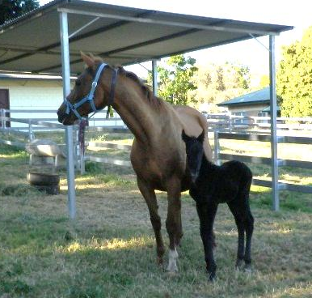
Vaccination of Pregnant Mares
17 mares in 2nd trimester of pregnancy
11 received JEV + Advax
4 received Advax only
2 untreated
Vaccination schedule & doses as for foals
Bled at vaccinations, at foaling & then regularly until day 331
Colostrum collected at foaling

Slide 18
Vaccination of Pregnant Mares
.
Time Point | JEV neutralizing |  |  | MVEV neutralizing |  |  | WNV_{KUN} neutralizing
 | Positive/total | Mean titre≠ | Positive titre range | Positive/total | Mean titre≠ | Positive titre range | Positive/ total | Mean titre≠ | Positive titre range
Day 0 (vaccination) | 0/11 | -- | -- | 0/11 | -- | -- | 0/11 | -- | --
Day 28 (booster) | 0/11 | -- | -- | 0/11 | -- | -- | 2/11 | 50 | 20-80
Days 56-183 | 8/11 | 180 | 20-320 | 4/11 | 100 | 20-160 | 3/11 | 560 | 20-1280
Day 230 (7.5 months) | 11/11 | 47 | 20-80 | 9/11 | 31 | 20-80 | 2/11* | 50 | 20-80
Day 331 (11 months) | 7/11 | 26 | 20-40 | 4/11 | 40 | 20-80 | 2/11* | 50 | 20-80
≠ mean of titres ≥ 20
* same two mares (# 10 & 33)
Bielefeldt-Ohmann et al. 2014, Vet Res.. 45: 130

Slide 19
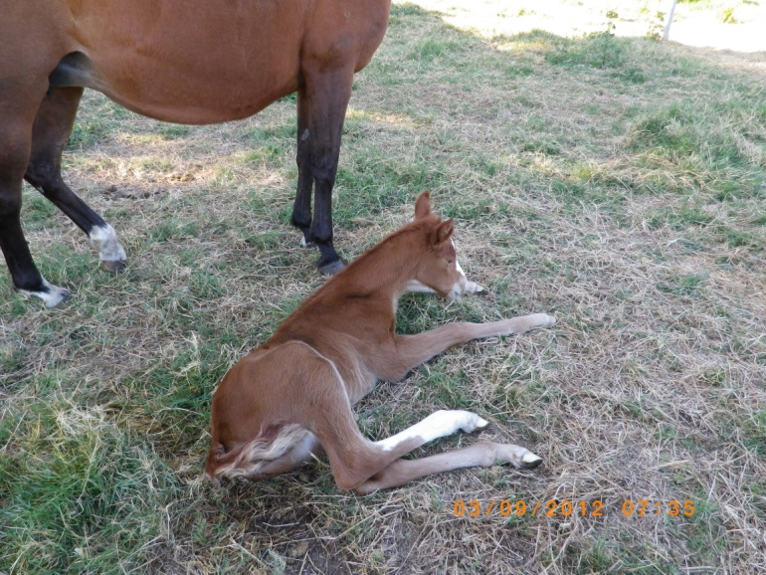
Passive Transfer of JEV-Immunity
Foals bled at birth and 12 hours after colostrum uptake
Colostrum collected at foaling.

Slide 20
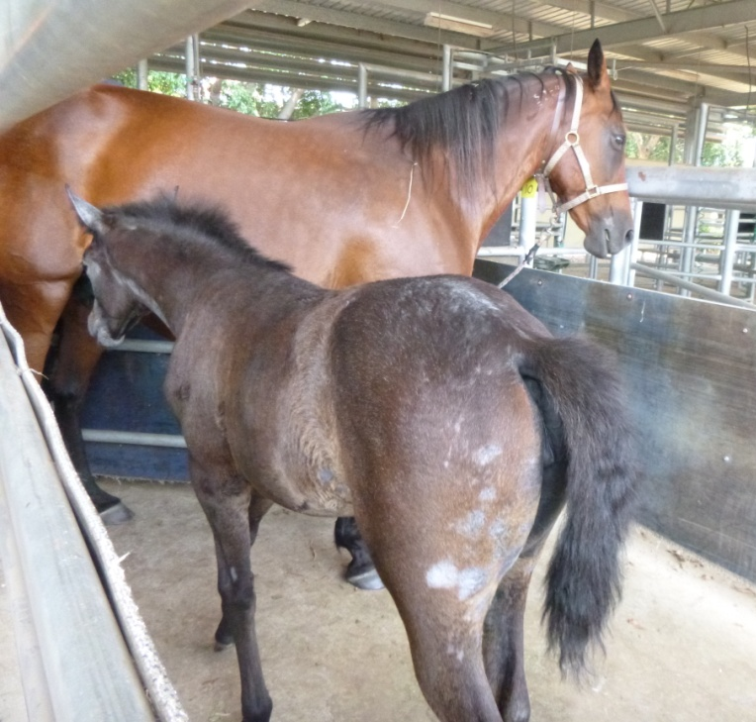
Effect of Passively Acquired JEV-Immunity on Subsequent Vaccine Responses in Foals
11 foals born to JEV-immune mares vaccinated with JEV+Advax at age 35-73 days of age
Boosted 4 weeks later
5 foals born to unvaccinated mares given Advax only (controls for natural exposure to flaviviruses).

Slide 21
Effect of Passively Acquired JEV-Immunity on Subsequent Vaccine Responses in Foals

Slide 22
Effect of Passively Acquired JEV-Immunity on Subsequent Vaccine Responses in Foals

Slide 23
Effect of Passively Acquired JEV-Immunity on Subsequent Vaccine Responses in Foals
Time Point | JEV neutralizing |  |  | MVEV neutralizing |  |  | WNV_{KUN} neutralizing
 | Positive/total | Mean titre≠ | Titre range | Positive/total | Mean titre≠ | Titre range | Positive/total | Mean titre≠ | Titre range
Pre-suckle | 0/11 | -- | -- | 0/11 | -- | -- | 0/11 | -- | --
Post suckle | 10/11 | 46 | < 20-80 | 8/11 | 30 | < 20-40 | 3/11 | 93 | < 20-160
Age 13-49 days | 3/10* | 26 | < 20-40 | 1/10* | 40 | < 20-40 | 2/10* | 30 | < 20-40
Vaccination Age 36-83 days | 3/11 | 20 | < 20-20 | 2/11 | 20 | < 20-20 | 1/11 | 40 | < 20-40
Booster 4 weeks post vaccination Age 64-111 days | 2/11 | 20 | < 20-20 | 3/11 | 20 | < 20-20 | 2/11 | 20 | < 20-20
4 weeks post booster Age 93-140 days | 10/11 | 88 | < 20-320 | 10/11 | 30 | < 20-40 | 1/11 | 20 | < 20-20
7 weeks post booster Age 114-161 days | 3/11 | 53 | < 20-80 | 6/11 | 26 | < 20-40 | 3/11 | 20 | < 20-20
10 weeks post booster Age 137-184 days | 5/11 | 24 | < 20-40 | 0/11 | - | < 20 | 1/11 | 20 | < 20-20
~9 months post 1st boost Age 332-379 days | 0/11 | -- | < 20 | 0/11 | -- | < 20 | 0/11 | -- | < 20
Bielefeldt-Ohmann et al. 2014, Vet Res.. 45: 130

Slide 24
Good Memory B Cell Response Induction Despite Initial Inhibition by Residual Passive Immunity
Time Point | JEV neutralizing |  |  | MVEV neutralizing |  |  | WNV_{KUN} neutralizing
 | Positive/total | Mean titre≠ | Titre range | Positive/total | Mean titre≠ | Titre range | Positive/total | Mean titre≠ | Titre range
~9 months post 1st boost (2nd boost) Age 332-379 days | 0/11 | -- | < 20 | 0/11 | -- | < 20 | 0/11 | -- | < 20
2 weeks post 2nd boost Age 346-393 days | 11/11 | > 902 | 160- > 2560 | 10/11 | 50 | < 20-80 | 1/11 | 20 | < 20-20
5.5 weeks post 2nd boost Age 370-417 days | 11/11 | 465 | 160-1280 | 7/11 | 17 | 20-40 | 0/11 | - | < 20
14 weeks post 2nd boost Age 454-501 | 8/11 | 150 | < 20-640 | 0/11 | - | < 20 | 9/11 | 31 | < 20-80
20 weeks post 2nd boost Age 498-545 days | 7/11 | 63 | < 20-160 | 0/11 | - | < 20 | 0/11 | - | < 20
Bielefeldt-Ohmann et al. 2014, Vet Res.. 45: 130

Slide 25
Conclusions
Inactivated JEV vaccine with Advax safe in foals and pregnant mares.
Provides protective immunity to JEV up to at least 10-11 months
Cross-protective immunity to MVEV and WNV_{KUN} more stochastic, but related to initial JEV-ab titres.
Passively acquired, virus-specific immunity interferes with quality of subsequent vaccine response: low to JEV and poor cross-reactivity to MVEV & WNV_{KUN}
However, good memory response induced in face of passive immunity resulting in fast and robust antibody response to later boosters or natural virus exposure.

Slide 26
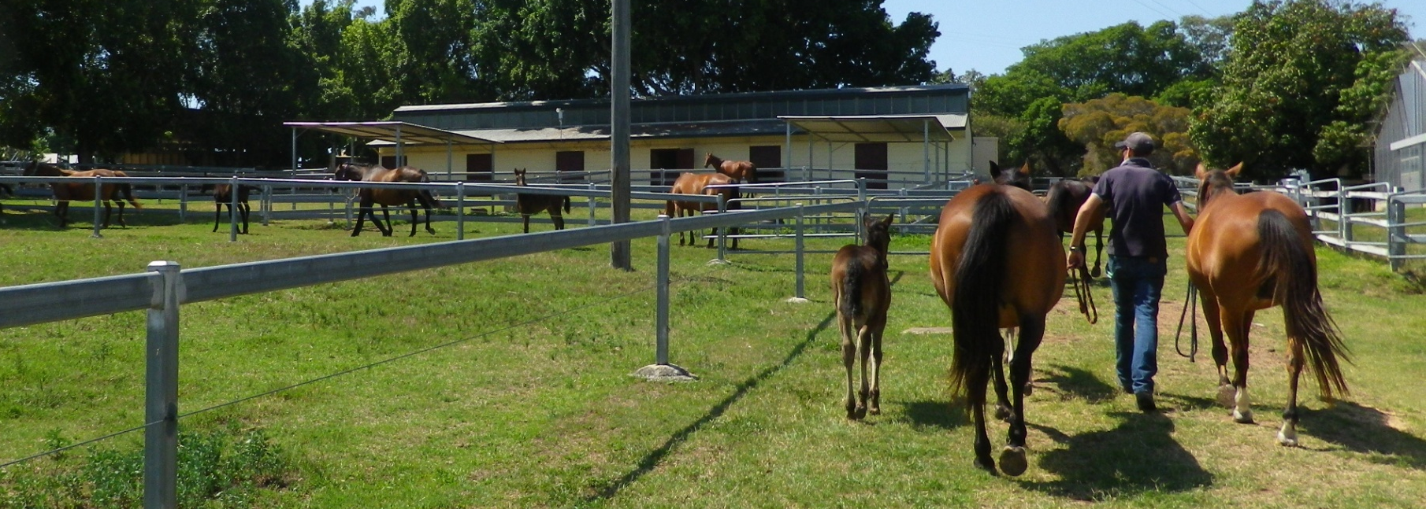
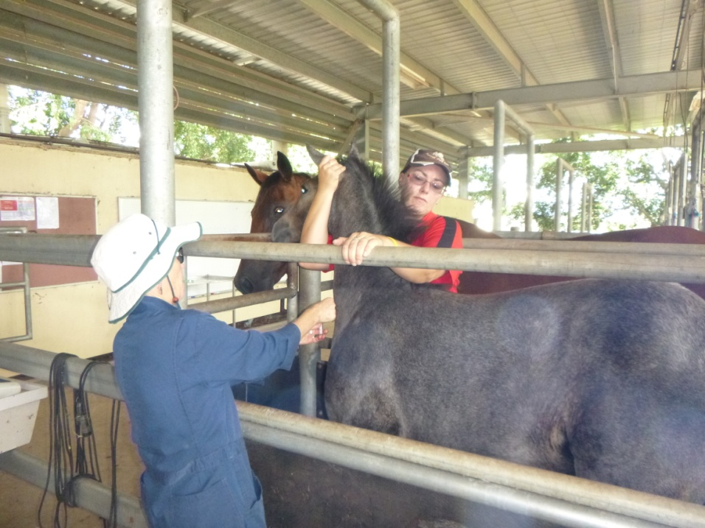
Acknowledgements
Mitch Coyle & Alisha Douma, UQ Equine Unit

Slide 27
Acknowledgements
Wenqi Wang
Lisa Kidd
Anita Barton
Sharon Blums
John Wright
Ristan Greer
Equine studies & vet students
Natalie Prow
Cindy Tan
Jody Hobson-Peters
Roy Hall
Nik Petrovsky
Mario Lobigs
Funding: UQ-CIEF, ARC-Linkage, Vaxine Pty Ltd.

