Slide 1

Evaluation of an obstacle course, the Sherbrooke Functional Evaluation of the Risk of Falls in Elderly (SFERE): reliability and validity study
Presented by:
Corriveau Hélène, PT, PhD
Karahasanovic M, Baril C,
Bédard J, Djilas N,
Juteau M, Larochelle J, Rivard M
Notes:
JB

Slide 2
Overview
Introduction
  Evaluation of risk of falls: obstacle course
  SFERE
Objectives of the study
Method
  Population
  Data collection
Results
Discussion
Conclusion

Slide 3
Introduction
Problematic
1/3 people over 65 years fall at least once each year¹
86% of hospitalizations of people over 65 years old are caused by falls²
Consequences of falls:
  Hospital and long-term care institutions^{3,4};
  Quality of life diminution⁵⁻⁸
  Economic burden³: In Canada, falls over 65 cost 2.5G$ per year⁹
1/3 of those falls could potentially be prevented¹⁰
¹ Word health Organization, 2007; ² Statistiques Canada; ³ Papaioannou, 2001; ⁴ Wiktorowicz, 2001; ⁵ Sawka, 2005; ⁶ Cranney, 2005; ⁷ Pasco,2005; ⁸Papaioannou, 2009; ⁹ OMSS, 2005; ¹⁰ Campbell, 2002

Slide 4
Problematic
Reliable and valid tool allowing the identification of fallers
Are not usefull because they:
Controlled the environment;
Evaluated a single task at a time;
Do not mimic the reality of daily living
Notes:
JB Est-ce que c vrai que le TUG, Berg et appui unipodal sont pas valides pour identifier les chuteurs?
L’étude n’est plus longitudinale, mais plutôt transversale
La personne est elle chuteuse → si oui elle a plus de chance de rechuter
Berg: sensibilité 54% pour identifier les chuteurs
Aucun évalue l’ensemble de tâches pour nous aider à dépister
Thus it is essential to have a reliable and valid tool allowing the identification of fallers.

Slide 5
Introduction
Solution!
A tool representative of daily living including double tasking^{1,2}
As an Obstacle Course like is the Sherbrooke Functional Evaluation of the Risk of Falls in Elderly (SFERE)
¹ Dubé, 2008; ² Means , 1998
Notes:
JB Est-ce que c vrai que le TUG, Berg et appui unipodal sont pas valides pour identifier les chuteurs?
L’étude n’est plus longitudinale, mais plutôt transversale
La personne est elle chuteuse → si oui elle a plus de chance de rechuter
Berg: sensibilité 54% pour identifier les chuteurs
Aucun évalue l’ensemble de tâches pour nous aider à dépister
To be more accurate, this tool needs to be representative of daily living and to include double tasking Thus it is essential to have a reliable and valid tool allowing the identification of fallers.

Slide 6
Introduction
  Developed by Marcel Rivard, PT¹
Total of 10 tasks
  Activities of daily living including double tasking^{1,2}
  Assessment of the participant’s endurance
  Assessment of the participant’s impulsivity
Score varying from 0 to 3 for each task
Total score of 30 points
The times taken to complete the test is 20 minutes
¹ Rivard, 2000
Notes:
The SFERE has eight functional tasks which simulate situations that can be encountered in daily life of elderly living in community. Those tasks are: sit-to-stand transfer, moving a towel on the ground with a foot, walking while counting backwards, walking and locating a visual target, walking around obstacles and going back and forth through a door. General endurance and impulsivity was also evaluated. There were 10 criteria in total, with a score varying from 0 to 3 for each criteria and a total score of 30.
The times taken to complete the test is also calculated

Slide 7
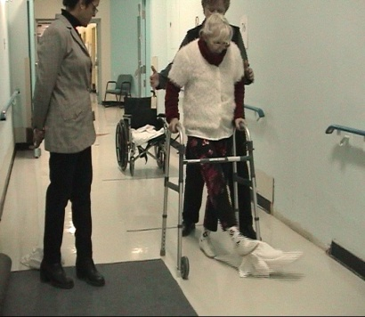
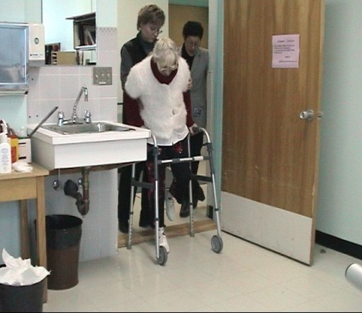
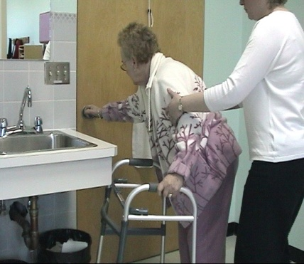
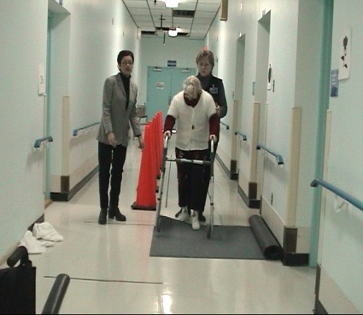
SFERE : COURSE DESCRIPTON
1. Sit to stand transfer from a chair with armrests and 1,83m (6’) walk
2. Move 2 towels using only the foot
3. Open a door, cross the door sill and close the door
4. Walk 1,83m (6’), sit and stand up from a chair without armrests
5. Open a door, cross the door sill and close the door
6. Zigzag through 6 obstacles
7. Walk 6,1m (20’) while counting from 20 to 10
8. Walk 4,57m (15’) while identifying 4 visual targets
Notes:
JB

Slide 8
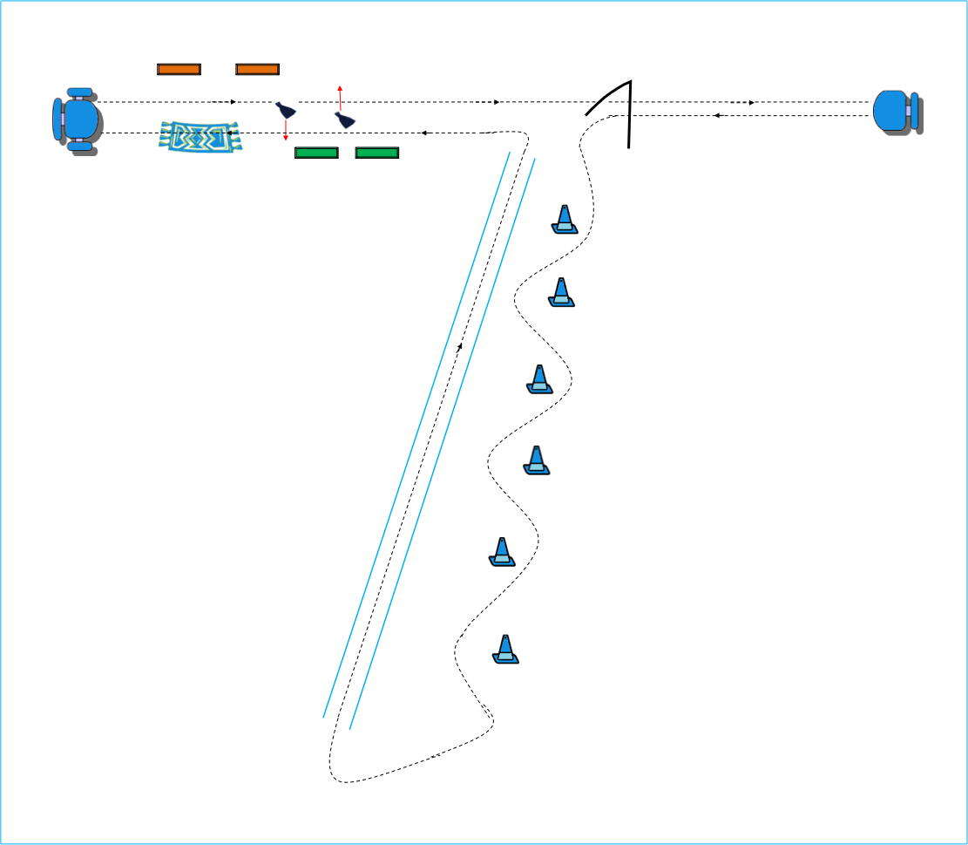
SFERE: OBSTACLE COURSE

Slide 9
Objectives of the study
Estimate the reliability :test-retest and simultaneous inter-rater
  Intraclass correlation coefficient
  Cohen Kappa
  2. Determine the validity (sensitivity and specificity );
  Is the tool adequate to identify fallers?
    Faller: decisional algorithm
    Receiver Operating Characteristic (ROC) curve
Notes:
Evaluate the content and construct validity
Est-ce que le parcours est valide ?
Peut-il identifier les chuteurs?
Établir un score seuil pour identifier les chuteurs
1) Comparer à une mesure étalon (TUG)
Corrélation de Pearson ou Spearman
2) Évaluer la sensibilité\spécificité par l’intermédiaire du courbe ROC.
Mesure étalon : chuteur (avoir chuté dans la dernière année)

Slide 10
Method
Population
 | Reliability study | Validity study
Inclusion criteria: | 1) Able to walk with or without walking aids; 2) Able to follow simple instructions; 3) Medically stable; 4) 65 years or older
Exclusion criteria: | Important comorbidity preventing them from accomplishing the obstacle course
 | Reliability study | Validity study
Data collection | 1) Social demographic (questionnaire); 2) Mobility (TUG); 3) Dual tasking (TUG manual); 4) Lower limb strength (Sit to Stand)
 | Interrater and test-retest reliability 1st session: 2 raters/participant; 2nd session (2-5 days later): one rater/participant | Validity: 1 session
Data analysis | Intraclass correlation coefficients (ICC) | Criterion concurrent validity: sensibility and specificity with receiver operating characteristic (ROC) curves for: 1) Total score of the SFERE; 2) Time to complete the SFERE; 3)Time to complete the TUG Construct convergent validity: Pearson’s correlation coefficient Spearman Rho
Notes:
Divided in two phases:
Reliability study in 2004
Validity study in 2013
Was conducted in the respective retirement home
Obstacle course was installed in each home the day of the data collection

Slide 11
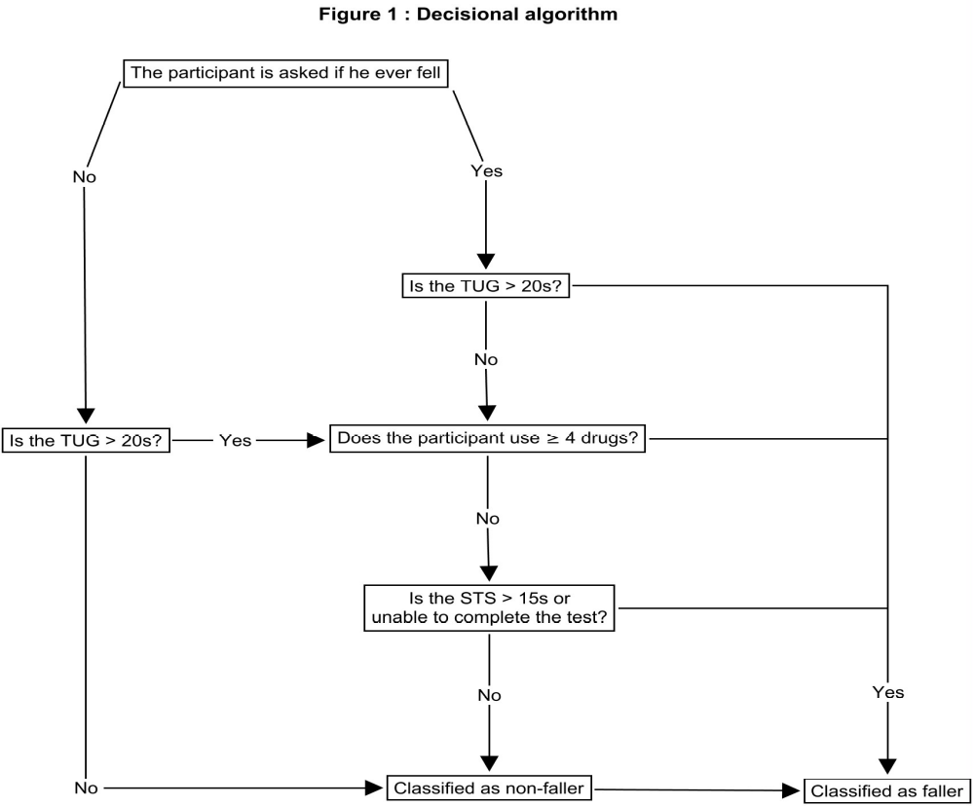
DECISIONAL ALGORITHM

Slide 12
RESULTS
Population characteristics
 | Reliability | Validity
Population | n=41 | n=95 (including 45 fallers)
Mean age (years) | 72.2 | 83.7
Sex | 35 women | 83 women
Mean number of drug taken | 5 | 6
Notes:
included two phases, first in 2004 for the reliability and second in 2013 for the validity.

Slide 13
Results - Reliability
Simultaneous inter-rater
ICC*: 0.90
CI**: (0.81- 0.95)
 | Mean ± SD | E1-E2
1st Evaluator (E1) | 22.80 ± 4.47 | 0.76 (p< 0.0001)
2nd Evaluator (E2) | 23.56 ± 4.80
Significant bias *Wilcoxon test
* Intraclass Correlation Coefficients
** Confidence Interval 95 %
Notes:
included two phases, first in 2004 for the reliability and second in 2013 for the validity.

Slide 14
Results - reliability
Test-retest
ICC*: 0.73
CI**: (0.55- 0.85)
 | Result Mean ± SD | E1-E2
Test 1 (E1) | 22.80 ± 4.47 | -0.98 (p< 0.0001)
Test 2 (E2) | 23.78 ± 4.18
Significant bias:
Learning phenomenon
Anxiety diminution
* Intraclass Correlation Coefficients
** Confidence interval 95 %
Notes:
included two phases, first in 2004 for the reliability and second in 2013 for the validity.

Slide 15
Results – Reliability of each item
Tasks | Kappa | CI (95%)
1. Transfer (sit to stand) | 0.44 | (0.18 - 0.70)
2. Move 2 towels | 0.474 | (0.24 – 0.71)
3. Cross a door | 0.511 | (0.27 – 0.75)
4. Transfer in a chair without armrests | 0.344 | (0.08 – 0.61)
5. Cross a door in reverse | 0.565 | (0.29 – 0.83)
6. Zigzaging | 0.27 | (-0.09 – 0.63)
7. Walk while counting | 0.119 | (-0.21 – 0.45)
8. Walk while looking at something | 0.154 | (-0.22 – 0.53)
9. Endurance | 0.696 | (0.48 – 0.91)
10. Comportement | 0.396 | (0.16 – 0.63)
Notes:
included two phases, first in 2004 for the reliability and second in 2013 for the validity.

Slide 16
Results – Convergent Construct Validity
Variables | Instruments | Obstacle course | p value
Balance | BERG | 0.536* | <0.0001
 | Time up and go (TUG) | -0.331 | 0.34
 | Walking speed | -0.343 | 0.28
Cognitive | 3MS | 0.506 | 0.001
Perceptual | Motor Free Visual Perceptual test (MVPT) | 0.256 | 0.106
Executive functions | Assessment of Motor and processing skills (AMPS) | 0.069 | 0.668
Fear of falling | ABC | 0.005 | 0.976
*Pearson Correlation
Notes:
included two phases, first in 2004 for the reliability and second in 2013 for the validity.

Slide 17
Results - Validity
Sensitivity and specificity
Cut-off | Sensibility | Specificity
SFERE score ≤ 27/30 | 0.911 | 0.620
SFERE time ≥ 89,2s | 0.911 | 0.800
Sensitivity and specificity for other screening tools
 | Sensibility | Specificity
BERG | 0,84 | 0,78
TUG | 0,87 | 0,87
TUG manual | 0,80 | 0,93
Sit-to-stand | 0,67 | 0,72
Notes:
included two phases, first in 2004 for the reliability and second in 2013 for the validity.

Slide 18
Results - Validity
Criterion concurrent validity
Cut-off | Sensibility | Specificity
SFERE score ≤ 27/30 | 0.911 | 0.620
SFERE time ≥ 89.2s | 0.911 | 0.800
Construct convergent validity
SFERE score and SFERE time | -0,804
SFERE time and TUG time | 0,846
SFERE score and TUG time | -0,731
Sensitivity and specificity for screening tools
 | Sensibility | Specificity
BERG | 0.84 | 0.78
TUG | 0.87 | 0.87
TUG manual | 0.80 | 0.93
Sit-to-stand | 0.67 | 0.72
Notes:
included two phases, first in 2004 for the reliability and second in 2013 for the validity.

Slide 19
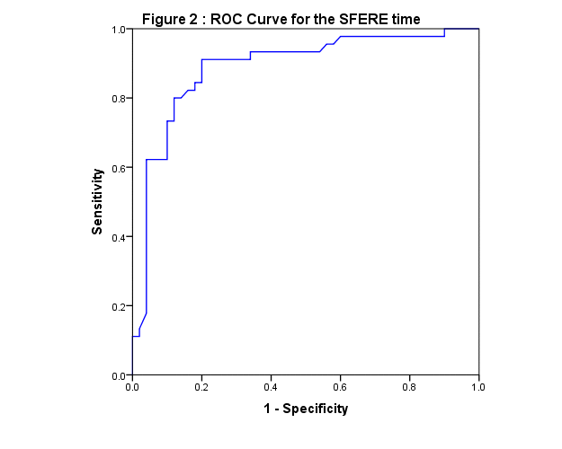
Results

Slide 20
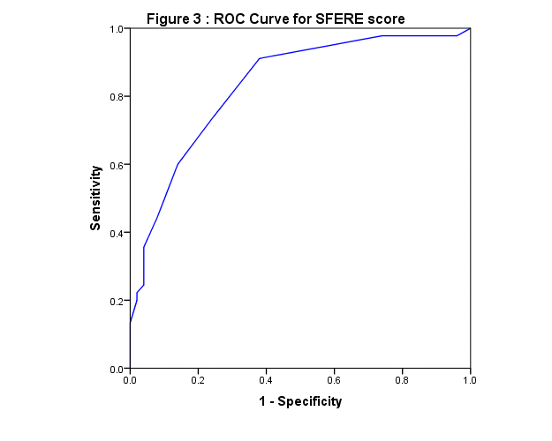
Results

Slide 21
Discussion
The SFERE have excellent inter-rater reliability (ICC = 0.90) and good test-retest reliability (ICC = 0.73)
  But the results are influenced by an unequal performance of the participants during a short period.
  Clinicians must be aware that different factors, such as anxiety and learning, could influence the performance during the obstacle course.
  The participants must practice at least one before the assessment
Notes:
The SFERE was found to have excellent inter-rater reliability (ICC = 0.90) and good test-retest reliability (ICC = 0.73)

Slide 22
Discussion
The cut-off of the time variable (89.2s) has values of sensitivity (0.911) and specificity (0.800) that are even better than those of the total score (≤27), sensitivity (0.911) and specificity (0.680).
An elderly having a score inferior to 89.2 sec is a faller.
The specificity is good,
  IT is important that a tool assessing the risk of falls has a good capacity of ruling out a non-faller
Notes:
Therefore, with an excellent sensitivity, it is possible to admit that an elderly having a score inferior to 89.2s is a faller. Furthermore, the good specificity allows for identification of non-fallers.
The good specificity allows for identification of non-fallers.
Clinically, it is important that a tool assessing the risk of falls has a good capacity of ruling out a non-faller because the consequences of wrongly ruling out a faller are greater than the consequences of wrongly ruling in a non-faller.

Slide 23
Conclusion
In comparison with traditional instruments, the numerous functional tasks present within the SFERE help health care professionals in developing a plan of treatment and preventive measures, in order to reduce the risk of falls.
  Guides the interventions related to less successfully tasks
  Gives recommendations for the safety within the home

Slide 24
Acknowledgement
All the participants who contributed to this study
Vitae Foundation and the Ordre Professionel de la Physiothérapie du Québec (OPPQ) for their financial support.
Notes:
We want to acknowledge all the participants who contributed to this study and both the Vitae Foundation and the Ordre Professionel de la Physiothérapie du Québec (OPPQ) for their financial support.

Slide 25
Références
BEAUCHET, O., DUBOST, V., NEVERS, A., STIERLAM, F., A BLANCHON, M., MOUREY, F., PFITZENMEYER, P. and GONTHIER, R., 2002. Development of a clinical test of gait in frail elderly by a cognitive approach of locomotion. Annales de readaptation et de medecine physique : revue scientifique de la Societe francaise de reeducation fonctionnelle de readaptation et de medecine physique, 45(3), pp. 123-130.
BONGUE, B., DUPRE, C., BEAUCHET, O., ROSSAT, A., FANTINO, B. and COLVEZ, A., 2011. A screening tool with five risk factors was developed for fall-risk prediction in community-dwelling elderly. Journal of clinical epidemiology, 64(10), pp. 1152-1160.
CHAIWANICHSIRI, D., JANCHAI, S. and TANTISIRIWAT, N., 2009. Foot disorders and falls in older persons. Gerontology, 55(3), pp. 296-302.
COLLÈGE NATIOANAL DES ENSEIGNANTS DE GÉRIATRIE., 2010-last update, Corpus de Gériatrie. Available: http://www.longuevieetautonomie.fr/index.php?option=com_content&view=article&id=47&Itemid=53 [07/12, 2012].
DUBE, F., ROUSSEAU, J., KAEGI, C., BOUDREAULT, R. and NADEAU, S., 2008. Development of a Walking-Safety Scale for Older Adults, Part II: Interrater and Test-Retest Agreement of the GEM Scale. Physiotherapy Canada.Physiotherapie Canada, 60(3), pp. 274-282.
EGGERMONT, L.H., PENNINX, B.W., JONES, R.N. and LEVEILLE, S.G., 2012. Depressive symptoms, chronic pain, and falls in older community-dwelling adults: the MOBILIZE Boston Study. Journal of the American Geriatrics Society, 60(2), pp. 230-237.
GAXATTE, C., NGUYEN, T., CHOURABI, F., SALLERON, J., PARDESSUS, V., DELABRIERE, I., THEVENON, A. and PUISIEUX, F., 2011. Fear of falling as seen in the Multidisciplinary falls consultation. Annals of physical and rehabilitation medicine, 54(4), pp. 248-258.
JEANDEL, C., 1998. Les chutes du sujet âgé. Soins gérontologique, (12),.
KAEGI, C., BOUDREAULT, R., ROUSSEAU, J., BOURBONNAIS, D., NADEAU, S. and DUBE, F., 2008. Development of a Walking Safety Scale for Older Adults, Part I: Content Validity of the GEM Scale. Physiotherapy Canada.Physiotherapie Canada, 60(3), pp. 264-273.
KOJIMA, T., AKISHITA, M., NAKAMURA, T., NOMURA, K., OGAWA, S., IIJIMA, K., ETO, M. and OUCHI, Y., 2012. Polypharmacy as a risk for fall occurrence in geriatric outpatients. Geriatrics & gerontology international, 12(3), pp. 425-430.
LORD, S.R., MENZ, H.B. and SHERRINGTON, C., 2006. Home environment risk factors for falls in older people and the efficacy of home modifications. Age and Ageing, 35 Suppl 2, pp. ii55-ii59.

Slide 26
References
MEANS, K.M., RODELL, D.E. and O'SULLIVAN, P.S., 1998. Obstacle course performance and risk of falling in community-dwelling elderly persons. Archives of Physical Medicine and Rehabilitation, 79(12), pp. 1570-1576.
MEANS, K.M., RODELL, D.E. and O'SULLIVAN, P.S., 1996. Use of an obstacle course to assess balance and mobility in the elderly. A validation study. American Journal of Physical Medicine & Rehabilitation / Association of Academic Physiatrists, 75(2), pp. 88-95.
MORRIS, R., HARWOOD, R.H., BAKER, R., SAHOTA, O., ARMSTRONG, S. and MASUD, T., 2007. A comparison of different balance tests in the prediction of falls in older women with vertebral fractures: a cohort study. Age and Ageing, 36(1), pp. 78-83.
MYERS, H. and NIKOLETTI, S., 2003. Fall risk assessment: a prospective investigation of nurses' clinical judgement and risk assessment tools in predicting patient falls. International journal of nursing practice, 9(3), pp. 158-165.
NEULS, P.D., CLARK, T.L., VAN HEUKLON, N.C., PROCTOR, J.E., KILKER, B.J., BIEBER, M.E., DONLAN, A.V., CARR-JULES, S.A., NEIDEL, W.H. and NEWTON, R.A., 2011. Usefulness of the Berg Balance Scale to predict falls in the elderly. Journal of geriatric physical therapy (2001), 34(1), pp. 3-10.
NORDIN, E., LINDELOF, N., ROSENDAHL, E., JENSEN, J. and LUNDIN-OLSSON, L., 2008. Prognostic validity of the Timed Up-and-Go test, a modified Get-Up-and-Go test, staff's global judgement and fall history in evaluating fall risk in residential care facilities. Age and Ageing, 37(4), pp. 442-448.
RUBENSTEIN, L.Z., JOSEPHSON, K.R., TRUEBLOOD, P.R., YEUNG, K., HARKER, J.O. and ROBBINS, A.S., 1997. The reliability and validity of an obstacle course as a measure of gait and balance in older adults. Aging (Milan, Italy), 9(1-2), pp. 127-135.
SIBLEY, K.M., STRAUS, S.E., INNESS, E.L., SALBACH, N.M. and JAGLAL, S.B., 2011. Balance assessment practices and use of standardized balance measures among Ontario physical therapists. Physical therapy, 91(11), pp. 1583-1591.
THRANE, G., JOAKIMSEN, R.M. and THORNQUIST, E., 2007. The association between timed up and go test and history of falls: the Tromso study. BMC geriatrics, 7, pp. 1.
TINETTI, M.E., WILLIAMS, T.F. and MAYEWSKI, R., 1986. Fall risk index for elderly patients based on number of chronic disabilities. The American Journal of Medicine, 80(3), pp. 429-434.
TODD C, S.D., 2004-last update, What are the main risk factors for falls among older people and what are the most<br />effective interventions to prevent these falls?. Available: http://www.euro.who.int/document/E82552.pdf [07/12, 2012].
WALKER, P.C., ALRAWI, A., MITCHELL, J.F., REGAL, R.E. and KHANDERIA, U., 2005. Medication use as a risk factor for falls among hospitalized elderly patients. American Journal of Health-System Pharmacy : AJHP : Official Journal of the American Society of Health-System Pharmacists, 62(23), pp. 2495-2499.

Slide 27
Results - Validity
Clinical variables
 | Mean ± SD | Standard deviation
SFERE score (/30) | 26 ± 0 | 3
SFERE time (s) | 126.8 ± 6.0 | 58.9
TUG (s) | 19.6 ± 1.2 | 11.5
TUG manual (s) | 15.1 ± 1.0 | 4.7
STS (s) | 27.01 ± 1.77 | 17.2
Notes:
included two phases, first in 2004 for the reliability and second in 2013 for the validity.

