Slide 1


Overview of challenges using speciated Hg measurements to support model evaluation and development
Helen M. Amos
(hamos@hsph.harvard.edu)
28 July 2014
Workshop @ Earth Science-2014
Notes:
20 minutes, including questions

Slide 2
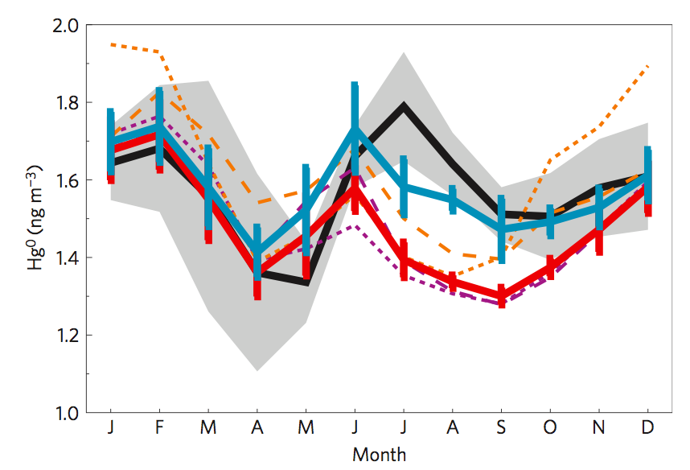
Observations support model evaluation and model development
Evaluation
Development
observation
1:1
model
final
model
original model
observations
Fisher et al. (2012)
The most interesting science happens when the model and observations don’t agree.

Slide 3
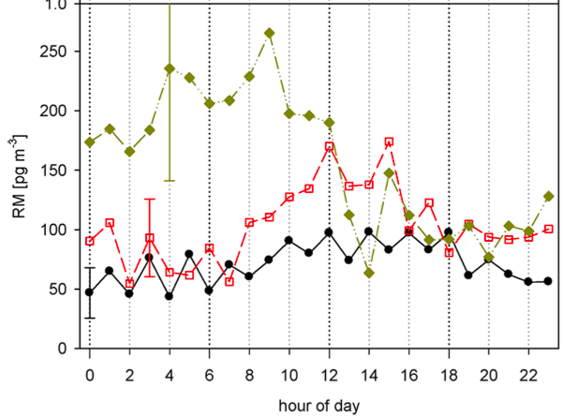
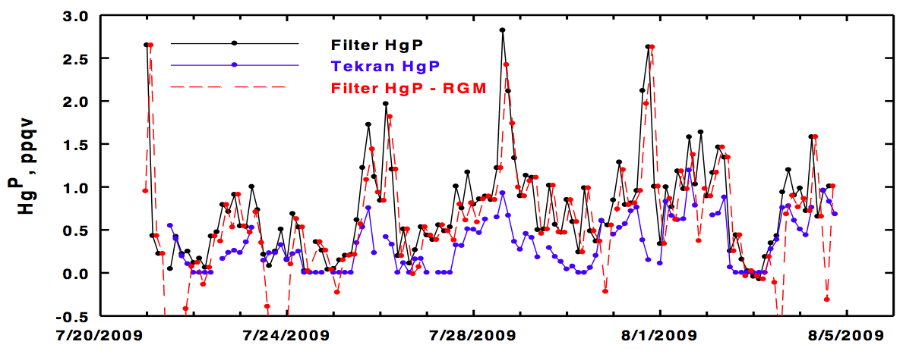
Mounting evidence suggests Tekran GOM and PBM have substantial problems
Gustin et al. (2013)
RM (pg m⁻³)
DOHGS
1.4 x Tekran #2
Tekran #1
Filter PBM - GOM
Talbot et al. (2011)
Filter PBM
PBM (ppqv)
Tekran PBM
Notes:
Gustin 2013 explanation of scaling factor for Tekran #2:
Comparison of Tekran 2537/1130/1135 data (includ- ing: manifold, free-standing, and during spikes; Table SI 2, Figures SI 6 and 7) showed systematically lower GEM and TM concentrations (GEM + GOM + PBM) measured by Spec 2. Despite repeated calibrations and quality assurance measures, this bias persisted throughout the experiment. Additionally, the RPD between mean hourly GEM concentrations, measured by Spec 1 and 2, consistently showed the latter to be lower by 25 to 35% (Figure 2). Because of this, the data collected using Spec 2 was adjusted based on the relationship between this unit and Spec 1 collected during the GEM spikes [Spec 2 (GEM ng m−3)=0.72×Spec1+0.08;r2=0.89,n=149,p<0.001] (Figure SI 6). Thus, Spec 2 data are divided by 0.72 and described as “Spec 2 adjusted” from here on.
Figure 2 from Talbot 2011. Thompson Farm. GOM subtracted off from PBM to make sure the spikes seen by the filter method weren’t just GOM artifacts/breakthrough.

Slide 4
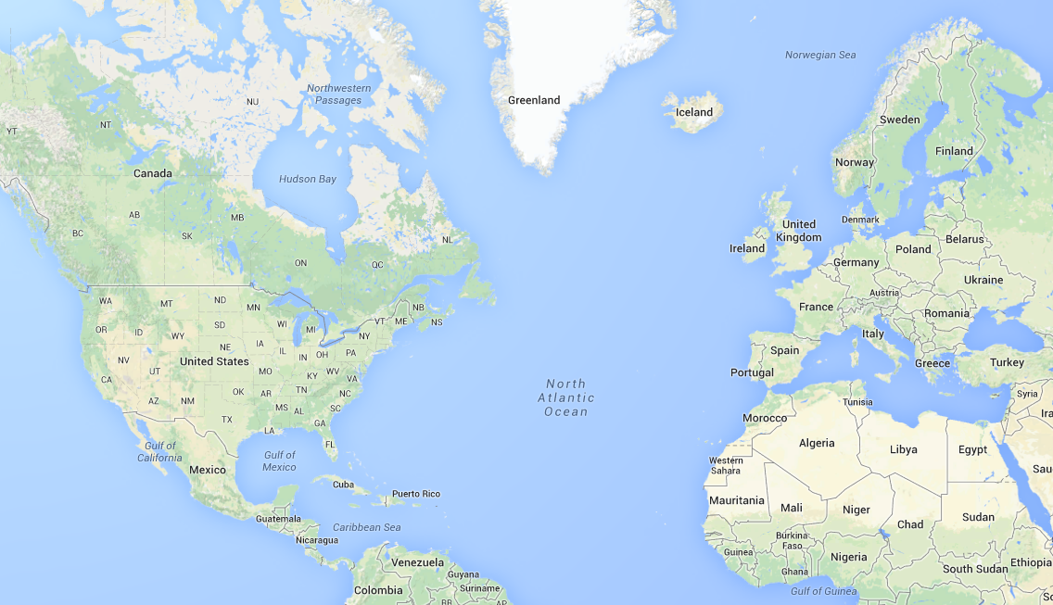
Numerous models simulate speciated atmospheric mercury
PHANTAS
MSCE-HM
GLEMOS
GRAHM
ADOM
ECHMERIT
CMAQ
TEAM
DEHM
HYSPLIT
GEOS-Chem
WorM³
WRF-Chem
STEM
Hg-CTM
Plus a few more…
Notes:
Highlighted in red are the real workhorses of Hg modeling. If you survey recent literature, these are the models the show up the most.
Do REMSAD and TEAM need to be added? Used in Bullock et al. (2009).
Add STEM-Hg? Pan et al. 2006; 2007; 2008
ECHMERIT → De Simone et al. 2014
WRF-Chem → Gencarelli et al. 2014
Hg-CTM → Shia et al. 1999; Seigneur et al. 2001
ADOM → Petersen et al. 2001
HYSPLIT → Cohen et al., 2004
DEHM → Christensen et al., 2004
EMAP → Syrakov et al., 1995
MSCE-HM → Ilyin et al., 2002

Slide 5
What are the topics being studied with speciated Hg models?
Wet deposition
AMDEs
Source-receptor
Upper troposphere /
lower stratosphere
Oxidation mechanisms
High-altitude
Dry deposition
Long-range transport
Marine boundary layer
Gas-particle partitioning
What have we learned from this work?

Slide 6
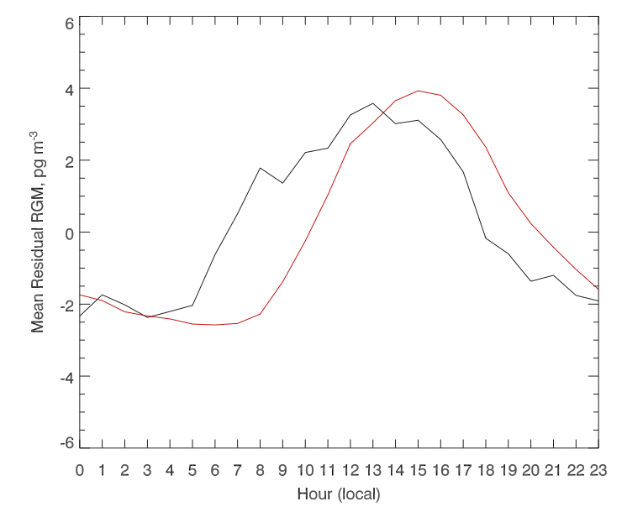
Halogen chemistry and sea-salt drive GOM diurnal variability in the marine boundary layer
Okinawa, Japan
observations
Jaffe et al. (2005)
Mean residual GOM (pg m⁻³)
model
sea-salt
scavenging
halogen
photochemistry
sea-salt
scavenging
Selin et al. (2007)
Local hour
Hedgecock & Pironne (2001; 2004); Hedgecock et al. (2003); Holmes et al. (2009)
Notes:
Make sure sea-salt scavenging is still consistent with Obrist Nature paper.
Need a copy of:
Hedgecock et al., 2003
Hedgecock & Pironne 2004
It had to be halogen chemistry because OH and O3 were too slow.
It had to be sea-salt scavenging because regular dry deposition wasn’t big enough.

Slide 7
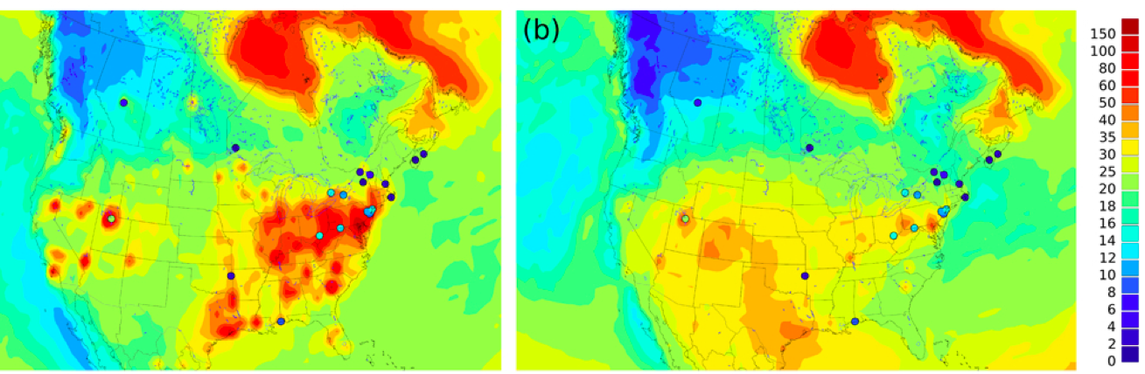
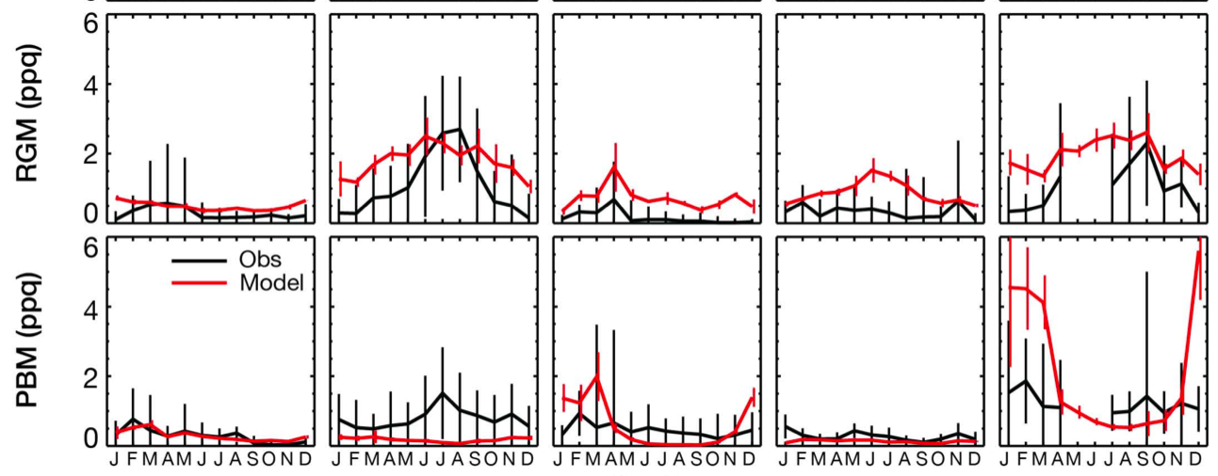
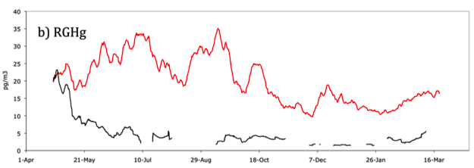
Models are overestimating GOM more than can be explained by instrument bias
pg m⁻³
Milwaukee (urban)
GRAHM
original
model
model
obs
GOM (ppq)
GEOS-Chem
Amos et al. (2012)
Kos et al. (2013)
Devil’s Lake (rural)
40
Holloway et al. (2012)
GOM (pg m⁻³)
model
CMAQ
20
observations
0
Apr 1
Aug 29
Jan 26
Notes:
Is Holloway showing the “corrected model”?

Slide 8
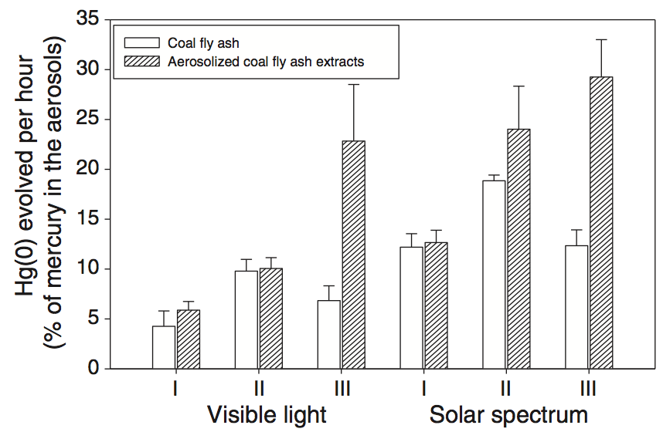
In-plume reduction hypothesized as mechanism to help reconcile model overestimate
Hg(0) evolved per hour
(from Hg in the aerosols)
Hg(II)
Hg(0)
water extracts from fly ash
c
(%)
Coal fly ash
Lohman et al. (2006); Edgerton et al. (2006)
Tong et al. (2014)
Laboratory evidence that in-plume reduction may be happening via heterogeneous chemistry.
Notes:
Add Vijayragahavan et al. (2008) as a reference? Did they do in-plume reduction?
Acknowledge Kolker et al. 2010 observed increasing Hg(II) downwind of plume, which would contradict this

Slide 9
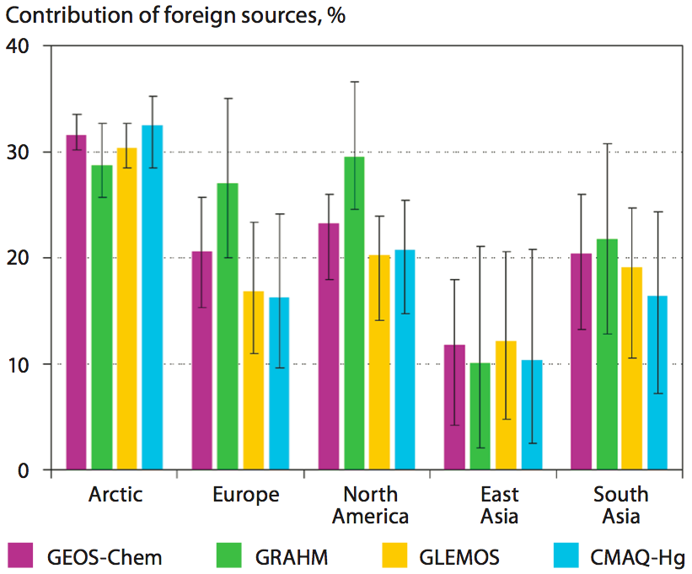
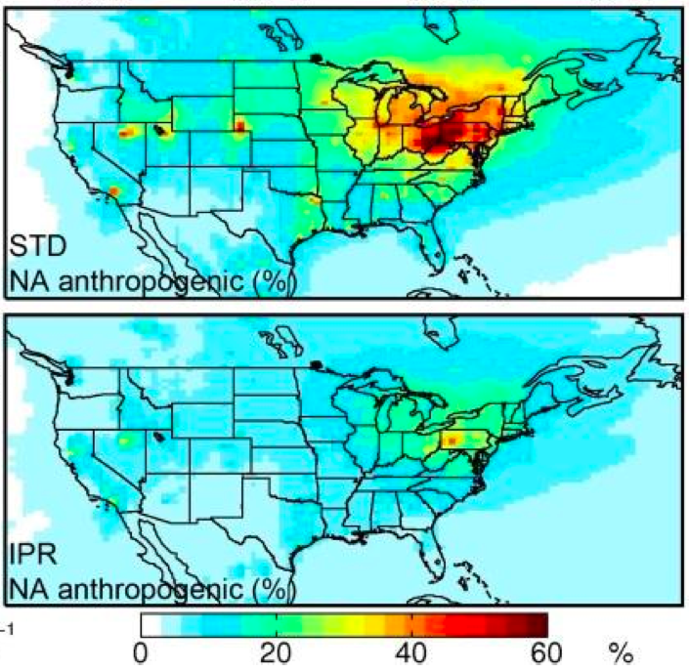
Modeled source-receptor relationships sensitive to emission speciation
Contribution to deposition from North American
anthropogenic sources
Foreign contribution to deposition in different receptor regions
GRAHM
GEOS-Chem
GLEMOS
(%)
CMAQ-Hg
Standard model
AMAP/UNEP (2013) adapted from Travnikov et al. (2010)
In-plume reduction
(%)
Y. Zhang et al. (2012)
Notes:
Papers to read before the talk: Travnikov et al. 2010; Ryaboshapko et al. 2007, STOTEN; ; L Zhang et al., 2012, Environmental Pollution; Lin et al. 2012 and papers that cite him/her
Yanxu’s work has implications for the efficacy of domestic regulation, such as the MATS rule. → Isn’t three a recent paper that suggests the MATs rule would be effective?
Caption from AMAP/UNEP-Travnikov figure:
Figure 3.16 (a) Contribution of foreign anthropogenic sources to mercury deposition in different receptor regions in 2005. Bars represent average values and whiskers show the 90%-confidence interval of the parameter variation over a region. (b) Global distribution of anthropogenic mercury emissions in 2005 and location of source regions considered in the analysis – Europe, North America, East Asia, South Asia, Central Asia, Africa, South America, Australia and Oceania. Source: Travnikov et al. (2010).

Slide 10
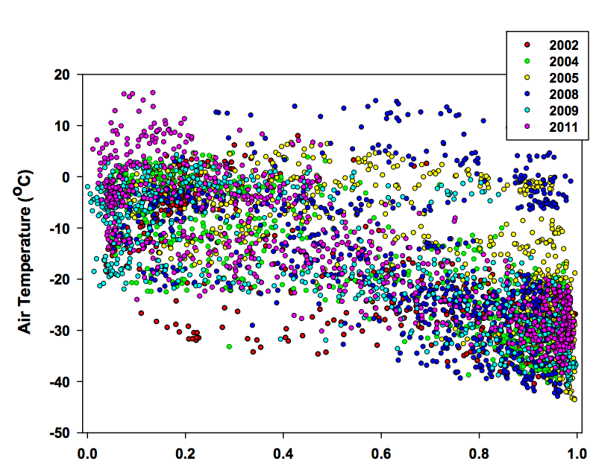
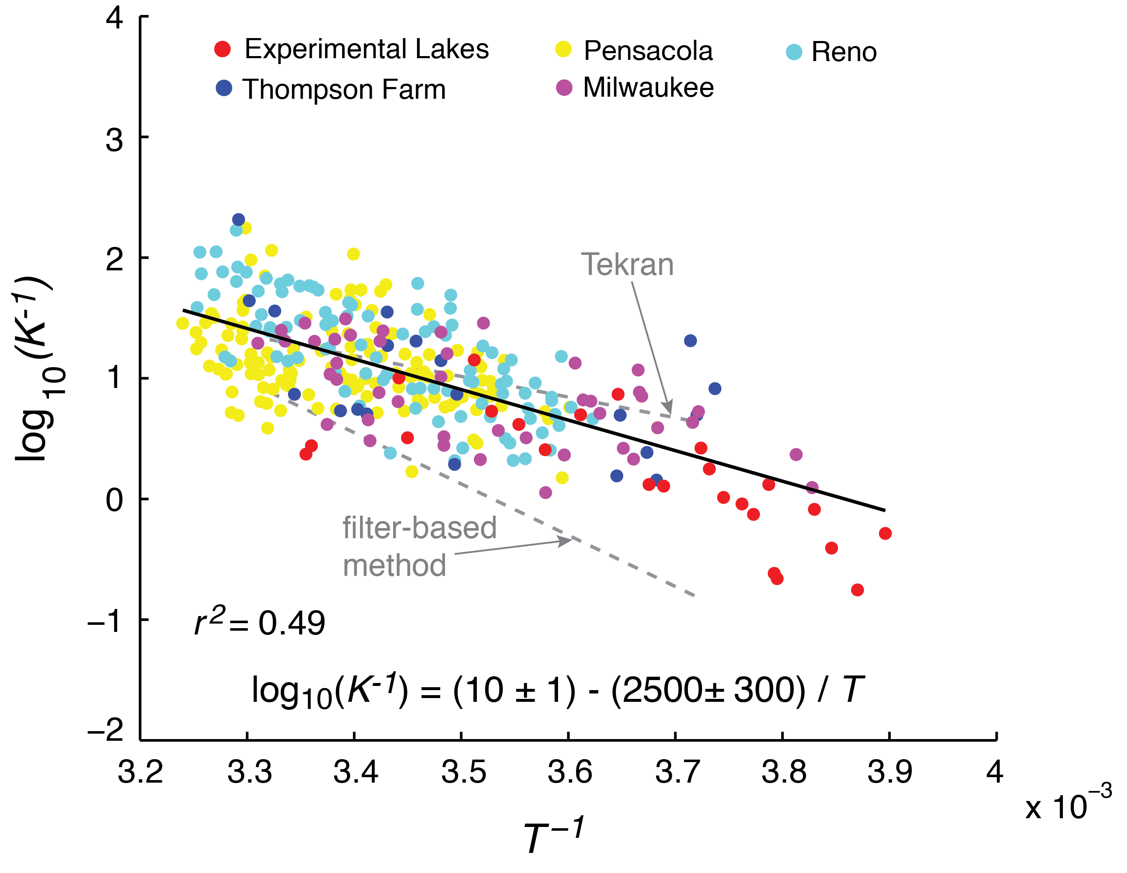
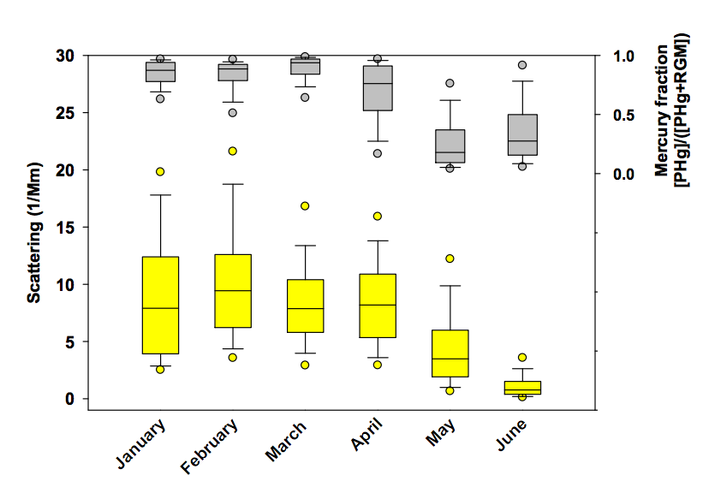
Temperature and aerosol concentration are driving GOM-PBM partitioning
Alert, Nunavut
Air temperature (°C)
Fraction Hg(II) as PBM
Rutter & Schauer ( 2007a)
Fraction
PBM
Amos et al. (2012)
Scattering (1/Mm)
Steffen et al. (2014)
Notes:
Mention that this work falls apart for the free troposphere – see Timonen et al. 2013

Slide 11
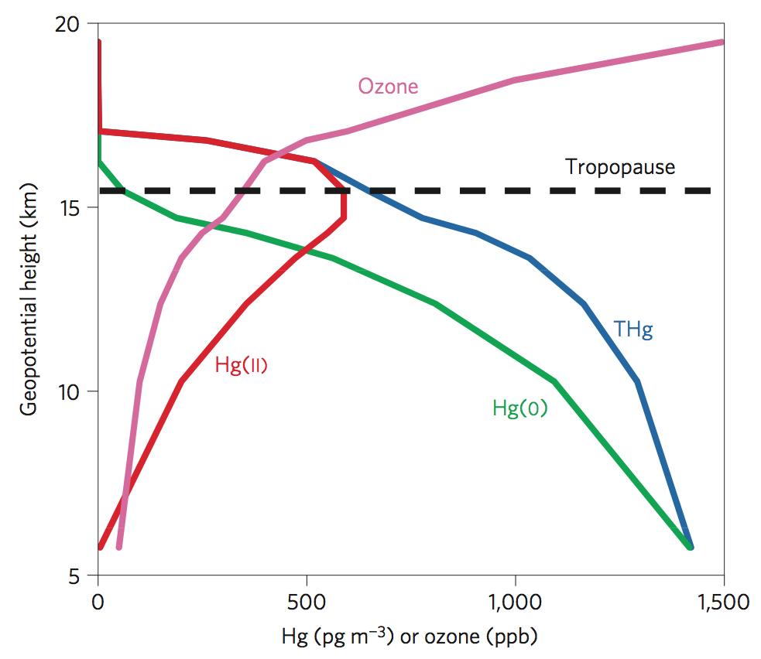
Gas-particle partitioning is a key process controlling Hg profiles near the UTLS
But measured PBM at
Mt. Bachelor much less than predicted.
(Timonen et al., 2014)
What’s different in the PBL, free troposphere, and UTLS?
- Aerosol composition?
(Rutter & Schauer, 2007b)
- Humidity?
Kim et al. (2012)
Geopotential height (km)
Hg(II)
Lyman & Jaffe (2012)
Hg (pg m⁻³) or ozone (ppb)

Slide 12
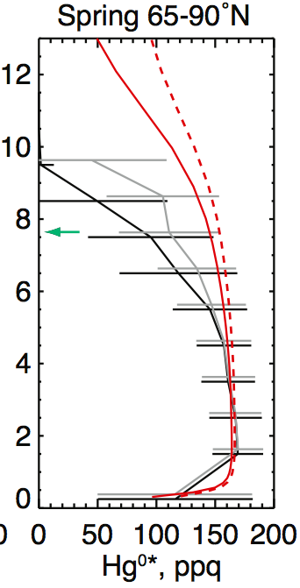
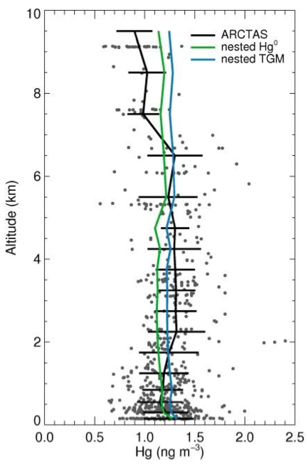
Hg removed from the upper troposphere/lower stratosphere (UTLS) faster than models can explain
ARCTAS
2008
California + Nevada (Summer)
Arctic (Spring)
model
Hg(0)
TGM
model
Hg(0)
model
TGM
obs
Altitude (km)
Altitude (km)
observations
Y. Zhang et al.
(2012)
Holmes et al.
(2010)
Hg (ng m⁻³)
Vertical distribution of speciated Hg is a key issue.
AMAP/UNEP (2013)
Notes:
Look up Sillman et al. 2005 – CMAQ study of air craft data
Grey line on Holmes 2010 is the obs – stratospheric air (O3 > 100 ppb).

Slide 13
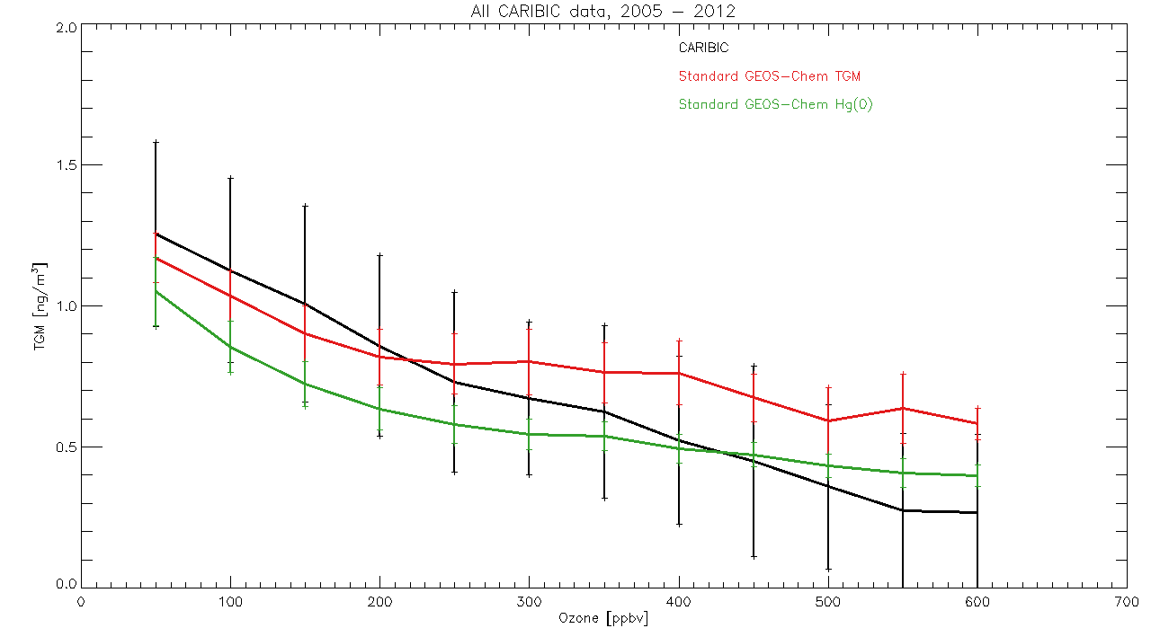
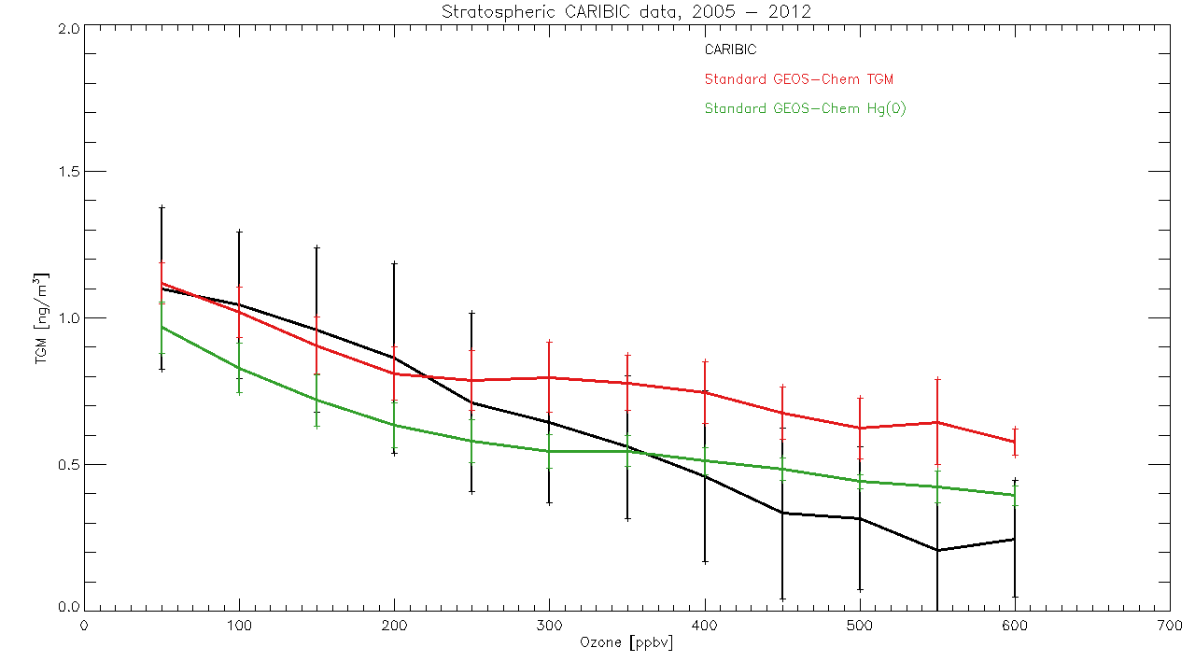

Comparisons with standard model indicate oxidation is too low in UT/LS
Too little oxidation in models in the upper troposphere / lower stratosphere (UTLS)
2.0
2005-2012 Average
underestimate
CARIBIC flight data
TGM*
1.5
GEOS-Chem TGM
GEOS-Chem Hg⁰
(ng m⁻³)
0.5
100
200
300 400 500 600
Ozone (ppbv)
Figure courtesy of Hannah Horowitz (hmhorow@fas.harvard.edu)
Notes:
Look for papers on heterogeneous chemistry applicable to stratospheric aerosol.
Check Murphy et al. 2006 again – they think this is also oxidation and not just Hg(0) condensation onto particles because peak TGM doesn’t coincide with temperature.
PV > 1.5 PVU and CO < 100 – lyman and Jaffe
GEOS-5; 4˚ x 5˚ resolution
(earlier work by Bess Corbitt showed this bias persisted at higher resolution

Slide 14
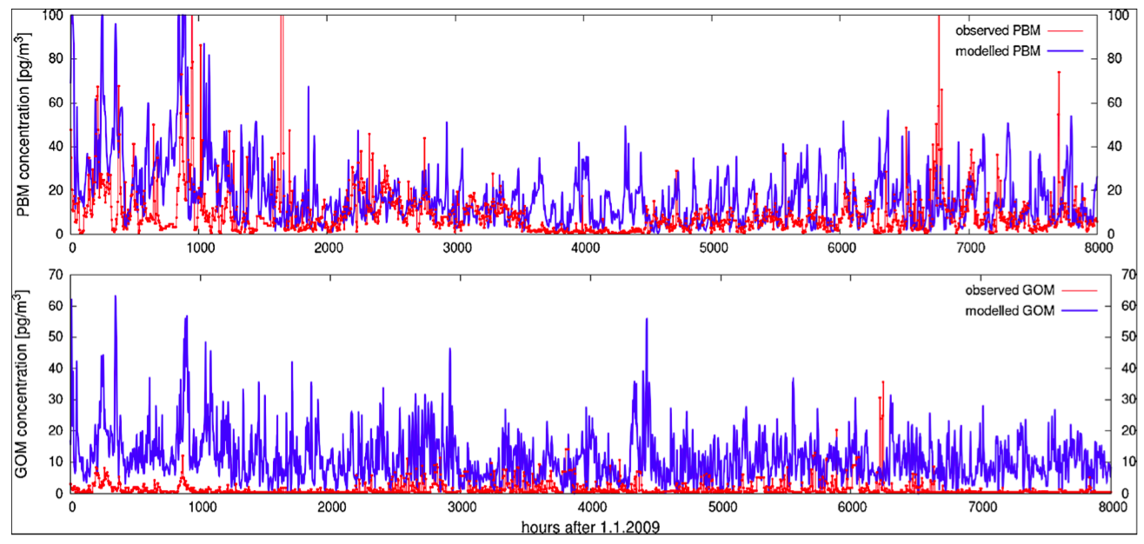
Some questions can’t be answered right now because of measurement uncertainty
Waldhof, Germany (2009)
PBM
(pg m⁻³)
GOM
observations
model
(pg m⁻³)
Hours after January 1, 2009
Bieser et al. (2014)

Slide 15
Some questions can’t be answered right now because of measurement uncertainty
Why, on average, are models doing a better job with PBM than GOM?
Waldhof, Germany (2009)
PBM
(pg m⁻³)
How much of the disagreement is analytical error? Model error?
GOM
observations
model
(pg m⁻³)
Hours after January 1, 2009
Bieser et al. (2014)

Slide 16
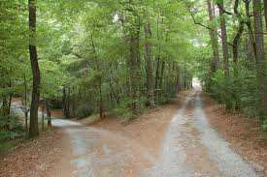
Moving forward
Develop new instrumentation
UW DOhGS (U. Washington)
GC-MS (U. Utah)
LIF (U. Miami)
Nylon filters (U. Nevada)
U. Houston system
?
?
Continue using Tekran units
Calibration
Characterize interferences (O₃, RH)
Correction factors
Reconfigure inlet?
Notes:
Make sure that recommending a move away from TGM is consistent with Jaffe letter.
Follow up on cavity ring down system with Daniel Obrist
Instrumentation in development pulled from RAMIX study (Gustin, 2013), except for GC-MS which is Seth Lyman’s talk. DOhGs is a dual channel instrument

Slide 17
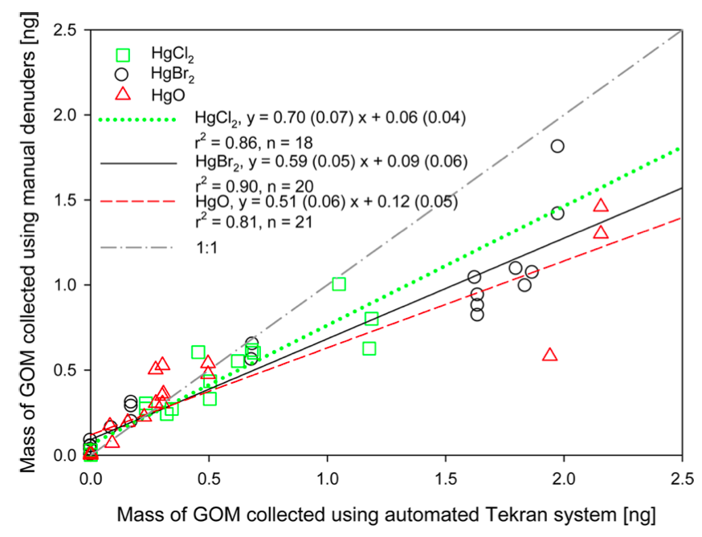
We want model output to be comparable to measurements (and vice versa)
Mass of GOM collected
Models
1:1
HgCl₂, HgBr₂, HgBrCl, HgO,…
Bulk Hg(II)
HgBr₂
manual denuders (ng)
HgCl₂
Tekran
HgO
Hg(II) compounds collected on a KCl denuder
Huang et al. (2013)
automated Tekran system (ng)
Notes:
I’m mentioning this because this presents an ongoing challenge, but is also a place where modelers and experimentalist need to come together to figure out the best way to handle this problem. As we figure out what to do with the Tekran GOM and PBM measurements or new instruments are developed, there would be benefit to keep an active and open dialogue with the modeling community. Can models stick with bulk Hg(II), which is less computationally expensive? Or do the need to resolve all these species, which is more computationally expensive?

Slide 18
Moving forward
Develop new instrumentation
UW DOhGS (U. Washington)
GC-MS (U. Utah)
LIF (U. Miami)
Nylon filters (U. Nevada)
U. Houston system
?
?
Continue using Tekran units
Calibration
Characterize artifacts (O₃, RH)
Correction factors
Reconfigure inlet?
My wish list
Gaseous Hg(II) – total or individual compounds
Size fractionated particulate Hg(II)
Notes:
Make sure that recommending a move away from TGM is consistent with Jaffe letter.
Follow up on cavity ring down system with Daniel Obrist
Instrumentation in development pulled from RAMIX study (Gustin, 2013), except for GC-MS which is Seth Lyman’s talk. DOhGs is a dual channel instrument

Slide 19
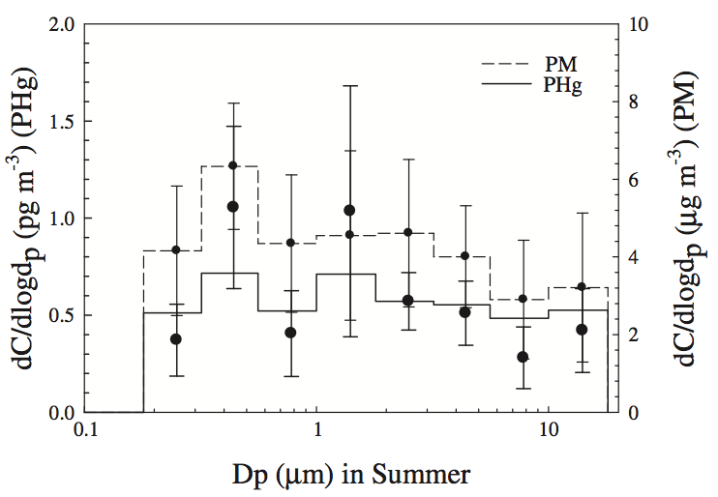
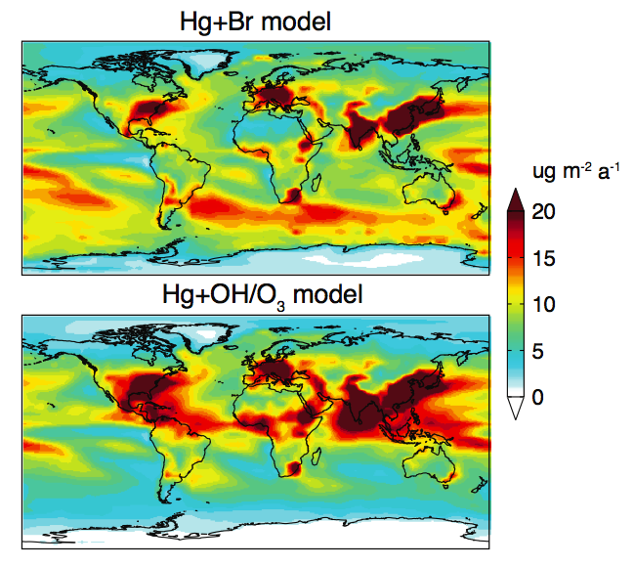
Reliable Hg(II) measurements are the key to pinning down the oxidation-reduction mechanism(s)
Particle size distribution
Seoul, Korea
No wet deposition data where model difference is largest
PM
2.5 μm
Br oxidation
PBM
Kim et al. (2012)
We’re missing PBM with a 2.5 μm cutoff.
Talbot et al. (2011); Malcom et al. (2008); Keeler et al. (1995)
OH + O₃ oxidation
Holmes et al. (2010)

Slide 20
Closing thoughts
Models cannot be evaluated against GOM and PBM.
Although limited, we’ve made progress understanding Hg(II) cycling:
  Halogens + sea salt in the MBL
  Gas-particle partitioning
  Emission speciation
  Vertical profile & UTLS
Moving forward, focus on gaseous Hg(II) measurement.
Broader Implications: Better constraining the atmosphere improves understanding of soil and ocean cycling.
hamos@hsph.harvard.edu

Slide 21
Extra slides

Slide 22
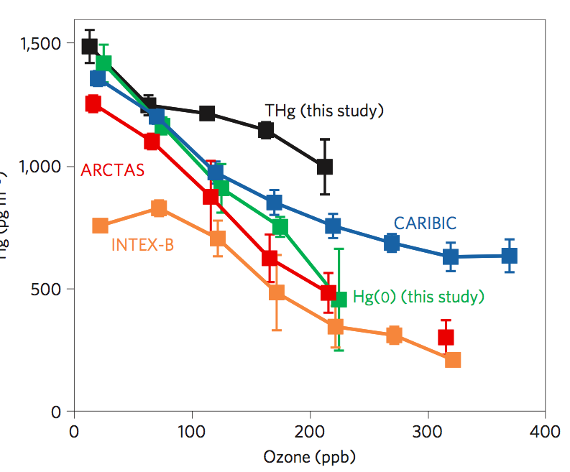
TGM becomes more ambiguous with height
Hg (pg m⁻³)
Lyman & Jaffe (2012)
Ozone (ppb)
Notes:
Do any of Franz Slemr’s papers talk about GOM breakthrough?
TGM in AMDEs?

Slide 23
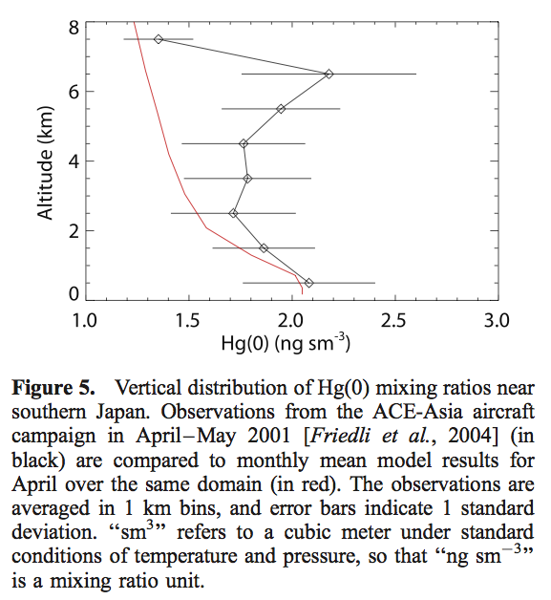
Selin et al. (2007)

Slide 24
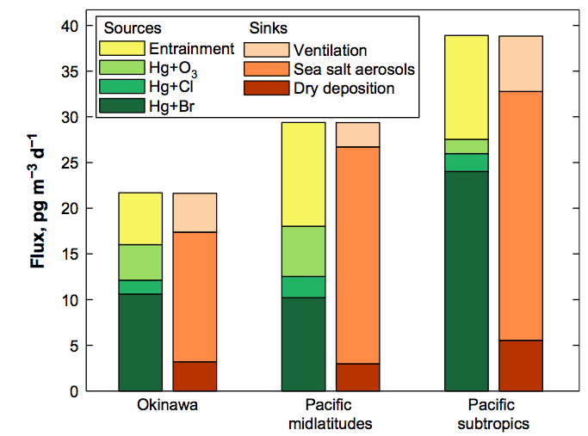
Hg budget in the marine boundary layer
Holmes et al. (2010)

Slide 25
References: Source-receptor studies
Wright et al. (2014), Investigation of mercury deposition and potential sources at six sites from the Pacific Coast to the Great basin, USA. STOTEN
I. Cheng et al. (2012), ACP – Experimental Lakes region
Corbitt et al. 2011
Sunderland et al. (2008), Environmental Pollution

Slide 26
What kind of problems are people working on with speciated Hg models?
Source-receptor
Wet and dry deposition (Myers et al., 2013, ACP; Leiming Zhang’s group + Chen; Yanxu Zhang 2012/3 in ACP and Atmosphere)
Gas-particle partitioning
High altitude (Peter; Lyman and Jaffe; Hannah Horowitz)
Marine boundary layer cycling
Oxidation mechanisms (De Simone et al., 2014)
Inverse analysis

Slide 27
In-plume reduction
Edgerton et al. 2006
Lohman et al. 2006
Arnot ter Schure’s blimp work
Tong et al. 2014, Atmospheric Research – Hg(II) reduction on fly ash and aerosols in power plant plumes. Isotopic measurements from Rollison et al. 2013 Chemical Geology support reduction on aerosols – note, I don’t think Rollison measured in plumes, or at least not deliberately

Slide 28
In a perfect world, I would ask for an instrument that…
Could distinguish between individual Hg(II) compounds
Size fractionated particle-bound Hg(II), not just a 2.5 um cutoff (G. C. Fang et al., 2012, Atmospheric Environment)

Slide 29
Better obs will support these specific model things
Inverse analysis (you need as much information as possible to beat down the error)
Diagnosing chemical mechanisms / chemical regimes, including aqueous reduction (Bash et al., 2014, Atmosphere)
Predicting GOM and PBM concentrations from wet deposition data (Chen et al., 2013, ACP – Leiming Zhang’s group)

Slide 30
What models need in order to use Tekran GOM/RGM and PBM data
Quantification of error
Characterization of artifacts
Correction factor (Huang et al., 2013)

Slide 31
Other Hg modeling talks
Frank Marsik: An overview of measurement and modeling approaches for the estimate of temporal and spatial variations in mercury dry deposition.
Xiaohong Xu: An overview on the use of trajectory models to investigate potential sources of atmospheric mercury
Peter Weiss-Penzias: Use of global model results to understand airborne oxidized mercury observations at five sites

Slide 32
Papers w/ speciated Hg modeling
Lyman and Jaffe (2011?) – Science or Nature
Timonen et al. (2012?) - ACP

Slide 33
Modelers to look up on Web of Science
Noelle Selin
Chris Holmes
Krish Vijayaraghavan
Jesse Bash
Tracey Holloway
Mark Cohen
Frank Marsik
Xiaohong Xu
Yanxu Zhang
Long Chen
Lyatt Jaegle
Oleg
Ian Hedgecock
Bieser
Ashu Dastoor

