Slide 1

6th World Congress on Biotechnology
Leaves extract of Damdei, Lamka for the synthesis of mixed oxide of Zn nanoparticles: Truly biogenic method
Presented by: Heikham Farida Devi
National Institute of Technology, Manipur

Slide 2
OUTLINE
· Introduction
· Application
· Synthesis of ZnO nanoparticles
· Characterization
· Results
· Conclusion

Slide 3

INTRODUCTION
Croton caudatum commonly known as Damdei
Found mainly in the hilly region of Lamka, Manipur,India
Belongs to Euphorbiaceae family
Its leaves are claimed to have anticancer properties, curative medicinal qualities for diabetes , malaria, indigestion etc.
Its roots and barks are claimed for the presence of dotriacontamol, bamyrin and b-sitosterol
Some of the phytochemicals such as flavonoids, cyanogenetic glycosides, alkaloids and phenolic compounds present in Damdei green leaves extract have the ability of biogenic growth of metal nanoparticles as reducing agent

Slide 4
APPLICATION
· Catalysis
· Fabrication
· Magneto-optic
· Biological field

Slide 5
· Catalytic activity of nanoparticles is mainly due to their high surface area to volume ratio contributing to enormous number of active sites for the reactant molecules to interact.
· Techniques of fabrication for the nanoparticles with controlled size and morphology play a crucial role in controlling their properties.

Slide 6
SYNTHESIS OF NANOPARTICLES
Zinc oxide nanoparticles was synthesized through reduction of zinc nitrate by leaves extract of Damdei at room temperature in aqueous medium following the twelve principle of green chemistry without involving any strong and harmful reducing agent.

Slide 7
CHARACTERIZATION
Particles fabricated using this method was characterized using HRTEM, SAED, IR-Spectroscopy, UV-Vis spectroscopy and XRD

Slide 8
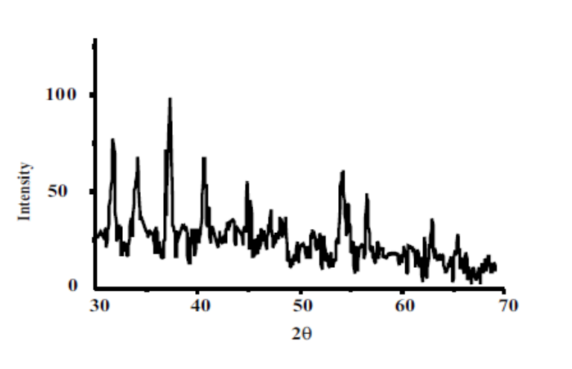
RESULTS
(a)
(b)
· High resolution transmission electron microscopy (HRTEM) images revealed that zinc oxide nanoparticles are of 2-5nm in size and crystalline in nature
· Selected area electron diffraction pattern (SAED) exhibits very good ring patterns which clearly depicts the particles are highly crystalline in nature.
· XRD confirmed the mixed oxide (ZnO + ZnO₂) nature of this synthesized zinc nanoparticles, showing surface plasma resonance band at 318 nm. The diffraction pattern indicates the presence of Zinc oxide instead of pure nanosphere zinc particles because Zinc particles undergo oxidation to its oxide form during drying process at room temperature since first row transition metals are very prone to oxidation upon aerial contact.
Figure 1. (a) High resolution transmission electron microscopic (HRTEM) picture of Zinc NPs (b) The selected area electron diffraction (SAED) pattern of zinc NPs
Figure 2. X-Ray Diffraction (XRD) analysis of Zinc oxide nanoparticles

Slide 9
Comparision of IR Spectra of Damdei coated ZnO nanoparticles and Damdei
Figure 3. (a) FTIR spectra of Damdei coated Zinc oxide nanoparticles (b) FTIR spectra of Damdei

Slide 10
· No prominent characteristic absorption peak of the ZnO nanoparticles was observed in the UV-Visible region.
· Metal oxides generally give absorption bands in fingerprint region i.e. below 1000 cm-1 arising from inter-atomic vibrations.
. The peaks at 1634.00, 620.93 cm-1 are correspond to Zn-O stretching and deformation vibration respectively.
· In the spectra of Damdei hydroxyl group observed at 3271cm-1, in Damdei coated ZnO NPs the corresponding peak do not appears .
· Thus ZnO NPs were stabilized by the phytochemicals present in Damdei.

Slide 11
CONCLUSION
We have successfully designed a single step aqueous phase green synthetic approach for zinc nanoparticles with an average size of 2-5 nm by reducing zinc nitrate solution with Damdei green leaves extract at room temperature. The phytochemicals present in the green leave extract are effective in both the generation and stabilization of zinc nanoparticles.

