Slide 1

Successful conduct of clinical trials to prove biosimilarity through defining a best fit outsourcing strategy
Heike Schoen,
LUMIS International GmbH, Germany
Hyderabad October 27, 2014

Slide 2
Agenda
Why to outsource to a Contract Research Organization
Outsourcing models – the best fit strategy
Key success factors in outsourcing
Get it right from the start

Slide 3
Why to outsource clinical trial conduct

Slide 4
Outsourcing Reasons
Compliment or addition to own expertise
What are your priorities?
Clinical expertise
Contacts in target countries
Niche expertise
Short
timelines
Short term resources
Reduce fixcosts
Cost reduction in resources (personell, manufacturing etc)
Clinical Experts, sites, local regulatory expertise
Add single functions to own resources (insourcing)
Biosimilar expertise, medical devices, single services, Phase I
Stepwise or mixed approaches
CROs as efficient process experts,

Slide 5
Outsourcing Models

Slide 6
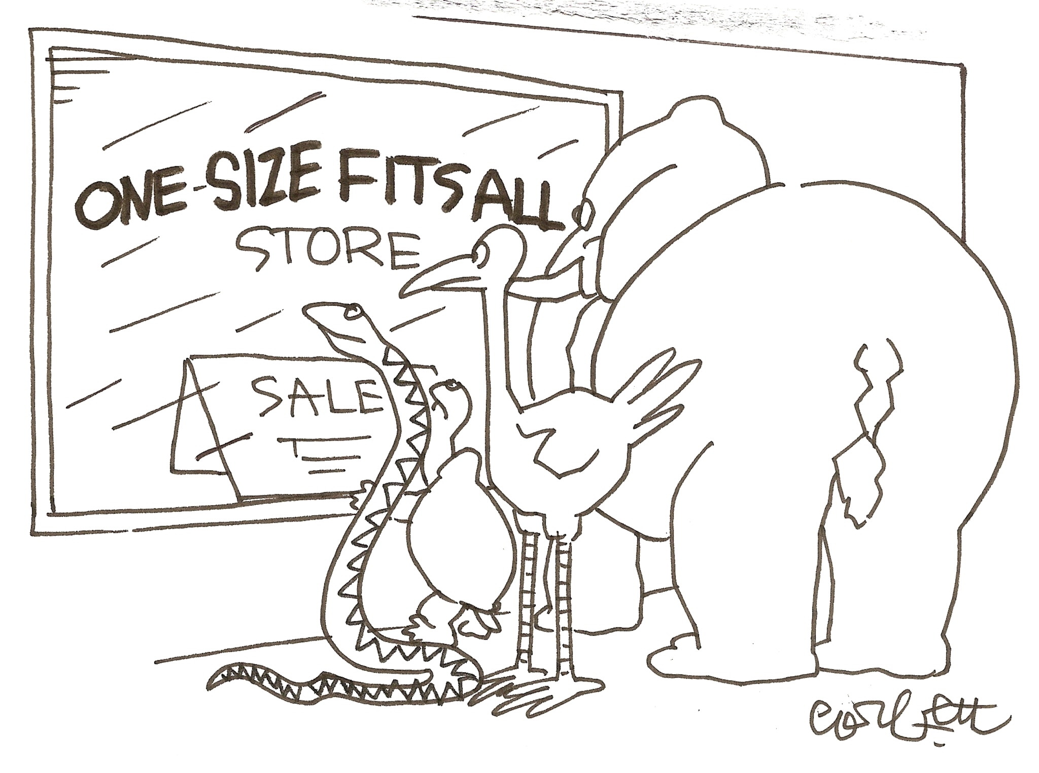

Slide 7


Outsourcing models
Functional/Speciality sourcing
Utilizing CRO staff (insourcing) to perform a specific function
Needs of specific services
Multiple reports into Sponsor
Managing multiple
providers
Full service sourcing
Complete range of services
One stop shopping
Global representation
One single point of contact
Disparate business units, Integration
across location not guaranteed

Slide 8
Sponsor size – CRO size
Avoca Group, Survey 2011
There is a close association in the size of a sponsor company and the size of the CRO selected
67% of „Big Pharma“ outsource mainly to „TOP 5“ CROs
10% of smaller sponsor companies spend outsourcing budget with TOP 5 CROs
70% of smaller sponsors spend <10% of outsourcing budget with TOP5 CROs
Smaller and midsize sponsors dedicate their outsourcing mainly to midsize (beyond Top 15) and small CROs (speciality CROs)

Slide 9
View to CROs: different sizes – different strengths
Large CROs
Global Player with global infrastructure
„deep“ experience
Large capacity
Standardized global procedures and quality control
High staff turnover
Less flexible
High costs
Midsized CROs
Less staff turnover than large CROs
More flexible
Quality personal services
Senior management involvement
Small CROs
Flexibility responsiveness, attention
Senior management involvement
Low turnover
Most cost-effective
Avoca Group, 2011

Slide 10

Challenges when working with CROs
Small Sponsor perspective
Common understanding of the project requirements
Different objectives of CROs and Sponsors
Sponsors feel loss of control
Micromanagement vs Trust – finding the right balance
Getting full attention from CROs
Promises and Reality/plan vs actual achievements
Ongoing Cost and Risk control
Oversight management

Slide 11
Key success factors in outsoucing

Slide 12
Prepare to outsource - Define your outsourcing strategy
Define the services you need to compliment your internal resources
Define your outsourcing budget
What core competencies do you need to manage the outsourcing process and the relationship with the CRO, oversight management
  Working with one CRO or several CROs
How much do you want to be involved during the clinical trial
  Site visits, investigator relationship, meetings, data review
What are your key timelines : Regulatory appovals, First patient in, interim analysis etc- any advice needed?
Implement a CRO evaluation team
Risk Management
Assessment

Slide 13

CRO Selection process
What type of CRO would fit the project?
General presentations of different CROs upfront
Request for Proposal – be as much precise as possible
  List of responsibilities, timelines
  Synopsis/Draft Protocol
  Cost sheet
  Your expectations of the CRO
  Which input do you need
Carefully evaluate and compare the proposals,
Understand the cost-drivers

Slide 14
Bid Defense Meetings
Organize face to face meetings with selected CROs
Sponsor CRO evaluation team and CRO functions represented
Have all CRO functions to present
Share your expectations of your expected working relationship
  Communication
  Study team organisation
  Governance and senior management access
  Contract details (risk sharing, fix price, milestones)
Allow for break out sessions – in depth discussions if needed

Slide 15

CRO evaluation key criteria
Timely and accurate response to RFP, understanding of sponsor requirements
Recent and proven indication experiences
Geographical representation (offices, freelance, subcontractors, experience)
Study team experience in the indication/region
Review performance metrics of CRO in e.g.:
  Time to first initiation visits
  Time for site contracts
  Enrollment timelines in comparable studies
Get references
Financial stability of CRO

Slide 16
Relationship building
Understand each other organisations – How do they work
Study team chemistry, Sponsor and CRO
Ensure to get full attention of CRO
  Sponsor - CRO steering committee
    Different levels of participation
    Matching decision power – Escalation process to Senior Management
Share information and provide the full picture as sponsor
Define common goals
Be flexible – open discussions – joint problem solving
Built trust – get to know each other
Sponsor - CRO
Sponsor – CRO
=
Sponsor - CRO

Slide 17
Get it right from the start

Slide 18

Summary
Define your outsourcing strategies and needs
Be clear about your expectations - avoid changing assumptions too often
Invest time and resources into the CRO selection process
Set up your CRO management system
Communication is key!
Invest in building the relationship and trust to get the required outcomes
Respect each other and be successfull together

Slide 19
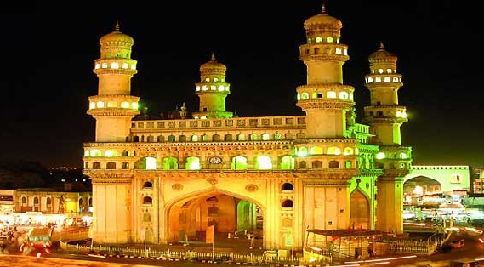
Dhanyavaad !
Thank you !

