Slide 1
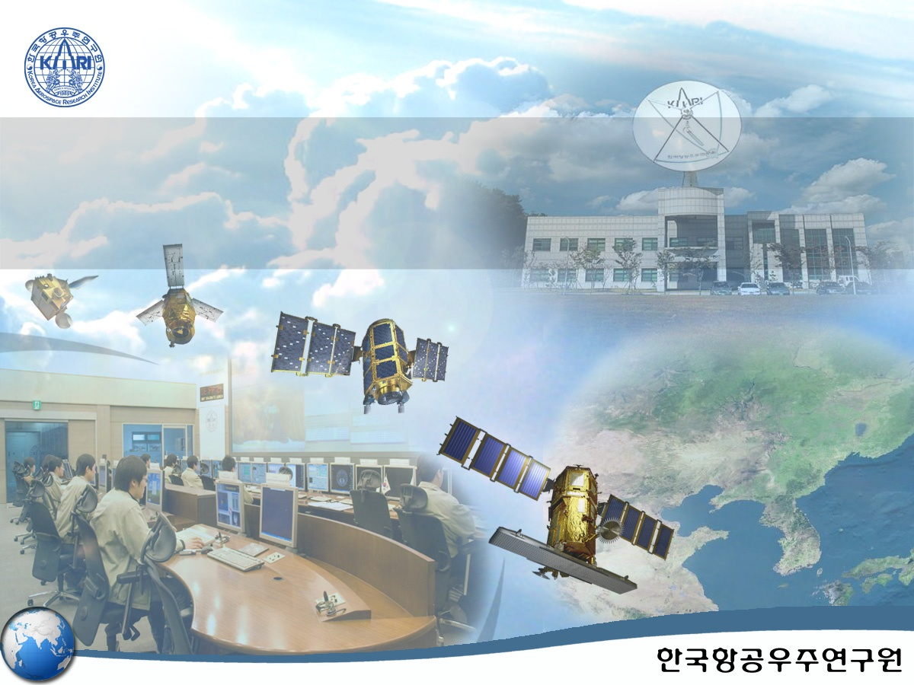
Optimized Image Collection Planning System for KOMPSAT
HeeJin BAE
chelry@kari.re.kr
Notes:
Good afternoon. It’s a great pleasure to make a presentation to you today on ISRS.
My name is heejin bae from KARI.
Today’s topic is Improved Design of Optimized Satellite Planning System for Multi-Satellite Operation.
Now, I’d like to get started.

Slide 2
Contents
Introduction
Image Collection planning system
Optimized Satellite Planning System for Multi-Satellite Operation
Optimization Algorithm Design
Conclusion
Notes:
This presentation will cover these following issues.
Introduction, Image Collection planning system, Optimized Satellite Planning System for Multi-Satellite Operation, Optimization Algorithm Design, Conclusion
Let’s get down to research.

Slide 3
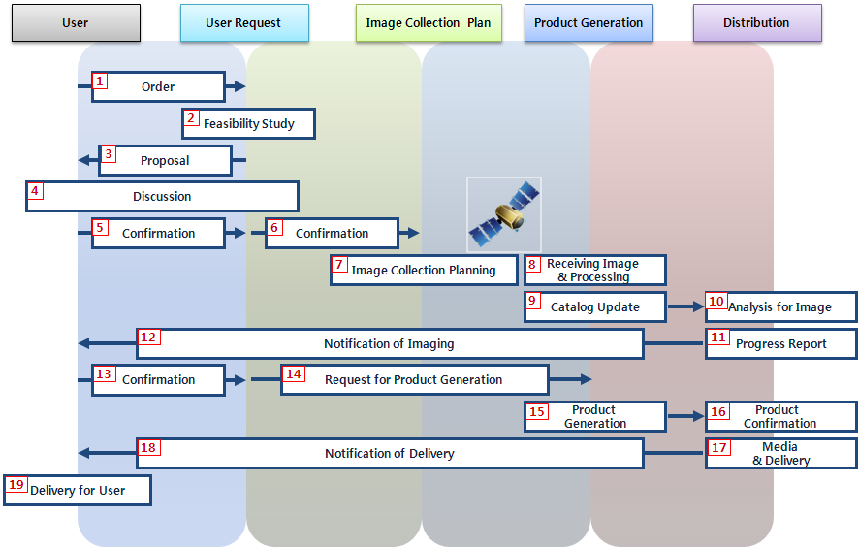
Introduction
Operation of satellite image
  User request
  Image collection planning
  Product generation
  Distribution
Figure 1. Operation Procedure for KOMPSAT-2
Notes:
This figure represents operation of satellite image.
Operation of satellite image is divided 4 parts as user request, image collection planning, product generation and distribution.

Slide 4
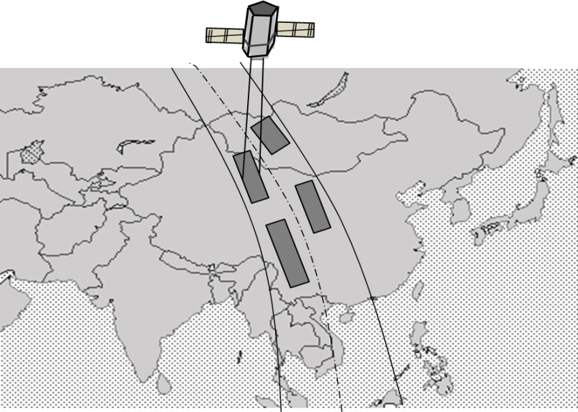
Introduction
Image collection planning
  Job scheduling of satellite
  To maximize satellite resources with NTO
  (New Task Order) and unfinished order from user
  request within several constraints
  Many parameters are considered in
  image collection planning
  ➔ Image collection planning: complexity
  KARI is expected to operate several satellites
  ➔ Image collection planning should be optimized for multi-satellite.
  Optimized image collection planning is already researched. But the optimized satellite planning system is able to be applied to several satellite separately (or partially) not multi-satellite operations
  In this paper, feasibility of efficiency improvement of optimized satellite planning
  system at present is investigated for image collection planning for multi-satellite.
Notes:
Image collection planning in operation performs job scheduling of satellite.
Job scheduling of image collection is to be applied to proper time to maximize satellite resources with NTO (New Task Order) and unfinished order from user request within several constraints.
Because many parameters are considered in image collection planning like this, image collection planning has complexity.
KARI (Korea Aerospace Research Institute) is expected to operate several satellites as not only KOMPSAT (KOrea Multi-Purpose SATellite)-2 and KOMPSAT-3 launched this year on operation at present but also KOMPSAT-5.
To manage these orders effectively and create best image collection plan, image collection planning system should be optimized for multi-satellite.
Optimized image collection planning is already researched. But the optimized satellite planning system is able to be applied to several satellite separately (or partially) not multi-satellite operations.
In this paper, feasibility of efficiency improvement of optimized satellite planning system at present is investigated for image collection planning for multi-satellite.

Slide 5
Image Collection Planning
NTO(New Task Order): Order Database
Simulated scene generation
Pre-Processing with simulated scene,
weather Information and satellite constraints
Optimization with all possible segments
Scheduling with optimized possible
segments
NTO
Order
Database
orders
Simulated Scene
Generation
Simulated Scene
Weather Info.
Satellite Constraints
Pre-Processing
All Possible Segments
Optimization
Inactivated
segments
Optimized Possible Segments
Scheduling
Notes:
This figure is overall process of image collection planning.
If NTO is received from user, NTO is transmitted to order database.
Simulated scene is generated with orders. Simulated scene is to generate expected scene for AOI by simulation. Size of simulated scene refers to FOV (Field of View) of Satellites.
pre-processing is performed with the results from simulated scene generation, weather information and satellite constraints like tilt angle, memory, agility characteristics etc.
Pre-processing is performed to generate all possible segments with orbit propagation for requested period. Segment is continuous simulated scene and unit used in one shot of satellite. If length of segment is long, the segment has many simulated scene. On the other hands, if length of segment is short, the segment has less simulated scene than long segment. And segment is to be generated within satellite constraints and user request.
All possible segments from pre-processing are to be optimized.
After optimization, only optimized possible segments are generated. Then, scheduling is performed with the optimized segment.
Finally, operator checks the scheduling result and the scheduling result are made as image collection plan for satellite.
Image collection planning is performed daily. After satellite imaging, if schedule is unfinished, remained job in the schedule is transmitted to database of OMS and regarded as remained order.

Slide 6
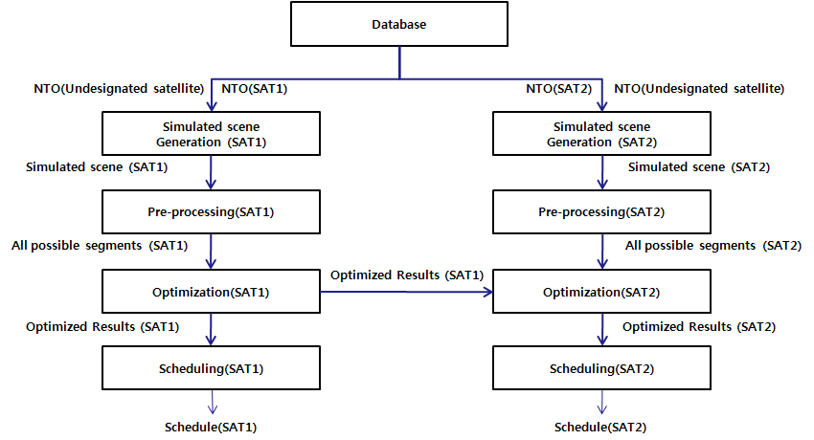
Optimized Image Collection Planning
Assumption: Multi-satellite operation (SAT1 & SAT2)
For orders of undesignated satellite
  First, image collection planning for SAT1 in order with undesignated satellite and order with designated SAT1
  Next, image collection planning for SAT2 in the result from SAT1, order with undesignated satellite and order with designated SAT2
  But processing of optimized satellite planning system is optimized for each SAT1 and SAT2
Notes:
There are 2 types in user request. One is order with designated satellite; another is order with undesignated satellite. If satellite is designated for order, image collection planning is simple. But if satellite is not designated, image collection planning is complex. That’s why it is necessary to decide for which satellite order with undesignated satellite
If there is order with undesignated satellite, the optimized satellite planning system derives image collection plan for SAT1 in order with undesignated satellite and order designated SAT1 at first. And the optimized satellite planning system derives image collection plan for SAT2 in the result from SAT1, order with undesignated satellite and order with designated SAT2.
The optimized satellite planning system has capability to perform image collection planning for multi-satellite as described this figure. But processing of optimized satellite planning system is optimized for each SAT1 and SAT2. Therefore, improved design of optimized satellite planning system is suggested in this paper.

Slide 7
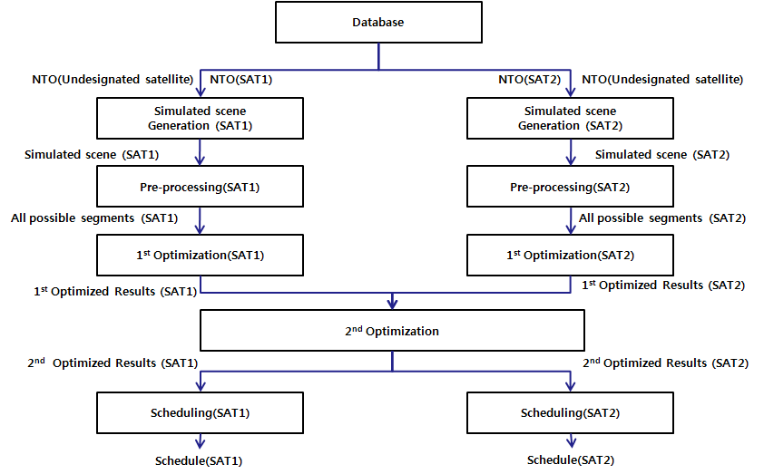
Optimized Image Collection Planning
Assumption: Multi-satellite operation (SAT1 & SAT2)
For orders of undesignated satellite
  First optimization: each SAT1 and SAT2
  Second optimization
    optimized SAT1 result and optimized SAT2 result
    if there is collision with optimized SAT1 result and optimized SAT2 result for order with undesignated satellite, optimization algorithm is performed to solve the collision. And it is necessary to make simulated scene number table for order undesignated satellite to solve the collision
Notes:
Improved optimized satellite planning system has two steps for optimization. First optimization is for each SAT1 and SAT2. Second optimization is for optimized SAT1 result and optimized SAT2 result. In second optimization, if there collision with optimized SAT1 result and optimized SAT2 result for order with undesignated satellite, optimization algorithm is performed to solve the collision. And it is necessary to make simulated scene number table for order undesignated satellite to solve the collision.

Slide 8
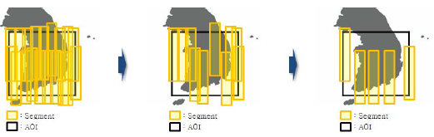
Optimization Algorithm Design
Heuristic Algorithm: Deletion
  Assumption: all segments are scheduled
  Delete a segment from schedule until
  segment meets satellite constraints.
All segments are scheduled
Find a best segment
(least decrement)
Delete a segment from schedule
Feasibility check
No
Yes
Terminate
Notes:
The daily imaging scheduling problem of satellite considers various imaging requests with different reward opportunities, changeover efforts between two consecutive imaging tasks, cloud-coverage effects, and the availability of the spacecraft resource. It belongs to a class of single-machine scheduling problems with salient features of sequence-dependent setup, job assembly, and the constraint of operating time windows. The scheduling problem is formulated as an integer-programming problem, which is NP-hard in computational complexity.
Processing time of optimized satellite planning system depends on performance of optimization algorithm.
In this paper, Heuristic method of insertion and deletion is suggested to solve NP-hard problem considering high computational time.
This figure is flow of deletion method.
Assumption is all segments are scheduled.
Then, a segment from schedule are performed deletion until segment meets satellite constraints.

Slide 9
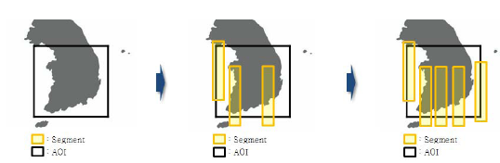
Optimization Algorithm Design
Heuristic Algorithm: Insertion
  Assumption: no segment is scheduled
  (empty schedule)
  Insert a segment in the schedule until
  segment is added to schedule no more.
Empty schedule
Find a best segment
(maximize objective function)
Insert a segment in the schedule
Checked all segments?
No
Yes
Terminate
Notes:
This figure is flow of insertion method.
Assumption is no segment is scheduled .
Then, a segment in the schedule are performed insertion until segment is added to schedule no more.

Slide 10
Conclusion
Improved design of optimized satellite planning system
  Two step optimization
  Simulated scene number table
Will be expected to develop and implement system for multi-operation
If optimized satellite planning system is used in multi-satellite operation, it lowers human resources, computational time and can process more order from user rapidly.
Notes:
KARI is expected to operate several satellites. Each satellite have different sensor characteristic and different operation system. For operation for several satellites, KARI has already researched optimized satellite planning system as prototype for multi-satellite. The optimized satellite planning system has capability to perform image collection planning for multi-satellite. But processing of optimized satellite planning system is optimized for each satellite.
Therefore, two step optimization and simulated scene number table for order undesignated satellite is suggested for improved design of optimized satellite planning system.
First optimization is for each satellite and second optimization is for each optimized results. In second optimization, if there collision with optimized results from first optimization for order with undesignated satellite, optimization algorithm is performed to solve the collision. And simulated scene number table for order undesignated satellite to solve the collision is needed.
Performance of optimized satellite planning system depends on optimization algorithm. In this paper, Heuristic method of insertion and deletion is suggested to solve NP-hard problem considering high computational cost.
This research result will be expected to develop and implement system for multi-operation.
If optimized satellite planning system is used in multi-satellite operation, it lowers human resources, computational time and can process more order from user rapidly.

Slide 11
Q&A
Notes:
Are there any questions?

Slide 12
THANK YOU!!
Notes:
Thank you for your time.

