Slide 1

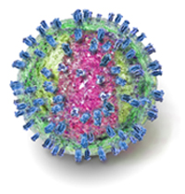
The Immune Response of Prolactin and the Induction of Tumor Necrosis Factor (TNF) in Iraqi Patients Infected with Hepatitis C Virus.
Prof. Hedef Dhafir El-Yassin (MRSC, Ph.D, Post Doctorate)
Department of Biochemistry, College of Medicine, University of Baghdad.
Rana A. Hadi M.B.Ch. B. Candidate for the fellowship of the Iraqi Board for Medical Specialization in Pathology/ Clinical Chemistry

Slide 2
Viral Hepatitis Type C is a serious public health challenge throughout the world and remain to be the major causes of chronic hepatitis.
During the 80s, Iraq had low endemicity among blood donors.
However its prevalence is now increased with high rate of mortality.

Slide 3
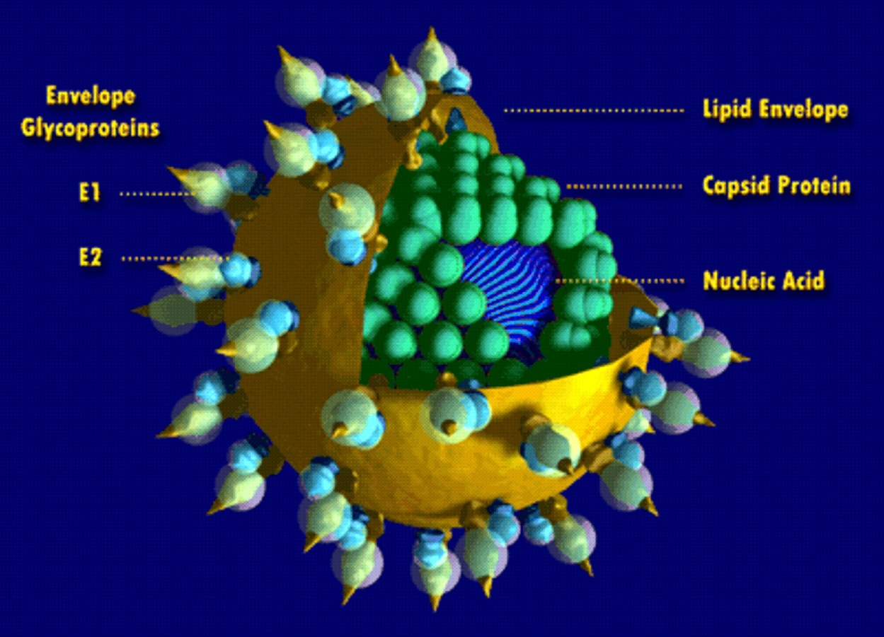
Hepatitis C is a contagious viral disease caused by hepatitis C virus.

Slide 4
Brett D. Lindenbach and charles M. Rice described a hypothesis for the detailed molecular mechanism of HCV infection in an article entitled :” The ins and outs of hepatitis C virus entry and assembly”, published in Nature Reviews Microbiology : Volume: 11, Pages:688–700 :(2013)

Slide 5
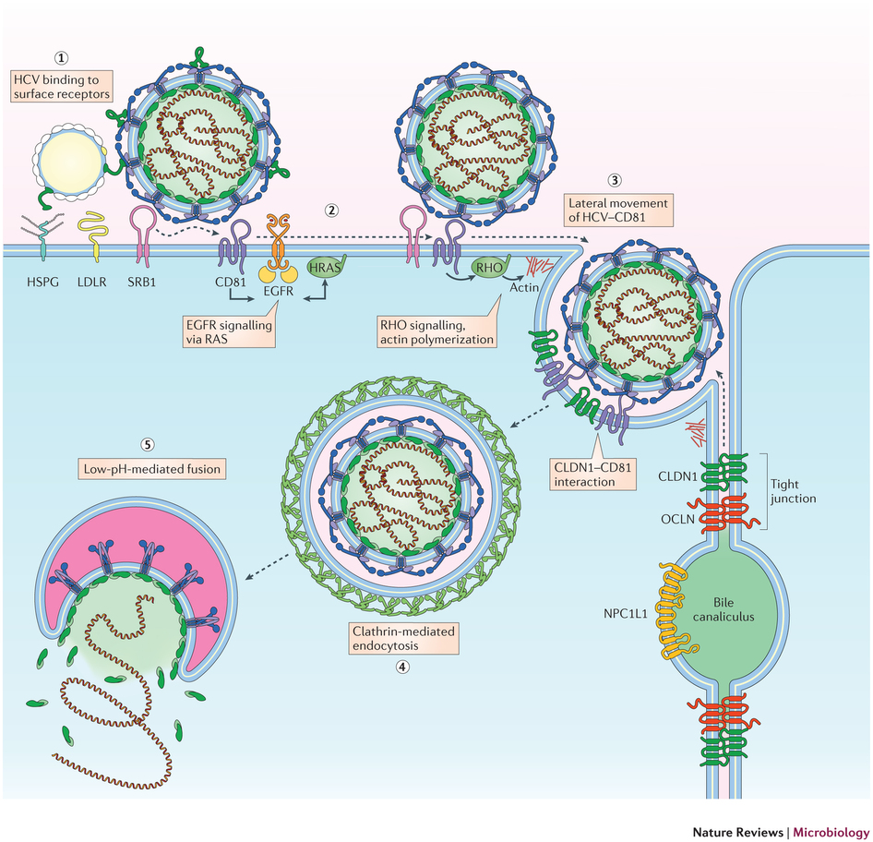

Slide 6
(step 1)
Hepatitis C virus (HCV) lipoviral particles (LVPs) attach to the cell surface by interacting with:
  heparan sulphate proteoglycans (HSPGs),
  low-density-lipoprotein receptor (LDLR) and
  scavenger receptor class B member 1 (SRB1).
SRB1 might delipidate HCV-associated lipoproteins and induces conformational changes in the E2 glycoprotein, exposing the CD81-binding site

Slide 7
(step 2)
Interaction of E2 with CD81 then activates signal transduction through epidermal growth factor receptor (EGFR) and HRAS, as well as through RHO GTPases.
(step 3)
These signaling events promote lateral movement of HCV– CD81 complexes to sites of cell–cell contact.

Slide 8
(step 5)
(step 4)
Interaction of CD81 with claudin 1 (CLDN1), and HCV internalization via clathrin-mediated endocytosis.
The low pH of the endosomal compartment induces HCV fusion.

Slide 9
Many cases (two –third) could go through undiagnosed because they might be asymptomatic.
However the rest one-third of people initially infected with hepatitis C develop symptoms and are more likely to be treatment efficiently with antiviral drugs.

Slide 10
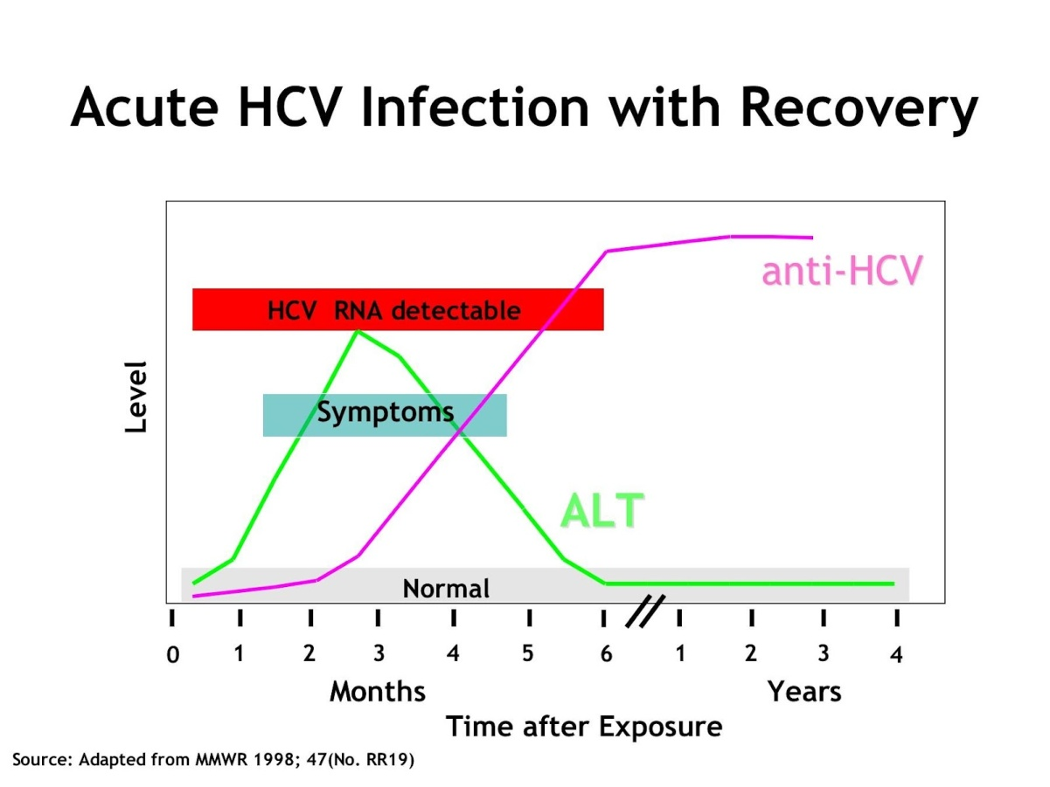

Slide 11
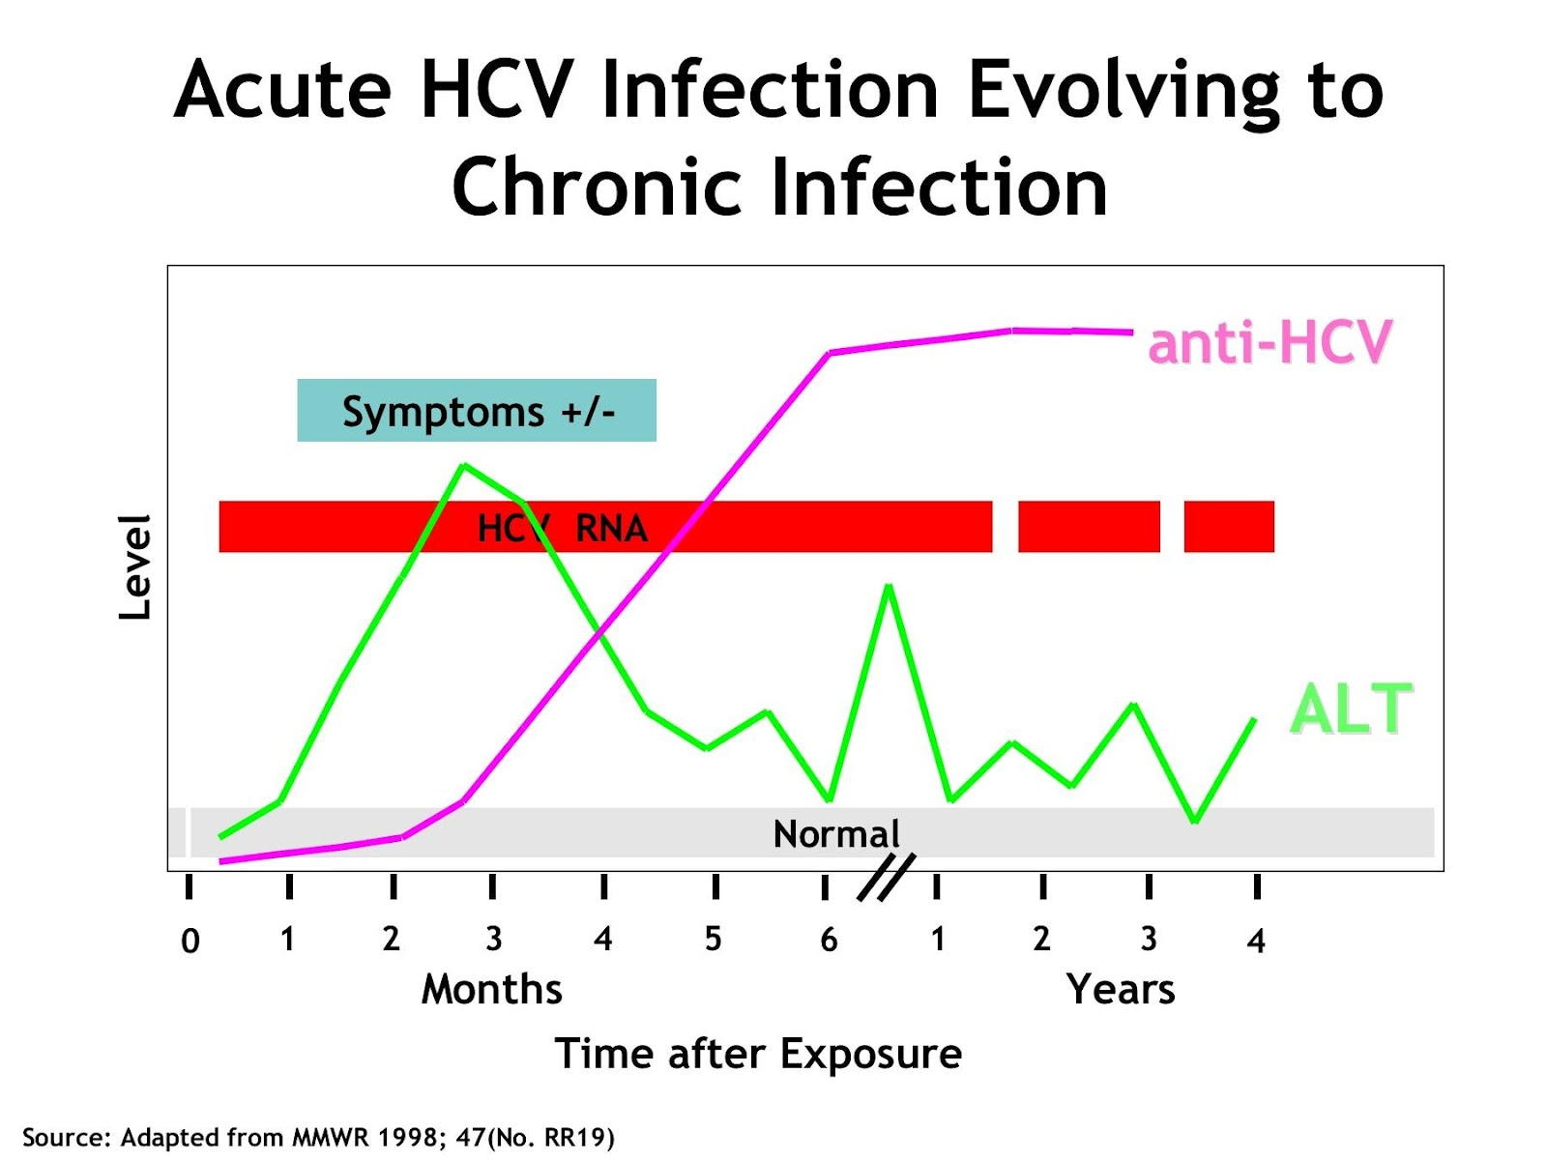
Those infected but asymptomatic will develop to chronic HCV and will initiate a broad-based immune response. (adaptive and innate immune response).

Slide 12
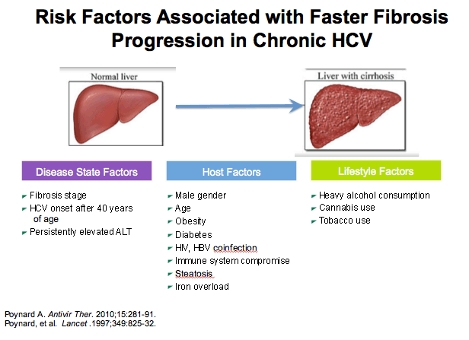

Slide 13
It is clinically important
to differentiate :
  incident HCV infections
  from
  chronic infections
and to identify
  primary infections that are asymptomatic.

Slide 14
Occasional occurrences of acute exacerbation in chronic infection, will complicate decisions regarding whom to treat with the suitable treatment.(1)

Slide 15
Hepatitis C virus-related chronic hepatitis is associated with various immunological disorders example:
Immuno-endocrine
Cytokines
Anti-tissue antibodies

Slide 16
Interaction of these molecules might trigger a cascade of reaction that will be involved in the progression of the disease.
And/or might influence the effect of drug of choice that is used for the management of the disease.

Slide 17
Aim of the study:
To evaluate the role of the immunoendocrine system in the pathogenesis of chronic hepatitis c, by measuring serum prolactin and tumor necrosis factor-alpha.

Slide 18
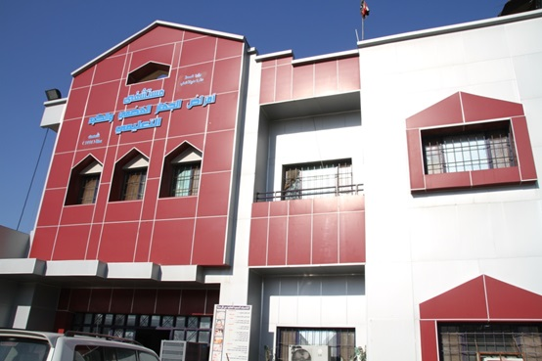
Subjects involved in the study were selected from Gastrointestinal Hospital in Baghdad, Iraq .
During the period from July 2014 to September 2014.
A written consent was taken from each.

Slide 19
Subjects
n.= 81
Patients:
n=61
Median Age =34.8 yrs.
Male
n.= 29
Control:
n=20
Median Age= 34.6 yrs.
Male
n. =10
Female
n.= 32
Female
n.= 10

Slide 20
All patients had chronic hepatitis C virus and were on interferon alpha therapy.
All of them were positive for HCV RNA by means of polymerase chain reaction.

Slide 21
Diagnostic algorithm for hepatitis C
Anti HCV ELISA
Reactive
.elevated transaminases
.immuno compromised
HCV RNA
Non reactive
No further investigation
+ve
-ve
Consider retesting in six months

Slide 22
Blood samples were collected between (9.00a.m-12.00p.m).
The blood was allowed to clot in plain tube for 30-45 minutes at room temperature.
Sera were obtained by centrifugation of the collected blood and then stored in plain tubes at -20 c.
ELISA technique was used to measure (TNF and Prolactin)

Slide 23
Serum prolactin (ng/ml)
Patients
12.54
2.9
Controls
11.50
Parameter
Groups
Mean ± SEM
2.7

Slide 24
The role of PRL in the immune reactions is stimulating; its presence significantly increases the ability of the immune cells to proliferate and produce cytokines such as TNF-alpha(2)

Slide 25
Recent studies suggest that prolactin is important both for normal liver growth and for regenerating the liver after part of it is removed, with extra prolactin providing a boost for repair mechanisms. Consequently, enhancing prolactin levels could provide a way to improve regeneration when the liver becomes damaged or diseased with viruses, or after surgery.(3)

Slide 26
Serum TNF-alpha (ng/ml)
Patients
65.57 x10⁻³
7.03x10⁻³
Controls
41.52x10⁻³
Parameter
Groups
Mean ± SEM
1.86x10⁻³

Slide 27
HCV infection enhances TNF-α-induced cell death by suppressing nuclear factor NF-κB activation through the action of core, (non structural HCV ) NS4B, and NS5B. This mechanism may contribute to immune-mediated liver injury in HCV infection. (4)

Slide 30
Serum ASMA
Patients
65.57 +ve
34.43% -ve
Controls
100% -ve
Parameter
Groups
%

Slide 31
The result agrees with Clifford et al in their study they reviewed the presence of autoimmune markers in sera of chronic hepatitis C patients.
Their study showed that treatment with interferon alfa (IFN-alpha) will exacerbate autoimmune hepatitis. (5)
The pathogenesis of autoimmune hepatitis due to medications is not clear.

Slide 32
Recommendations from an expert panel
Aiming for treatment optimization by filling some of the gaps of the current guidelines, a group of Italian experts, experienced on treatment of HCV infection, met in Stresa in February 2016.
The summary of all the considerations arising from this two-day meeting and the final statements are reported in Digestive and Liver Disease Journal June 2016 [Epub ahead of print]

Slide 33
“Treatment of chronic HCV (CHC) has been revolutionized in the last few years by the introduction of highly effective and well tolerated direct acting antiviral agents (DAAs) able to achieve >90% rates of sustained virological response (SVR) in many groups of patients, including those previously excluded from interferon-based regimens.
For such reason interferon-free regimens are now the treatments of choice for all patients.
Successful anti-HCV treatment can stop liver disease progression and can solve the HCV-related extra hepatic manifestations, eventually reducing both liver-related and overall mortality.”

Slide 34
Conclusions:
Chronic hepatitis C is associated with an immunological abnormality mainly represented by tumor necrosis factor-alpha and prolactine.
This might shed a light of the type of therapy and drug of choice when managing the disease.

Slide 35
References:
C.H. Chen, and C.-S. Changchien. Is it possible to diagnose acute hepatitis C virus (HCV) infection by a rising anti-HCV titer rather than by seroconversion? J. Viral Hepat. 11:563–570, 2004
Fojtíková M¹, Cerná M, Pavelka K. A review of the effects of prolactin hormone and cytokine on the development and pathogenesis of autoimmune diseases.Vnitr Lek.56(5):402-13, .2010 [Article in Czech].
CarmenC, Moreno B, Maite G. Prolactin promotes normal liver growth survival and regeneration in rodents. American Physiological Society; 10:1152, 2012.
Park J, Kang W, Ryu SW.Hepatitis C virus infection enhances TNFα-induced cell death via suppression of NF-Κb.Journal of Hepatology; 56(3):831-40, 2012
Clifford BD,Donahue D,Smith L.High prevalence of serological markers of autoimmunity in patients with chronic hepatitis C. Journal of Hepatology; 21(3):613, 1995
Craxì A, Perno CF, Viganò M, Ceccherini-Silberstein F, Petta S; AdHoc (Advancing Hepatitis C for the Optimization of Cure) From current status to optimization of HCV treatment: Recommendations from an expert panel. Dig Liver Dis. 2016 Jun

Slide 36
Thank You
Any questions?

