Slide 1
About OMICS Group
OMICS Group is an amalgamation of Open Access publications and worldwide international science conferences and events. Established in the year 2007 with the sole aim of making the information on Sciences and technology ‘Open Access’, OMICS Group publishes 500 online open access scholarly journals in all aspects of Science, Engineering, Management and Technology journals. OMICS Group has been instrumental in taking the knowledge on Science & technology to the doorsteps of ordinary men and women. Research Scholars, Students, Libraries, Educational Institutions, Research centers and the industry are main stakeholders that benefitted greatly from this knowledge dissemination. OMICS Group also organizes 500 International conferences annually across the globe, where knowledge transfer takes place through debates, round table discussions, poster presentations, workshops, symposia and exhibitions.

Slide 2
About OMICS International Conferences
OMICS International is a pioneer and leading science event organizer, which publishes around 500 open access journals and conducts over 500 Medical, Clinical, Engineering, Life Sciences, Pharma scientific conferences all over the globe annually with the support of more than 1000 scientific associations and 30,000 editorial board members and 3.5 million followers to its credit.
OMICS Group has organized 500 conferences, workshops and national symposiums across the major cities including San Francisco, Las Vegas, San Antonio, Omaha, Orlando, Raleigh, Santa Clara, Chicago, Philadelphia, Baltimore, United Kingdom, Valencia, Dubai, Beijing, Hyderabad, Bengaluru and Mumbai.

Slide 3
Onychomycosis:
1064-nm Nd:YAG q-switch laser Treatment.
MD. Ricardo Galván García
Notes:
Haga clic para agregar notas

Slide 4
Conflict of interests
This talk has no conflict of interest with any pharmaceutical company or laboratory the medical industry.

Slide 5


Introduction
  Publications since 2000
Notes:
Cómo va a beneficiar la presentación a los asistentes: los adultos están más interesados en un tema si saben cómo y por qué es importante para ellos.
Nivel de experiencia en este tema del presentador: describa brevemente sus credenciales en este apartado o por qué los participantes deberían escucharle.

Slide 6
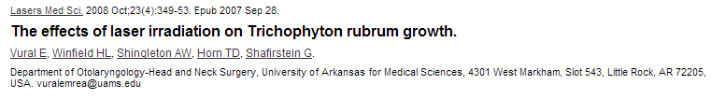
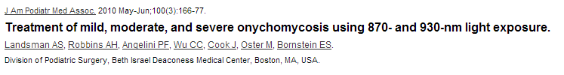
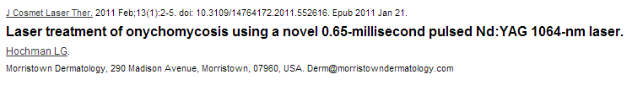
Introduction
  Publications since 2000

Slide 7
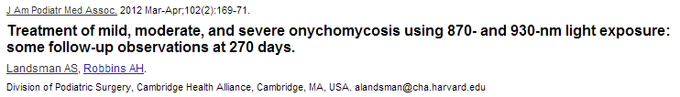


Introducción
  Publications since 2000

Slide 8

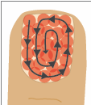
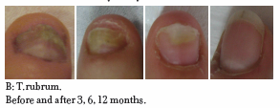
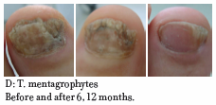
Previous Studies Laser (2012)
Laser Nd:YAG 1064 nm Long pulse fluency: 35 to 40 J/cm2, pulse duration: 25 milliseconds, spot size 4 mm, frequency: 1 Hz.
Three passes by session, divided into 4 sessions affected fingernail every 7 days. In total a month.
42 patients: effectiveness 93% at 3 months / 6 months 100%. More than 50% T.rubrum, 20% T.mentagrophyte with 0 side effects.

Slide 9
Previous Studies Laser ( 2013 )
Treatment of onychomycosis using a sub
milisecond 1064-nm neodymium:yttrium-
aluminium-garnet laser.
J Am Acad Dermatol 2013 oct. 69(4): 578-82.
Carney C.,Cantrell W.,Warner J.,Elewski B.
T.rubrum was exposed to 50 degrees centigrade for 15 min.
E.floccosum was exposed to 50 degrees for 10 minutes.
Scytalidium SP. was exposed to 55 degrees for 5 min.
Conclusions: There was no reply.

Slide 10
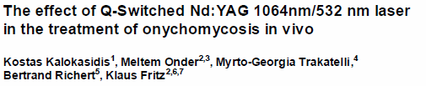
Previous Studies Laser (2013)
Journal of the European Academy of Dermatology & Venerology-Nov. 2013
131 patients both sex diagnosis
Onychomycosis culture (+) pre and post
A session of ND: YAG Q – switch 1064nm / 532 nm second pass
14 J/cm² 5 Hz spot 2.5 mm
Results:
83.21% of patients reported moderate pain
16.79% reported no pain
Mycological cure two months (95.42% of patients)

Slide 11

Cultures:
105 patients evaluated, 93 were positive to only 1 of the four methods of diagnosis. (KOH, culture, biopsy/PAS, calcofluor white)
KOH: 80% +
Culture: 59% +
Biopsy: 92%+

Slide 12
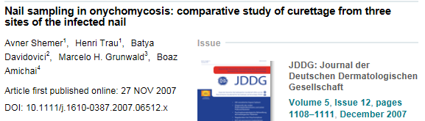
Cultures:
194 patients with Onychomycosis, distal medial and proximal by curettage, KOH and culture.
165 with proximal Onychomycosis and 29 with proximal and lateral. Proximal Onychomycosis: 123 patients (63.4% + KOH)
120 patients (61.8% + culture)
Lateral Onychomycosis: 82 patients (42% + KOH)
63 patients (32% + culture)

Slide 13


Cultures:
127 patients:
3 tests Mycological each
(KOH and culture)
at intervals of 1 month.
They found 82% with Candida species and 13.4% * dermatophyte
Candida : highest percentage 25% Albicans
Dermatophytes: highest percentage T.rubrum 5%
Results
Notes:
Las descripciones de las lecciones deben ser breves.

Slide 14
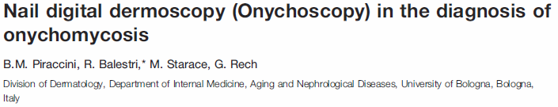
Onychoscopy :
Dermatoscopy ( Onychoscopy ) it is a simple method of diagnosis , which reveals key sings for the diagnosis of onychomycosis , present “jagged edge” and “longitudinal striae” , they were : the first is in the proximal margin of the onycholytic área has a jagged edge , with Sharp longitudinal whitsh indentations directed to proximal nail fold. It is best observed with magnification of 20x. and second longitudinal striae of different colours of the onychlytic nail plate, their color ranges from White to yellow, orange and Brown .magnification of 40x is best for their observation. at 95-100% cases , these two sings are present.

Slide 15
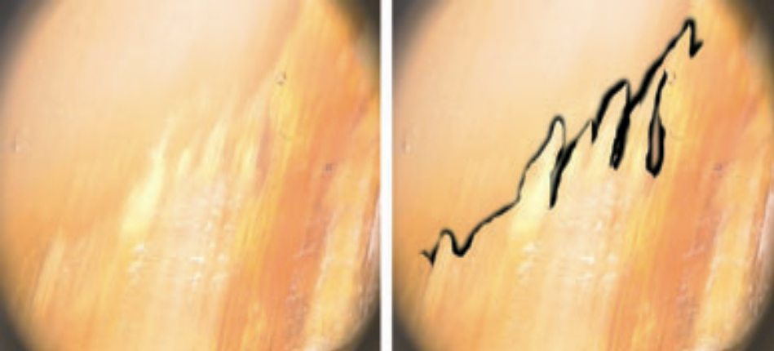
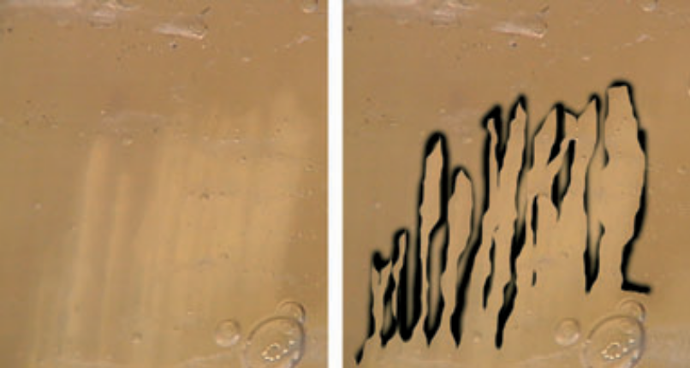
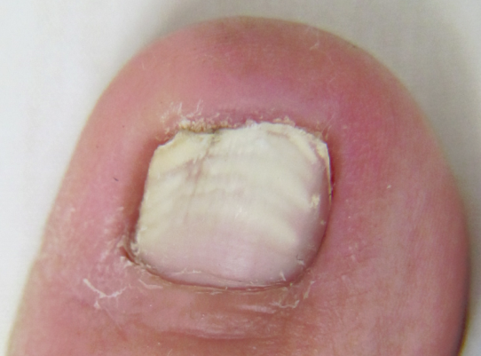
Onychoscopy
‘Spikes’ of the proximal margin
of the onycholytic area, which acquires a jagged edge (20x).
‘Longitudinal striae’ of different
colours in the onycholytic nail plate (40x).

Slide 16
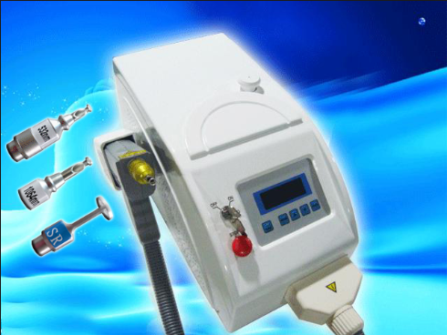
Study:
Background and Objectives.
Demonstrate the effectiveness of the Laser Nyqs 1064 mn
Long-wavelength Nd-Yag 1064 laser / 1320 nm 1,2,3 Hz penetration of 4 - 6 mm (papillary and deep dermis) Vascular-hair removal (red and Blue Color)
Laser NYQS 532-1064 nm 1,2,3 Hz
Penetration of 4 mm (papillary and middle dermis)
Pigment (melanin) tattoos (brown, black and blue color) 1064 nm Tattoos (red, yellow and others) at 532 nm.
Q Switch:
Peaks of high energy at high frequency, does not heat the tissue and generates a mechanical crash energy damaging only the objective.
PASSIVE PULSE IN NANOSECONDS 3 Hz.

Slide 17
Study
Material and methods:
200 patients
Both gender
Any age.
Diagnosis clinical:
  Onichodistrophy (Onychomycosis)
  types: distal, proximal, lateral.

Slide 18
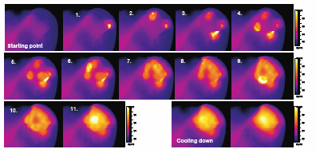
Materials and methods:
Laser NYQS 1064 nm 3 Hz, 600 mJ/cm² (equivalence at 12 J/cm²), spot 3 mm
One single session with three applications in a squared form across ungual plate for each case.
Random
Monalisa laser, sincoheren Co Beijin China
Q-Clear TM Light Age, Inc, Somerset, NJ, USA

Slide 19
Patient Tracking:
Photography (Pre y Post)
KOH (initial and final)
Onychoscopy
Laser Treatment (first visit)
Clinical revisions at 3,6, 12 and 18 months.
Final Survey.

Slide 20
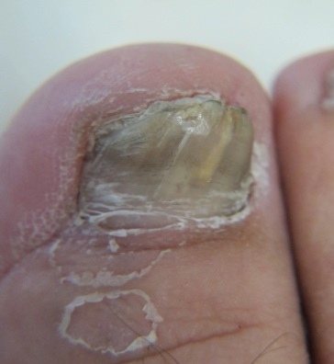
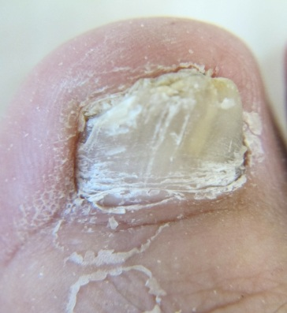
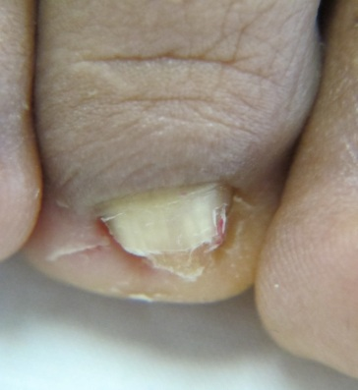
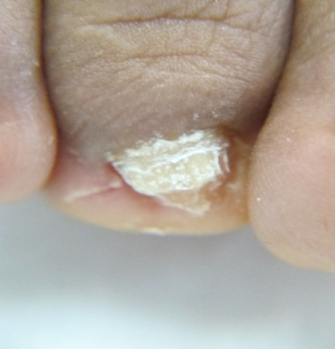
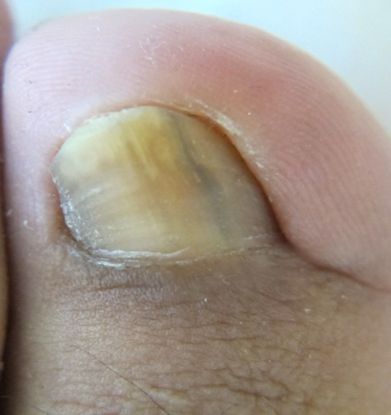
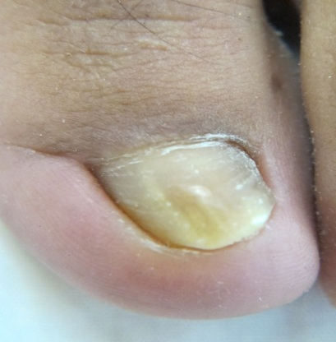
immediate results :
Near-instantaneous clearance of the affected nail with laser therapy

Slide 21
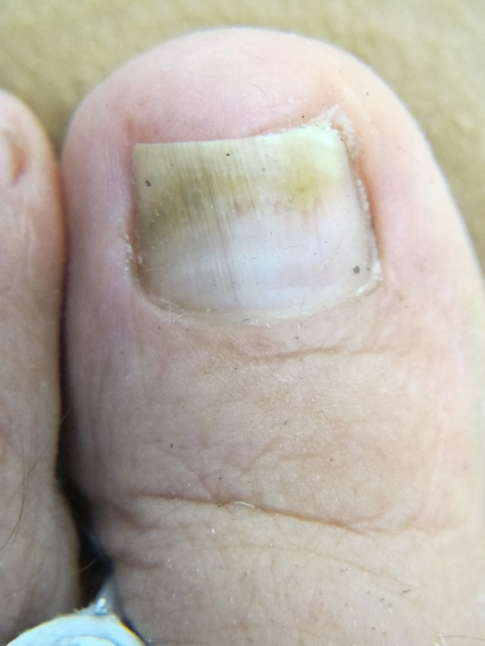
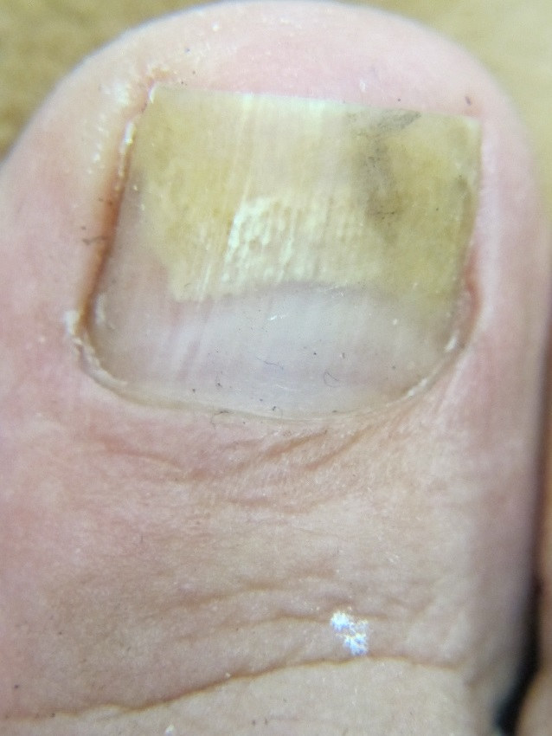
Clinical response at 3 months
Line of clearance in nails 3 months post laser

Slide 22
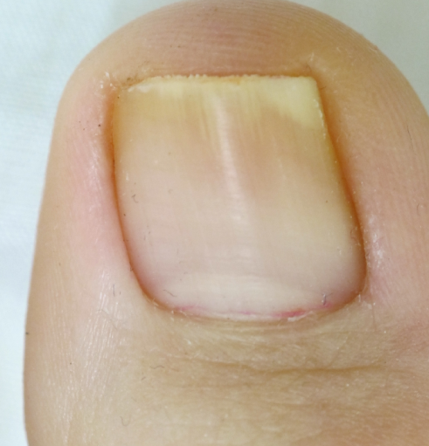
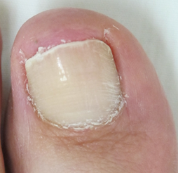
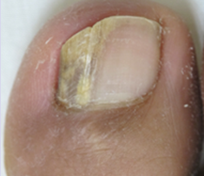
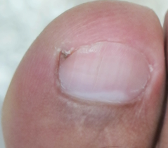
Clinical response at 12 months:
Pre
Post
Pre
Post

Slide 23
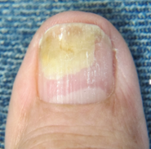
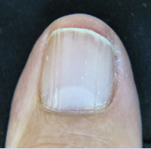
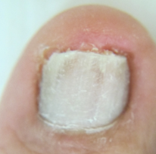
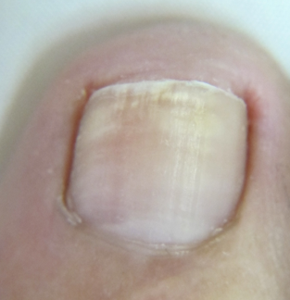
Clinical response at 12 months:
Pre
Post
Pre
Post

Slide 24
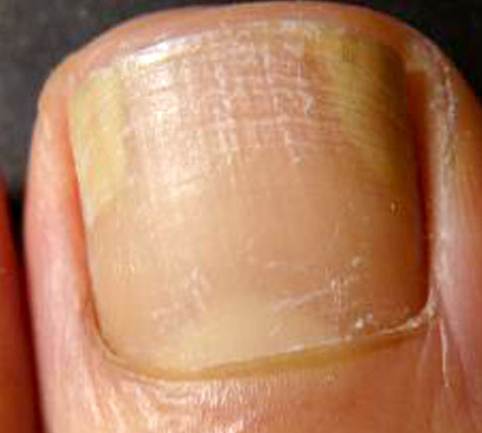
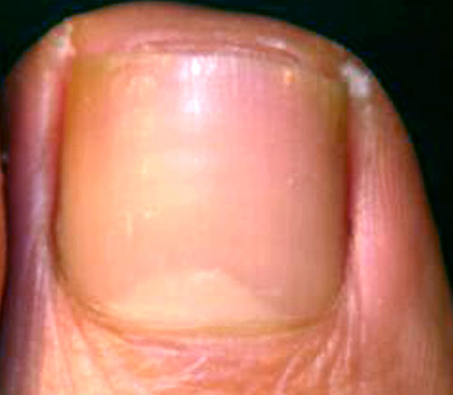
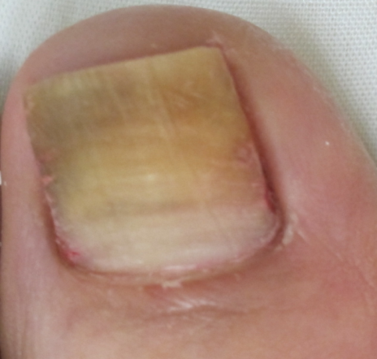
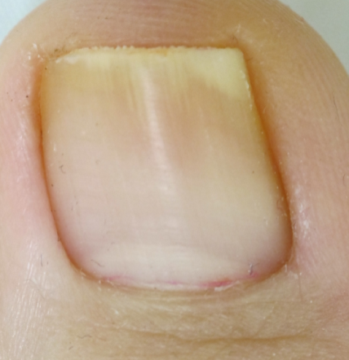
Clinical response at 12 months
Pre
Post
Pre
Post

Slide 25
Results
200 patients in total
Ages : from 6 to 79 years
190 adults and 10 children
Total of nails 1233 :
  1070 toenail
  163 fingernails
  12 patients, affected in both locations.

Slide 26
Results:
93% response at 3 months.
100% at 6 months
100% at 12 months
100% at 18 months
0% side effects (0% pain)
Answers to the satisfaction survey:
  Pain during treatment or later at the same... 0%
  Changes in the nail shape after treatment... 0%
  Compliance rate after 12 months… 97%

Slide 27
DISCUSION
Laser therapy offers major advantages over conventional therapies.
Culture, were not taken in different publications the KOH has a high specificity 60-80% vs 30-60% of the cultures.
During laser therapy we observed the instant "whitening" of the affected parts of the nail.
The signature sound during the shooting that hit the "target", is similar to the "popcorn".

Slide 28
Conclusions:
NYQS 1064 nm / 600 mJ, is effective in the Treatment of Onychomycosis.
The average time of clinical response is three months after laser therapy.
It is a method of easy application, fast, in a single session and without adverse effects.
We did not find any difference between any of the two laser equipment.

Slide 29
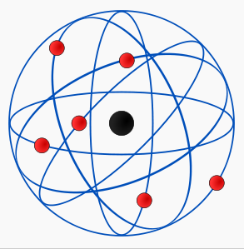
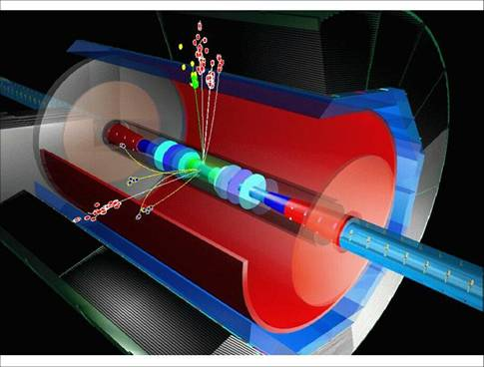
Conclusions:
Selective PHOTOTHERMOLYSIS works according to type of pigment, type of light used and pulse frequency (light + heat + impact power).
Rutherford atomic model
Linear Particle accelerator

Slide 30

LET'S LIGHT THE FUTURE!

Slide 31
Let Us Meet Again
We welcome you all to our future conferences of OMICS International
Please Visit:
http://integrativebiology.conferenceseries.com/
http://conferenceseries.com/
http://www.conferenceseries.com/genetics-and-molecular-biology-conferences.php

