Slide 1
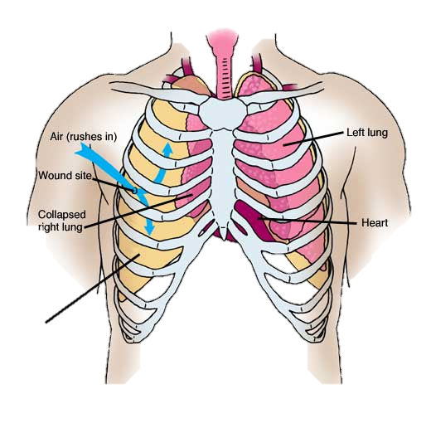
Follow up in Chest Tumors : Value of integrated
PET/CT
By : Dr. Heba Nabil , MSc
Radiology Specialist at Nasser Institute For Research and Treatment
Notes:
T

Slide 2
Introduction

Slide 3
The management of oncology patients depends on
Accurate local staging of tumor spread
Identification of nodal involvement and distant metastases
Assessing treatment plans
Determining prognosis
Evaluating response to treatment.

Slide 4
.
Indications of PET/CT in chest tumors include
Evaluation of the solitary pulmonary nodule
Staging of NSCLC, SCLC, mesothelioma and lymphoma
Monitoring of treatment response
Assessment for recurrent tumor after radio/chemotherapy.

Slide 5
.
Aim of the work
To identify the role of PET-CT in management of chest tumors .

Slide 6
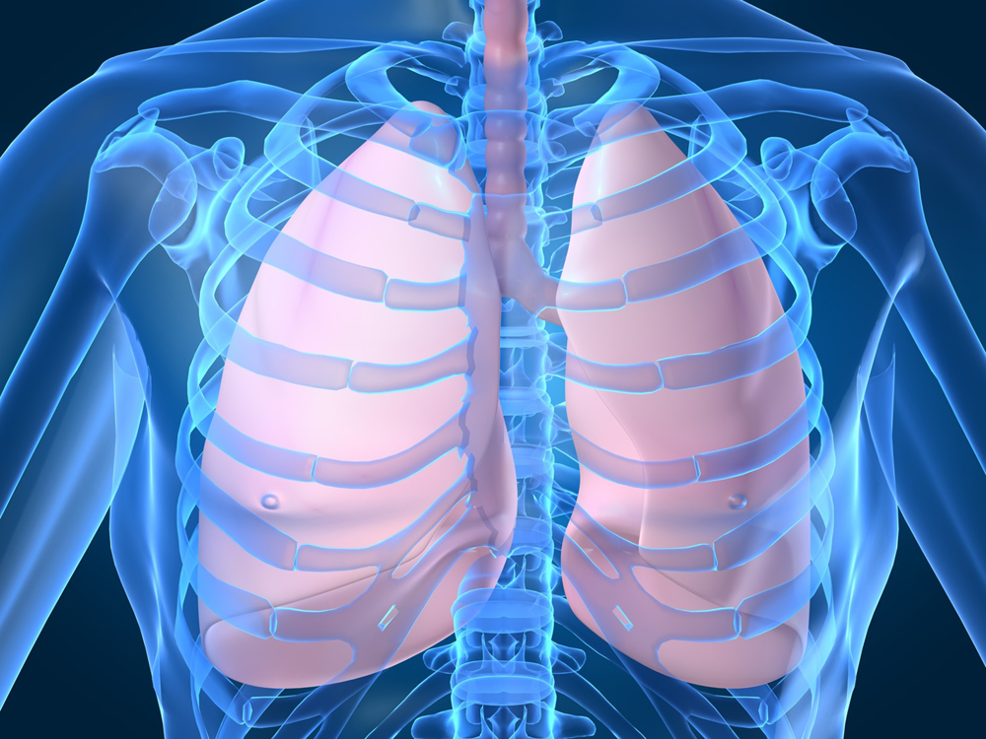
                Anatomy

Slide 7
Lung segments

Slide 8
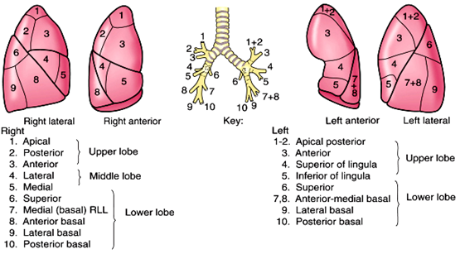

Slide 9
Mediastinum

Slide 10
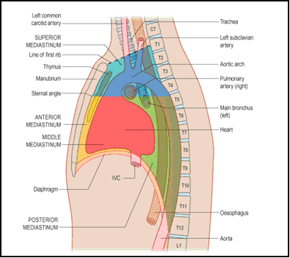

Slide 11
Mediastinal LNs

Slide 12
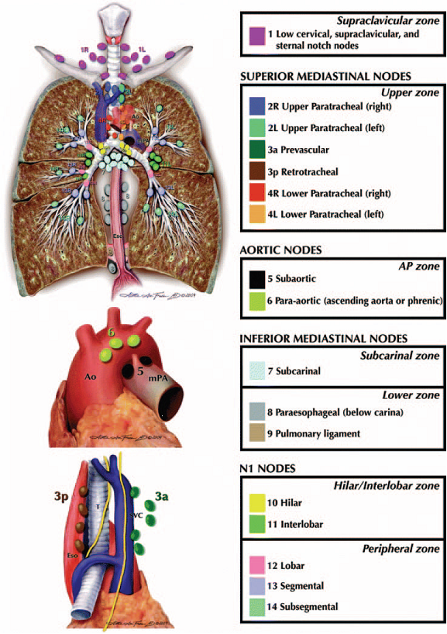

Slide 13
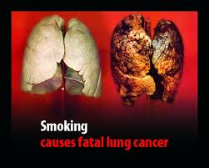
Pathology

Slide 14
Chest tumors are subgroubed into

Slide 15
Lung
Pleura
Mediastinum
Chest wall

Slide 16
Physical Principles

Slide 17
PET is a nuclear medicine imaging modality and belongs to the family of emission CT (ECT) which also includes single photon emission CT (SPECT).
It is a physiological imaging technique that uses radiopharmaceuticals produced by labeling metabolic markers such as amino acids or glucose with positron-emitting radio nuclides such as fluorine-18.
The radio marker is then imaged by coincidence detection of two 511 KeV photons that are produced by annihilation of the emitted positrons.

Slide 18
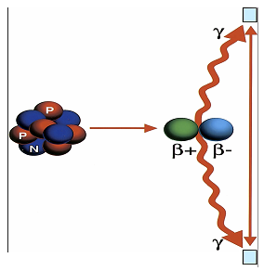
Annihilation reaction:
Positrons (β+) released from the nucleus of FDG annihilate with electrons (β-), releasing two coincidence 511-keV photons (γ), which are detected by scintillation crystals (blue rectangles). N neutron, P proton

Slide 19
Technique

Slide 20
For whole body
PET/CT study
1) CT portion
of the technique
2) PET portion
of the technique
3) PET/CT Fusion &
Image Interpretation

Slide 21
CT Technique
Single-phase contrast material-enhanced helical CT is performed
About 125 ml of a low osmolarity iodinated contrast medium is injected at a rate of 4 ml/sec by using a power injector.
For a typical whole body PET/CT study (neck, chest, abdomen, and pelvis), scanning begins at the level of the skull base and extends caudally to the level of the symphysis pubis

Slide 22
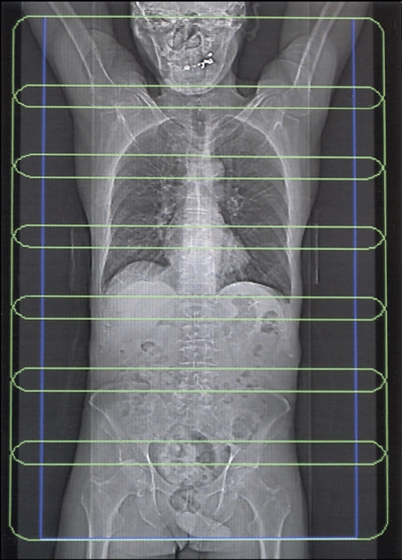
Typical scout image obtained during an FDG PET/CT study.
The blue-purple rectangle represents CT coverage during the study.
Each overlapping green rectangle represents PET coverage.
Six to seven bed positions are required for PET coverage of the neck, chest, abdomen, and pelvis.

Slide 23
PET Technique
The total length of CT coverage is an integral number of bed positions scanned during acquisition of PET data.
PET is performed on a dedicated PET scanner with a 5-minute emission acquisition per imaging level. The images are acquired in a caudocranial direction from the symphysis pubis to the skull base.
Detection of coincidence photons emitted during positron annihilation is the key to PET imaging, whereas accurate co registration of this quantitative/functional information with the CT data is the key to successful PET/CT imaging.

Slide 24
PET/CT Fusion & Image Interpretation:
Workstations have been available serving to overlay the PET and CT images onto one another, properly putting on consideration the anatomical landmarks for excellent fusion between CT and PET images.

Slide 25
PET/CT Fusion & Image Interpretation: ( Cont.)
The volume of data generated is enormous. PET and CT images are first reconstructed. Then reformatted into coronal and sagittal images to facilitate image interpretation. For each of these sets of PET and CT images, corresponding “fusion” images, combining the two types of data.
There are different methods for assessment of radiotracer uptake by normal and pathologic tissues, such as visual inspection and the standardized uptake value (SUV).

Slide 26
Imaging

Slide 27
Indication of PET/CT in lung cancer
Characterizing indeterminate pulmonary nodules.
Staging and restaging of non-small cell lung cancers, including lymph node metastasis and distant metastasis to adrenal glands or bone.
Evaluating for recurrent disease.
Planning for radiation therapy.

Slide 28
Materials and Methods

Slide 29
Patients
This is a cross sectional study carried out at Nasser Institute from May 2011 to May 2013 .It included 32 patients.
The inclusion criteria for our study were the following:-
patients who were suspected to have primary or secondary chest tumors by recent CT, referred for staging before treatment and or follow up after treatment.
the exclusion criterion was for uncontrolled diabetic patients
The whole study population included 32 patients of variable primary & secondary chest malignancies

Slide 30
Patients included performed one or more of the following: 4 patients out of 32 patients had initial PET/CT for staging, intermediate PET/CT and end of treatment PET/CT and follow up, 24 patients out of 32 patients had intermediate PET/CT and end of treatment PET/CT and follow up and 7 patients out of 32 patients had intermediate PET/CT study.
The study population was split into two major groups:

Slide 31
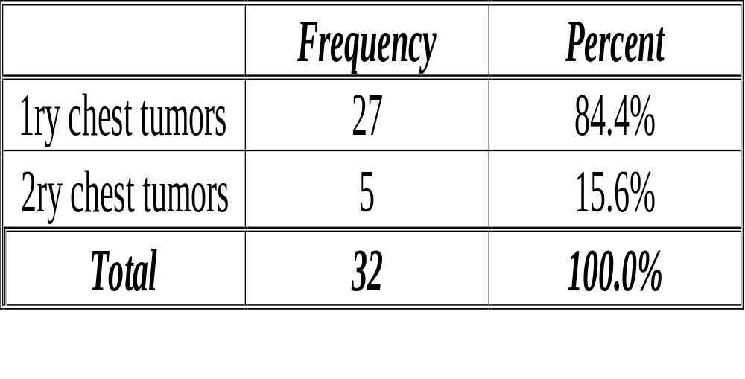

Slide 32
Number of patients | Age range | Sex | Preliminary diagnosis
32 | 14-65 | 19 male 13 female | 27 primary chest tumors 8 lung tumors 2 pleural tumors 3 chest wall tumors 7 mediastinal tumors 7 lymphoma 5 secondary chest tumors

Slide 33

Results

Slide 34
Aim of the study | Frequency | Percent
Assessement before Preparation for BMT | 2 | 6.3 %
Assessement of locoregional recurrence/residue or distant metastasis | 3 | 9.4%
Assessment of activity of the residual mass | 1 | 3.1%
Assessment of treatment response | 19 | 59.4%
Determination of treatment line | 1 | 3.1 %
differeniate between residue or irradiation pneumonitis | 1 | 3.1%
Follow up | 5 | 15.6%
Total | 32 | 100.0%

Slide 35
28 patients received CTH, 14 received RTH and 12 patients underwent surgery,It is to be noted that in most of patients received mixed lines of treatment that mentioned formerly
CT images were analyzed and we found that

Slide 36
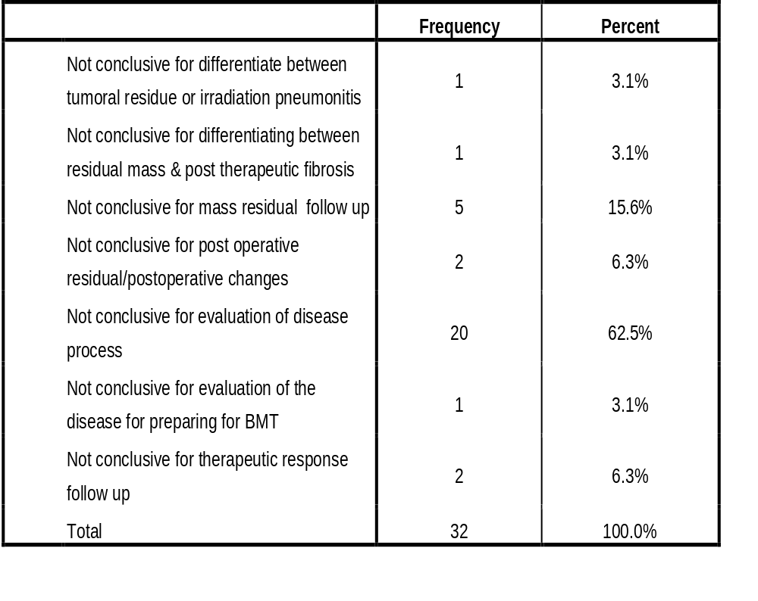

Slide 37
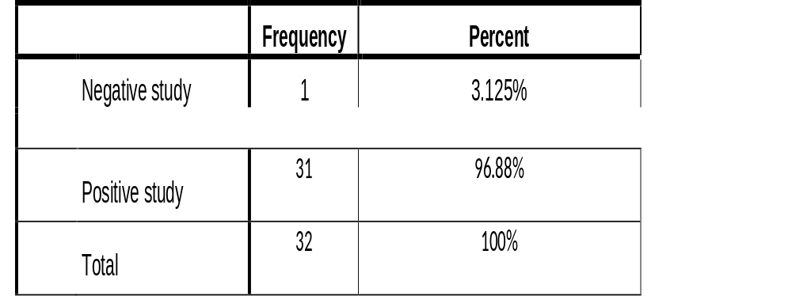
Then the fused PET/CT images were analyzed

Slide 38
And we reported findings beyond PET/CT resolution in 2 patients out of 32 patients in the form of multiple subcentimetric pulmonary nodules

Slide 39
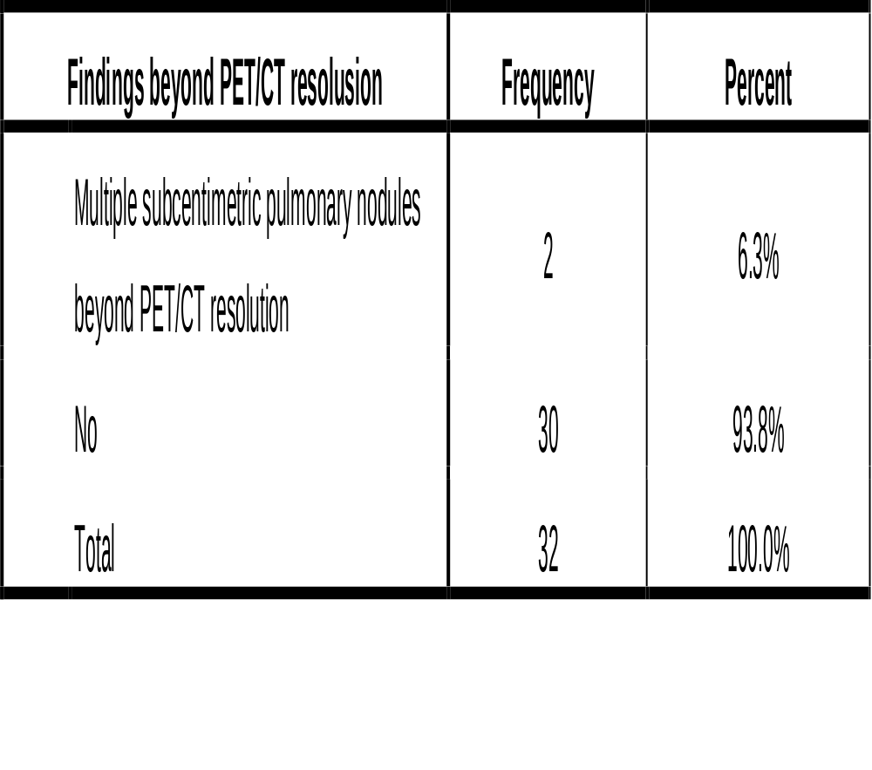

Slide 40
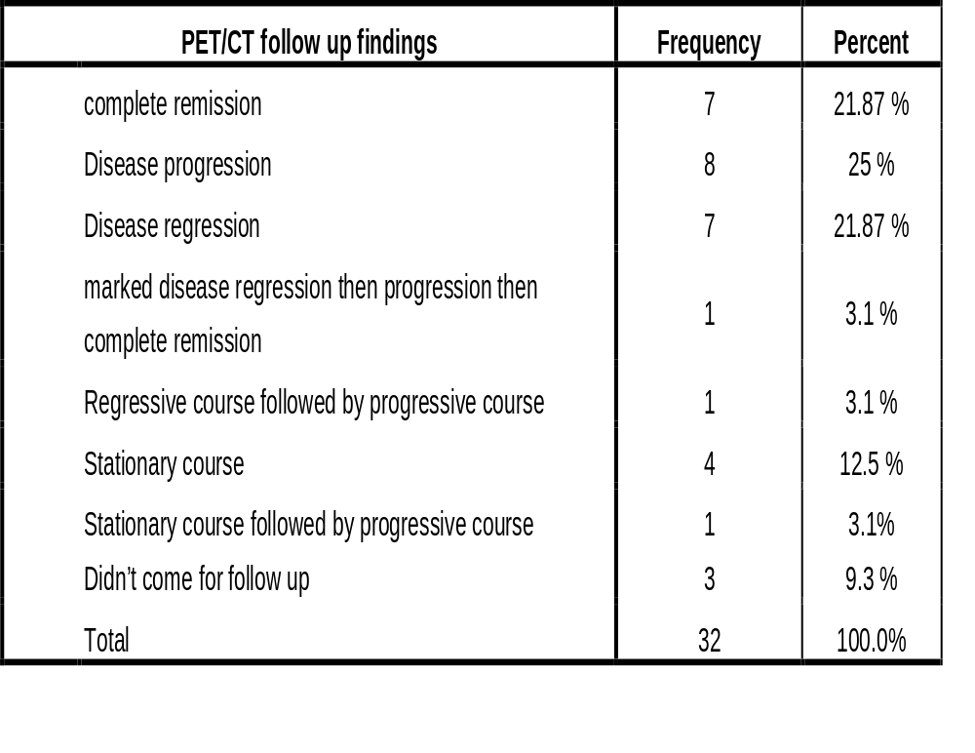

Slide 41
According to these findings 9 patients out of 32 patients were cured &23 patients out of 32 patient were still on treatment

Slide 42
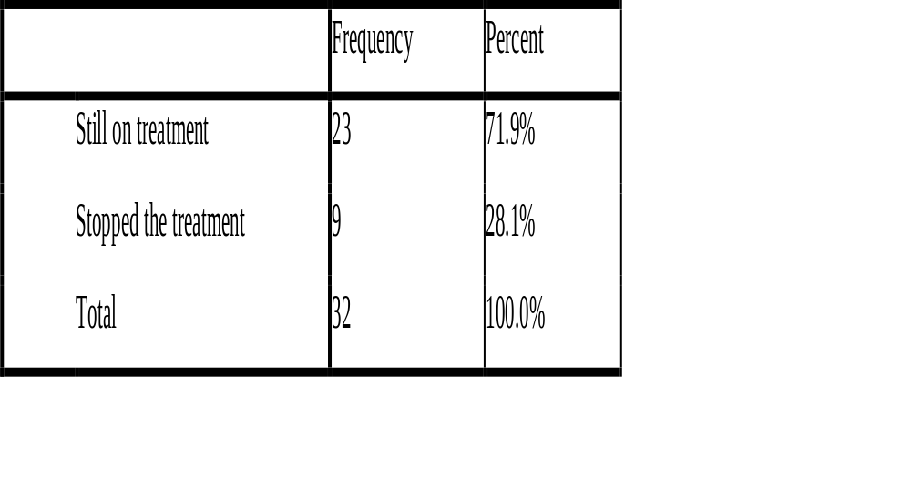

Slide 43
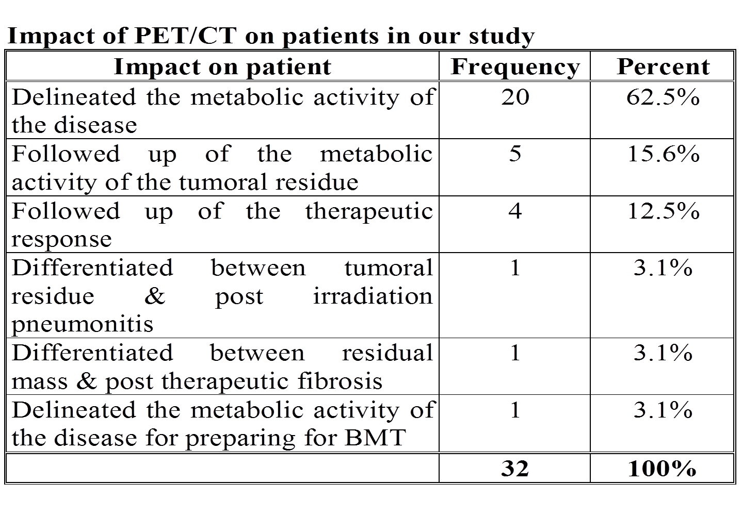

Slide 44
Illustrative Cases

Slide 45
Case 1

Slide 46
Male patient, 49 years old, known to have lung cancer. Received chemotherapy PET/CT scan was requested for assessment of treatment response. PET/CT scan: revealed multiple metabolically active FDG avid wide spread lesions at the RT kidney, lungs (with lymphangitis carcinomatosa) as well as multiple abdominal & mediastinal LNs
3 months follow up study: rather stationary course.

Slide 47
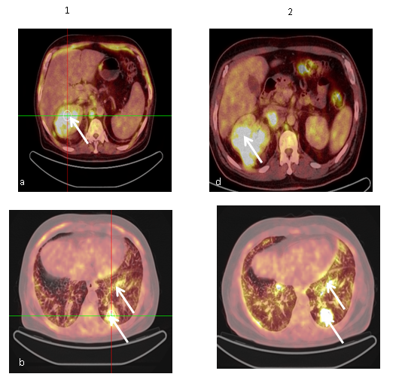

Slide 48
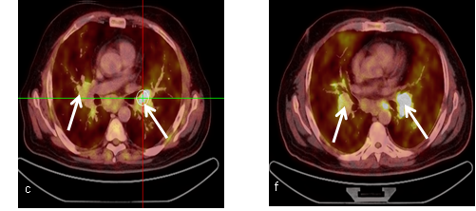

Slide 49
Case 2

Slide 50
Male patient, 57 years old, known to have left lung adenocarcinoma. received chemotherapy & radiotherapy The patient was referred for assessment of the treatment response PET/CT scan: revealed metabolically active FDG avid residual primary lung tumor with hepatic & left suprarenal deposits.9 months follow up study: Regressive course of the MA FDG avid residual left lower lung lobe as well as the distant metastasis

Slide 51
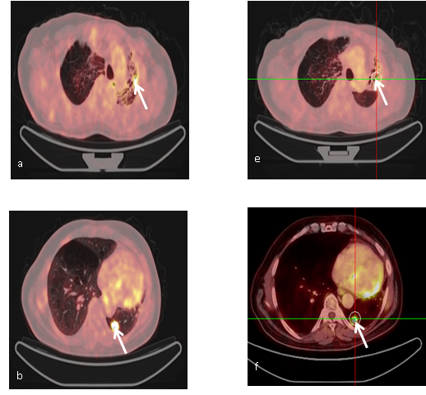

Slide 52
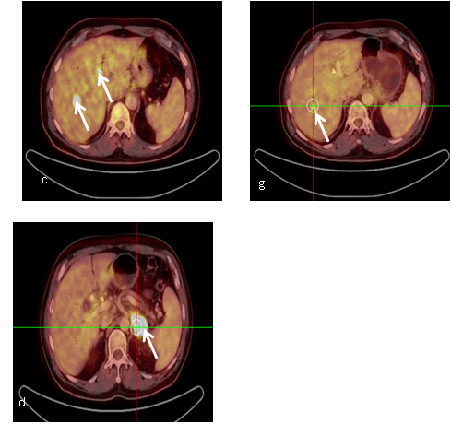

Slide 53
Case 3

Slide 54
Male patient, 42 years old, known to have left mesothelioma. The patient received chemotherapy& radiotherapy after surgical excision and was referred for assessement of treatment response. PET/CT scan: metabolic active FDG avid local tumoral recurrence at the mediastinal pleura with nodal, hepatic & muscular deposits.

Slide 55
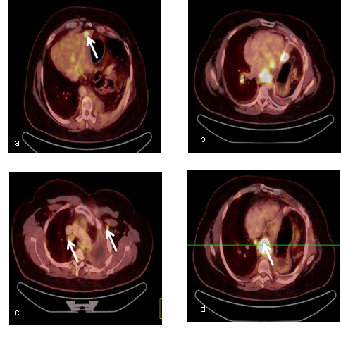

Slide 56
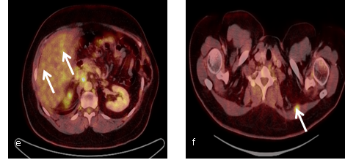

Slide 57
Case 4

Slide 58
A female patient, 29 years old, known case of HD received chemotherapy was referred for assessement of treatment response PET/CT scan: MA FDG avid multiple nodal lesions above the diaphragm

Slide 59
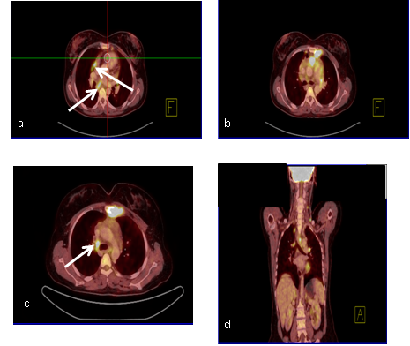

Slide 60
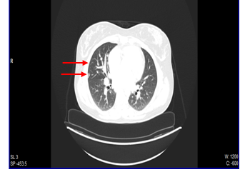

Slide 61

Summary & Conclusion

Slide 62
PET/CT imaging is changing the care of patients with lung cancer in several ways:

Slide 63
Metabolic and anatomic whole-body staging of patients can be performed in one examination and much reduced scan times, thus, increasing patient comfort.

Slide 64
2. Because of limited patient motion, near ideal fusion of metabolic and anatomic images can be achieved.

Slide 65
3. Anatomic landmarks provided by CT will greatly facilitate the assignment of functional abnormalities to anatomic structures.

Slide 66
4. ‘’ Difficult to image" regions of the body (such as the head and neck and mediastinum) will be evaluated with a high diagnostic accuracy.

Slide 67
5.Fused images can be used to target radiation treatment more accurately and monitor the effects of chemotherapy, surgery, and radiation treatment.

Slide 68
By recognizing the relevant radiologic appearances of chest tumors, understanding the appropriateness of staging disease with the TNM classification system, and being familiar with potential imaging pitfalls, radiologists can make an important contribution to treatment and outcome in thoracic cancer patients.

Slide 69

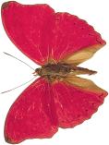


Thank You

