Slide 1

Evaluation of antitumor potential and expression of p53/p16 genes in Ehrlich solid carcinoma bearing mice treated with magnetite nanoparticles
Dr/ Heba Bassiony Atwa Mohamed
PhD.
Lecturer
Zoology Department, Faculty of Science,
Cairo University

Slide 2
Introduction
Breast cancer
Most prevalent malignancy among women.
About 11.9% of cancers worldwide.
Second leading cause of cancer-related deaths after lung cancer.
About 458,000 deaths each year (WHO, 2014).
In Egypt, 37.7% among females cancers.

Slide 3
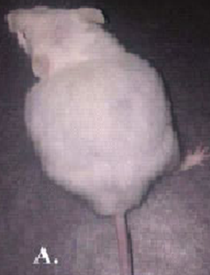
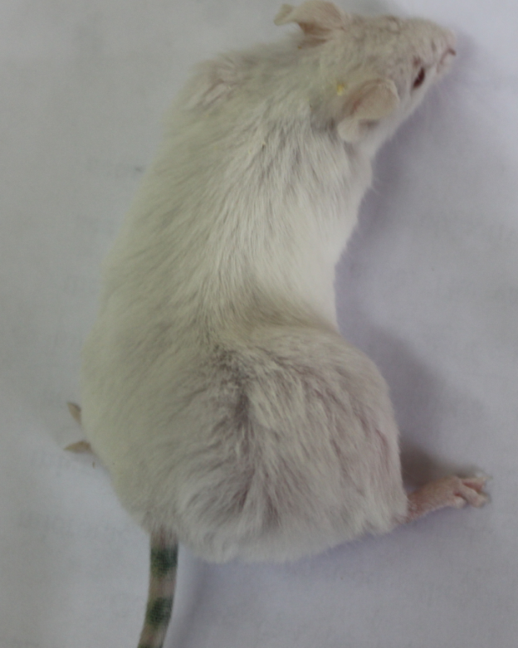
Ehrlich tumor
Experimental breast cancer model
Aacites (EAC) Solid tumor (ESC)

Slide 4
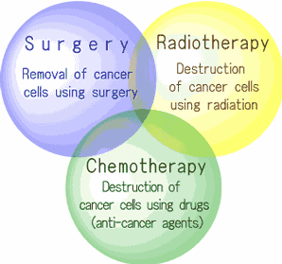
Cancer treatment
http://www.nptc.city.nagoya.jp/e_proton/e_radiotherapy.html

Slide 5
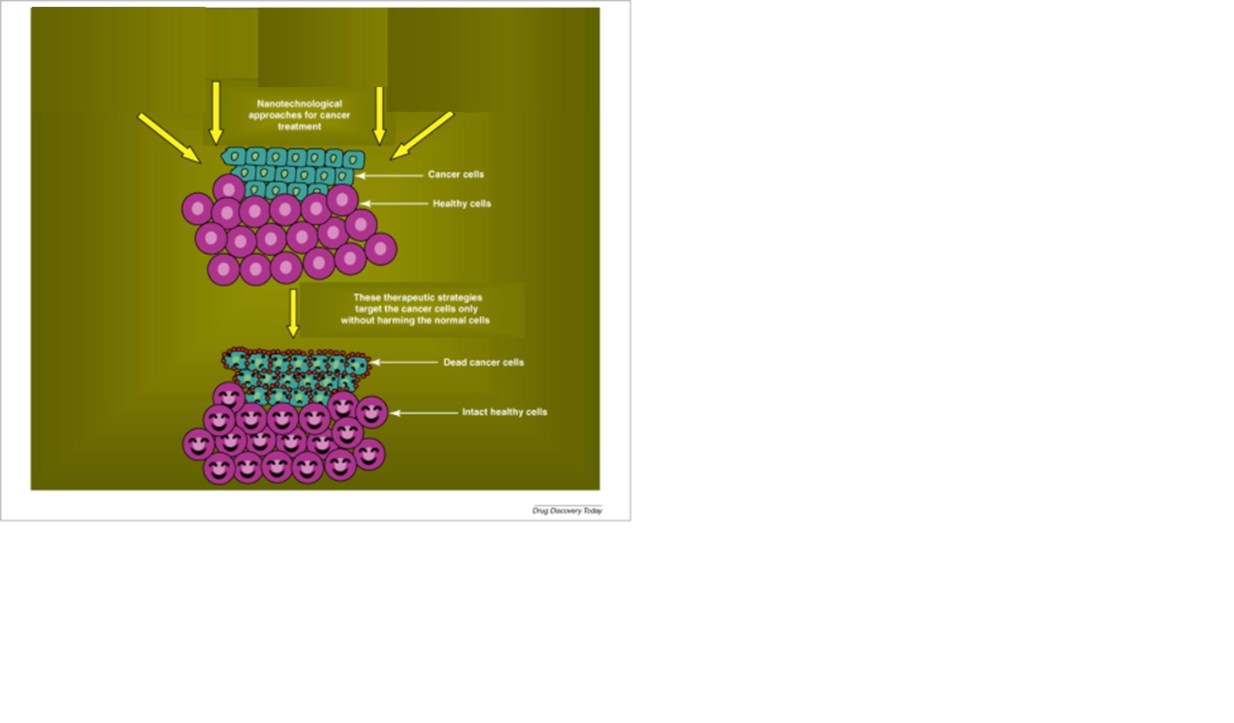
Nanotechnology
http://www.drugdiscoverytoday.com/view/15998/cancer-nanotechnology-application-of-nanotechnology-in-cancer-therapy/

Slide 6
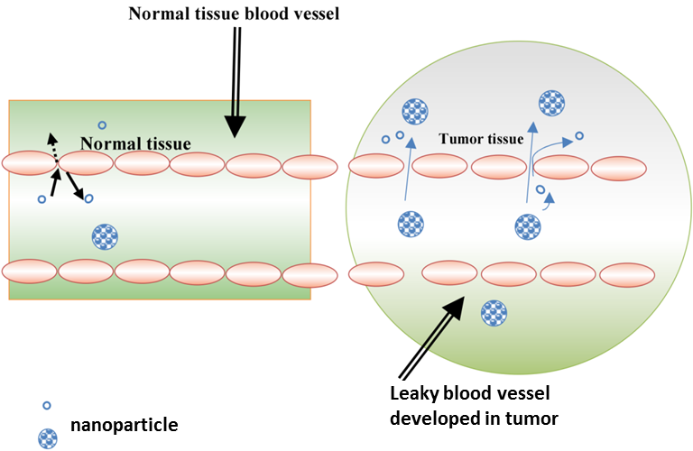
Difference between Normal and Cancer cells

Slide 7
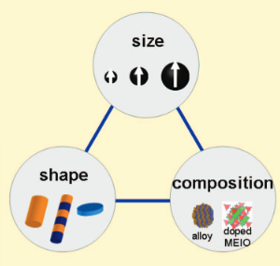
NPs effect depends on

Slide 8
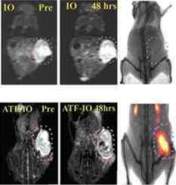
Iron Oxide NPs
• Wüstite (FeO)
• Fe₂O₃
o hematite (α-Fe₂O₃)
o β-Fe₂O₃
o maghemite (γ-Fe₂O₃)
o ε-Fe₂O₃
Magnetite (Fe₃O₄)
Most significant in biomedical research
Why ?
Magnetic Resonance Imaging (MRI)

Slide 9
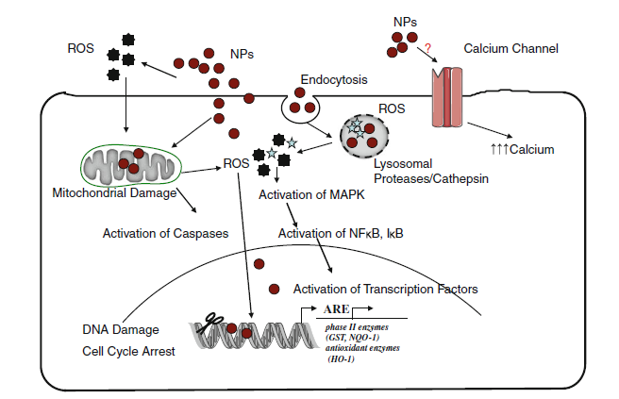
Nanoparticles affect DNA and alter gene expression

Slide 10
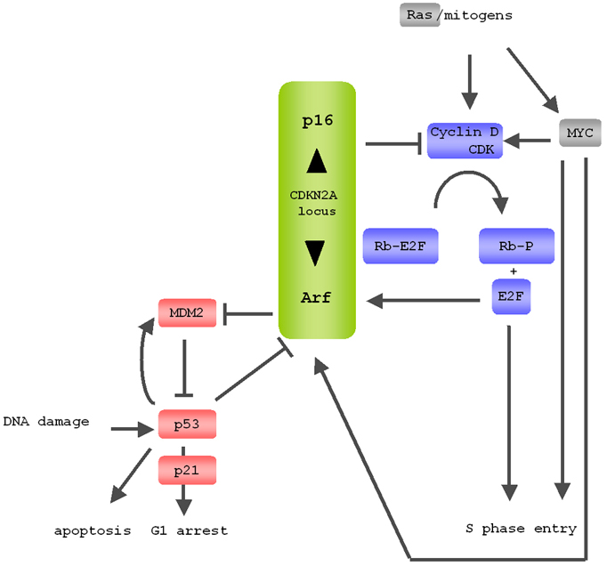
Tumor suppressor genes (p53 and p16)
p53 and p16 deficiency cooperate in tumorigenesis
x
x
x

Slide 11
Aim of Work
MNPs
Use ESC Antitumor activity
MNPs Distribution (by ICP)
MNPs Histopathological changes (by H&E)
MNPs DNA damage (by Comet assay)
MNPs Expression of p53 & p16 (mRNA & protein)

Slide 12
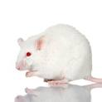
Experimental Design
Swiss female albino mice
(6 mice in each group)
IP-MNPs
Control
Group 6
Group 3
Group 2
Group 1
Group 4
Group 5
ESC
ESC + IP MNPs
IM-MNPs
ESC + IT MNPs
Dose was 60 mg/k
Termination for all mice after 9 injections of MNPs day by day

Slide 13
1.
MNPs
2.
Mice growth
3. Tumor growth
Results
4.
Iron distribution
5.
Histopathology
Muscles
Liver
Brain
Spleen
Kidney
Lung
ESC
6. Comet
7.
Genes expression
8.
Protein expression
Muscles
p53
P53
ESC
Liver
Brain
p16

Slide 14
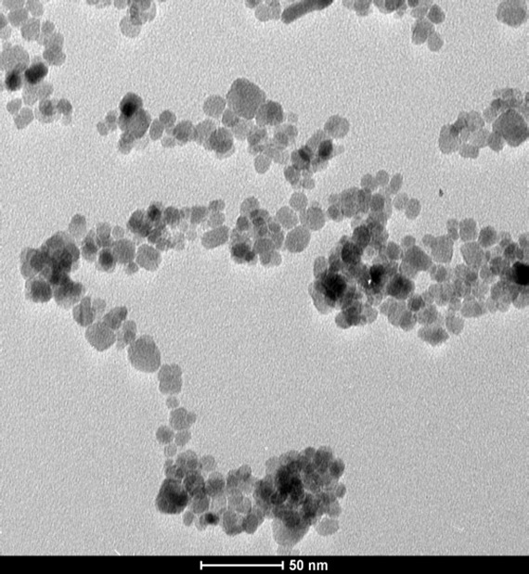
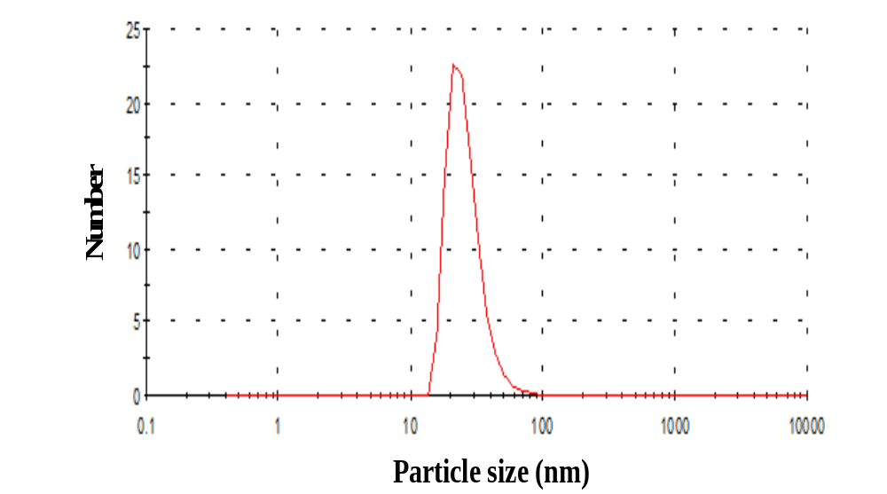
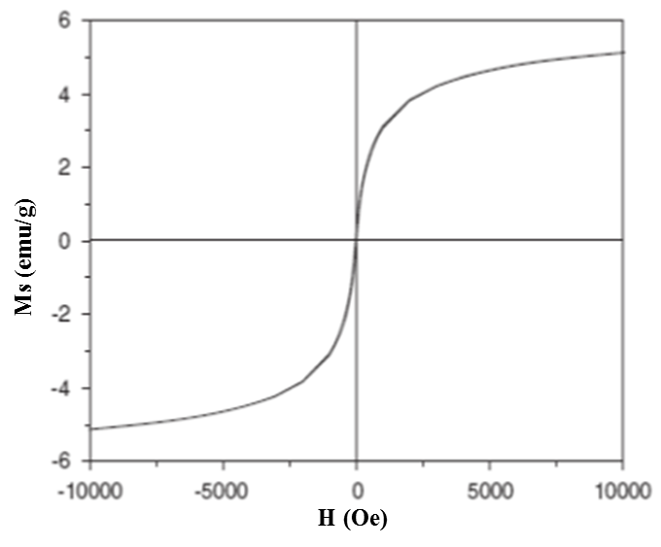
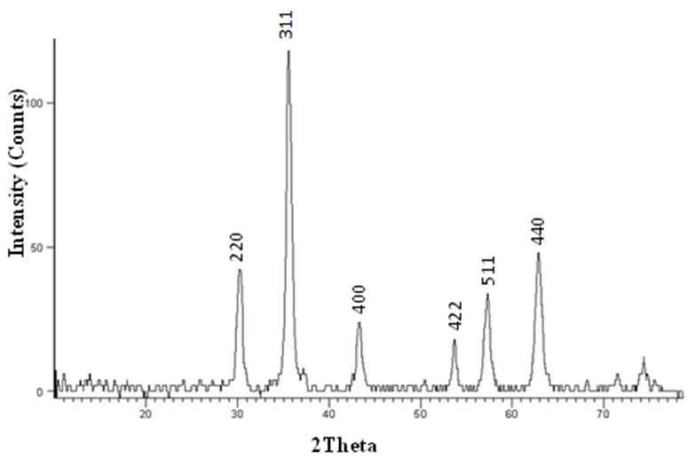
1. Characterization of MNPs
25.8 nm
20.0 ± 2.0 nm
HR-TEM
PSA
VSM
XRD

Slide 15
2-Mice growth rate
No signs of toxicity were observed in all mice groups

Slide 16
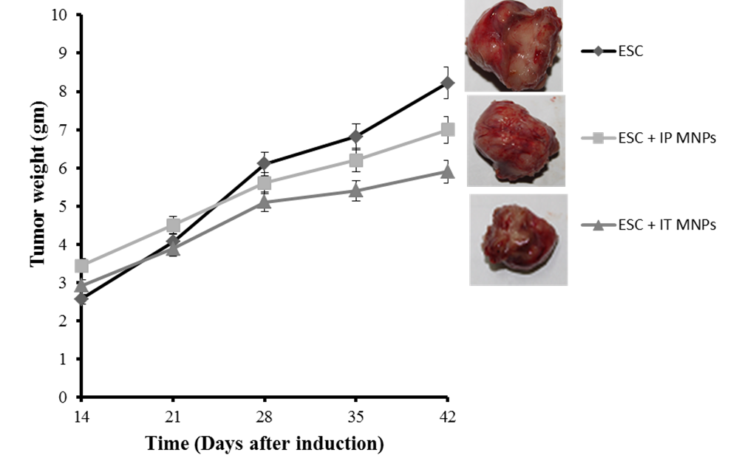
3-Tumor growth rate
Growth inhibition of ESC was 47.35 % for IT-treated and
37.1 % for IP-treated

Slide 17
4- MNPs biodistribution

Slide 18
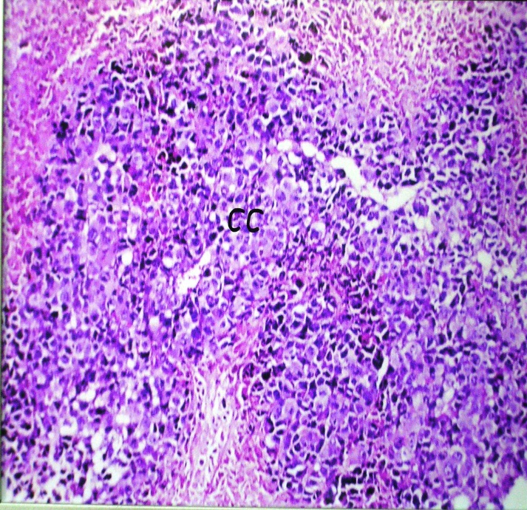
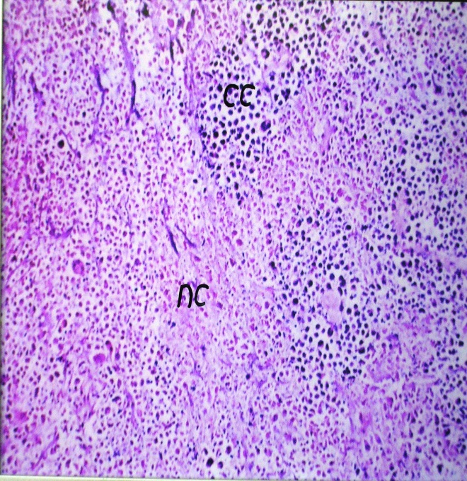
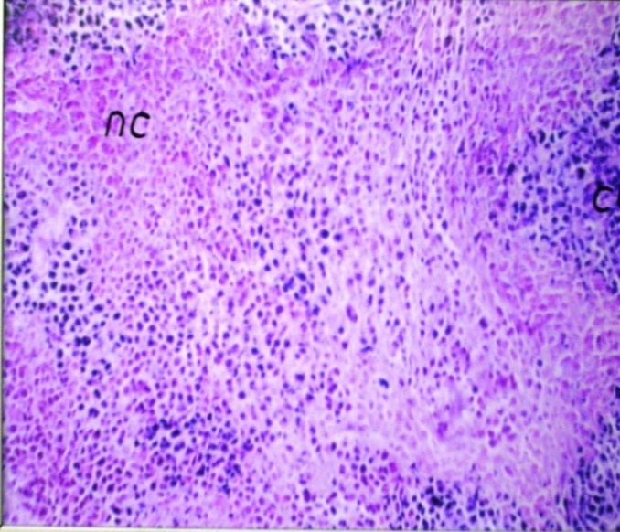
5- Histopathology (H&E)
ESC
ESC
ESC + IP MNPs
ESC + IT MNPs
60%
40%
40X
40X
40X
cc= cancer cells
nc= necrotic cells

Slide 19
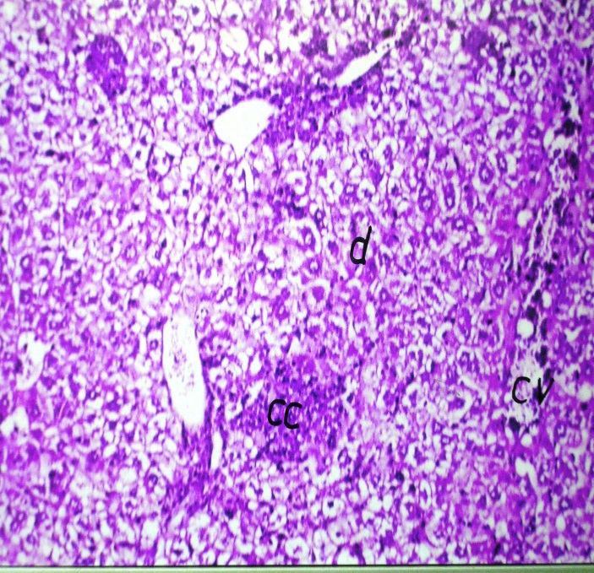
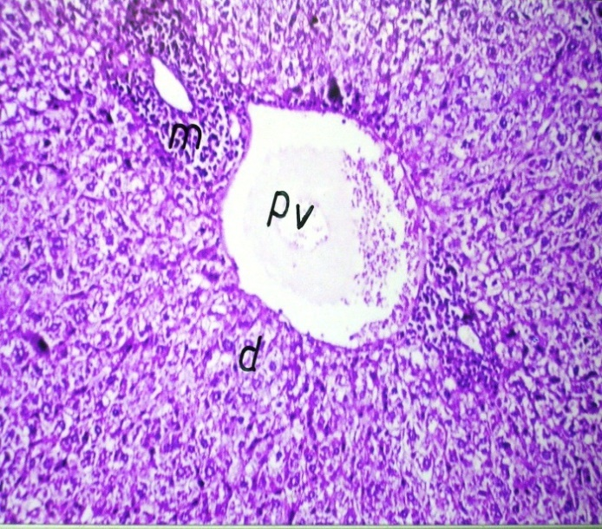
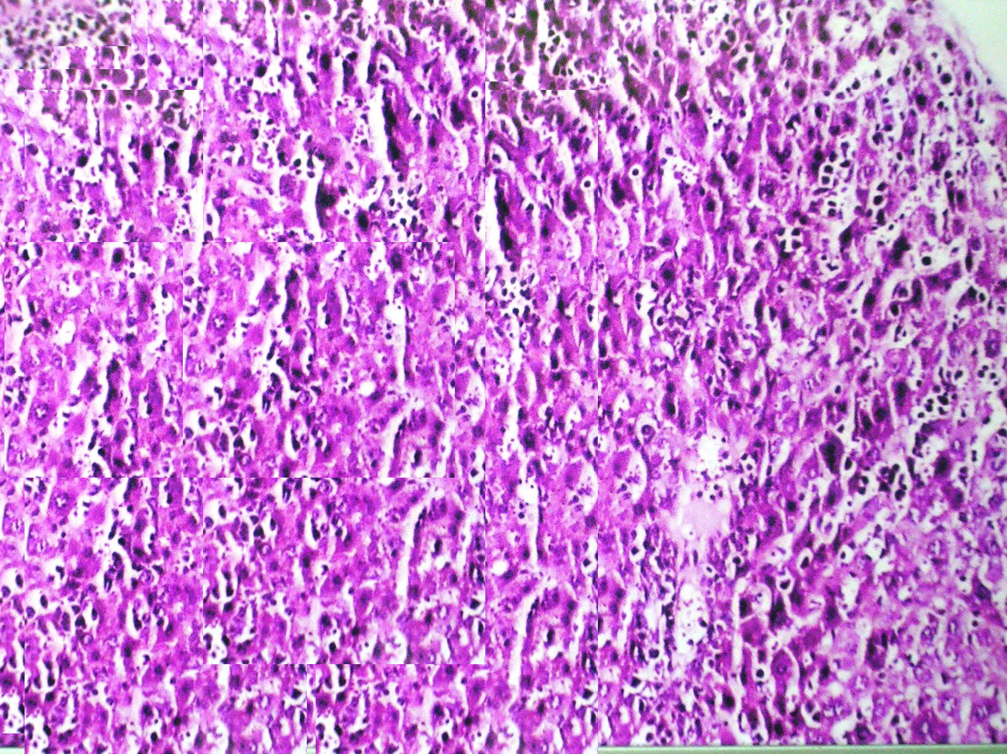
Liver
ESC
ESC + IP MNPs
ESC + IT MNPs
40X
40X
40X
cc= cancer cells
m=inflammatory cells

Slide 20
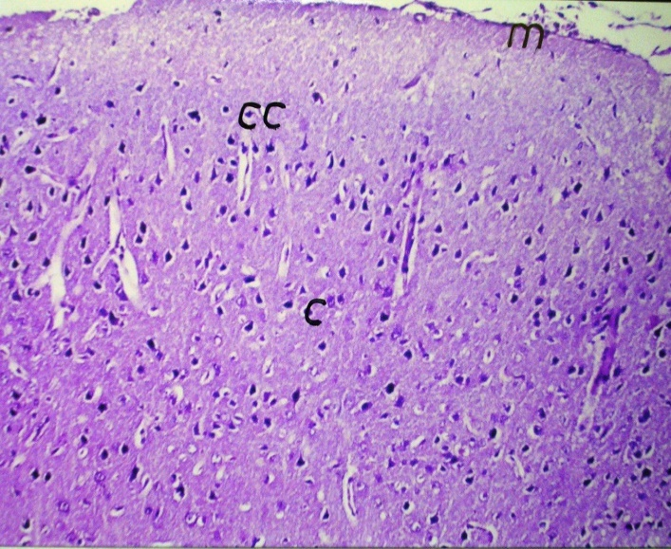
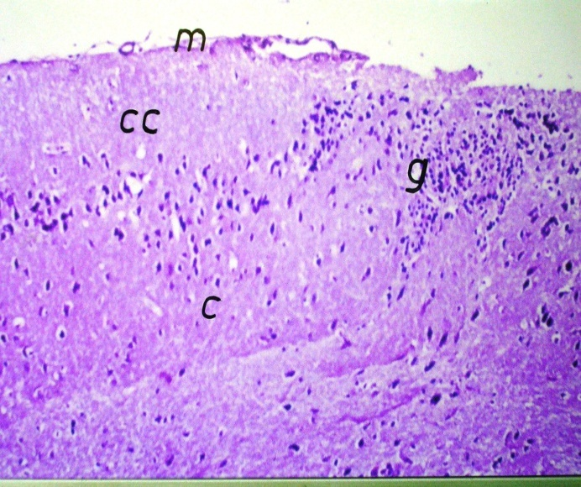
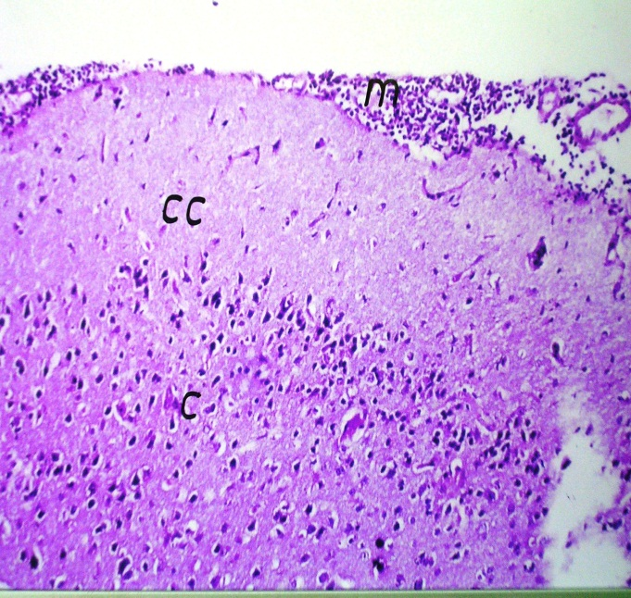
Brain
ESC
ESC + IP MNPs
ESC + IT MNPs
40X
40X
40X
g=gliosis

Slide 21
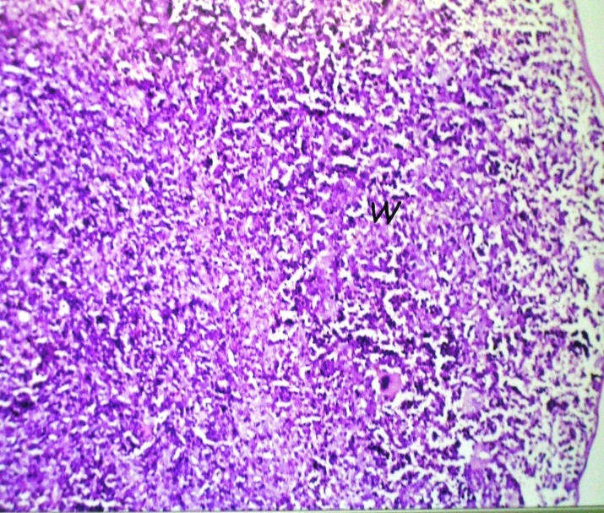
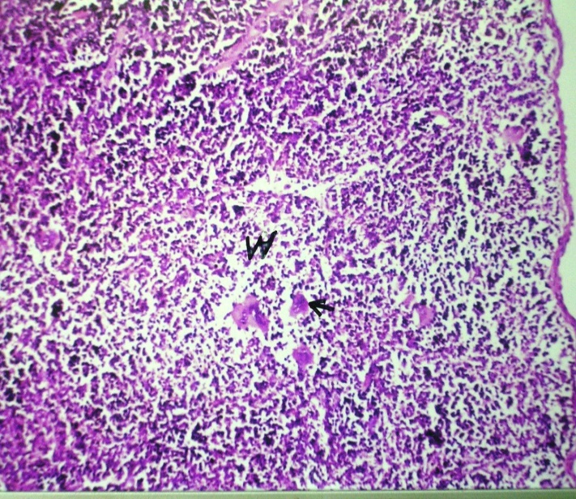
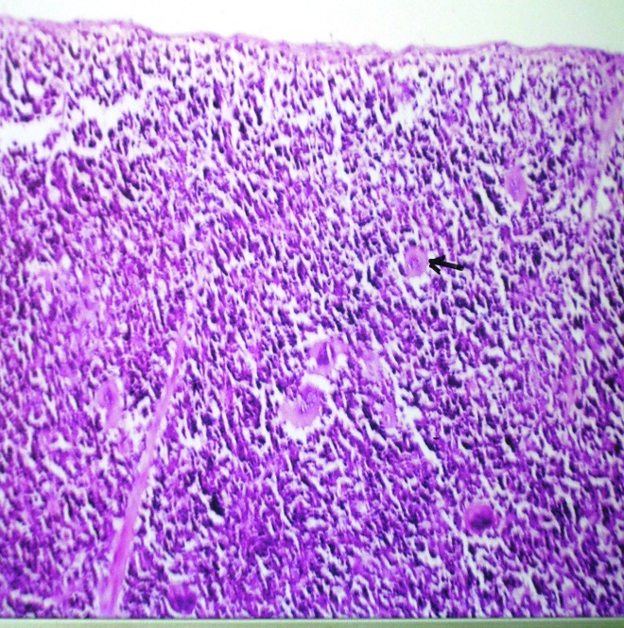
Spleen
ESC
ESC + IP MNPs
ESC + IT MNPs
40X
40X
40X
arrow= karyomegaloblast

Slide 22
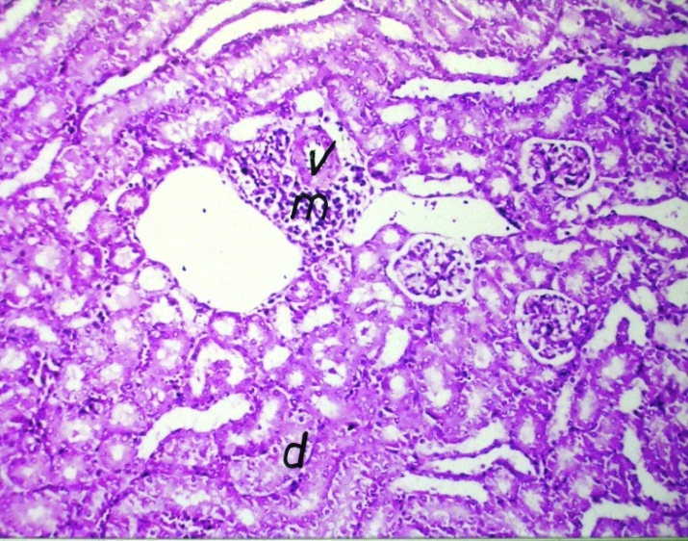
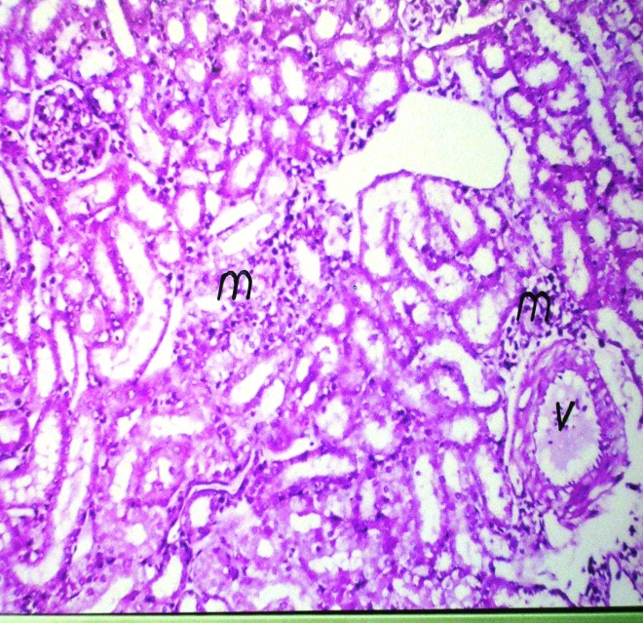
Kidney
ESC
ESC + IP MNPs
ESC + IT MNPs
40X
40X
40X
m=inflammatory cells
D= degeneration
m=inflammatory cells

Slide 23
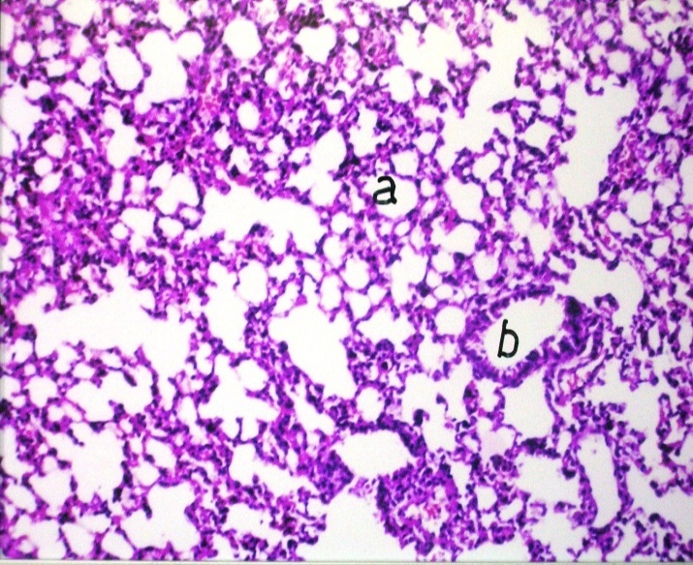
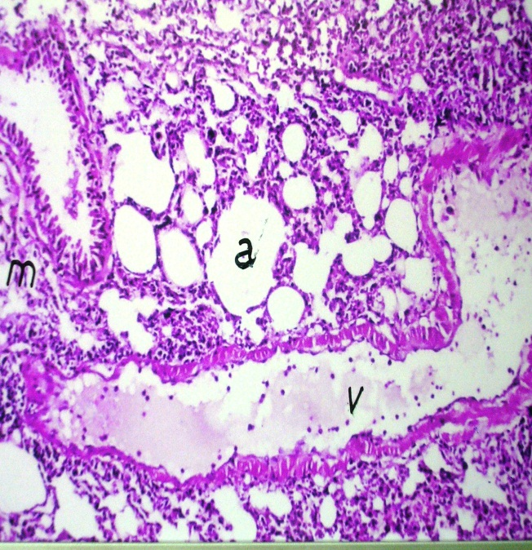
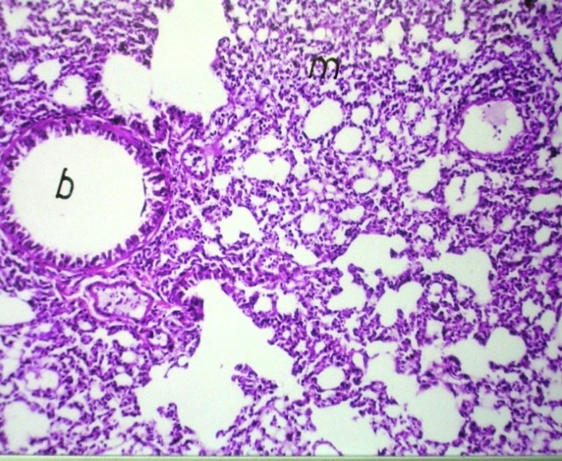
Lung
ESC
ESC + IP MNPs
ESC + IT MNPs
40X
40X
40X
a= emphysema
V=vessel dilatation
m=inflammatory cells

Slide 24
6- Comet assay
Photomicrograph showing typical nuclei with various degrees of DNA damage observed as comet. 400X
A
B
C
D
E
F

Slide 25
MNPs induced DNA damage
in ESC
in Liver
*
*
NOT in Brain
* Statistically significant vs control

Slide 26
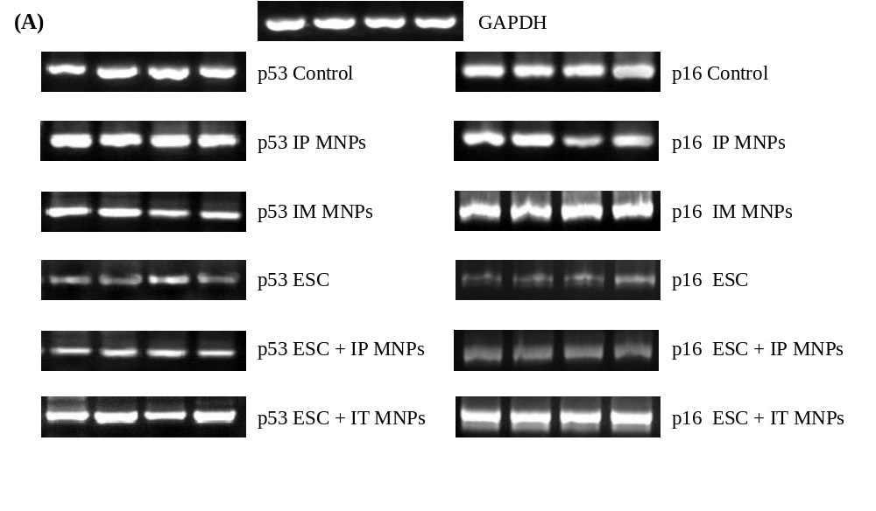
7- Changes in expression of p53 and p16 genes
MNPs p53 and p16 mRNA in ESC compared to the control
by semiquantitative conventional PCR.
p53
p16

Slide 27
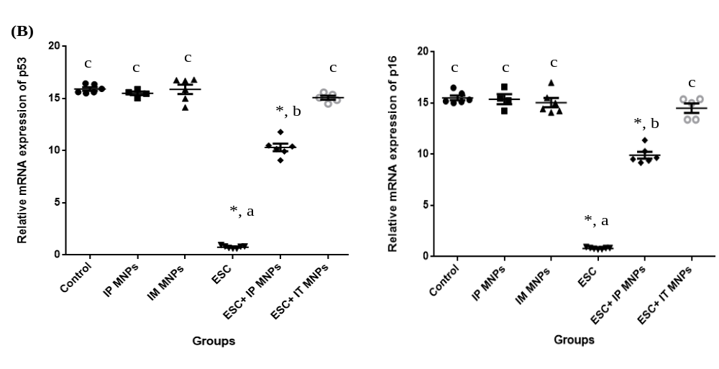
MNPs p53 and p16 mRNA in ESC compared to the control
by Real time PCR
p53
p16

Slide 28
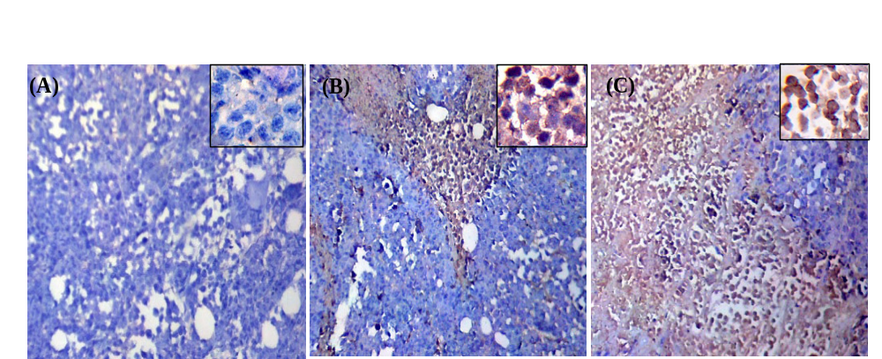
8- MNPs p53 protein level in ESC tissues
by Immunohistochemistry
ESC
ESC + IP MNPs
ESC + IT MNPs
10X
10X
10X
negative staining for p53
moderate expression of p53 (++)
overexpression of p53 (+++)

Slide 29
Conclusion
MNPs
Tumor growth
IT injection had more necrotic effect on tumor cells with low toxicological effects
Expression of p53 and p16 genes
But, Induced inflammatory responses in organs
Induced p53 DNA damage or apoptosis
MNPs may be useful in breast cancer treatment.

Slide 30
Recommendation
IT injection of MNPs is preferable to direct these NPs to tumor tissues and avoid their side effects on the normal tissues.
More investigation for other tumor suppressor genes and oncogenes.

Slide 31
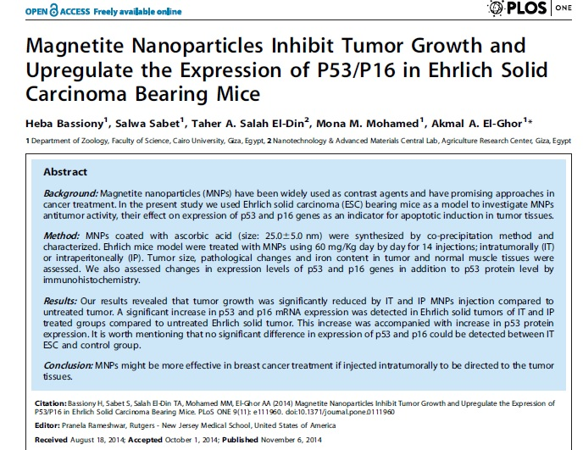

Slide 32


Slide 33


