Slide 1
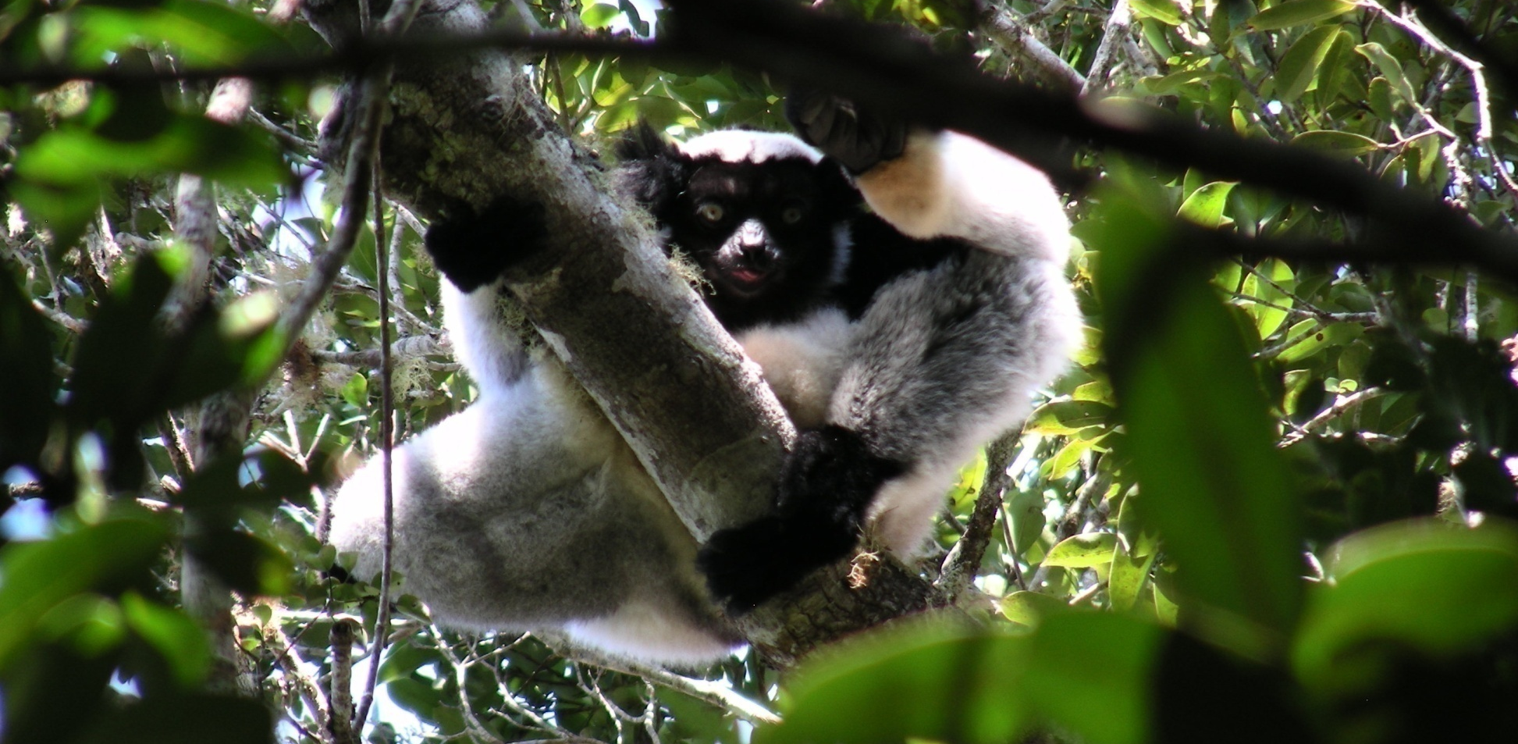
Designing Protected Areas to Conserve Biodiversity:
A Case Study of the Malagasy Lemurs
Heather Peacock, Steig Johnson, Darren Bender
3rd International Conference on Biodiversity & Sustainable Energy Development 2014

Slide 2
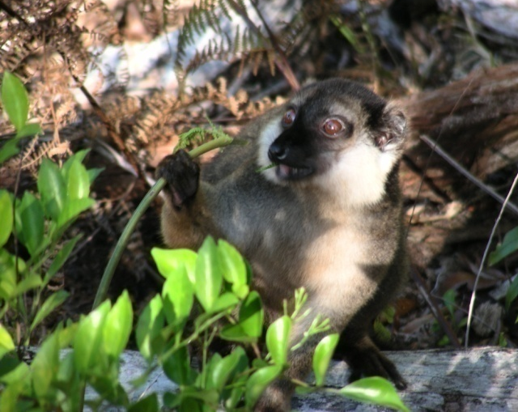
Lemurs – Madagascar’s Primates
Highly diverse: 101 recognized species
Arboreal primates
Range of:
  Sizes: 30 g to ~7 kg
  Activity pattern
  Foraging strategies
  Social structure
  Female dominant
  Umbrella species

Slide 3
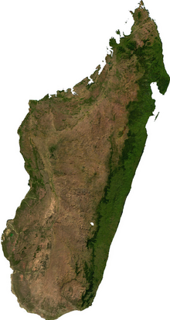
Madagascar =
Global Conservation Priority
Species Diversity
“Hotspot”
Species Endemism
101 lemur species
94% at risk of extinction
Higher Order Endemism
Habitat Diversity
High Rates of Forest Loss

Slide 4
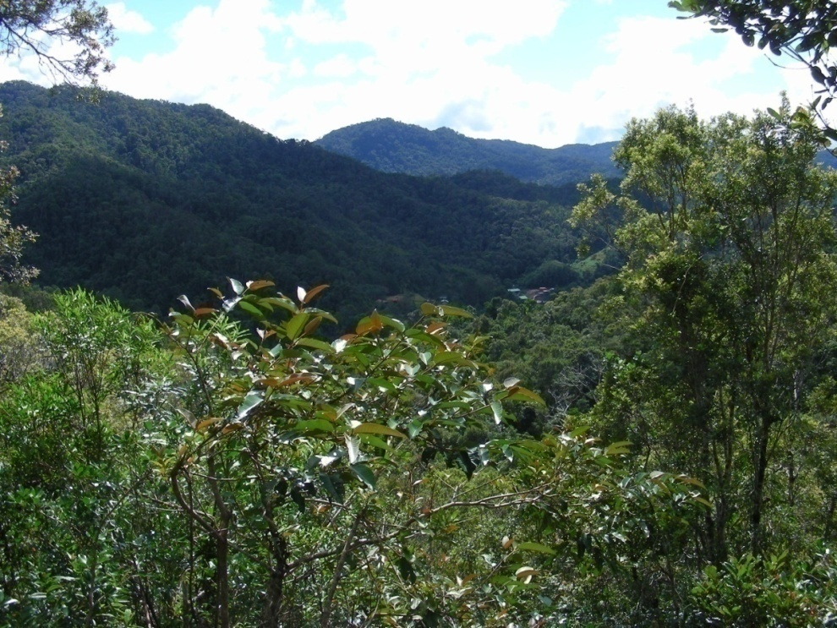
Protected Areas
One of the most successful measures implemented for the conservation of biodiversity
Often selected opportunistically
  Undevelopable land
  Lower cost to acquire
  Not necessarily to protect species
    Recreational or cultural value
Varying levels of protection –
  IUCN categories
  Most with some recreational use or resource extraction

Slide 5
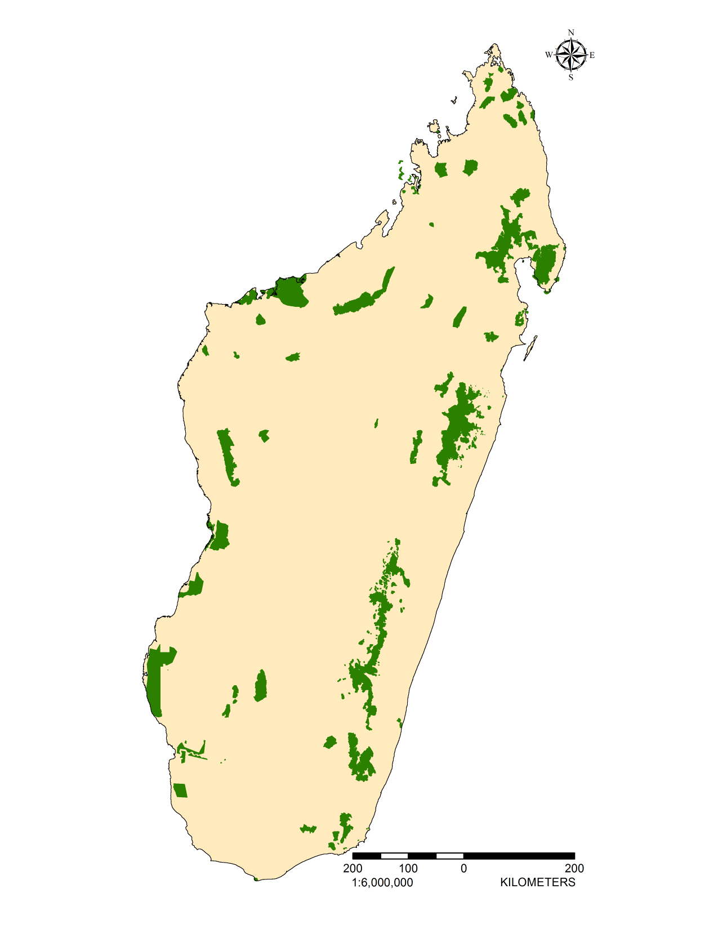
Protected Areas of Madagascar
PAs cover 41,633 km²
~ 7-8% of Madagascar
(WDPA 2009)

Slide 6
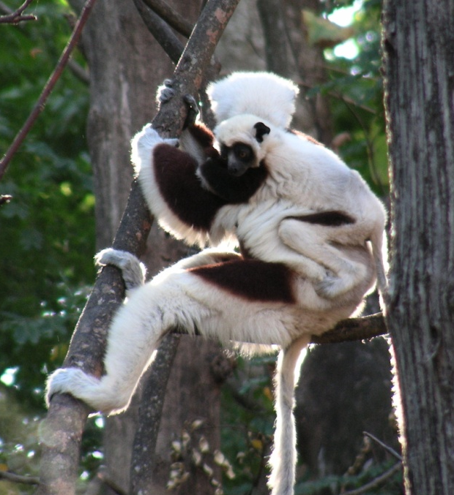
Conservation Planning
Systematic methods/models
  Select PAs to maximize biodiversity protection
  Consider size, shape, connectivity, location and cost
Determine patterns of diversity
Set conservation targets
Evaluate current reserve system
Fill in the gaps to meet targets
Prioritize where to focus efforts

Slide 7
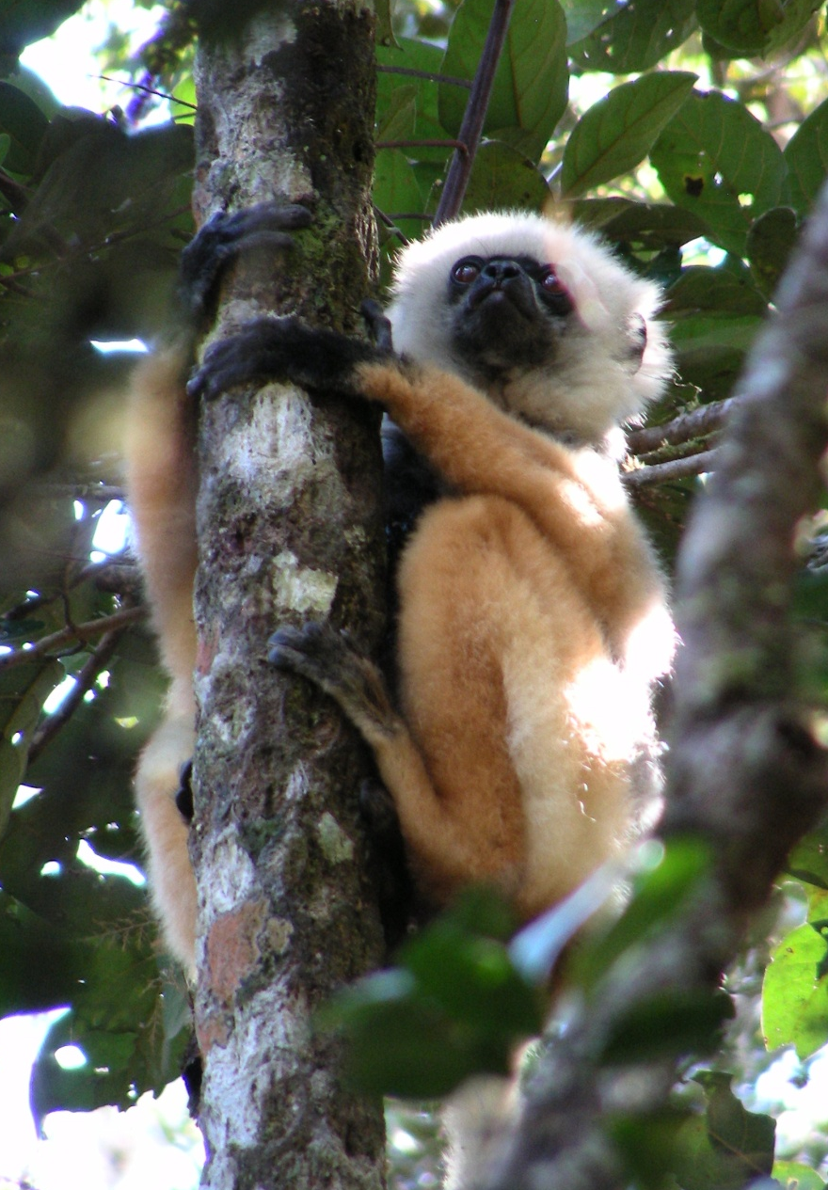
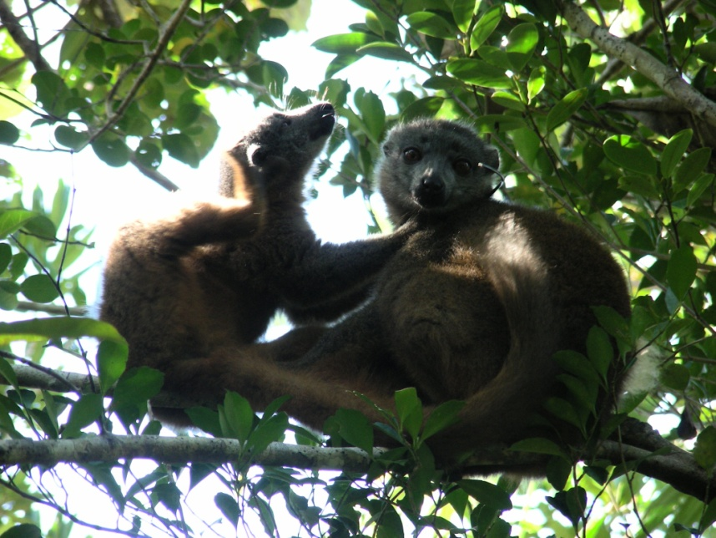
Research Goal
Determine if PAs in Madagascar represent lemur diversity effectively

Slide 8
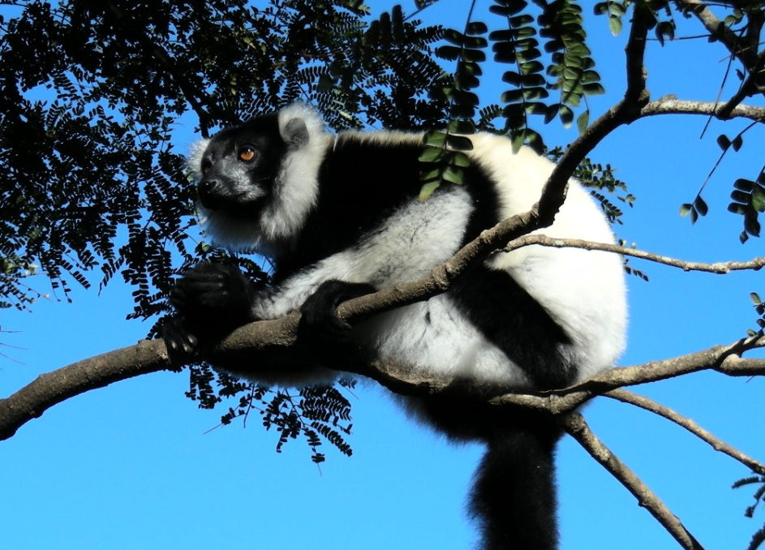
Research Questions
What are the patterns of lemur diversity?
How much of lemur geographic ranges are protected within the existing PA network?
Does the PA network include sufficient lemur habitat to be adequately protected?
If not, where can the PAs be expanded so that they do?
Where are the priority areas to conserve first?

Slide 9
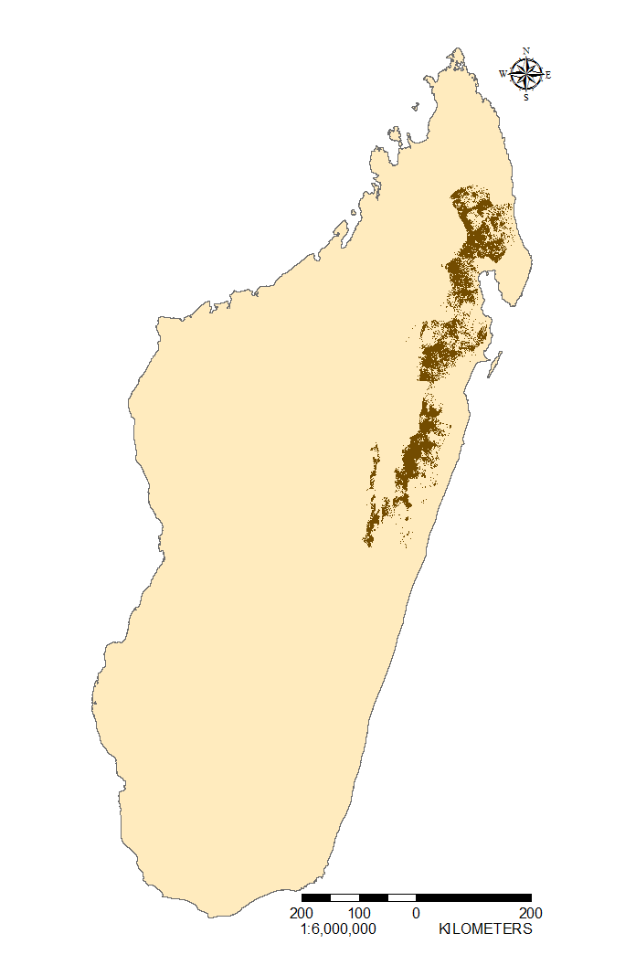
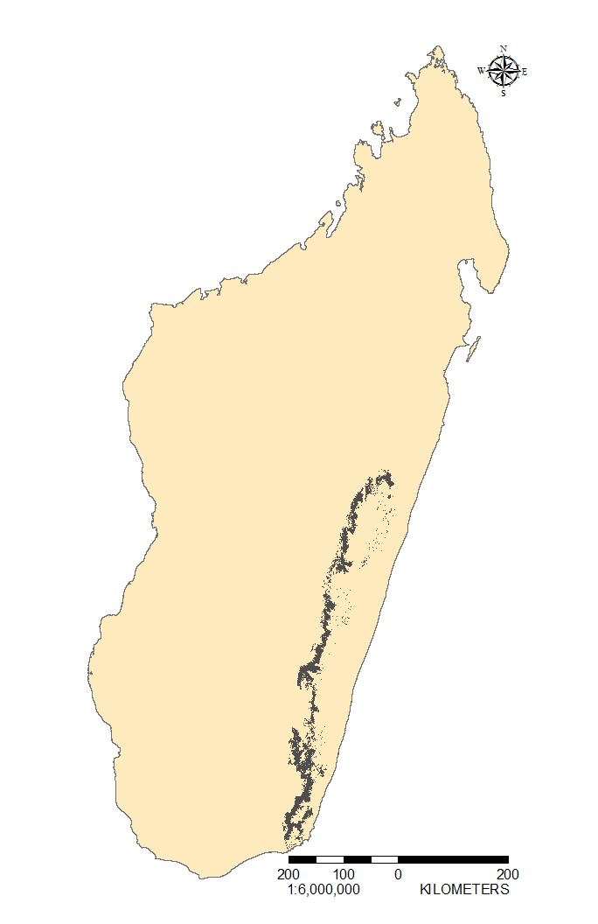
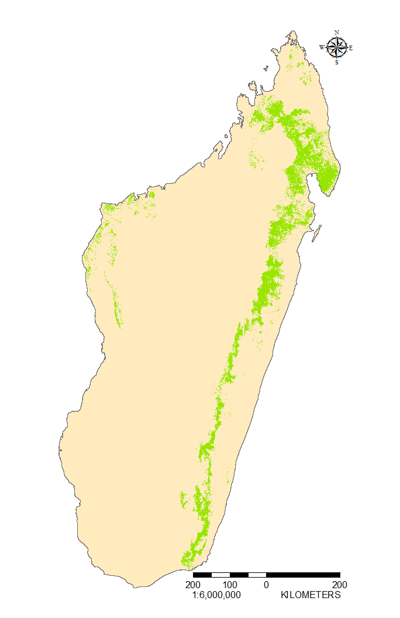
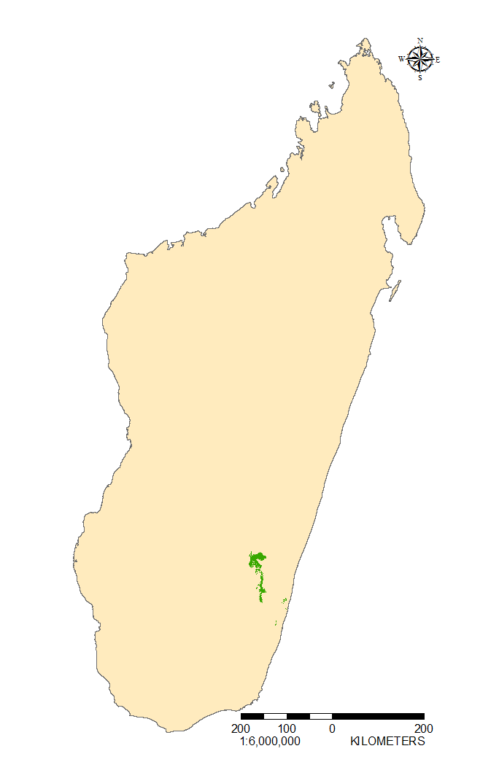
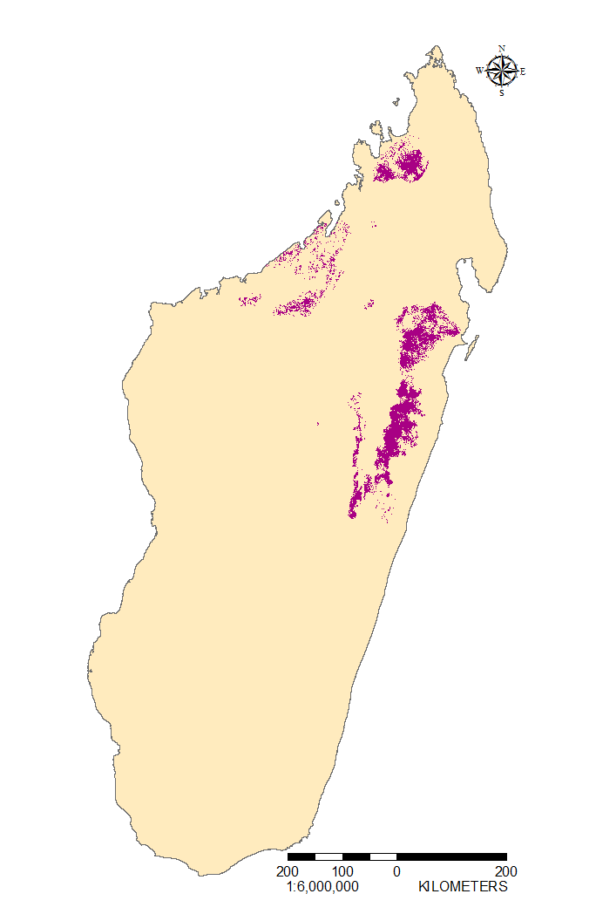
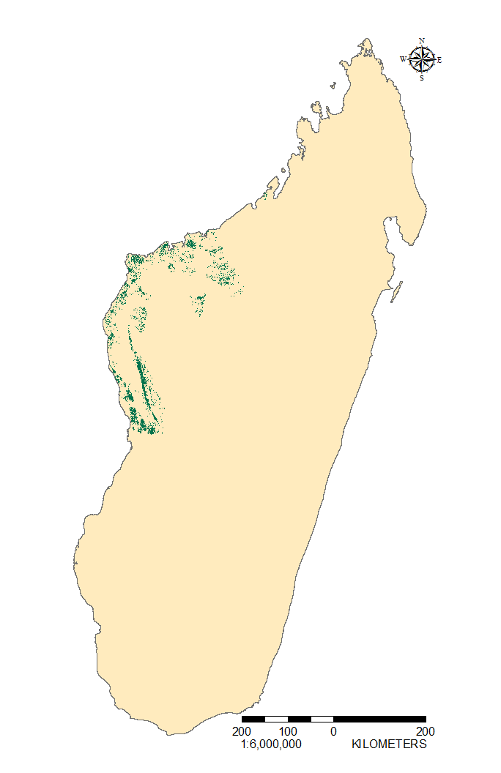
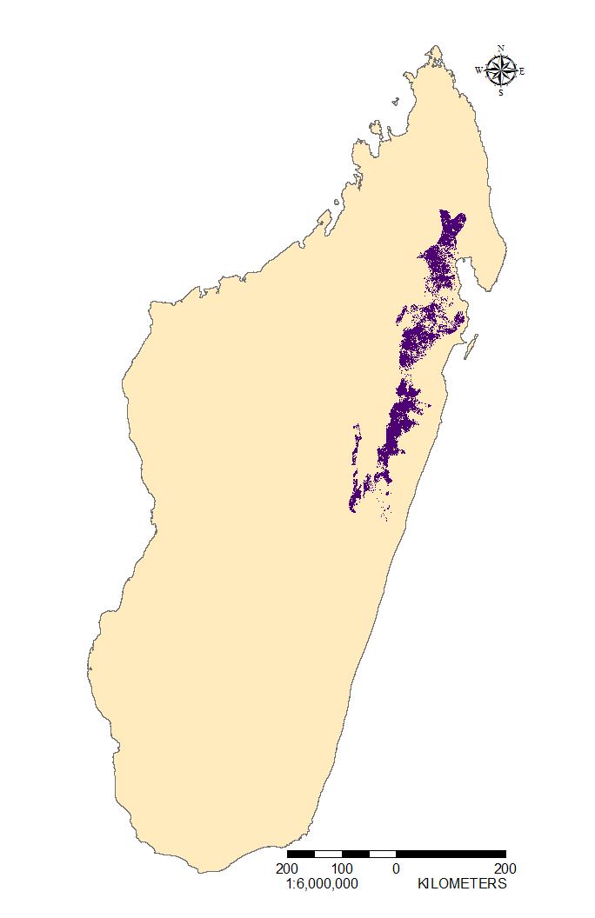
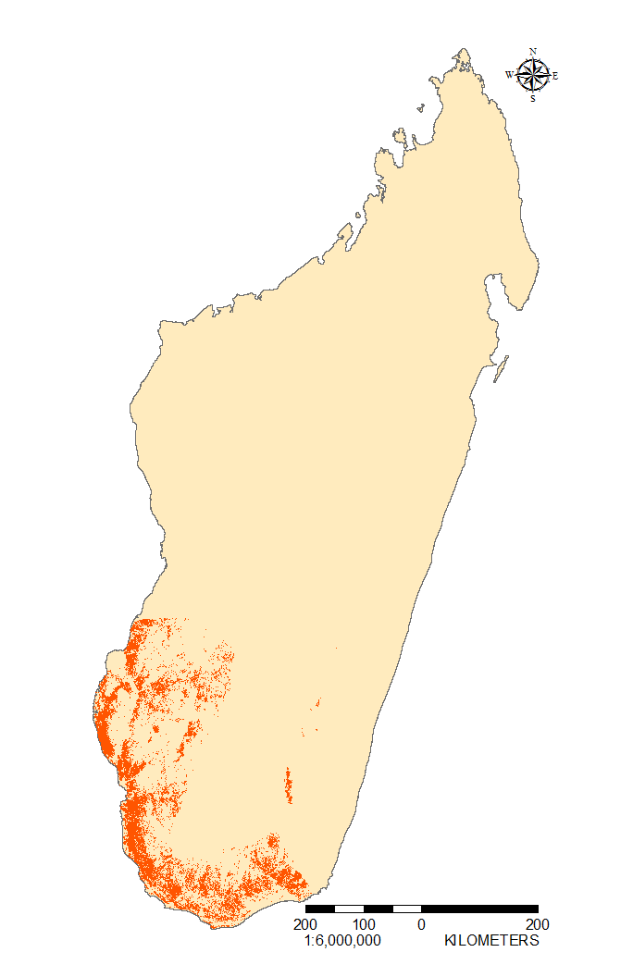
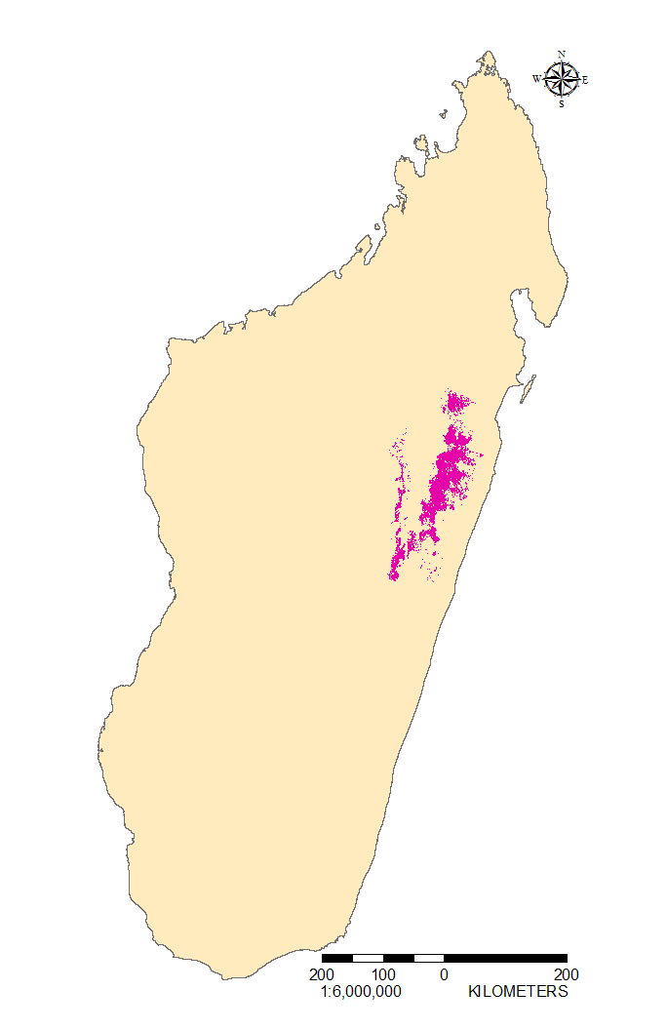
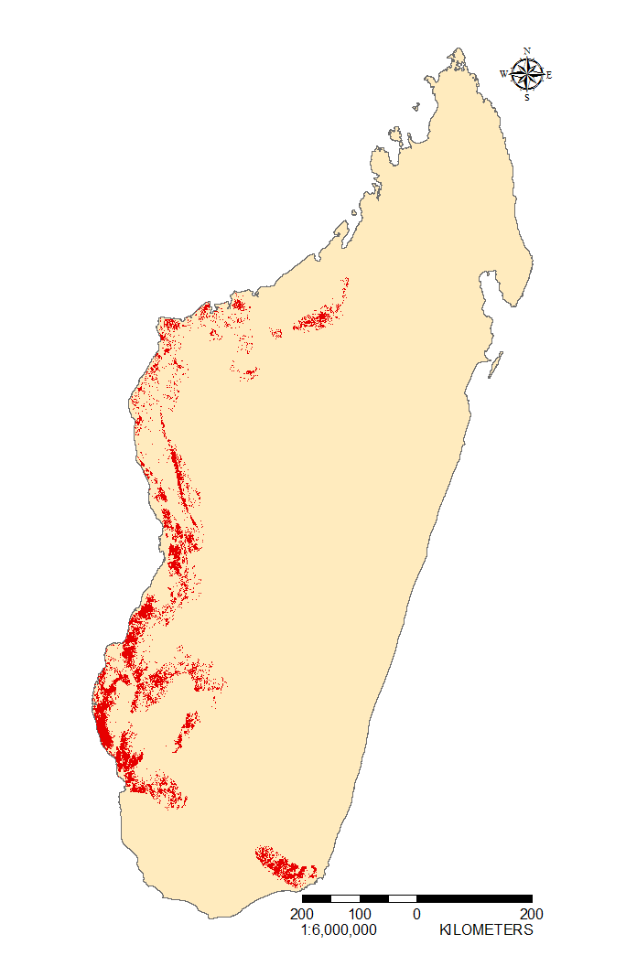
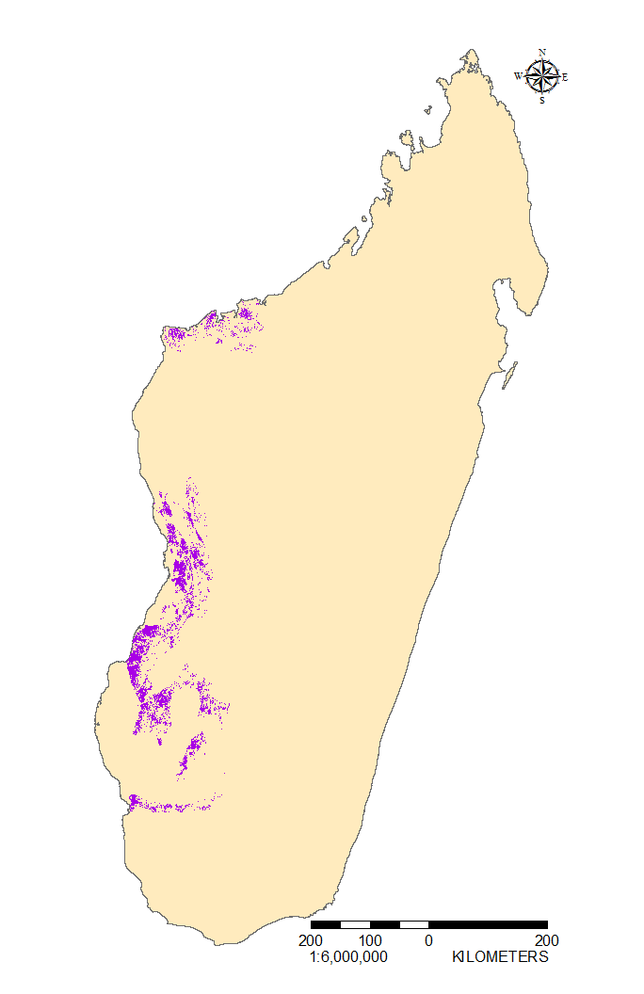
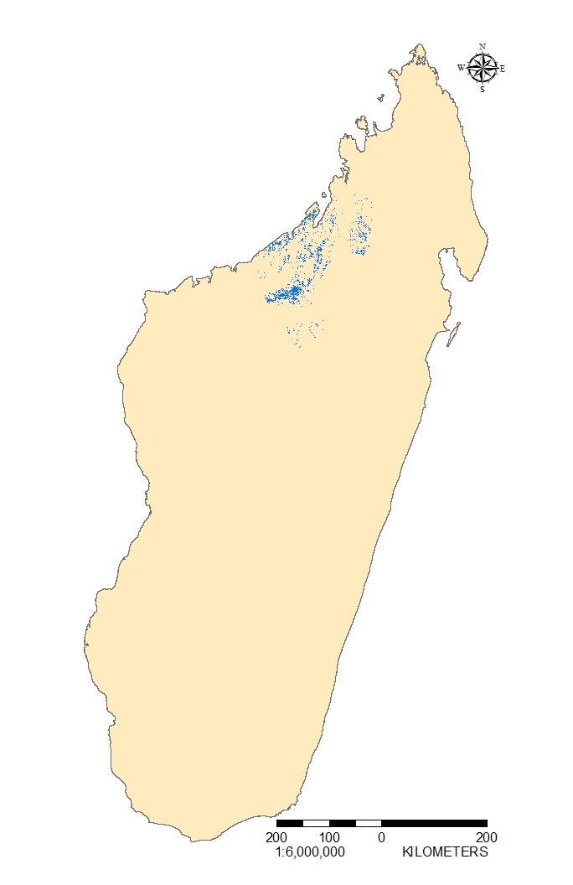
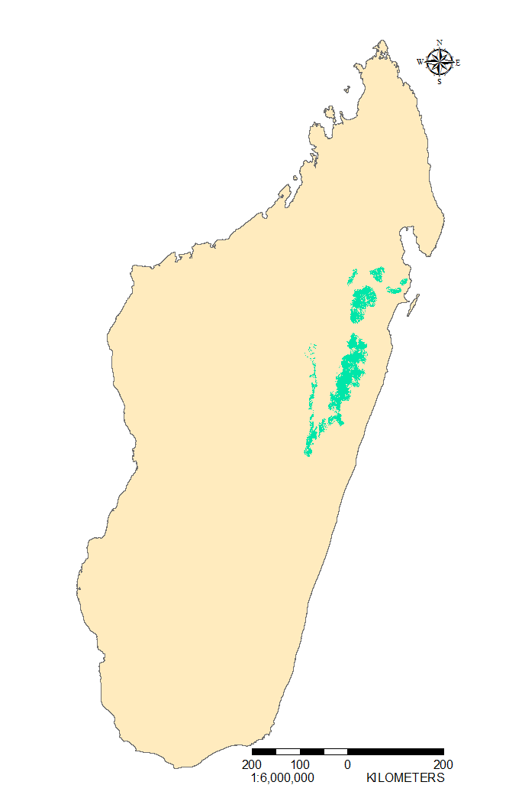
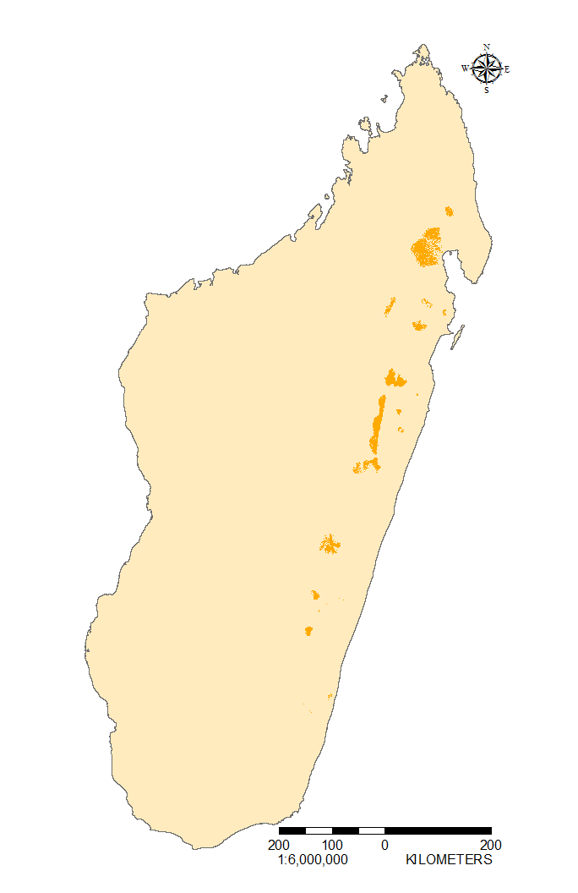
Lemur Ranges

Slide 10
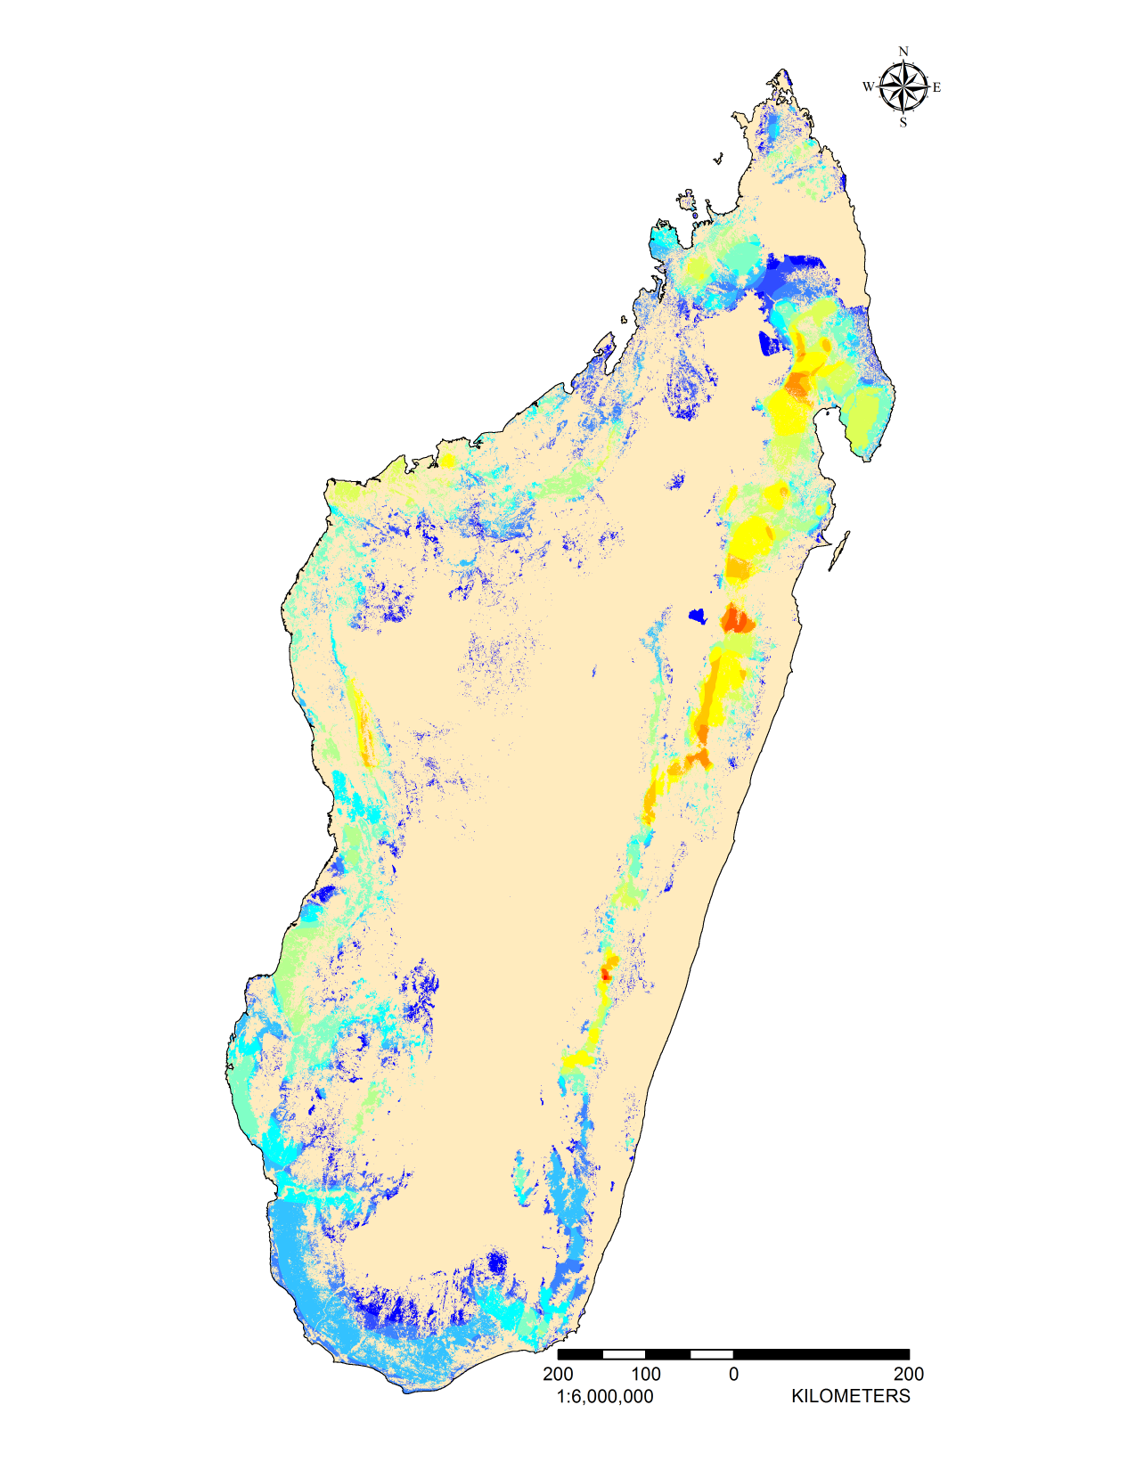

Distribution of Lemur Diversity

Slide 11
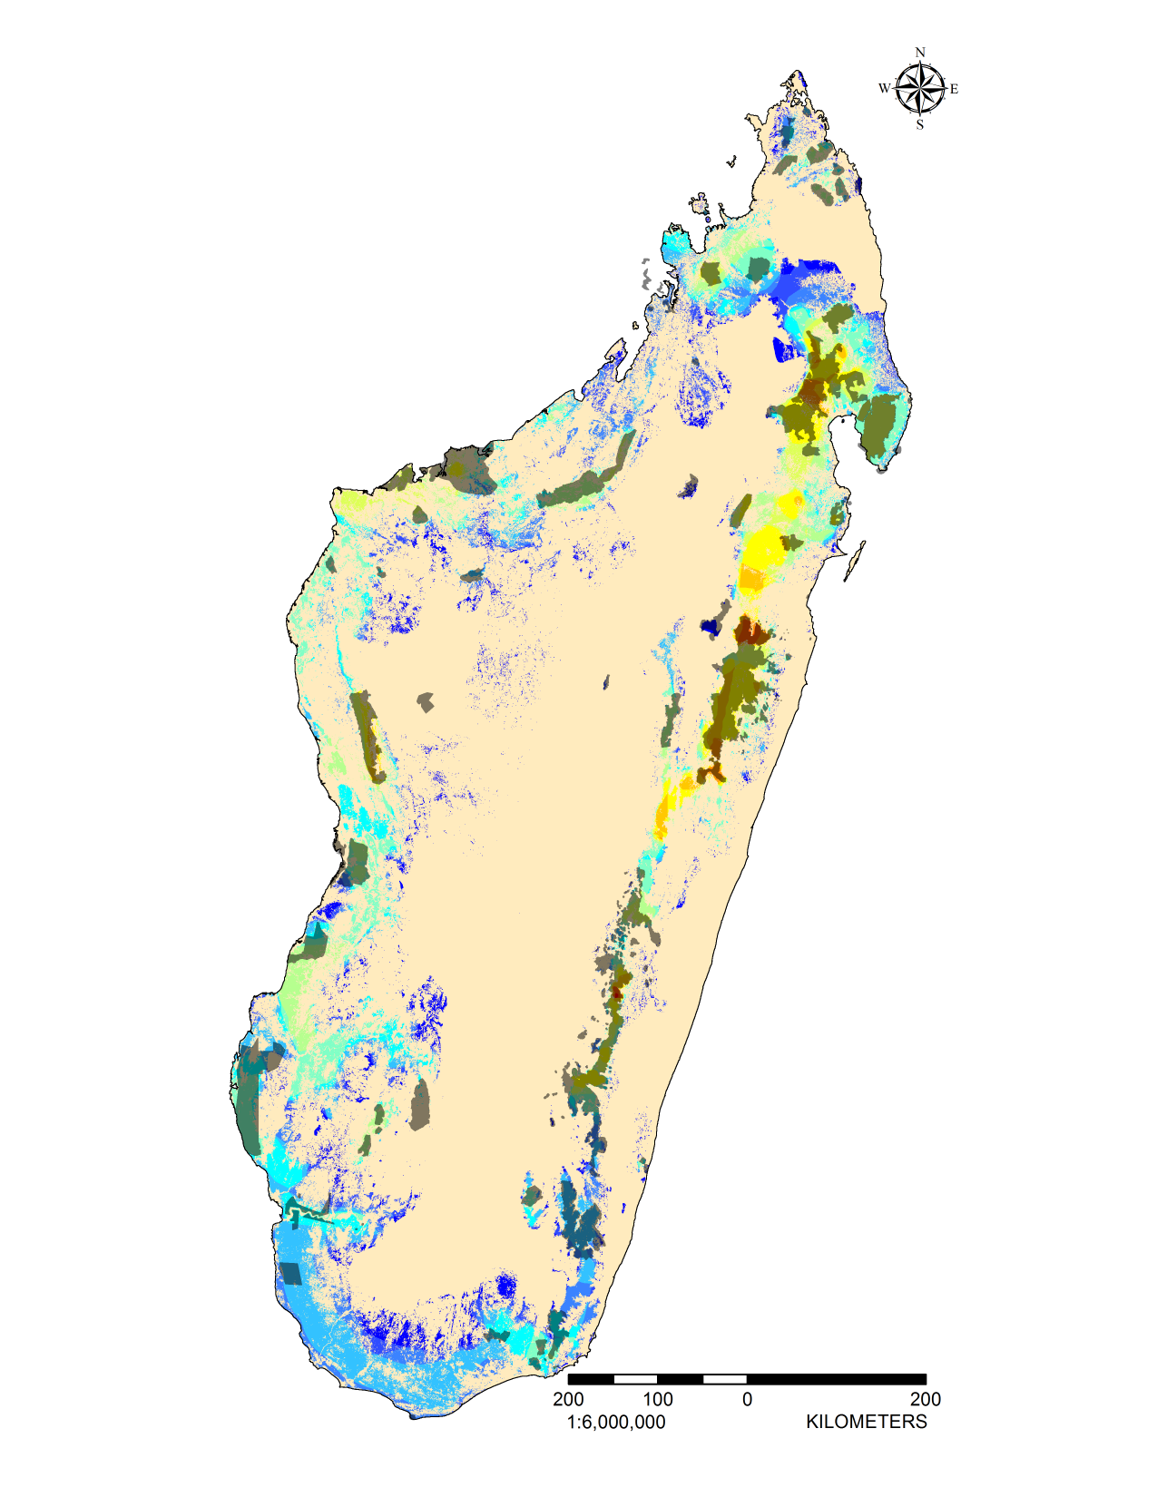
Distribution of Lemur Diversity

Slide 12
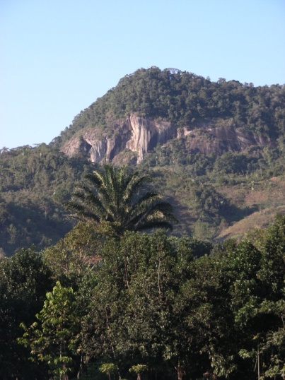
Conservation Planning
Algorithm systematically selects areas to be included in reserve network
Maximizes species protection while minimizing area (cost)
2 scenarios:
  Optimal network
    Ignoring existing PAs
  Where to expand current PA network

Slide 13
Conservation Targets
Targets by Area:
Additional Targets by Status:
Range Size | Area (ha) | % Range to Include
Small | 88 - 446 | 100%
Moderately Small | 446 - 1,273 | 75%
Moderately Large | 1,273 - 5,181 | 50%
Large | 5,181 - 43,100 | 25%
Status | Percent Range Added
Critically Endangered | +25%
Endangered | +20%
Vulnerable | +15%
Near Threatened | +10%
Least Concern | +0%
Data Deficient | +15%

Slide 14
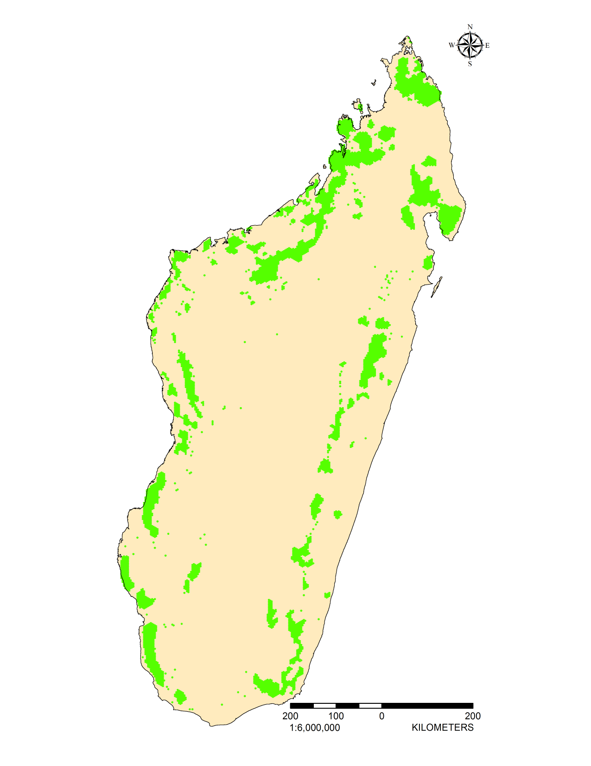

Results: Optimal Network
Total Area = 66,280 km²

Slide 15
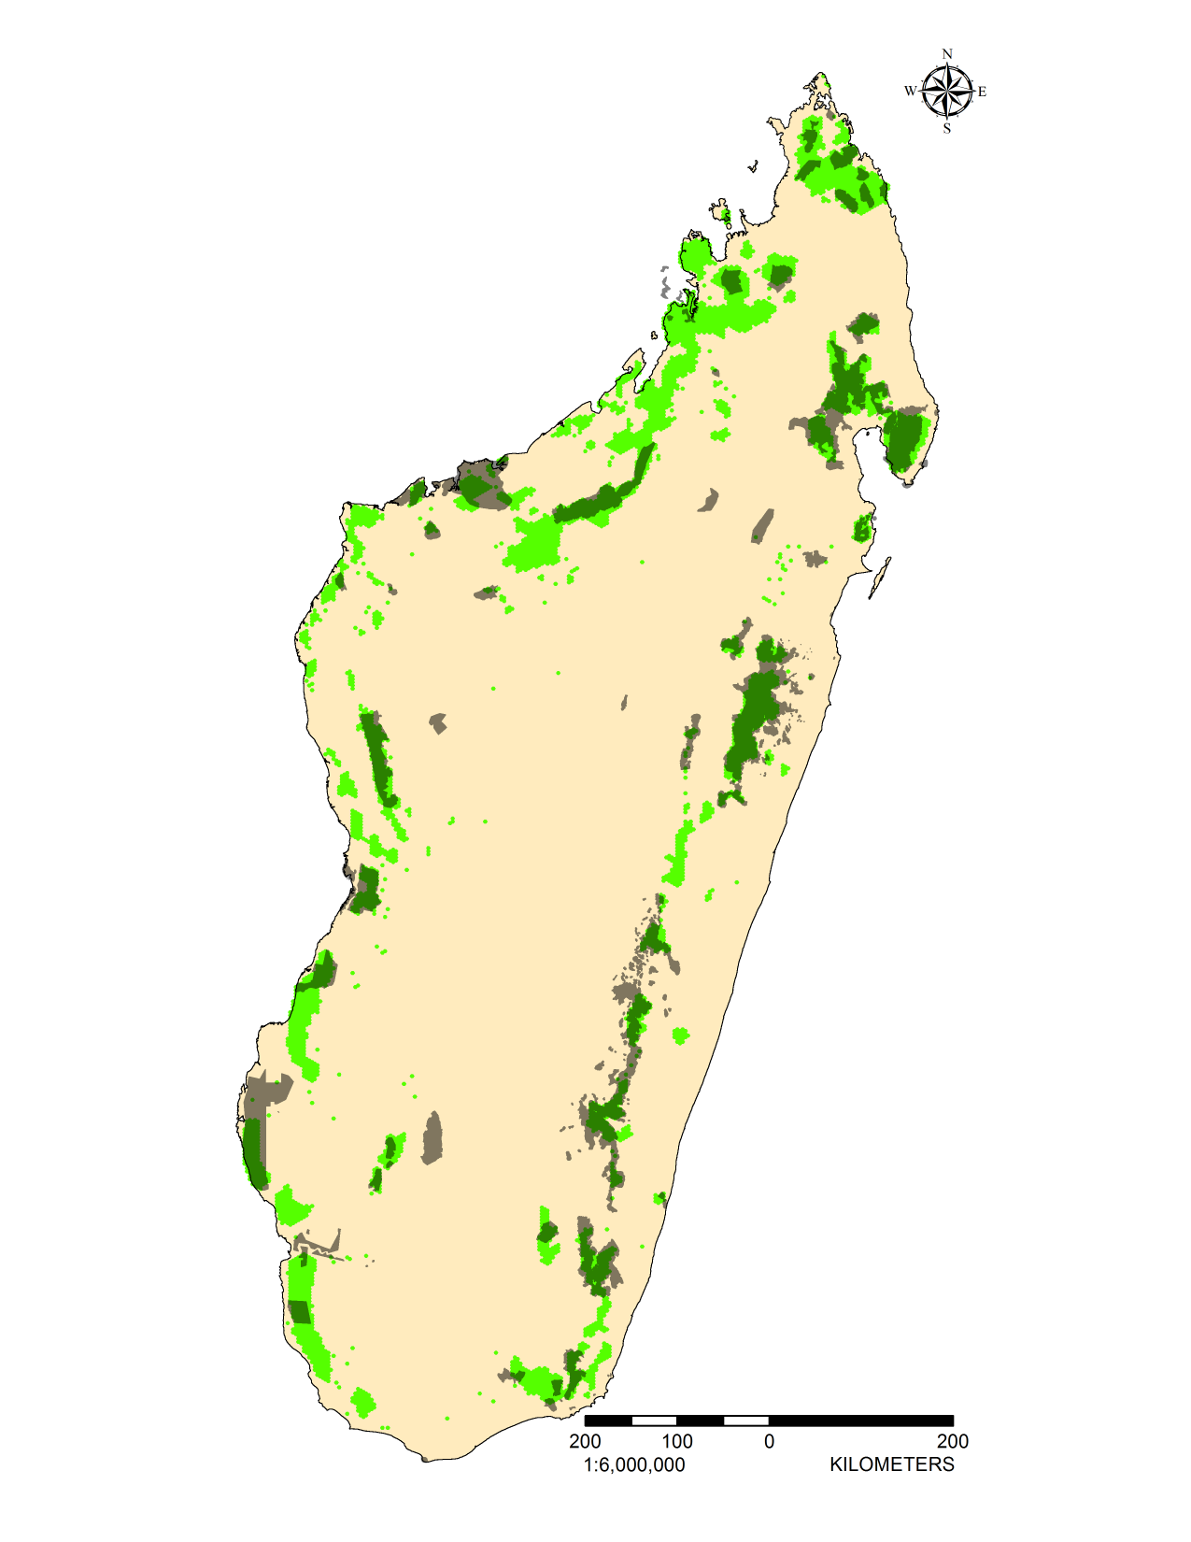
Results: Optimal Network
Total Area = 66,280 km²
Overlap with PA network = 59.5%
Optimal area requirements for 24
species not met by 9-20% of range

Slide 16

Results: Expansion Scenario
Protected Areas = 41,633 km²

Slide 17
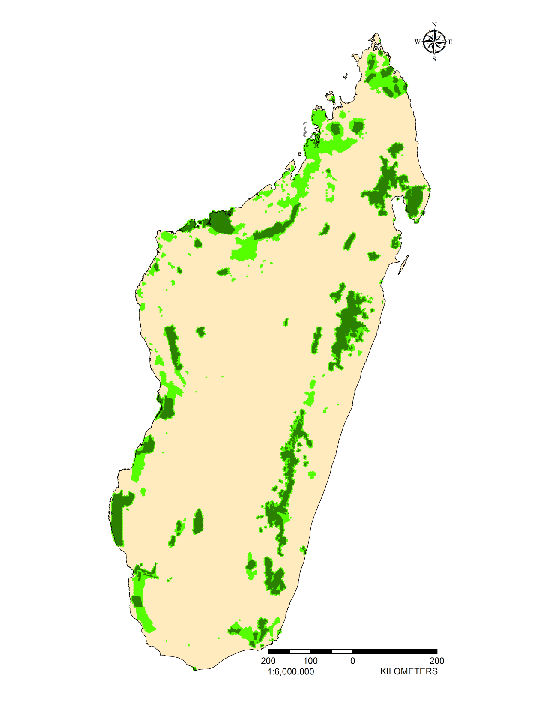
Results: Expansion Scenario
Total Area = 93,500 km²
Percent greater than PA network = 225%
Optimal area requirements for 24
species not met by 9-20% of range

Slide 18
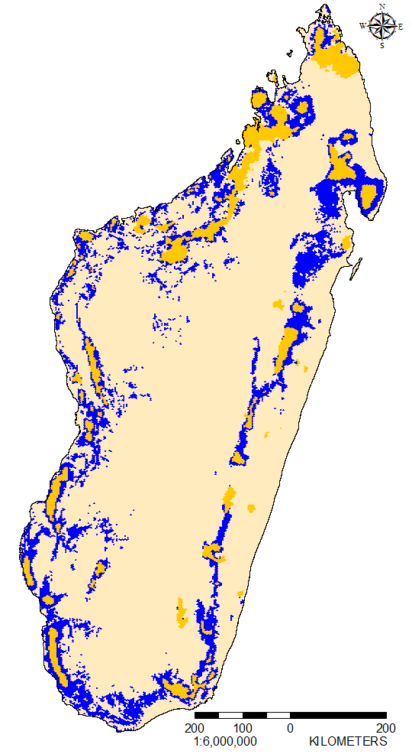
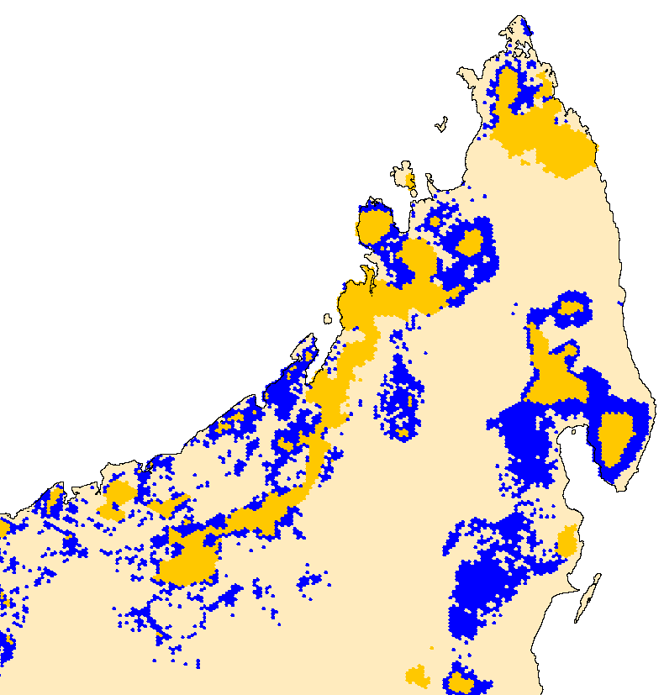

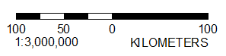
Important Area: Optimal Network
Important Area = 43,370 km²
= 70% of predicted network

Slide 19

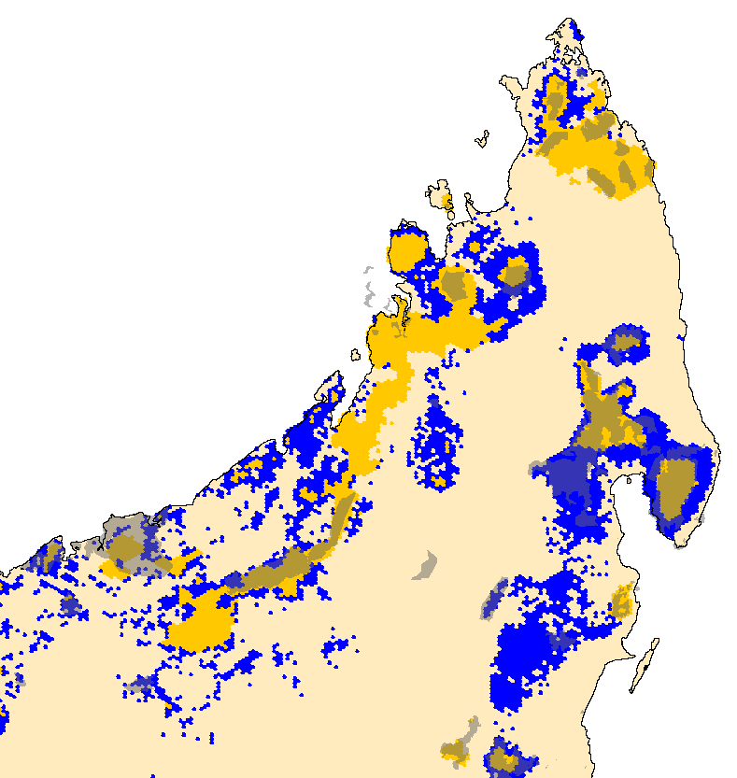
Important Area: Optimal Network
Important Area = 43,370 km²
Important Area In PAs = 17,239 km²
Overlap = 41.4%

Slide 20
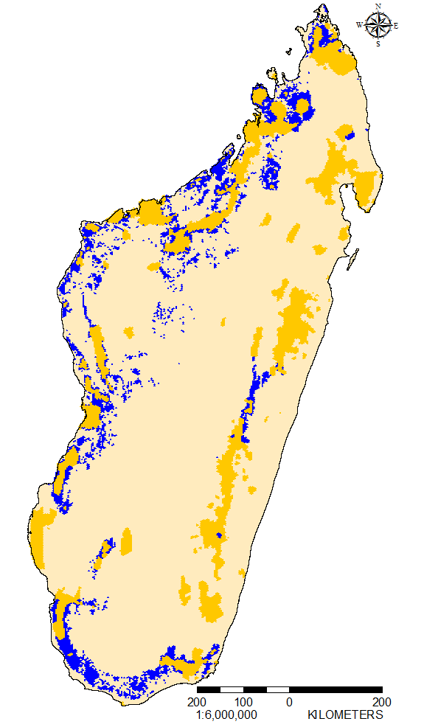
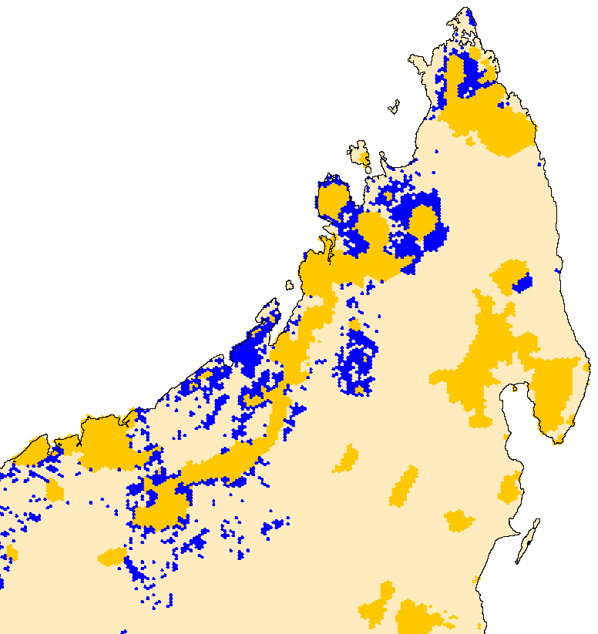
Important Area: Expansion Scenario
Important Area = 83,460 km²
= 90% of predicted network

Slide 21
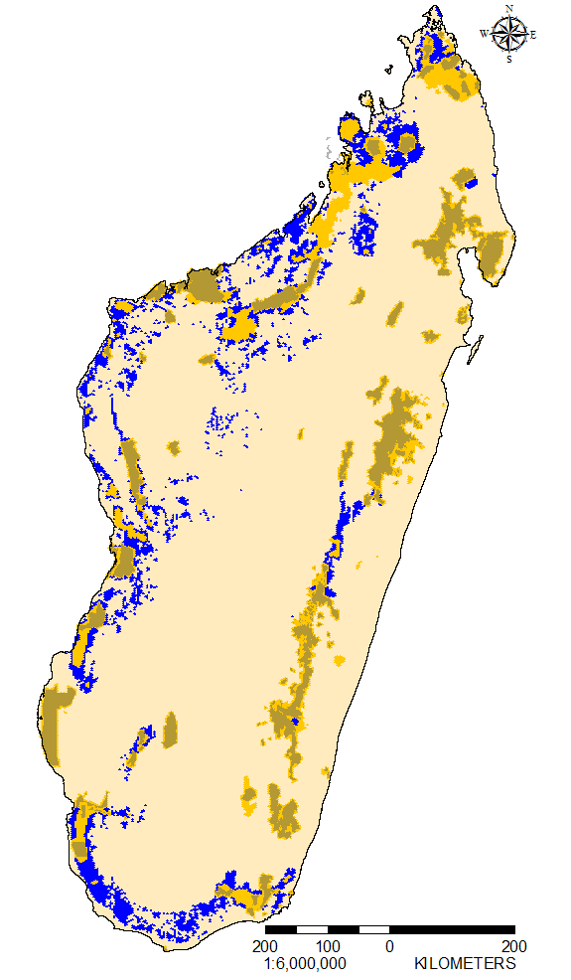
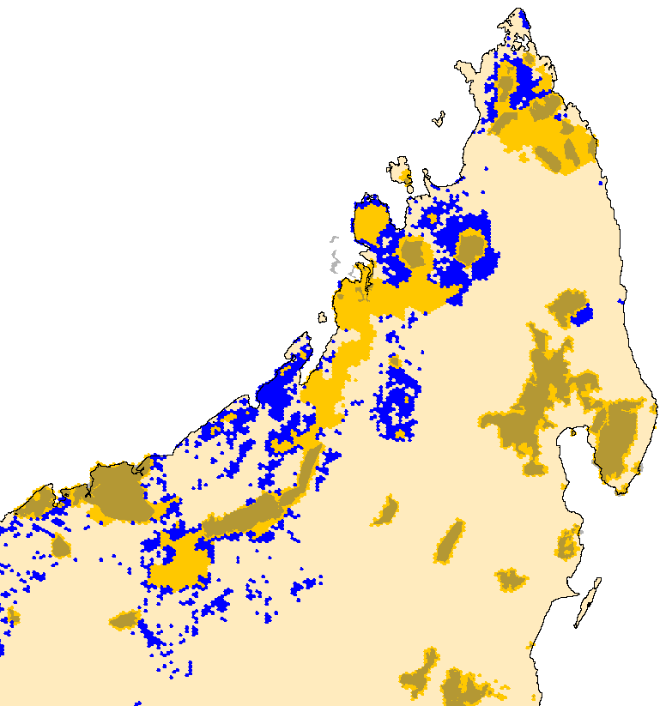
Important Area: Expansion Scenario
Important Area = 83,460 km²
Important Area In Addition
To PAs = 41,826 km²
= 100% > existing network
Total area required
= 15% of Madagascar

Slide 22
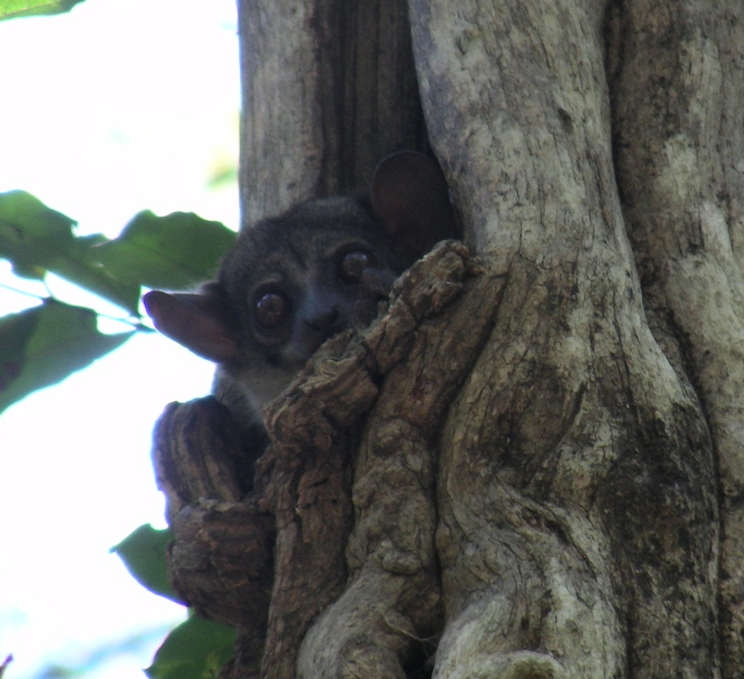
Prioritization
Algorithm iteratively selects pixels to remove that contribute the least amount of loss
Keep removing until there are no pixels left
Looked at top 10% area
  “Durban Vision”
    political target
It it enough?

Slide 23
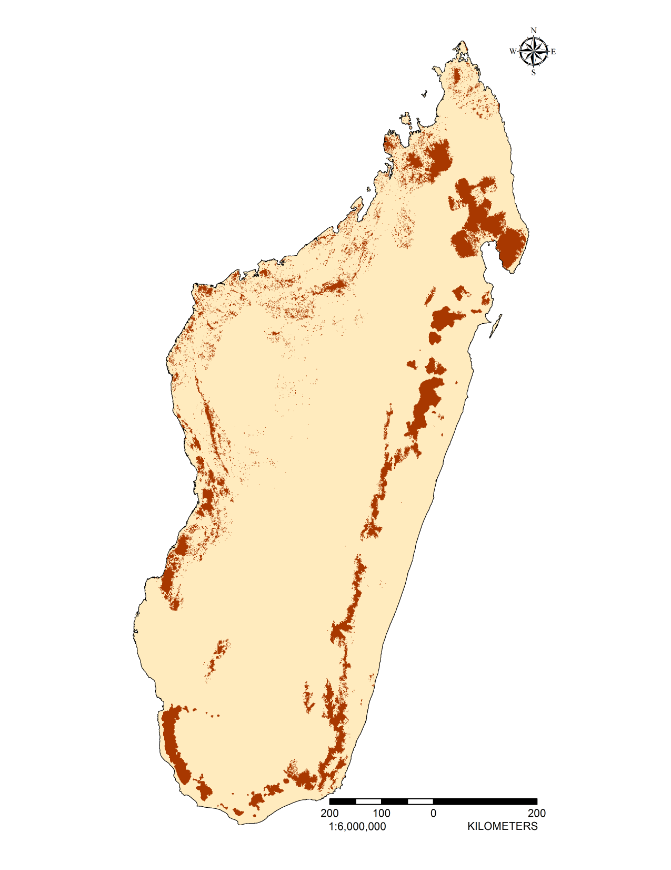

Results: Priority Areas (Top 10%)
Priority area meets targets for 43 species

Slide 24

Results: Priority Areas (Top 10%)
Over
Only 39% of Priority Areas within PAs

Slide 25
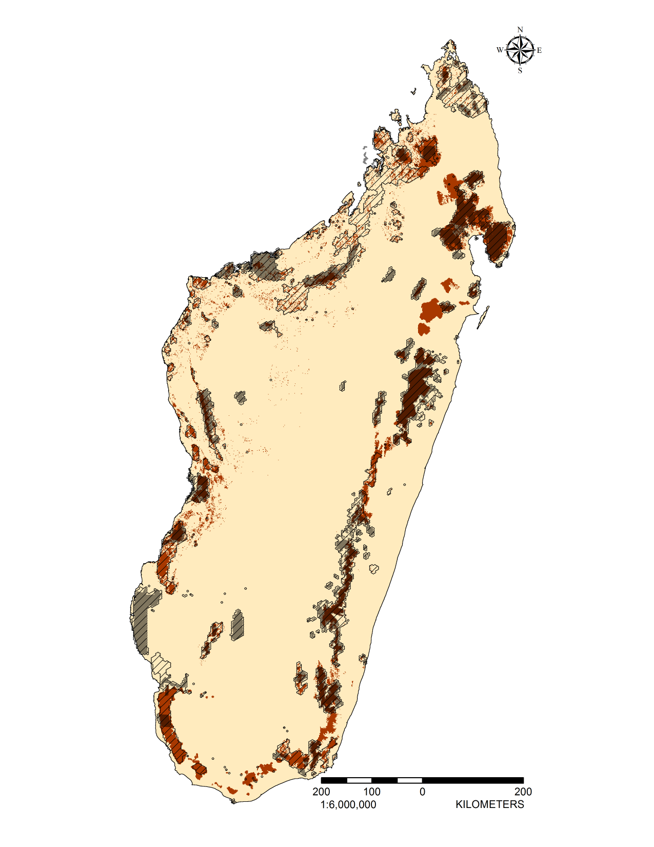
Results: Priority Areas (Top 10%)
70% of Priority Areas within
Expansion Scenario

Slide 26
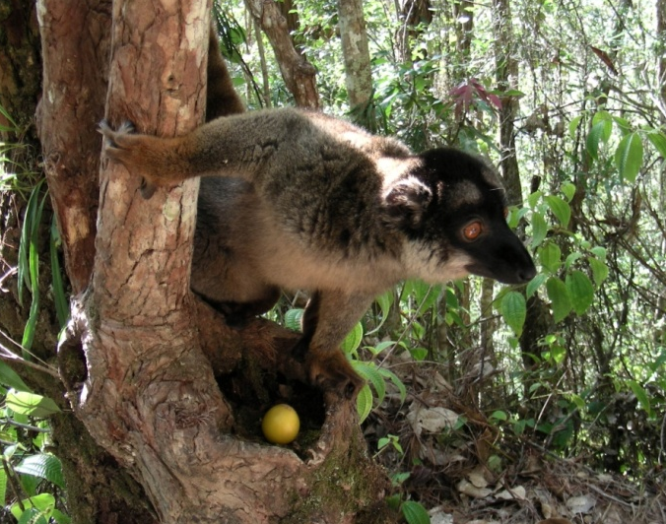
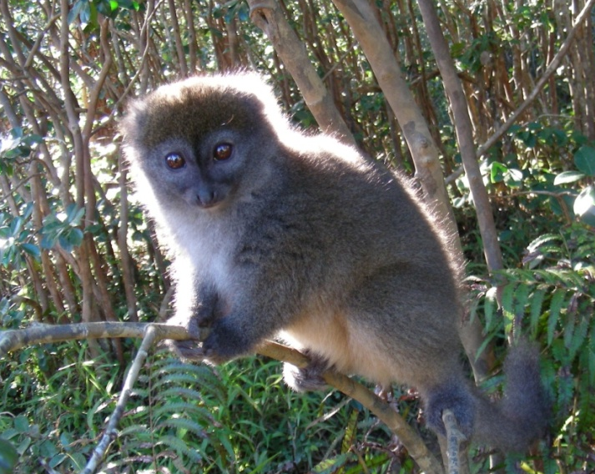
Key
Findings
PA network meets conservation targets for:
    30 / 98 species
  9 species not represented at all
  22 species only represented by 1 PA
Need to double the PA network to meet targets
    To cover ~15% of Madagascar
Top 10% priority area meets conservation targets for:
    43 / 98 species

Slide 27
Key
Findings
Design PAs for species specific conservation
Use both methods for comprehensive results
Methods applicable to other areas of conservation concern:
  Southeast Asia
  Africa
  South and Central America

Slide 28
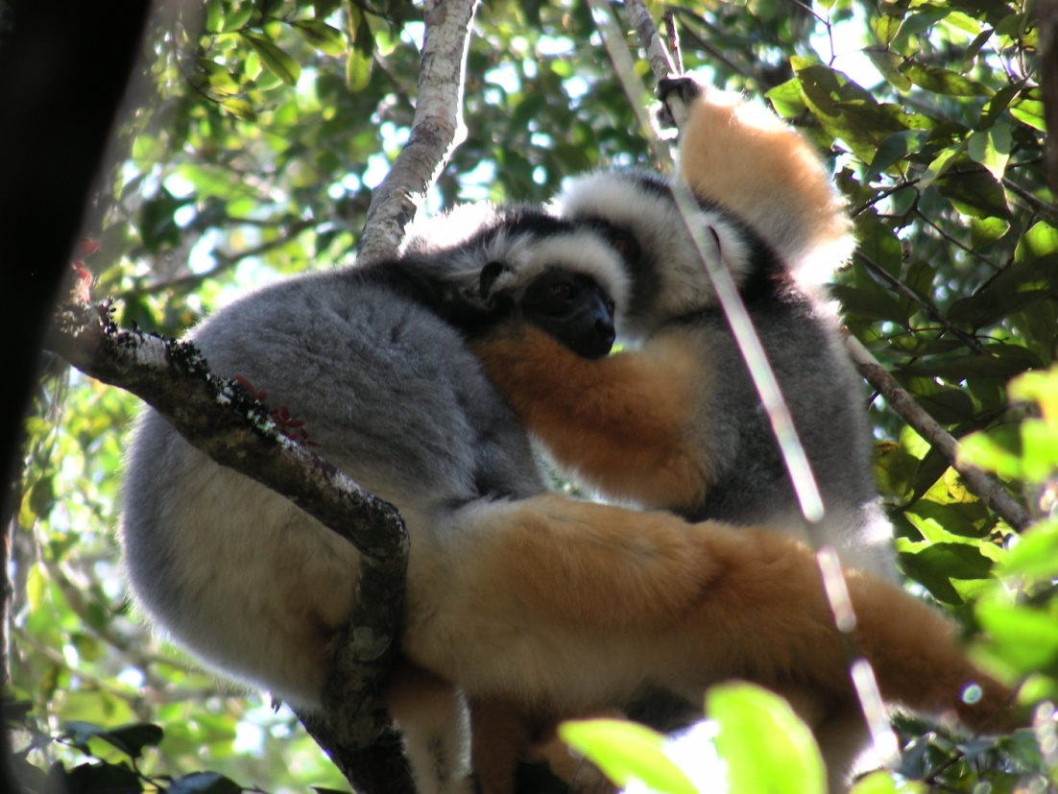
Thank-you!

